Slide 1
AI-Based Computer Vision and Deep Learning Approach for Multiple Sclerosis (MS) Lesion Detection
B.Sc. Final-Defense
Amir Rahman Arafat
ID : 0242220005101874
Most.Sanjida Islam
ID: 0242220005101249
Department of CSE
Daffodil International University

Slide 2
Outline
Introduction
Objective
Background Study
Gap Analysis
Methodology
Results & Analysis
Novelty of the Work
Sample Dataset
Conclusion
References
B.Sc. Final-Defense

Slide 3
Introduction
Multiple Sclerosis (MS) is a chronic neurological disease that affects the central nervous system and can produce lesions in different regions of the brain. MRI is widely used to identify and monitor these lesions, but manual lesion segmentation is time-consuming, requires expert knowledge, and may vary between observers. These challenges create a need for accurate and efficient automated segmentation methods.
Deep learning has shown strong potential for automated MS lesion segmentation from three-dimensional MRI data. In this work, the MSLesSeg dataset is used with FLAIR, T1-weighted, and T2-weighted images. N4 bias-field correction and non-zero voxel Z-score normalization are applied before training, while a FLAIR-only UNETR serves as the baseline and a proposed gated residual multimodal model uses FLAIR as the primary modality with T1 and T2 as complementary information. The models are evaluated using Dice, Precision, Recall, IoU, and lesion-level analysis.
B.Sc. Final-Defense

Slide 4
Objective
Develop a FLAIR-based 3D deep learning model and establish UNETR as the baseline for automated MS lesion segmentation.
Design a gated residual multimodal model using FLAIR as the primary modality and T1- and T2-weighted MRI as complementary inputs.
Develop an automated preprocessing pipeline to convert and prepare MRI data through volume validation, registration, skull stripping, bias-field correction, intensity normalization, and spatial alignment for model-ready input.
Analyze how lesion size and FLAIR brightness affect segmentation performance, particularly for difficult-to-detect lesions.
B.Sc. Final-Defense

Slide 5
Background Study
Study | Method | MRI Input | Key Finding
Hindawi et al. [2] | Federated nnU-Net | Multimodal MRI | Combined self-configuring nnU-Net with federated learning and reported Dice scores of approximately 0.66–0.80 across sites.
Andishgar et al. [3] | R2AUNet | FLAIR | Achieved 0.768 Dice with recurrent residual blocks and dual attention.
Guarnera et al. [6] | MSLesSeg benchmark | FLAIR + T1+T2 | Reported 0.6421 mean Dice for UNETR and highlighted complementary information from T1/T2.
Wiltgen et al. [9] | LST-AI Ensemble | T1+FLAIR | Achieved about 0.65 Dice and showed that lesion detection decreases for smaller lesions.
Zhang et al. [10] | Self-Ensembled Lesion Fusion | Multimodal MRI | Used instance normalization and test-time lesion fusion, achieving about 68.2% Dice on ISBI 2015.
B.Sc. Final-Defense

Slide 6
Gap Analysis
Existing methods use multimodal MRI, but selective control of auxiliary information while preserving the strong FLAIR representation remains insufficiently explored.
Research Gap | Existing Limitation | Our Approach
Multimodal MRI utilization | T1 and T2 provide complementary information, but their contribution is not always selectively controlled. | Use FLAIR as the primary modality and T1/T2 as auxiliary modalities.
Multimodal feature fusion | Existing methods use approaches such as direct feature concatenation or output-level fusion. | Introduce Gated Feature Fusion to control the contribution of auxiliary features.
Preservation of FLAIR information | Unrestricted multimodal fusion may weaken the strong lesion representation provided by FLAIR. | Use a FLAIR-centered primary branch with Bounded Residual Correction.
Small and low-contrast lesions | Lesion detection remains difficult, particularly for small and less conspicuous lesions. | Perform lesion-level analysis based on lesion size and FLAIR brightness to examine difficult cases.
Overall evaluation | A high overall Dice score may not fully represent individual lesion detection ability. | Evaluate Dice, Precision, Recall, IoU, and lesion-level recall and detection rate.
B.Sc. Final-Defense

Slide 7
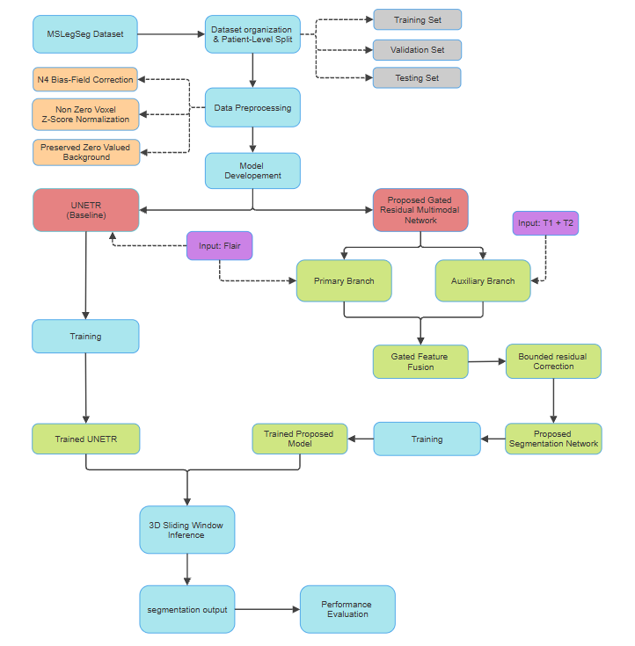
Methodology
A structured pipeline integrates MRI preprocessing, UNETR baseline, proposed multimodal model, training, and 3D lesion segmentation.
B.Sc. Final-Defense

Slide 8
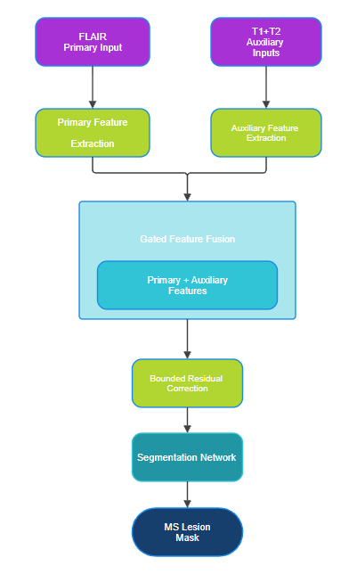
Methodology
Proposed Model Architecture

Slide 9
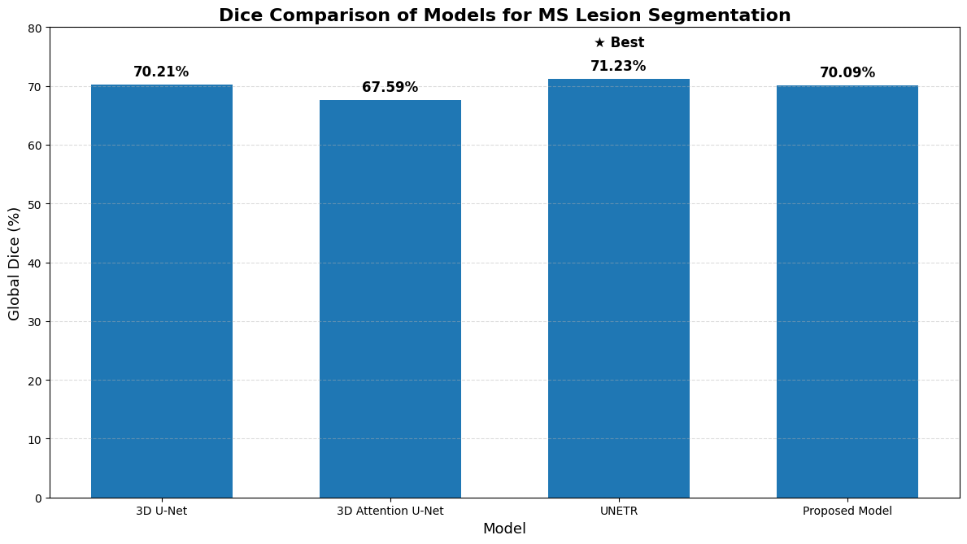
Result and Analysis
Accuracy Performance
Model | Accuracy
Proposed Model | 70.09%
UNETR | 71.23%
3D Attention U-Net | 67.59%
3d U-Net | 70.21%
B.Sc. Final-Defense

Slide 10
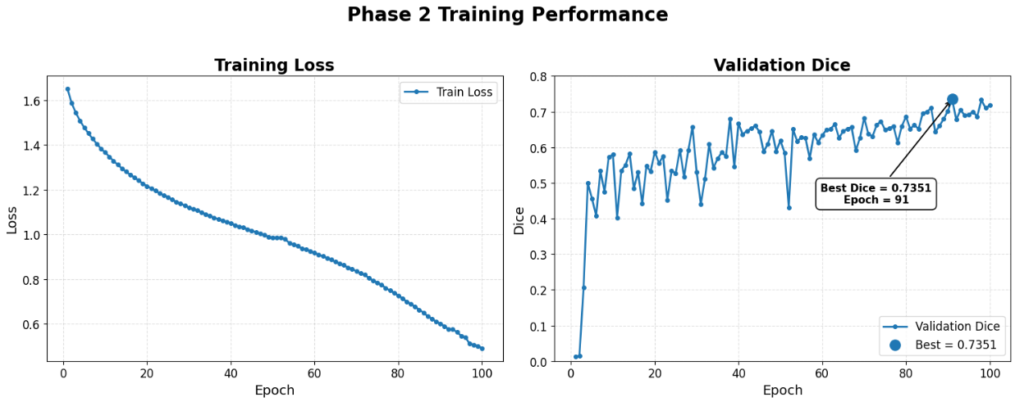
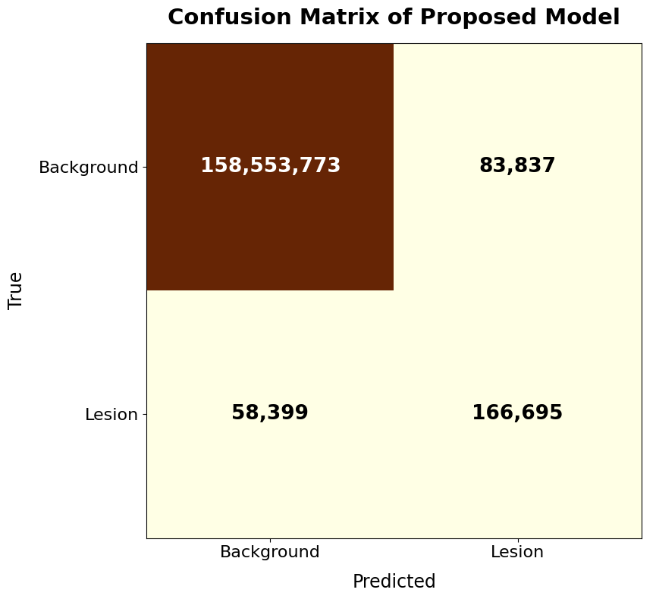
Result and Analysis

Slide 11
Novelty of the Work
FLAIR-Preserving Multimodal Architecture:
Uses FLAIR as the primary modality while incorporating T1- and T2-weighted MRI as complementary inputs.
Gated Feature Fusion:
Introduces a gating mechanism to selectively control how much auxiliary T1/T2 information contributes to the primary FLAIR representation.
Bounded Residual Correction:
Uses bounded residual learning to refine the FLAIR-based features without replacing the primary lesion representation.
Lesion-Level Performance Analysis:
Goes beyond overall Dice by analyzing individual lesions according to size and FLAIR brightness, focusing on difficult-to-detect lesions.
Rescue/Harm Analysis:
Directly compares lesions detected or missed by the UNETR baseline and the proposed model to identify which lesions are recovered through multimodal refinement.
Controlled Multimodal Evaluation:
Compares a FLAIR-only UNETR baseline with the multimodal model under the same patient-level test setting, allowing the contribution of multimodal refinement to be examined.
B.Sc. Final-Defense

Slide 12
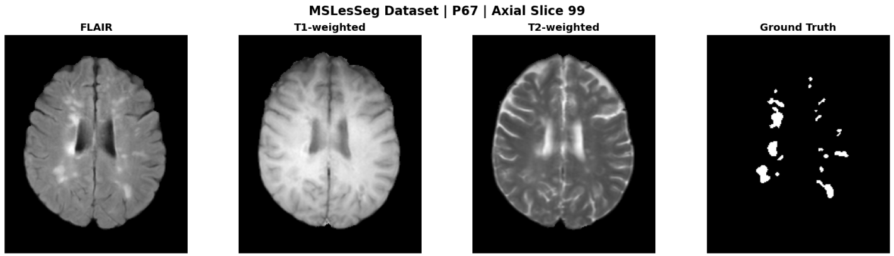
Sample dataset
Representative 3D MRI samples from the MSLesSeg dataset, including FLAIR, T1-weighted, T2-weighted images, and the corresponding lesion mask.
Cloud flare web link: https://drive.google.com/drive/folders/1fWJRcZzo4tRTPWTay6KNUCGY4RQoGBoQ
B.Sc. Final-Defense

Slide 13
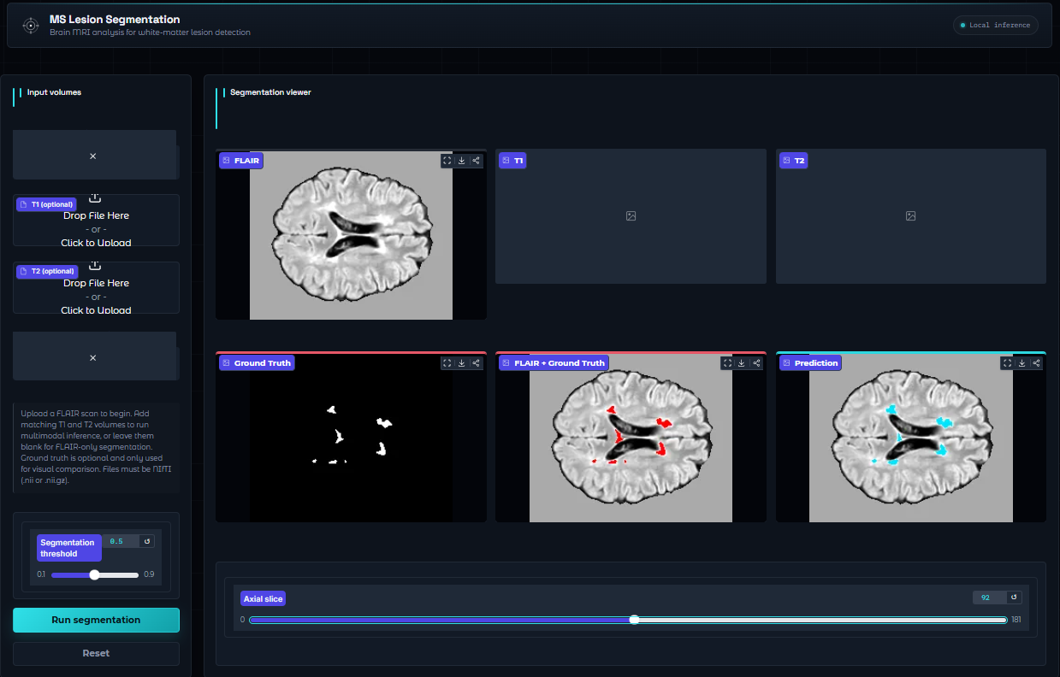
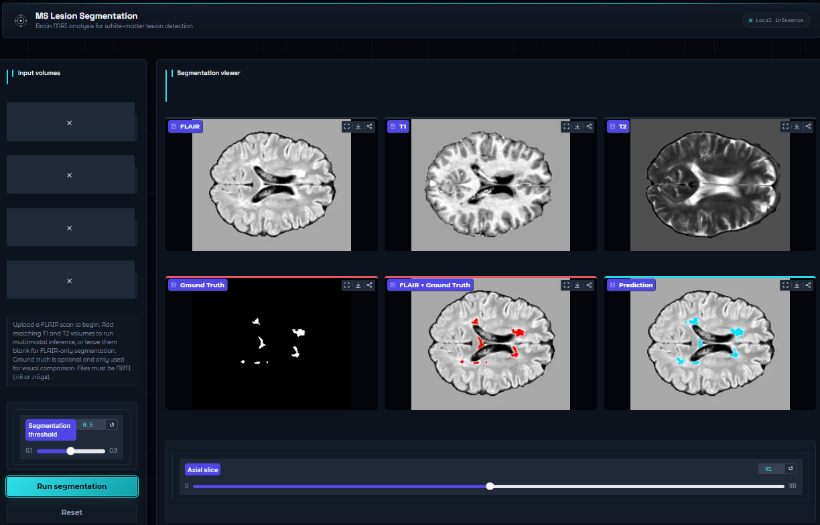
Web Interface of Image Enhancement
UNETR Visualization of MS lesions by only flair
Proposed Model Visualization by T1+T2+flair
Cloud flare web link: https://acdbentity-counting-sara-fiction.trycloudflare.com
B.Sc. Final-Defense

Slide 14
Conclusion
This study developed an automated three-dimensional MS lesion segmentation framework using the MSLesSeg dataset with N4 bias-field correction and non-zero voxel Z-score normalization. A FLAIR-only UNETR model was established as the baseline, while the proposed model used FLAIR as the primary modality and incorporated T1- and T2-weighted MRI through gated feature fusion and bounded residual correction. In the overall evaluation, UNETR achieved the highest global Dice of 71.23%, whereas the proposed model achieved the highest global Recall of 74.06%. Furthermore, lesion-level analysis showed that the proposed model improved mean lesion recall from 42.00% to 48.30% and increased lesion detection rate from 66.13% to 71.62%. These findings indicate that the proposed multimodal approach can improve sensitivity to challenging MS lesions, although further improvement is needed to reduce false-positive predictions and enhance overall segmentation accuracy.
B.Sc. Final-Defense

Slide 15
References
[1] J. Zhang et al., “UNISELF: A unified network with instance normalization and self-ensembled lesion fusion for multiple sclerosis lesion segmentation,” Med. Image Anal., vol. 109, p. 103954, Mar. 2026, doi: 10.1016/J.MEDIA.2026.103954.
[2] S. Hindawi, B. Szubstarski, E. Boernert, B. Tackenberg, and J. Wuerfel, “Federated learning for lesion segmentation in multiple sclerosis: a real-world multi-center feasibility study,” Front. Neurol., vol. 16, p. 1620469, 2025, doi: 10.3389/FNEUR.2025.1620469.
[3] A. Andishgar et al., “Automated multiple sclerosis lesion segmentation from 3D-FLAIR MRI using R2AUNet: A deep learning approach with recurrent residual and attention mechanisms,” Mult. Scler. Relat. Disord., vol. 102, Oct. 2025, doi: 10.1016/j.msard.2025.106620.
[4] S. Gaj, B. Thoomukuntla, D. Ontaneda, and K. Nakamura, “Subject-Based Transfer Learning in Longitudinal Multiple Sclerosis Lesion Segmentation,” J. Neuroimaging, vol. 35, no. 1, Jan. 2025, doi: 10.1111/JON.70024.
[5] P. Belwal and S. Singh, “Multiple Sclerosis Lesion Segmentation using MRI: U-Net Approach,” Procedia Comput. Sci., vol. 260, pp. 513–522, 2025, doi: 10.1016/J.PROCS.2025.03.229.
B.Sc. Final-Defense

Slide 16
THANK YOU
B.Sc. Final-Defense

