Slide 1
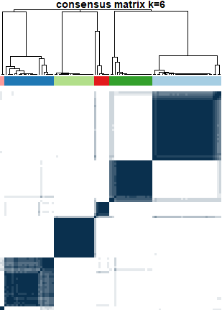

Never grouped together
Always grouped together
0.97
other artifacts
banding
0.95
ghosting
Class Precision
0.71
motion
0.94
ringing
no artifact
0.68
1
1
1
0.85
0.5
0.9
0.94
Class Recall

