Slide 1
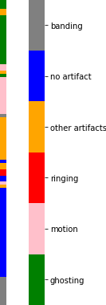
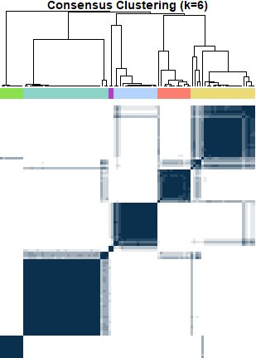


Consensus Labels
never grouped together
always grouped together
Class Labels
cluster 1
0.8
cluster 2
cluster 3
cluster 4
0.92
cluster 5
cluster 6
Class Precision
0.94
1
True Labels
banding
no artifact
0.94
other artifacts
ringing
motion
1
ghosting
0.9
0.97
0.8
0.8
1
1
Class Recall

Slide 2
Heatmap with colorbar
Heatmap
CC (cropped version)
Class labels

