Slide 1
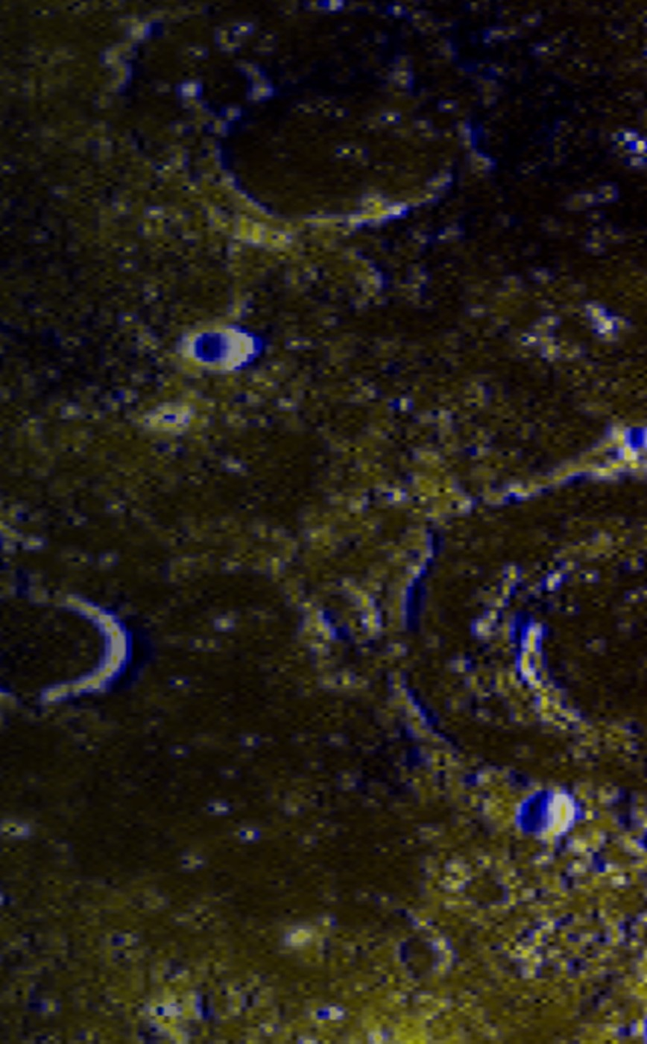
LCP MODULE B · PHYSICS OF DATA · 2026
Lunar Feature
Recognition
Instance segmentation of the Moon with Mask R-CNN
4
50.8M
epoch 8
feature classes
parameters
best checkpoint
Amirmohammad Saiedi Saber
Computational Physics 2026 · Laboratory of Computational Physics, module B
Notes:
OPEN (~50s). "My part is lunar feature recognition — a Mask R-CNN that finds AND outlines each surface feature: craters, pit/skylights, wrinkle ridges, lobate scarps, on 256x256 Marius Hills tiles." Point to the chips: 4 classes, 50.8M params, best checkpoint at epoch 8. TRANSITION: "The most important decisions happen in the data — let me start there."

Slide 2
From 7 noisy channels to 4 trainable classes
I scanned every tile, then kept only the classes with enough evidence to train.
15,935
4 kept
4,198
3,345 / 853
tiles scanned
›
classes ≥ 200 tiles
›
usable tiles
›
train / val
every NPZ tile
3 dropped as rare
≥ 1 instance each
spatial split
Kept — 4 classes
Dropped — too rare
impact_crater
15,935 tiles
irregular_mare_patch
103 tiles
wrinkle_ridge
2,993 tiles
apollo_site
175 tiles
lobate_scarp
272 tiles
candidate_rille
20 tiles
pit_skylight
246 tiles
pit_skylight is the key science target — and the scarcest.
Lunar Feature Recognition · 2 / 8
Notes:
DATA (~70s). "7 semantic channels ship with the data, but not all are usable. I scanned all 15,935 tiles and kept only classes present in >=200 tiles — 4 kept, 3 dropped. After requiring >=1 instance I had 4,198 usable tiles, split 3,345/853 with a SPATIAL split so neighbouring tiles can't leak." HONEST FLAG: "pit_skylight has only 246 tiles — that's why it scores low later. I'd rather say it up front." TRANSITION: "Here's how a mask becomes training targets."

Slide 3
Semantic masks become object instances
Mask R-CNN needs one target per object, so each mask channel is split into instances.
Load tile
image + 7-ch mask
Normalize
3 × 256 px
Split channels
one layer / class
Components
blob → instance
Targets
boxes·labels·masks
›
›
›
›
Key idea
Connected-component labelling turns each bright blob into one object with a box, a label and a pixel mask. That single conversion is what lets one network learn detection and segmentation together.
Lunar Feature Recognition · 3 / 8
Notes:
PIPELINE (~45s). "Mask R-CNN can't train on a 7-channel semantic mask. Per tile: load, normalize to 3x256, split channels, then connected-component labelling so each blob is one object with a box, label and mask. I filter tiny and oversized noise." KEY IDEA: "that conversion is what lets ONE model do detection and segmentation together." TRANSITION: "Now the architecture."

Slide 4
Mask R-CNN: pretrained backbone, custom heads
COCO-pretrained ResNet-50 + FPN, with deeper heads tuned for small lunar features.
Input
3 × 256 × 256
ResNet-50 + FPN
multi-scale features
RPN
region proposals
ROI-Align
crop per proposal
›
›
›
Custom heads (my contribution)
Box head
4-layer MLP → class + box refinement
Mask head
stem + 4 residual blocks → pixel mask
50.8M
84
8–128 px
5
parameters
weighted layers
lunar anchors
labels (incl. bg)
Lunar Feature Recognition · 4 / 8
Notes:
ARCHITECTURE — my contribution (~70s). "COCO-pretrained ResNet-50 + FPN gives multi-scale features. RPN proposes, ROI-Align crops. Then MY heads: a deeper 4-layer box head and a residual mask head — stem + 4 residual blocks. I retuned anchors to lunar scales, 8 to 128 px, and kept native 256 resolution." Numbers: 50.8M params, 84 weighted layers, 3 anchors/level. If asked why custom heads: more capacity for fine, low-contrast lunar texture. TRANSITION: "How did it train?"

Slide 5
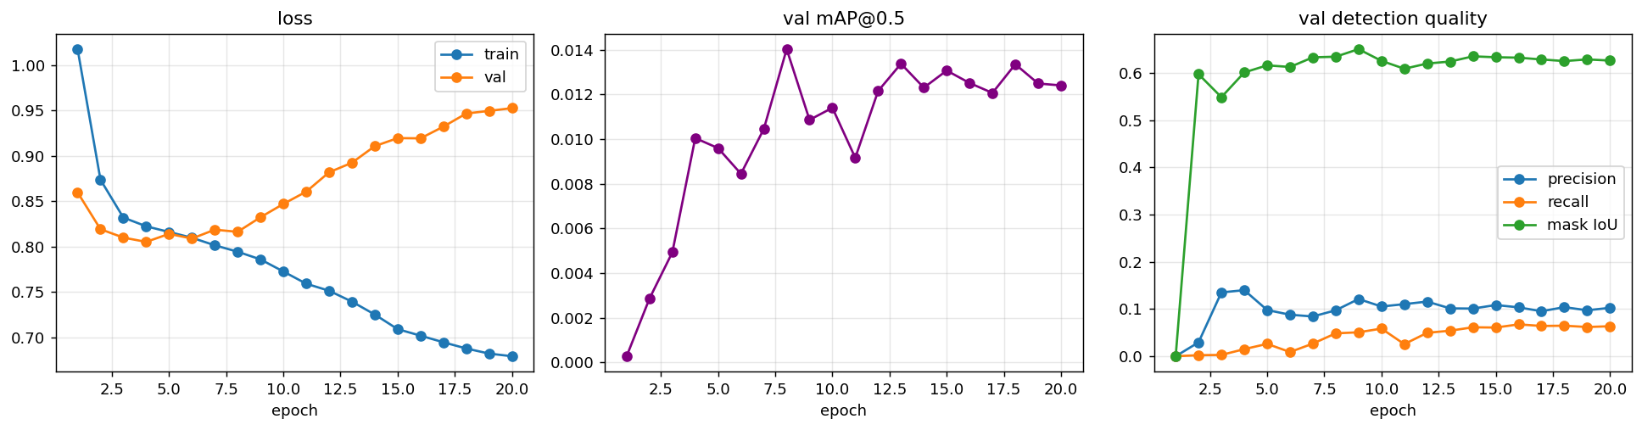
Principled checkpoint selection
Trained 20 epochs; kept epoch 8 — the validation-mAP peak, before overfitting set in.
epoch 8
0.0140
after ~epoch 4
selected checkpoint
selection mAP @0.5
val loss starts rising
Lunar Feature Recognition · 5 / 8
Notes:
TRAINING — principled, not luck (~55s). "20 epochs, but I deliberately don't use the last one. Training loss kept falling while validation loss bottomed early then rose — overfitting. I select by validation mAP, which peaks at epoch 8 (0.014). That's best_model.pth, and every later number comes from it." Point at the curve. TRANSITION: "So what does it score?"

Slide 6
Final evaluation: what the numbers mean
Best checkpoint, evaluated on the held-out validation set.
0.010
0.104
0.056
0.073
0.636
0.773
mAP@0.5
precision
recall
F1
mask IoU
mask Dice
The key finding
The model draws features well — mask IoU 0.64 — but doesn’t find enough of them: recall 0.056, with 461 found vs 7,790 missed. Detection, not segmentation, is the bottleneck.
AP per class
Detection counts
crater
wrinkle
skylight
scarp
TP
FP
FN
0.023
0.017
0.000
0.000
461
3,973
7,790
Lunar Feature Recognition · 6 / 8
Notes:
HONEST RESULTS — calm, do NOT apologise (~75s). "Detection is weak: mAP ~0.01, precision 0.10, recall 0.056. But when it DOES match an object the mask is strong — IoU 0.64, Dice 0.77. The decoupling IS the finding: it learns what features look like, it just isn't finding enough. 461 found vs 7,790 missed." Per class: craters/ridges carry the AP; skylight/scarp ~0 because rare.
Q&A DEFENSE (if pressed): Why mAP ~1%? -> data-starved, recall is the bottleneck, not a broken model. Good masks but weak detection? -> mask metrics only score MATCHED objects; the RPN under-proposes on small low-contrast terrain. Overfit/lucky epoch? -> epoch 8 chosen by val mAP before val loss climbs = principled early stop.

Slide 7
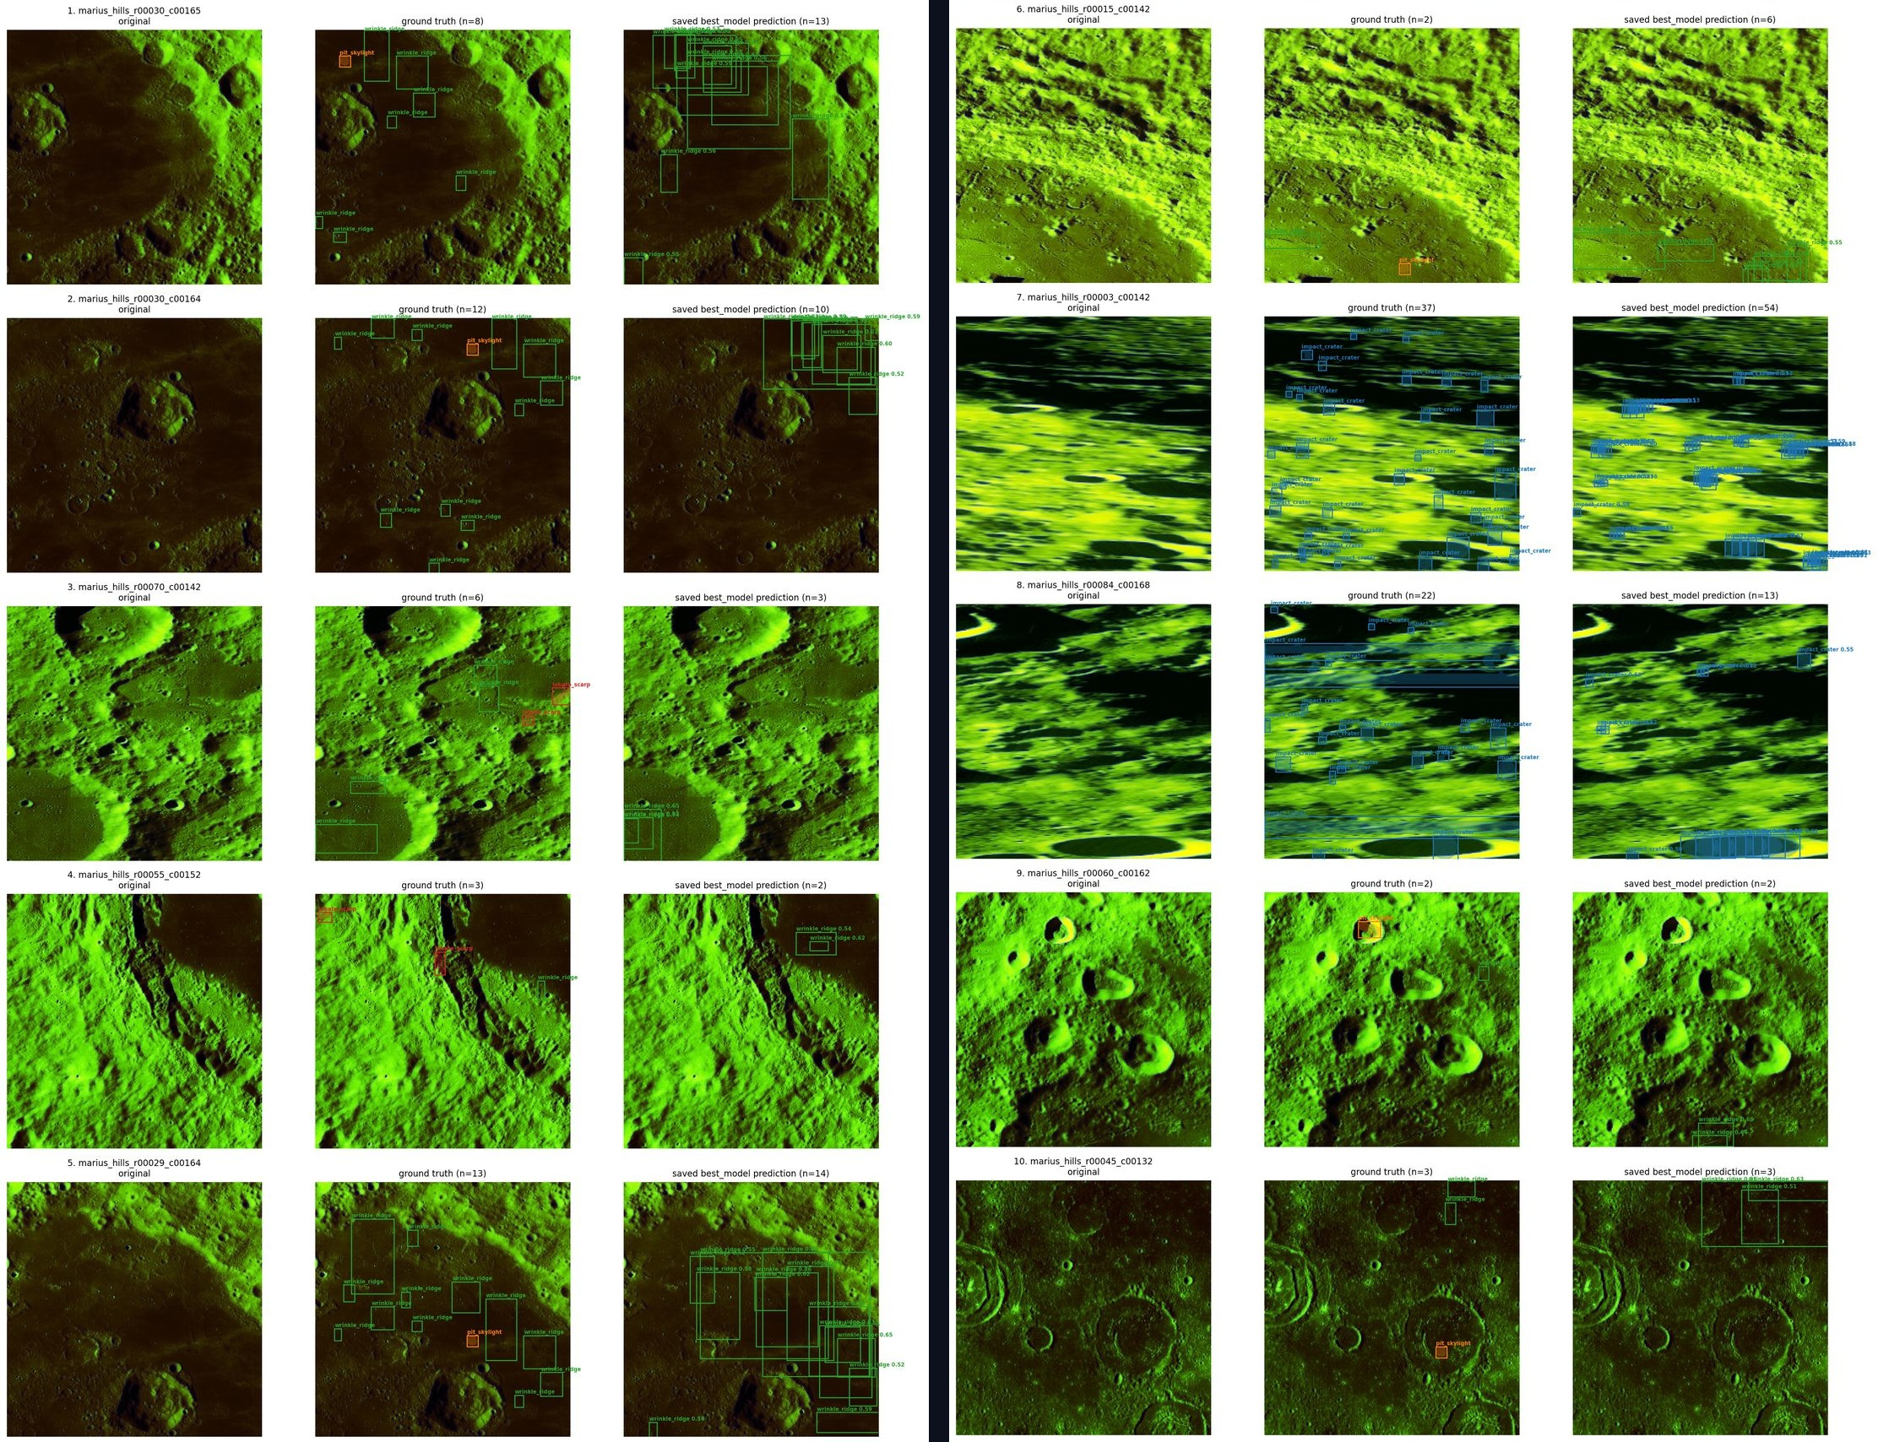
Predictions on validation tiles
Each triplet: original · ground truth · prediction.
How to read it
Clear, high-contrast craters and ridges are localized and outlined well.
Faint or small features are missed — exactly what the low recall predicts.
Lunar Feature Recognition · 7 / 8
Notes:
QUALITATIVE (~45s). "Three panels per tile: original, ground truth, prediction. On clear high-contrast craters and ridges the boxes and masks line up. On faint or small features it under-detects — exactly what recall predicted. The point: it fails predictably, not randomly." TRANSITION: "Where does it fall short, and what's next?"

Slide 8
Honest limitations — and the fix for each
The results aren’t perfect, but every gap has a concrete next step.
1
Low recall — most objects missed
2
False positives from shadow & texture
Class-balanced sampling, anchor tuning, and validation-based early stopping.
Hard-negative mining and confidence-threshold tuning for cleaner output.
3
Rare classes are starved
4
Long thin features aren’t compact
Oversample skylight & scarp, or use a focal / class-weighted loss.
Hybrid: Mask R-CNN for blobs + U-Net-style segmentation for ridges.
Bottom line: the pipeline is sound and the masks are good — the gap is data balance and tuning, not the architecture.
Lunar Feature Recognition · 8 / 8
Notes:
CLOSE STRONG (~70s). Four limitations, each with a fix: 1) low recall -> balanced sampling + anchor tuning + early stopping. 2) false positives from shadow/texture -> hard negatives + threshold tuning. 3) rare classes starved -> oversampling or focal loss. 4) long thin features -> hybrid with U-Net-style segmentation. LAND IT: "The pipeline is sound and the masks are good — the gap is data balance and tuning, not the architecture. I know exactly where to push next. Thank you — happy to take questions."
Q&A DEFENSE: What would actually fix it? -> imbalance first (balanced sampling + focal loss), then anchor/threshold tuning on GPU; scarp AP 0 and skylight ~0 are data starvation, not architecture.

