Slide 1

SPI PROTOCOL WITH APB INTERFACE
Digital Design Using FPGA — A Memory-Mapped SPI Controller
RTL Modules: APB_spi_interface · master · slave (×4)

Slide 2
Agenda
1
SPI & APB Fundamentals
2
Project Overview
What each protocol is and why they're paired
The problem this design solves
3
System Architecture
4
Register Map & FSM
Three RTL modules and signal flow
How software drives the hardware
5
Transaction Walkthrough
6
Synthesis Result
Step-by-step data transfer
The design after synthesis
7
Advantages & Design Notes
Strengths and known scope boundaries
2

Slide 3

What Is SPI?
Serial Peripheral Interface (SPI) is a synchronous, full-duplex, point-to-point serial protocol used to connect microcontrollers to sensors, memories, displays, and other peripherals.
SCK / SCLK Serial clock — generated by the master, coordinates timing
SPI Master
MOSI Master Out, Slave In — data from master to slave
SCLK
MISO Master In, Slave Out — data from slave to master
MOSI
SS / CS Slave/Chip Select — one dedicated line per slave device
MISO
Slave
CS
Because master and slave shift data on the same clock edge, SPI achieves high throughput with a very simple interface — at the cost of a dedicated chip-select per slave.
SPI can address up to 4 slaves in this design — one CS line per device, shared SCLK / MOSI / MISO bus.
3

Slide 4


What Is APB?
The Advanced Peripheral Bus (APB) is the low-complexity member of ARM's AMBA bus family, built for simple register-style access to peripherals that don't need high bandwidth.
1 · SETUP Phase
2 · ACCESS Phase
PSEL is asserted, addressing the target peripheral and signalling the start of a transfer.
PENABLE is asserted; PWDATA/PADDR/PWRITE select the operation and the slave returns PRDATA, optionally inserting wait states via PREADY.
Core APB Signals
Why it fits this project
PCLK / PRESETn — bus clock & reset
PREADY is tied permanently high in this design (zero wait-state slave), and PSLVERR is tied low — every register access completes in the minimum two cycles.
PSEL / PENABLE — transfer handshake
PWRITE, PADDR, PWDATA — write access
PRDATA, PREADY, PSLVERR — slave response
4

Slide 5


The Problem This Project Solves
A processor talks in memory-mapped registers. SPI peripherals talk in raw, timing-sensitive serial bits. Something has to translate.
Protocol Mismatch
CPU-Driven Bit-Banging
The Fix
SPI has no addressable registers, wait states, or bus arbitration — the CPU only understands load/store. apb_spi_interface bridges the two into ordinary register accesses.
Without hardware support, software must toggle SCLK/MOSI and sample MISO itself — burning CPU cycles and risking incorrect mode timing.
master_spi_final_form owns clock generation, shifting, and mode handling in hardware — software just writes data and polls a status bit.
5

Slide 6



Advantages of This Design
Standard-Bus Compliant
Full SPI Mode Coverage
Configurable Clock Rate
Correct PSEL/PENABLE/PWRITE handshake — drops into any AMBA-based SoC
CPOL/CPHA are software-programmable, covering all four SPI modes (0–3)
4-bit DVSR trades throughput vs. signal integrity, no hardware changes
Multi-Slave Support
Zero-Wait-State Access
Modular, Reusable RTL
2-bit SLAVE_SEL + one-cold 4-bit CS bus address up to 4 slaves
PREADY tied high — every register access completes in 2 cycles
Clean narrow interfaces let each module be reused independently
12

Slide 7

Three RTL Modules
APB_spi_interface
master
slave (×4)
APB slave / register file
SPI master FSM
Reference SPI slave
Exposes the SPI controller to software as four memory-mapped registers: TX_DATA, RX_DATA, CTRL, STATUS. Writes are captured synchronously on PCLK; reads are combinational with PREADY tied high.
Generates SCLK from a programmable divider, drives the selected chip-select, and shifts 32 bits in/out — reproducing all four standard SPI clock modes via CPOL/CPHA.
A minimal loopback slave that shifts MOSI in and MISO out, used to close the loop and validate the master. Not a production peripheral.
7

Slide 8
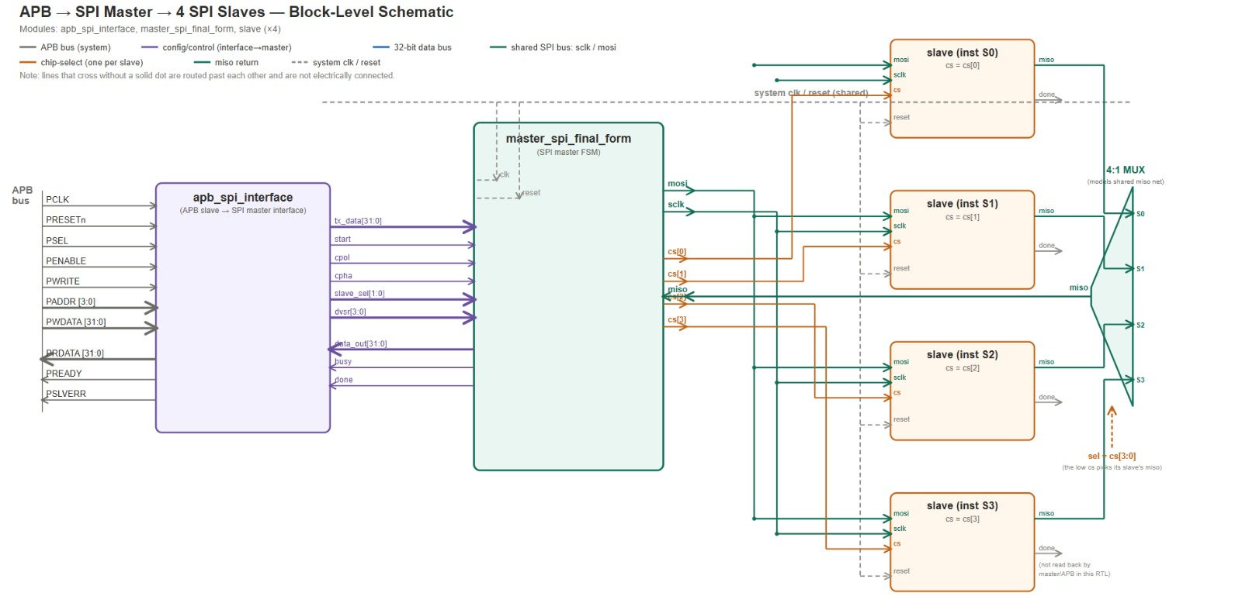
System Architecture
APB → SPI Master → 4 SPI Slaves — three RTL modules translate register accesses into serial transactions.
6

Slide 9
APB Register Map
apb_spi_interface decodes a 4-bit PADDR into four word-aligned registers.
Addr | Register | Access | Description
0x0 | TX_DATA | W | 32-bit data to transmit; loaded into the shift register on transaction start
0x4 | RX_DATA | R | 32-bit word most recently received from the SPI slave
0x8 | CTRL | R/W | START, CPOL, CPHA, SLAVE_SEL[1:0], DVSR[3:0] — see field table below
0xC | STATUS | R | bit0 = BUSY, bit1 = DONE — mirrors the master's status flags
Addr | Register | Access | Description
0x0 | TX_DATA | W | 32-bit data to transmit; loaded into the shift register on transaction start
0x4 | RX_DATA | R | 32-bit word most recently received from the SPI slave
0x8 | CTRL | R/W | START, CPOL, CPHA, SLAVE_SEL[1:0], DVSR[3:0] — see field table below
0xC | STATUS | R | bit0 = BUSY, bit1 = DONE — mirrors the master's status flags
CTRL Register (0x8) — Bit Fields
Bit(s) | Field | Meaning
0 | START | One-clock pulse that begins a new transaction
1 | CPOL | Clock polarity — idle level of SCLK
2 | CPHA | Clock phase — which edge samples/shifts data
4:3 | SLAVE_SEL | Selects which of 4 chip-select lines is active
8:5 | DVSR | 4-bit clock divider setting SPI clock frequency
Bit(s) | Field | Meaning
8

Slide 10

SPI Master — Two-State FSM
master_spi_final_form runs an IDLE / RUN state machine driven by the START pulse and a programmable clock divider.
IDLE
RUN
Holds SCLK at the CPOL-defined idle level; de-asserts all chip-selects
On START: latches CPOL, CPHA, SLAVE_SEL
Loads 32-bit data_in into the TX shift register
Clears RX register and bit counter
Drives selected CS active (one-cold) and moves to RUN
START
4-bit counter compares against DVSR to generate SCLK edges
CPHA decides sample edge (shift MISO in) vs. shift edge (drive MOSI out)
Repeats for all 32 bits
On final bit: latches data_out, releases CS, returns SCLK to idle
Clears BUSY, pulses DONE, returns to IDLE
32nd bit
BUSY / DONE let software know — via the STATUS register — when it's safe to write new TX_DATA or read fresh RX_DATA, without needing an interrupt line.
9

Slide 11
Typical Transaction Sequence
1
2
3
4
5
Write TX_DATA (0x0)
Write CTRL (0x8)
Forward to SPI master
Shift 32 bits
Poll & read
CPU writes the 32-bit word to transmit
Sets CPOL, CPHA, SLAVE_SEL, DVSR, and START=1 in the same write
The interface forwards these fields; START produces a single clock pulse
The master asserts the chosen CS and shifts data over SCLK/MOSI/MISO
Software polls STATUS until BUSY=0, DONE=1, then reads RX_DATA (0x4)
10

Slide 12
Design Notes & Possible Extensions
Known scope boundaries of this version — not defects, but starting points for anyone extending the project.
No Error Reporting
PSLVERR is hard-wired to 0 — malformed APB accesses cannot be signalled back to the bus master.
Polling Only
Completion is only observable via STATUS; no interrupt output, so the CPU must poll BUSY/DONE.
Fixed 32-bit Transfers
Master and reference slave always exchange exactly 32 bits; variable length would need a length field.
Limited Divider Range
DVSR is 4 bits wide, limiting SPI clock rate selection to 16 steps from the system clock.
13

Slide 13
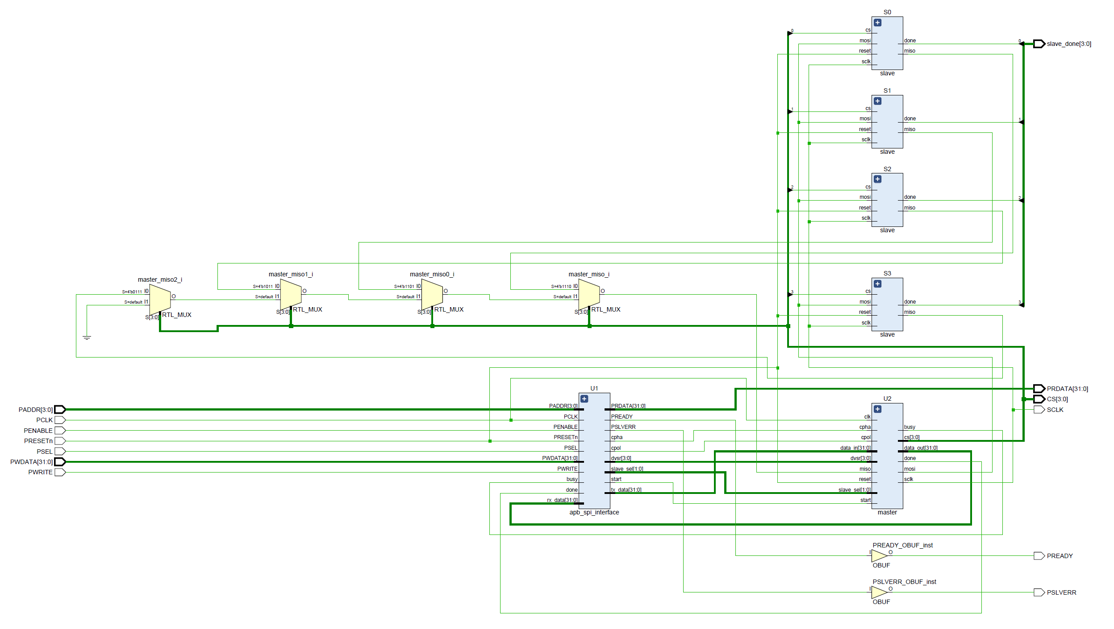
Synthesis Result
The gate-level schematic after synthesis, showing the master, APB interface, four slaves, and the MISO select MUX network.
11

Slide 14

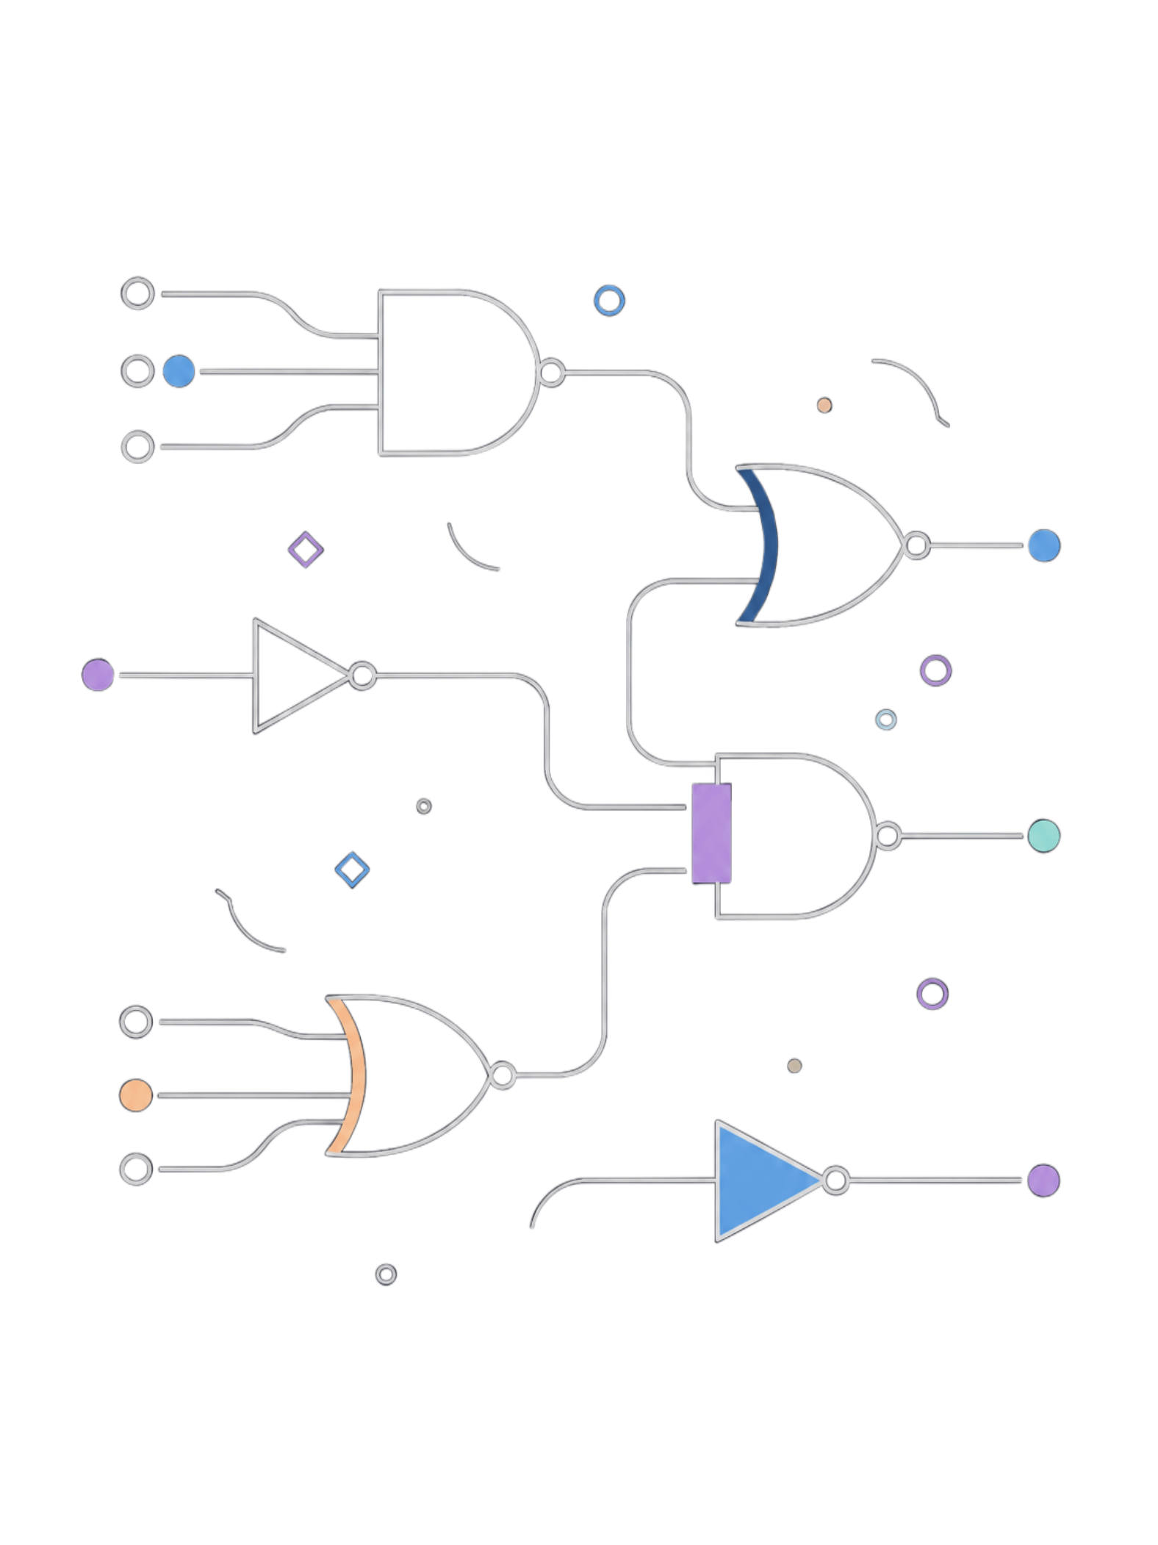
Linting & Synthesis
Lint Clean
Full linting pass performed on all RTL modules — zero warnings, no undriven signals or latches inferred. Design is synthesis-ready.
Full Protocol Synthesized
Complete SPI-APB communication stack synthesized to gate-level netlist APB interface, SPI master FSM, and slave all realized in hardware.

