Slide 1
Bankruptcy Prevention

Slide 2


Mentor Name Sravani
Group – 6 Members
G. Mohammed Amir Suhel
Bandi Manoj
Abhinav Cheekurthi
Sandhya.D.N
Srinivasu Murali Kantamneni

Slide 3

Agenda
Objective
Dataset Details
Exploratory Data Analysis
Model Building
Model Evaluation
Deployment

Slide 4
Objective
Objective: Predict the likelihood of bankruptcy in companies using historical data.
Importance: Helps in early detection of financial distress to prevent sudden business failures.
Method: Utilizes machine learning algorithms for classification and risk prediction.
Data Scope: Financial ratios, operational indicators, and historical company performance data.
Outcome: A predictive model that aids in credit risk assessment and decision-making.
Impact: Enables businesses and financial institutions to take timely preventive measures.

Slide 5
Dataset Details
Feature Name | Description | Possible Values
industrial_risk | Risk from industrial operations | 0 = Low, 0.5 = Medium, 1 = High
management_risk | Risk from poor management practices | 0 = Low, 0.5 = Medium, 1 = High
financial_flexibility | Ability to manage finances during uncertainty | 0 = Low, 0.5 = Medium, 1 = High
credibility | Company’s creditworthiness or reputation | 0 = Low, 0.5 = Medium, 1 = High
competitiveness | Firm’s position in the market | 0 = Low, 0.5 = Medium, 1 = High
operating_risk | Day-to-day business risk | 0 = Low, 0.5 = Medium, 1 = High
Class | the target or label in the dataset | 0 = Non-bankruptcy, 1 = bankruptcy

Slide 6
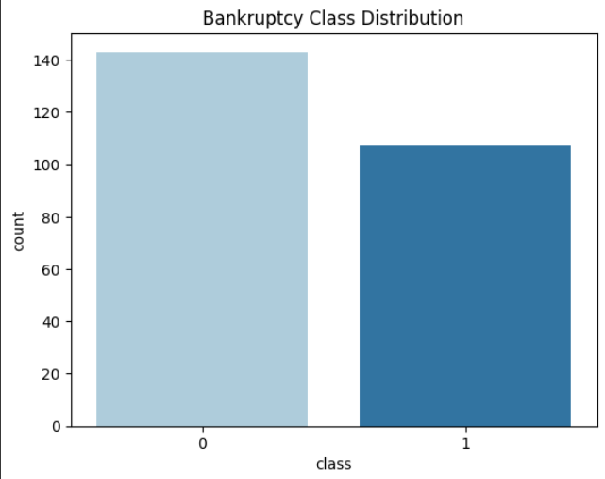
Exploratory Data Analysis (EDA)
📊 Class Distribution
Understanding the distribution of the target variable is crucial before training any model.
The target column class indicates whether a company is at risk of bankruptcy or not.
A count plot was used to visualize the frequency of each class.
This helps identify if the data is balanced or imbalanced, which can impact model performance.

Slide 7
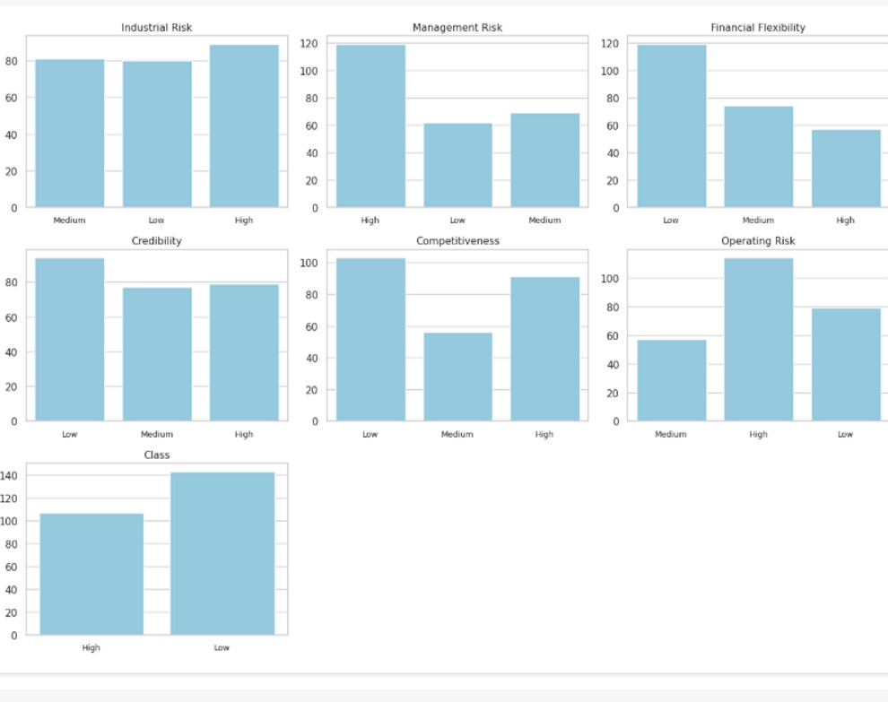

Slide 8
Feature Distribution by Class (Box Plot Analysis)
Box plots were created for each feature against the target variable class to analyze feature-wise distribution.
Purpose:
To observe how feature values differ between bankrupt and non-bankrupt companies.
To detect outliers, range, and median shifts across classes.
Observations:
Some features show clear separation between the two classes.
Others show overlapping distributions.
This analysis reveals which features are potentially more informative for classification.
Conclusion:
Features with better separation can be strong predictors for model building.
Box plots also help in identifying outliers, which may need to be treated during preprocessing.

Slide 9
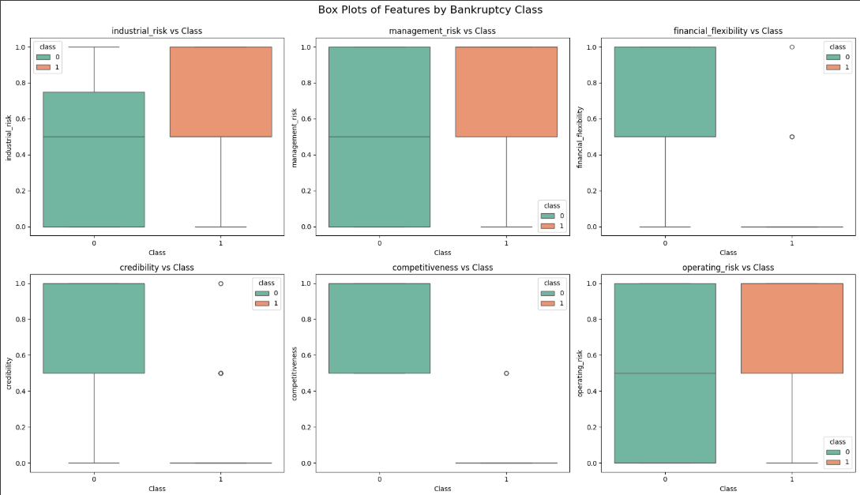

Slide 10
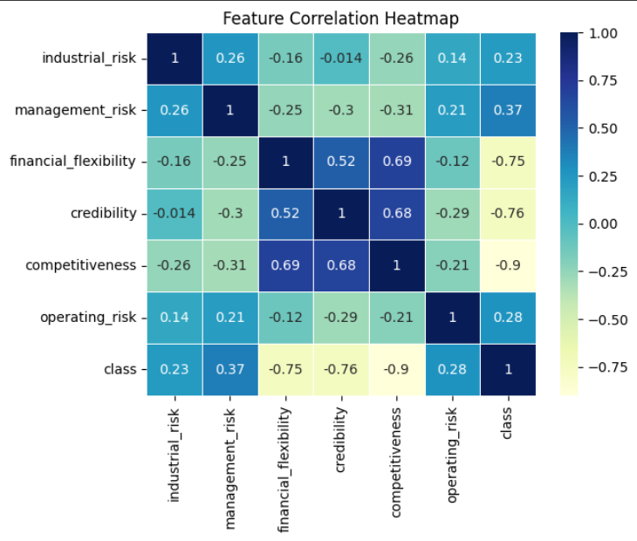
Correlation Heatmap
Competitiveness has strongest link to bankruptcy risk (-0.9)
Financial flexibility & credibility also strongly related to outcome (-0.75/-0.76)
Management risk shows moderate positive correlation (0.37)
Industrial risk has weakest relationship (-0.014)
High correlation between some features (e.g., financial flexibility & credibility: 0.52) may cause multicollinearity

Slide 11
Model Building
1. Logistic Regression
A statistical linear model used for binary classification.
Assumes a linear relationship between input features and the log-odds of the target class.
Useful as a baseline model due to its simplicity and interpretability.
Achieved 100% accuracy on test data.
Performed exceptionally well with perfect precision and recall.
Accuracy: 100%
Precision: 1.00 (for both classes)
Recall: 1.00 (for both classes)
F1-Score: 1.00 (for both classes)
Support:
Class 0 (Non-Bankruptcy): 29
Class 1 (Bankruptcy): 21

Slide 12
SVM Model
SVM achieved 100% accuracy on test data
Both classes (0 and 1) were predicted perfectly
Precision, Recall, and F1-Score are all 1.00
No false positives or false negatives
SVM is effective for binary classification
Performs well in high-dimensional spaces
Suitable for well-separated class boundaries
Accuracy: 100%
Precision: 1.00 (for both classes)
Recall: 1.00 (for both classes)
F1-Score: 1.00 (for both classes)
Support:
Class 0 (Non-Bankruptcy): 29
Class 1 (Bankruptcy): 21

Slide 13
Random Forest
Achieved perfect classification performance
Very effective in handling both classes equally
No overfitting observed despite being an ensemble method
Robust to noise and irrelevant features
Excellent at capturing non-linear patterns
Feature importance can be extracted for interpretation
Accuracy: 100%
Precision: 1.00 (for both classes)
Recall: 1.00 (for both classes)
F1-Score: 1.00 (for both classes)
Support:
Class 0 (Non-Bankruptcy): 29
Class 1 (Bankruptcy): 21

Slide 14
XGBoost
High overall accuracy of 98%
Slightly lower precision for Class 1 (0.95) indicating a few false positives
Perfect recall for Class 1 (1.00), no actual bankruptcies missed
Very effective gradient boosting model
Balances bias and variance well with regularization
Suitable for complex patterns with good generalization
Accuracy: 98%
Precision:
Class 0: 1.00
Class 1: 0.95
Recall:
Class 0: 0.97
Class 1: 1.00
F1-Score: 0.98 (for both classes)
Support:
Class 0 (Non-Bankruptcy): 29
Class 1 (Bankruptcy): 21

Slide 15
Model Evolution Journey
Model Tried | Reason for Use
Logistic Regression | Simple, interpretable, baseline model
Support Vector Machine (SVM) | Good for binary classification problems
Random Forest Classifier | Handles non-linearity, reduces overfitting
XGBoost Classifier | High performance, works well with tabular data

Slide 16
Performance Comparison
Model Tried | Test Accuracy | Cross-Validation Accuracy
Logistic Regression | 100% | 99.60%
Support Vector Machine (SVM) | 100% | 99.60%
Random Forest Classifier | 100% | 99.60%
XGBoost Classifier | 98% | 99.60%

Slide 17
Why Finalize Logistic Regression?
1️⃣ Interpretability: Financial institutions prefer explainable models for risk prediction. Logistic Regression provides clear coefficients & probabilities.
2️⃣ Simplicity: Less prone to overfitting with small datasets. Easy to deploy & maintain.
3️⃣ Comparable Accuracy: Achieved the same accuracy as complex models like Random Forest & SVM.
4️⃣ Business Use-Case Fit: Ideal for use in financial risk assessment due to transparency

Slide 18
Final Model Selected
Model Chosen: Logistic Regression
Test Accuracy : 100%
Cross-Validation Accuracy: 99.60%
Precision: 1.00
Recall : 1.00
F1-Score: 1.00

Slide 19
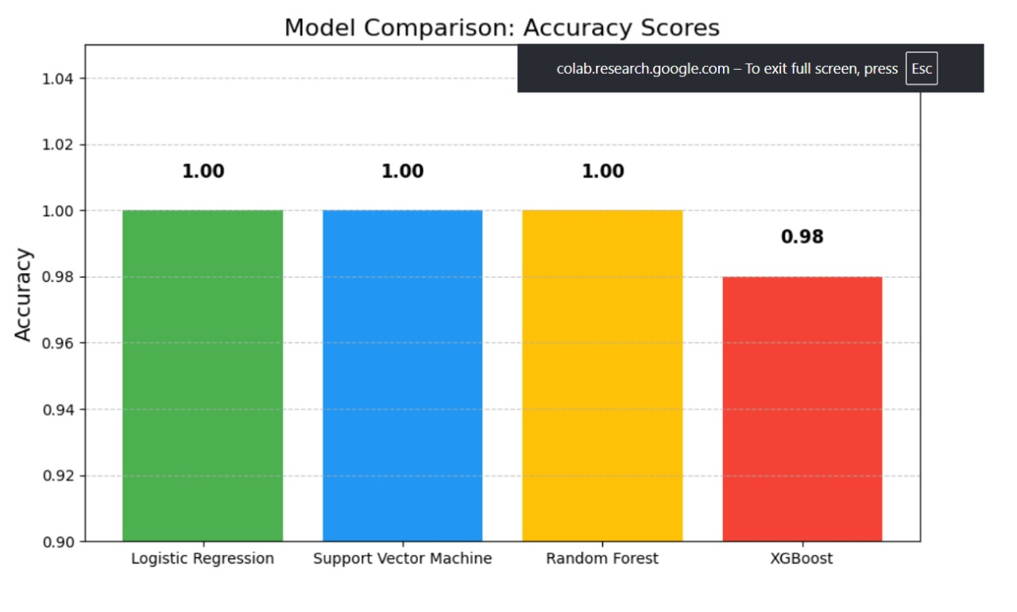
Summary of Model Evolution:
Started with multiple ML models.
Compared both performance and interpretability.
Chose Logistic Regression for its simplicity, accuracy, and explainability.

Slide 20
Deployment
Goal: Make the model accessible to end-users (business analysts, financial officers, etc.)
Real-world Use: Predict bankruptcy risk instantly using a web interface
No technical expertise needed for users.

Slide 21
Deployment Approach
Step | Action
Model Training | Offline using Jupyter Notebook
Model Saving | Saved as .pkl files using joblib
App Development | Web app built using Streamlit
App Hosting | Runs locally or can be deployed on the cloud

Slide 22
Files Used in Deployment
File Name | Purpose
logistic_bankruptcy_model.pkl | Trained Logistic Regression model
scaler_bankruptcy.pkl | Scaler to normalize new user inputs
App.py | Web application file (Streamlit)

Slide 23
Deployment Architecture
1️⃣ User Inputs Financial Data
↓
2️⃣ Scaler Normalizes Inputs
↓
3️⃣ Logistic Regression Model Predicts Bankruptcy Risk
↓
4️⃣ Results Displayed on Web App (Streamlit GUI)

Slide 24
Features of the Web App
Feature | Benefit
User-friendly Sliders | Easy input of financial factors
Real-time Predictions | Instant risk output
Risk Meter Visualization | Helps interpret risk level clearly
Download Report Option | Generates a CSV of results

Slide 25
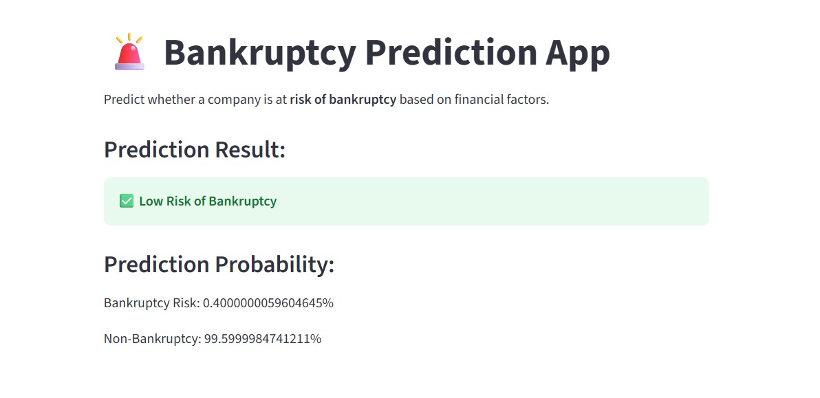

Slide 26
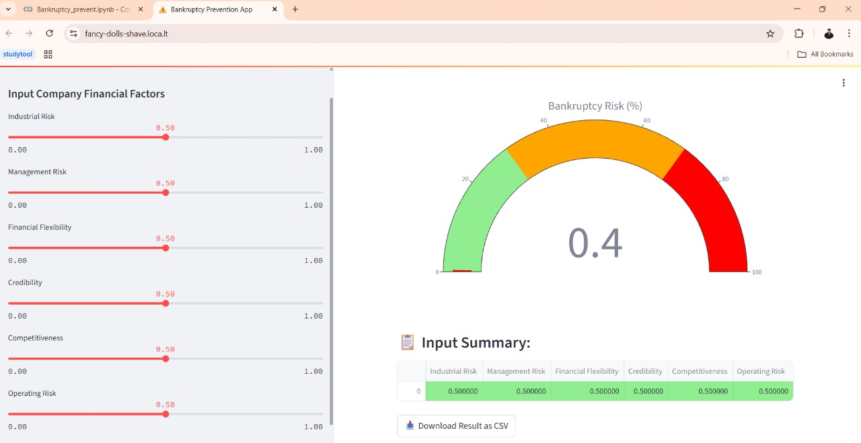

Slide 27
Thank you

