Slide 1
Banque_Misr_ATMs
File created on: 9/13/2023 8:50:58 AM

Slide 2
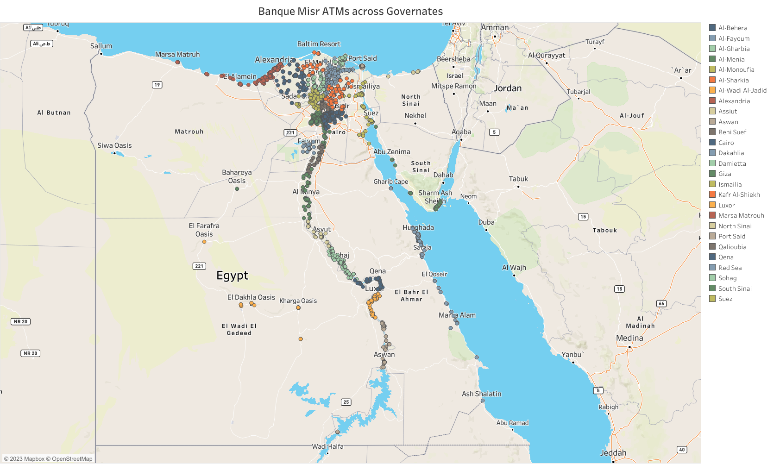

Slide 3
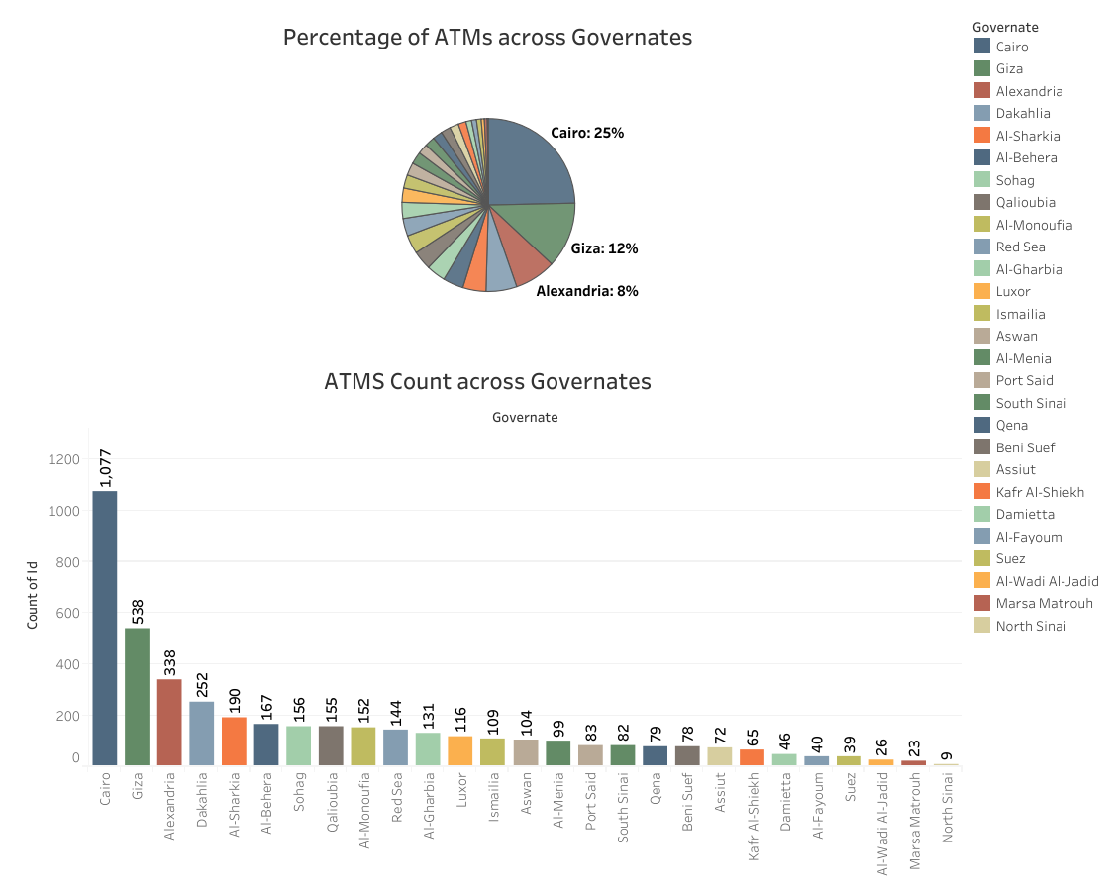

Slide 4
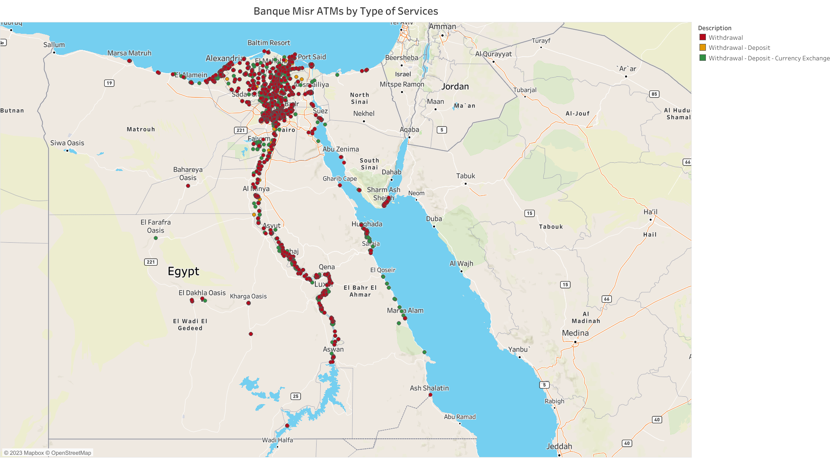

Slide 5
