Slide 1
Variational Autoencoder (VAE) Analysis
AmirHossein
Ghanaatian
New datasets
OLD datasets
23 CRS F1 AND HO COMBINED AGRON AND SPECTRAL DATA_WEATHER to Caragea 9_16_24
TO CARAGEA WORKING 2022_2023 ALL LOC_KPEGG_MULTISPECTRAL_stacked
TO CARAGEA WORKING 2023 ALL LOC_KPEGG_THERMAL_stacked

Slide 2
Data Preprocessing
Selected relevant columns
Sorted data based on 'expt', 'plot', and 'entry'
Replaced "." with null values
Converted columns to numeric format
Aggregated data by grouping and calculating means
Added 'yield' and 'stage' columns back
Reordered columns

Slide 3
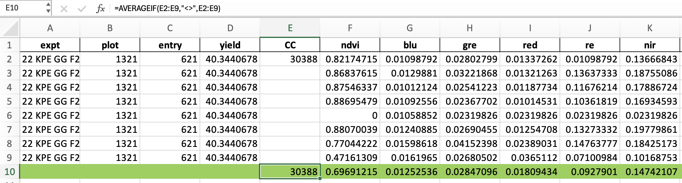
Aggregated data by grouping and calculating means

Slide 4
VAE Implementation
Implemented a Variational Autoencoder on the preprocessed data
Performance metrics:
Metric | Value
Test Mean Squared Error | 45.9015
Test R² | 0.7479
Test Mean Absolute Error | 5.1987
Test Mean Percentage Error | 13.5262%

Slide 5
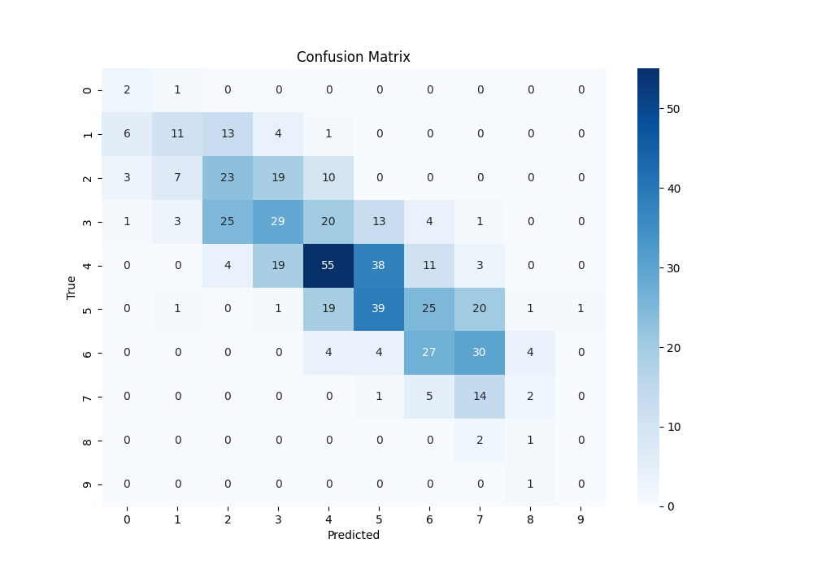
Confusion Matrix

Slide 6
Confusion Matrix Analysis
Multi-class classification model performance (classes 0-9)
Best performance for classes 4, 5, 6, 7
Class 9: insufficient data, misclassified as class 8
Classes 0, 1, 2: few instances, class imbalance, similarity
Misclassifications more common between adjacent classes
Higher precision for middle classes, better recall for classes 6, 7

Slide 7
Data Preprocessing for STAGE
Drop the Rows which 'Stage' is null
Divided the dataset based on the "Stage" columns
Preprocess every sub-dataset based on number of nulls
If a column has 100% null, we remove that column in training the models
If percentage of columns is low, we remove only rows with nulls in that columns

Slide 8
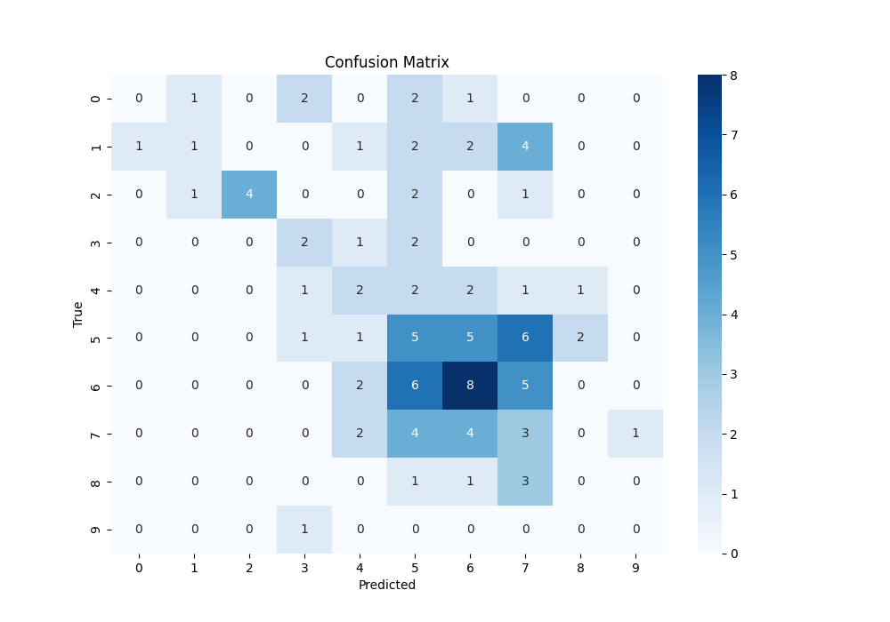
R1
Precentage of nulls in each column:
yield 0.0
stage 0.0
CC 100.0
ndvi 0.0
blu 0.0
gre 0.0
red 0.0
re 0.0
nir 0.0
expt 0.0
plot 0.0
entry 0.0
loc 0.0
prow 0.0
pcol 0.0
Ignoring CC Column,
Trained on: 'ndvi', 'blu', 'gre', 'red', 're', 'nir'
Test R²: 0.1278

Slide 9
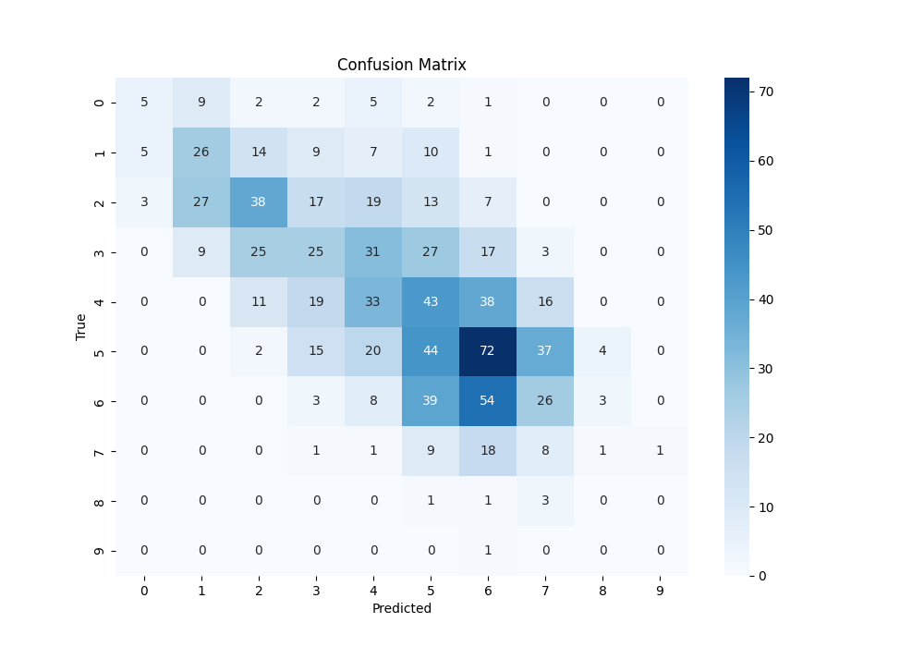
R5
Percentage of missing values in each column:
yield 1.980198
stage 0.000000
CC 32.673267
ndvi 0.000000
blu 0.000000
gre 0.000000
red 0.000000
re 0.000000
nir 0.000000
expt 0.000000
plot 1.980198
entry 1.980198
loc 0.000000
prow 0.000000
pcol 0.000000
Ignoring CC Column, Removing rows with nulls in Yield
Trained on: 'ndvi', 'blu', 'gre', 'red', 're', 'nir'
Test R²: 0.3878

Slide 10
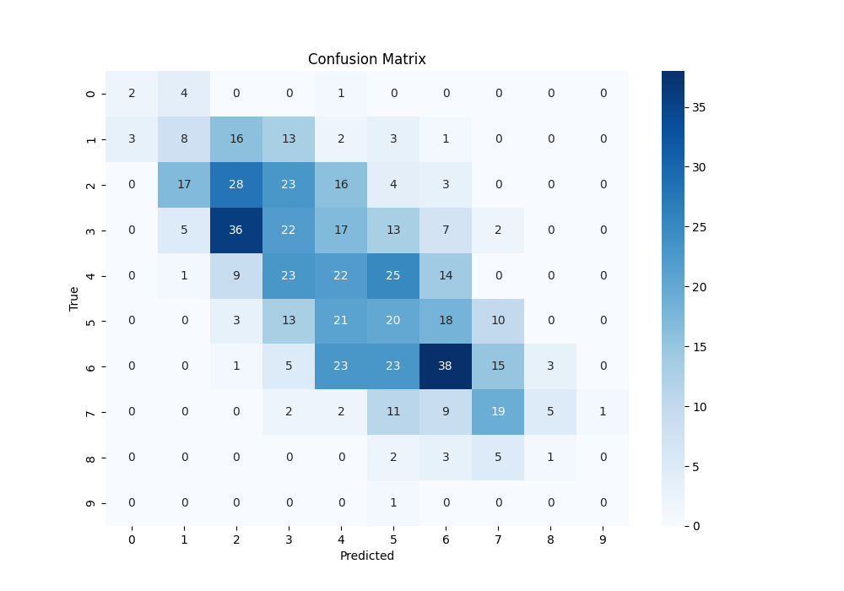
R5
Percentage of missing values in each column:
yield 1.980198
stage 0.000000
CC 32.673267
ndvi 0.000000
blu 0.000000
gre 0.000000
red 0.000000
re 0.000000
nir 0.000000
expt 0.000000
plot 1.980198
entry 1.980198
loc 0.000000
prow 0.000000
pcol 0.000000
Removing rows with nulls in Yield and CC
Trained on: 'CC', 'ndvi', 'blu', 'gre', 'red', 're', 'nir'
Test R²: 0.5063

Slide 11
Summary
Stage | Which Column Ignored? | Null Cleaning on? | nu. of rows after preproccessing | R2 (test, 20%)
R1 | CC | - | 660 | 0.1278
R2 | CC | yield | 3300 | 0.1041
R3 |  | yield | 1320 | 0.7206
R4 |  | yield, CC | 1320 | 0.024
R4 | CC | yield | 1980 | 0.1092
R5 | CC | yield | 5940 | 0.3878
R5 |  | yield, CC | 3960 | 0.5063
R6 | CC | - | 1320 | 0.633
R7 | CC | yield | 7260 | 0.6245
R8 | CC | - | 660 | 0.1296
V4 | - | ndvi', 'blu', 'gre', 'red', 're', 'nir' | 0 | -
V6.5 | CC | - | 660 | 0.3291

Slide 12
Data Preprocessing 23 CRS F1 AND HO COMBINED AGRON AND SPECTRAL DATA_WEATHER to Caragea 9_16_24.xlsx
Selected relevant columns
Sorted data based on 'expt', 'plot', and 'entry'
Replaced "." with null values
Converted columns to numeric format
Aggregated data by grouping and calculating means

Slide 13
More details
all P4 data = [cc, blu, gre, red, re, nir, ndvi]
4800 rows
all Thermal data = [TH]
3072 rows
Agron = [Yeild]
384 rows
Merge these data based on the uniqe match of 'expt', 'plot', and 'entry', remove rows with nulls
381 rows

Slide 14
Aggregated data by grouping and calculating means

Slide 15
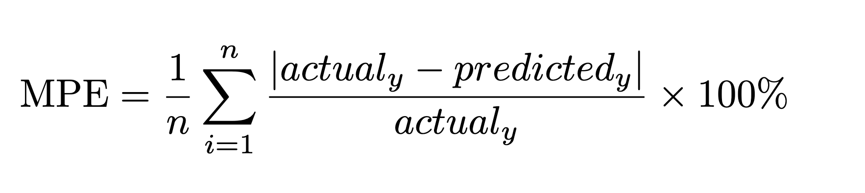
VAE Implementation
Implemented a Variational Autoencoder
K-fold cross-validation results (K=5)
Average Metrics
Mean Squared Error (MSE): 60.1191
R² Score: 0.5313
Fold | MSE | R² | MAE | MPE
1 | 70.2446 | 0.4908 | 6.0127 | 13.2878%
2 | 39.6278 | 0.7020 | 5.1391 | 11.2822%
3 | 61.5302 | 0.5877 | 6.1645 | 12.9856%
4 | 64.1423 | 0.3772 | 5.9125 | 12.7816%
5 | 65.0506 | 0.4986 | 5.9600 | 12.5112%

Slide 16
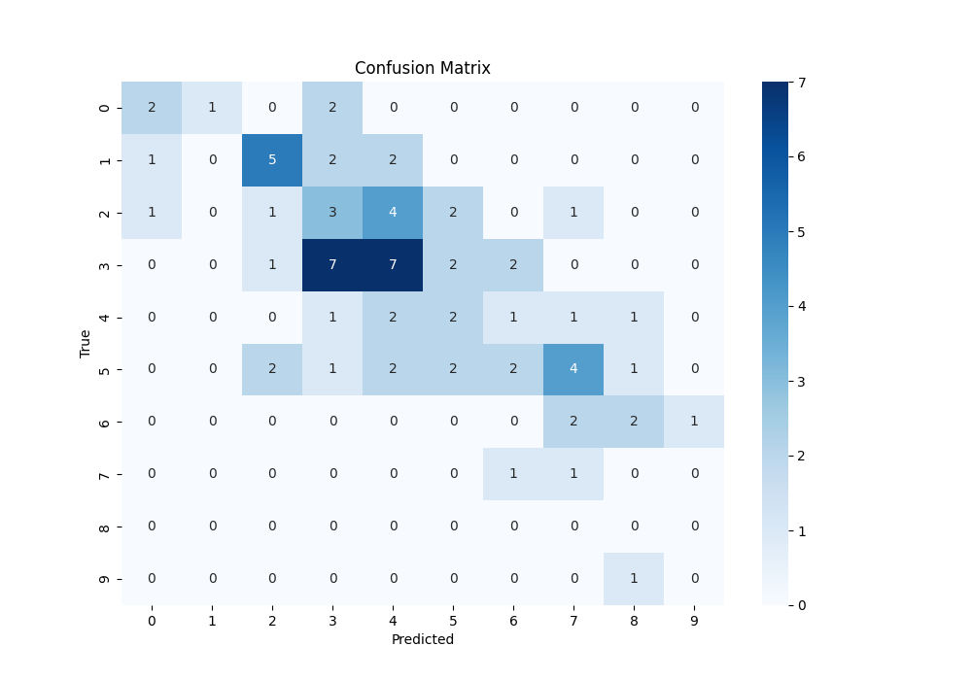
Confusion matrix

Slide 17
Results for "sas" data 23 CRS F1 AND HO COMBINED AGRON AND SPECTRAL DATA_WEATHER to Caragea 9_16_24.xlsx
Model Performance Evaluation
K-fold cross-validation results (K=5)
Average Metrics
Mean Squared Error (MSE): 53.0747
R² Score: 0.5893
Results by Fold
Fold | MSE | R² | MAE | MPE
1 | 69.3842 | 0.4971 | 6.1160 | 13.5881%
2 | 30.8453 | 0.7681 | 4.4166 | 9.1228%
3 | 55.6282 | 0.6272 | 5.6451 | 12.2313%
4 | 50.9172 | 0.5056 | 5.3736 | 11.7496%
5 | 58.5982 | 0.5483 | 5.7079 | 11.4970%

Slide 18
Data Overview
Old Data
Multispectral
Thermal
Data Aggregation
Aggregate based on experiment plot entry
Calculate averages for:
NDVI
RED
GREEN
...
THERMAL
Data Cleaning
Row count mismatch between multispectral and thermal data
Remove extra multispectral entries to synchronize
Final row count after cleaning: 1980 rows
Merge based on experiment plot entry
To have Thermal and Multispectral together

Slide 19
Model Performance
Old DATA Performance
Metrics
Test Mean Squared Error: 53.6881
Test R²: 0.7681
Test Mean Absolute Error: 5.7176
Test Mean Percentage Error: 14.0103%
New DATAPerformance
Metrics
Test Mean Squared Error: 68.9005
Test R²: 0.5616
Test Mean Absolute Error: 6.5699
Test Mean Percentage Error: 14.6783%

Slide 20
Model Transfer Test
Old Data
90% used for training
10% used for testing
Model saved after training
Old Data TEST
MSE = 54
R² = 0.976
New Data TEST (ALL 381 ROWS)
Saved model tested on new data
R² = -2.5
MSE = 468

Slide 21
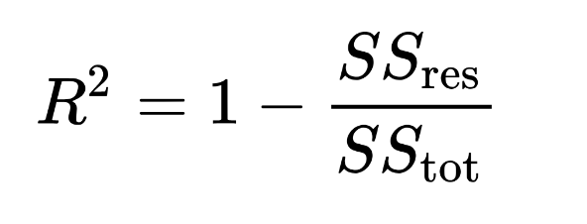
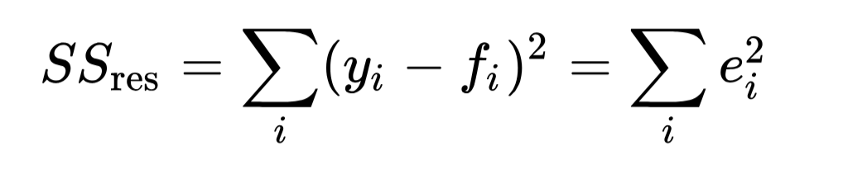
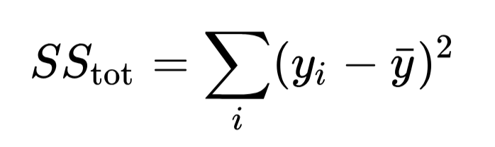
Negative R-Squared?
For example, a model with an R-squared value of 0.9 means that approximately 90% of the variance in the dependent variable is explained by the independent variables. This suggests a strong relationship between the variables and indicates that the model provides a good fit to the data.
R2 is negative only when the chosen model does not follow the trend of the data, so fits worse than a horizontal line.
When SSres is greater than SStot, that equation could compute a negative value for R2, if the value of the coeficient is greater than 1.
It simply means that the chosen model (with its constraints) fits the data really poorly.

