Slide 1
GRIPex AI CEI Project: Reconstructing Atomic Positions from Coulomb Explosion Data
An Encoder-Decoder Approach to Solve the Inverse Problem
September 30th, 2024
Amirhossein Ghanaatian
Supervisor: Prof. Caragea

Slide 2
Last Session's Review
Develop an Encoder-Decoder model to solve the inverse problem
Input: Final momenta of atoms
Condition: Some features made of momenta
Output: Predicted initial positions of atoms before Coulomb explosion
Inverse problem: Final momentum → Initial atomic positions

Slide 3
Approach 1
Auto-encoder
Build an auto-encoder to:
Reconstruct x
Find a representation as an inference (latent layer or probability distribution of positions)
Conditional Variational Autoencoder (CVAE)​
Use the latent representation (probability) from the auto-encoder as the input of CVAE​
Add momenta as the condition of the model​
CVAE learns to generate the position based on the latent representation and the momenta condition​

Slide 4
Approach 1
Training Phase
Learn the representation of position in the training phase using the auto-encoder
Train the CVAE using the latent representation as input and momenta as the condition
CVAE learns to map the latent space to the position space conditioned on the momenta
Testing Phase​
Use the probability of z from the auto-encoder developed in the training phase​
Feed the latent representation and momenta from the test set into the trained CVAE​
CVAE generates the predicted position based on the learned mapping

Slide 5
Approach 1
Condition: momenta Input: learned representation from the auto-encoder in the training phase Pay attention to the definition of input and condition in a CVAE
In the testing phase: Use the learned representation (z) from the training phase Do NOT use the test's position to learn a new representation

Slide 6
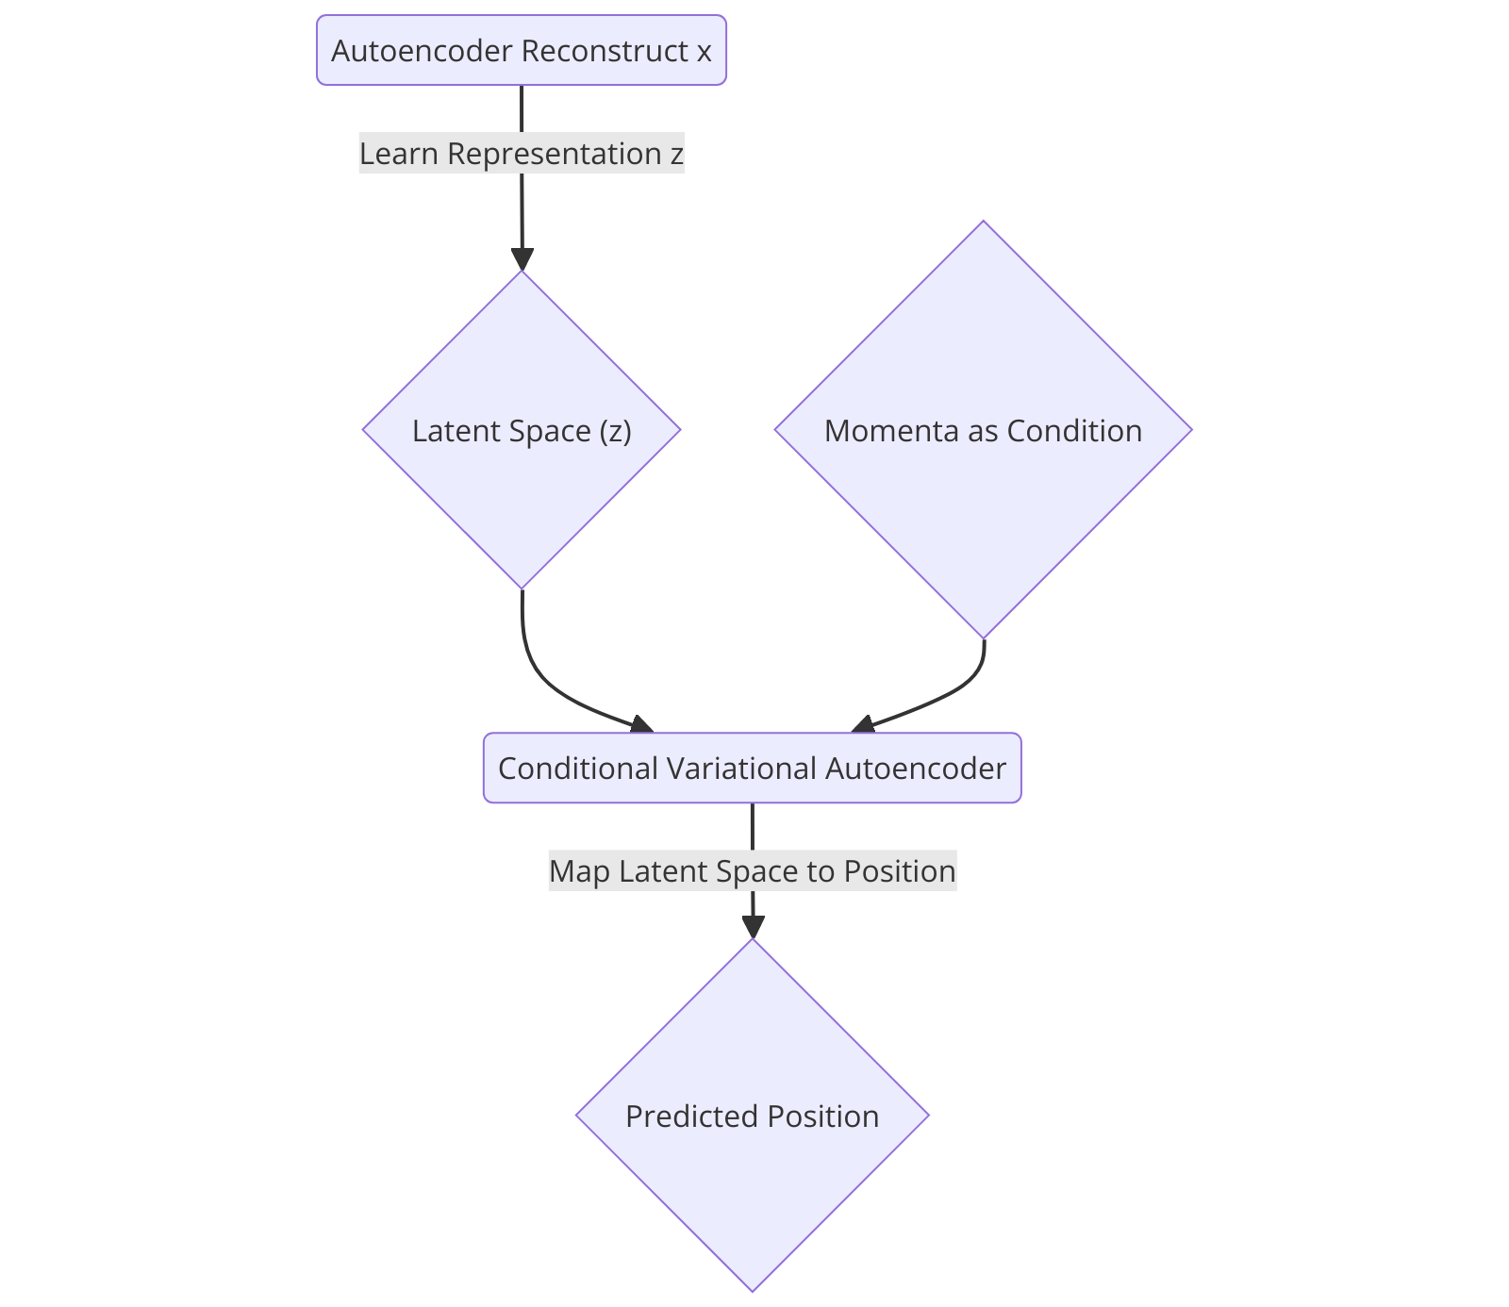
Approach 1

Slide 7
Approach 2
Model Initialization
CVAE model defined with an encoder and decoder
Encoder processes positions (X) to produce latent variables (Z) via mu and log(var)
Decoder reconstructs positions (X) from latent variable Z and conditions on momenta (Y)

Slide 8
Approach 2
Training Phase
Training loop trains model using reconstruction loss and KL divergence (required for CVAEs)
Encoder processes positions (X) to produce latent distribution parameters (mu, logvar)
Z is sampled using the reparameterization trick
Decoder reconstructs positions using latent Z and momenta (Y), optimizing the loss function

Slide 9
Approach 2
Latent Representation Saving
After training, latent parameters (mu, logvar) are saved
Saved parameters will be used for sampling during testing phase

Slide 10
Approach 2
Testing Phase
Encoder is not used during testing (safeguard against data leakage)
Latent variables are sampled from the learned distribution in the training phase
Decoder uses sampled latent variables along with test momenta (Y) to predict test positions (X)

Slide 11
Approach 2
Evaluation
Evaluation metrics (MSE, MAE) computed by comparing predicted positions with actual test positions
Results are saved and visualized as specified
Latent space (Z) is only sampled from the learned distribution in the training phase
Ensures no test positions (X) are used to influence the prediction

Slide 12
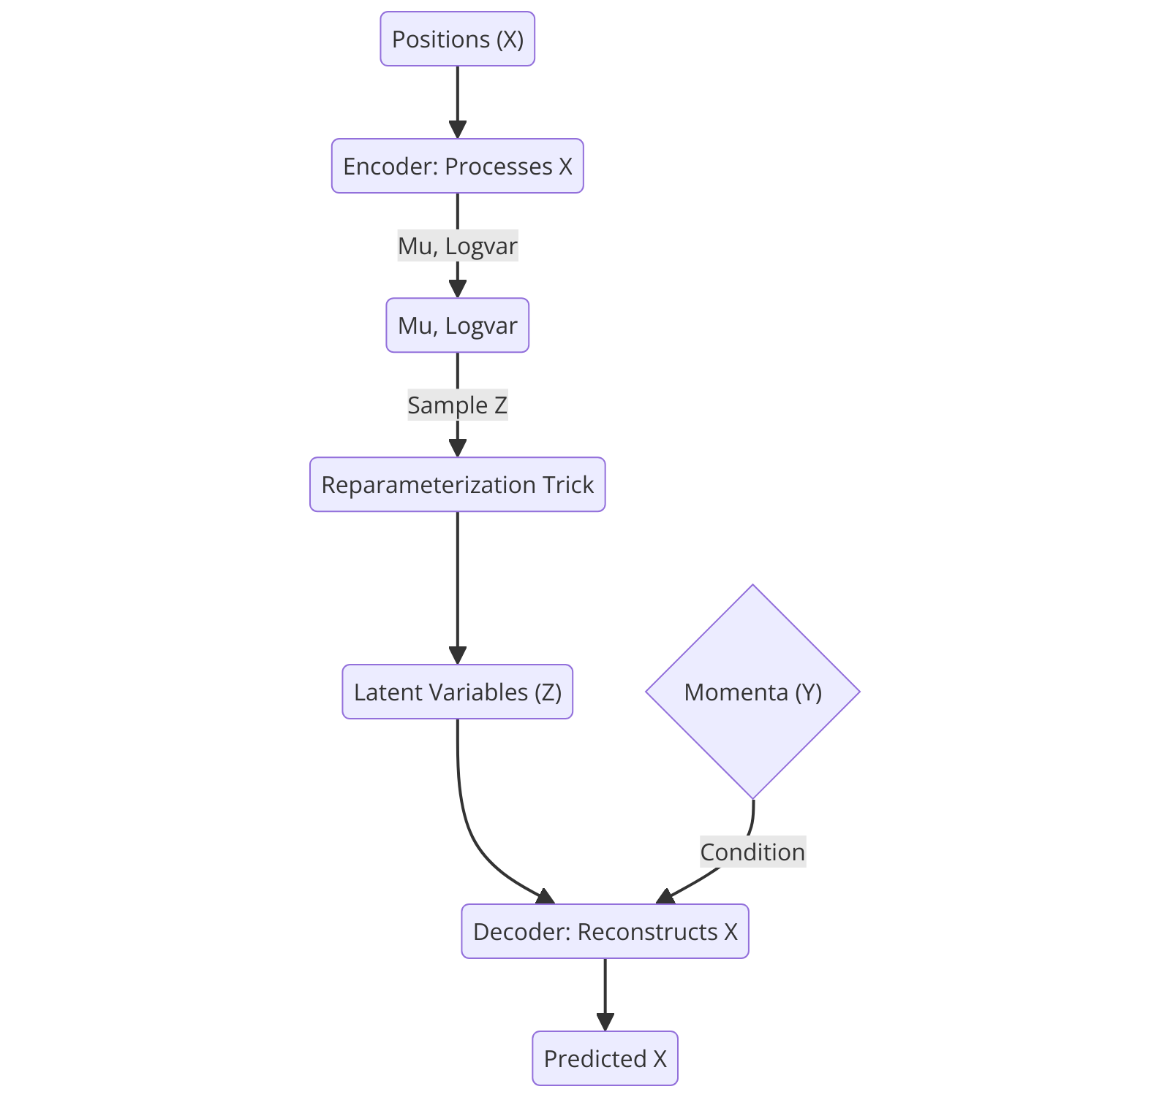
Approach 2

Slide 13
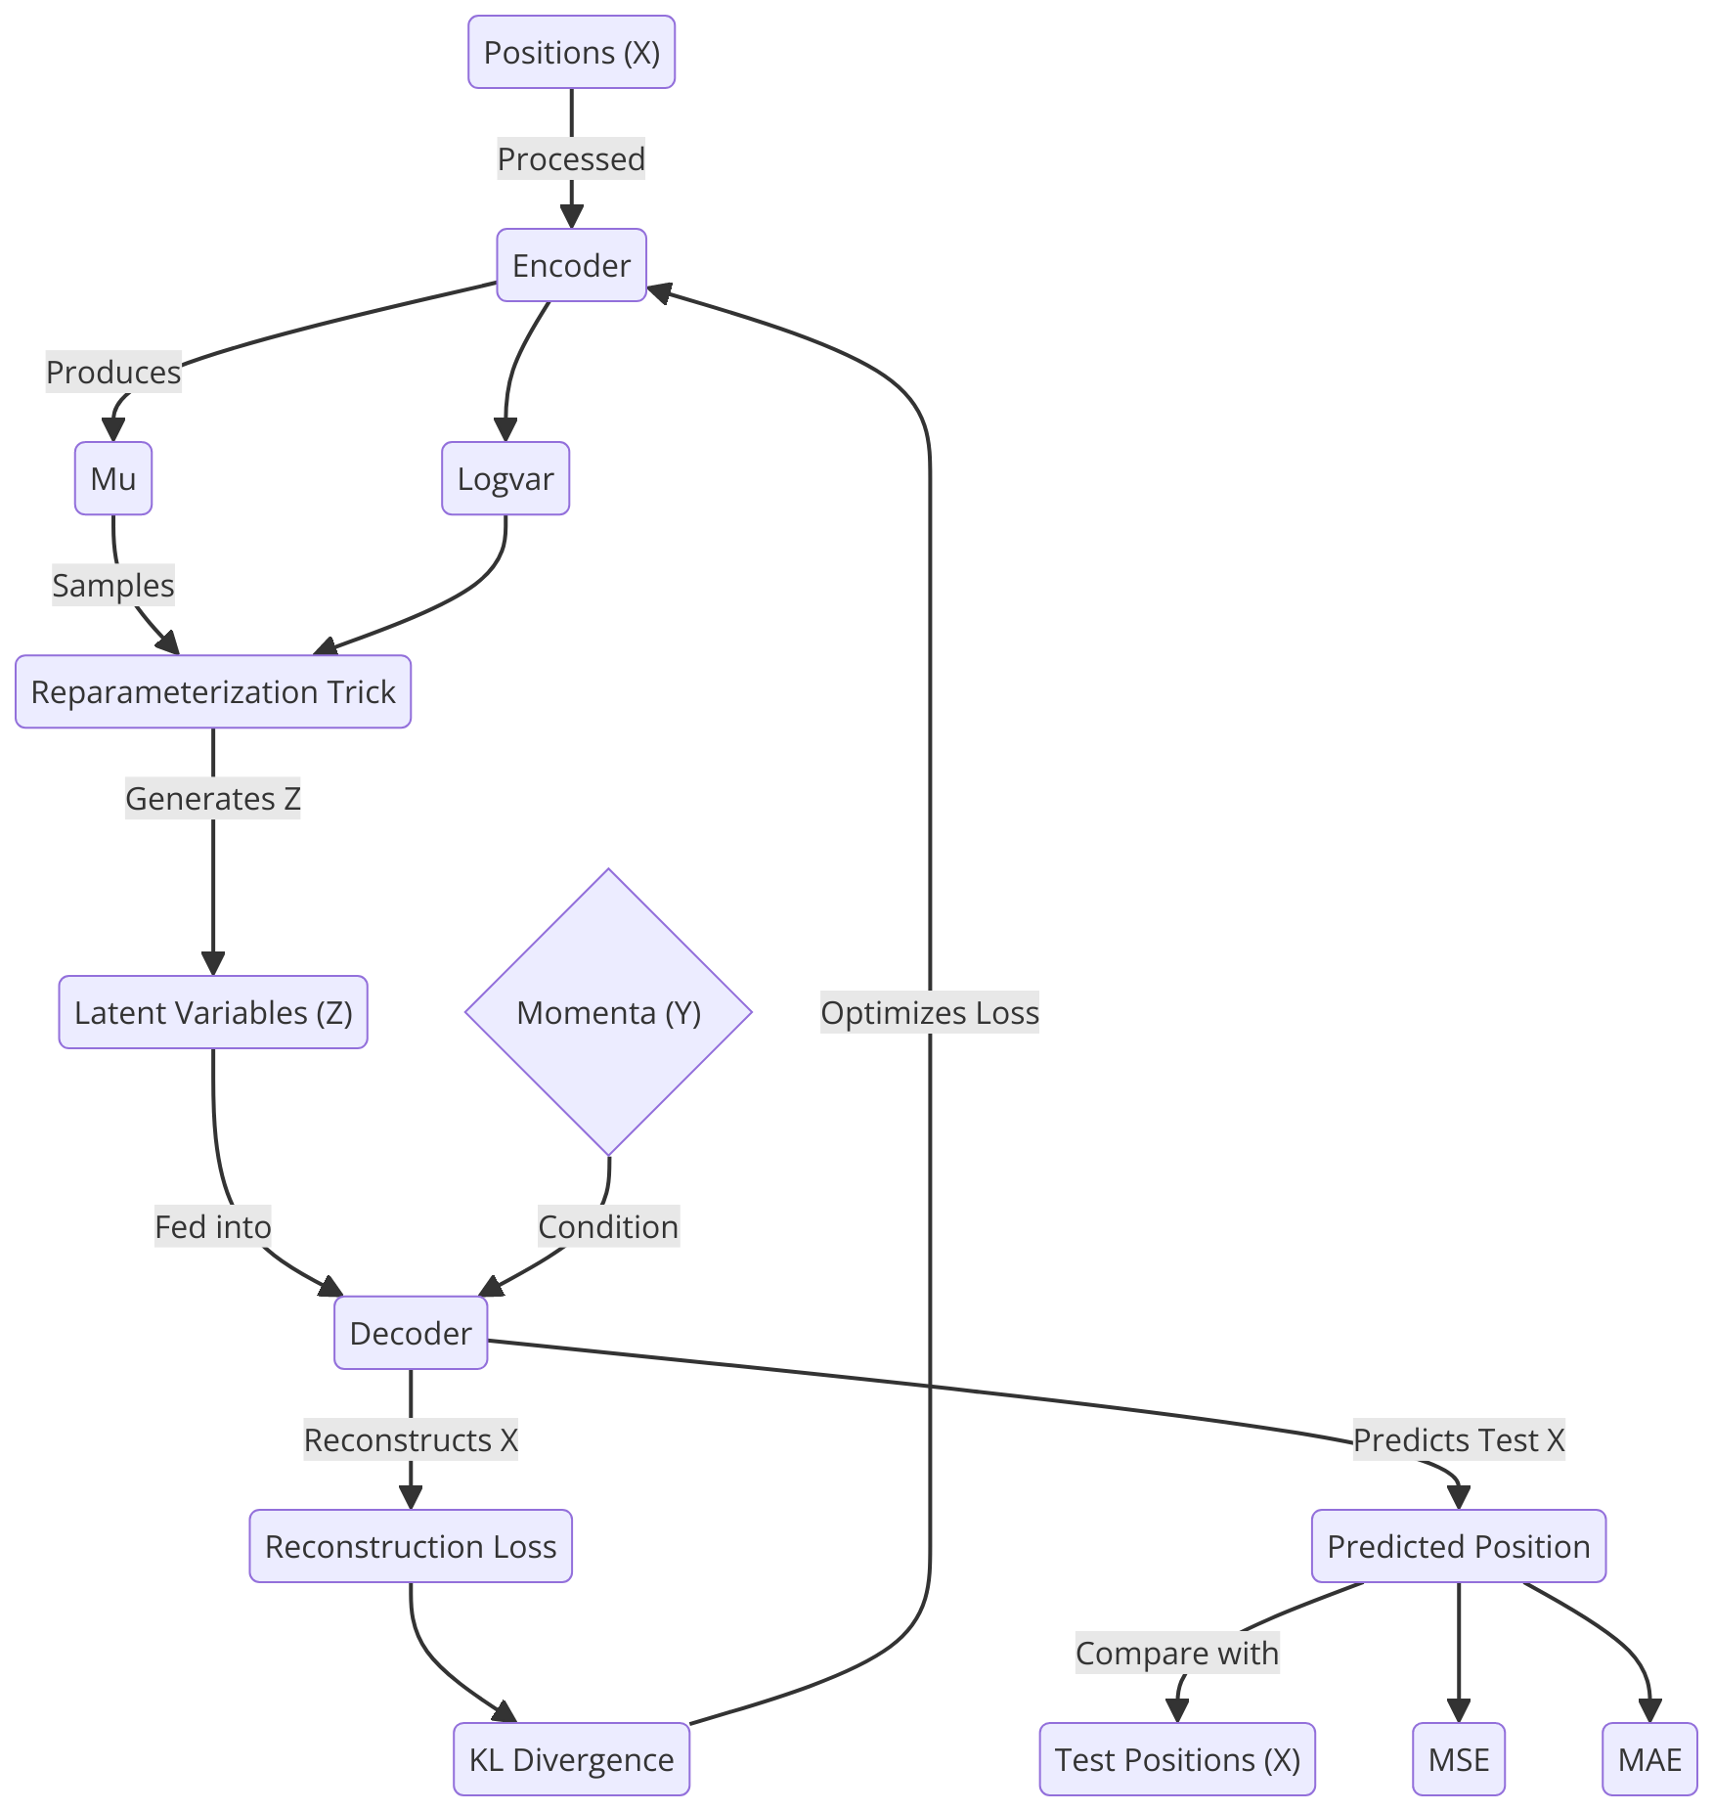
More Details

Slide 14
Results
Dataset | Approach1 |  | Approach2
 | MSE | MAE | MSE | MAE
generated_cos3d_check | 1.0499 | 0.8151 | 1.0559 | 0.8179
random_cos3d_10000 | 0.1518 | 0.3107 | 0.1549 | 0.322
cei_traning_orient_1 | 0.6814 | 0.4914 | 0.677 | 0.4922

