Slide 1

Web Fundamentals
Checkpoint 1
Amir Ben Younes

Slide 2
How does the web works?

Slide 3
The Web is:
Invented by “Tim Berners-Lee” in the early 1990
a system for publishing pages of information on the internet, and for linking pages together using link
based on the idea of ’hypertext’

Slide 4
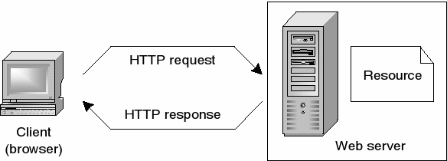
How does it work?
Web servers and web browsers communicate via HTTP
HTTP ensures that all parts of the web page are delivered.
Web browser decides how these items are displayed.

Slide 5
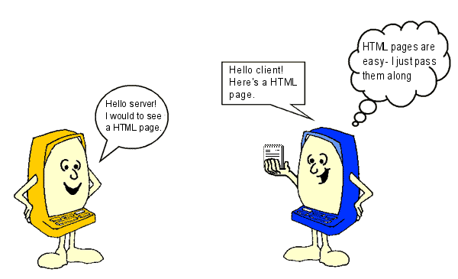
Web pages are written in text with HTML
then uploaded to a host computer running web server software(Apache,IIS..)
The web server sends out pages when they are requested by a web browser.
The host and client communicate using an agreed ’language’ called HTTP

Slide 6
What do you need to be a web developer?

Slide 7
HTML/CSS skills
Analytical skills
Responsive design skills
JavaScript skills
Interpersonal skills
Testing and debugging skills
Back-end basics
Search engine optimization
To become a web developer, you'll need a variety of hard and soft skills to succeed.
Here are some of the most common skills to have in this role:

Slide 8
What’s the role of
a web developer?

Slide 9
As a Web Developer you will be:
building and maintaining websites.
responsible for the design, layout and coding of websites, depending on whether your are a Front or Back-End Developer.

Slide 10
Thank you for your attention

