Slide 1

Medical Vision
HL7 C-CDA® Rendering Tool Challenge
Medical vision is Tesch Global’s approach to C-CDA Rendering tool challenge,
It is a web tool based in:
Talend (for CDA document parsing)
Node.js for web server
React as front-end language
Bootstrap and HTML5 based.
The main reason we decided to use this tools, is because the lightweight of them, along with the ease to use and understand, so; anyone which wants to use, integrate or extend the tool, doesn’t need to complicate much.

Slide 2
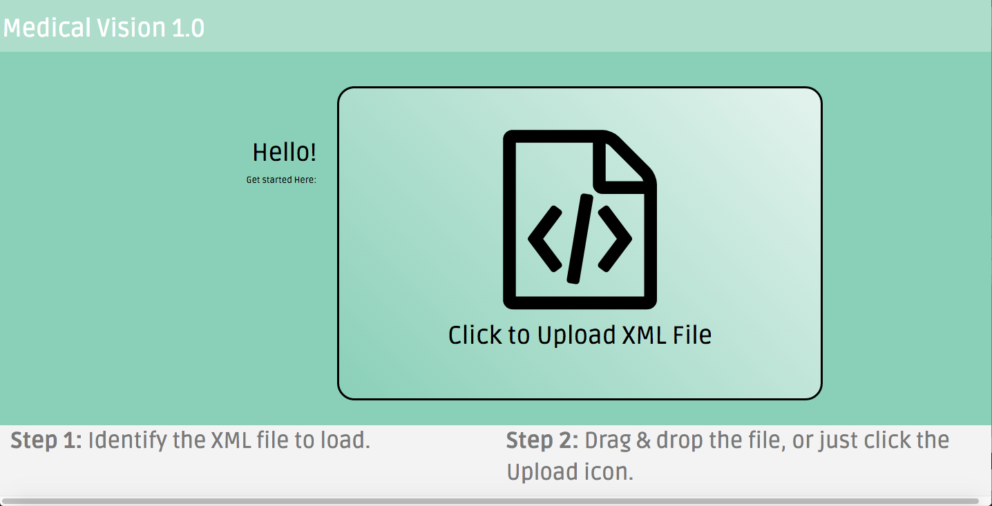
“Medical vision” components
We believe a powerful tool, doesn’t have to be complicated to use, that’s the main axiom we had in mind when designed the tool.
This is why it has only 2 screens: Loading screen and the Main screen, as we show in the next 2 slides
Loading screen: It is self-descriptive, you can just drag & drop the C-CDA document you want to render, or click on the icon to upload it.

Slide 3
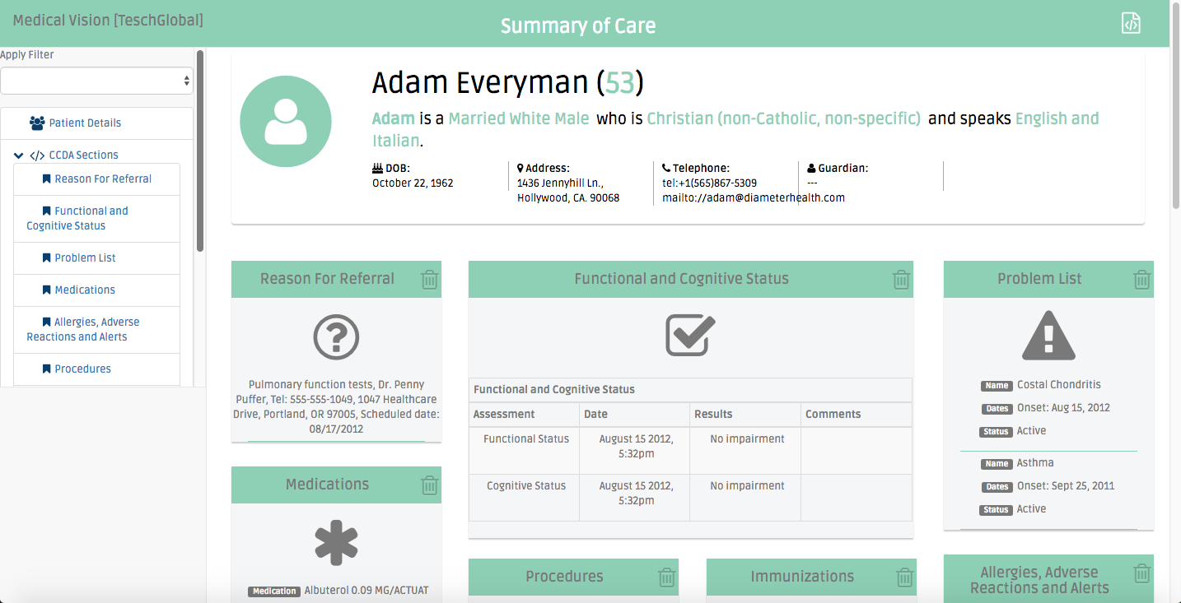
“Medical Vision” components (Continued)
Quick jump to specific component panel or opens it if closed
Load another document
Apply a preconfigured filter
Jump to main patient info panel
Close a panel

