Slide 1
Initial Exploration Findings:
Comedy Movies
The findings summarized:
25,127 movies were classified Comedy, including combinations such as Comedy–Drama etc.
Comedy movies counts increased from 2010 to 2014, then fluctuated through to 2018, then fell substantially in 2019 within this dataset.
Average ratings for movies classified as Comedy (including combinations) around 5.92–6.08 from 2010–2018, then increased to 6.43 in 2019.

Slide 2
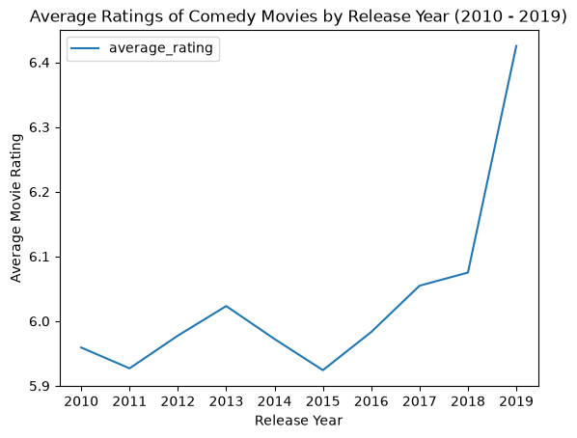
Business Question for Further Analysis
Does accounting for how many people rated each Comedy movie change how 2019’s average rating compares with earlier years?
2019 had the highest average rating in the exploration. Further analysis would examine whether accounting for vote counts changes this comparison.

Slide 3
Potential Data Cleaning Tasks
Finding and exclude the records missing the genres, ratings, or vote counts needed for the analysis, without filling in missing information.
Normalize genre data by separating the genres so that each genre can be analysed individually.
Making sure numvotes's data are whole numbers, and also check for zero, negative, or non-numeric values before using them in any potential calculations.
Check movie_basics and movie_ratings for repeated movie IDs. Fix this to avoid counting movies more than once.

