Slide 1

By: Amir Aly

Slide 2
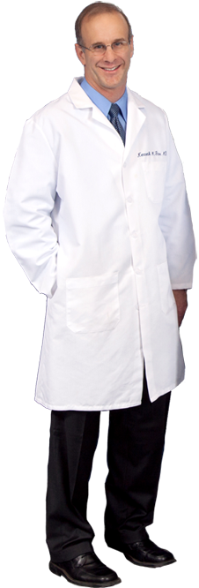
The problem
Doctors always busy !

Slide 3
A Doctor Quote
“For over 30 years in the field, I never know how to manage my schedule for collage, lectures, clinics, operations and FAMILY”
“Neither know how cash flows throw all of this”

Slide 4

The Deal
A cloud based Mobile App and web platform that takes care of doctor life in 2 main directions TIME AND MONEY

Slide 5
The App
The App manages time and cash flow of
Clinics
Operation
Private dates
Other revenues and costs
Cloud based Patient profile
Sub accounts for assistants
Accessible from IOS, Android devices or any web browser.

Slide 6
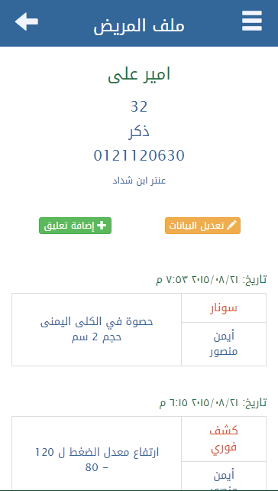
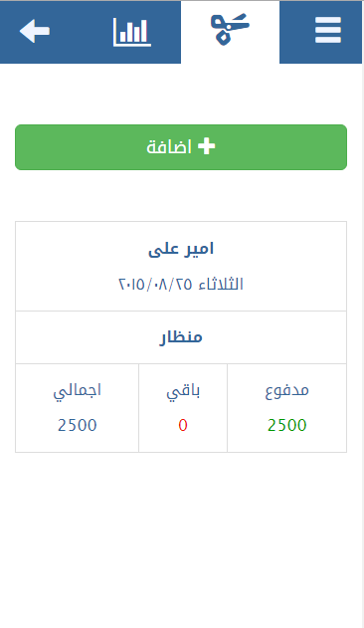
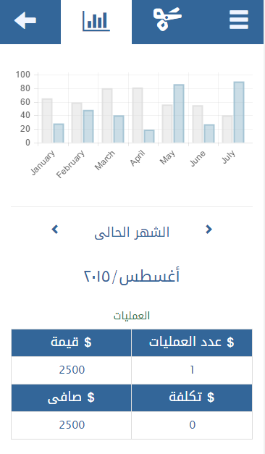
And its life now !

Slide 7
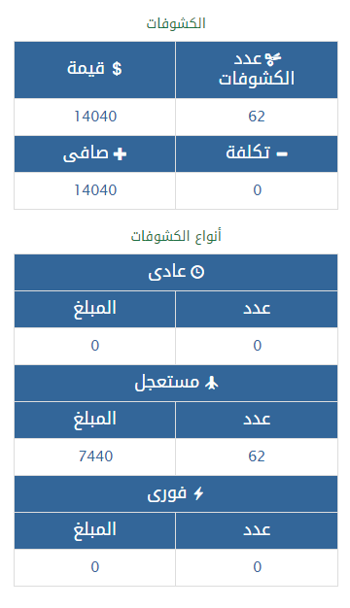
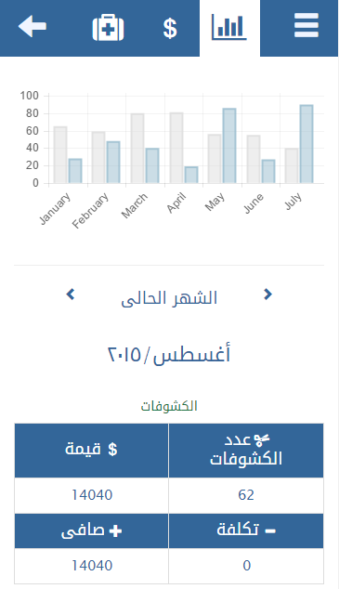
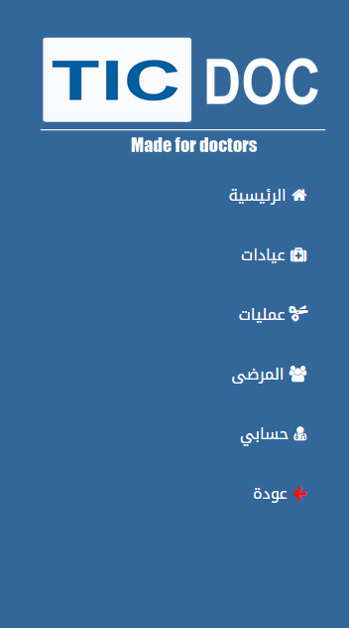

Slide 8
Benchmark
Competition
Legacy clinics systems
ToDo Apps
Financial Apps
Advantages
Integrated Solution
Cloud based
Localized
Direct support

Slide 9
Market projection real data collected from pharmaceutical companies
This numbers indicates doctors we clinics in Delta, Cairo and Alex.
divided into 3 different categories as in medical field,
the high category is Class (A)
Which contains well known names
 | Delta | Cairo | Alex
Class A | 4190 | 9330 | 2872
Class B | 5965 | 8426 | 4313
Class C | 7938 | 8503 | 3282
Totals | 18093 | 26259 | 10467
Grand Total | 54819

Slide 10
Subscriber plans
 | Free | Pro | Advanced
Clinics | 1 | 3 | Unlimited
Patient profiles | 300 | 1500 | Unlimited
Operation | 0 | Unlimited | Unlimited
Assistant accounts | 0 | 3 | Unlimited
 | 0 L.E | 110 L.E | 250 L.E

Slide 11
Phase 1 Target and marketing strategy
Target
Class A in Delta -> 4190
Strategy
KOL
Direct Sales
Events

Slide 12
The team behind this
Amir Aly
Founder
Software engineer with over 7 years of experience
Ayham Aly
Co-founder
Sales director in the medical field for over 14 years
Technical team
Sameh Aly – Developer
Samar Bakr – Developer
Anisa Ibrahim – Tester
Mohamed al Shafei – E-Marketing specialist

Slide 13
Thank you.
We have more details for you to ask about ☺

