Slide 1
Spam Email Detection
Performed by :
Amir Amemi
&
Bacem Boukhatem
Notes:
"Good morning, everyone. Welcome to today's presentation on the 'Spam Email Detection Project.'As you know, my name is Amir Amemi, and I am accompanied by Baccem Boukhatem . Today, we'll delve into the realm of identifying and combating the ever-increasing challenge of spam emails.

Slide 2
TABLE OF CONTENTS
01
04
02
05
03
06
Problem Statement
Data Collection and Preprocessing
Objectives
Data Visualization
Methodology
Model Evaluation and Testing
04
08
DataSet & Algorithm choice
Conclusion
Notes:
So, our Table of contents was devided into 8 main parts , What it is the problem , Whats our objective, the Methodology that we follow , the DataSet and Algrithme choice , data collection , Data visualization that help to evaluated our model , the model evaluation and testion and we close with the Conclusion

Slide 3
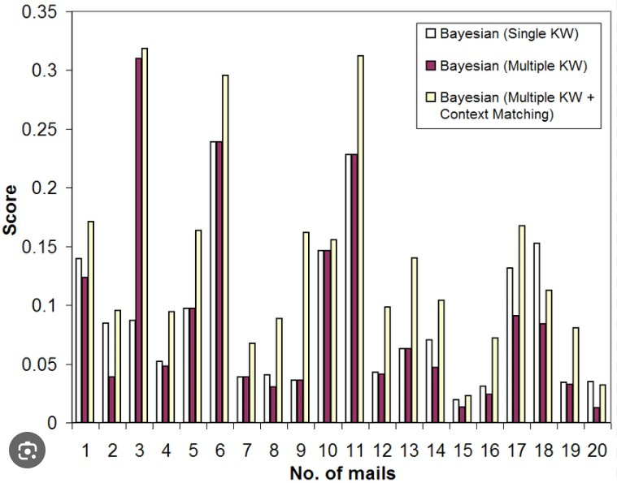
Problem Statement
Spam emails aren't just an annoyance—they pose significant risks. Our bar chart highlights the overwhelming volume of spam emails compared to legitimate ones. This flood of unsolicited messages not only wastes time but also harbors security threats, challenging our traditional filtering methods.
Notes:
Before we delve deeper into our project, let's address the core issue: the impact and challenges posed by spam emails.
The bar chart represents the distribution of emails received by a group of people, categorized into "bayesian" and "single." Each bar in the chart represents a different recipient, and the height of the bar indicates the number of emails received. The bars are colored differently to distinguish between the two categories, with some bars being red and others being purple. The legend provides an explanation of the colors used in the chart. This visualization allows for a quick comparison of the email distribution among the recipients in the two categories.

Slide 4
Objectives
Our project is driven by three primary goals: accuracy, efficiency, and scalability. We aim to enhance accuracy in spam detection, ensuring a high precision rate in differentiating spam from legitimate emails. Efficiency is crucial; we strive to minimize false positives while maximizing the identification of spam emails. Scalability is key to accommodate increasing email volumes, aiming for a system that adapts and remains effective as the email landscape evolves.
Notes:
Our project prioritizes accuracy, efficiency, and scalability. We're dedicated to improving spam detection precision, minimizing false positives, and creating a scalable system to adapt to evolving email volumes effectively.

Slide 5
Methodology
1st step
Feature Engineering
2nd step
Data Visualization for Insights
Model Testing and Validation
3rd step
Modeling
4th step
Model Evaluation
Notes:
Feature Engineering: Enhance model insights with diverse textual features..
Data visualization : assists in gaining a better understanding of the data
Modeling: Utilize Logistic Regression for effective binary text classification.
Model Evaluation: Evaluate model using accuracy, precision, recall, F1-score, confusion matrices, and ROC curves
Model Testing and Validation: Tested model with real-world email messages, analyzing predictions, discussing misclassifications, and evaluating model strengths and weaknesses..

Slide 6

DataSet & Algorithm choice
The dataset, focusing on email categorization into spam and non-spam (ham), was explored to understand its structure and content.
Selected Logistic Regression for its interpretability and effectiveness in binary classification, particularly in distinguishing between spam and ham emails, given its simplicity and ease of implementation

Slide 7
Data Collection and Preprocessing
The dataset's richness and quality have significantly empowered our research, serving as an invaluable resource for training and validating our spam detection model. Its depth and diversity have been pivotal in facilitating the development of a robust and accurate detection system.
Preprocessing involved several steps: cleaning the text, punctuation, and special characters. Additionally, we performed tokenization, stemming, and lemmatization to normalize the text data. Feature extraction techniques such as TF-IDF (Term Frequency-Inverse Document Frequency) were applied to represent the emails numerically for model training
Notes:
The dataset's high quality and depth have been instrumental in fueling our research, providing an invaluable foundation for training and validating our spam detection model. In our preprocessing phase encompassed various steps, including text cleaning, removal of punctuation and special characters, tokenization, stemming, and lemmatization to standardize the text data. Moreover, we employed feature extraction methods like TF-IDF (Term Frequency-Inverse Document Frequency) to convert emails into numerical representations, essential for effective model training.

Slide 8


Data Visualization Common Words
Notes:
These visual representations effectively highlighted the prevalence and distinct word usage patterns in spam messages, aiding in discerning key distinguishing factors between spam and non-spam content.

Slide 9

Data Visualization Word, Character, and Sentence Dynamics in Textual Analysis
Notes:
Data visualization, including 3D Scatter Plots, reveals intricate relationships among various data dimensions, while textual analysis, focusing on word, character, and sentence dynamics, translates textual content into numerical insights, enabling visual exploration and comprehension of text-based patterns and structures.

Slide 10
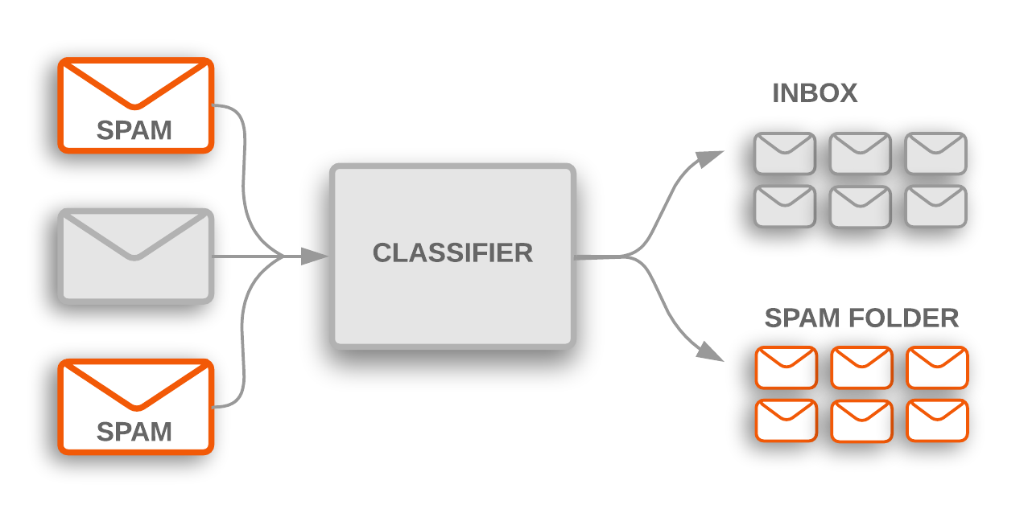
Model Evaluation and Testing
The model exhibits exceptional performance, boasting high precision 0.95, recall 0.99, and an F1 score of 0.97, achieving an impressive accuracy rate of 0.96. This stellar performance ensures its practical viability, reducing spam threats and bolstering email security for businesses in real-world scenarios.

Slide 11


Conclusion
This model serves as a vital safeguard against email threats, preserving businesses by saving crucial time and resources while mitigating security risks. Its scalability potential offers an integrated solution, fortifying existing systems for heightened email security, ensuring a safer and more efficient communication environment.
Notes:
In conclusion, our model stands as a critical defense mechanism against email threats, safeguarding businesses by conserving essential resources, time, and mitigating security risks. Its scalability potential presents an integrated solution that bolsters current systems, elevating email security and fostering a safer, more efficient communication environment.

Slide 12


THANKS
Please keep this slide for attribution
Notes:
Thank you for you attention , i want to emphasize that im here today to adresse any thoughts or questions so feel free to ask

