Slide 1
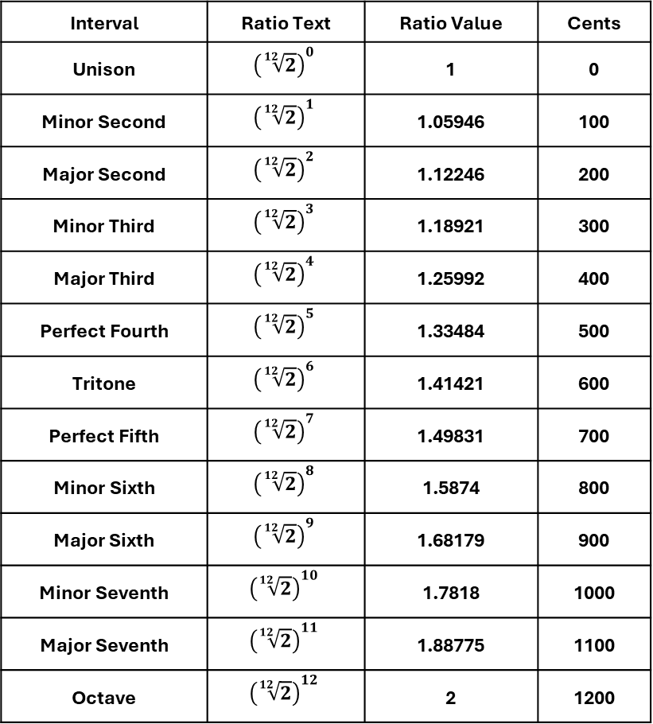
Interval | Ratio Text | Ratio Value | Cents
Unison | $${\left(\sqrt[12]{2}\right)}^{0}$$ | 1 | 0
Minor Second | $${\left(\sqrt[12]{2}\right)}^{1}$$ | 1.05946 | 100
Major Second | $${\left(\sqrt[12]{2}\right)}^{2}$$ | 1.12246 | 200
Minor Third | $${\left(\sqrt[12]{2}\right)}^{3}$$ | 1.18921 | 300
Major Third | $${\left(\sqrt[12]{2}\right)}^{4}$$ | 1.25992 | 400
Perfect Fourth | $${\left(\sqrt[12]{2}\right)}^{5}$$ | 1.33484 | 500
Tritone | $${\left(\sqrt[12]{2}\right)}^{6}$$ | 1.41421 | 600
Perfect Fifth | $${\left(\sqrt[12]{2}\right)}^{7}$$ | 1.49831 | 700
Minor Sixth | $${\left(\sqrt[12]{2}\right)}^{8}$$ | 1.5874 | 800
Major Sixth | $${\left(\sqrt[12]{2}\right)}^{9}$$ | 1.68179 | 900
Minor Seventh | $${\left(\sqrt[12]{2}\right)}^{10}$$ | 1.7818 | 1000
Major Seventh | $${\left(\sqrt[12]{2}\right)}^{11}$$ | 1.88775 | 1100
Octave | $${\left(\sqrt[12]{2}\right)}^{12}$$ | 2 | 1200

Slide 2
Interval | Ratio Text | Ratio Value | Cents
Unison | 1:1 | 1 | 0
Minor Second | 16:15 | 1.06667 | 111.73
Major Second | 9:8 | 1.125 | 203.91
Minor Third | 6:5 | 1.2 | 315.64
Major Third | 5:4 | 1.25 | 386.31
Perfect Fourth | 4:3 | 1.33333 | 498.04
Tritone | 45:32 | 1.40625 | 590.22
Perfect Fifth | 3:2 | 1.5 | 701.96
Minor Sixth | 8:5 | 1.6 | 813.69
Major Sixth | 5:3 | 1.66667 | 884.36
Minor Seventh | 9:5 | 1.8 | 1017.6
Major Seventh | 15:8 | 1.875 | 1088.27
Octave | 2:1 | 2 | 1200

