Slide 1
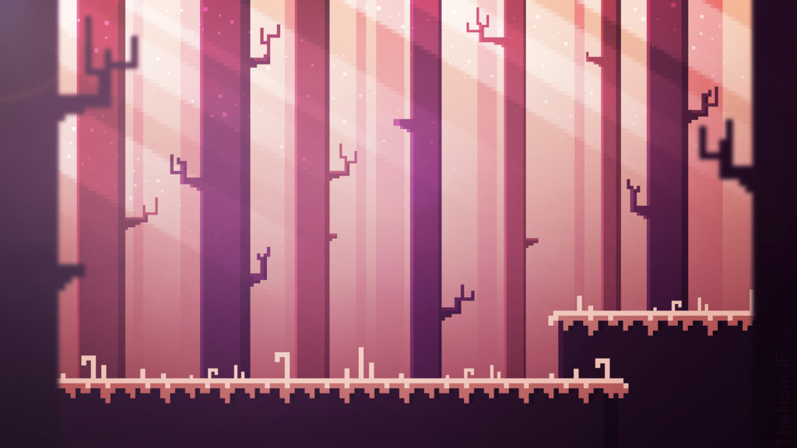
THIS IS YOUR PRESENTATION TITLE
Touch wizards

Slide 2
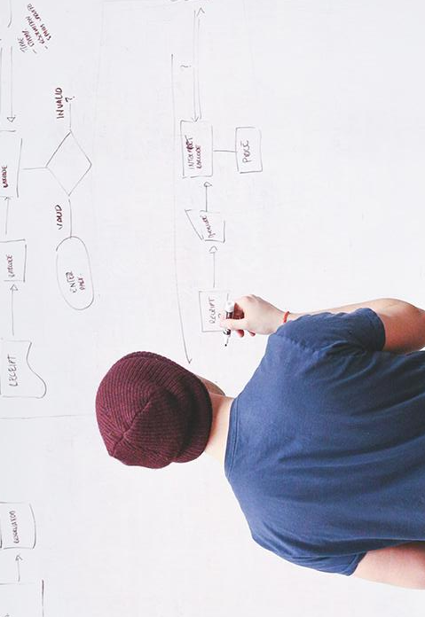
HELLO!
We are Trash Productions
We are here because We love making Games!

Slide 3
Market
Our audience: 10-30 years old Platform: Mobile
Over 4M mobile gamers in Tunisia
Mobile Gaming market growing exponentially

Slide 4
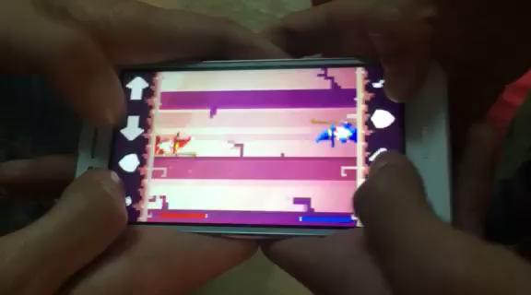
Place your screenshot here
TAKE A LOOK!

Slide 5
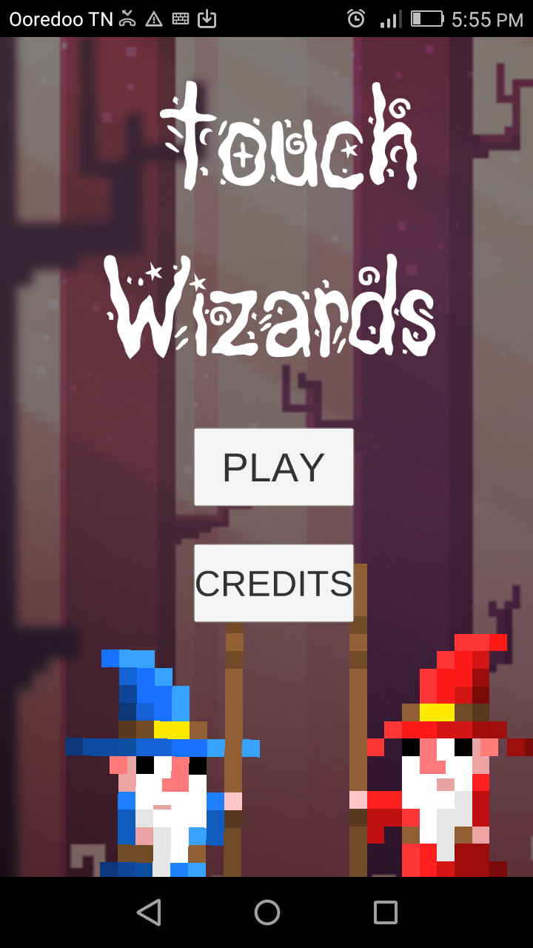
Our game
Fast paced
Local Multiplayer
Action packed
Free2play
Place your screenshot here

Slide 6
WE ARE DIFFERENT
People tend to stay isolated when they are on their smartphone
Touch Wizard pushes people to interqct with other people
Create fun moments

Slide 7
Where we’re going
We still have a lot of plans for our game

Slide 8
THANKS!
Any questions?
You can find us on LinkedIn:
Khalil Acheche
Amir Braham

Slide 9
Credits
Special thanks to the whole GoMyCode community and especially Yahya Bouhlel for uniting us for this special event!

