Slide 1
UVic Residence Room Availability System
G11: Aaron, Amir, Merrick, Myles, Sebastian
Notes:
Aaron

Slide 2

Our Team
Clients:
Amir
Merrick
Analysts:
Aaron
Myles
Sebastian
Notes:
Aaron

Slide 3

Problem
The current system uses a lottery to assign rooms
Difficulty in allocating available rooms
Long waiting times
Limited transparency
Many dorm rooms are left empty despite demand during the year
During Victoria’s affordable housing crisis
Students currently have little control over their dorm room
The timing of the current system is not favourable to students looking for housing
Notes:
Merrick

Slide 4

Proposed Solution
Vision
A dorm room system which focuses on the best experience and results for the most amount of students
A system which gives control to students to select their rooms
A system which allows vacated rooms to be easily filled
Approach
Systems development strategy using Agile method
Series of 1 week sprints for iterating on planning, risk analysis and system models
Notes:
Myles - Frame the Vision as a benefit to the students

Slide 5
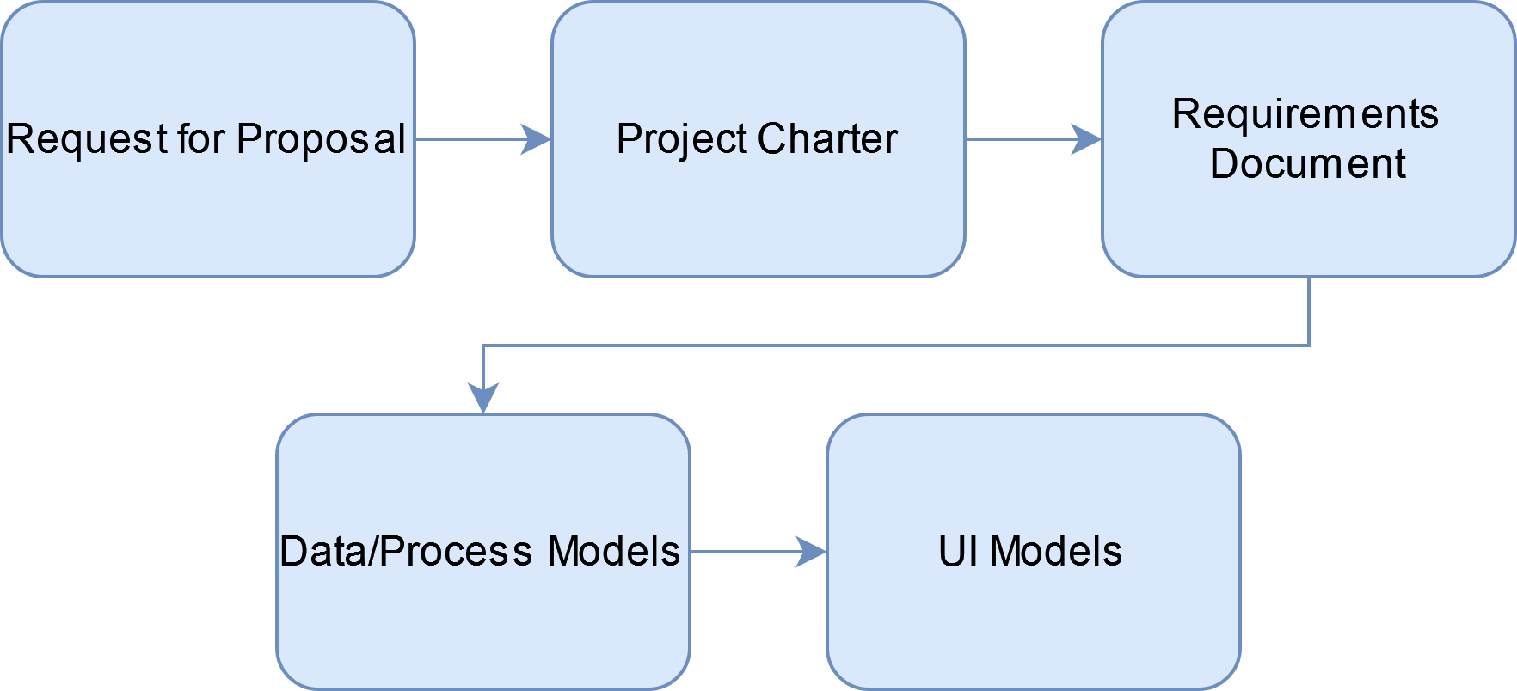
System Analysis/Design Process
Notes:
Myles

Slide 6

Potential Roadblocks
Risks
Security vulnerabilities
Technical feasibility
Scope creep
Mitigation Strategies
Professional cybersecurity team
System analysis by experienced consultants
Clear definition of requirements
Notes:
Myles

Slide 7

Business Requirements and Rules
Display available rooms, provide information on rooms, buildings, and student eligibility
Provide an online booking method
Integration with UVic NetLinkID
Charge security deposits/acceptance fees but pass on full residence payments to student services
Ensure conditions are met when booking rooms with specific criteria (ie. single-gender floors, LLCs, etc.)
Notes:
seb

Slide 8

User Requirements
Functionality for coordinating with other users in order to book double rooms or cluster housing with preferred roommates.
The system should enable users to filter and search rooms by attributes such as room type, room size, bathroom type, building, elevation, etc.
Notes:
seb

Slide 9

Functional Requirements
Mark a room as “unavailable” for 10 minutes if a user is in the process of booking that room.
Send out confirmation emails after bookings.
Maintain accurate and up-to-date info at all times.
Notes:
seb

Slide 10
Non-Functional Requirements
Ensure that user inputs are met with fast response times.
Accessible on any platform which already supports UVic’s other online tools
Easily updated and/or scaled as new residence buildings are built or existing residence buildings are changed
Notes:
seb

Slide 11

Data Flow Diagrams

Slide 12
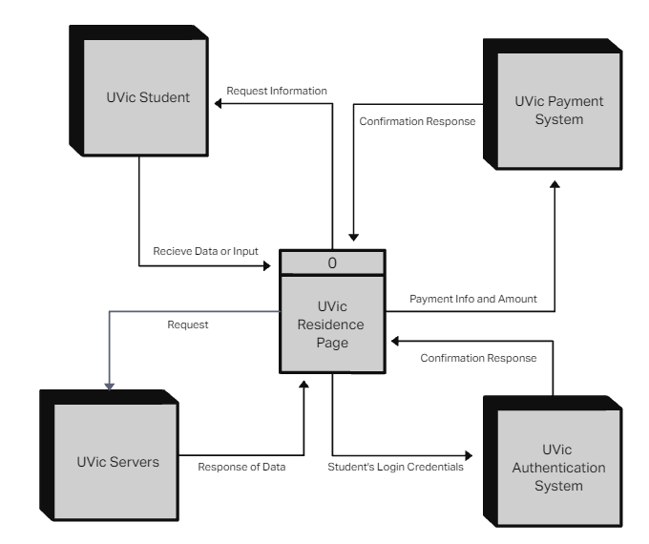
Context
Diagram
Notes:
Aaron

Slide 13
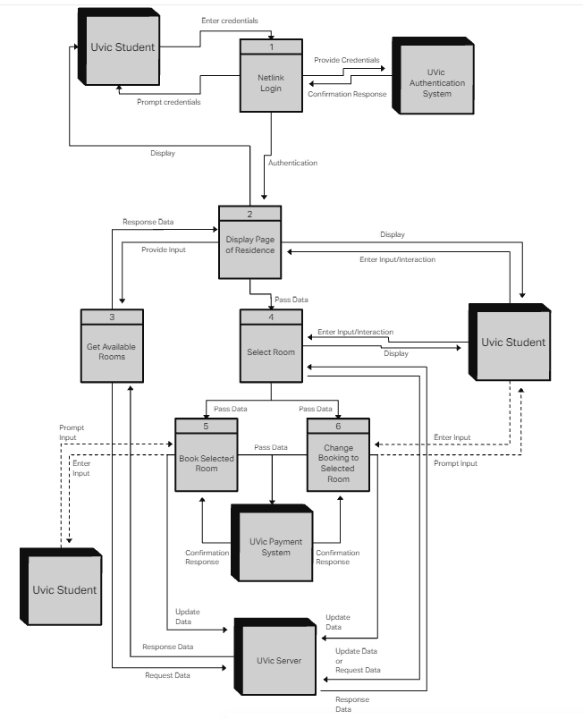
Diagram 0
Notes:
Aaron

Slide 14
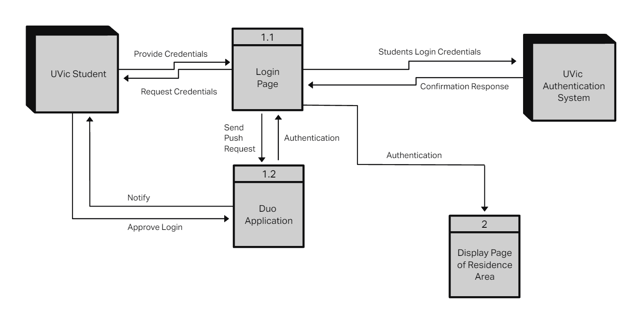
Diagram 1
Notes:
Aaron

Slide 15
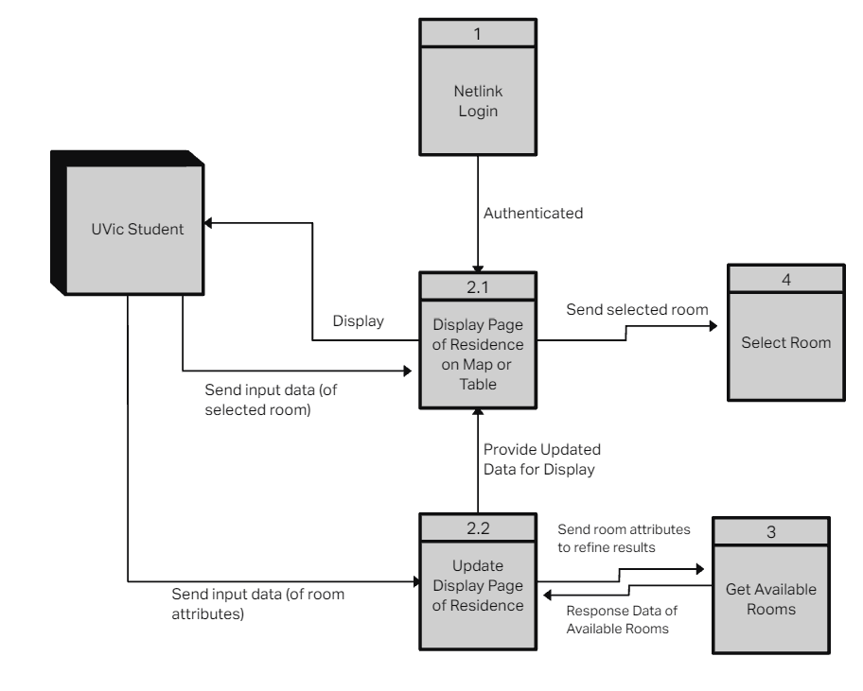
Diagram 2
Notes:
Aaron

Slide 16
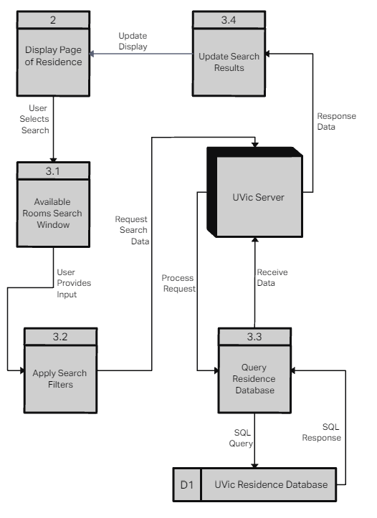
Diagram 3
Notes:
Merrick

Slide 17
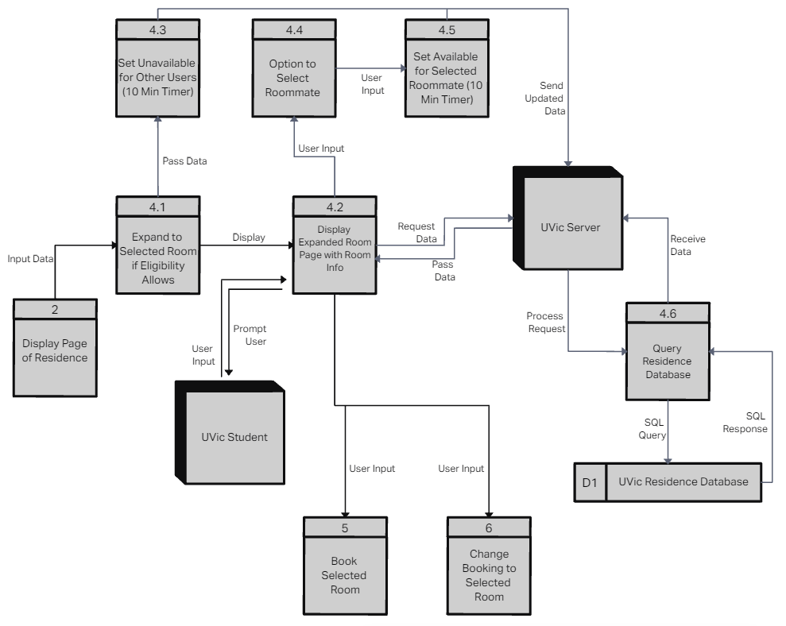
Diagram 4
Notes:
Merrick

Slide 18
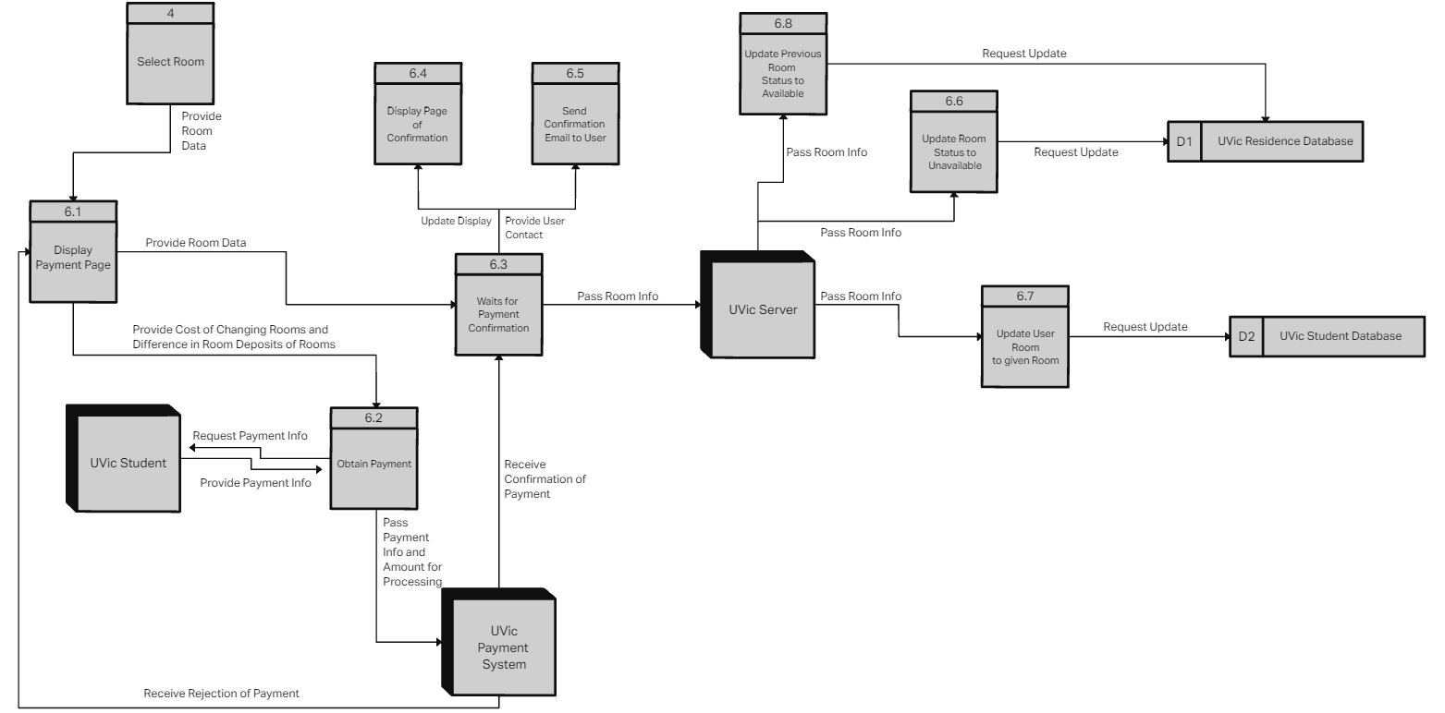
Diagram 6
Notes:
Merrick

Slide 19
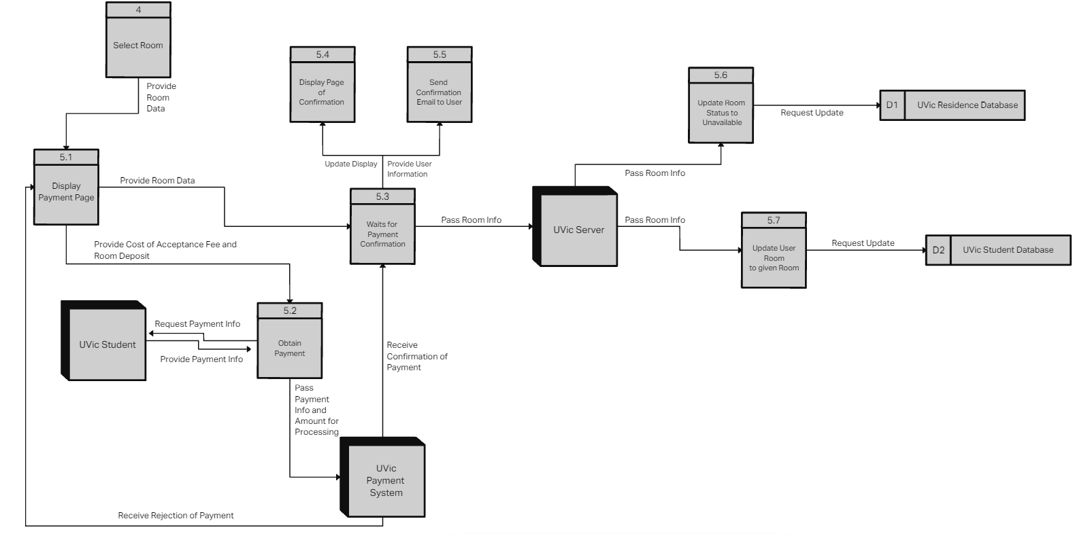
Diagram 5
Notes:
Merrick

Slide 20

User Interface
Notes:
Amir

Slide 21
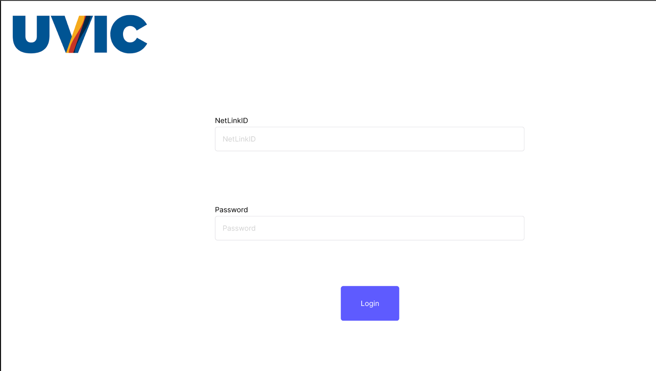
Notes:
Amir

Slide 22
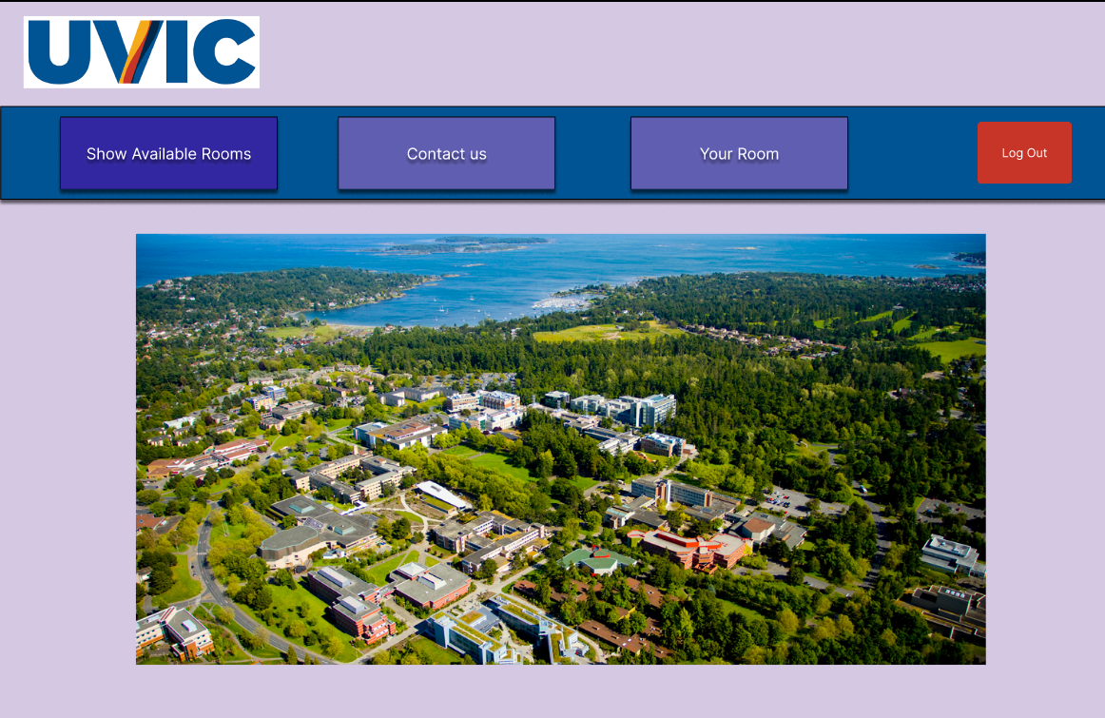
Notes:
Amir

Slide 23
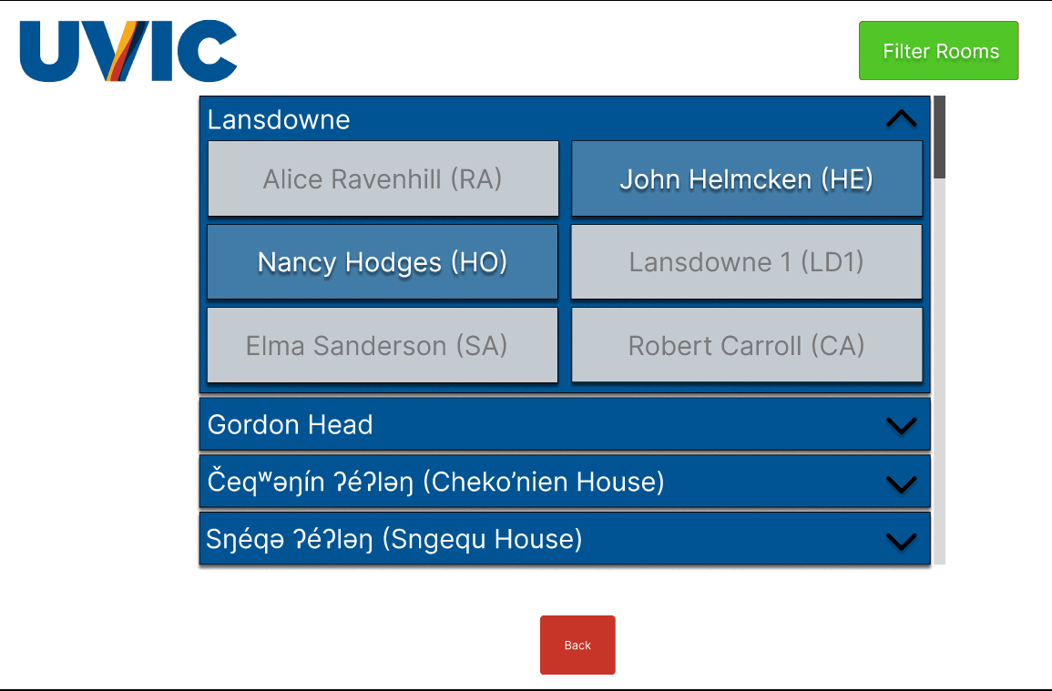
Notes:
Amir

Slide 24
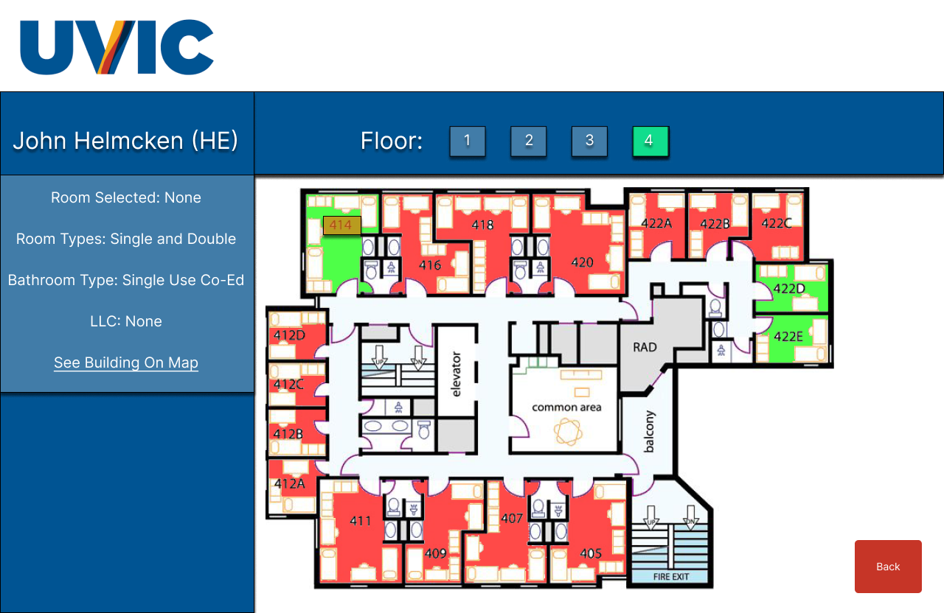
Notes:
Amir

Slide 25
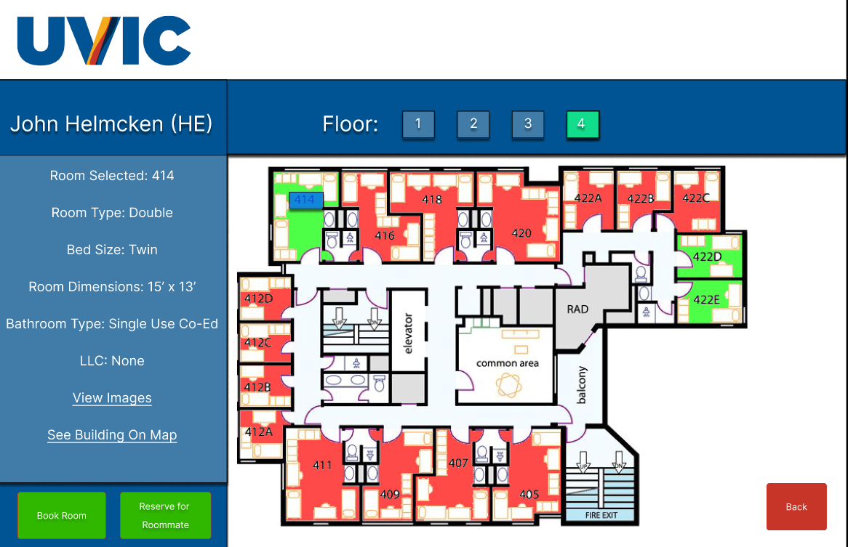
Notes:
Amir

Slide 26
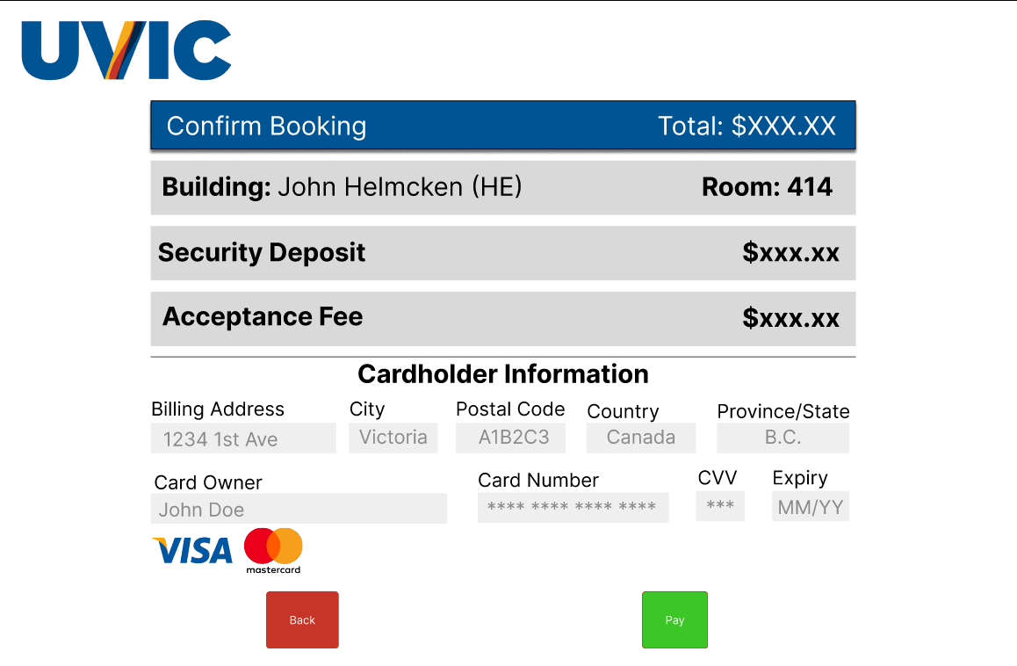
Notes:
Amir

Slide 27
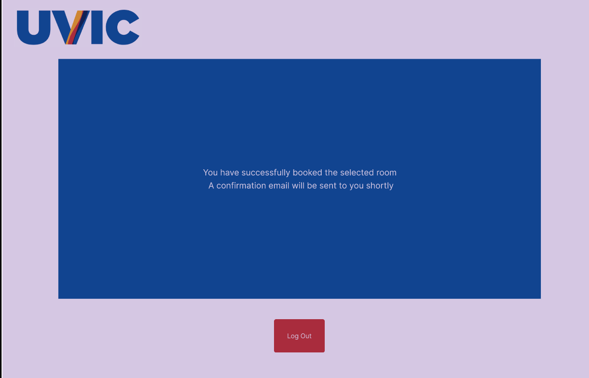
Notes:
Amir

Slide 28
Thank you

