Slide 1
























LayerAlterator: A Raster Processing Tool for Urban Change Simulation
Author: Amirhossein Donyadidegan
Supervisor: Dr. Daniele Oxoli
Course: GeoInformatics Project (GIP), AY 2024–2025
Date: Jun 2025

Slide 2
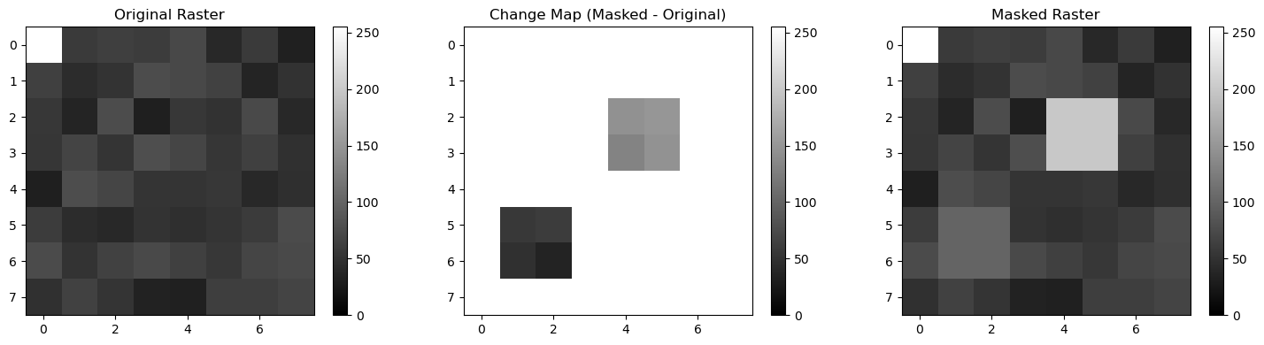
Introduction
Urban Change Modeling: A Need for Lightweight Tools
Urban planners need to test interventions like reforestation or densification.
LayerAlterator provides a way to modify such layers through rule-based processing.”
LayerAlterator offers a modular, fast alternative:
Modify raster layers using polygon-based rules
Supports masking (absolute) and percentage (relative) updates
Built with open-source Python libraries

Slide 3
Related Work
Urban Raster Processing in Literature
Local Climate Zones (LCZ)
Stewart & Oke (2012): Classification for urban temperature modeling
Rigid categories, not designed for dynamic simulation
Urban Land Cover Mapping
Okujeni et al. (2016): Fractional abundance via spectral unmixing
Provides detailed input layers but no simulation capability
Climate Modeling Platforms
Require high computational resources and complex inputs
Tool | Focus | Limitation
LCZ | Urban class mapping | No layer modification
Okujeni | Fractional land cover | Static data
LayerAlterator | Rule-based simulation | Lightweight

Slide 4
Innovation
What Makes LayerAlterator Unique?
Supports both masking and percentage operations
Apply absolute values or modify relative to the current raster data.
Rule-driven engine
Uses simple JSON configuration for flexible simulations.
Modular Python architecture
Easy to extend, debug, or integrate into Digital Twin platforms.
Built-in validation
CRS, normalization, and attribute checks prevent faulty simulations.
Transparent and reproducible
Designed for Jupyter workflows, with visual inspection support.

Slide 5
Architecture Overview
Modular & Reproducible Processing Pipeline
Main Controller: layer_alterator() orchestrates the workflow
Key Phases:
Input Loading: load_vector_mask(), check_crs_match()
Rule Handling: parse_rules_from_mask(),
Masking Ops: apply_masking(), apply_mask_rule_all(),
Percentage Ops: apply_pct_ucp(), apply_pct_all_fractions(), apply_pct_all()
Functions are independently testable and integrated in Jupyter
Validation embedded in every major step

Slide 6
Input and Rule Logic
Input Types
Vector Mask: Polygons (e.g., .gpkg, .geojson) with attribute values
Raster Layers:
Rule File: rules.json defines layer operations
Rule Logic
Operations: mask, pct, none
Classified into rule types (C0 to C5)
Invalid mixes (e.g., mask + pct) trigger errors

Slide 7
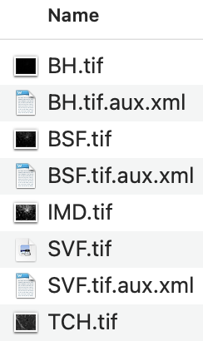
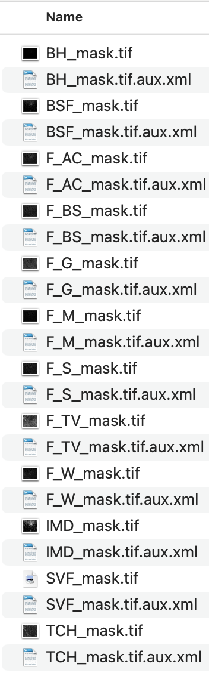
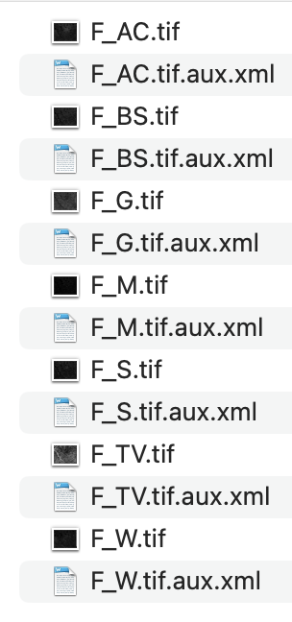
Output Example
Traceable Raster Output
Processed rasters saved in the output/ folder
Naming Convention:
*_mask.tif → layers updated with fixed values (masking)
*_pct.tif → layers updated with percentage changes
CRS, NoData, and resolution preserved
Visual verification in QGIS (e.g., coverage, alignment, NoData integrity)
Metadata and filenames support scenario comparison

Slide 8
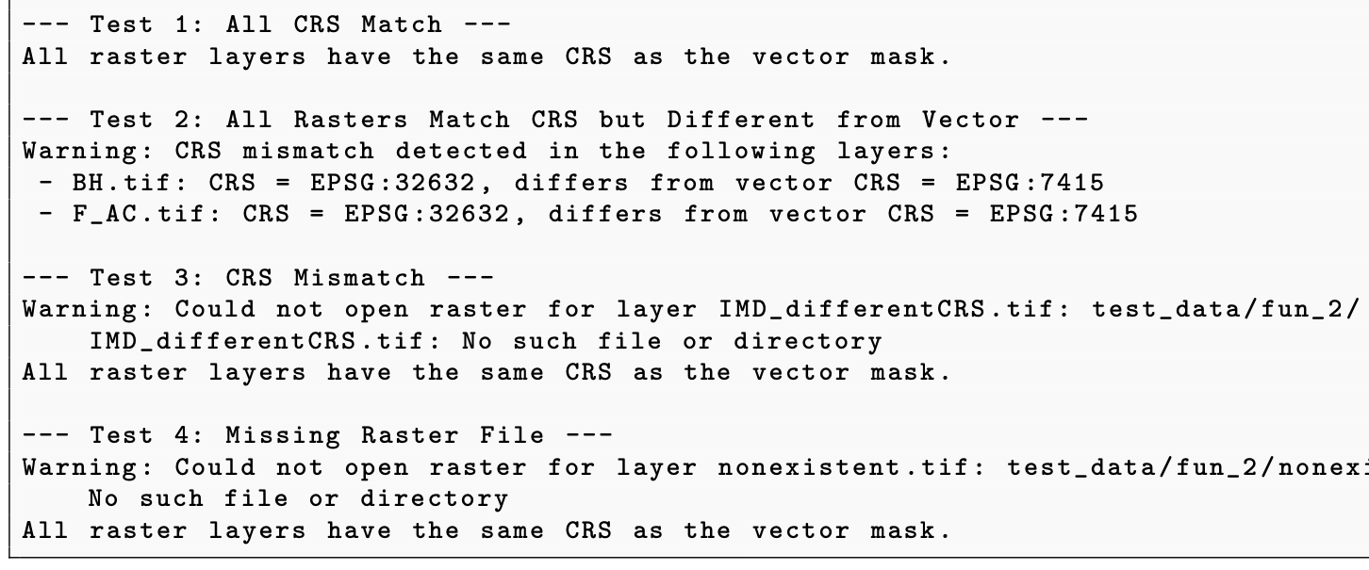
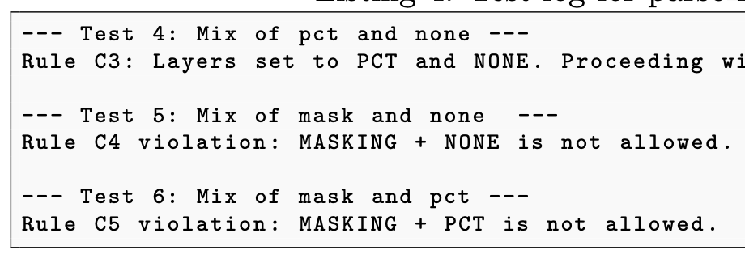
Validation and Testing
Ensuring Data Integrity and Simulation Accuracy
Validation Checks (Pre-Processing)
CRS match between vector and rasters
Required attributes present
Rule logic consistency
During Processing
NoData regions preserved
Normalization of fractional rasters
Warnings for overlapping polygons or abnormal updates
Testing Strategy
Unit tests in Jupyter Notebook (test_functions.ipynb)
Visual inspection in QGIS
Controlled edge-case scenarios

Slide 9
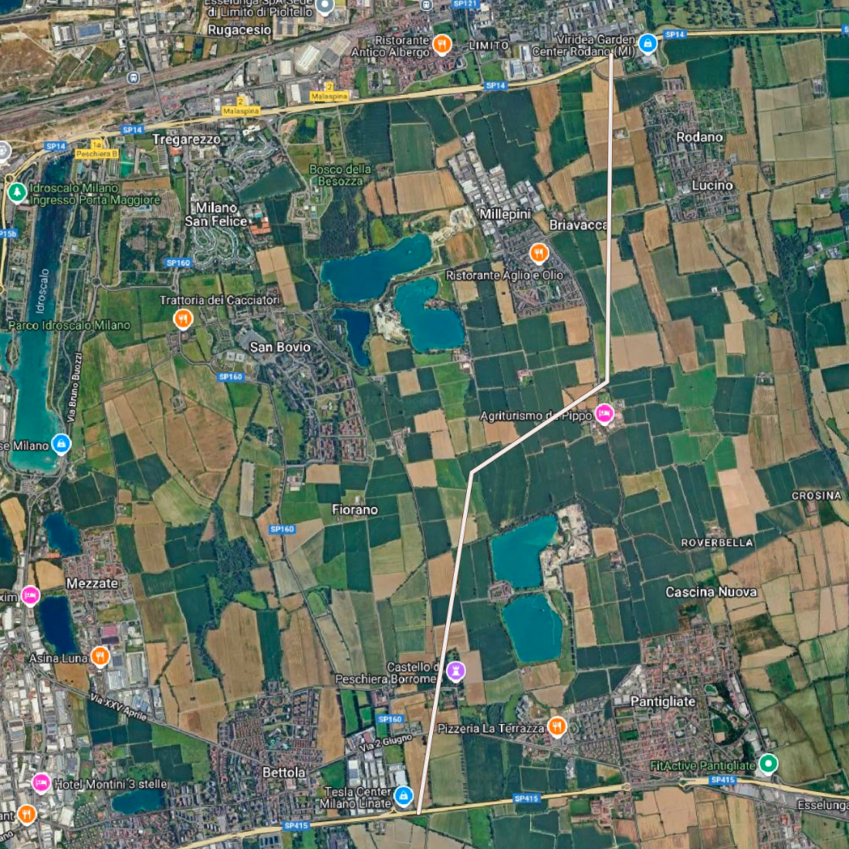
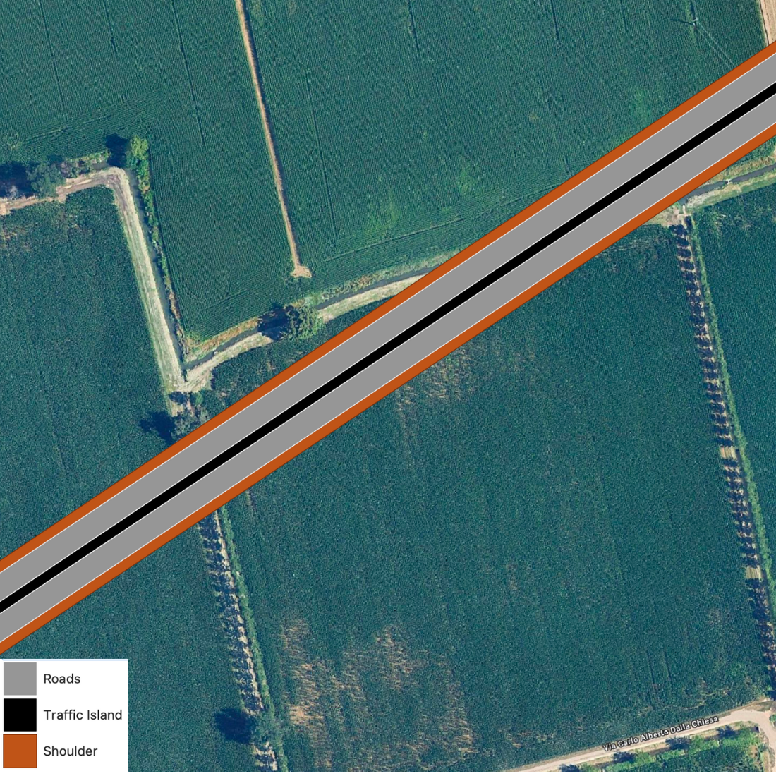
Demonstration
Scenario: New Highway in Milan
Objective: Simulate the effect of a new highway on urban surface characteristics.
Inputs:
Vector polygon for highway area (in .gpkg)
Rule: Apply mask to set land cover fractions (e.g., increase F_AC, reduce F_G)
Execution:
layer_alterator() applied with rules.json and polygon attributes
Outputs generated: F_AC_mask.tif, F_G_mask.tif, etc.
Results:
Clear spatial update of asphalt fraction (F_AC)
Preservation of surrounding NoData
Ready-to-use outputs for further modeling (e.g., UHI impact)

Slide 10
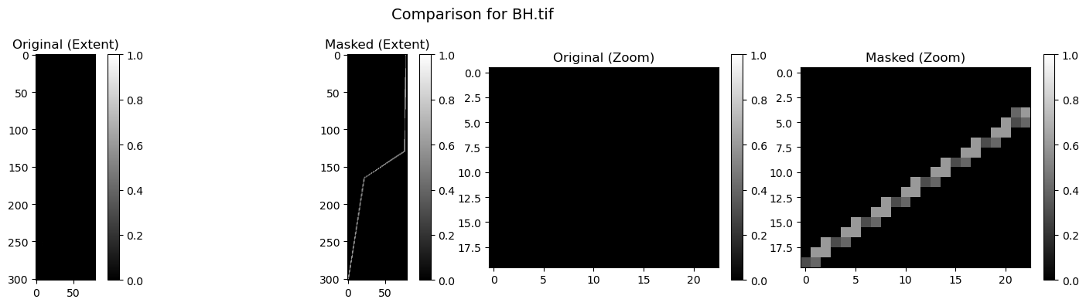
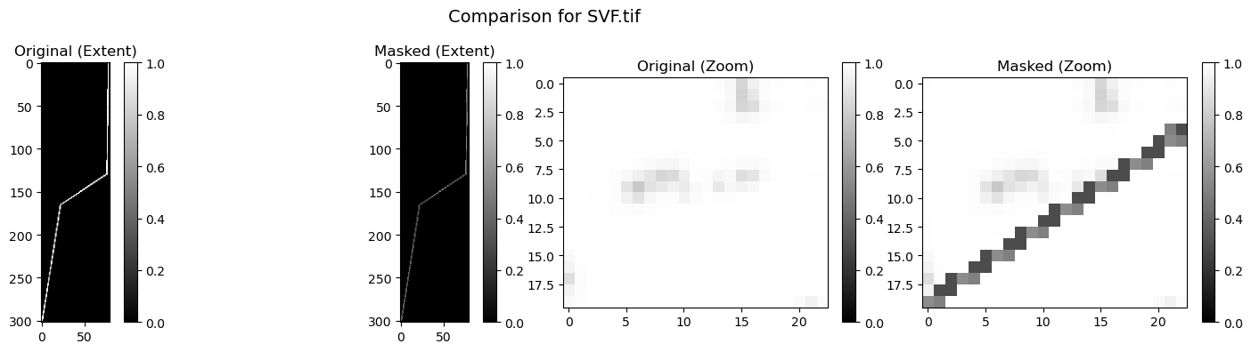
Demonstration

Slide 11
Conclusions
Project Achievements
Delivered a working tool for spatial raster updates via vector-defined rules
Successfully supports both deterministic (mask) and relative (pct) operations
Modular architecture with embedded validation ensures reliability
Integrated into Jupyter for transparent, reproducible workflows
Impact & Future Work
Valuable tool for urban planning, especially in Digital Twin contexts
Enables “what-if” simulations with minimal overhead
Future extensions:
GUI or API interface
Batch rule processing
Tiled processing for large datasets

