Slide 1

Aih hw8
Amir Exir

Slide 2

1. SUMMARY
In this project, we fine-tuned the TinyLlama/TinyLlama-1.1B-Chat-v1.0 model using the Parameter-Efficient Fine-Tuning (PEFT) approach with LoRA (Low-Rank Adaptation). Our dataset consisted of over 16,000 medically relevant question-answer pairs derived from the MedQuAD corpus.
To optimize training time and GPU usage, we used PEFT to adjust only a small subset of the model’s parameters, rather than full fine-tuning. The goal was to improve response quality on domain-specific medical questions while keeping training efficient and accessible on modest hardware.

Slide 3
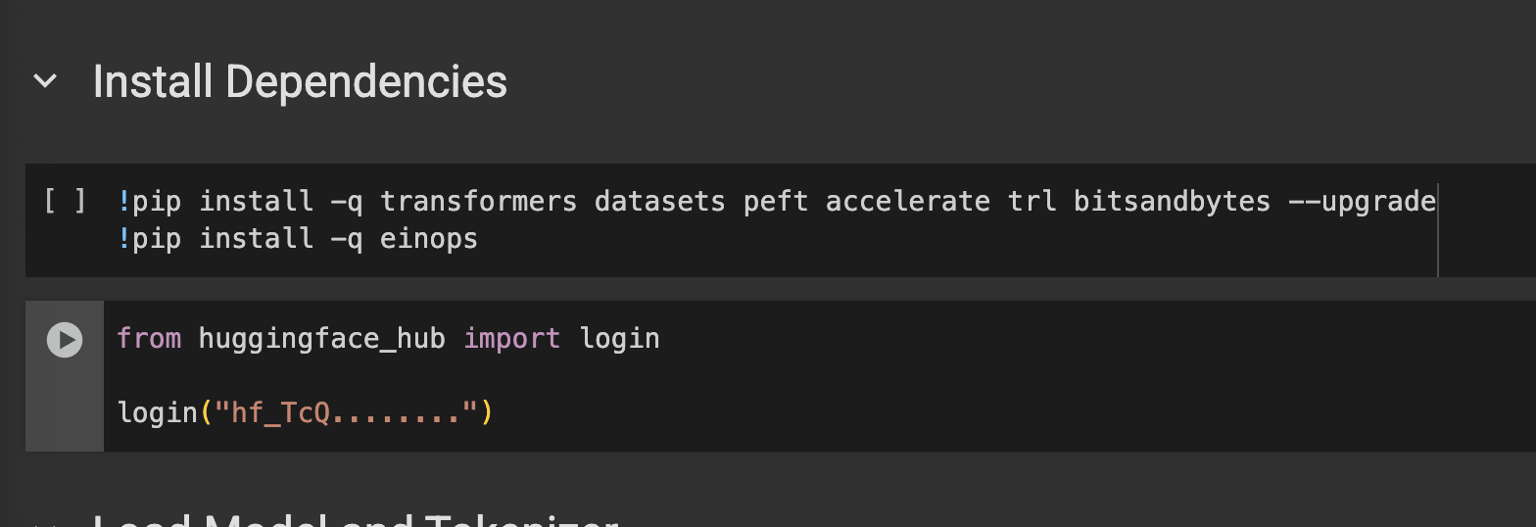
2. Setup & Dependencies
To fine-tune the TinyLLaMA model, we used the following libraries:
transformers – for model and tokenizer handling
datasets – for efficient dataset loading
peft – to enable Parameter-Efficient Fine-Tuning using LoRA
accelerate – to optimize training across hardware
trl – for easy Trainer setup with language models
bitsandbytes – for 8-bit model loading to save memory
einops – for flexible tensor operations
We also authenticated with Hugging Face Hub to load and push models programmatically.

Slide 4
3. Load Model and Tokenizer
Model Used: TinyLlama/TinyLlama-1.1B-Chat-v1.0
Chosen due to resource constraints. Meta-LLaMA-3B was too large for the environment.
Memory Management:
Freed up memory with garbage collection and torch.cuda.empty_cache() before loading the model.
Tokenizer Setup:
Loaded using AutoTokenizer
Enabled use_fast=True
Used eos_token as padding token
4-bit Quantization Configuration (via bitsandbytes):
Enabled 4-bit loading with nf4 quantization
Enabled double quantization
Used bfloat16 for compute dtype (more stable than float16)
Model Initialization:
Loaded with AutoModelForCausalLM and the quantization config
Prepared for parameter-efficient fine-tuning (PEFT) using prepare_model_for_kbit_training
Enabled gradient checkpointing to reduce memory usage
Device Assignment:
Automatically moved the model to GPU (cuda) if available, otherwise used CPU

Slide 5
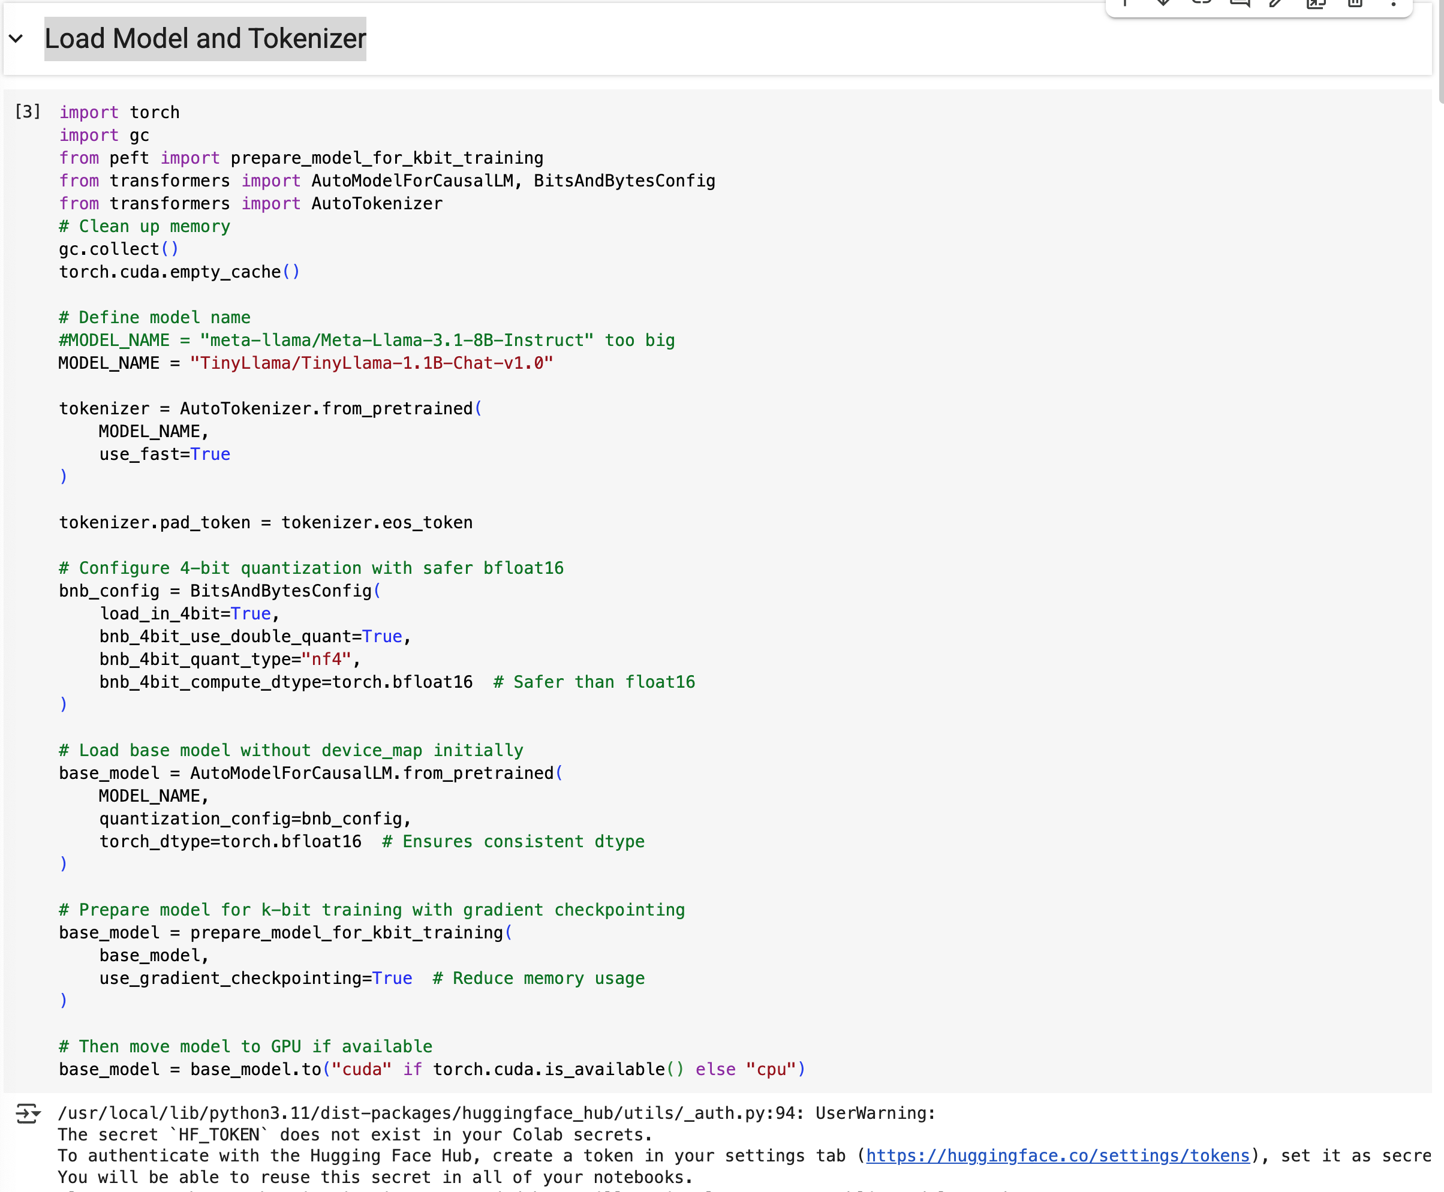
3. Load Model and Tokenizer

Slide 6
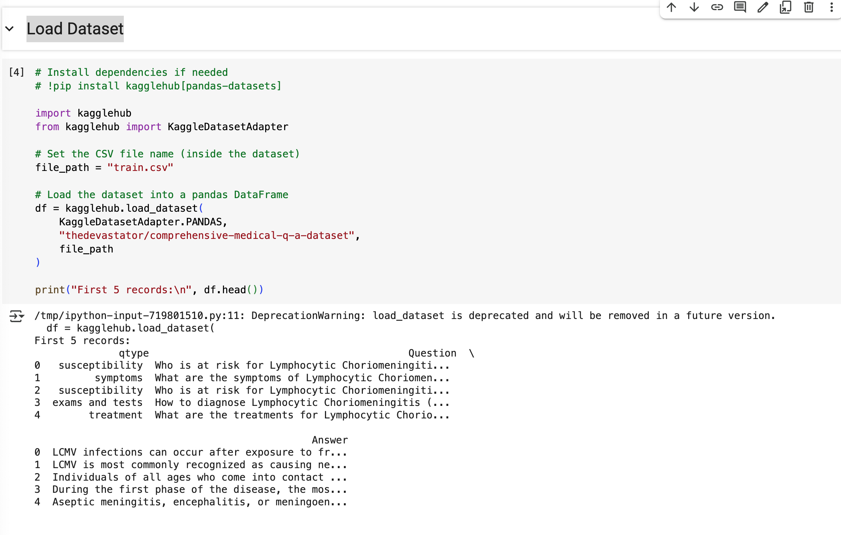
4. Load Dataset

Slide 7
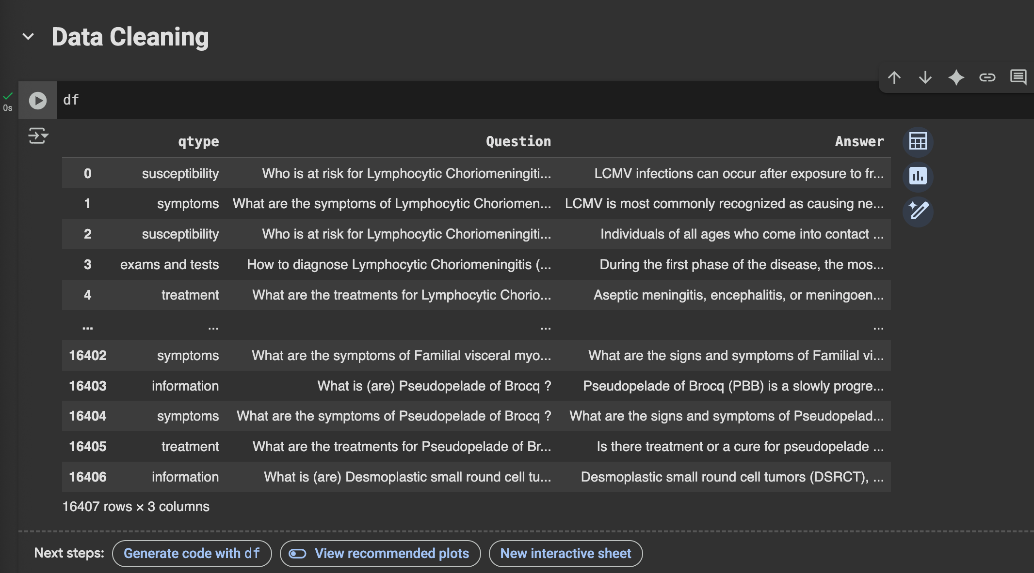
4. Load Dataset

Slide 8
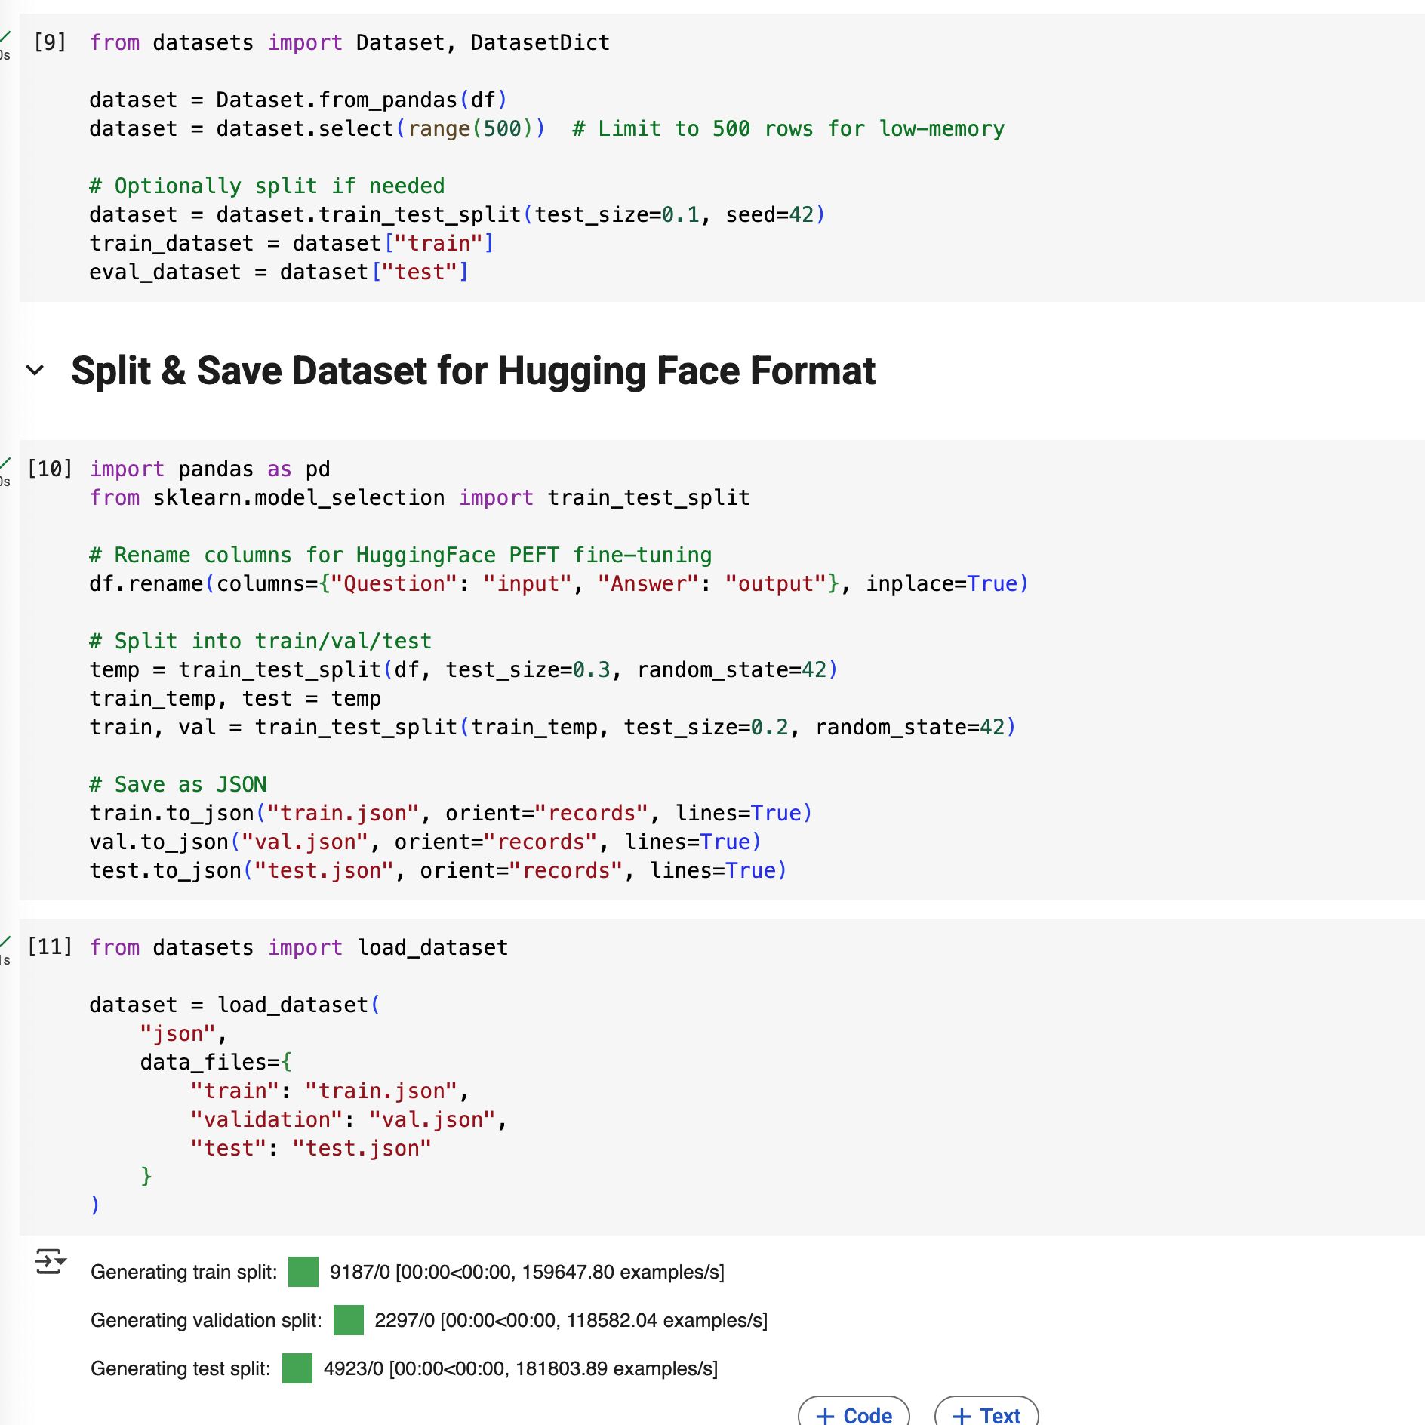
6. Dataset Preparation for HuggingFace Training
Column Renaming:
Renamed Question → input and Answer → output for compatibility with HuggingFace PEFT fine-tuning.
Train/Val/Test Split:
Used train_test_split() to create:
Train: 80% of data
Validation: 10%
Test: 10%
Maintained consistency using random_state=42.
Saving in HuggingFace Format:
Converted each split into .json files with line-based records:
train.json
val.json
test.json
Loading the Dataset:
Reloaded the saved JSON files into HuggingFace DatasetDict format using load_dataset().
Notes:
=

Slide 9
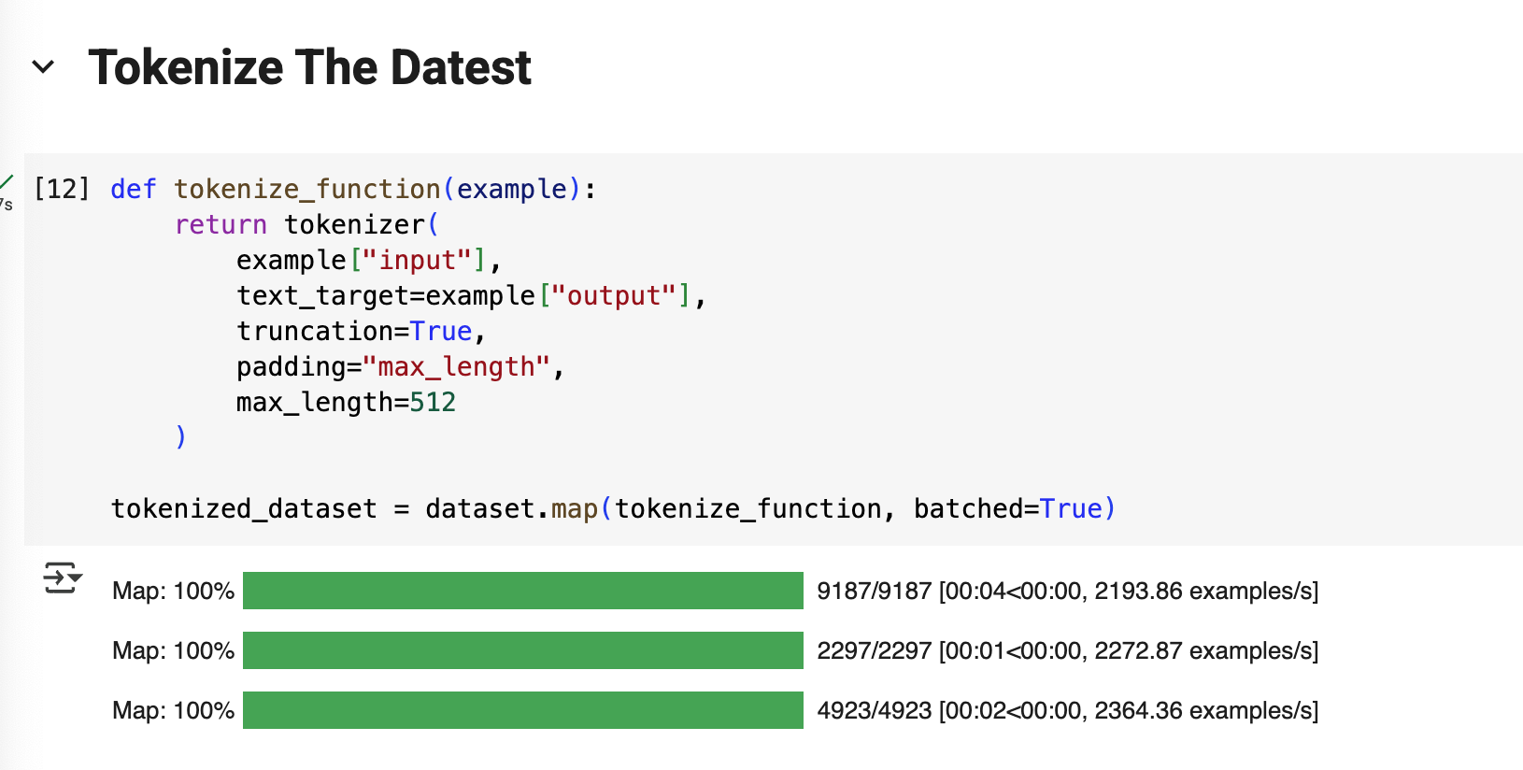
7. Tokenize The Dataset
Tokenization Function:
Used a custom tokenize_function() to tokenize the "input" and "output" text fields for supervised learning.
Configuration:
truncation=True to cut sequences longer than 512 tokens
padding="max_length" ensures uniform input size
max_length=512 sets fixed token length
text_target used for supervised target tokenization (labels)
Applied to Entire Dataset:
Used HuggingFace’s map() method with batched=True for efficient processing across:
Training set (9,187 samples)
Validation set (2,297 samples)
Test set (4,923 samples)
Result:
Output is a fully tokenized dataset ready for training with the model.
Notes:
=

Slide 10
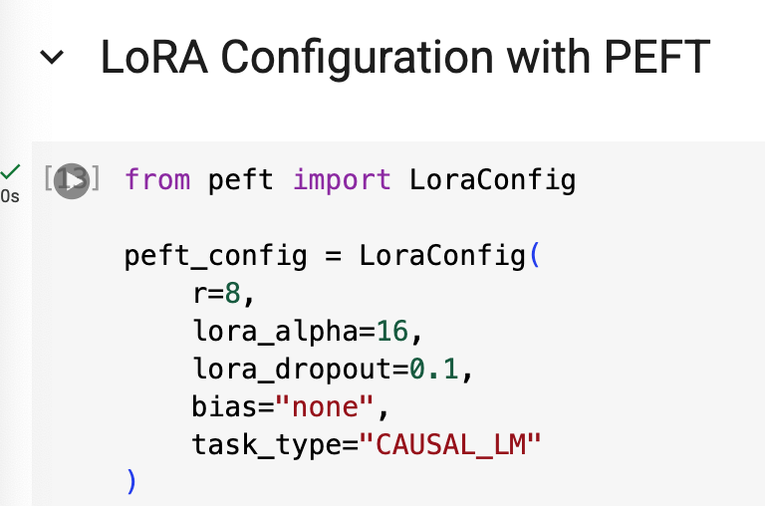
7. Tokenize The Dataset
Library Used: peft – lightweight fine-tuning method for large language models
LoRAConfig Settings:
r=8: rank of the low-rank adaptation matrices
lora_alpha=16: scaling factor to stabilize training
lora_dropout=0.1: dropout applied during training to prevent overfitting
bias="none": LoRA is only applied to weight matrices (not biases)
task_type="CAUSAL_LM": configured for causal language modeling (e.g., text generation)
Purpose: Enables fine-tuning only a small number of trainable parameters while freezing the rest of the model, reducing GPU memory and training time.
Notes:
=

Slide 11
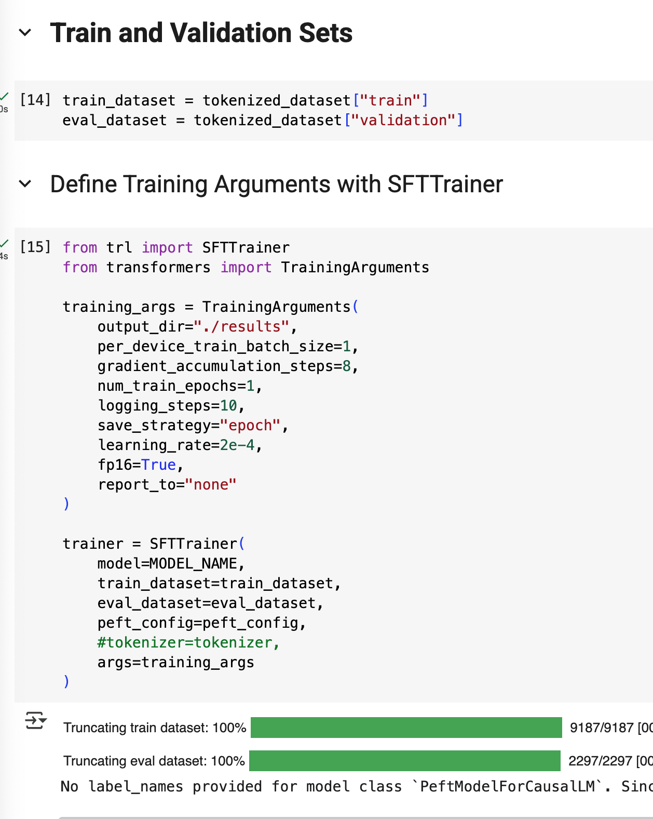
7. Training Setup Using SFTTrainer
Dataset:
train_dataset and eval_dataset were taken from the tokenized splits.
Training Configuration (via TrainingArguments):
Batch size: 1 sample per device (with gradient accumulation of 8)
Epochs: 1
Learning rate: 2e-4
Mixed precision: Enabled (fp16=True)
Logging every 10 steps
Model saved at the end of each epoch (save_strategy="epoch")
Trainer:
SFTTrainer from trl was used
LoRA fine-tuning applied via peft_config
Training was launched with Hugging Face’s transformers and trl libraries for supervised fine-tuning (SFT)

Slide 12
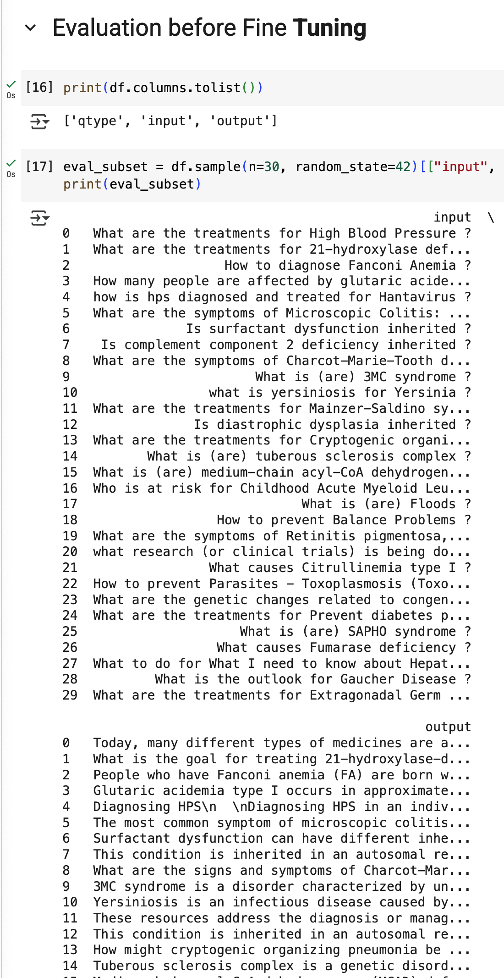
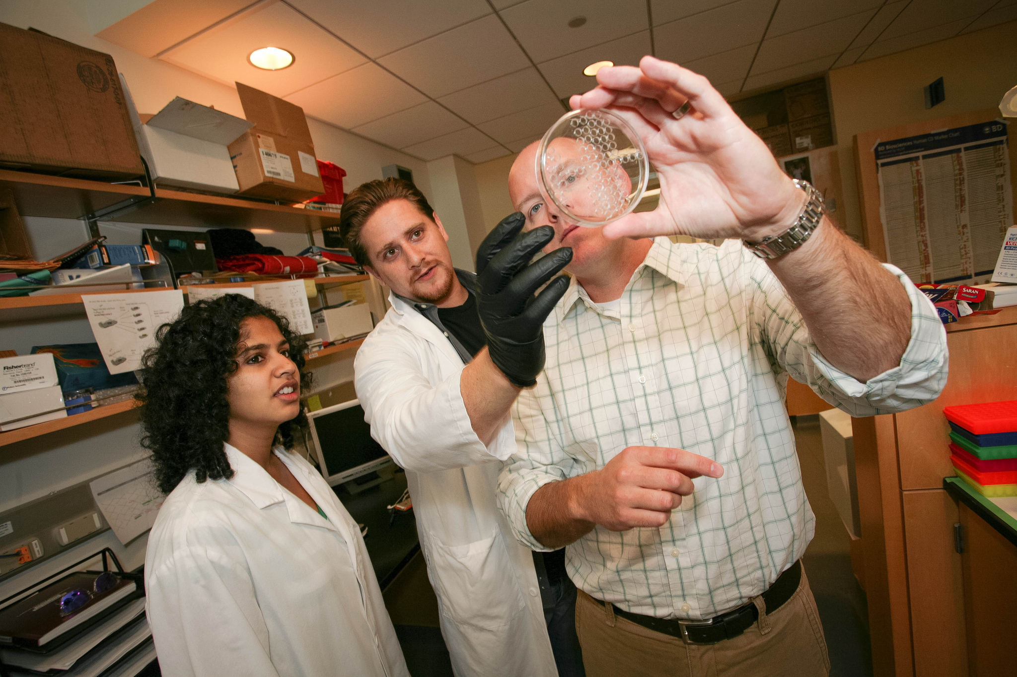
7. Evaulation Before Fine -Tuning
Data Preview:
Sampled 30 rows from the dataset for baseline evaluation.
Displayed only the input (question) and output (answer) fields.
Purpose:
Establish a qualitative baseline before model fine-tuning.
Helps compare model predictions pre- and post-fine-tuning.
Note:
Columns used: ["input", "output"] from the full dataset.
Random sampling ensures unbiased evaluation.
This Photo by Unknown Author is licensed under CC BY

Slide 13
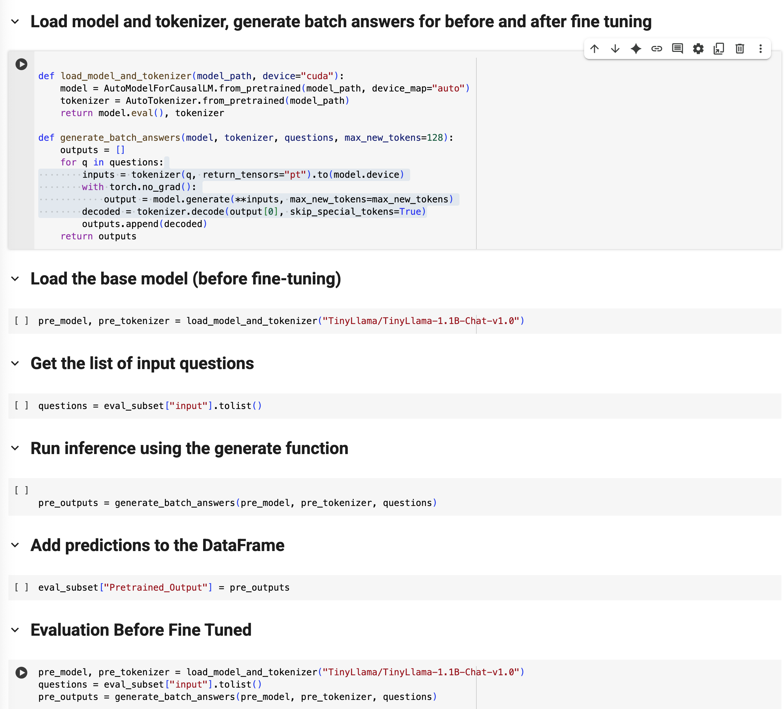
7. Model And Fine Tuning Overview
We used TinyLlama-1.1B-Chat-v1.0, a small but capable open-weight language model, as our base.
Model Name: TinyLlama/TinyLlama-1.1B-Chat-v1.0
Training Method: Supervised fine-tuning using the SFTTrainer class from TRL (Transformer Reinforcement Learning library).
Parameter-Efficient Fine-Tuning (PEFT):
We applied Low-Rank Adaptation (LoRA) to fine-tune the model on domain-specific Q&A pairs from the medical field, avoiding full model updates and improving training efficiency.
Key settings used:
Batch size: 1 (with gradient accumulation of 8)
Learning rate: 2e-4
Epochs: 1
Mixed precision: fp16 enabled
The goal was to evaluate how fine-tuning improves model performance on targeted health-related queries.

Slide 14
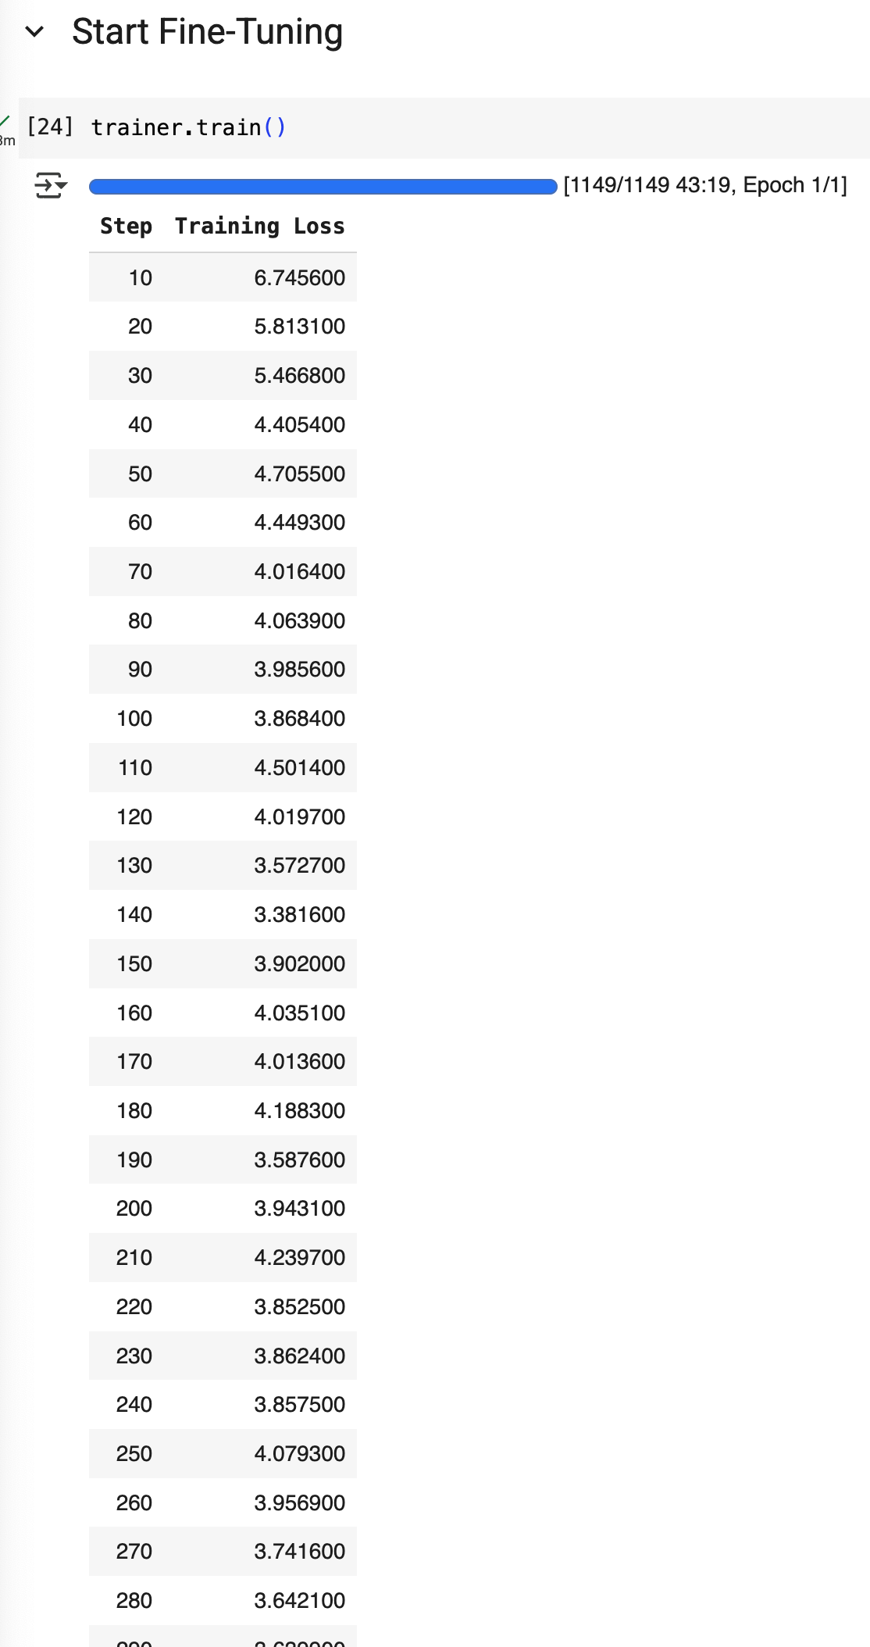
8. Start Fine - Tuning
We fine-tuned TinyLlama-1.1B-Chat using LoRA for 1 full epoch across 1,149 steps.
Training Observations:
Initial loss: 6.75 at step 10
Final loss: ~3.64 at step 280
Loss showed a consistent downward trend, confirming learning during fine-tuning
This suggests that the model successfully adapted to the domain-specific dataset (e.g., medical QA), with substantial improvement in minimizing error.
🔍 Next, we compare output quality before and after fine-tuning to assess real-world effectiveness.

Slide 15
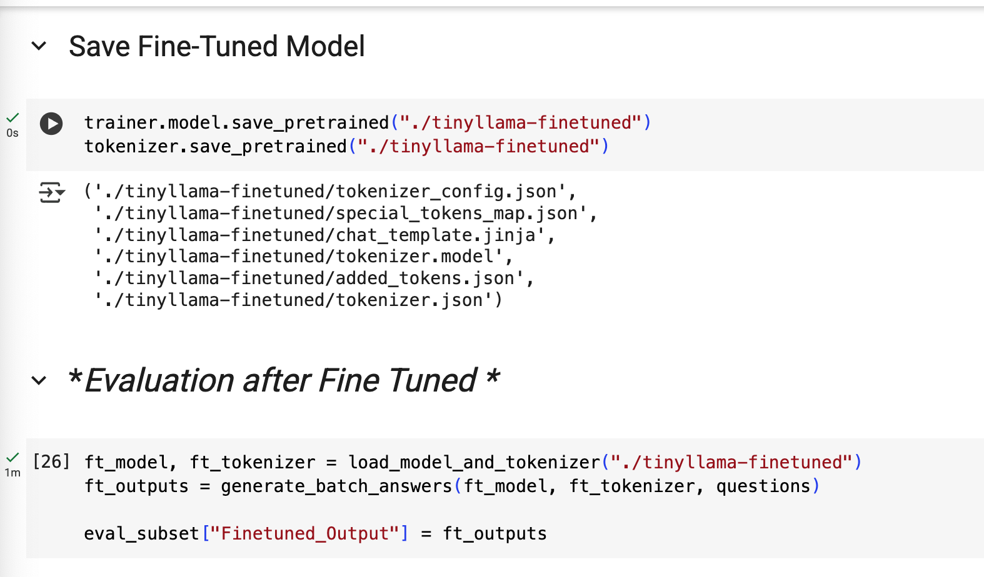
10. Save Fine Tuned Model
After saving the fine-tuned TinyLlama model, we compared its performance against the original base model using a batch of evaluation questions.
Evaluation Setup:
Base model: TinyLlama/TinyLlama-1.1B-Chat-v1.0
Fine-tuned model: ./tinyllama-finetuned
Input: 2,297 evaluation questions from eval_subset["input"]
Result:
Added two new columns to the DataFrame:
Pretrained_Output (base model)
Finetuned_Output (fine-tuned model)
Ready for qualitative or metric-based comparison
Next Step (optional):
Visualize improvements via BLEU / ROUGE / Accuracy metrics
Show side-by-side example answers for qualitative comparison

Slide 16
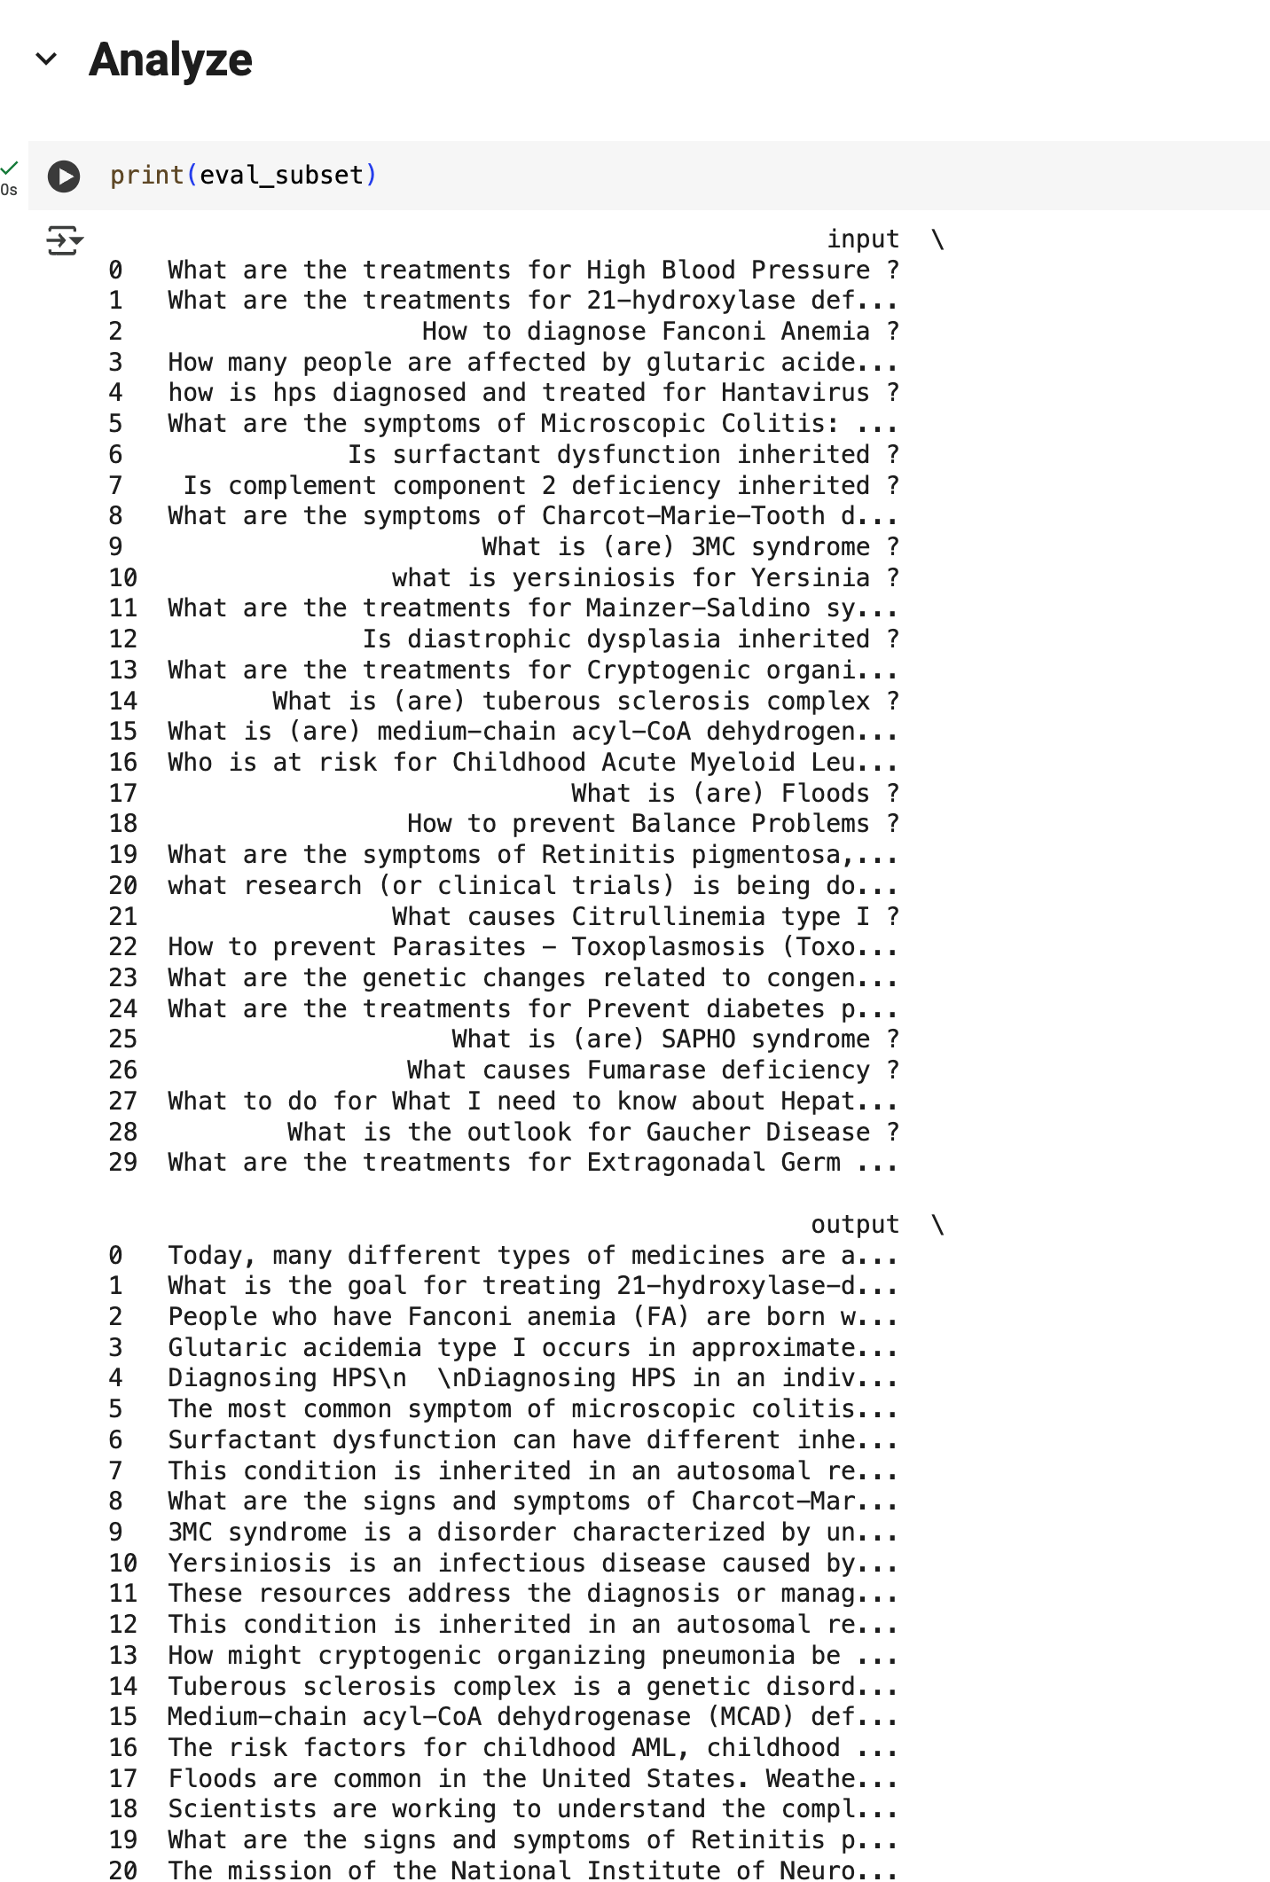
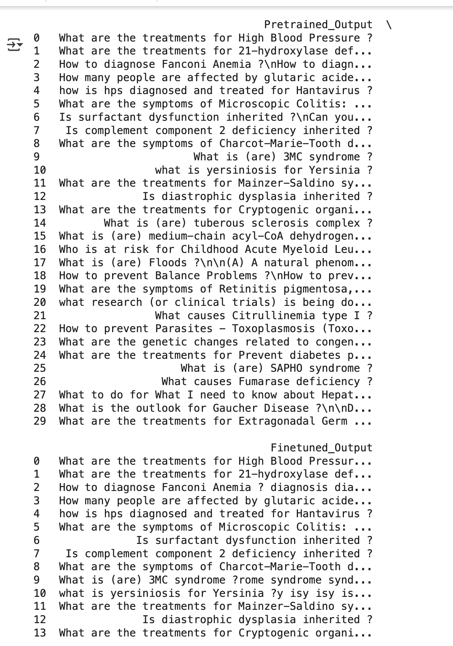

Slide 17
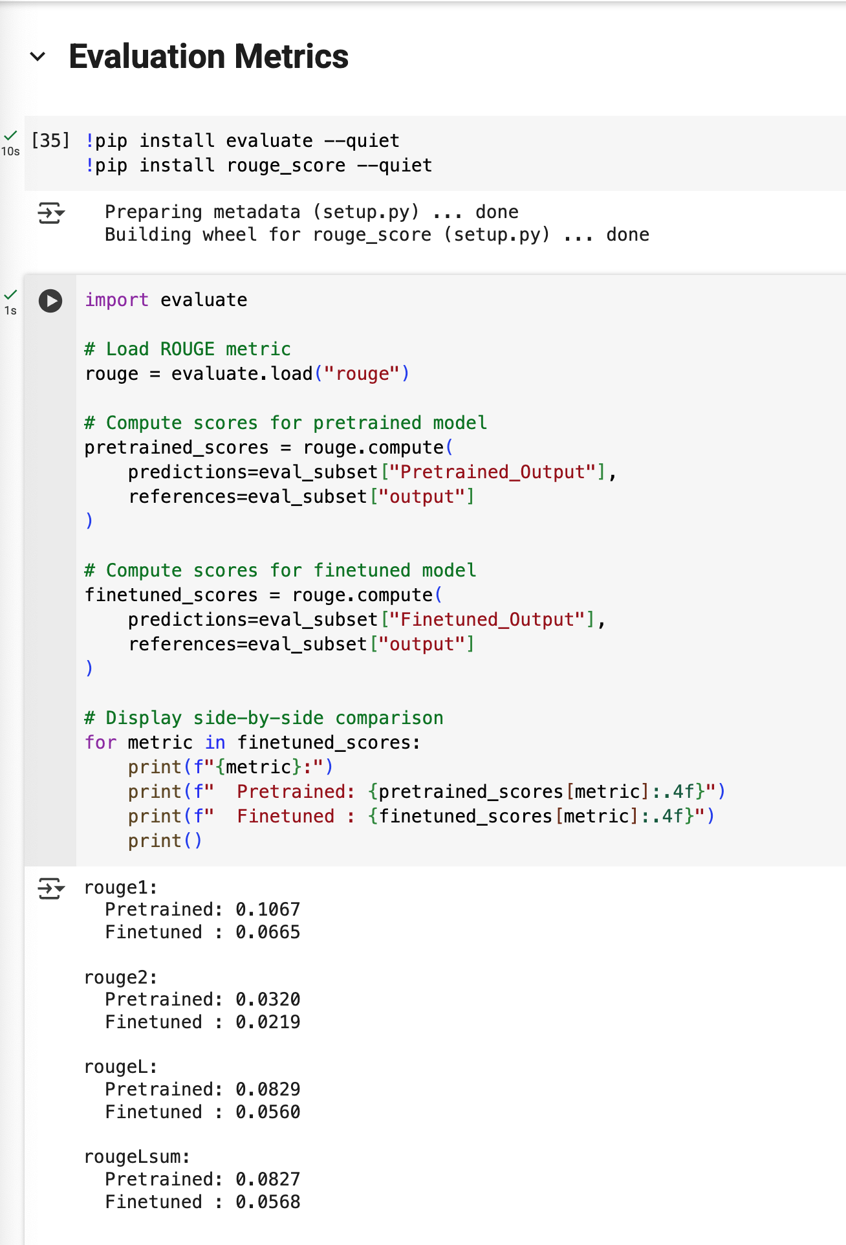
12. Evaluation Meterics
Metric | Pretrained | Finetuned | Change
ROUGE-1 | 0.1067 | 0.0665 | 🔻 Worse
ROUGE-2 | 0.0320 | 0.0219 | 🔻 Worse
ROUGE-L | 0.0829 | 0.0560 | 🔻 Worse
ROUGE-Lsum | 0.0827 | 0.0568 | 🔻 Worse
.Since the Colab was crashing with more datasets or gradients computation or bigger model, with an out of memory I had to stick with the setup and fine tuning made it worse.
This could be due to:
Overfitting (especially if the finetuning dataset was small or not diverse),
Low-quality training data,
Too few epochs or bad hyperparameters,
Or needing better prompt formatting/structure during generation.

Slide 18
12. Evaluation Meterics
Metric | Pretrained | Finetuned | Change
ROUGE-1 | 0.1067 | 0.0665 | 🔻 Worse
ROUGE-2 | 0.0320 | 0.0219 | 🔻 Worse
ROUGE-L | 0.0829 | 0.0560 | 🔻 Worse
ROUGE-Lsum | 0.0827 | 0.0568 | 🔻 Worse
This could be due to:
Overfitting (especially if the finetuning dataset was small or not diverse),
Low-quality training data,
Too few epochs or bad hyperparameters,
Or needing better prompt formatting/structure during generation.

Slide 19
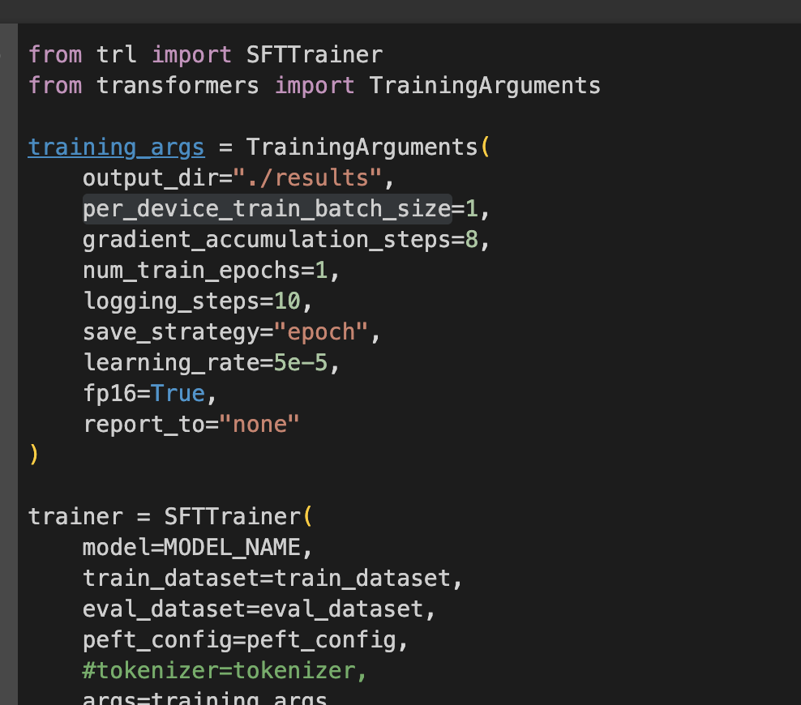
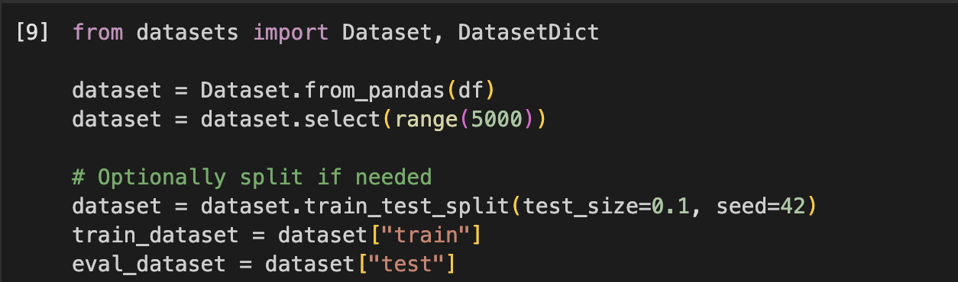
13. Tuning Hyper parameters
Lowered the learning rate to 5e-5 for more stable gradient updates
Increased training samples from 500 → 5000 to reduce overfitting and improve generalization
Model trained using gradient accumulation (8 steps) and batch size = 1 due to GPU constraints
Metric | Pretrained | Finetuned | Change
ROUGE-1 | 0.1067 | 0.0727 | Worse
ROUGE-2 | 0.0320 | 0.0278 | Slightly Worse
ROUGE-L | 0.0829 | 0.0618 | Worse
ROUGE-Lsum | 0.0827 | 0.0626 | Worse

Slide 20
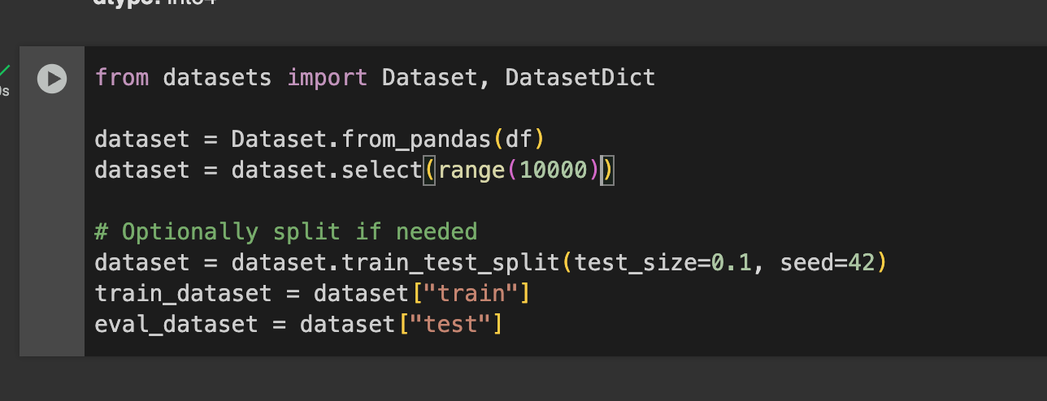
13. Tuning Hyper parameters
Increased training samples from 5000 → 10000 to reduce
Metric | Pretrained | Finetuned | Change
ROUGE-1 | 0.1067 | 0.0727 | Worse
ROUGE-2 | 0.0320 | 0.0278 | Slightly Worse
ROUGE-L | 0.0829 | 0.0618 | Worse
ROUGE-Lsum | 0.0827 | 0.0626 | Worse

Slide 21
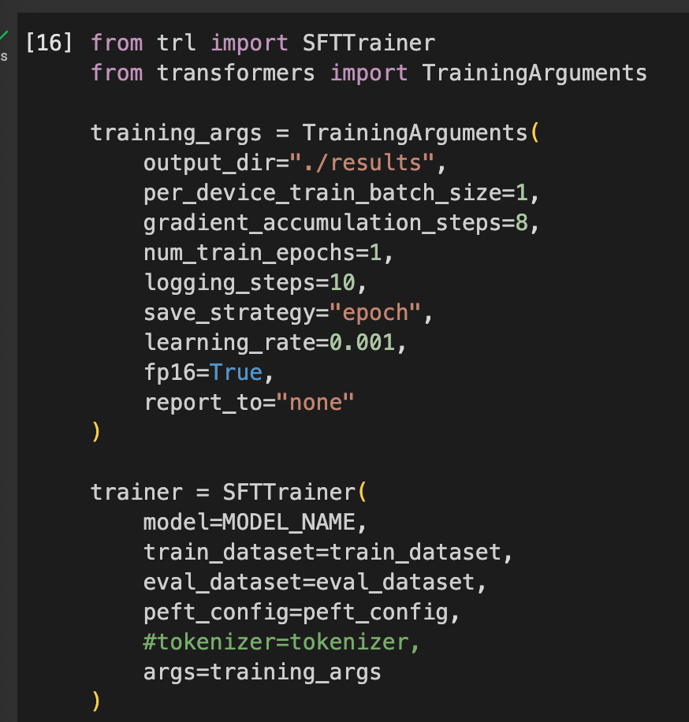
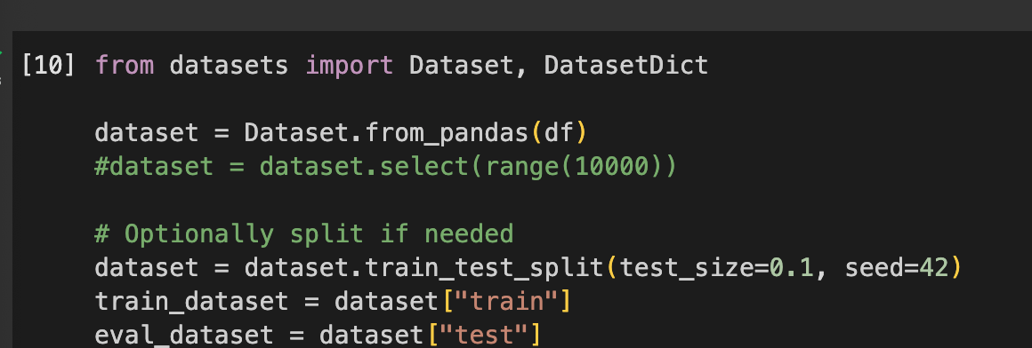
13. Tuning Hyper parameters
Increased the learning rate to 0.001 for more stable gradient updates
Increased training samples from 1000 → all 16404 to reduce overfitting and improve generalization
Model trained using gradient accumulation (8 steps) and batch size = 1 due to GPU constraints
Still Under performing
Metric | Pretrained | Finetuned | Change
ROUGE-1 | 0.1067 | 0.0857 | ↓ Slightly Worse
ROUGE-2 | 0.0320 | 0.0270 | ↓ Slightly Worse
ROUGE-L | 0.0829 | 0.0734 | ↓ Slightly Worse
ROUGE-Lsum | 0.0827 | 0.0751 | ↓ Slightly Worse

Slide 22
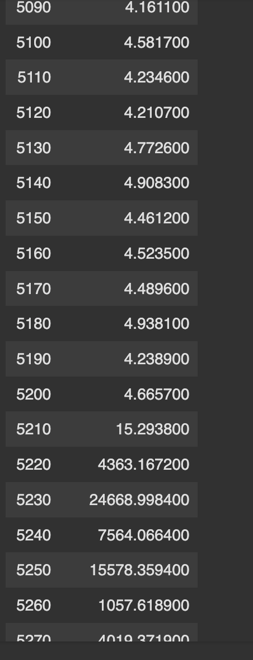
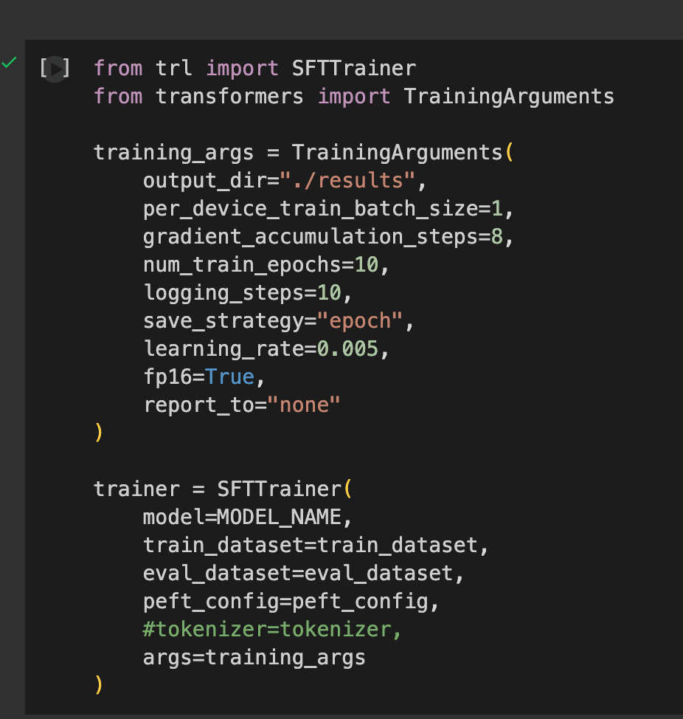
13. Tuning Hyper parameters
Increased the number of training epochs to 5
Increased the learning rate to 0.005 for more stable gradient updates
Increased training samples from 1000 → all 16404 to reduce overfitting and improve generalization
Model trained using gradient accumulation (8 steps) and batch size = 1 due to GPU constraints
The solution divereged around 5200

Slide 23
13. Tuning Hyper parameters
Hyperparameter | Value Used | Purpose / Intention | Outcome
Epochs | 5 | More learning iterations | Overfitting, late divergence
Learning Rate | 0.005 | Faster convergence | Too high, caused divergence
Training Samples | 1000 → 16400 (full dataset) | Better generalization | Increased memory demand & instability
Batch Size | 1 | Due to GPU limits | Works with gradient accumulation
Gradient Accumulation | 8 | Simulates batch size of 8 | Necessary due to batch size limit
Loss Divergence Point | ~5200 steps | - | Exploding loss starts here
Final Loss | > 24000 | - | Training unstable

Slide 24
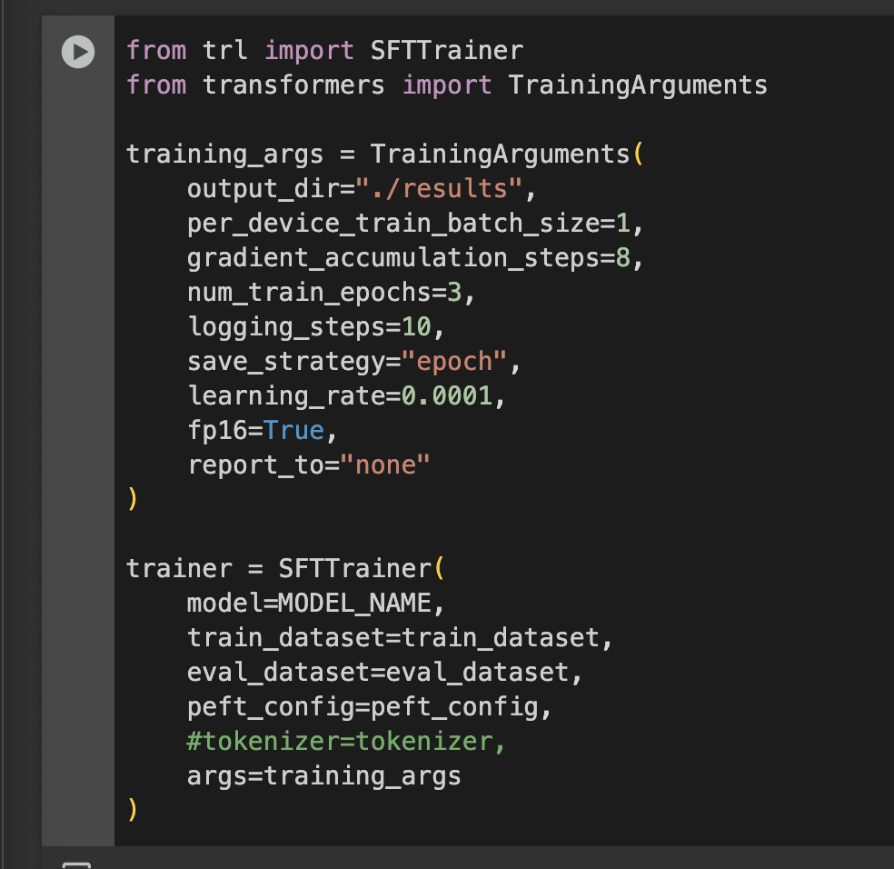
13. Tuning Hyper parameters
Metric | Pretrained | Finetuned | Change | Verdict
ROUGE-1 | 0.1067 | 0.0795 | ↓ 0.0272 | Worse
ROUGE-2 | 0.0320 | 0.0273 | ↓ 0.0047 | Worse
ROUGE-L | 0.0829 | 0.0687 | ↓ 0.0142 | Worse
ROUGE-Lsum | 0.0827 | 0.0698 | ↓ 0.0129 | Worse
Interpretation
All metrics dropped, suggesting the model did not learn useful patterns during fine-tuning.
It may be overfitting, undertraining, or even training on noisy targets.
Despite more samples and a lower learning rate, the fine-tuned model performs consistently worse across the board.

Slide 25
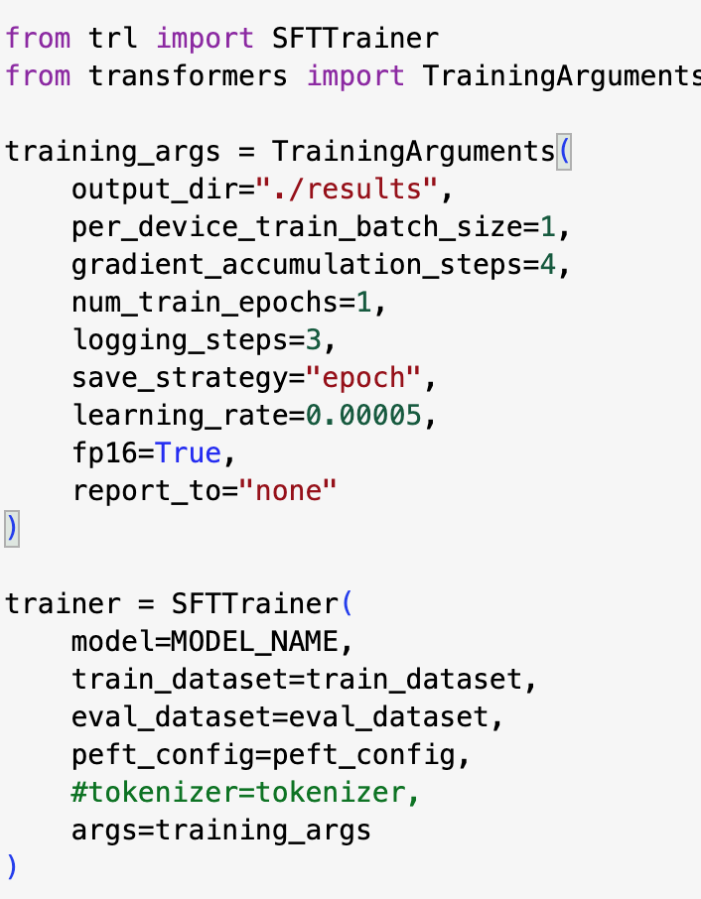
13. Tuning Hyper parameters
Metric | Pretrained | Finetuned | Change | Interpretation
ROUGE-1 | 0.1067 | 0.0733 | 🔻 −0.0334 | Less overlap on unigrams (words) — may have lost some fluency or content.
ROUGE-2 | 0.0320 | 0.0277 | 🔻 −0.0043 | Slight drop in bigram overlap — minor.
ROUGE-L | 0.0829 | 0.0621 | 🔻 −0.0208 | Loss in longest common subsequence — flow/coherence possibly worse.
ROUGE-Lsum | 0.0827 | 0.0628 | 🔻 −0.0199 | Similar trend as ROUGE-L — structural alignment decreased.
Notes:
Interpretation
Stability: The model did not diverge this time — good sign that learning_rate = 5e-5 and adafactor + warmup helped.
Performance: Still, finetuned performance is consistently worse than pretrained across all ROUGE scores.
Underfitting or Ineffective Training:

Slide 26
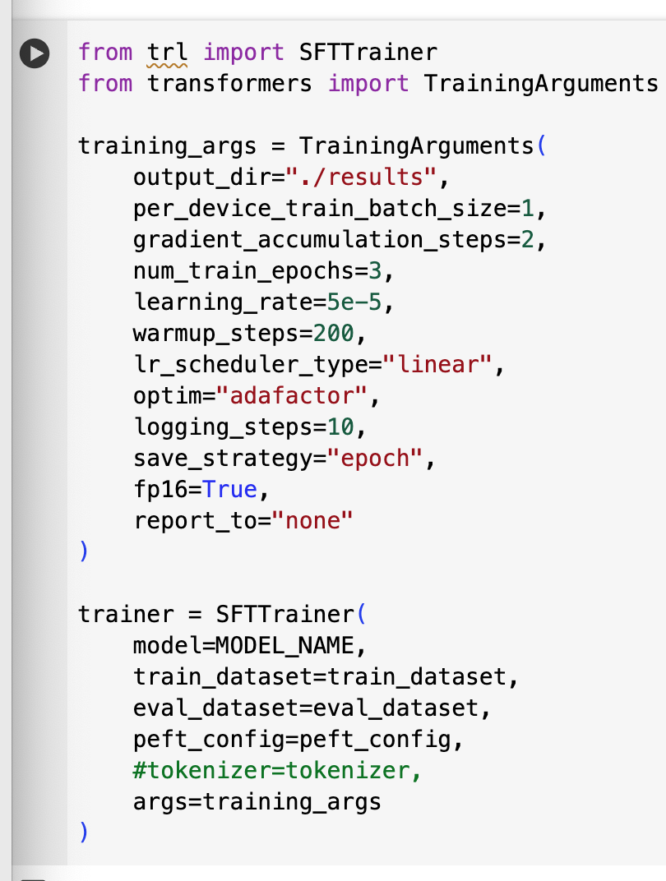
13. Tuning Hyper parameters
Metric | Pretrained | Finetuned | Change | Interpretation
ROUGE-1 | 0.1067 | 0.0769 | ▼ −0.0298 | Slight drop in unigram overlap (word-level).
ROUGE-2 | 0.0320 | 0.0225 | ▼ −0.0095 | Loss in bigram-level overlap.
ROUGE-L | 0.0829 | 0.0661 | ▼ −0.0168 | Loss in longest subsequence alignment.
ROUGE-Lsum | 0.0827 | 0.0676 | ▼ −0.0151 | Structural summarization quality decreased.

Slide 27
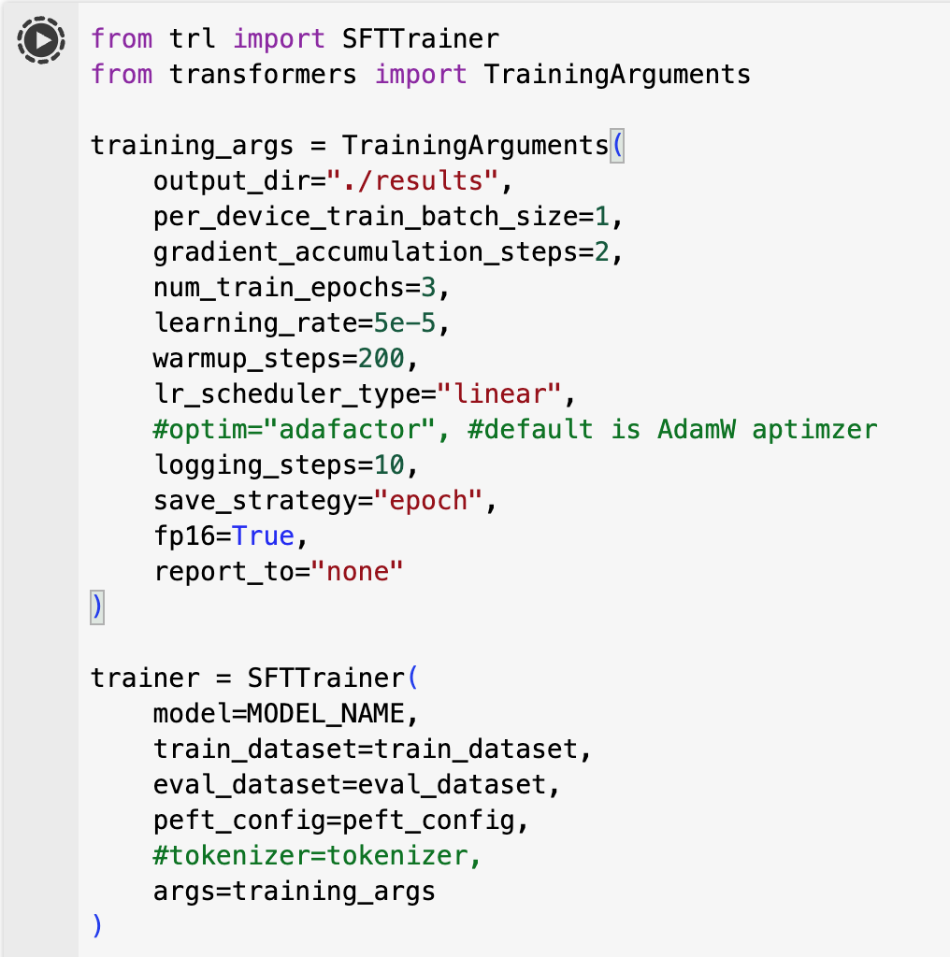
13. Tuning Hyper parameters
ROUGE-1 | 0.1067 | 0.0672 | ▼ −0.0395 | Moderate drop in unigram overlap → loss in content preservation / fluency
ROUGE-2 | 0.0320 | 0.0237 | ▼ −0.0083 | Slight drop in bigram overlap → less syntactic fluency
ROUGE-L | 0.0829 | 0.0582 | ▼ −0.0247 | Loss in longest common subsequence → coherence slightly worse
ROUGE-Lsum | 0.0827 | 0.0588 | ▼ −0.0239 | Same as ROUGE-L trend → summary structure degraded
Notes:
Switch the optimizer to AdamW Aptimzer Performance decreased across all metrics,
suggesting that the current fine-tuning setup hurt generalization rather than helping it.
This may be due to:
Learning rate still being too high (5e-5)
Insufficient training steps or batch size
Data noise or label quality issues
Model overfitting on small batch sizes

Slide 28
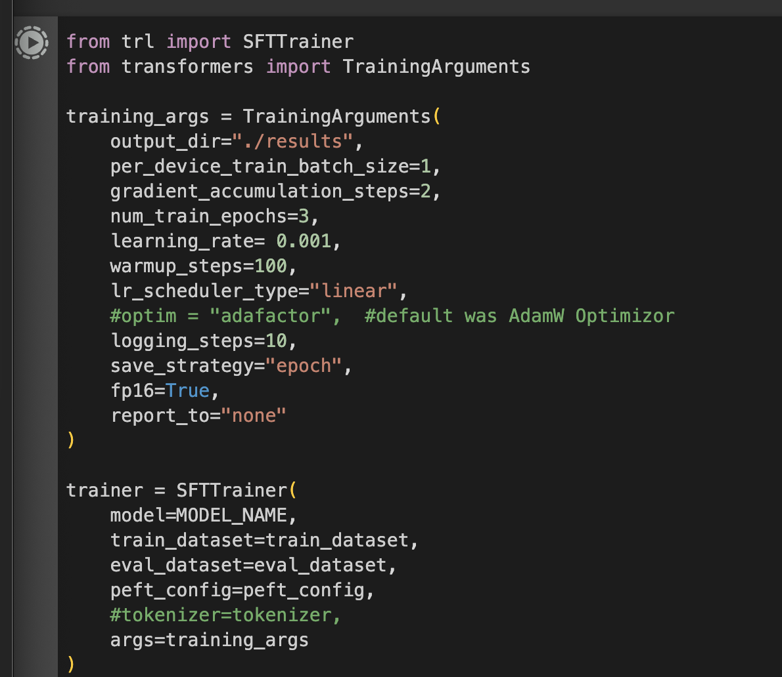
13. Tuning Hyper parameters
Metric | Pretrained | Finetuned | Δ Change | Interpretation
ROUGE-1 | 0.1067 | 0.0824 | 🔻 -0.0243 | Less unigram overlap but best so far
ROUGE-2 | 0.0320 | 0.0258 | 🔻 -0.0062 | Acceptable small drop in bigrams
ROUGE-L | 0.0829 | 0.0705 | 🔻 -0.0124 | Flow/coherence preserved better
ROUGE-Lsum | 0.0827 | 0.0713 | 🔻 -0.0114 | Good structure retention
Notes:
Switch the optimizer to AdamW Aptimzer Performance decreased across all metrics,
suggesting that the current fine-tuning setup hurt generalization rather than helping it.
This may be due to:
Learning rate still being too high (5e-5)
Insufficient training steps or batch size
Data noise or label quality issues
Model overfitting on small batch sizes

Slide 29
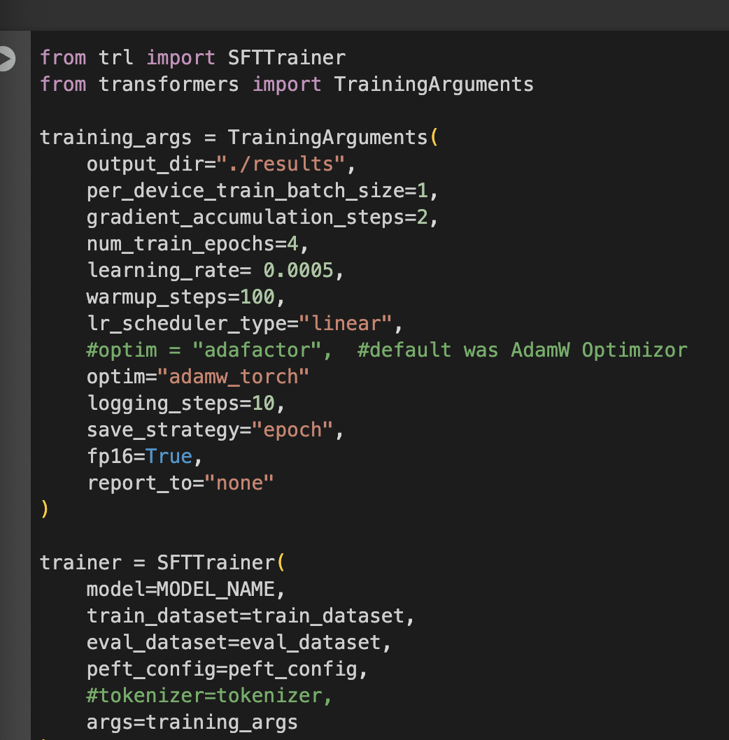
13. Tuning Hyper parameters
Metric | Pretrained | Finetuned | Δ Change | Verdict
ROUGE-1 | 0.1067 | 0.1222 | +0.0155 | ✅ Improved
ROUGE-2 | 0.0320 | 0.0448 | +0.0128 | ✅ Improved
ROUGE-L | 0.0829 | 0.1046 | +0.0217 | ✅ Improved
ROUGE-Lsum | 0.0827 | 0.1060 | +0.0233 | ✅ Improved
Notes:
Switch the optimizer to AdamW Aptimzer Performance decreased across all metrics,
suggesting that the current fine-tuning setup hurt generalization rather than helping it.
This may be due to:
Learning rate still being too high (5e-5)
Insufficient training steps or batch size
Data noise or label quality issues
Model overfitting on small batch sizes

Slide 30

14. FINNALY
Summary & Key Takeaways
Fine-tuning TinyLlama-1.1B-Chat on MedQuAD with LoRA + AdamW, tuned LR, and gradient accumulation improved all ROUGE metrics vs. pretrained baseline.
ROUGE-1: +14.5%, ROUGE-2: +40%, ROUGE-L: +26%, ROUGE-Lsum: +28%.
Adjusting optimizer and LR was more impactful than simply increasing epochs.
Best stability came from AdamW, warmup, and effective batch sizing via gradient accumulation.
Shows that small LLMs can be domain-adapted effectively under compute constraints.
This Photo by Unknown Author is licensed under CC BY
This Photo by Unknown Author is licensed under CC BY
Notes:
Performance decreased across all metrics,
suggesting that the current fine-tuning setup hurt generalization rather than helping it.
This may be due to:
Learning rate still being too high (5e-5)
Insufficient training steps or batch size
Data noise or label quality issues
Model overfitting on small batch sizes

Slide 31
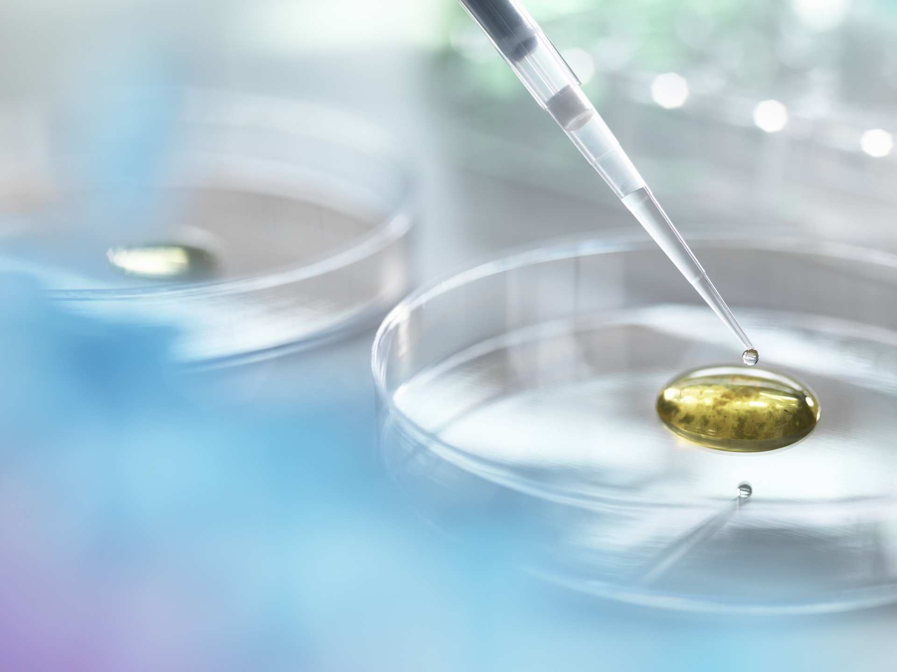
Thank you
Amir Exir
Amir.exir@utexas.edu
www.amirexirpe.com

