Slide 1

DESS
Distributed Enterprise Security System
Log in to system to use all about DESS security tool
How to use This Program
User name
What's the Meaning of DESS
How Electric-Fence Works
Password
www.emenhesarpouya.com
Log in
EHP
Emen Hesar Pouya
About
© 2020 EHP Corp.

Slide 2





















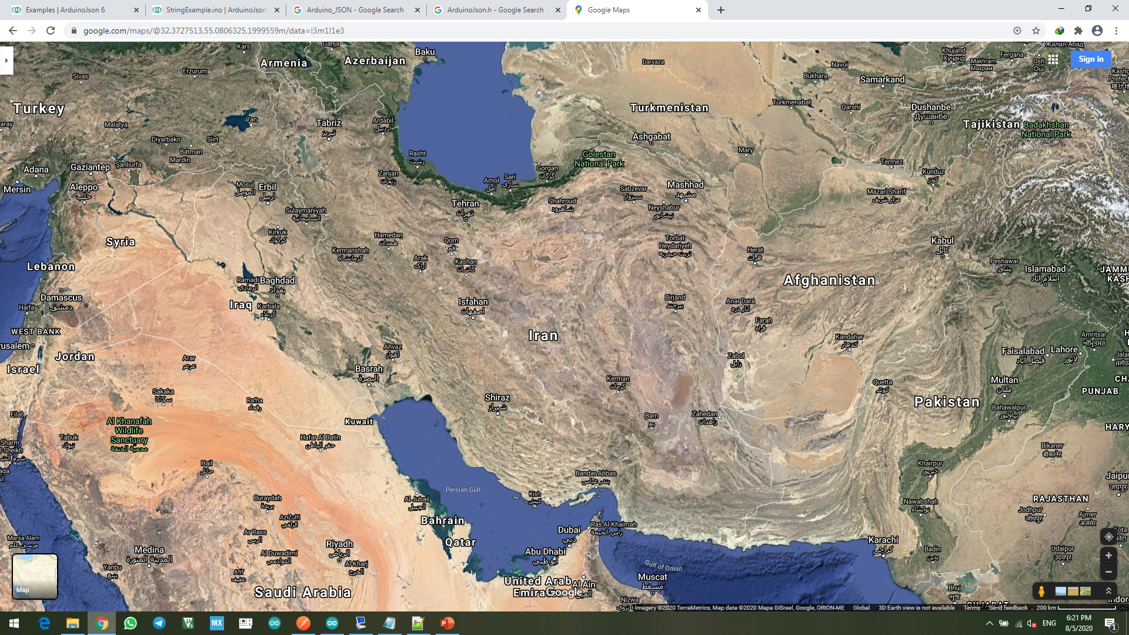
DESS Security System
Type site name here
Home
Sites
Setting
Users
Report
Help
Active Sites
+ 65981-TBZ-56 | OK T:25°c 25% 62
+ 65981-TBZ-56 | OK T:25°c 25% 62
Mute Alarm
Raise Alarm
Find location
Add location
Assign
Show/Hide
Refresh
Filter Sites
Fit View
Statistic
Schedule
Offline Sites
+ 36546-THR-60 | OFF T:--°c --% --
Not Defined
+ 36546-THR-60 | OFF T:--°c --% --
About
© 2020 EHP Corp.

Slide 3
DESS Security System
Type site name here
Home
Sites
Setting
Users
Report
Help
Active Sites
- 65981-TBZ-56 | OK T:25°c 54% 62
65981-TBZ-56
Mute Alarm
Active Alarm
Find location
Add location
Assign
Show/Hide
Refresh
Filter Sites
Best View
Statistic
Schedule
HV: OK
LV: OK
Tamper: OK
Errors: NO
Power: 75 %
Voltage: 6.3 kV
Temp: 45 °c - High
Battery: 83 %
Signal Strength: 62 % - Good
Input-1: OFF
Output-1: OFF
Input-2: OFF
Output-2: OFF
VIEW ACK
RESET
+ 65981-TBZ-56 | OK T:25°c 60% 62
Offline Sites
+ 36546-THR-60 | OFF T:--°c --% --
Not Defined
+ 36546-THR-60 | OFF T:--°c --% --
About
© 2020 EHP Corp.

Slide 4
DESS Security System
Type site name here
Home
Modules
Setting
Users
Report
Help
Active Sites
+ 65981-TBZ-56 | OK T:25°c 25% 62
+ 65981-TBZ-56 | OK T:25°c 25% 62
Mute Alarm
Active Alarm
Find location
Add location
Assign
Show/Hide
Refresh
Filter Sites
Best View
Statistic
Schedule
65981-TBZ-56
TURN OFF
HV PROTECTION: ON
TURN OFF
LV PROTECTION: ON
Edit Module
Assign Location
Show/Hide on map
Highlight on map
Offline Sites
+ 36546-THR-60 | OFF T:--°c --% --
Not Defined
+ 36546-THR-60 | OFF T:--°c --% --
About
© 2020 EHP Corp.

Slide 5








DESS Security System
Type site name here
Home
Modules
Setting
Users
Report
Help
Active Sites
+ 65981-TBZ-56 | OK T:25°c 25% 62
+ 65981-TBZ-56 | OK T:25°c 25% 62
Add Site
Add List
Remove
Export List
Add Group
Edit Group
Search
Filter
Name
Site ID
Power
Alarm Level
Repeat
Phone Number
Location
Data Interval
Input
Output
Grouping
Last Update
1
EF-1
T8757
75 %
20
3
+989363662886
Auto
Global 20 s
Listen
Listen
On
On
R10
04/11/2020-12:44
2
EF-2
T9452
80 %
20
3
+989376524626
Manual
15 s
Listen
---
OFF
On
R10
25/10/2020-15:20
3
EF-3
T8167
80 %
20
3
-
Manual
15 s
Listen
---
OFF
On
R9
25/10/2020-15:20
4
EF-4
T7629
80 %
20
3
-
Auto
15 s
---
---
OFF
On
R9
25/10/2020-15:20
5
EF-5
T9374
80 %
20
3
-
Manual
15 s
---
---
OFF
On
R10
25/10/2020-15:20
6
EF-6
T5163
80 %
20
3
-
Manual
10 s
---
---
OFF
On
R4
25/10/2020-15:20
7
EF-7
T5991
80 %
20
3
-
Auto
10 s
---
---
OFF
On
R4
25/10/2020-15:20
8
EF-8
T8945
80 %
20
3
-
Auto
10 s
Listen
Listen
OFF
On
R6
25/10/2020-15:20
9
EF-9
T5168
80 %
20
3
-
Auto
10 s
Listen
Listen
OFF
On
R4
25/10/2020-15:20
10
EF-10
T8001
80 %
20
3
-
Manual
10 s
---
Listen
OFF
On
R5
25/10/2020-15:20
Offline Sites
+ 36546-THR-60 | OFF T:--°c --% --
Not Defined
+ 36546-THR-60 | OFF T:--°c --% --
About
© 2020 EHP Corp.

Slide 6






DESS Security System
Type site name here
Home
Modules
Setting
Users
Report
Help
Active Sites
+ 65981-TBZ-56 | OK T:25°c 25% 62
+ 65981-TBZ-56 | OK T:25°c 25% 62
Save
Cancel
Back
Reload
Name
Enter Device Name
Number
Grouping
Site ID
Select
Serial Num.
Phone Number
Location
Enter Name
Auto
Latitude ____________
HV Protection
Enable
Longitude ____________
LV Protection
Enable
Edit group
Enable
Remove group
Box Tamper
Add new group
Offline Sites
Power
+ 36546-THR-60 | OFF T:--°c --% --
Voltage
Temperature
Battery
Alarm Level
min
min
Repeat
max
max
Not Defined
Data Interval
+ 36546-THR-60 | OFF T:--°c --% --
Input
Input-1
Enter Name
Enable
Reverse
Input-2
Enter Name
Enable
Reverse
Output
Output-1
Enter Name
Enable
Reverse
Output-2
Enter Name
Enable
Reverse
About
© 2020 EHP Corp.

Slide 7


DESS Security System
Type site name here
Home
Modules
Setting
Users
Report
Help
Active Sites
+ 65981-TBZ-56 | OK T:25°c 25% 62
+ 65981-TBZ-56 | OK T:25°c 25% 62
Save
Cancel
Import
Export
Language
English
Farsi
Interval
Username
Change Password
current
new
confirm
Offline Sites
+ 36546-THR-60 | OFF T:--°c --% --
Not Defined
+ 36546-THR-60 | OFF T:--°c --% --
About
© 2020 EHP Corp.

Slide 8

DESS Security System
Type site name here
Home
Modules
Setting
Users
Report
Help
Active Sites
+ 65981-TBZ-56 | OK T:25°c 25% 62
+ 65981-TBZ-56 | OK T:25°c 25% 62
Apply
Cancel
Import
Export
Offline Sites
+ 36546-THR-60 | OFF T:--°c --% --
Not Defined
+ 36546-THR-60 | OFF T:--°c --% --
About
© 2020 EHP Corp.

Slide 9

DESS Security System
Type site name here
Home
Modules
Setting
Users
Report
Help
Active Sites
+ 65981-TBZ-56 | OK T:25°c 25% 62
+ 65981-TBZ-56 | OK T:25°c 25% 62
Apply
Cancel
Import
Export
Offline Sites
+ 36546-THR-60 | OFF T:--°c --% --
Not Defined
+ 36546-THR-60 | OFF T:--°c --% --
About
© 2020 EHP Corp.

Slide 10

DESS Security System
Type site name here
Home
Modules
Setting
Users
Report
Help
Active Sites
+ 65981-TBZ-56 | OK T:25°c 25% 62
+ 65981-TBZ-56 | OK T:25°c 25% 62
Back
Reload
How to use This Program
What's the Meaning of DESS
How Electric-Fence Works
Legal Rights
About EHP
Help Center
www.emenhesarpouya.com
Offline Sites
+ 36546-THR-60 | OFF T:--°c --% --
Not Defined
+ 36546-THR-60 | OFF T:--°c --% --
About
© 2020 EHP Corp.

