Slide 1
Recipes Holder
1
Presented By:
Gennaro Finelli, Amir-Georges Haya, Sen Bellotiny Donissint

Slide 2
Introduction
1
2
Recipe Holder is an application designed to store recipes and view, modify and add any recipes in the application. This program provides features such as the ability to select a recipe and view all ingredients and steps that go with that recipe. As well as the ability which allows the user to add recipes. Finally, the ability to modify any recipe of the user’s choice, they can add or delete an ingredient as well as add or delete a step.

Slide 3
1
2
3
Features
We have a total of 4 forms, each of which has multiple features.
The home page has access to the other three forms.
The home page allows the user to select the language.
The other forms allow the user to:
View the recipes
Create recipes
Modify recipes

Slide 4
2
3
4
View Form Features
The view form has a ListBox with a list of recipe names that are saved into a database. When the user selects a recipe from the ListBox two text boxes get filled, one with the ingredients and another with the steps for that recipe.
The view form also has a timer that allows the user to keep track of the time they’ve been cooking. As an example, if the recipe requires eggs to be cooked for 15 minutes, the user can keep track of the 15 minutes using the timer provided by the application.

Slide 5
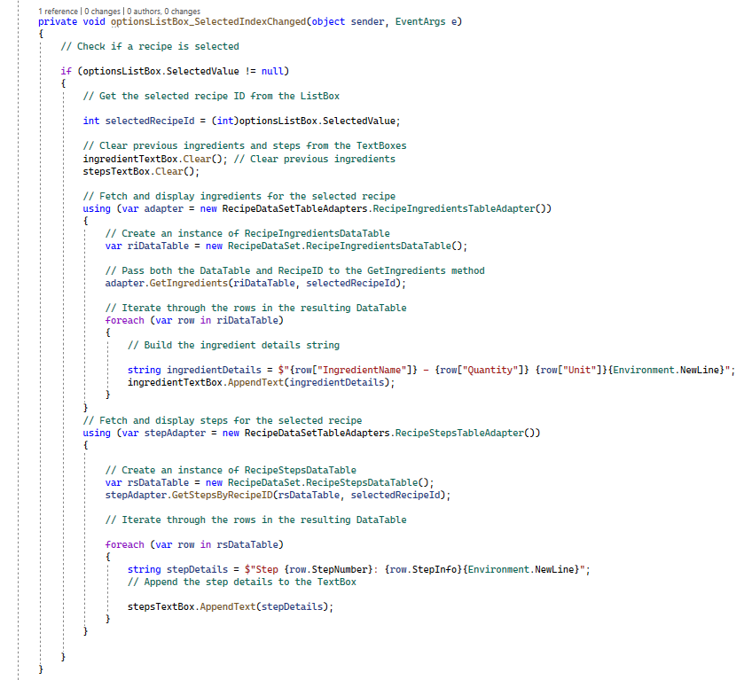
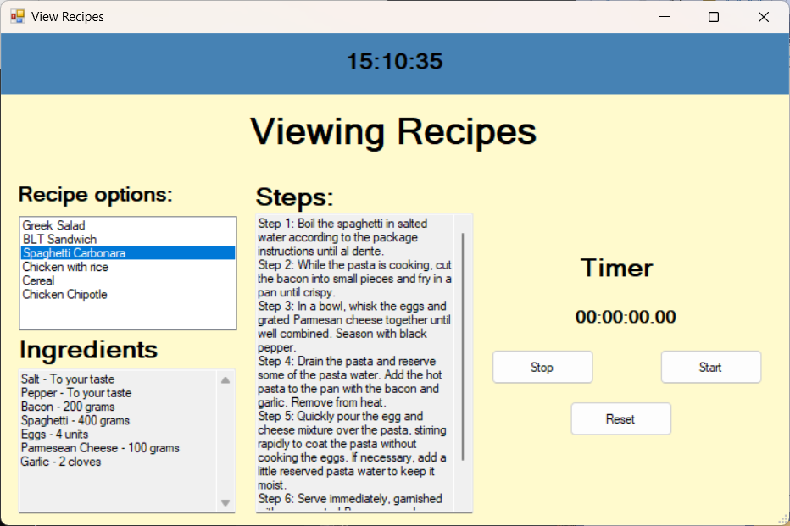
2
3
4
View Form Features

Slide 6
3
4
5
Create Form Features
The create form has two TextBoxes one that allows the user to enter the recipe name and the other allows the user cook time.
The create form also has two different data grid views, one data grid view allows the user to input the step order and the step description. The other data grid view allows the user to input the ingredient as well as the quantity and units.

Slide 7
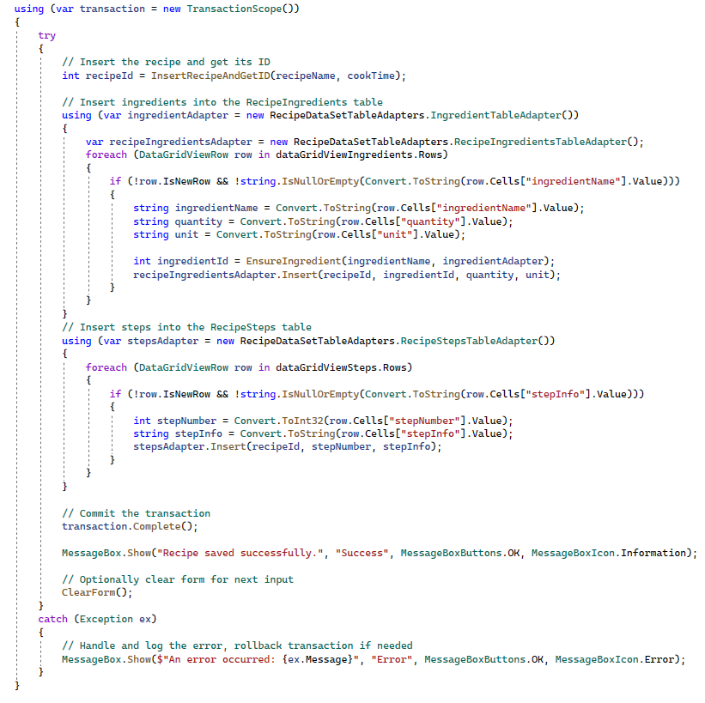
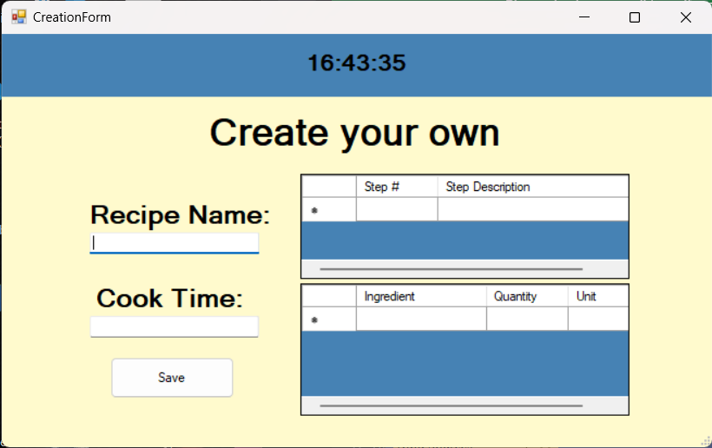
3
4
5
Create Form Features

Slide 8
4
5
6
Modify Form Features
The modify form has a ListBox similar to the one found in the view form. However, this form has two data grid views, one for the steps and their order of the steps, another is for ingredients and their quantity and units.
The modify form has two sets of buttons, one set has the ability to add or delete a step for the selected recipe. The other set has the ability to add or delete an ingredient for the selected recipe.
The modify form also has a button that has the option to remove a recipe from the database entirely.

Slide 9
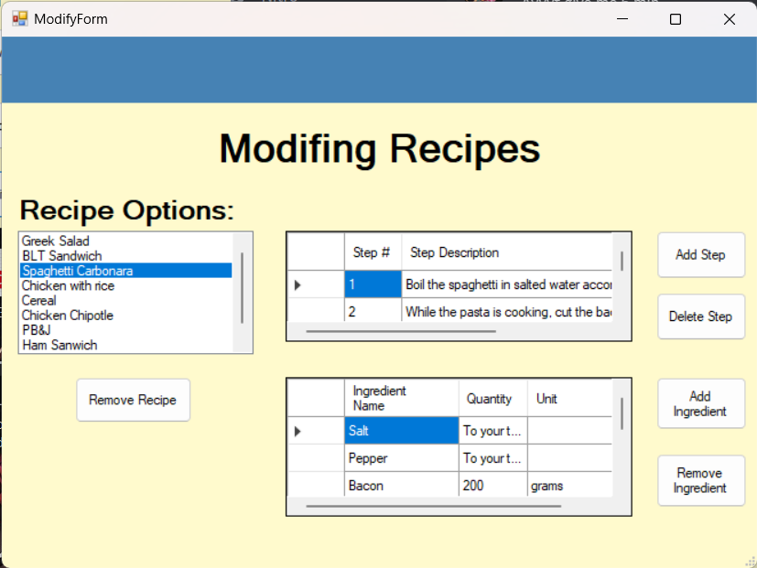
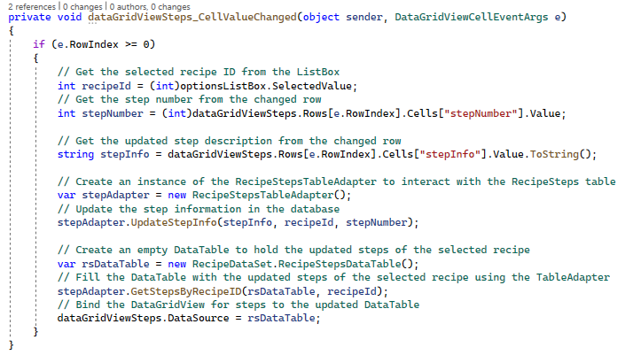
4
5
6
Modify Form Features

Slide 10
5
6
7
Future Enhancements
Some future enhancements are:
Allowing the user to sort the databases.
Make it so that when the user deletes a middle ground step, the rest of the steps auto reorder the order of the steps.
Add background music to the project, to bring more atmosphere.
Add more language compatibility.
Add data grid view compatibility with other languages.
Allow the user to modify the cook time and recipe name.
User Database automatically links correctly to prevent loss data

Slide 11
6
7
8
Project Contribution
Amir: Project Proposal, Designing the forms, SQL commands, Designing the database and its relations, Globalization.
Sen: Project Proposal, Designing the forms, PowerPoint, User Guide, Globalization.
Gennaro: Designing the forms, Designing the database and its relations, PowerPoint, User Guide.

