Slide 1
In the name of God
Database And DBms

Slide 2
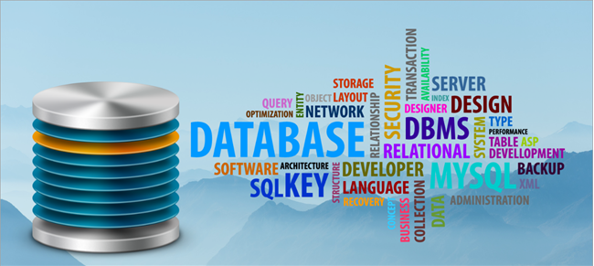
218/

Slide 3
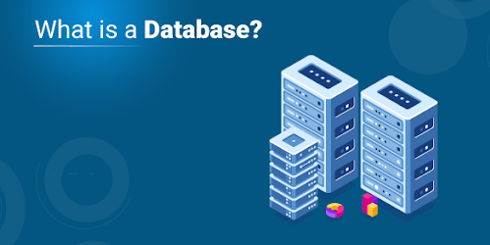
318/

Slide 4
A database is an organized collection of information that is stored together in a specific order and rules. Management of information stored in the database by users is usually done through the database management system. DBMSs provide us with various tools and mechanisms for creating and managing databases.
The concept of databases has been around since the 1960s to reduce the growing problems in designing, building, and maintaining information systems. This concept has evolved with the concept of database management systems that enable effective and efficient manipulation of databases.
418/

Slide 5
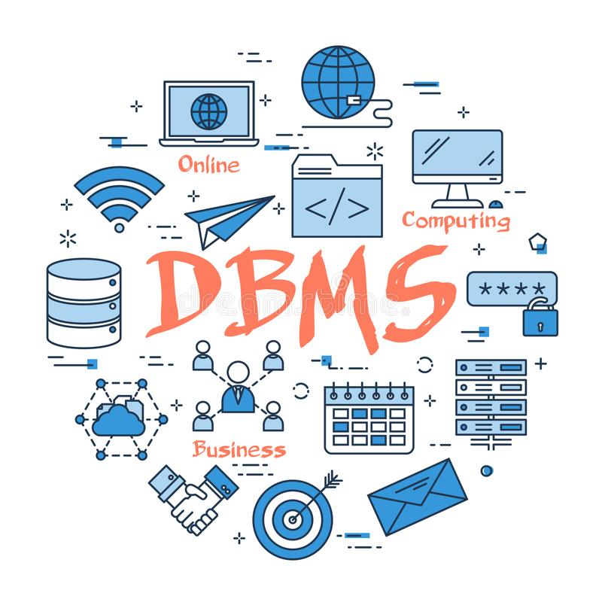
518/

Slide 6
What is DBMS?
Database management system is software that consists of a set of tools and related parts in order to provide the ability to fully manage the information stored in the database. DBMS is a bridge between the database, the user and the application, which is responsible for facilitating communication and interaction between these components.
618/

Slide 7
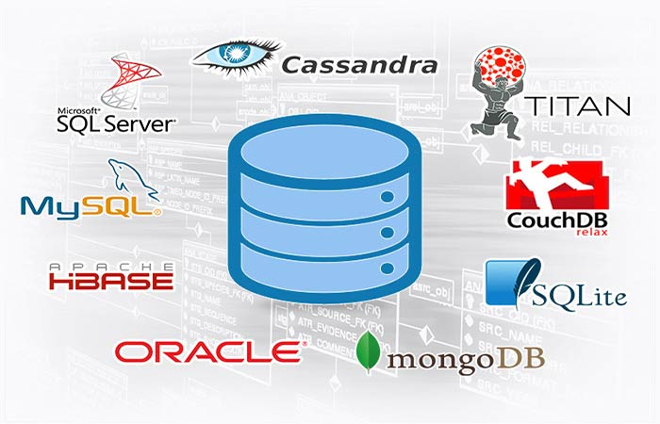
718/

Slide 8
Types of database management systems
Different types of database management systems have been developed in terms of structure and rules for storing information. Each of them is created for a specific purpose that has relative advantages and disadvantages over each other. Each type of DBMS‌ should be used according to the purpose and need that exists.
818/

Slide 9
Hierarchical DBMS : The structure of this system is tree
Network DBMS : This system uses a network structure to store information
Relational DBMS : This system is one of the most widely used database management systems that considers the structure of data as a relationship.
Object Oriented DBMS : In this system, data is considered as an object.
NoSQL : This system is the newest database management system that is used for when the data is not tabular.
918/

Slide 10

1018/

Slide 11
Advantages and disadvantages of database management system
Database management systems have been developed to address the limitations of file storage systems. Of course, these DBMSs have advantages and disadvantages over file storage systems.
1118/

Slide 12
Advantages of using DBMSs:
Ability to quickly access information
Ensure data accuracy and concurrent connectivity
Flexible and scalable
Data processing and review
high security
1218/

Slide 13
Disadvantages of using DBMSs:
In addition to all the advantages that database management systems offer us, there are also disadvantages. These disadvantages that must be considered are:
Complexity in database design
Need to provide hardware and install software
Concentration of stored information
1318/

Slide 14

1418/

Slide 15
Database information management
One of the uses of DBMS is to perform four operations: Create, Update, Read and Delete information. These operations are called CRUD for short. There are several DBMSs for managing database information, each with its own advantages and disadvantages. The following is a list of commonly used DBMSs:
1518/

Slide 16
MySQL
PostgreSQL
SQLite
SQL Server
IBM Db2
Microsoft SQL Server
Oracle Database
MariaDB
Microsoft Access
LibreOffice Base
MongoDB
1618/

Slide 17
Tip :
SQL or Structured Query Language is the language of requesting databases, in other words, the common language among DBMSs.
1718/

Slide 18
Conclusion :
As you can see, database management systems act as a gateway between the database, the user, and the application software. Today, the use of DBMSs is almost inevitable for all programmers and developers. For this reason, every programmer must learn how to work with these systems well in order to be able to easily manage their data and software information by using them.
1818/

Slide 19
The end

