Slide 1

Database
Management
system
Dr. Amir Hammami
Based on Dr. Rihab Mohamed Naceur ABDELKRIM Lecture
1442

Slide 2
RECALL 1
1- Introduction about DBMS
2- Characteristics of the Database Approach
3-Actors on the Scene and Workers behind Scene
4-Advantages of Using the DBMS Approach
5- A Brief History of Database Applications
6- When Not to Use a DBMS

Slide 3
Database Management system
Chapter 2
Database System Concepts and Architecture
1442
3

Slide 4
Outline
1- Data Models, schemas, and Instances
2-Three schemas architecture and data independence
3- Database Languages and interfaces
4- Database System Environment
5-Centralized and client/ server architecture for DBMS.
6- Classification of database Management systems

Slide 5
Outline
1- Data Models, schemas, and Instances
1-1- Data models
1-1-1- Definition
1-1-2- low-level or physical data models
1-1-3- representational (or implementation) data
models
Relational data model
Network and hierarchical models
1-1-4- High-level or conceptual data models
Entity-Relationship model
Object-based data model

Slide 6
1-1- Data models
1-1-1- Definition
Data abstraction generally refers to the suppression of details of data organization and storage, and the highlighting of the essential features for an improved understanding of data.
One of the main characteristics of the database approach is to support data abstraction so that different users can perceive data at their preferred level of detail.
A data model—a collection of concepts that can be used to describe the structure of a database—provides the necessary means to achieve this abstraction.

Slide 7

1-1- Data models
provide concepts that describe the details of how data is stored on the computer storage media, typically magnetic disks.
Concepts provided by low-level data models are generally meant for computer specialists, not for end users.
1-1-3- representational (or implementation)
data models
which provide concepts that may be easily understood by end users
but that are not too far removed from the way data is organized in computer storage.
Representational data models hide many details of data storage
on disk but can be implemented on a computer system directly.
representational (or implementation) data models are the models used most frequently in traditional commercial DBMSs.
These include the widely used:
Relational data model
Network and hierarchical models

Slide 8
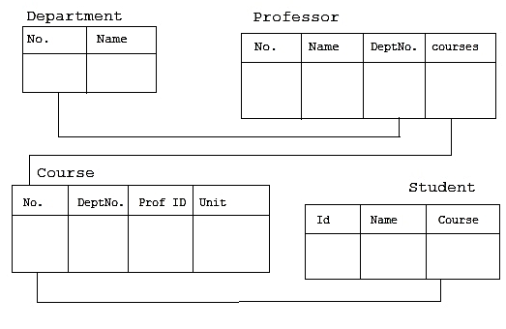
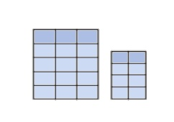
1-1- Data models
Relational data model
The data is stored in two-dimension tables (rows and columns). The data is manipulated based on the rows and columns.
The data is manipulated based on the relational theory of mathematics.
A relational database management system (RDBMS) is a DBMS that is based
Some well known RDBMS; My SQL, Oracle, Microsoft SQL server.

Slide 9
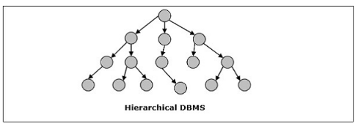
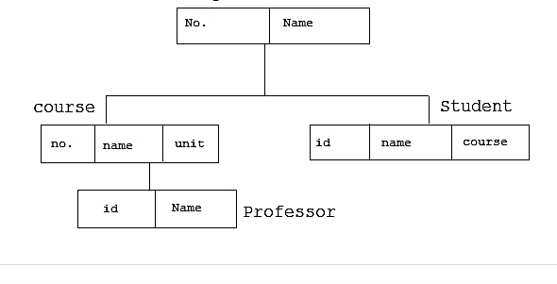
1-1- Data models
Hierarchical model
In this model each entity has only one parent but can have several children .
At the top of hierarchy there is only one entity which is called Root.
Example
Hierarchical model

Slide 10
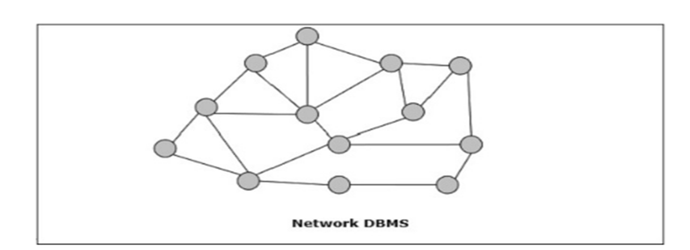
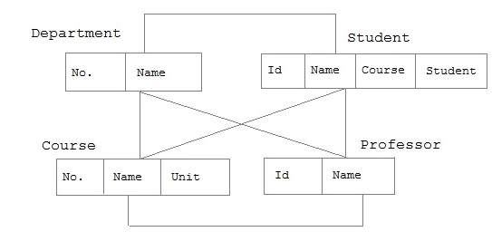
1-1- Data models
Network model
In the network model, entities are organized in a graph, in which some entities can be accessed through several path
Network model

Slide 11
1-1- Data models
1-1-4- High-level or conceptual data models
Conceptual data models use concepts such as entities, attributes, and relationships.
An entity represents a real-world object or concept, such as an employee or a project from the mini world that is described in the database.
An attribute represents some property of interest that further describes an entity, such as the employee’s name or salary.

Slide 12
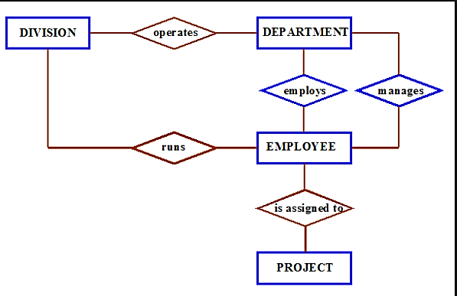
1-1- Data models
A relationship among two or more entities represents an association among the entities, for example, a works-on relationship between an employee and a project.
Entity-Relationship model model—a popular high-level conceptual data model
Object-based data model
It is considered as an example of a new family of higher-level
implementation data models that are closer to conceptual data models.
A standard for object databases called the ODMG object model has been proposed by the Object Data Management Group (ODMG).

Slide 13
1-2- schemas,
and Instances
In any data model, it is important to distinguish between the description of the database and the database itself.
The description of a database is called the database schema, which is specified during database design and is not expected to change frequently.
A displayed schema is called a schema diagram.

Slide 14
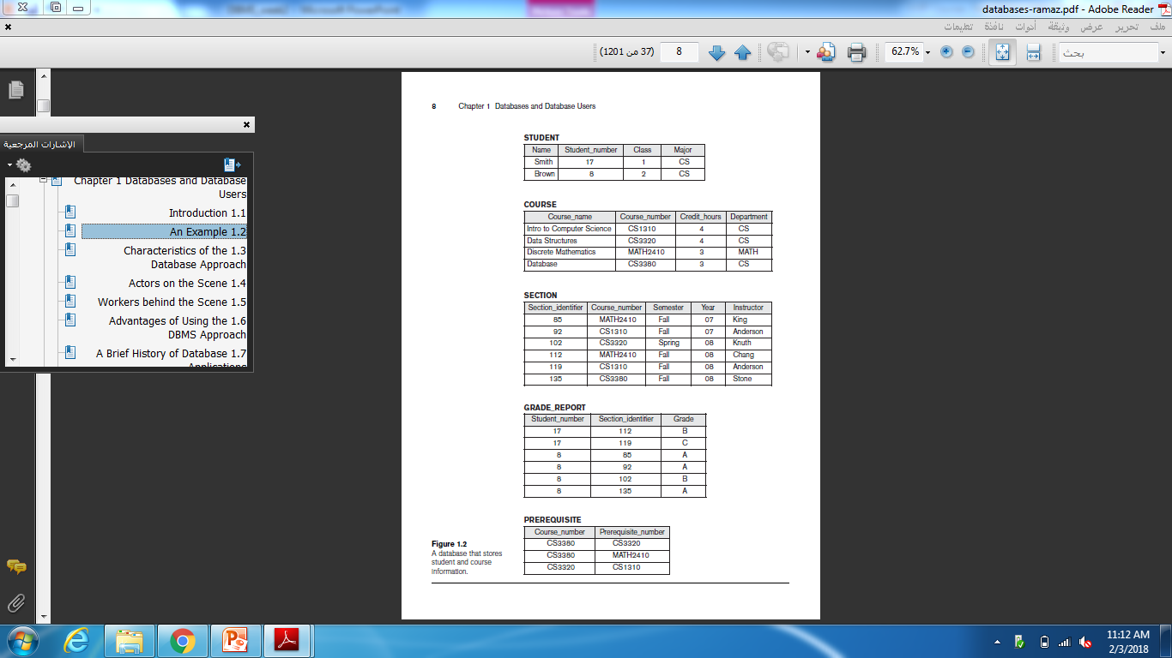
1-2- schemas,
and Instances
Example

Slide 15
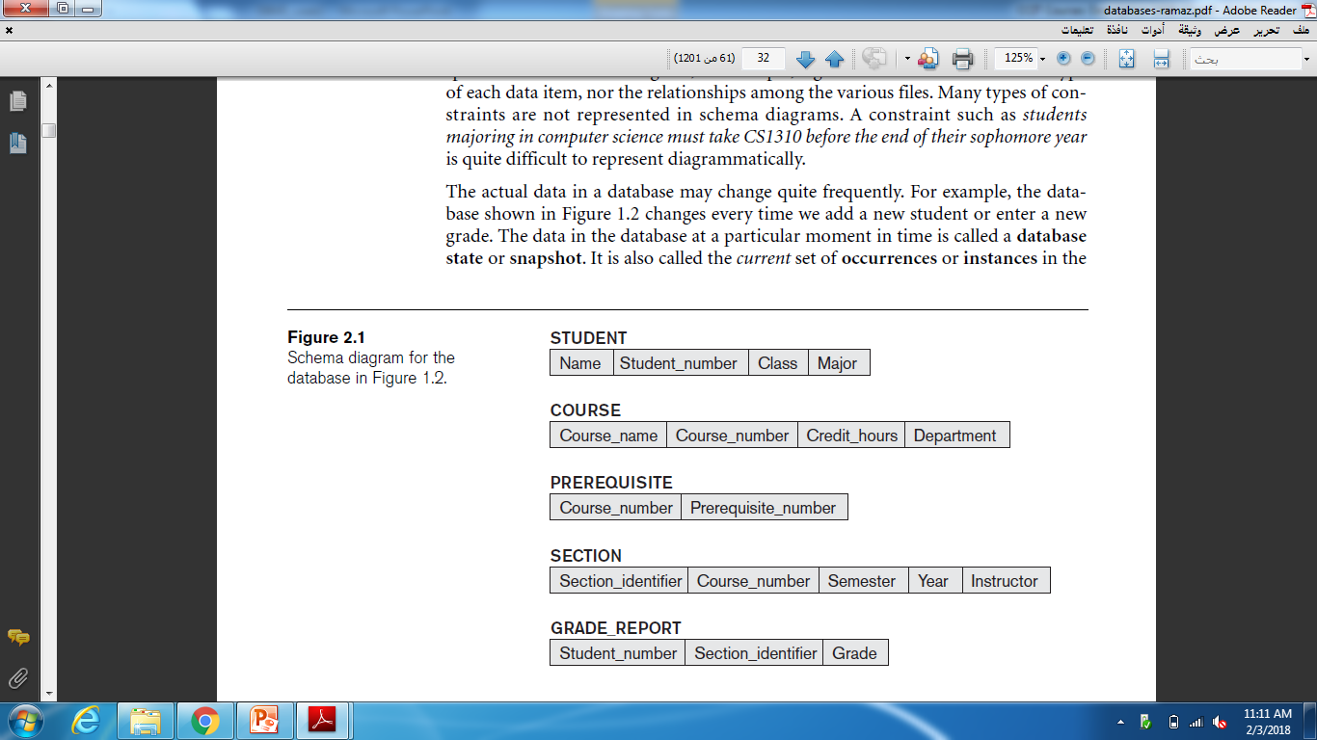
1-2- schemas,
and Instances
Example of schema
We call each object in the schema—such as STUDENT or COURSE—a schema construct.

Slide 16
1-2- schemas,
and Instances
A schema diagram displays only some aspects of a schema, such as the names of record types and data items, and some types of constraints.
Remark 1
Other aspects are not specified in the schema diagram;
for example, Figure 2.1 shows neither the data type of each data item, nor the relationships among the various files.
Many types of constraints are not represented in schema diagrams.
A constraint such as students majoring in computer science must take CS1310 before the end of their sophomore year is quite difficult to represent diagrammatically.

Slide 17
1-2- schemas,
and Instances
Remark 2
The actual data in a database may change quite frequently.
For example, the database shown in Figure 1.2 changes every time we add a new student or enter a new grade.
The data in the database at a particular moment in time is called a database state or snapshot.
It is also called the current set of occurrences or instances in the database.

Slide 18
1-2- schemas,
and Instances
The distinction between database schema and database state is very important.
When we define a new database, we specify its database schema only to the DBMS.
At this point, the corresponding database state is the empty state with no data.
We get the initial state of the database when the database is first populated or loaded with the initial data.

Slide 19
2-Three schemas architecture
and data independence
2-Three schemas architecture and data independence
The three levels are −
Internal Level having Internal Schema − It describes the physical structure, details of internal storage and access paths for the database.
Conceptual Level having Conceptual Schema − It describes the structure of the whole database while hiding the details of physical storage of data. This illustrates the entities, attributes with their data types and constraints, user operations and relationships.
External or View Level having External Schemas or Views − It describes the portion of a database relevant to a particular user or a group of users while hiding the rest of database.

Slide 20
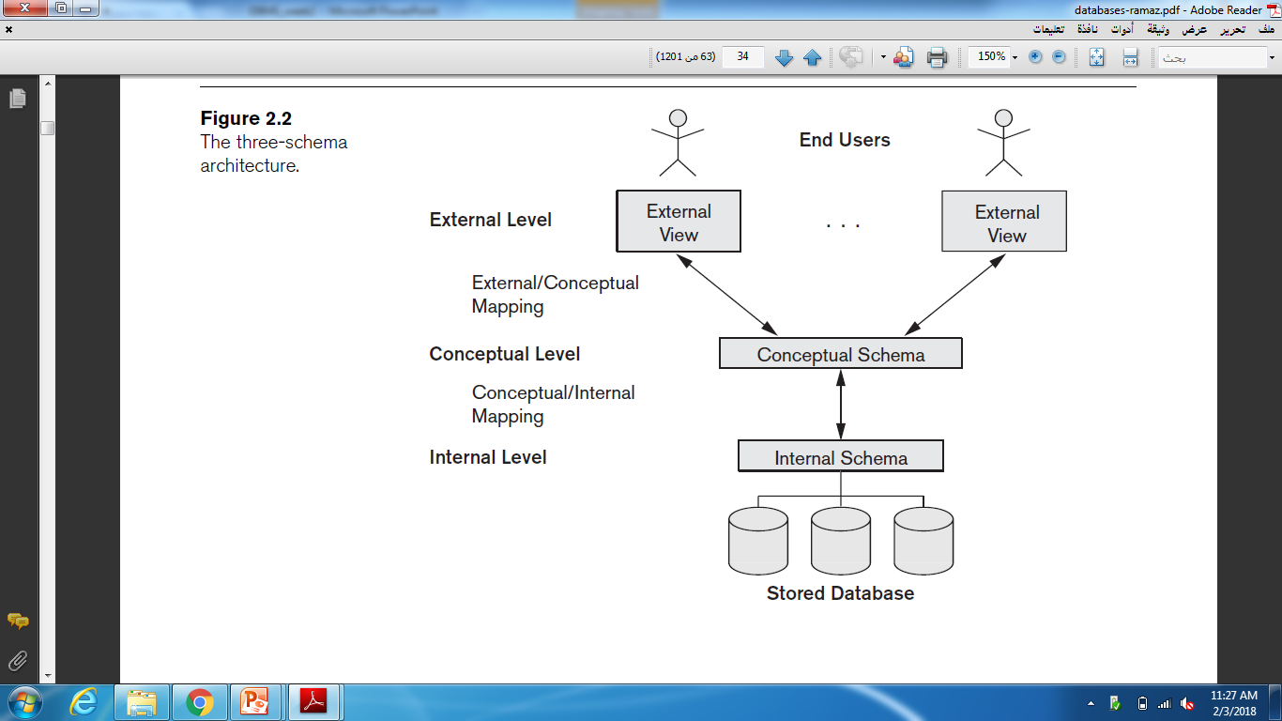
2-Three schemas architecture
and data independence
Remark 3:
The processes of transforming requests and results between levels are
called mappings.

Slide 21
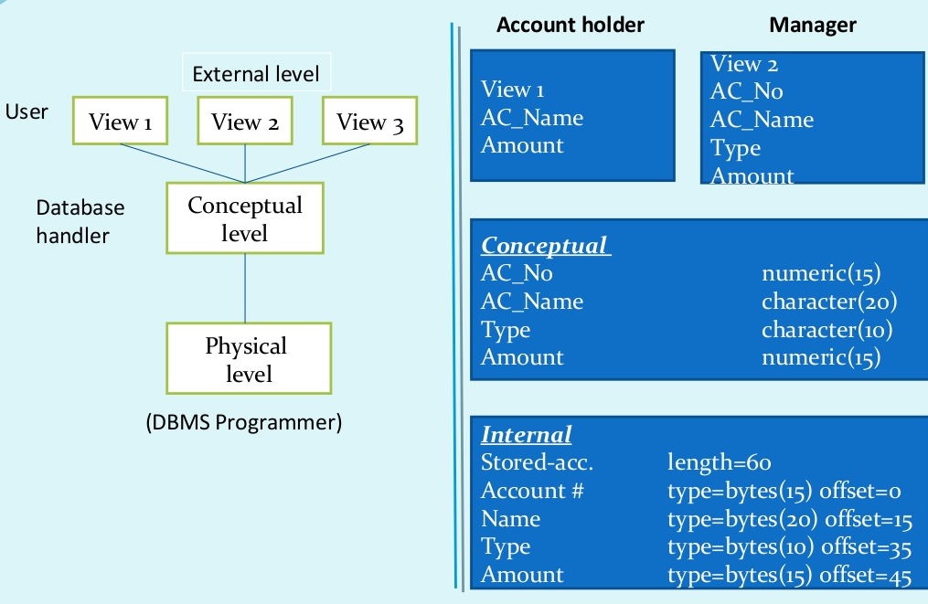
2-Three schemas architecture
and data independence
Example

Slide 22
2-Three schemas architecture
and data independence
Data Independence
The three-schema architecture can be used to further explain the concept of data independence, which can be defined as the capacity to change the schema at one level of a database system without having to change the schema at the next higher level.
We can define two types of data independence:
1- Logical data independence
2- Physical data independence

Slide 23
2-Three schemas architecture
and data independence
1- Logical data independence
Logical data independence is the capacity to change the conceptual schema without having to change external schemas or application programs.
2- Physical data independence
Physical data independence is the capacity to change the internal schema without having to change the conceptual schema.

