Slide 1
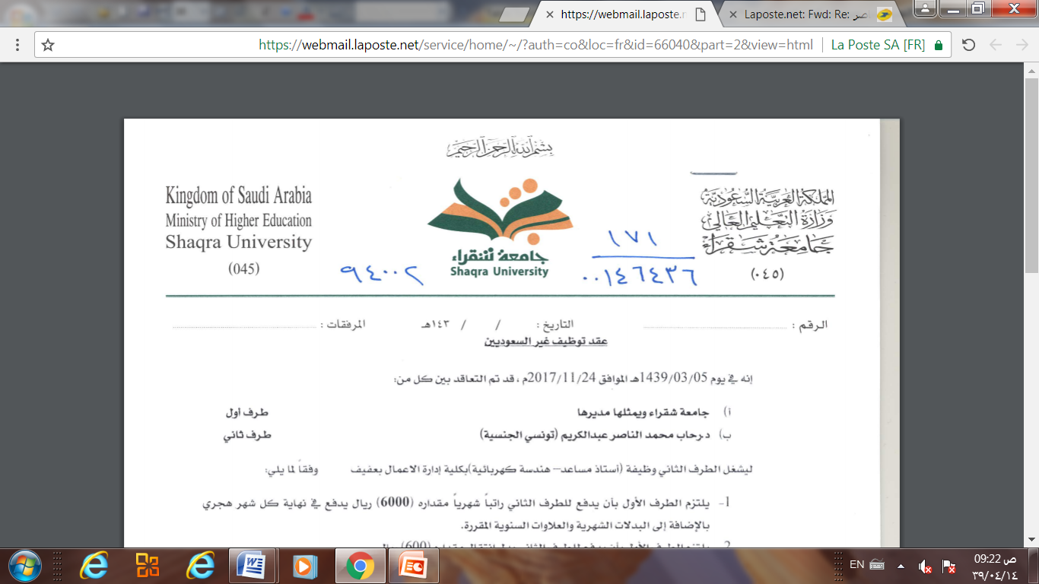
Database
Management
system
Dr. Rihab Mohamed Naceur ABDELKRIM
E-mail: rihab@su.edu.sa
2017 - 2018

Slide 2
Database Management system
Chapter 2
Database System Concepts and Architecture
-Part 2-
2017 - 2018

Slide 3
Outline
1- Data Models, schemas, and Instances
2-Three schemas architecture and data independence
3- Database Languages and interfaces
4- Database System Environment
5-Centralized and client/ server architecture for DBMS.
6- Classification of database Management systems

Slide 4
3- Database Languages
and interfaces
The DBMS must provide appropriate languages and interfaces for each category of users.
In this section we discuss the types of languages and interfaces provided by a DBMS and the user categories targeted by each interface.
3-1- Data Definition Language (DDL):
Data Definition Language (DDL) statements are used to classify the database structure or schema.
It is a type of language that allows the DBA or user to depict and name those entities, attributes, and relationships that are required for the application along with any associated integrity and security constraints.
Here are the lists of tasks that come under DDL:
CREATE - used to create objects in the database
ALTER - used to alters the structure of the database
DROP - used to delete objects from the database
TRUNCATE - used to remove all records from a table, including all spaces allocated for the records are removed
COMMENT - used to add comments to the data dictionary
RENAME - used to rename an object

Slide 5
3- Database Languages
and interfaces
3-2- Storage Definition Language (SDL)
the storage definition language (SDL), is used to specify the internal schema. The mappings between the two schemas may be specified in either one of these languages.
3-3- View definition language (VDL)
For a true three-schema architecture, we would need a third language, the view definition language (VDL), to specify user views and their mappings to the conceptual schema.
Remark
But in most DBMSs the DDL is used to define both conceptual and external schemas.

Slide 6
3- Database Languages
and interfaces
3-4- Data Manipulation Language (DML)
A language that offers a set of operations to support the fundamental data manipulation operations on the data held in the database.
Data Manipulation Language (DML) statements are used to manage data within schema objects.
Here are the lists of tasks that come under DML:
SELECT - It retrieves data from a database
INSERT - It inserts data into a table
UPDATE - It updates existing data within a table
DELETE - It deletes all records from a table, the space for the records remain
MERGE - UPSERT operation (insert or update)
CALL - It calls a PL/SQL or Java subprogram
EXPLAIN PLAN - It explains access path to data
LOCK TABLE - It controls concurrency

Slide 7
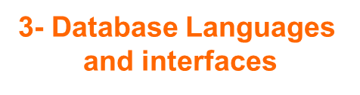
3-5- Transaction Control Language (TCL)
Transaction Control statements are used to run the changes made by DML statements. It allows statements to be grouped together into logical transactions.
COMMIT - It saves the work done
SAVEPOINT - It identifies a point in a transaction to which you can later roll back
ROLLBACK - It restores database to original since the last COMMIT
SET TRANSACTION - It changes the transaction options like isolation level and what rollback segment to use

Slide 8
User-friendly interfaces provided by a DBMS may include the following:
1- Menu-Based Interfaces for
Web Clients or Browsing
2- Forms-Based Interfaces
3- Graphical User Interfaces
4- Natural Language Interfaces
5- Speech Input and Output
6- Interfaces for Parametric Users.
7- Interfaces for the DBA.

Slide 9
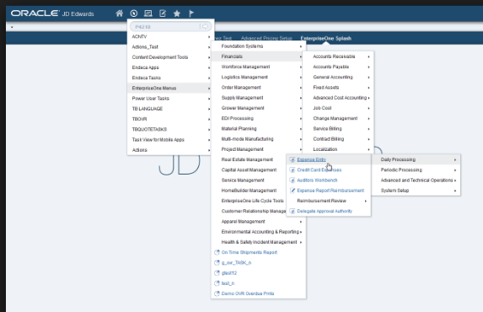
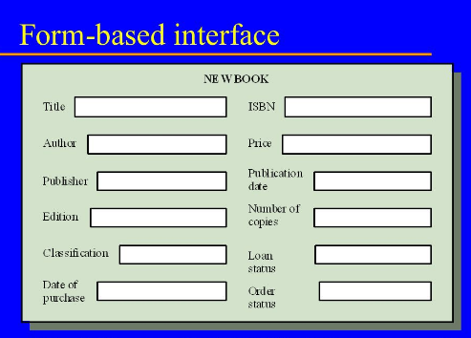
1- Menu-Based Interfaces for Web Clients or Browsing
Present users with list of options (menus)
Lead user through formulation of request
Query is composed of selection options from menu displayed by system.
2- Forms-Based Interfaces
Displays a form to each user.
User can fill out form to insert new data or fill out only certain entries.
Designed and programmed for naïve users as interfaces to canned transactions.

Slide 10
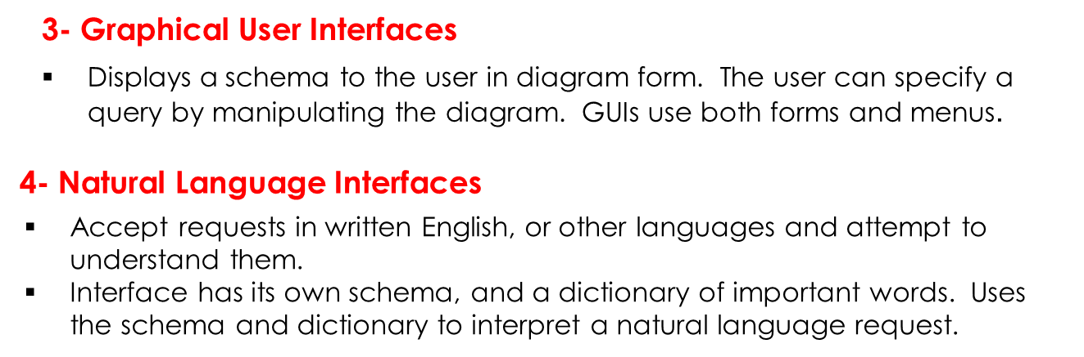
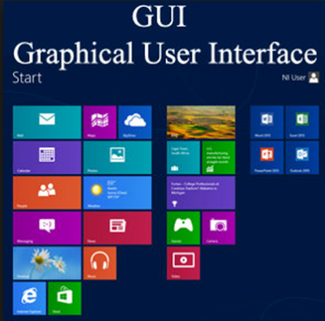
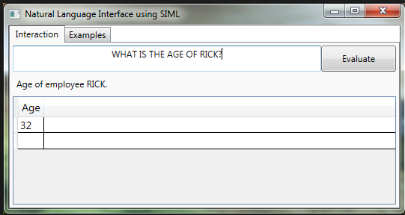

Slide 11
5- Speech Input and Output
Speech input is detected using a library of predefined words
Used to set up the parameters that are supplied to the queries.
For output, a similar conversion from text or numbers into speech takes place.
6- Interfaces for Parametric Users
Parametric users have small set of operations they perform.
Analysts and programmers design and implement a special interface for each class of naïve users.
7- Interfaces for the DBA
Systems contain privileged commands only for DBA staff.
Include commands for creating accounts, setting parameters, authorizing accounts, changing the schema, reorganizing the storage structures etc.

Slide 12
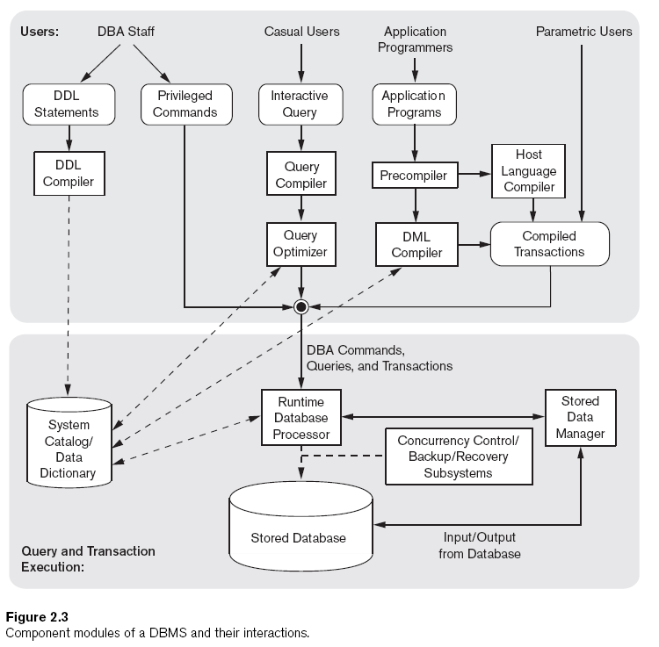
4- Database System
Environment
The figure is divided into two halves.
The top half of the figure refers to the various users of the database environment and their interfaces.
The lower half shows the internals of the DBMS responsible for storage of data and processing of transaction.

Slide 13
DBMS Components Modules
4- Database System
Environment
1- Buffer management : The database and the DBMS catalog are usually stored
on disk. Access to the disk is controlled primarily by the operating system (OS),
which schedules disk read/write. Many DBMSs have their own buffer management
module to schedule Mdisk read/write, because this has a considerable effect on
performance.
Reducing disk read/write improves performance considerably.
2- Stored Data Manager : controls access to DBMS information that is stored on disk, whether it is part of the database or the catalog.
3- DDL compiler : Processes the schema definitions and stores the descriptions
(meta-data) in the catalogue.
4- Interactive query interface : Interface that casual users and persons with occasional need for information from the database interact.
Query compiler : Compiles queries into an internal form. Queries are analyzed and validated for correctness of the query syntax, the names of files and data elements..
Query optimizer : Concerned with the rearrangement and possible reordering of operations, elimination of redundancies, and use of correct algorithms and indexes during execution.

Slide 14
4- Database System
Environment
5- Precompiler : extracts DML commands from an application program written in a host programming language. These commands are sent to the DML compiler for compilation into object code for database access. The rest of the program is sent to the host language compiler.
6- Runtime database processor : executes the privileged commands, the executable query plans and the canned transactions with runtime parameters.
7- System catalog : The catalog includes information such as names and sizes of the sizes of the files, data types of data of data items.
Storage details of each file, mapping information among schemas and constraints.
8- Concurrency control system and Backup and recovery system
They are integrated into the working of the runtime database processor for purposes of transaction management.

Slide 15
4-2-Database System Utilities
4- Database System
Environment
In addition to possessing the software modules just described, most DBMSs have database utilities that help the DBA manage the database system.
Common utilities have the following types of functions:
1- Loading
Load existing data files such as text files or sequential files into the database.
2- Backup
Creates a backup copy of the database, usually by dumping the entire database onto tape or other mass storage medium.
Restore the database in case of catastrophic disk failure.
3- Database storage reorganization
Reorganize a set of database files into different file organizations, and create new access paths to improve performance.
4- Performance monitoring
Monitors database usage and provides statistics to the DBA. DBA uses the statistics for decision-making.

Slide 16
4-3-Tools, Application Environments, and Communications Facilities
4- Database System
Environment
1- CASE tools
CASE tools are used in the design phase of database systems.
2- Data Dictionary
Store catalog information about schemas and constraints, as well as design decisions, usage standards, application program descriptions, user information. Also called an information repository. Can be accesses directly by DBA or users when needed.
3- Application Development Environments (i.e. PowerBuilder)
Provide an environment for developing database applications and include facilities that help in many facets of database systems, including database design, GUI development, querying and updating, and application program development.
4- Communications software
Allow users at remote locations to access the database through computer terminals, workstations or personal computers. Connected to the database through data communications hardware such as phone lines, local area networks etc

Slide 17

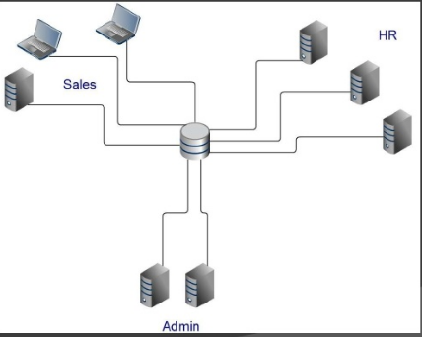
5- Architecture for
DBMS
The design of a DBMS depends on its architecture.
5- 1- Centralized architecture for DBMS
A simple central database accessed by multiple users.
Easier to organize and edit query.
But it can be slower because of high usage and load

Slide 18
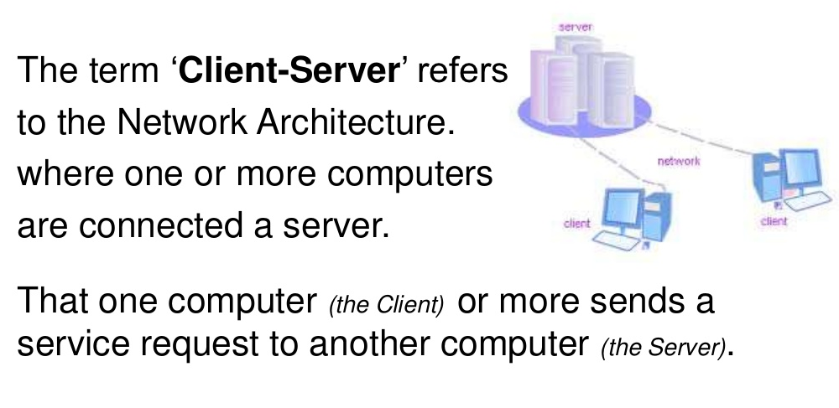
5- Architecture for
DBMS
5- 2- Basic Client/Server Architectures

Slide 19
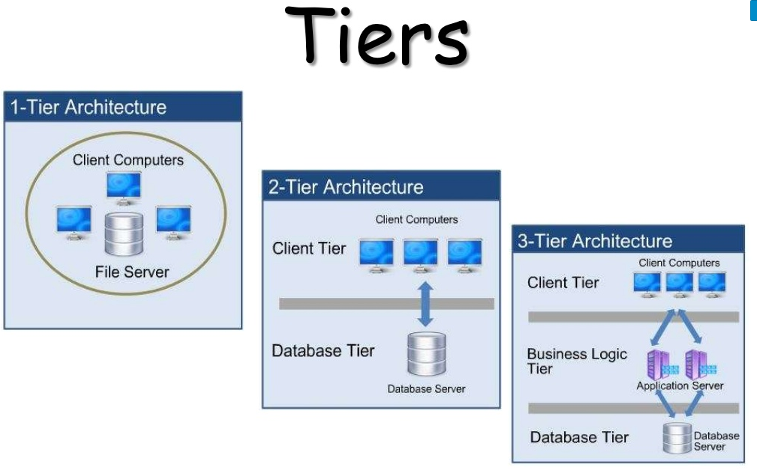
5- Architecture for
DBMS
5- 2- Basic Client/Server Architectures

Slide 20
5- Architecture for
DBMS
In 1-tier architecture, the DBMS is the only entity where the user directly sits on the DBMS and uses it. Any changes done here will directly be done on the DBMS itself. It does not provide handy tools for end-users. Database designers and programmers normally prefer to use single-tier architecture.
If the architecture of DBMS is 2-tier, then it must have an application through which the DBMS can be accessed. Programmers use 2-tier architecture where they access the DBMS by means of an application. Here the application tier is entirely independent of the database in terms of operation, design, and programming.

Slide 21
3-tier Architecture
5- Architecture for
DBMS
Database (Data) Tier
At this tier, the database resides along with its query processing languages.
We also have the relations that define the data and their constraints at this level.

Slide 22
3-tier Architecture
5- Architecture for
DBMS
Application (Middle) Tier
At this tier reside the application server and the programs that access the database.
For a user, this application tier presents an abstracted view of the database.
End-users are unaware of any existence of the database beyond the application.
At the other end, the database tier is not aware of any other user beyond the application tier.
Hence, the application layer sits in the middle and acts as a mediator between the end-user and the database.

Slide 23
3-tier Architecture
5- Architecture for
DBMS
User (Presentation) Tier
End-users operate on this tier and they know nothing about any existence of the database beyond this layer.
At this layer, multiple views of the database can be provided by the application.
All views are generated by applications that reside in the application tier.

Slide 24
6- Classification of database Management systems
Database management systems can be classified based on several criteria:
Based on the data model
The most popular data model in use today is the relational data model. Well-known DBMSs like Oracle, MS SQL Server, DB2 and MySQL support this model. Other traditional models, such as hierarchical data models and network data models, are still used in industry mainly on mainframe platforms.
In recent years, the newer object-oriented data models were introduced. This model is a database management system in which information is represented in the form of objects as used in object-oriented programming..

Slide 25
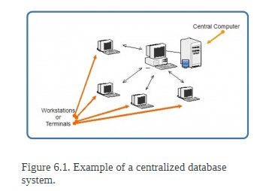
6- Classification of database Management systems
Based on the number of users
A DBMS can be classification based on the number of users it supports. It can be a single-user database system, which supports one user at a time, or a multiuser database system, which supports multiple users concurrently.
Based on the number of sites
There are four main distribution systems for database systems and these, in turn, can be used to classify the DBMS.
1. Centralized database system
The DBMS and database are stored at the single site that is used by several other systems too. We can simply say that data here is maintained on the centralized server.

Slide 26
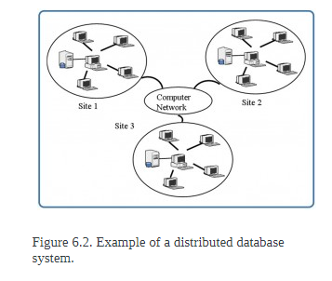
6- Classification of database Management systems
2. Distributed database system
In a distributed database system, the actual database and the DBMS software are distributed from various sites that are connected by a computer network.
Further they are classified as
2.1. Homogeneous distributed DBMS
They use same software but from the multiple sites. Data exchange between the sites can be handled easily.
2.2. Heterogeneous distributed DBMS
They use different DBMS software for different sites but there is a additional software that helps the exchange of the data between the sites.

Slide 27
6- Classification of database Management systems
Based on the cost
Low cost DBMS
The cost of these systems vary from $100 to $3000.
Medium cost DBMS
Cost varies from $10000 to $100000.
High cost DBMS
Cost of these systems are usually more than $100000.

Slide 28
Do you have any questions ???
???

