Slide 1
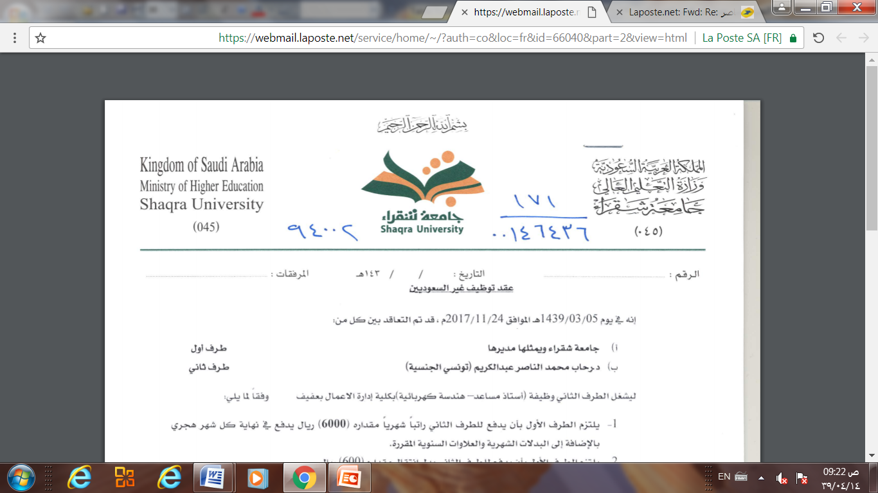
Database Management system
Lecture 9
Transaction Processing
Dr. Rihab Mohamed Naceur ABDELKRIM
E-mail: rihab@su.edu.sa
2017 - 2018

Slide 2
Outline
1- What is a transaction.
2- ACID properties.
3- Serializability.
4- Equivalence schedules.
5- States of transactions.
6- Transactions control commands.

Slide 3

Transaction
A transaction can be defined as a group of tasks.
A single task is the minimum processing unit which cannot be divided further.

Slide 4
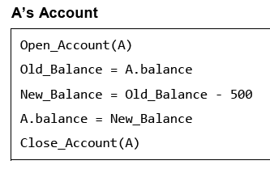
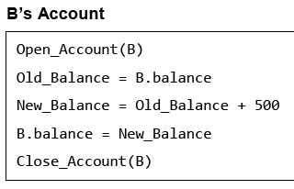
transaction
Example:
Let’s take an example of a simple transaction. Suppose a bank employee transfers Rs 500 from A's account to B's account. This very simple and small transaction involves several low-level tasks.

Slide 5
ACID Properties
A transaction is a very small unit of a program and it may contain several low level tasks.
A transaction in a database system must maintain Atomicity, Consistency, Isolation, and Durability, commonly known as ACID properties.
In order to ensure accuracy, completeness, and data integrity.

Slide 6
ACID properties : Atomicity
Atomicity
This property states that a transaction must be treated as an atomic unit, that is, either all of its operations are executed or none.
There must be no state in a database where a transaction is left partially completed.
States should be defined either before the execution of the transaction or after the execution/failure of the transaction.

Slide 7
Acid properties: consistency
Consistency:
The database must remain in a consistent state after any transaction.
No transaction should have any negative effect on the data residing in the database.
If the database was in a consistent state before the execution of a transaction, it must remain consistent after the execution of the transaction as well.

Slide 8
Acid properties : isolation
Isolation
In a database system where more than one transaction are being executed simultaneously and in parallel, the property of isolation states that all the transactions will be carried out and executed as if it is the only transaction in the system.
No transaction will affect the existence of any other transaction.

Slide 9
Acid properties : durability
Durability
The database should be durable enough to hold all its latest updates even if the system fails or restarts.
If a transaction updates a chunk of data in a database and commits, then the database will hold the modified data.
If a transaction commits but the system fails before the data could be written on to the disk, then that data will be updated once the system springs back into action.

Slide 10
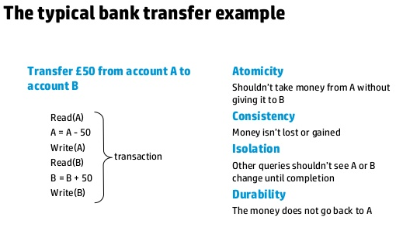
Example

Slide 11
Serializability
When multiple transactions are being executed by the operating system in a multiprogramming environment, there are possibilities that instructions of one transaction are interleaved with some other transaction.
Schedule
Serial schedule

Slide 12
Serializability
Schedule
A chronological execution sequence of a transaction is called a schedule.
A schedule can have many transactions in it, each comprising of a number of instructions/tasks.

Slide 13
Serializability
Serial Schedule
It is a schedule in which transactions are aligned in such a way that one transaction is executed first.
When the first transaction completes its cycle, then the next transaction is executed.
Transactions are ordered one after the other.
This type of schedule is called a serial schedule, as transactions are executed in a serial manner.

Slide 14
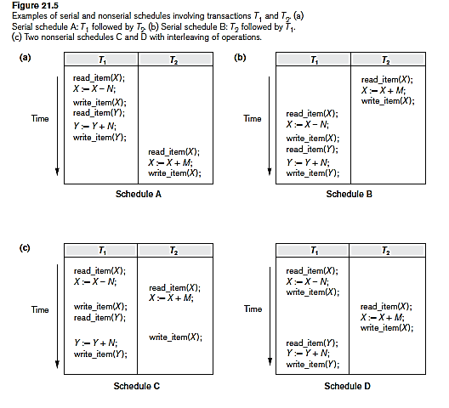
Serializability
Example

Slide 15
Equivalence schedules
An equivalence schedule can be of the following types:
If two schedules produce the same result after execution, they are said to be result equivalent.
They may yield the same result for some value and different results for another set of values.
That's why this equivalence is not generally considered significant.

Slide 16
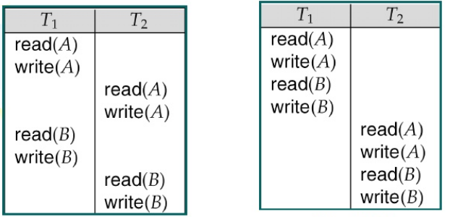
example

Slide 17
Equivalence schedules
View Equivalence
Two schedules would be view equivalence if the transactions in both the schedules perform similar actions in a similar manner.
For example:
If T reads the initial data in S1, then it also reads the initial data in S2.
If T reads the value written by J in S1, then it also reads the value written by J in S2.
If T performs the final write on the data value in S1, then it also performs the final write on the data value in S2.

Slide 18
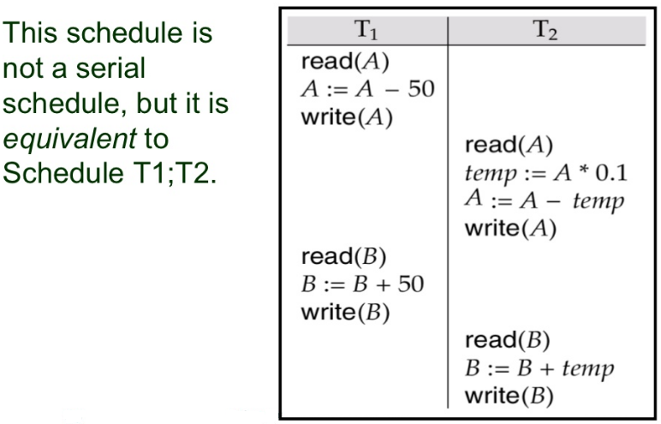
example

Slide 19
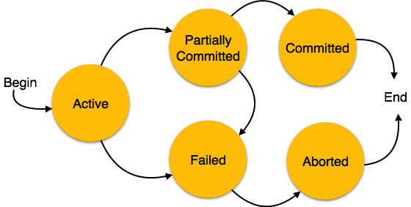
States of transactions
A transaction in a database can be in one of the following states:

Slide 20
States of transactions
Active: In this state, the transaction is being executed. This is the initial state of every transaction.
Partially Committed: When a transaction executes its final operation, it is said to be in a partially committed state.
Failed: A transaction is said to be in a failed state if any of the checks made by the database recovery system fails. A failed transaction can no longer proceed further.

Slide 21
States of transactions
Aborted: If any of the checks fails and the transaction has reached a failed state, then the recovery manager rolls back all its write operations on the database to bring the database back to its original state where it was prior to the execution of the transaction.
Transactions in this state are called aborted.
The database recovery module can select one of the two operations after a transaction aborts:
Re-start the transaction
Kill the transaction

Slide 22
States of transactions
Committed: If a transaction executes all its operations successfully, it is said to be committed.
All its effects are now permanently established on the database system.

Slide 23
Transactional control commands
Transactional control commands are only used with the DML Commands such as INSERT, UPDATE and DELETE only.
cannot be used while creating tables or dropping them because these operations are automatically committed in the database.
The COMMIT Command.
The ROLLBACK Command.
The SAVEPOINT Command.

Slide 24
The commit command
The COMMIT command is the transactional command used to save changes invoked by a transaction to the database.
The COMMIT command saves all the transactions to the database since the last COMMIT or ROLLBACK command.
The syntax for the COMMIT command is as follows:

Slide 25
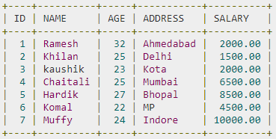
The commit command: example
Consider the CUSTOMERS table having the following records:

Slide 26

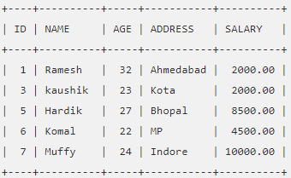
The commit command: example
Following is an example which would delete those records from the table which have age = 25 and then COMMIT the changes in the database.
Thus, two rows from the table would be deleted and the SELECT statement would produce the following result.

Slide 27
The rollback command
The ROLLBACK command is the transactional command used to undo transactions that have not already been saved to the database.
This command can only be used to undo transactions since the last COMMIT or ROLLBACK command was issued.
The syntax for a ROLLBACK command is as follows :

Slide 28
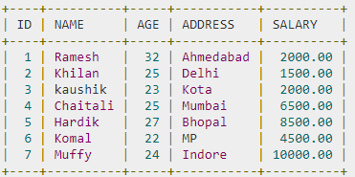
The rollback command: example
Consider the CUSTOMERS table having the following records :

Slide 29

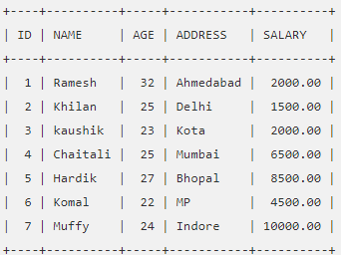
The rollback command: example
Following is an example, which would delete those records from the table which have the age = 25 and then ROLLBACK the changes in the database.
Thus, the delete operation would not impact the table and the SELECT statement would produce the following result.

Slide 30
The savepoint command
A SAVEPOINT is a point in a transaction when you can roll the transaction back to a certain point without rolling back the entire transaction.
The syntax for a SAVEPOINT command is as shown below:
This command serves only in the creation of a SAVEPOINT among all the transactional statements. The ROLLBACK command is used to undo a group of transactions.
The syntax for rolling back to a SAVEPOINT is as shown below:

Slide 31
The savepoint command
Following is an example where you plan to delete the three different records from the CUSTOMERS table.
You want to create a SAVEPOINT before each delete, so that you can ROLLBACK to any SAVEPOINT at any time to return the appropriate data to its original state.

Slide 32
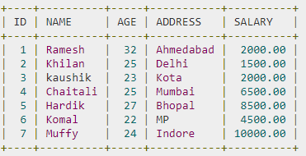
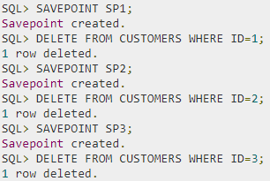
The savepoint command : example
Consider the CUSTOMERS table having the following records.
The following code block contains the series of operations.

Slide 33

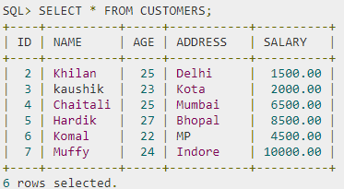
The savepoint command : example
Now that the three deletions have taken place, let us assume that you have changed your mind and decided to ROLLBACK to the SAVEPOINT that you identified as SP2. Because SP2 was created after the first deletion, the last two deletions are undone :
Notice that only the first deletion took place since you rolled back to SP2.

Slide 34
The release savepoint command
The RELEASE SAVEPOINT command is used to remove a SAVEPOINT that you have created.
The syntax for a RELEASE SAVEPOINT command is as follows:
Once a SAVEPOINT has been released, you can no longer use the ROLLBACK command to undo transactions performed since the last SAVEPOINT.

Slide 35
The set transaction command
The SET TRANSACTION command can be used to initiate a database transaction.
This command is used to specify characteristics for the transaction that follows.
For example, you can specify a transaction to be read only or read write.
The syntax for a SET TRANSACTION command is as follows:

