Slide 1

Database Management system
Lecture 5
More Complex SQL Retrieval Queries
Dr. Amir Hammami
Based on Dr. Rihab Mohamed Naceur ABDELKRIM Lectures
1442

Slide 2
Recall of lecture 4
1-SQL Data Definition and Data Types
2-Specifying Constraints in SQL
3- Basic Retrieval Queries in SQL
4-INSERT, DELETE, and UPDATE Statements
in SQL
5- Additional Features of SQL

Slide 3
Outline
1- More Complex SQL Retrieval Queries
2- Specifying Constraints as Assertions and Actions as Triggers
3- Views (Virtual Tables) in SQL
4-Schema Change Statements in SQL

Slide 4
1- More Complex SQL Retrieval Queries
1.1 Comparisons Involving NULL and Three-Valued Logic
1.2 Nested Queries, Tuples, and Set/Multiset Comparisons
1.3 Correlated Nested Queries
1.4 The EXISTS and UNIQUE Functions in SQL
1.5 Explicit Sets and Renaming of Attributes in SQL
1.6 Joined Tables in SQL and Outer Joins
1.7 Aggregate Functions in SQL
1.8 Grouping: The GROUP BY and HAVING Clauses

Slide 5
1- More Complex SQL Retrieval Queries
Additional features allow users to specify more complex retrievals from database:
Nested queries,
joined tables,
outer joins,
aggregate functions,
and grouping

Slide 6
1.1 Comparisons Involving NULL and Three-Valued Logic
Meanings of NULL
Unknown value
Unavailable or withheld value
Not applicable attribute
Each individual NULL value considered to be different from every other NULL value
SQL uses a three-valued logic:
TRUE, FALSE, and UNKNOWN

Slide 7
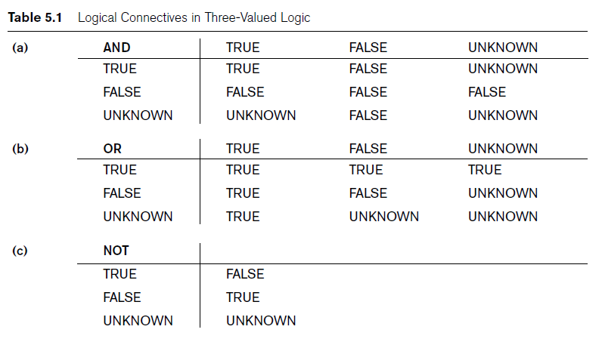
1.1 Comparisons Involving NULL and Three-Valued Logic

Slide 8

1.1 Comparisons Involving NULL and Three-Valued Logic
SQL allows queries that check whether an attribute value is NULL
IS NULL or IS NOT NULL
Example

Slide 9
1.2 Nested Queries, Tuples, and Set/Multiset Comparisons
Nested queries
Complete select-from-where blocks within WHERE clause of another query
Outer query
Comparison operator IN
Compares value v with a set (or multiset) of values V
Evaluates to TRUE if v is one of the elements in V

Slide 10
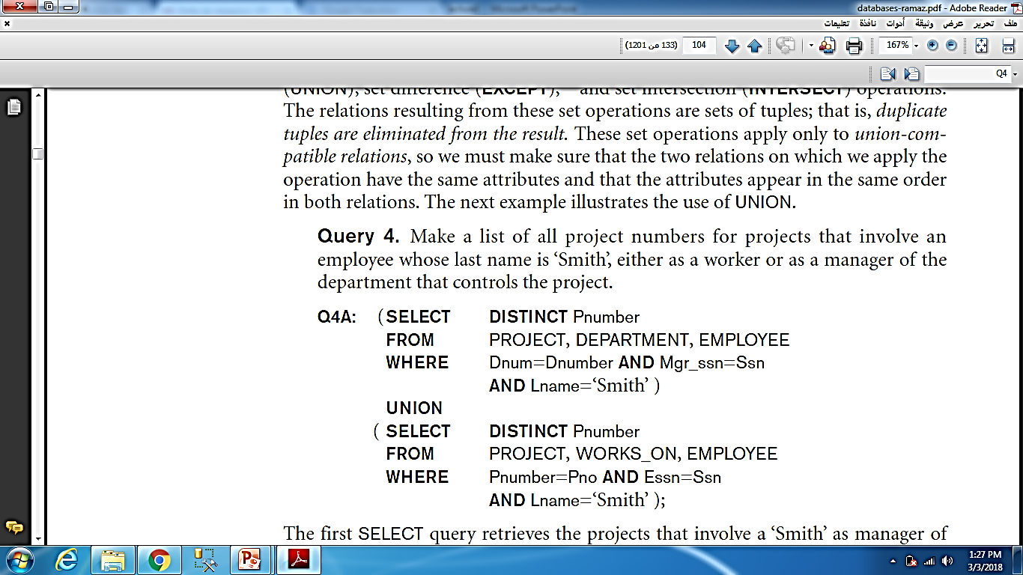
1.2 Nested Queries, Tuples, and Set/Multiset Comparisons
Example
The first SELECT query retrieves the projects that involve a ‘Smith’ as manager of the department that controls the project, and the second retrieves the projects that involve a ‘Smith’ as a worker on the project.
Notice that if several employees have the last name ‘Smith’, the project names involving any of them will be retrieved.
Applying the UNION operation to the two SELECT queries gives the desired result.

Slide 11
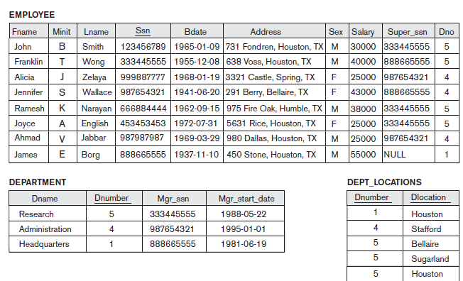
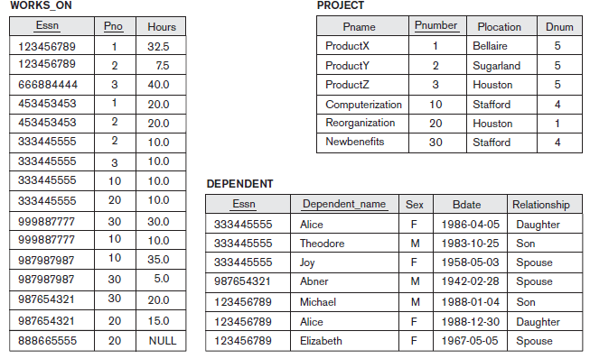

Slide 12
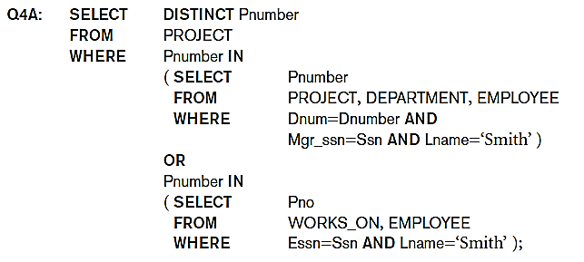
1.2 Nested Queries, Tuples, and Set/Multiset Comparisons
Example
Query 4 is formulated in Q4 without a nested query, but it can be rephrased to use nested queries as shown in Q4A
Outer query

Slide 13
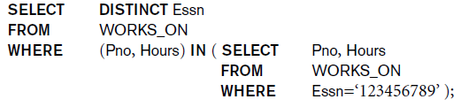
1.2 Nested Queries, Tuples, and Set/Multiset Comparisons
Use tuples of values in comparisons
Place them within parentheses
Example
This query will select the Essns of all employees who work the same (project, hours) combination on some project that employee ‘John Smith’ (whose Ssn = ‘123456789’) works on.
In this example, the IN operator compares the subtuple of values in parentheses (Pno, Hours) within each tuple in WORKS_ON with the set of type-compatible tuples produced by the nested query.

Slide 14
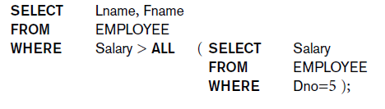
1.2 Nested Queries, Tuples, and Set/Multiset Comparisons
Use other comparison operators to compare a single value v
= ANY (or = SOME) operator
Returns TRUE if the value v is equal to some value in the set V and is hence equivalent to IN
Other operators that can be combined with ANY (or SOME): >, >=, <, <=, and <>
Example
An example is the following query, which returns the names of employees whose salary is greater than the salary of all the employees in department 5:

Slide 15
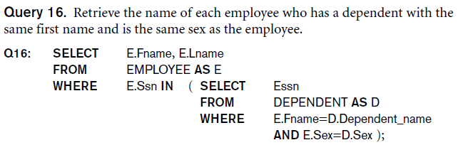
1.2 Nested Queries, Tuples, and Set/Multiset Comparisons
Avoid potential errors and ambiguities
Create tuple variables (aliases) for all tables referenced in SQL query
Example

Slide 16
1.3 Correlated Nested Queries
Correlated nested query
Evaluated once for each tuple in the outer query

Slide 17
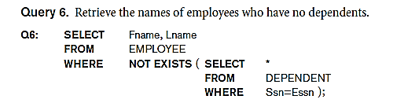
1.4 The EXISTS and UNIQUE Functions in SQL
EXISTS function
Check whether the result of a correlated nested query is empty or not
EXISTS and NOT EXISTS
Typically used in conjunction with a correlated nested query
SQL function UNIQUE(Q)
Returns TRUE if there are no duplicate tuples in the result of query Q

Slide 18


1.5 Explicit Sets and Renaming of Attributes in SQL
Can use explicit set of values in WHERE clause
Use qualifier AS followed by desired new name
Rename any attribute that appears in the result of a query
Examples

Slide 19

1.6 Joined Tables in SQL and Outer Joins
Joined table
Permits users to specify a table resulting from a join operation in the FROM clause of a query
The FROM clause in Q1A
Contains a single joined table
Example
For example, consider query Q1, which retrieves the name and address of every employee who works for the ‘Research’ department. It may be easier to specify the join of the EMPLOYEE and DEPARTMENT relations first, and then to select the desired tuples and attributes. This can be written in SQL as in Q1A:

Slide 20
1.6 Joined Tables in SQL and Outer Joins
Specify different types of join
NATURAL JOIN
Various types of OUTER JOIN
NATURAL JOIN on two relations R and S
No join condition specified
Implicit EQUIJOIN condition for each pair of attributes with same name from R and S

Slide 21
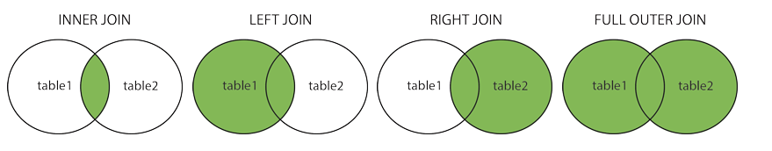
1.6 Joined Tables in SQL and Outer Joins
Inner join
Default type of join in a joined table
Tuple is included in the result only if a matching tuple exists in the other relation
LEFT OUTER JOIN
Every tuple in left table must appear in result
If no matching tuple
Padded with NULL values for attributes of right table

Slide 22
1.6 Joined Tables in SQL and Outer Joins
RIGHT OUTER JOIN
Every tuple in right table must appear in result
If no matching tuple
Padded with NULL values for the attributes of left table
FULL OUTER JOIN
Can nest join specifications

Slide 23
1.7 Aggregate Functions in SQL
Used to summarize information from multiple tuples into a single-tuple summary.
Grouping
Create subgroups of tuples before summarizing
Built-in aggregate functions
COUNT, SUM, MAX, MIN, and AVG
Functions can be used in the SELECT clause or in a HAVING clause

Slide 24
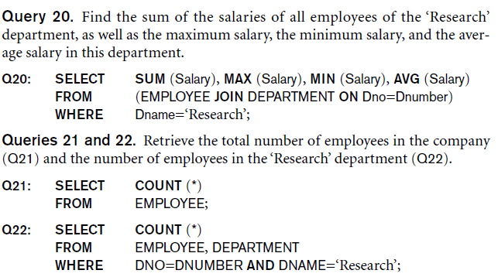
1.7 Aggregate Functions in SQL
NULL values discarded when aggregate functions are applied to a particular column
Example

Slide 25
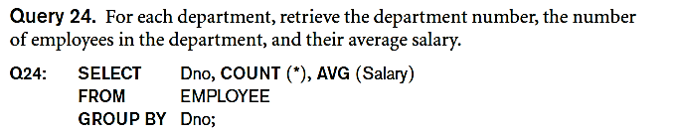
1.8 Grouping: The GROUP BY and HAVING Clauses
Partition relation into subsets of tuples
Based on grouping attribute(s)
Apply function to each such group independently
GROUP BY clause
Specifies grouping attributes

Slide 26
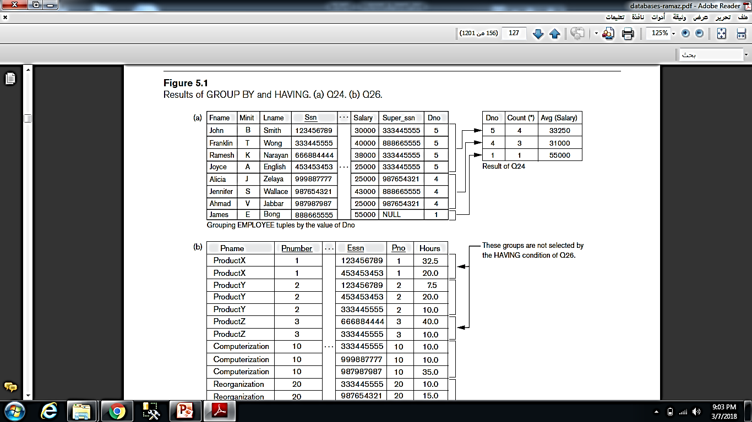
1.8 Grouping: The GROUP BY and HAVING Clauses
If NULLs exist in grouping attribute
Separate group created for all tuples with a NULL value in grouping attribute

Slide 27
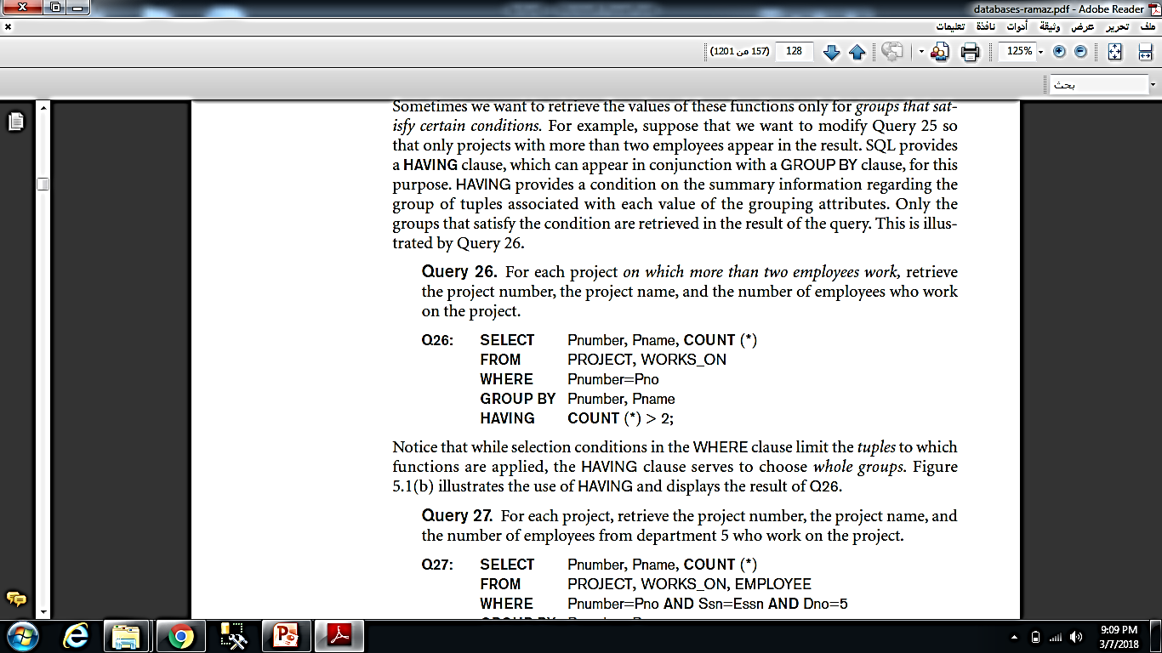
1.8 Grouping: The GROUP BY and HAVING Clauses
HAVING clause
Provides a condition on the summary information
Example

Slide 28
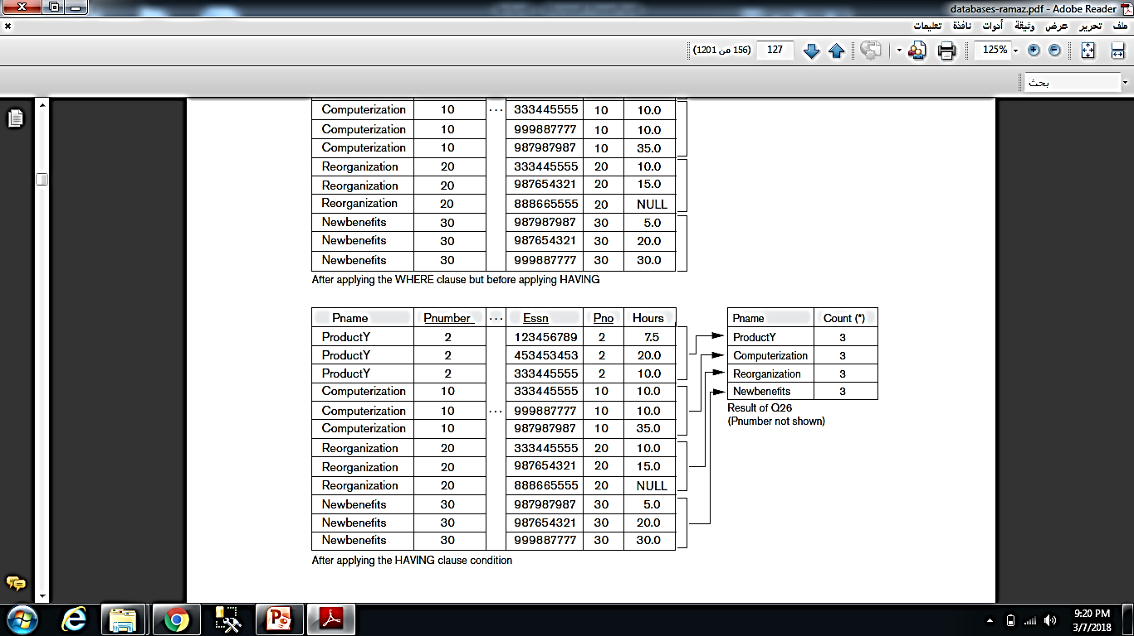
1.8 Grouping: The GROUP BY and HAVING Clauses
Result of Example

Slide 29
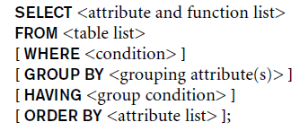
1.8 Grouping: The GROUP BY and HAVING Clauses

Slide 30
2-Specifying Constraints as Assertions and Actions as Triggers
2.1 Specifying General Constraints as Assertions in SQL
CREATE ASSERTION
Specify additional types of constraints outside scope of built-in relational model constraints
CREATE TRIGGER
Specify automatic actions that database system will perform when certain events and conditions occur

Slide 31
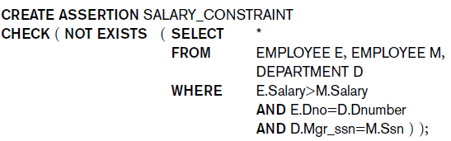
2-Specifying Constraints as Assertions and Actions as Triggers
2.1 Specifying General Constraints as Assertions in SQL
CREATE ASSERTION
Specify a query that selects any tuples that violate the desired condition
Use only in cases where it is not possible to use CHECK on attributes and domains
Example
For example, to specify the constraint that the salary of an employee must not be greater than the salary of the manager of the department that the employee works for in SQL, we can write the following assertion:

Slide 32
2-Specifying Constraints as Assertions and Actions as Triggers
2.2 Introduction to Triggers in SQL
CREATE TRIGGER statement
Used to monitor the database
Typical trigger has three components:
Event(s)
Condition
Action

Slide 33
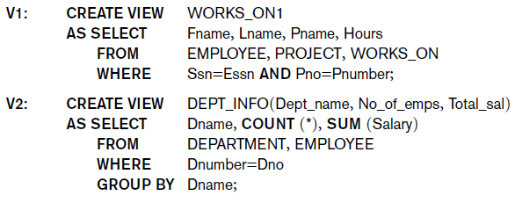
3 - Views (Virtual Tables) in SQL
3.1 Concept of a View in SQL
Single table derived from other tables
Considered to be a virtual table
3.2 Specification of Views in SQL
CREATE VIEW command
Give table name, list of attribute names, and a query to specify the contents of the view

Slide 34
3.2 Specification of Views in SQL
Specify SQL queries on a view
View always up-to-date
Responsibility of the DBMS and not the user
DROP VIEW command
Dispose of a view

Slide 35
3.3 View Implementation, View Update, and Inline Views
Complex problem of efficiently implementing a view for querying
Query modification approach
Modify view query into a query on underlying base tables
Disadvantage: inefficient for views defined via complex queries that are time-consuming to execute

Slide 36
3.3 View Implementation, View Update, and Inline Views
View materialization approach
Physically create a temporary view table when the view is first queried
Keep that table on the assumption that other queries on the view will follow
Requires efficient strategy for automatically updating the view table when the base tables are updated

Slide 37
3.3 View Implementation, View Update, and Inline Views
Incremental update strategies
DBMS determines what new tuples must be inserted, deleted, or modified in a materialized view table

Slide 38
3.3 View Implementation, View Update, and Inline Views
Update on a view defined on a single table without any aggregate functions
Can be mapped to an update on underlying base table
View involving joins
Often not possible for DBMS to determine which of the updates is intended

Slide 39
3.3 View Implementation, View Update, and Inline Views
Clause WITH CHECK OPTION
Must be added at the end of the view definition if a view is to be updated
In-line view
Defined in the FROM clause of an SQL query

Slide 40
4 - Schema Change Statements in SQL
4.1 The DROP Command
4.2 The ALTER Command
Schema evolution commands
Can be done while the database is operational
Does not require recompilation of the database schema

Slide 41
4.1 The DROP Command
DROP command
Used to drop named schema elements, such as tables, domains, or constraint
Drop behavior options:
CASCADE and RESTRICT
If CASCADE is chosen, all constraints and views that reference the column are dropped automatically from the schema, along with the column.
If RESTRICT is chosen, the command is successful only if no views or constraints (or other schema elements) reference the column.
Example:
DROP SCHEMA COMPANY CASCADE;

Slide 42
4.2 The ALTER Command
Alter table actions include:
Adding or dropping a column (attribute)
Changing a column definition
Adding or dropping table constraints
Example:
ALTER TABLE COMPANY.EMPLOYEE ADD COLUMN Job VARCHAR(12);
To drop a column
Choose either CASCADE or RESTRICT

Slide 43

4.2 The ALTER Command
Change constraints specified on a table
Add or drop a named constraint
Example:

