Slide 1

Database Management system
Lecture 6 (Part2)
The Relational Algebra
and
Relational Calculus
Dr. Rihab Mohamed Naceur ABDELKRIM
E-mail: rihab@su.edu.sa
2017 - 2018

Slide 2
Outline
1- Unary Relational Operations: SELECT and PROJECT
2- Relational Algebra Operations from Set Theory
3- Binary Relational Operations: JOIN and DIVISION
4- Additional Relational Operation
5- The Tuple Relational Calculus
6- The Domain Relational Calculus

Slide 3
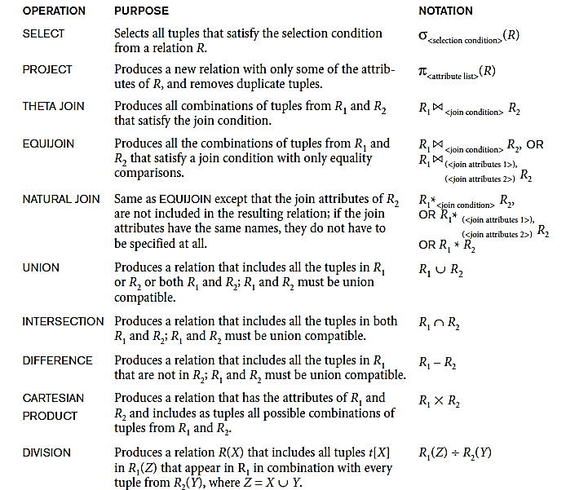
Operations of Relational Algebra

Slide 4
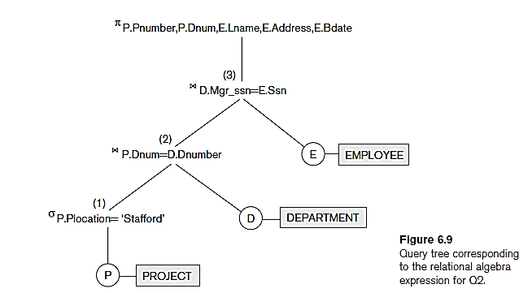
Notation for Query Trees
A query tree is a tree data structure that corresponds to a relational algebra expression.
It represents the input relations of the query as leaf nodes of the tree, and represents the relational algebra operations as internal nodes.
Example

Slide 5

For every project located in ‘Stafford’, list the project number, the controlling department number, and the department manager’s last name, address, and birth date.
In Figure 6.9, the three leaf nodes P, D, and E represent the three relations PROJECT, DEPARTMENT, and EMPLOYEE.
The relational algebra operations are represented by internal tree nodes.
The query tree signifies an explicit order of execution in the following sense 1-2-3.

Slide 6
4- Additional Relational Operation
Another type of request that cannot be expressed in the basic relational algebra is to specify mathematical aggregate functions.
Common functions applied to collections of numeric values include SUM, AVERAGE, MAXIMUM, and MINIMUM.
The COUNT function is used for counting tuples or values.

Slide 7
4- Additional Relational Operation
Use of the Aggregate Functional operation ℱ
ℱ_{MAX Salary} (EMPLOYEE) retrieves the maximum salary value from the EMPLOYEE relation
ℱ_{MIN Salary} (EMPLOYEE) retrieves the minimum Salary value from the EMPLOYEE relation
ℱ_{SUM Salary} (EMPLOYEE) retrieves the sum of the Salary from the EMPLOYEE relation
ℱ_{COUNT SSN, AVERAGE Salary} (EMPLOYEE) computes the count (number) of employees and their average salary
Note: count just counts the number of rows, without removing duplicates

Slide 8
Relational Calculus
A relational calculus expression creates a new relation, which is specified in terms of variables that range over rows of the stored database relations which is tuple calculus or over columns of the stored relations which is domain calculus.
In a calculus expression, there is no order of operations to specify how to retrieve the query result—a calculus expression specifies only what information the result should contain.
This is the main distinguishing feature between relational algebra and relational calculus.

Slide 9
5- Tuple Relational Calculus
The tuple relational calculus is based on specifying a number of tuple variables.
Each tuple variable usually ranges over a particular database relation, meaning that the variable may take as its value any individual tuple from that relation.
A simple tuple relational calculus query is of the form
{t | COND(t)}
where t is a tuple variable and COND (t) is a conditional expression involving t.
The result of such a query is the set of all tuples t that satisfy COND (t).

Slide 10
5- Tuple Relational Calculus
Example:
To find the first and last names of all employees whose salary is above $50,000, we can write the following tuple calculus expression:
{t.FNAME,t.LNAME|EMPLOYEE(t) AND t.SALARY>50000}

Slide 11
6- The Domain Relational Calculus
An expression of the domain calculus is of the form
{ x₁, x₂, . . ., x_{n} |
COND(x₁, x₂, . . ., x_{n}, x_{n+1}, x_{n+2}, . . ., x_{n+m})}
where x₁, x₂, . . ., x_{n}, x_{n+1}, x_{n+2}, . . ., x_{n+m} are domain variables that range over domains (of attributes)
and COND is a condition or formula of the domain relational calculus.

Slide 12
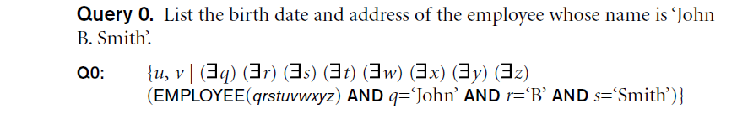
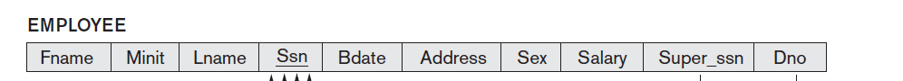
6- The Domain Relational Calculus
q | r | s | t | u | v | w | x | y | z

