Slide 1
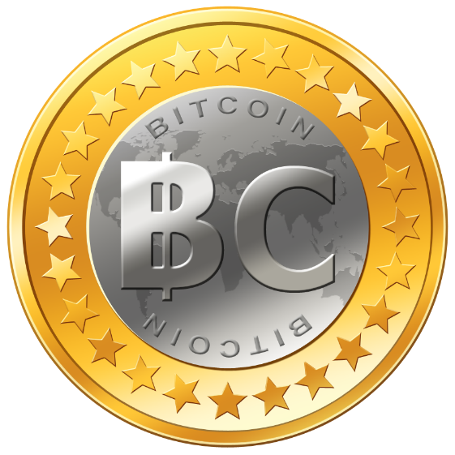
Digital Currencies
Modified from Jason Madden

Slide 2
Introduction: What is Money?
Physical or Electronic Tokens or Commodities
that can be have the following properties:
Unit of Account → defined value
Medium of Exchange → acceptability
Store of Value → non-perishable

Slide 3
What is Electronic Money?
Narrow View of Term:
  Tokens of Exchange transacted only electronically
  Examples: Facebook Gold, Digital Gold Currency, BitCoin, and other electronic currencies
Broad Usage of Term includes Both:
  Electronic Payment Authorization → Credit cards
  Value Holding Electronic Tokens
A currency has value by it being widely used.
  Bitcoin is a startup currency with a deflationary bootstrapping economy

Slide 4

Overview: Early Money
Early Intermediary Tokens of Exchange
  Commodities or Objects of Perceived Worth
Minted Coins → standardized units of metal
  Code of Hammurabi: legal debt payment
Trade Bills → credit certificate for production
  Led to Local Merchant Banks for redemption
  Goldsmiths → demand deposits & promissory notes

Slide 5
Beginnings of Modern Money
Private Bank Notes
  Loans based on deposits on account
  Beginning of Fractional Banking
National Currencies
  from Central Reserve Banks
  backed by Gold or Silver
  Legal Tender for Payments

Slide 6
Modern Fiat Money
World War 1 & End of Gold Standard
  Scarcity of Gold Reserves with Enlarging Circulation
  Bank Notes no longer redeemable for gold
  Floating value in exchange market
Money by Decree of Government
  Backed by issuers ability to repay debts
  Susceptible to public distrust
  Possible uncontrolled inflation or deflation
Notes:
Electronic Currency by Jason Madden

Slide 7
Types of Electronic Money
Private Currency → free banking
Community Currency→ local acceptability
World Currency → trade reference
Hard Currency → non-reversible
Soft Currency → allows payment disputes

Slide 8
Private Currency
  Free Banking → No Central Reserve Bank
  Free Entry into Banking Industry
  Freedom to Issue Notes, Accept Deposits, and Collect Checks for Payment
  Freedom to Borrow Money on Term Deposit
  Freedom to Lend Money & Invest Assets

Slide 9
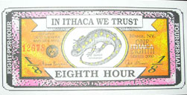

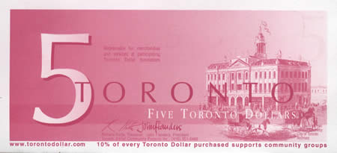
Community Currency
Ithaca HOURS
  Ithaca, NY
  http://www.ithacahours.org/#whatareithacahours
BerkShares
  Berkshire, MS
  http://www.berkshares.org/whatareberkshares.htm
Toronto Dollar
  Toronto, Ontario
  http://torontodollar.com/aboutus/index.php

Slide 10
World Currency
Global Trade Reference
  Gold, British Pound, US Dollar, Euro, Yen
  Private Complementary Currency efforts
International Monetary Fund (IMF)
  Special Drawing Rights (SDR)
  Supplementary Reserve Assets

Slide 11
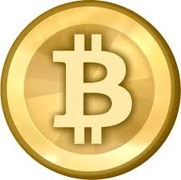
BitCoin
It is simply a means of sending and receiving numbers to and from "addresses"
An Open-Source Peer-To-Peer Payment Network
  Using Digital Signatures & Encryption
    decentralization is the basis for Bitcoin's security and freedom
Public –Private Key Encryption
  Alice & Bob Illustration
  Digital Certificate Blocking Chain
http://www.weusecoins.com/

Slide 12
Bitcoin
Governance - an open source community of developers backed by the Bitcoin Foundation.
Democratic - if you don't like one of the changes, you are more than welcome to fork the chain and implement your own rules
Money Creation - is given to the people, not to the central bankers.
Deflationary by design - money supply cannot be manipulated and is fixed at 21 million coins, each divisible up to 8 decimal

Slide 13
How it works
The block chain is the fundamental data structure of the Bitcoin protocol.
It's a single data file participants pass around to each other.
It allows them to know who owns what.
Anyone can change it to send money to someone else.
Other users mathematically verify the transaction to ensure it's validity.

Slide 14
How It Works
It's essentially an accounting ledger:
  3/3/13 Sally found : $15.00
  3/3/13 Sally -> Bob : $10.00
  3/4/13 Bob -> Jimmy : $4.00
  3/4/13 Sally -> Barb : $4.00
  3/4/13 Jimmy -> Sally : $2.00
How much money does Sally have in her wallet?
  Sally had $15, then gave $10 to Bob, then $4 to Barb, then was given $2 from Jimmy. Sally has $3 as of right now.

Slide 15
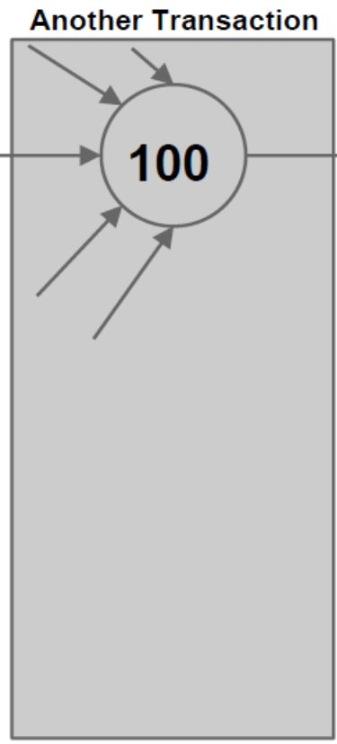
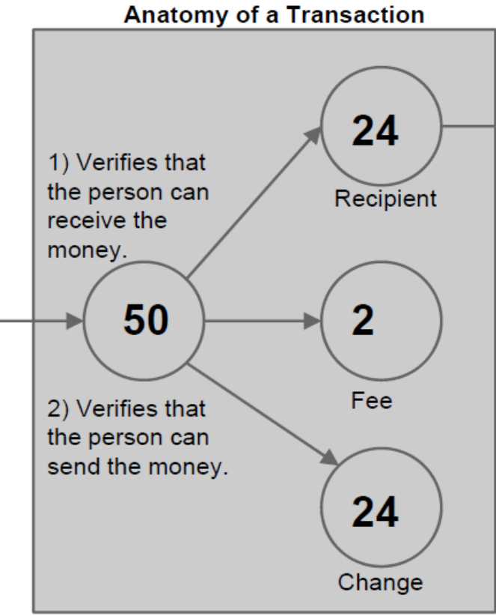
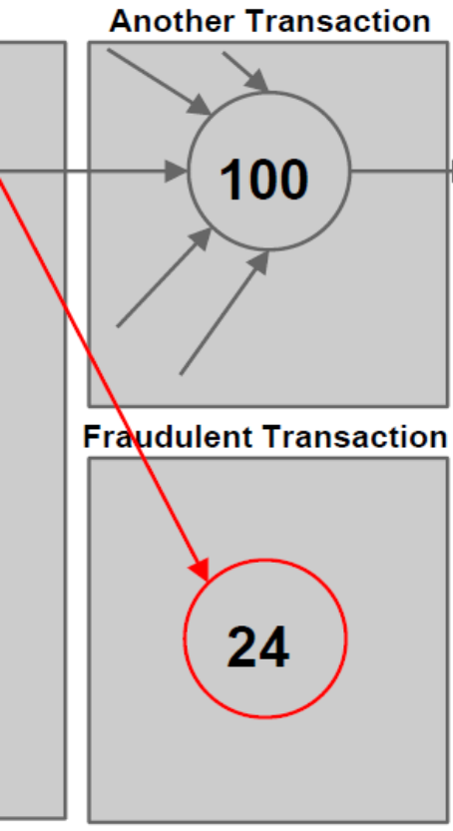
Transactions
Input contains
1) A public key that belongs to the redeemer of the output transaction.
2) An ECDSA hash over a hash of the transaction.
Output contains
1) The actual amount being sent to the recipient.
2) The change amount being sent back to the original sender (if any) 3) The voluntary transaction fee attached to the output (if any).
The block chain prevents the double spend attack by giving other nodes the power to verify that transaction inputs were not already spent somewhere else.

Slide 16
Mining
Miners collect the transactions on the network into large bundles called blocks
  like "Alice pays Karim 10 bitcoins" and "Liam pays Sofia 8.3 bitcoins".
These blocks are strung together into one continuous, authoritative record called the block chain,
  which doesn't permit any conflicting transactions.
  lets you know for sure exactly which transactions count and can be trusted (no double spending!).

Slide 17
Block Chain
Bitcoin makes sure there is only one block chain by making blocks really hard to produce.
miners have to compute a cryptographic hash of the block that meets certain criteria
  difficulty of the criteria for the hash is adjusted based on how frequently blocks are appearing
  also carefully validate all the transactions that go into their blocks
Successful miners are rewarded some bitcoins according to a preset schedule

Slide 18
Fraud prevention
Users can trust the block chain that was most difficult to produce
  longest chain wins
If there was a "fake" blockchain competing with the real ones the fraudster would have to do as much work as the rest of the network to make their block chain look as trustworthy
  intense work that goes into finding blocks through hashing secures the network against fraud

Slide 19
BitCoin Mining
Collects transactions from the network
Validates them, and doesn't allow conflicting ones
Puts them into large bundles called blocks
Computes cryptographic hashes over and over until if finds one "good enough to count"
Then submits the block to the network, adding it to the block chain and earning a reward in return

Slide 20
Bitcoin Security
  Bitcoin addresses are RACE Integrity Primitives Evaluation Message Digest RIPEMD-160 of SHA-256 of an Elliptic Curve Digital Signature Algorithm public key
    any vulnerabilities in the algorithms would constitute a vulnerability in bitcoin itself
An attacker with > 50% of hash power can
  Double spend: Reverse transactions that he sends while he's in control
  Prevent some or all transactions from gaining any confirmations
  Prevent some or all other generators from getting any generations

Slide 21
Bitcoin Concerns
Wallet Vulnerable To Theft
Tracing a coin's history
Packet sniffing
Sybil attack (cancer nodes)
No authentication for IP transfers
  This attack is downright likely if you're using Tor
Denial of Service (DoS) attacks
Illegal content in the block chain
Energy Consumption

Slide 22
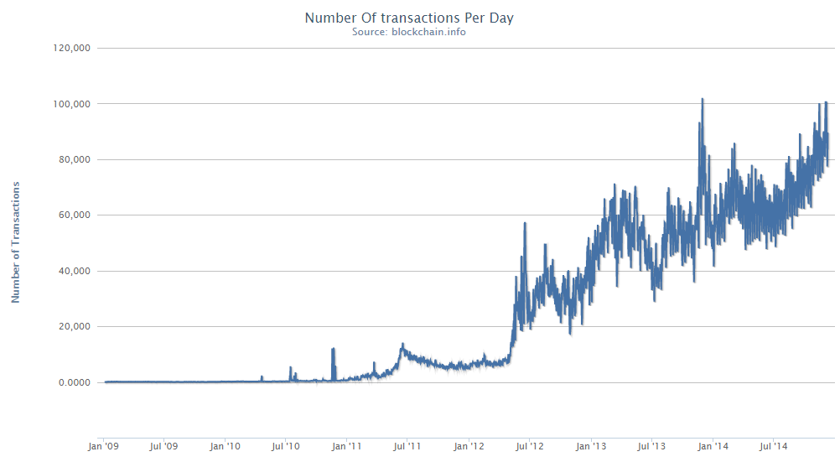
Number of Transactions per Day

Slide 23
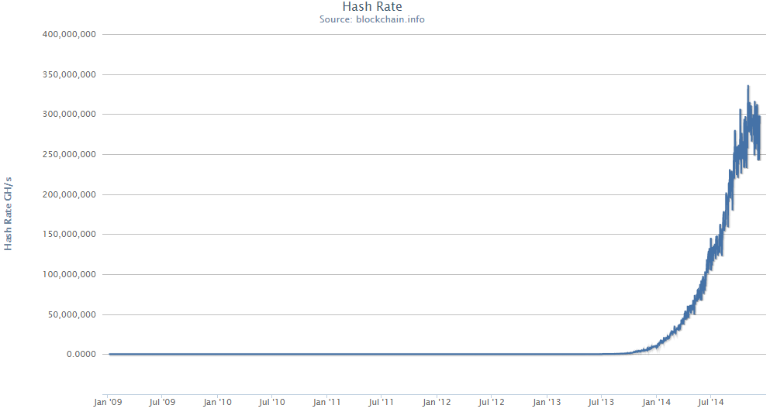
Hash Rate

Slide 24
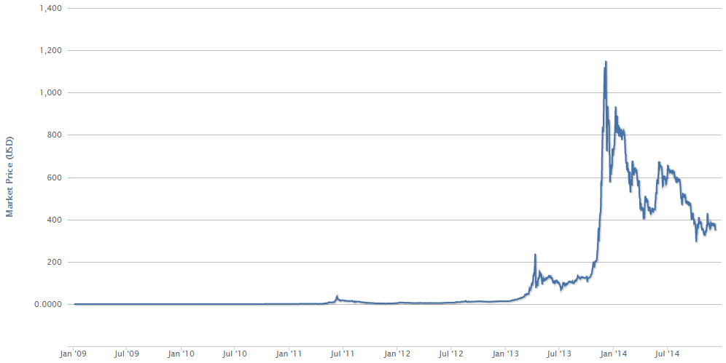
Market Price

Slide 25
Alternatives
Litecoin (LTC)
  transaction confirmation in 2.5 min
  prevent ASICs
Dogecoin (DOGE)
  transaction confirmation in 1 min
  target social network users
PPCoin (PPC)
  proof-of-stake
  energy efficient

Slide 26
Alternatives
DarkCoin (DRK)
  Uses different hash functions
NameCoin (NMC)
  Decentralized DNS
  .bit domain
Auroracoin (AUR)
Quarkcoin (QRK)
Feathercoin (FTC)
Vertcoin (VTC)
Novacoin (NVC)
…
Ripple (XRP)
  Account ledger
  transactions in 2-5 sec
BitShares (BTS)
  Digital asset exchange
…
As of Dec 8, 2014
Currency | BTC | LTC | DOGE | PPC | DRK | NMC
Value | $350 | $3.52 | $0.0002 | $0.7 | $2.22 | $0.86
Total | 13.6 m | 34.5 m | 96 b | 21.9 m | 4.9 m | 10.4 m
Capitalization | $4.7 b | $122 m | $20.5 m | $15.3 m | $11 m | $9 m
http://coinmarketcap.com/all/

