Slide 1
Network Security
slides are modified from Dave Hollinger

Slide 2
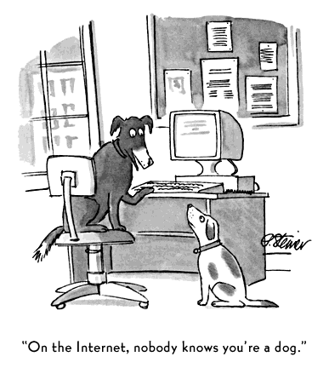
by Peter Steiner,
New York, July 5, 1993
CPE 401/601 Lecture 17: Network Security

Slide 3
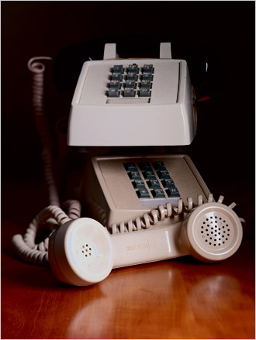



Early Hacking – Phreaking
In1957, a blind seven-year old, Joe Engressia Joybubbles, discovered a whistling tone that resets trunk lines
  Blow into receiver – free phone calls
Cap’n Crunch cereal prize
  Giveaway whistle produces 2600 MHz tone
CPE 401/601 Lecture 17: Network Security

Slide 4
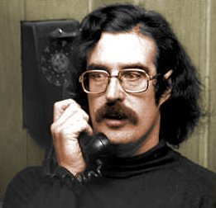
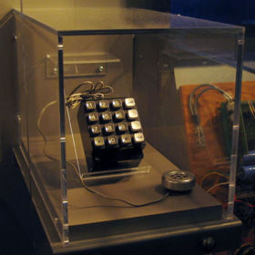
The Seventies
John Draper
  a.k.a. Captain Crunch
  “If I do what I do, it is only
  to explore a system”
In 1971, built Bluebox
Pranksters, free calls
  Mark Bernay and Al Bernay
  Steve Jobs and Steve Wozniak
CPE 401/601 Lecture 17: Network Security

Slide 5
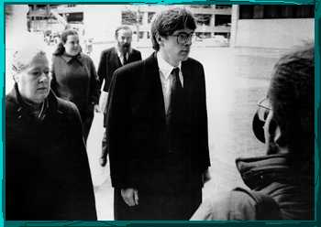
The Eighties
Robert Morris worm - 1988
  Developed to measure the size of the Internet
    However, a computer could be infected multiple times
  Brought down a large fraction of the Internet
    ~ 6K computers
  Academic interest in network security
CPE 401/601 Lecture 17: Network Security

Slide 6
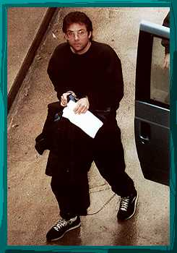
The Nineties
Kevin Mitnick
  First hacker on FBI’s Most Wanted list
  Hacked into many networks
    including FBI
  Stole intellectual property
    including 20K credit card numbers
  In 1995, caught 2nd time
    served five years in prison
CPE 401/601 Lecture 17: Network Security

Slide 7
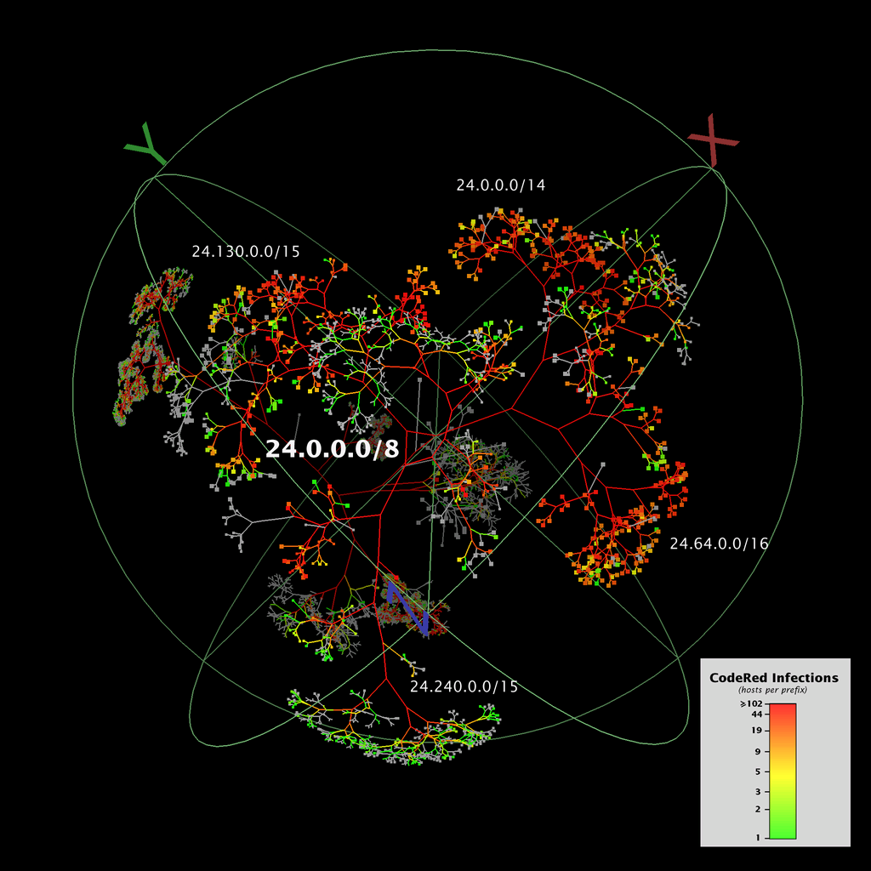
Code-Red Worm
On July 19, 2001, more than 359,000 computers connected to the Internet were infected in less than 14 hours
Spread
CPE 401/601 Lecture 17: Network Security

Slide 8
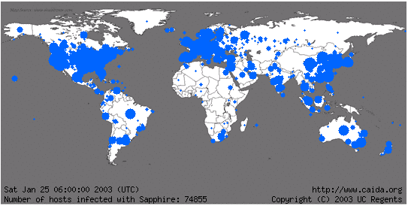
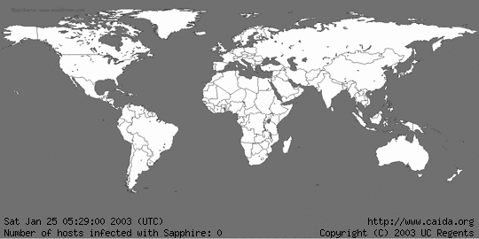
Sapphire Worm
was the fastest computer worm in history
  doubled in size every 8.5 seconds
  infected more than 90 percent of vulnerable hosts within 10 minutes.
CPE 401/601 Lecture 17: Network Security

Slide 9
DoS attack on SCO
On Dec 11, 2003
  Attack on web and FTP servers of SCO
    a software company focusing on UNIX systems
  SYN flood of 50K packet-per-second
  SCO responded to more than 700 million attack packets over 32 hours
CPE 401/601 Lecture 17: Network Security
Notes:
CAIDA

Slide 10
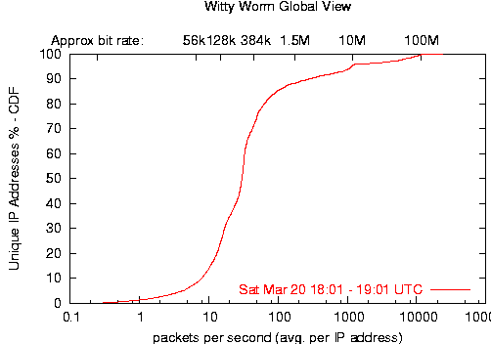
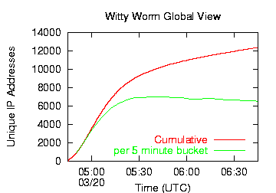
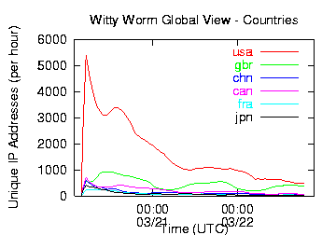
Witty Worm
25 March 2004
  reached its peak activity after approximately 45 minutes
  at which point the majority of vulnerable hosts had been infected
World
USA
CPE 401/601 Lecture 17: Network Security

Slide 11
Nyxem Email Virus
  Jan 15, 2006: infected about 1M computers within two weeks
  At least 45K of the infected computers were also compromised by other forms of spyware or botware
Spread
CPE 401/601 Lecture 17: Network Security

Slide 12
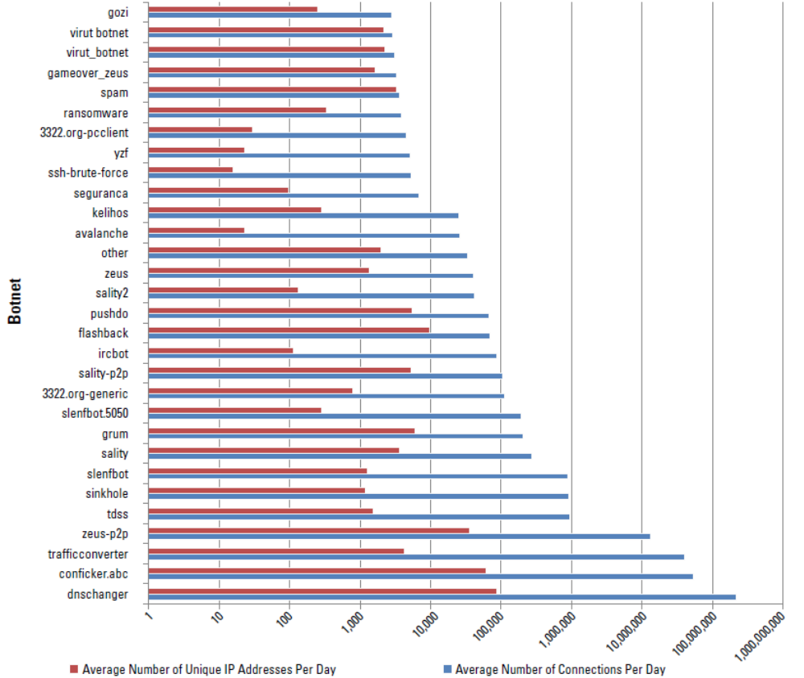

Slide 13
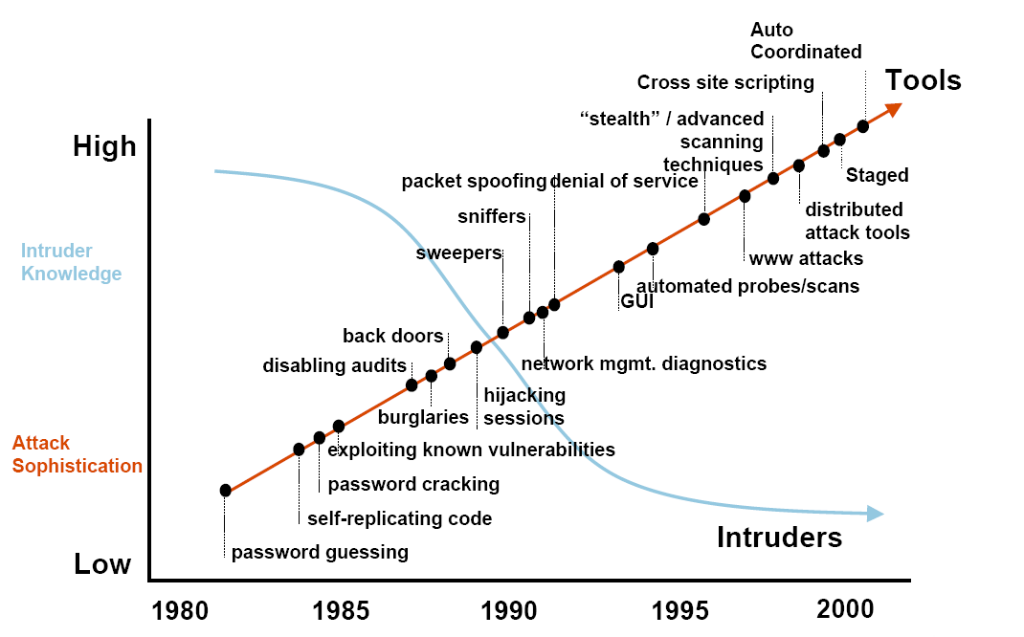
Security Trends
www.cert.org (Computer Emergency Readiness Team)
CPE 401/601 Lecture 17: Network Security
Notes:
Discuss observed security trends, noting growth in sophistication of attacks contrasting with decrease in skill & knowledge needed to mount an attack.
Computer Emergency Readiness Team

Slide 14
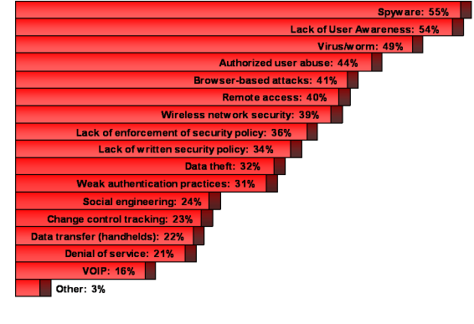
Top Security Threats
Computing Technology Industry Association, 2009 survey

Slide 15
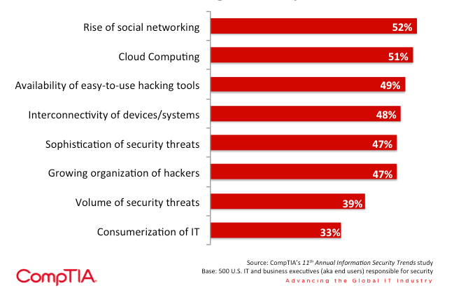
Changes on the technology landscape affecting security

Slide 16
Concern for Security
Explosive growth of desktops started in ‘80s
  No emphasis on security
    Who wants military security, I just want to run my spreadsheet!
Internet was originally designed for a group of mutually trusting users
  By definition, no need for security
  Users can send a packet to any other user
  Identity (source IP address) taken by default to be true
Explosive growth of Internet in mid ’90s
  Security was not a priority until recently
    Only a research network, who will attack it?
CPE 401/601 Lecture 17: Network Security

Slide 17
Concern for Security
Explosive growth of desktops started in ‘80s
  No emphasis on security
    Who wants military security, I just want to run my spreadsheet!
Internet was originally designed for a group of mutually trusting users
  By definition, no need for security
  Users can send a packet to any other user
  Identity (source IP address) taken by default to be true
Explosive growth of Internet in mid ’90s
  Security was not a priority until recently
    Only a research network, who will attack it?
CPE 401/601 Lecture 17: Network Security

Slide 18



Friends and enemies: Alice, Bob, Trudy
well-known in network security world
Bob, Alice want to communicate “securely”
Trudy (intruder) may intercept, delete, add messages
Alice
Bob
channel
data, control messages
secure
sender
secure
receiver
data
data
Trudy

Slide 19
Who might Bob, Alice be?
… well, real-life Bobs and Alices!
Web browser/server for electronic transactions (e.g., on-line purchases)
on-line banking client/server
DNS servers
routers exchanging routing table updates
other examples?

Slide 20
There are bad guys (and girls) out there!
Q: What can a “bad guy” do?
A: A lot!
  eavesdrop: intercept messages
  actively insert messages into connection
  impersonation: can fake (spoof) source address in packet (or any field in packet)
  hijacking: “take over” ongoing connection by removing sender or receiver, inserting himself in place
  denial of service: prevent service from being used by others (e.g., by overloading resources)

Slide 21
Alice’s Online Bank
Alice opens Alice’s Online Bank (AOB)
What are Alice’s security concerns?
If Bob is a customer of AOB, what are his security concerns?
How are Alice and Bob concerns similar? How are they different?
How does Trudy view the situation?
CPE 401/601 Lecture 17: Network Security
Notes:
What are Alice’s security concerns?
If Bob is a customer of AOB, what are his security concerns?
How are Alice and Bob concerns similar? How are they different?
How does Trudy view the situation?
Confidentiality: Prevent unauthorized reading of information
Integrity : prevent unauthorized writing of information

Slide 22
Alice’s Online Bank
AOB must prevent Trudy from learning Bob’s balance
  Confidentiality (prevent unauthorized reading of information)
Trudy must not be able to change Bob’s balance
Bob must not be able to improperly change his own account balance
  Integrity (prevent unauthorized writing of information)
AOB’s info must be available when needed
  Availability (data is available in a timely manner when needed
CPE 401/601 Lecture 17: Network Security
Notes:
What are Alice’s security concerns?
If Bob is a customer of AOB, what are his security concerns?
How are Alice and Bob concerns similar? How are they different?
How does Trudy view the situation?
Confidentiality: Prevent unauthorized reading of information
Integrity : prevent unauthorized writing of information

Slide 23
Alice’s Online Bank
How does Bob’s computer know that “Bob” is really Bob and not Trudy?
When Bob logs into AOB, how does AOB know that “Bob” is really Bob?
  Authentication (assurance that other party is the claimed one)
Bob can’t view someone else’s account info
Bob can’t install new software, etc.
  Authorization (allowing access only to permitted resources)
CPE 401/601 Lecture 17: Network Security
Notes:
Availability: Data is available in a timely manner when needed

Slide 24
Think Like Trudy
Good guys must think like bad guys!
A police detective
  Must study and understand criminals
In network security
  We must try to think like Trudy
  We must study Trudy’s methods
  We can admire Trudy’s cleverness
  Often, we can’t help but laugh at Alice and Bob’s carelessness
  But, we cannot act like Trudy
CPE 401/601 Lecture 17: Network Security

Slide 25
Aspects of Security
Security Services
  Enhance the security of data processing systems and information transfers of an organization.
  Counter security attacks.
Security Attack
  Action that compromises the security of information owned by an organization.
Security Mechanisms
  Designed to prevent, detect or recover from a security attack.
CPE 401/601 Lecture 17: Network Security
Notes:
The services are intended to counter security attacks, and they make use of one or more security methods to provide the service

Slide 26
Security Services
Enhance security of data processing systems and information transfers
Authentication
  Assurance that the communicating entity is the one claimed
Authorization
  Prevention of the unauthorized use of a resource
Availability
  Data is available in a timely manner when needed
CPE 401/601 Lecture 17: Network Security
Notes:
Consider the role of a security service, and what may be required.
Note both similarities and differences with traditional paper documents, which for example:
have signatures & dates;
need protection from disclosure, tampering, or destruction;
may be notarized or witnessed;
may be recorded or licensed
This list includes the various "classic" security services which are traditionally discussed.
Note there is a degree of ambiguity as to the meaning of these terms, and overlap in their use.
Authentication – Ensures that the origin of a message or electronic document is correctly identified, with an assurance that the identity is not false
Access control (Authorization) – Requires that access to information resources may be controlled by or for the target system
Availability – Requires that computer system assets be available to authorized parties when needed

Slide 27
Security Services
Confidentiality
  Protection of data from unauthorized disclosure
Integrity
  Assurance that data received is as sent by an authorized entity
Non-Repudiation
  Protection against denial by one of the parties in a communication
CPE 401/601 Lecture 17: Network Security
Notes:
Confidentiality – Ensures that the information in a computer system and transmitted information are accessible only for reading by authorized parties
Integrity – Ensures that only authorized parties are able to modify computer systems assets and transmitted information.
Nonrepudiation– Requires that neither the sender nor the receiver of a message be able to deny the transmission (nonrepudiation with proof of origin/delivery)

Slide 28
Security Attacks
Information
source
Information
destination
Normal Flow
CPE 401/601 Lecture 17: Network Security

Slide 29
Security Attacks
Information
source
Information
destination
Interruption
Attack on availability
(ability to use desired information or resources)
CPE 401/601 Lecture 17: Network Security
Notes:
Availability is ability to use information or resources desired
An asset of the system is destroyed or becomes unavailable; Overwhelm or crash servers, disrupt infrastructure

Slide 30
Denial of Service
Smurf Attack
ICMP echo (spoofed source address of victim)
Sent to IP broadcast address
ICMP = Internet Control
Message Protocol
ICMP echo reply
Internet
1 SYN
Perpetrator
Victim
10,000 SYN/ACKs – Victim is dead
Innocent
reflector sites
CPE 401/601 Lecture 17: Network Security

Slide 31
Security Attacks
Information
source
Information
destination
Interception
Attack on confidentiality
(concealment of information)
CPE 401/601 Lecture 17: Network Security
Notes:
Confidentiality is Concealment of information
An unauthorized party gains access to an asset; Eavesdropping, packet sniffing, illegal copying

Slide 32
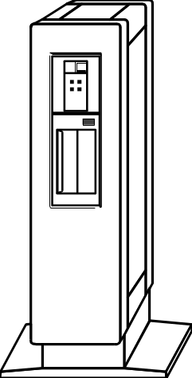

Packet Sniffing
Every network interface card has a unique 48-bit Media Access Control (MAC) address,
e.g. 00:0D:84:F6:3A:10 24 bits assigned by IEEE; 24 by card vendor
Packet Sniffer
Server
Client
Network Interface Card
allows only packets
for this MAC address
Packet sniffer sets his
card to promiscuous mode
to allow all packets
CPE 401/601 Lecture 17: Network Security

Slide 33
Security Attacks
Information
source
Information
destination
Fabrication
Attack on authenticity
(identification and assurance of origin of information)
CPE 401/601 Lecture 17: Network Security
Notes:
Authenticity is identification and assurance of origin of information
An unauthorized party inserts counterfeit objects into the system; Unauthorized assumption of another’s identity

Slide 34
IP Address Spoofing
IP addresses are filled in by the originating host
Using source address for authentication
  r-utilities (rlogin, rsh, rhosts etc..)
2.1.1.1
C
Can A claim it is B to the server S?
  ARP Spoofing
Can C claim it is B to the server S?
  Source Routing
Internet
1.1.1.3
S
A
1.1.1.1
1.1.1.2
B
CPE 401/601 Lecture 17: Network Security

Slide 35
Security Attacks
Information
source
Information
destination
Modification
Attack on integrity
(prevention of unauthorized changes)
CPE 401/601 Lecture 17: Network Security
Notes:
Integrity is Prevention of unauthorized changes
An unauthorized party not only gains access to but tampers with an asset; Intercept messages, temper and release again

Slide 36
TCP Session Hijack
When is a TCP packet valid?
  Address / Port / Sequence Number in window
How to get sequence number?
  Sniff traffic
  Guess it
    Many earlier systems had predictable Initial Sequence Number
Inject arbitrary data to the connection
CPE 401/601 Lecture 17: Network Security

Slide 37
Security Attacks
Passive attacks
Traffic
analysis
Message interception
eavesdropping, monitoring transmissions
Active attacks
Masquerade
Replay
Modification of message contents
Denial of
service
some modification of the data stream
CPE 401/601 Lecture 17: Network Security
Notes:
Have “passive attacks” which attempt to learn or make use of information from the system but does not affect system resources.
By eavesdropping on, or monitoring of, transmissions to:
+ obtain message contents (as shown above in Stallings Figure 1.3a), or
+ monitor traffic flows
Are difficult to detect because they do not involve any alteration of the data.
Release of Message Contents: Illegal interception (secrecy)
An example is that opponent captures telephone conversation and obtains sensitive message.
Traffic Analysis
The opponent could determine the location and identity of communication host and could observe the frequency and length of messages being exchanged.
Also have “active attacks” which attempt to alter system resources or affect their operation.
By modification of data stream to:
+ masquerade of one entity as some other
+ replay previous messages (as shown above in Stallings Figure 1.4b)
+ modify messages in transit
+ denial of service
Active attacks present the opposite characteristics of passive attacks. Whereas passive attacks are difficult to detect, measures are available to prevent their success. On the other hand, it is quite difficult to prevent active attacks absolutely, because of the wide variety of potential physical,software,and network vulnerabilities. Instead, the goal is to detect active attacks and to recover from any disruption or delays caused by them.
Denial of Service / Interruption (availability)
Un-authorised modification (integrity)
Fabrication (authenticity)
Replay
Man-in-the-middle attacks
Modification of messages

Slide 38

Model for Network Security
CPE 401/601 Lecture 17: Network Security
Notes:
In considering the place of encryption, its useful to use the following two model that models information flowing over an insecure communications channel, in the presence of possible opponents. Hence an appropriate security transform (encryption algorithm) can be used, with suitable keys, possibly negotiated using the presence of a trusted third party.

Slide 39
Security Mechanism
Feature designed to
  Prevent attackers from violating security policy
  Detect attackers’ violation of security policy
  Recover, continue to function correctly even if attack succeeds.
No single mechanism that will support all services
  Authentication, authorization, availability, confidentiality, integrity, non-repudiation
CPE 401/601 Lecture 17: Network Security
Notes:
Prevention is ideal, because then there are no successful attacks.
Detection occurs after someone violates the policy. The mechanism determines that a violation of the policy has occurred (or is underway), and reports it. The system (or system security officer) must then respond appropriately.
Recovery means that the system continues to function correctly, possibly after a period during which it fails to function correctly. If the system functions correctly always, but possibly with degraded services, it is said to be intrusion tolerant. This is very difficult to do correctly; usually, recovery means that the attack is stopped, the system fixed (which may involve shutting down the system for some time, or making it unavailable to all users except the system security officers), and then the system resumes correct operations.
Now introduce “Security Mechanism” which are the specific means of implementing one or more security services.
Note these mechanisms span a wide range of technical components, but one aspect seen in many is the use of cryptographic techniques.
Cryptography is the most common used technique to provide system security.

Slide 40
What is network security about ?
It is about secure communication
  Everything is connected by the Internet
There are eavesdroppers that can listen on the communication channels
Information is forwarded through packet switches which can be reprogrammed to listen to or modify data in transit
Tradeoff between security and performance
CPE 401/601 Lecture 17: Network Security

