Slide 1

Anonymity
Modified from Levente Buttyan, Michael K. Reiter and Aviel D. Rubin

Slide 2
User privacy – the problem
private information is processed and stored extensively by various individuals and organizations
  location of user → telecom operators
  financial situation of user → banks, tax authorities
  wealth of user → insurance companies
  shopping information of user → credit card companies, retailers (via usage of fidelity cards)
  illnesses of user → medical institutions
  …
complete and meaningful profiles on people can be created and abused
information technology makes this easier
  no compartmentalization of information
  cost of storage and processing (data mining) decreases → technology is available to everyone

Slide 3
User privacy – the goal
private data should be protected from abuse by unauthorized entities
  transactional data
    access/usage logs at telecom operators, buildings, parking, public transport, …
  data that reveals personal interests
    rentals, credit card purchases, click stream data (WWW), …
  data that was disclosed for a well-defined purpose
    tax data revealed to tax authorities, health related data revealed to doctors, address information revealed in mail orders, …

Slide 4

User privacy – existing approaches
data avoidance
  “I don’t tell you, so you can’t abuse it.”
  effective but not always applicable
  often requires anonymity
  examples: cash transactions, public phones
data protection
  “If ever you abuse it, you will be punished.”
  well-established approach
  difficult to define, enforce, and control
  requires legislation or voluntary restrictions
multilateral security
  cooperation of more than two parties
  shared responsibilities and partial knowledge
combinations of the above

Slide 5
Anonymous Communication Concepts
What do we want to hide?
  sender anonymity
    attacker cannot determine who the sender of a particular message is
  receiver anonymity
    attacker cannot determine who the intended receiver of a particular message is
  unlinkability
    attacker may determine senders and receivers but not the associations between them (attacker doesn’t know who communicates with whom)

Slide 6
Anonymous Communication Concepts
From whom do we want to hide this?
  communication partner (sender anonymity)
  external attackers
    local eavesdropper (sniffing on a particular link (e.g., LAN))
    global eavesdropper (observing traffic in the whole network)
  internal attackers
    (colluding) compromised system elements (e.g., routers)

Slide 7
Types of attackers
collaborating crowd members
  crowd members that can pool their information and deviate from the protocol
local eavesdropper
  can observe communication to and from the users computer
end server
  the web server to which the transaction is directed

Slide 8



Anonymity loves company
The sole mechanism of anonymity is blending and obfuscation.
The Crowds approach
  Data may be in clear text
  Hide in a group and make everyone in the group equally responsible for an act
The Mix approach
  Obfuscate the data
  Blend the data with cover traffic
The Onion Routing approach
  Obfuscate the data
  Use cell padding to make data look similar

Slide 9
Crowds in operation: Setup
User first joins a crowd of other users and he is represented by a jondo process on his local machine. He registers to a server machine which is called a Blender.
User configures his browser to use the local jondo as the proxy for all new services.
The blender sends the data of other nodes in the crowd to the local jondo.
All other members in the crowd go through a Join Commit.

Slide 10
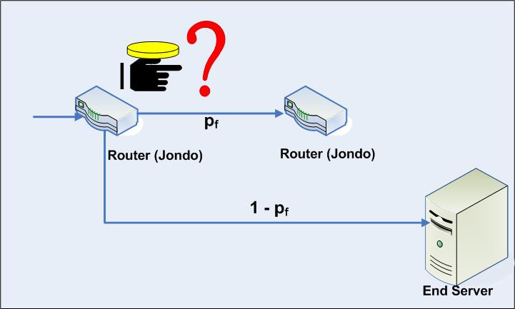
Crowds in operation: Communication
User passes her request to a random member in the crowd.
The selected router flips a biased coin with forwarding probability p_{f .}
With probability (1- p_{f} ), it delivers the message directly to destination. Otherwise it forwards the message to a randomly selected next router.

Slide 11
Distinct Characteristics of Crowds
Use of encryption
A single path key is used for end-to-end encryption
At each node, path key is re-encrypted using link encryption
Fast stream cipher for encrypting reply traffic
Static Path
Paths are changed during join and failure
Protection against timing attacks
Sender revealed if it is an immediate predecessor of malicious jondo.
Introduce delays for thwarting attacks

Slide 12
Concepts coming out of Crowds
Every node is a MIX
Making the end nodes and the MIXes indistinguishable
Distributed workload
Used in MorphMix / Tarzan for Peer to Peer communication
The leaky pipe architecture
Any node is an exit node
Used in Tor to provide better protection
Robustness
No single point of failure
Distributed Blender
Anonymity loves company
The more the user base, the better the anonymity
Highly scalable

Slide 13
Limitations of Crowds
Content in plaintext
Apply end-to-end encryption to protect content
Limitation: Gathering multimedia content
Restriction on using ActiveX controls etc.
Current Internet landscape is different from this requirement
Vulnerable to DoS attacks
Malicious jondos can simply drop packets.
Performance overhead
Increased network traffic, increased retrieval time and load on jondos
Deployment problem with firewalls

Slide 14
Chaum MIX
goal
  sender anonymity (for communication partner)
  unlinkability (for global eavesdropper)
implementation
  { r, m }_{KMIX} → MIX → m
  where m is the message and r is a random number
MIX
batches messages
discards repeats
changes order
changes encoding

Slide 15
MIX chaining
defense against colluding compromised MIXes
  if a single MIX behaves correctly, unlinkability is still achieved
MIX
MIX
MIX

Slide 16
Crowds versus MIX networks
Crowds and MIX solve different anonymity problems
Crowds provide (probable innocence) sender anonymity
MIX networks provide sender and receiver un-linkability
Different type of protection against global passive eavesdropper
Crowds provide no protection
MIX networks provide protection
Different approach in routing (Efficiency)
In Crowds paths are selected randomly
In a MIX, the circuit has to be determined first

Slide 17
Anonymizer
www.anonymizer.com
special protection for HTTP traffic
acts as a proxy for browser requests
rewrites links in web pages and adds a form where URLs can be entered for quick jump
disadvantages:
  must be trusted
  single point of failure/attack
browser
request
anonymizer
request
server
reply
reply
href =“http://anon.free.anonymizer.com/http://www.server.com/” ← href =“http://www.server.com/”

Slide 18
Onion routing
general purpose infrastructure for anonymous comm.
  supports several types of applications through the use of application specific proxies
operates over a (logical) network of onion routers
  onion routers are real-time Chaum MIXes
    messages are passed on nearly in real-time
      this may limit mixing and weaken the protection!
  onion routers are under the control of different administrative domains
    makes collusion less probable
  anonymous connections through onion routers are built dynamically to carry application data
distributed, fault tolerant, and secure

Slide 19
Overview of architecture
long-term socket
connections
application
(initiator)
onion router
application proxy
- prepares the data
stream for transfer
- sanitizes appl. data
- processes status
msg sent by the
exit funnel
application
(responder)
exit funnel
- demultiplexes connections
from the OR network
- opens connection to responder
application and reports a one
byte status msg back to the
application proxy
onion proxy
- opens the anonymous
connection via the OR
network
- encrypts/decrypts data
entry funnel
- multiplexes connections
from onion proxies

Slide 20
Onions
an onion is a multi-layered data structure
it encapsulates the route of the anonymous connection within the OR network
each layer contains
  backward crypto function (DES-OFB, RC4)
  forward crypto function (DES-OFB, RC4)
  IP address and port number of the next onion router
  expiration time
  key seed material
    used to generate the keys for the backward and forward crypto functions
each layer is encrypted with the public key of the onion router for which data in that layer is intended
bwd fn | fwd fn | next = blue | keys
bwd fn | fwd fn | next = green | keys
bwd fn | fwd fn | next = 0 | keys

Slide 21
OR network setup and operation
long-term socket connections between “neighboring” onion routers are established → links
neighbors on a link setup two DES keys using the Station-to-Station protocol (one key in each direction)
several anonymous connections are multiplexed on a link
  connections are identified by a connection ID (ACI)
  an ACI is unique on a link, but not globally
every message is fragmented into fixed size cells (48 bytes)
cells are encrypted with DES in Output FeedBack mode (null IV)
  optimization: if the payload of a cell is already encrypted (e.g., it carries part of an onion) then only the cell header is encrypted
cells of different connections are mixed
  but order of cells of each connection is preserved
6
5
4
3
2
1
6
5
4
4
3
3
2
2
1
1
mixing
4
3
2
1

Slide 22
Anonymous connection setup
upon a new request, the application proxy
  decides whether to accept the request
  opens a socket connection to the onion proxy
  passes a standard structure to the onion proxy
  standard structure contains
    application type (e.g., HTTP, FTP, SMTP, …)
    retry count (number of times the exit funnel should retry connecting to the destination)
    format of address that follows (e.g., NULL terminated ASCII string)
    address of the destination (IP address and port number)
  waits response from the exit funnel before sending application data

Slide 23
Anonymous connection setup
upon reception of the standard structure, the onion proxy
  decides whether to accept the request
  establishes an anonymous connection through some randomly selected onion routers by constructing and passing along an onion
  sends the standard structure to the exit funnel of the connection
  after that, it relays data back and forth between the application proxy and the connection
upon reception of the standard structure, the exit funnel
  tries to open a socket connection to the destination
  it sends back a one byte status message to the application proxy through the anonymous connection (in backward direction)
  if the connection to the destination cannot be opened, then the anonymous connection is closed
  otherwise, the application proxy starts sending application data through the onion proxy, entry funnel, anonymous connection, and exit funnel to the destination

Slide 24
Anonymous connection setup
onion
proxy
onion
application
(responder)

Slide 25
Anonymous connection setup
onion
proxy
application
(responder)
onion
bwd: entry funnel, crypto fns and keys
fwd: blue, ACI = 12, crypto fns and keys

Slide 26
Anonymous connection setup
onion
proxy
onion
ACI = 12
application
(responder)

Slide 27
Anonymous connection setup
onion
proxy
application
(responder)
onion
bwd: magenta, ACI = 12, crypto fns and keys
fwd: green, ACI = 8, crypto fns and keys

Slide 28
Anonymous connection setup
onion
proxy
onion
ACI = 8
application
(responder)

Slide 29
Anonymous connection setup
onion
proxy
application
(responder)
onion
bwd: blue, ACI = 8, crypto fns and keys
fwd: exit funnel

Slide 30
Anonymous connection setup
bwd: entry funnel, crypto fns and keys
fwd: blue, ACI = 12, crypto fns and keys
onion
proxy
bwd: blue, ACI = 8, crypto fns and keys
fwd: exit funnel
standard structure
status
open socket
application
(responder)
bwd: magenta, ACI = 12, crypto fns and keys
fwd: green, ACI = 8, crypto fns and keys

Slide 31
Data movement
forward direction
  the onion proxy adds all layers of encryption as defined by the anonymous connection
  each onion router on route removes one layer of encryption
  responder application receives plaintext data
backward direction
  the responder application sends plaintext data to the last onion router of the connection
    due to sender anonymity it doesn’t even know who is the real initiator application
  each onion router adds one layer of encryption
  the onion proxy removes all layers of encryption

Slide 32
Connection tear-down
anonymous connections are terminated by the initiator, the responder, or one of the onion routers in the middle
a special DESTROY message is propagated by the onion routers
  if an onion router receives a DESTROY msg, it passes it along the route
    forward or backward
  sends an acknowledgement to the onion router from which it received the DESTROY msg
  if an onion router receives an acknowledgement for a DESTROY messages it frees up the corresponding ACI

Slide 33
Tor Components
Entrance Node
  The first node in a circuit
  Knows the user
Exit Node
  Final node in the circuit
  Knows the destination
  May see actual message
Directory Servers
  Keep list of which onion routers are up, their locations, current keys, exit policies, etc
  Control which nodes can join network

Slide 34



How Tor Works?
Alice
Bob
C2
√
M
M
OR2
C3
M
C2
C3
M
C1
OR1
OR3
C1
C2
C3
Port
A circuit is built incrementally one hop by one hop
Onion-like encryption
  Alice negotiates an AES key with each router
  Messages are divided into equal sized cells
  Each router knows only its predecessor and successor
  Only the Exit router (OR3) can see the message, however it does not know where the message is from

Slide 35
Invisible Internet Project (I2P)
An anonymizing Peer-to-Peer network providing end to end protection
  utilizes decentralized structure to protect identity of both the sender and the receiver
email, torrents, web browsing, IM and more
UDP based
  unlike Tor’s TCP streams

Slide 36
I2P Terminology
Router
  the software which participates in the network
Tunnel
  a unidirectional path through several routers
  Every router has several incoming connections (inbound tunnels) and outgoing connections (outbound tunnels)
  Tunnels use layered encryption
Gateway
  first router in a tunnel
    Inbound Tunnel: first router of the tunnel
    Outbound Tunnel: creator of the tunnel

Slide 37
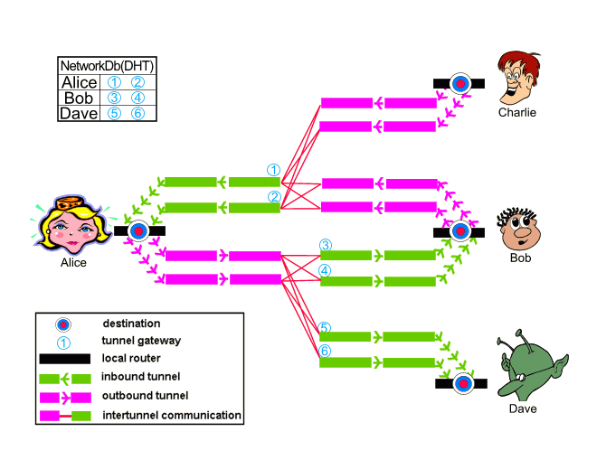
I2P Tunnels

Slide 38
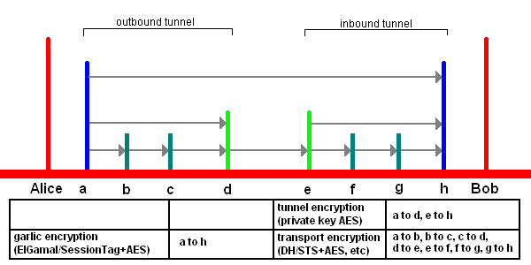
I2P Encryption
I2P works by routing traffic through other peers
All traffic is encrypted end-to-end

Slide 39
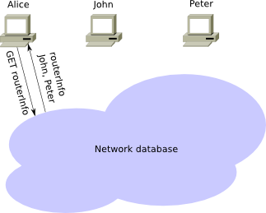
Joining the Network

Slide 40
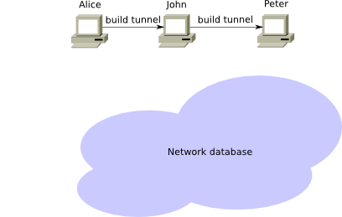
Establishing a Tunnel

Slide 41
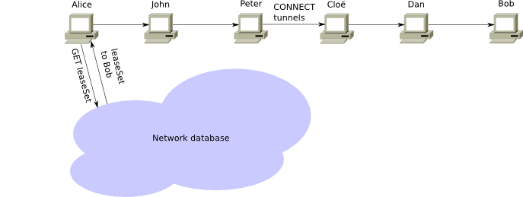
Establishing a Connection

