Slide 1

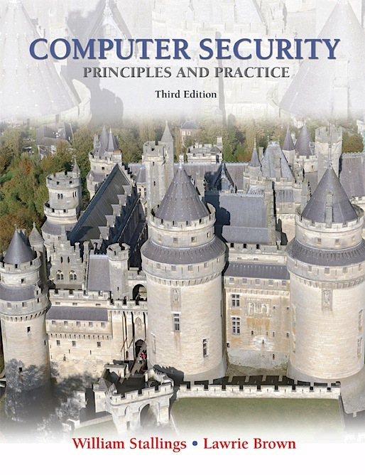
Lecture 1: Overview
modified from slides of Lawrie Brown
Notes:
This chapter provides an overview of computer security. We begin with a discussion of what we mean by computer security. In essence, computer security deals with computer-related assets that are subject to a variety of threats and for which various measures are taken to protect those assets. Accordingly, the next section of this chapter provides a brief overview of the categories of computer-related assets that users and system managers wish to preserve and protect, and a look at the various threats and attacks that can be made on those assets. Then, we survey the measures that can be taken to deal with such threats and attacks. This we do from three different viewpoints, in Sections 1.3 through 1.5 . We then look at some recent trends in computer security and lay out in general terms a computer security strategy.

Slide 2
Outline
The focus of this chapter is on three fundamental questions:
What assets do we need to protect?
How are those assets threatened?
What can we do to counter those threats?
Notes:
The focus of this chapter, and indeed this book, is on three fundamental questions:
1. What assets do we need to protect?
2. How are those assets threatened?
3. What can we do to counter those threats?

Slide 3
Computer Security Overview
The NIST Computer Security Handbook defines the term Computer Security as:
“The protection afforded to an automated information system in order to attain the applicable objectives of preserving the integrity, availability and confidentiality of information system resources”
includes hardware, software, firmware, information/data, and telecommunications.
Notes:
The NIST Computer Security Handbook [NIST95] defines the term computer security as follows:
Computer Security: The protection afforded to an automated information system in order to attain the applicable objectives of preserving the integrity, availability, and confidentiality of information system resources (includes hardware, software, firmware, information/data, and telecommunications).
This definition introduces three key objectives that are at the heart of computer security:
• Confidentiality: This term covers two related concepts:
— Data confidentiality : 1 Assures that private or confidential information is
not made available or disclosed to unauthorized individuals.
— Privacy : Assures that individuals control or influence what information
related to them may be collected and stored and by whom and to whom
that information may be disclosed.
• Integrity: This term covers two related concepts:
— Data integrity : Assures that information and programs are changed only
in a specified and authorized manner.
— System integrity : Assures that a system performs its intended function in
an unimpaired manner, free from deliberate or inadvertent unauthorized
manipulation of the system.
• Availability: Assures that systems work promptly and service is not denied to
authorized users.

Slide 4
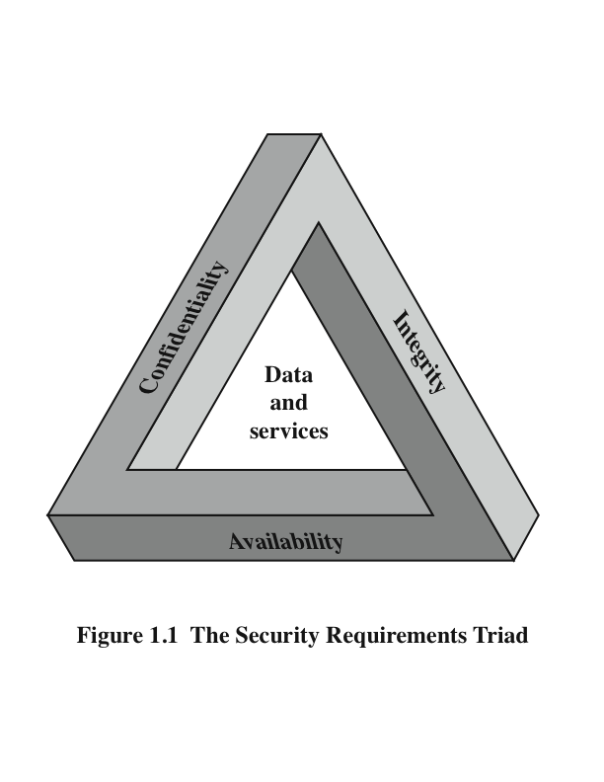
The CIA Triad
Notes:
This definition introduces three key objectives that are at the heart of computer
security:
• Confidentiality: This term covers two related concepts:
— Data confidentiality: Assures that private or confidential information is
not made available or disclosed to unauthorized individuals.
— Privacy: Assures that individuals control or influence what information
related to them may be collected and stored and by whom and to whom
that information may be disclosed.
• Integrity: This term covers two related concepts:
— Data integrity: Assures that information and programs are changed only
in a specified and authorized manner.
— System integrity: Assures that a system performs its intended function in
an unimpaired manner, free from deliberate or inadvertent unauthorized
manipulation of the system.
• Availability: Assures that systems work promptly and service is not denied to
authorized users.
These three concepts form what is often referred to as the CIA triad.
The three concepts embody the fundamental security objectives for
both data and for information and computing services. For example, the NIST standard
FIPS 199 ( Standards for Security Categorization of Federal Information
and Information Systems ) lists confidentiality, integrity, and availability as the three
security objectives for information and for information systems.

Slide 5
Key Security Concepts
Confidentiality
Integrity
Availability
preserving authorized restrictions on information access and disclosure.
including means for protecting personal privacy and proprietary information
guarding against improper information modification or destruction,
including ensuring information nonrepudiation and authenticity
ensuring timely and reliable access to and use of information
Is this all?
Notes:
FIPS PUB 199
provides a useful characterization of these three objectives in terms of requirements and the definition of a loss of security in each category:
• Confidentiality: Preserving authorized restrictions on information access and disclosure, including means for protecting personal privacy and proprietary information. A loss of confidentiality is the unauthorized disclosure of
information.
• Integrity: Guarding against improper information modification or destruction, including ensuring information non-repudiation and authenticity. A loss of integrity is the unauthorized modification or destruction of information.
• Availability: Ensuring timely and reliable access to and use of information. A loss of availability is the disruption of access to or use of information or an information system.
Although the use of the CIA triad to define security objectives is well established, some in the security field feel that additional concepts are needed to present a complete picture. Two of the most commonly mentioned are as follows:
• Authenticity: The property of being genuine and being able to be verified and trusted; confidence in the validity of a transmission, a message, or message originator. This means verifying that users are who they say they are and that each input arriving at the system came from a trusted source.
• Accountability: The security goal that generates the requirement for actions of an entity to be traced uniquely to that entity. This supports nonrepudiation, deterrence, fault isolation, intrusion detection and prevention, and after-action recovery and legal action. Because truly secure systems aren’t yet an achievable goal, we must be able to trace a security breach to a responsible party. Systems must keep records of their activities to permit later forensic analysis to trace security breaches or to aid in transaction disputes.
Note that FIPS PUB 199 includes authenticity under integrity.

Slide 6
Levels of Impact
Low
Moderate
High
The loss could be expected to have a limited adverse effect on organizational operations, organizational assets, or individuals
The loss could be expected to have a serious adverse effect on organizational operations, organizational assets, or individuals
The loss could be expected to have a severe or catastrophic adverse effect on organizational operations, organizational assets, or individuals
Notes:
We use three levels of impact on organizations or
individuals should there be a breach of security (i.e., a loss of confidentiality, integrity,
or availability). These levels are defined in FIPS 199:
• Low: The loss could be expected to have a limited adverse effect on organizational
operations, organizational assets, or individuals. A limited adverse effect
means that, for example, the loss of confidentiality, integrity, or availability
might (i) cause a degradation in mission capability to an extent and duration
that the organization is able to perform its primary functions, but the effectiveness
of the functions is noticeably reduced; (ii) result in minor damage to
organizational assets; (iii) result in minor financial loss; or (iv) result in minor
harm to individuals.
• Moderate: The loss could be expected to have a serious adverse effect on
organizational operations, organizational assets, or individuals. A serious
adverse effect means that, for example, the loss might (i) cause a significant
degradation in mission capability to an extent and duration that the organization
is able to perform its primary functions, but the effectiveness of the functions
is significantly reduced; (ii) result in significant damage to organizational
assets; (iii) result in significant financial loss; or (iv) result in significant harm
to individuals that does not involve loss of life or serious, life-threatening
injuries.
• High: The loss could be expected to have a severe or catastrophic adverse
effect on organizational operations, organizational assets, or individuals. A
severe or catastrophic adverse effect means that, for example, the loss might
(i) cause a severe degradation in or loss of mission capability to an extent
and duration that the organization is not able to perform one or more of its
primary functions; (ii) result in major damage to organizational assets; (iii)
result in major financial loss; or (iv) result in severe or catastrophic harm to
individuals involving loss of life or serious life-threatening injuries.

Slide 7
Computer Security Challenges
computer security is not as simple as it might first appear to the novice
potential attacks on the security features must be considered
procedures used to provide particular services are often counterintuitive
physical and logical placement needs to be determined
multiple algorithms or protocols may be involved
Notes:
Computer security is both fascinating and complex. Some of the reasons follow:
1. Computer security is not as simple as it might first appear to the novice. The requirements seem to be straightforward, but the mechanisms used to meet those requirements can be quite complex and subtle.
2. In developing a particular security mechanism or algorithm, one must always consider potential attacks (often unexpected) on those security features.
3. Hence procedures used to provide particular services are often counterintuitive.
4. Having designed various security mechanisms, it is necessary to decide where to use them.
5. Security mechanisms typically involve more than a particular algorithm or protocol, but also require participants to have secret information, leading to issues of creation, distribution, and protection of that secret information.
6. Computer security is essentially a battle of wits between a perpetrator who tries to find holes and the designer or administrator who tries to close them.
7. There is a natural tendency on the part of users and system managers to perceive little benefit from security investment until a security failure occurs.
8. Security requires regular monitoring, difficult in today's short-term environment.
9. Security is still too often an afterthought - incorporated after the design is complete.
10. Many users / security administrators view strong security as an impediment to efficient and user-friendly operation of an information system or use of information.

Slide 8
Computer Security Challenges
attackers only need to find a single weakness, the developer needs to find all weaknesses
users and system managers tend to not see the benefits of security until a failure occurs
security requires regular and constant monitoring
is often an afterthought to be incorporated into a system after the design is complete
thought of as an impediment to efficient and user-friendly operation
Notes:
Computer security is both fascinating and complex. Some of the reasons follow:
1. Computer security is not as simple as it might first appear to the novice. The requirements seem to be straightforward, but the mechanisms used to meet those requirements can be quite complex and subtle.
2. In developing a particular security mechanism or algorithm, one must always consider potential attacks (often unexpected) on those security features.
3. Hence procedures used to provide particular services are often counterintuitive.
4. Having designed various security mechanisms, it is necessary to decide where to use them.
5. Security mechanisms typically involve more than a particular algorithm or protocol, but also require participants to have secret information, leading to issues of creation, distribution, and protection of that secret information.
6. Computer security is essentially a battle of wits between a perpetrator who tries to find holes and the designer or administrator who tries to close them.
7. There is a natural tendency on the part of users and system managers to perceive little benefit from security investment until a security failure occurs.
8. Security requires regular monitoring, difficult in today's short-term environment.
9. Security is still too often an afterthought - incorporated after the design is complete.
10. Many users / security administrators view strong security as an impediment to efficient and user-friendly operation of an information system or use of information.

Slide 9
Computer Security Terminology
Adversary (threat agent)
An entity that attacks, or is a threat to, a system.
Attack
An assault on system security that derives from an intelligent threat; a deliberate attempt to evade security services and violate security policy of a system.
Countermeasure
An action, device, procedure, or technique that reduces a threat, a vulnerability, or an attack by eliminating or preventing it, by minimizing the harm it can cause, or by discovering and reporting it so that corrective action can be taken.
Notes:
We now introduce some terminology that will be useful throughout the book, relying on RFC 2828, Internet Security Glossary . 3 Table 1.1 defines terms.
Adversary (threat agent) - An entity that attacks, or is a threat to, a system.
Attack -An assault on system security that derives from an intelligent threat; a deliberate attempt to evade security services and violate security policy of a system.
Countermeasure - An action, device, procedure, or technique that reduces a threat, a vulnerability, or an attack by eliminating or preventing it, by minimizing the harm it can cause, or by discovering and reporting it so that corrective action can be taken.
Risk - An expectation of loss expressed as the probability that a particular threat will exploit a particular vulnerability with a particular harmful result.
Security Policy - A set of rules and practices that specify how a system or org provides security services to protect sensitive and critical system resources.
System Resource (Asset) - Data; a service provided by a system; a system capability; an item of system equipment; a facility that houses system operations and equipment.
Threat - A potential for violation of security, which exists when there is a circumstance, capability, action, or event that could breach security and cause harm.
Vulnerability - Flaw or weakness in a system's design, implementation, or operation and management that could be exploited to violate the system's security policy.

Slide 10
Computer Security Terminology
Risk
An expectation of loss expressed as the probability that a particular threat will exploit a particular vulnerability with a particular harmful result.
Security Policy
A set of rules and practices that specify how a system or org provides security services to protect sensitive and critical system resources.
System Resource (Asset)
Data; a service provided by a system; a system capability; an item of system equipment; a facility that houses system operations and equipment.
Notes:
We now introduce some terminology that will be useful throughout the book, relying on RFC 2828, Internet Security Glossary . 3 Table 1.1 defines terms.

Slide 11
Computer Security Terminology
Threat
A potential for violation of security, which exists when there is a circumstance, capability, action, or event that could breach security and cause harm.
Vulnerability
Flaw or weakness in a system's design, implementation, or operation and management that could be exploited to violate the system's security policy.
Notes:
We now introduce some terminology that will be useful throughout the book, relying on RFC 2828, Internet Security Glossary . 3 Table 1.1 defines terms.

Slide 12

Security Concepts and Relationships
Notes:
Figure 1.2 [CCPS04a] shows the relationship among some terminology that will be useful throughout the book, drawn from RFC 2828, Internet Security Glossary:

Slide 13
Assets of a Computer System
Hardware
Software
Data
Communication facilities and networks
Notes:
The assets of a computer system can be categorized as follows:
• Hardware: Including computer systems and other data processing, data storage,
and data communications devices
• Software: Including the operating system, system utilities, and applications.
• Data: Including files and databases, as well as security-related data, such as
password files.
• Communication facilities and networks: Local and wide area network
communication links, bridges, routers, and so on.

Slide 14
Vulnerabilities, Threats and Attacks
vulnerabilities
leaky (loss of confidentiality)
corrupted (loss of integrity)
unavailable or very slow (loss of availability)
threats
capable of exploiting vulnerabilities
represent potential security harm
attacks (threats carried out)
passive or active attempt to alter/affect system resources
insider or outsider
Notes:
In the context of security, our concern is with the vulnerabilities of system resources. [NRC02] lists the following general categories of vulnerabilities of a computer system or network asset:
• It can be corrupted , so that it does the wrong thing or gives wrong answers.
For example, stored data values may differ from what they should be because they have been improperly modified.
• It can become leaky . For example, someone who should not have access to some or all of the information available through the network obtains such access.
• It can become unavailable or very slow. That is, using the system or network becomes impossible or impractical.
These three general types of vulnerability correspond to the concepts of integrity, confidentiality, and availability, enumerated earlier in this section.
Corresponding to the various types of vulnerabilities to a system resource are threats that are capable of exploiting those vulnerabilities. A threat represents a potential security harm to an asset. An attack is a threat that is carried out (threat action) and, if successful, leads to an undesirable violation of security, or threat consequence. The agent carrying out the attack is referred to as an attacker, or threat agent . We can distinguish two types of attacks:
• Active attack: An attempt to alter system resources or affect their operation.
• Passive attack: An attempt to learn or make use of information from the system that does not affect system resources.
We can also classify attacks based on the origin of the attack:
• Inside attack: Initiated by an entity inside the security perimeter (an “insider”). The insider is authorized to access system resources but uses them in a way not approved by those who granted the authorization.
• Outside attack: Initiated from outside the perimeter, by an unauthorized or illegitimate user of the system (an “outsider”). On the Internet, potential outside attackers range from amateur pranksters to organized criminals, international terrorists, and hostile governments.

Slide 15
Countermeasures
prevent
detect
recover
means used to deal with security attacks
may introduce new vulnerabilities
Residual vulnerabilities may remain
goal is to minimize residual level of risk to the assets
Notes:
Finally, a countermeasure is any means taken to deal with a security attack.
Ideally, a countermeasure can be devised to prevent a particular type of attack from succeeding. When prevention is not possible, or fails in some instance, the goal is to detect the attack and then recover from the effects of the attack.
A countermeasure may itself introduce new vulnerabilities.
In any case, residual vulnerabilities may remain after the imposition of countermeasures. Such vulnerabilities may be exploited by threat agents representing a residual level of risk to the assets.
Owners will seek to minimize that risk given other constraints.

Slide 16
Lecture 2: Overview (cont)
modified from slides of Lawrie Brown
Notes:
This chapter provides an overview of computer security. We begin with a discussion of what we mean by computer security. In essence, computer security deals with computer-related assets that are subject to a variety of threats and for which various measures are taken to protect those assets. Accordingly, the next section of this chapter provides a brief overview of the categories of computer-related assets that users and system managers wish to preserve and protect, and a look at the various threats and attacks that can be made on those assets. Then, we survey the measures that can be taken to deal with such threats and attacks. This we do from three different viewpoints, in Sections 1.3 through 1.5 . We then look at some recent trends in computer security and lay out in general terms a computer security strategy.

Slide 17
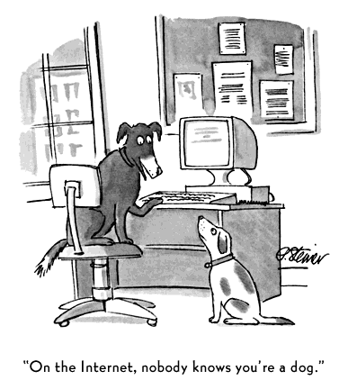
by Peter Steiner,
New York, July 5, 1993

Slide 18
Threat Consequences
Unauthorized disclosure is a threat to confidentiality
Exposure: This can be deliberate or be the result of a human, hardware, or software error
Interception: unauthorized access to data
Inference: e.g., traffic analysis or use of limited access to get detailed information
Intrusion: unauthorized access to sensitive data
Notes:
Table 1.2 , based on RFC 2828, describes four kinds of threat consequences and lists the kinds of attacks that result in each consequence.
Unauthorized disclosure is a threat to confidentiality. The following types of attacks can result in this threat consequence:
• Exposure: This can be deliberate, as when an insider intentionally releases sensitive information, such as credit card numbers, to an outsider. It can also be the result of a human, hardware, or software error, which results in an entity gaining unauthorized knowledge of sensitive data. There have been numerous instances of this, such as universities accidentally posting student confidential information on the Web.
• Interception: Interception is a common attack in the context of communications. On a shared local area network (LAN), such as a wireless LAN or a broadcast Ethernet, any device attached to the LAN can receive a copy of packets intended for another device. On the Internet, a determined hacker can gain access to e-mail traffic and other data transfers. All of these situations create the potential for unauthorized access to data.
• Inference: An example of inference is known as traffic analysis, in which an adversary is able to gain information from observing the pattern of traffic on a network, such as the amount of traffic between particular pairs of hosts on the network. Another example is the inference of detailed information from a database by a user who has only limited access; this is accomplished by repeated queries whose combined results enable inference.
• Intrusion: An example of intrusion is an adversary gaining unauthorized access to sensitive data by overcoming the system’s access control protections.

Slide 19
Threat Consequences
Deception is a threat to either system or data integrity
Masquerade: an attempt by an unauthorized user to gain access to a system by posing as an authorized user
Falsification: altering or replacing of valid data or the introduction of false data
Repudiation: denial of sending, receiving or possessing the data.
Notes:
Deception is a threat to either system integrity or data integrity. The following types of attacks can result in this threat consequence:
• Masquerade: One example of masquerade is an attempt by an unauthorized user to gain access to a system by posing as an authorized user; this could happen if the unauthorized user has learned another user’s logon ID and password. Another example is malicious logic, such as a Trojan horse, that appears to perform a useful or desirable function but actually gains unauthorized access to system resources or tricks a user into executing other malicious logic.
• Falsification: This refers to the altering or replacing of valid data or the introduction of false data into a file or database. For example, a student may alter his or her grades on a school database.
• Repudiation: In this case, a user either denies sending data or a user denies receiving or possessing the data.

Slide 20
Threat Consequences
Usurpation is a threat to system integrity.
Misappropriation: e.g., theft of service, distributed denial of service attack
Misuse: security functions can be disabled or thwarted
Notes:
Usurpation is a threat to system integrity. The following types of attacks can result in this threat consequence:
• Misappropriation: This can include theft of service. An example is a distributed denial of service attack, when malicious software is installed on a number of hosts to be used as platforms to launch traffic at a target host. In this case, the malicious software makes unauthorized use of processor and operating system resources.
• Misuse: Misuse can occur by means of either malicious logic or a hacker that has gained unauthorized access to a system. In either case, security functions can be disabled or thwarted.

Slide 21
Threat Consequences
Disruption is a threat to availability or system integrity
Incapacitation: a result of physical destruction of or damage to system hardware
Corruption: system resources or services function in an unintended manner; unauthorized modification
Obstruction: e.g. overload the system or interfere with communications
Notes:
Disruption is a threat to availability or system integrity. The following types of attacks can result in this threat consequence:
• Incapacitation: This is an attack on system availability. This could occur as a result of physical destruction of or damage to system hardware. More typically, malicious software, such as Trojan horses, viruses, or worms, could operate in such a way as to disable a system or some of its services.
• Corruption: This is an attack on system integrity. Malicious software in this context could operate in such a way that system resources or services function in an unintended manner. Or a user could gain unauthorized access to a system and modify some of its functions. An example of the latter is a user placing backdoor logic in the system to provide subsequent access to a system and its resources by other than the usual procedure.
Obstruction: One way to obstruct system operation is to interfere with communications by disabling communication links or altering communication control information. Another way is to overload the system by placing excess burden on communication traffic or processing resources.

Slide 22
Scope of Computer Security
Notes:
The assets of a computer system can be categorized as hardware, software, data, and communication lines and networks. In this subsection, we briefly describe these four categories and relate these to the concepts of integrity, confidentiality, and availability introduced in Section 1.1 (see Figure 1.3 and Table 1.3 ).

Slide 23
Computer and Network Assets
Jamming
Notes:
HARDWARE A major threat to computer system hardware is the threat to availability. Hardware is the most vulnerable to attack and the least susceptible to automated controls. Threats include accidental and deliberate damage to equipment as well as theft. The proliferation of personal computers and workstations and the widespread use of LANs increase the potential for losses in this area. Theft of CD-ROMs and DVDs can lead to loss of confidentiality. Physical and administrative security measures are needed to deal with these threats.
SOFTWARE Software includes the operating system, utilities, and application programs. A key threat to software is an attack on availability. Software, especially application software, is often easy to delete. Software can also be altered or damaged to render it useless. Careful software configuration management, which includes making backups of the most recent version of software, can maintain high availability. A more difficult problem to deal with is software modification that results in a program that still functions but that behaves differently than before, which is a threat to integrity/authenticity. Computer viruses and related attacks fall into this category. A final problem is protection against software piracy. Although certain countermeasures are available, by and large the problem of unauthorized copying of software has not been solved.
DATA Hardware and software security are typically concerns of computing center professionals or individual concerns of personal computer users. A much more widespread problem is data security, which involves files and other forms of data controlled by individuals, groups, and business organizations. Security concerns with respect to data are broad, encompassing availability, secrecy, and integrity. In the case of availability, the concern is with the destruction of data files, which can occur either accidentally or maliciously.
The obvious concern with secrecy is the unauthorized reading of data files or databases, and this area has been the subject of perhaps more research and effort than any other area of computer security. A less obvious threat to secrecy involves the analysis of data and manifests itself in the use of so-called statistical databases, which provide summary or aggregate information. Presumably, the existence of aggregate information does not threaten the privacy of the individuals involved. However, as the use of statistical databases grows, there is an increasing potential for disclosure of personal information. In essence, characteristics of constituent individuals may be identified through careful analysis. For example, if one table records the aggregate of the incomes of respondents A, B, C, and D and another records the aggregate of the incomes of A, B, C, D, and E, the difference between the two aggregates would be the income of E. This problem is exacerbated by the increasing desire to combine data sets. In many cases, matching several sets of data or consistency at different levels of aggregation requires access to individual units. Thus, the individual units, which are the subject of privacy concerns, are available at various stages in the processing of data sets.
Finally, data integrity is a major concern in most installations. Modifications to data files can have consequences ranging from minor to disastrous.

Slide 24
Passive and Active Attacks
Passive attacks attempt to learn or make use of information from the system but does not affect system resources
eavesdropping/monitoring transmissions
difficult to detect
emphasis is on prevention rather than detection
two types:
message contents
traffic analysis
Active attacks involve modification of the data stream
goal is to detect them and then recover
categories:
masquerade
replay
modification of messages
denial of service
Notes:
COMMUNICATION LINES AND NETWORKS
Network security attacks can be classified as passive attacks and active attacks . A passive attack attempts to learn or make use of information from the system but does not affect system resources. An active attack attempts to alter system resources or affect their operation.
Passive attacks are in the nature of eavesdropping on, or monitoring of, transmissions. The goal of the attacker is to obtain information that is being transmitted. Two types of passive attacks are release of message contents and traffic analysis.
The release of message contents is easily understood. A telephone conversation, an electronic mail message, and a transferred file may contain sensitive or confidential information. We would like to prevent an opponent from learning the contents of these transmissions.
A second type of passive attack, traffic analysis , is subtler. Suppose that we had a way of masking the contents of messages or other information traffic so that opponents, even if they captured the message, could not extract the information from the message. The common technique for masking contents is encryption. If we had encryption protection in place, an opponent might still be able to observe the pattern of these messages. The opponent could determine the location and identity of communicating hosts and could observe the frequency and length of messages being exchanged. This information might be useful in guessing the nature of the communication that was taking place.
Passive attacks are very difficult to detect because they do not involve any alteration of the data. Typically, the message traffic is sent and received in an apparently normal fashion and neither the sender nor receiver is aware that a third party has read the messages or observed the traffic pattern. However, it is feasible to prevent the success of these attacks, usually by means of encryption.
Thus, the emphasis in dealing with passive attacks is on prevention rather than detection.
Active attacks involve some modification of the data stream or the creation of a false stream and can be subdivided into four categories: replay, masquerade, modification of messages, and denial of service.
Replay involves the passive capture of a data unit and its subsequent retransmission to produce an unauthorized effect.
A masquerade takes place when one entity pretends to be a different entity. A masquerade attack usually includes one of the other forms of active attack. For example, authentication sequences can be captured and replayed after a valid authentication sequence has taken place, thus enabling an authorized entity with few privileges to obtain extra privileges by impersonating an entity that has those privileges.
Modification of messages simply means that some portion of a legitimate message is altered, or that messages are delayed or reordered, to produce an unauthorized effect. For example, a message stating, “Allow John Smith to read confidential file accounts” is modified to say, “Allow Fred Brown to read confidential file accounts.”
The denial of service prevents or inhibits the normal use or management of communications facilities. This attack may have a specific target; for example, an entity may suppress all messages directed to a particular destination (e.g., the security audit service). Another form of service denial is the disruption of an entire network, either by disabling the network or by overloading it with messages so as to degrade performance.
Active attacks present the opposite characteristics of passive attacks. Whereas passive attacks are difficult to detect, measures are available to prevent their success. On the other hand, it is quite difficult to prevent active attacks absolutely, because to do so would require physical protection of all communications facilities and paths at all times. Instead, the goal is to detect them and to recover from any disruption or delays caused by them. Because the detection has a deterrent effect, it may also contribute to prevention.

Slide 25
Security Functional Requirements
computer security technical measures
management controls and procedures
overlap computer security technical measures and management controls
access control
identification & authentication;
system & communication protection
system & information integrity
awareness & training
audit & accountability
certification, accreditation, & security assessments
contingency planning
maintenance
physical & environmental protection
planning
personnel security
risk assessment
systems & services acquisition
configuration management
incident response
media protection
Notes:
There are a number of ways of classifying and characterizing the countermeasures that may be used to reduce vulnerabilities and deal with threats to system assets. It will be useful for the presentation in the remainder of the book to look at several approaches, which we do in this and the next two sections. In this section, we view countermeasures in terms of functional requirements, and we follow the classification defined in FIPS PUB 200 ( Minimum Security Requirements for Federal Information and Information Systems ). This standard enumerates 17 security-related areas with regard to protecting the confidentiality, integrity, and availability of information systems and the information processed, stored, and transmitted by those systems.
The requirements listed in FIP PUB 200 encompass a wide range of countermeasures to security vulnerabilities and threats. Roughly, we can divide these countermeasures into two categories: those that require computer security technical measures (covered in this book in Parts One and Two), either hardware or software, or both; and those that are fundamentally management issues (covered in Part Three).
Each of the functional areas may involve both computer security technical measures and management measures. Functional areas that primarily require computer security technical measures include access control, identification and authentication, system and communication protection, and system and information integrity. Functional areas that primarily involve management controls and procedures include awareness and training; audit and accountability; certification, accreditation, and security assessments; contingency planning; maintenance; physical and environmental protection; planning; personnel security; risk assessment; and systems and services acquisition. Functional areas that overlap computer security technical measures and management controls include configuration management, incident response, and media protection.
Note that the majority of the functional requirements areas in FIP PUB 200 are either primarily issues of management or at least have a significant management component, as opposed to purely software or hardware solutions. This may be new to some readers and is not reflected in many of the books on computer and information security. But as one computer security expert observed, “If you think technology can solve your security problems, then you don’t understand the problems and you don’t understand the technology” [SCHN00]. This book reflects the need to combine technical and managerial approaches to achieve effective computer security.
FIPS PUB 200 provides a useful summary of the principal areas of concern, both technical and managerial, with respect to computer security.

Slide 26
Data Origin Authentication
corroboration of the source of a data
supports applications where there are no prior interactions
Authentication
Service
assuring a communication is from the source that it claims to be from
interference by a third party masquerading as one of the two legitimate parties
Peer Entity Authentication
corroboration of the identity of a peer entity
confidence that an entity is not performing
a masquerade or
an unauthorized replay
Notes:
AUTHENTICATION
The authentication service is concerned with assuring that a communication is authentic. In the case of a single message, such as a warning or alarm signal, the function of the authentication service is to assure the recipient that the message is from the source that it claims to be from. In the case of an ongoing interaction, such as the connection of a terminal to a host, two aspects are involved. First, at the time of connection initiation, the service assures that the two entities are authentic, that is, that each is the entity that it claims to be. Second, the service must assure that the connection is not interfered with in such a way that a third party can masquerade as one of the two legitimate parties for the purposes of unauthorized transmission or reception.
Two specific authentication services are defined in the standard:
• Peer entity authentication: Provides for the corroboration of the identity of a peer entity in an association. Two entities are considered peer if they implement the same protocol in different systems (e.g., two TCP users in two communicating systems). Peer entity authentication is provided for use at the establishment of, or at times during the data transfer phase of, a connection. It attempts to provide confidence that an entity is not performing either a masquerade or an unauthorized replay of a previous connection.
• Data origin authentication: Provides for the corroboration of the source of a data unit. It does not provide protection against the duplication or modification of data units. This type of service supports applications like electronic mail where there are no prior interactions between the communicating entities.

Slide 27
Access Control
Service
Nonrepudiation
Service
prevents either sender or receiver from denying a transmitted message
limit and control the access to host systems and applications
each entity trying to gain access must first be identified, or authenticated
Notes:
ACCESS CONTROL In the context of network security, access control is the ability
to limit and control the access to host systems and applications via communications
links. To achieve this, each entity trying to gain access must first be identified, or
authenticated, so that access rights can be tailored to the individual.
NONREPUDIATION prevents either sender or receiver from
denying a transmitted message. Thus, when a message is sent, the receiver can
prove that the alleged sender in fact sent the message. Similarly, when a message
is received, the sender can prove that the alleged receiver in fact received the
message.

Slide 28
Data Confidentiality
Service
connection confidentiality
connectionless confidentiality
selective-field confidentiality
traffic-flow confidentiality
protection of transmitted data from passive attacks
protects user data transmitted over a period of time
Notes:
DATA CONFIDENTIALITY
In the context of network security, confidentiality
is the protection of transmitted data from passive attacks. With respect to the
content of a data transmission, several levels of protection can be identified. The
broadest service protects all user data transmitted between two users over a period
of time. For example, when a TCP connection is set up between two systems,
this broad protection prevents the release of any user data transmitted over the
TCP connection. Narrower forms of this service can also be defined, including
the protection of a single message or even specific fields within a message. These
refinements are less useful than the broad approach and may even be more complex
and expensive to implement.
The other aspect of confidentiality is the protection of traffic flow from
analysis. This requires that an attacker not be able to observe the source and
destination, frequency, length, or other characteristics of the traffic on a communications
facility.

Slide 29
connectionless integrity service
provides protection against message modification only
connection-oriented integrity service
assures that messages are received as sent
no duplication, insertion modification, reordering, or replays
Data
Integrity
Service
can apply to a stream of messages, a single message, or selected fields within a message
with and without recovery
Notes:
DATA INTEGRITY
In the context of network security, as with data confidentiality,
data integrity can apply to a stream of messages, a single message, or selected fields
within a message. Again, the most useful and straightforward approach is total
stream protection.
A connection-oriented integrity service, one that deals with a stream
of messages, assures that messages are received as sent, with no duplication,
insertion, modification, reordering, or replays. The destruction of data is also covered
under this service. Thus, the connection-oriented integrity service addresses
both message stream modification and denial of service. On the other hand, a
connectionless integrity service, one that deals with individual messages without
regard to any larger context, generally provides protection against message modification
only.
We need to make a distinction between the service with and without recovery.
Because the integrity service relates to active attacks, we are concerned with
detection rather than prevention. If a violation of integrity is detected, then the
service may simply report this violation, and some other portion of software or
human intervention is required to recover from the violation. Alternatively, there
are mechanisms available to recover from the loss of integrity of data, as we will
review subsequently. The incorporation of automated recovery mechanisms is, in
general, the more attractive alternative.

Slide 30
a variety of attacks can result in the loss of or reduction in availability
some of these attacks are amenable to authentication and encryption
some attacks require a physical action to prevent or recover from loss of availability
depends on proper management and control of system resources
Availability
Service
a service that protects a system to ensure its availability
being accessible and usable upon demand by an authorized system entity
Notes:
AVAILABILITY
Both X.800 and RFC 2828 define availability to be the property
of a system or a system resource being accessible and usable upon demand by an
authorized system entity, according to performance specifications for the system (i.e.,
a system is available if it provides services according to the system design whenever
users request them). A variety of attacks can result in the loss of or reduction in
availability. Some of these attacks are amenable to automated countermeasures,
such as authentication and encryption, whereas others require a physical action to
prevent or recover from loss of availability.
X.800 treats availability as a property to be associated with various security
services. X.805, Security Architecture for Systems Providing End-to-End
Communications , refers specifically to an availability service. An availability service
is one that protects a system to ensure its availability. This service addresses the
security concerns raised by denial-of-service attacks. It depends on proper management
and control of system resources and thus depends on access control service
and other security services.

Slide 31
Security Implementation
prevention
detection
complementary courses of action
recovery
response
Notes:
Security implementation involves four complementary courses of action:
• Prevention: An ideal security scheme is one in which no attack is successful.
Although this is not practical in all cases, there is a wide range of threats in
which prevention is a reasonable goal. For example, consider the transmission
of encrypted data. If a secure encryption algorithm is used, and if measures
are in place to prevent unauthorized access to encryption keys, then attacks on
confidentiality of the transmitted data will be prevented.
• Detection: In a number of cases, absolute protection is not feasible, but it is
practical to detect security attacks. For example, there are intrusion detection
systems designed to detect the presence of unauthorized individuals logged
onto a system. Another example is detection of a denial of service attack, in
which communications or processing resources are consumed so that they are
unavailable to legitimate users.
• Response: If security mechanisms detect an ongoing attack, such as a denial of
service attack, the system may be able to respond in such a way as to halt the
attack and prevent further damage.
• Recovery: An example of recovery is the use of backup systems, so that if data
integrity is compromised, a prior, correct copy of the data can be reloaded.

Slide 32
Security Mechanism
Feature designed to
Prevent attackers from violating security policy
Detect attackers’ violation of security policy
Response to mitigate attack
Recover, continue to function correctly even if attack succeeds
No single mechanism that will support all services
Authentication, authorization, availability, confidentiality, integrity, non-repudiation
Notes:
Security Mechanisms
Table 1.6 lists the security mechanisms defined in X.800. The mechanisms are
divided into those that are implemented in a specific protocol layer, such as TCP
or an application-layer protocol, and those that are not specific to any particular
protocol layer or security service. These mechanisms will be covered in the appropriate
places in the book and so we do not elaborate now, except to comment on the
definition of encipherment. X.800 distinguishes between reversible encipherment
mechanisms and irreversible encipherment mechanisms. A reversible encipherment
mechanism is an encryption algorithm that allows data to be encrypted and subsequently
decrypted. Irreversible encipherment mechanisms include hash algorithms
and message authentication codes, which are used in digital signature and message
authentication applications.

Slide 33
Fundamental Security Design Principles
Economy of mechanism
Fail-safe defaults
Complete mediation
Open design
Separation of privilege
Least privilege
Least common mechanism
Psychological acceptability
Isolation
Encapsulation
Modularity
Layering
Least astonishment
Notes:
Despite years of research and development, it has not been possible to develop
security design and implementation techniques that systematically exclude security
flaws and prevent all unauthorized actions. In the absence of such foolproof techniques,
it is useful to have a set of widely agreed design principles that can guide
the development of protection mechanisms. The National Centers of Academic
Excellence in Information Assurance/Cyber Defense, which is jointly sponsored by
the U.S. National Security Agency and the U. S. Department of Homeland Security,
list the following as fundamental security design principles [NCAE13]:
• Economy of mechanism
• Fail-safe defaults
• Complete mediation
• Open design
• Separation of privilege
• Least privilege
• Least common mechanism
• Psychological acceptability
• Isolation
• Encapsulation
• Modularity
• Layering
• Least astonishment

Slide 34
Attack Surfaces
Consist of the reachable and exploitable vulnerabilities in a system
Examples:
Open ports on outward facing Web and other servers, and code listening on those ports
Services available on the inside of a firewall
Code that processes incoming data, email, XML, office documents, and industry-specific custom data exchange formats
Interfaces, SQL, and Web forms
An employee with access to sensitive information vulnerable to a social engineering attack
Notes:
An attack surface consists of the reachable and exploitable vulnerabilities in a system
[MANA11, HOWA03]. Examples of attack surfaces are the following:
• Open ports on outward facing Web and other servers, and code listening on
those ports
• Services available on the inside of a firewall
• Code that processes incoming data, email, XML, office documents, and industry-specific
custom data exchange formats
• Interfaces, SQL, and Web forms
• An employee with access to sensitive information vulnerable to a social engineering
attack

Slide 35
Attack Surface Categories
Network Attack Surface
Software Attack Surface
Human Attack Surface
Vulnerabilities over an enterprise network, wide-area network, or the Internet
Vulnerabilities in application, utility, or operating system code
Vulnerabilities created by personnel or outsiders, such as social engineering, human error, and trusted insiders
Included in this category are network protocol vulnerabilities, such as those used for a denial-of-service attack, disruption of communications links, and various forms of intruder attacks
Particular focus is Web server software
Notes:
Attack surfaces can be categorized in the following way:
• Network attack surface: This category refers to vulnerabilities over an enterprise
network, wide-area network, or the Internet. Included in this category
are network protocol vulnerabilities, such as those used for a denial-of-service
attack, disruption of communications links, and various forms of intruder attacks.
• Software attack surface: This refers to vulnerabilities in application, utility,
or operating system code. A particular focus in this category is Web server
software.
• Human attack surface: This category refers to vulnerabilities created by personnel
or outsiders, such as social engineering, human error, and trusted insiders.
An attack surface analysis is a useful technique for assessing the scale and
severity of threats to a system. A systematic analysis of points of vulnerability
makes developers and security analysts aware of where security mechanisms are
required. Once an attack surface is defined, designers may be able to find ways to
make the surface smaller, thus making the task of the adversary more difficult. The
attack surface also provides guidance on setting priorities for testing, strengthening
security measures, or modifying the service or application.

Slide 36
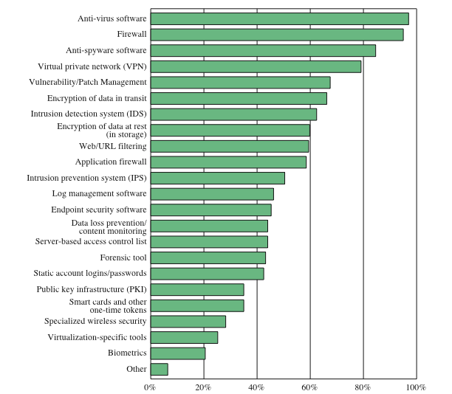
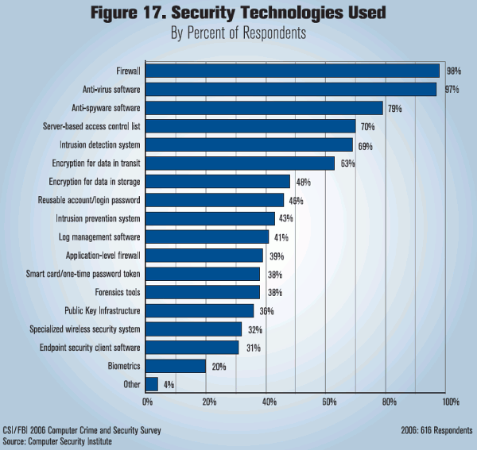
Security Technologies Used
Notes:
Figure 1.5 indicates the types of security technology used by organizations to
counter threats. Both firewalls and antivirus software are used almost universally.
This popularity reflects a number of factors:
• The maturity of these technologies means that security administrators are
very familiar with the products and are confident of their effectiveness.
• Because these technologies are mature and there are a number of vendors, costs
tend to be quite reasonable and user-friendly interfaces are available.
• The threats countered by these technologies are among the most significant
facing security administrators.

Slide 37
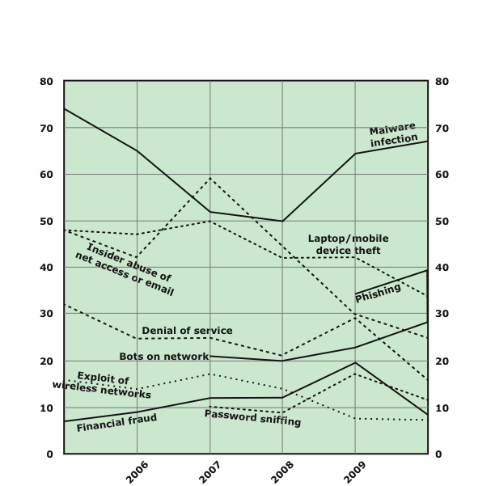
Types of Attacks Experienced
Notes:
In order to assess the relative severity of various threats and the relative importance
of various approaches to computer security, it is useful to look at the experience of
organizations. A useful view is provided by the CSI Computer Crime and Security
Survey for 2010/2011, conducted by the Computer Security Institute. The respondents
consisted of over 350 U.S.-based companies, nonprofit organizations, and
public sector organizations.
Figure 1.4 shows the types of attacks experienced by respondents in nine
major categories. 6 Most noteworthy is the large and growing prevalence of malicious
software (malware) attacks. It is also worth noting that most categories of
attack exhibit a somewhat downward trend. The CSI report speculates that this is
due in large part to improved security techniques by organizations.

Slide 38
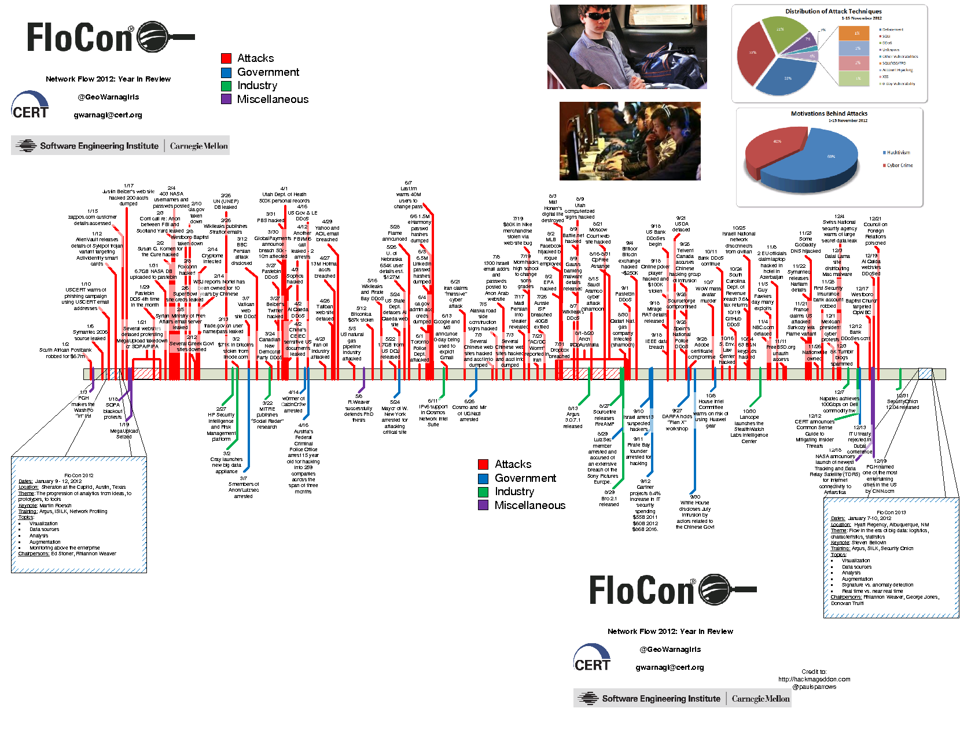

Slide 39
Defense in Depth and Attack Surface
Notes:
As illustrated in Figure 1.3, the use of layering, or defense in depth, and attack
surface reduction complement each other in mitigating security risk.

Slide 40
Computer Security Strategy
Specification & policy
Implementation & mechanisms
Correctness & assurance
what is the security scheme supposed to do?
how does it do it?
does it really work?
Notes:
We conclude this chapter with a brief look at the overall strategy for providing
computer security. [LAMP04] suggests that a comprehensive security strategy
involves three aspects:
• Specification/policy: What is the security scheme supposed to do?
• Implementation/mechanisms: How does it do it?
• Correctness/assurance: Does it really work?

Slide 41
Computer Security Strategy
Security Policy
Formal statement of rules and practices that specify or regulate how a system or organization provides security services to protect sensitive and critical system resources
Security Implementation
Involves four complementary courses of action:
Prevention
Detection
Response
Recovery
Assurance
The degree of confidence one has that the security measures, both technical and operation, work as intended to protect the system and the information it processes
Evaluation
Process of examining a computer product or system with respect to certain criteria
Notes:
The first step in devising security services and mechanisms is to develop a security
policy. Those involved with computer security use the term security policy in
various ways. At the least, a security policy is an informal description of desired
system behavior [NRC91]. Such informal policies may reference requirements for
security, integrity, and availability. More usefully, a security policy is a formal statement
of rules and practices that specify or regulate how a system or organization
provides security services to protect sensitive and critical system resources (RFC
4949). Such a formal security policy lends itself to being enforced by the system’s
technical controls as well as its management and operational controls.
In developing a security policy, a security manager needs to consider the
following factors:
• The value of the assets being protected
• The vulnerabilities of the system
• Potential threats and the likelihood of attacks
Security implementation involves four complementary courses of action:
• Prevention: An ideal security scheme is one in which no attack is successful.
Although this is not practical in all cases, there is a wide range of threats in
which prevention is a reasonable goal. For example, consider the transmission
of encrypted data. If a secure encryption algorithm is used, and if measures
are in place to prevent unauthorized access to encryption keys, then attacks on
confidentiality of the transmitted data will be prevented.
• Detection: In a number of cases, absolute protection is not feasible, but it is
practical to detect security attacks. For example, there are intrusion detection
systems designed to detect the presence of unauthorized individuals logged
onto a system. Another example is detection of a denial of service attack, in
which communications or processing resources are consumed so that they are
unavailable to legitimate users.
• Response: If security mechanisms detect an ongoing attack, such as a denial of
service attack, the system may be able to respond in such a way as to halt the
attack and prevent further damage.
• Recovery: An example of recovery is the use of backup systems, so that if data
integrity is compromised, a prior, correct copy of the data can be reloaded.
The NIST Computer Security Handbook [NIST95] defines assurance as the
degree of confidence one has that the security measures, both technical and operational,
work as intended to protect the system and the information it processes. This
encompasses both system design and system implementation. Thus, assurance deals
with the questions, “Does the security system design meet its requirements?” and
“Does the security system implementation meet its specifications?”
Note that assurance is expressed as a degree of confidence, not in terms of a formal
proof that a design or implementation is correct. The state of the art in proving
designs and implementations is such that it is not possible to provide absolute proof.
Much work has been done in developing formal models that define requirements and
characterize designs and implementations, together with logical and mathematical
techniques for addressing these issues. But assurance is still a matter of degree.
Evaluation is the process of examining a computer product or system with
respect to certain criteria. Evaluation involves testing and may also involve formal
analytic or mathematical techniques. The central thrust of work in this area is
the development of evaluation criteria that can be applied to any security system
(encompassing security services and mechanisms) and that are broadly supported
for making product comparisons.

Slide 42
Security Policy
formal statement of rules and practices that specify or regulate security services
factors to consider:
value of the protected assets
vulnerabilities of the system
potential threats and the likelihood of attacks
trade-offs to consider:
ease of use versus security
cost of security versus cost of failure and recovery
Notes:
The first step in devising security services and mechanisms is to develop a security
policy. Those involved with computer security use the term security policy in
various ways. At the least, a security policy is an informal description of desired
system behavior [NRC91]. Such informal policies may reference requirements for
security, integrity, and availability. More usefully, a security policy is a formal statement
of rules and practices that specify or regulate how a system or organization
provides security services to protect sensitive and critical system resources (RFC
2828). Such a formal security policy lends itself to being enforced by the system’s
technical controls as well as its management and operational controls.
In developing a security policy, a security manager needs to consider the
following factors:
• The value of the assets being protected
• The vulnerabilities of the system
• Potential threats and the likelihood of attacks
Further, the manager must consider the following trade-offs:
• Ease of use versus security: Virtually all security measures involve some penalty
in the area of ease of use. The following are some examples. Access control
mechanisms require users to remember passwords and perhaps perform other
access control actions. Firewalls and other network security measures may
reduce available transmission capacity or slow response time. Virus-checking
software reduces available processing power and introduces the possibility of
system crashes or malfunctions due to improper interaction between the security
software and the operating system.
• Cost of security versus cost of failure and recovery: In addition to ease of use
and performance costs, there are direct monetary costs in implementing and
maintaining security measures. All of these costs must be balanced against the
cost of security failure and recovery if certain security measures are lacking.
The cost of security failure and recovery must take into account not only the
value of the assets being protected and the damages resulting from a security
violation, but also the risk, which is the probability that a particular threat will
exploit a particular vulnerability with a particular harmful result.
Security policy is thus a business decision, possibly influenced by legal requirements.

Slide 43
Assurance and Evaluation
assurance
the degree of confidence one has that the security measures work as intended
both system design and implementation
evaluation
process of examining a system with respect to certain criteria
involves testing and formal analytic or mathematical techniques
Notes:
Those who are “consumers” of computer security services and mechanisms (e.g.,
system managers, vendors, customers, and end users) desire a belief that the security
measures in place work as intended. That is, security consumers want to feel that the
security infrastructure of their systems meet security requirements and enforce security
policies. These considerations bring us to the concepts of assurance and evaluation.
The NIST Computer Security Handbook [NIST95] defines assurance as the
degree of confidence one has that the security measures, both technical and operational,
work as intended to protect the system and the information it processes. This
encompasses both system design and system implementation. Thus, assurance deals
with the questions, “Does the security system design meet its requirements?” and
“Does the security system implementation meet its specifications?”
Note that assurance is expressed as a degree of confidence, not in terms of a formal
proof that a design or implementation is correct. With the present state of the art,
it is very difficult if not impossible to move beyond a degree of confidence to absolute
proof. Much work has been done in developing formal models that define requirements
and characterize designs and implementations, together with logical and mathematical
techniques for addressing these issues. But assurance is still a matter of degree.
Evaluation is the process of examining a computer product or system with
respect to certain criteria. Evaluation involves testing and may also involve formal
analytic or mathematical techniques. The central thrust of work in this area is
the development of evaluation criteria that can be applied to any security system
(encompassing security services and mechanisms) and that are broadly supported
for making product comparisons.

Slide 44
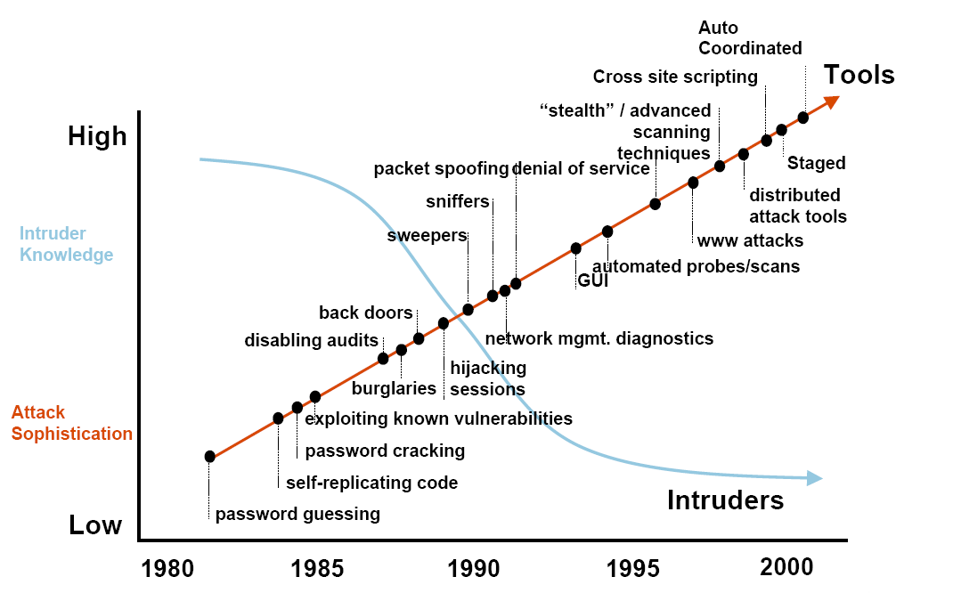
Security Trends
www.cert.org (Computer Emergency Readiness Team)
Notes:
Discuss observed security trends, noting growth in sophistication of attacks contrasting with decrease in skill & knowledge needed to mount an attack.
Computer Emergency Readiness Team

Slide 45
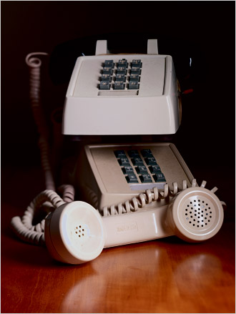


Early Hacking – Phreaking
In1957, a blind seven-year old, Joe Engressia Joybubbles, discovered a whistling tone that resets trunk lines
Blow into receiver – free phone calls
Cap’n Crunch cereal prize
Giveaway whistle produces 2600 MHz tone

Slide 46

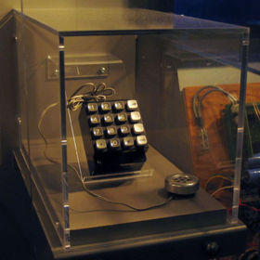
The Seventies
John Draper
a.k.a. Captain Crunch
“If I do what I do, it is only
to explore a system”
In 1971, built Bluebox
with Steve Jobs and
Steve Wozniak

Slide 47

The Eighties
Robert Morris worm - 1988
Developed to measure the size of the Internet
However, a computer could be infected multiple times
Brought down a large fraction of the Internet
~ 6K computers
Academic interest in network security

Slide 48

The Nineties
Kevin Mitnick
First hacker on FBI’s Most Wanted list
Hacked into many networks
including FBI
Stole intellectual property
including 20K credit card numbers
In 1995, caught 2nd time
served five years in prison

Slide 49
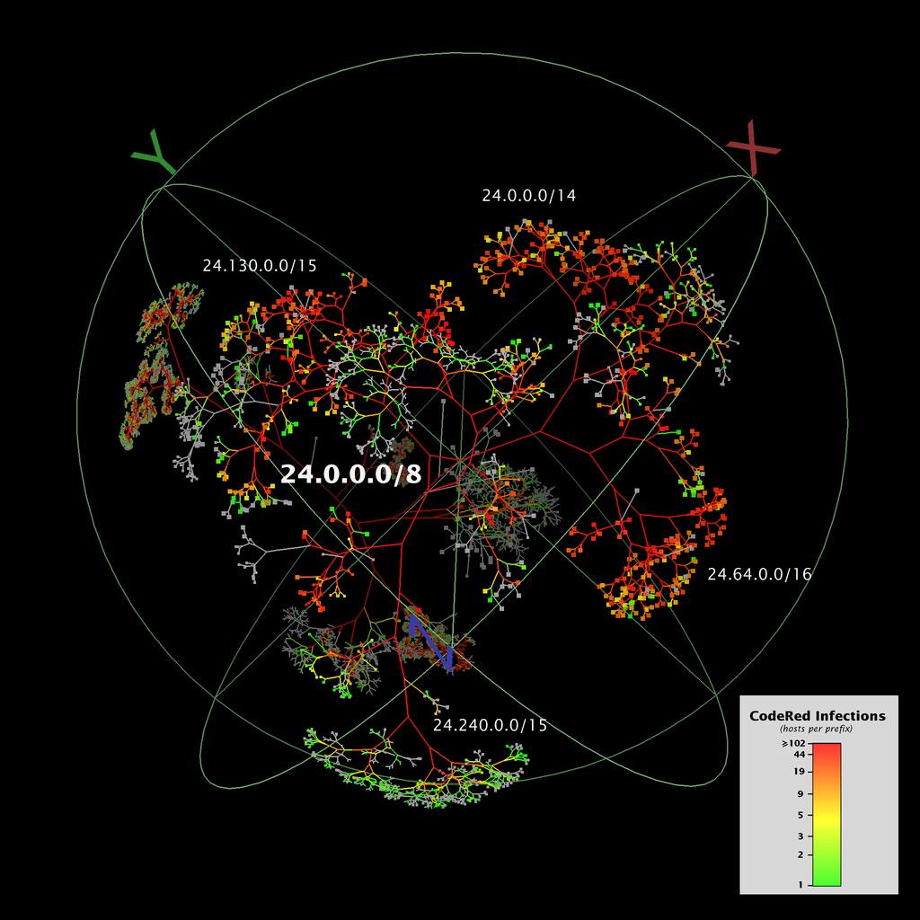
Code-Red Worm
On July 19, 2001, more than 359,000 computers connected to the Internet were infected in less than 14 hours
Spread

Slide 50
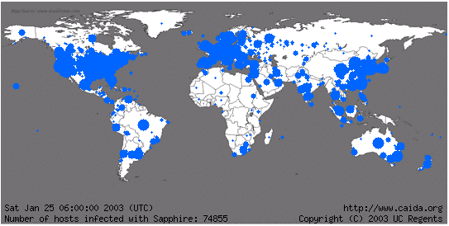
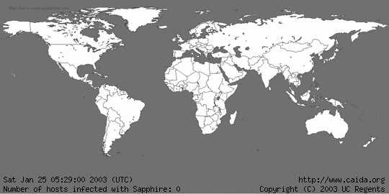
Sapphire Worm
was the fastest computer worm in history
doubled in size every 8.5 seconds
infected more than 90 percent of vulnerable hosts within 10 minutes.

Slide 51
DoS attack on SCO
On Dec 11, 2003
Attack on web and FTP servers of SCO
a software company focusing on UNIX systems
SYN flood of 50K packet-per-second
SCO responded to more than 700 million attack packets over 32 hours
Notes:
CAIDA

Slide 52
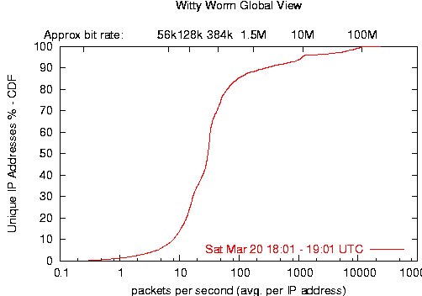
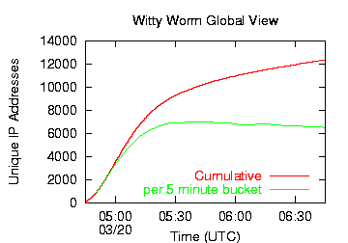
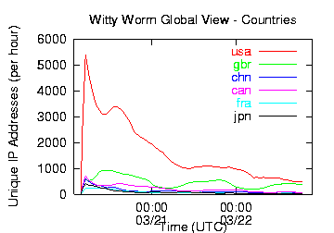
Witty Worm
25 March 2004
reached its peak activity after approximately 45 minutes
at which point the majority of vulnerable hosts had been infected
World
USA

Slide 53
Nyxem Email Virus
Jan 15, 2006: infected about 1M computers within two weeks
At least 45K of the infected computers were also compromised by other forms of spyware or botware
Spread

Slide 54
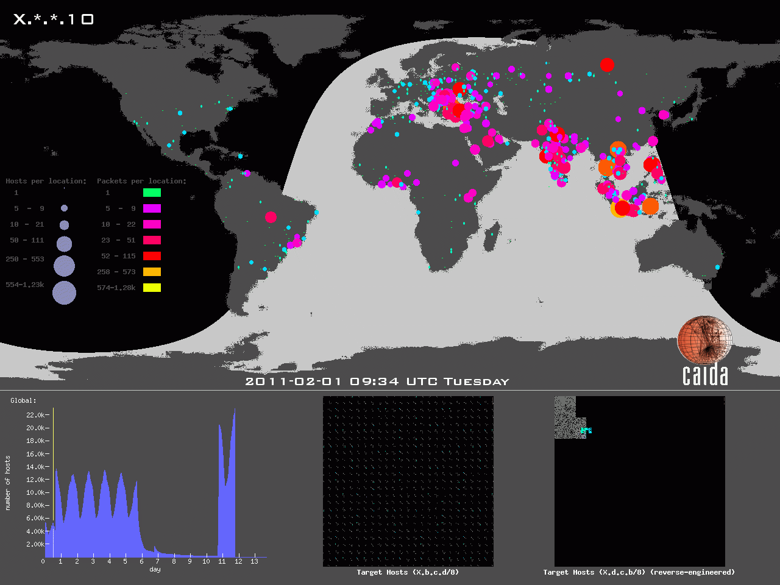
Sipscan Botnet
a botnet-orchestrated stealth scan of the entire IPv4 address space
31 Jan–12 Feb 2011
probing

