Slide 1
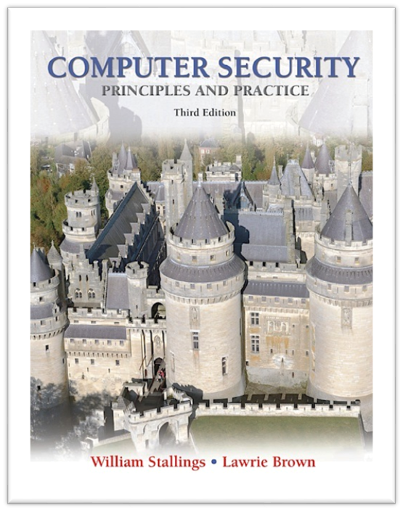
Public-Key Cryptography and
Message Authentication
modified from slides of Lawrie Brown

Slide 2
Public-Key Cryptography and Message Authentication
now look at technical detail concerning:
  secure hash functions and HMAC
  RSA & Diffie-Hellman Public-Key Algorithms
Notes:
This chapter goes into technical detail on the topics of secure hash functions, HMAC, and the RSA and Diffie-Hellman Public-Key algorithms.

Slide 3
Hash Functions
a one-way or secure hash function used in message authentication, digital signatures
all hash functions process input a block at a time in an iterative fashion
one of simplest hash functions is the bit-by-bit exclusive-OR (XOR) of each block
  Ci = bi1 ⊕ bi2 ⊕ . . . ⊕ bim
  effective data integrity check on random data
  less effective on more predictable data
  virtually useless for data security
Notes:
The one-way hash function, or secure hash function, is important not only in message authentication but in digital signatures. Here, we look at several hash functions, concentrating on perhaps the most widely used family of hash functions: SHA.
All hash functions operate using the following general principles. The input (message, file, etc.) is viewed as a sequence of n-bit blocks. The input is processed one block at a time in an iterative fashion to produce an n-bit hash function. One of the simplest hash functions is the bit-by-bit exclusive-OR (XOR) of every block. This produces a simple parity for each bit position and is known as a longitudinal redundancy check, and can be expressed as follows:
C_{i} = b_{i1} ⊕ b_{i2} ⊕ . . . ⊕ b_{im}
It is reasonably effective for random data as a data integrity check. Each n-bit hash value is equally likely. With more predictably formatted data, the function is less effective. A simple way to improve matters is to perform a one-bit circular shift, or rotation, on the hash value after each block is processed. This has the effect of "randomizing" the input more completely and overcoming any regularities that appear in the input. Although the second procedure provides a good measure of data integrity, it is virtually useless for data security when an encrypted hash code is used with a plaintext message. Given a message, it is an easy matter to produce a new message that yields that hash code: Simply prepare the desired alternate message and then append an n-bit block that forces the new message plus block to yield the desired hash code.

Slide 4
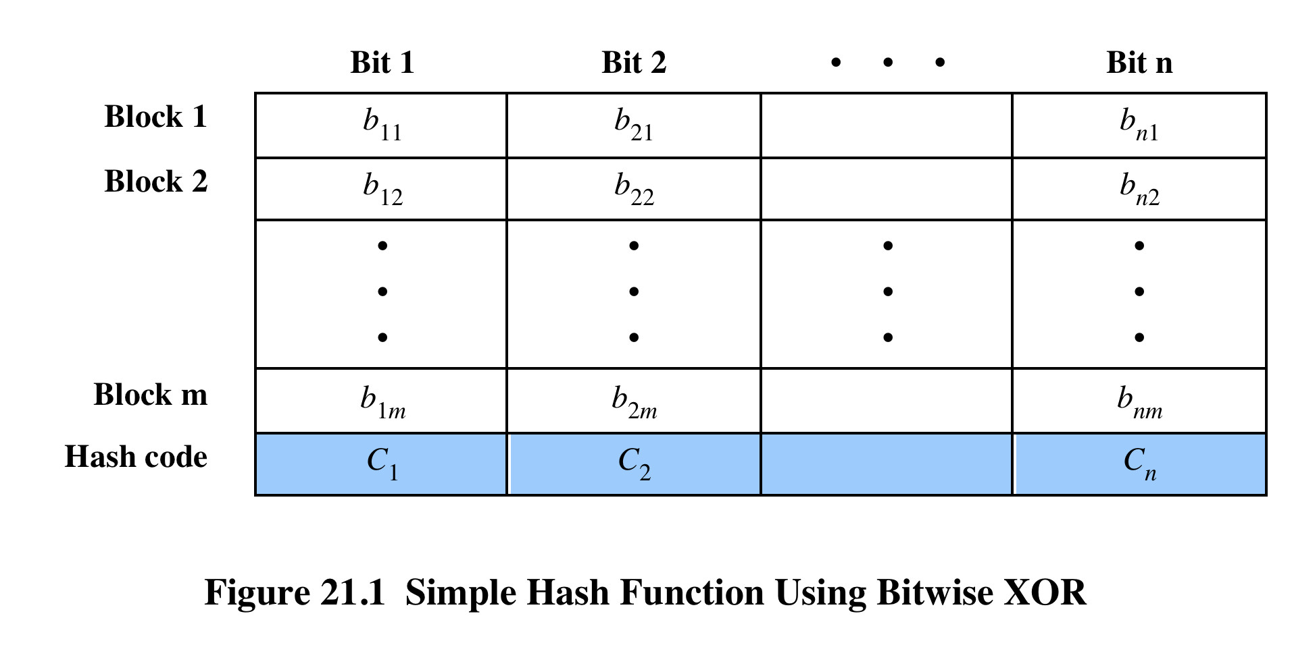
Hash Functions
Notes:
The one-way hash function, or secure hash function, is important not only in
message authentication but also in digital signatures. The requirements for and
security of secure hash functions are discussed in Section 2.2 . Here, we look at
several hash functions, concentrating on perhaps the most widely used family of
hash functions: SHA.
All hash functions operate using the following general principles. The input
(message, file, etc.) is viewed as a sequence of n -bit blocks. The input is processed
one block at a time in an iterative fashion to produce an n -bit hash function.
One of the simplest hash functions is the bit-by-bit exclusive-OR (XOR) of
every block. This can be expressed as follows:
C_{i} = b_{i1} ⊕ b_{i2} ⊕ . . . ⊕ b_{im}
Figure 21.1 illustrates this operation; it produces a simple parity for each bit
position and is known as a longitudinal redundancy check. It is reasonably effective
for random data as a data integrity check. Each n -bit hash value is equally likely.
Thus, the probability that a data error will result in an unchanged hash value is 2^{-n}.
With more predictably formatted data, the function is less effective. For example, in
most normal text files, the high-order bit of each octet is always zero. So if a 128-bit
hash value is used, instead of an effectiveness of 2⁻¹²⁸, the hash function on this type
of data has an effectiveness of 2⁻¹¹².

Slide 5
Collision-resistant, One-way hash fnc.
Given M,
  it is easy to compute h
Given any h,
  it is hard to find any M such that H(M) = h
Given M1, it is difficult to find M2
  such that H(M1) = H(M2)
Functions that satisfy these criteria are called message digest
  They produce a fixed-length digest (fingerprint)

Slide 6
SHA Secure Hash Functions
SHA originally developed by NIST/NSA in 1993
was revised in 1995 as SHA-1
  US standard for use with DSA signature scheme
  standard is FIPS 180-1 1995, also Internet RFC3174
  produces 160-bit hash values
NIST issued revised FIPS 180-2 in 2002
  adds 3 additional versions of SHA
  SHA-256, SHA-384, SHA-512
  with 256/384/512-bit hash values
  same basic structure as SHA-1 but greater security
NIST intend to phase out SHA-1 use
Notes:
The Secure Hash Algorithm (SHA) was developed by the National Institute of Standards and Technology (NIST) and published as a federal information processing standard (FIPS 180) in 1993; a revised version was issued as FIPS 180-1 in 1995 and is generally referred to as SHA-1. SHA-1 is also specified in RFC 3174, which essentially duplicates the material in FIPS 180-1, but adds a C code implementation.
SHA-1 produces a hash value of 160 bits. In 2002, NIST produced a revision of the standard, FIPS 180-2, that defined three new versions of SHA, with hash value lengths of 256, 384, and 512 bits, known as SHA-256, SHA-384, and SHA-512 as detailed in (Table 20.1 in the text). These new versions have the same underlying structure and use the same types of modular arithmetic and logical binary operations as SHA-1. In 2005, NIST announced the intention to phase out approval of SHA-1 and move to a reliance on the other SHA versions by 2010. Shortly thereafter, a research team described an attack in which two separate messages could be found that deliver the same SHA-1 hash using 2⁶⁹ operations, far fewer than the 2⁸⁰ operations previously thought needed to find a collision with an SHA-1 hash. This result should hasten the transition to the other versions of SHA.

Slide 7
SHA
 | Output size (bits) | Internal state size (bits) | Block size (bits) | Max message size (bits) | Word size (bits) | Rounds | Operations | Collisions found
SHA-0 | 160 | 160 | 512 | 2⁶⁴ − 1 | 32 | 80 | +, and, or, xor, rot | Yes
SHA-1 | 160 | 160 | 512 | 2⁶⁴ − 1 | 32 | 80 | +, and, or, xor, rot | None (2⁵¹ attack)
SHA-2 | 256/224 | 256 | 512 | 2⁶⁴ − 1 | 32 | 64 | +, and, or, xor, shr, rot | None
 | 512/384 | 512 | 1024 | 2¹²⁸ − 1 | 64 | 80 | +, and, or, xor, shr, rot | None
Security of them is 2^{n/2} due to birthday attack

Slide 8
SHA-1 Step 1 -- Padding
Padding → the total length of a padded message is multiple of 512
  Every message is padded even if its length is already a multiple of 512
Padding is done by appending to the input
  A single bit, 1
  Enough additional bits, all 0, to make the final 512 block exactly 448 bits long
  A 64-bit integer representing the length of the original message in bits

Slide 9
SHA-1 Padding (cont.)
Message
1
0…0
Message length
1 bit
64 bits
Multiple of 512

Slide 10
SHA-1 Example
M = 01100010 11001010 1001 (20 bits)
Padding is done by appending to the input
  A single bit, 1
  427 0s
  A 64-bit integer representing 20
Pad(M) = 01100010 11001010 10011000 … 00010100

Slide 11
SHA-1 Example
Length of M = 500 bits
Padding is done by appending to the input:
  A single bit, 1
  459 0s
  A 64-bit integer representing 500
Length of Pad(M) = 1024 bits

Slide 12
SHA-1 Step 2 -- Dividing Pad(M)
Pad (M) = B₁, B₂, B₃, …, B_{n}
Each B_{i} denote a 512-bit block
Each B_{i} is divided into 16 32-bit words
  W₀, W₁, …, W₁₅
CS 450/650 Lecture 8: Secure Hash Algorithm

Slide 13
SHA-1 Step 3 – Compute W₁₆ – W₇₉
To Compute word W_{j} (16<=j<=79)
  W_{j-3}, W_{j-8}, W_{j-14} , W_{j-16} are XORed
  The result is circularly left shifted one bit
CS 450/650 Lecture 8: Secure Hash Algorithm

Slide 14
SHA-1 Initialize 32-bit words
A = H₀ = 67452301
B = H₁ = EFCDAB89
C = H₂ = 98BADCFE
D = H₃ = 10325476
E = H₄ = C3D2E1F0
K₀ – K₁₉ = 5A827999
K₂₀ – K₃₉ = 6ED9EBA1
K₄₀ – K₄₉ = 8F1BBCDC
K₆₀ – K₇₉ = CA62C1D6

Slide 15
SHA-1 Step 5 – Loop
For j = 0 … 79
TEMP = CircLeShift_5 (A) + f_{j}(B,C,D) + E + W_{j} + K_{j}
E = D; D = C;
C = CircLeShift_30(B);
B = A; A = TEMP
Done
    + → addition (ignore overflow)

Slide 16
SHA-1 Four functions
For j = 0 … 19
  f_{j}(B,C,D) = (B AND C) OR (B AND D) OR (C AND D)
For j = 20 … 39
  f_{j}(B,C,D) = (B XOR C XOR D)
For j = 40 … 59
  f_{j}(B,C,D) = (B AND C) OR ((NOT B) AND D)
For j = 60 … 79
  f_{j}(B,C,D) = (B XOR C XOR D)

Slide 17
SHA-1 Step 6 – Final
H₀ = H₀ + A
H₁ = H₁ + B
H₂ = H₂ + C
H₃ = H₃ + D
H₄ = H₄ + E

Slide 18
SHA-1 Done
Once these steps have been performed on each 512-bit block (B₁, B₂, …, B_{n}) of the padded message,
  the 160-bit message digest is given by
H₀ H₁ H₂ H₃ H₄

Slide 19
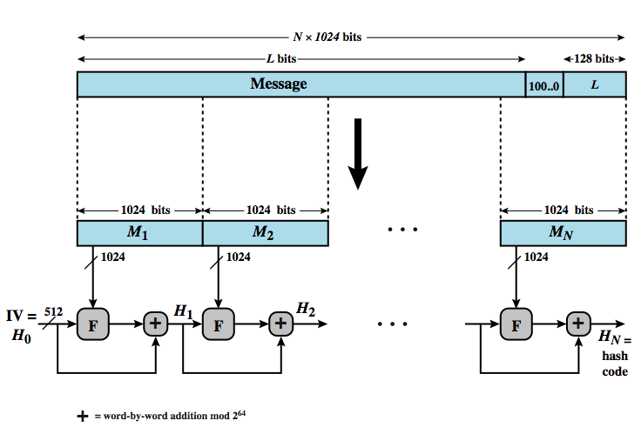
SHA-512 Structure
Notes:
Now examine the structure of SHA-512, noting that the other versions are quite similar. The algorithm takes as input a message with a maximum length of less than 2¹²⁸ bits and produces as output a 512-bit message digest. The input is processed in 1024-bit blocks. Figure 22.2 depicts the overall processing of a message to produce a digest. The processing consists of the following steps (see text for additional details):
• Step 1: Append padding bits: so that message length is congruent to 896 modulo 1024 [length ≡ 896 (mod 1024)]. The padding consists of a single 1-bit followed by the necessary number of 0-bits.
• Step 2: Append length: as a block of 128 bits being an unsigned 128-bit integer length of the original message (before padding).
• Step 3: Initialize hash buffer: to the specified 64-bit integer values (see text).
• Step 4: Process the message in 1024-bit (128-word) blocks, which forms the heart of the algorithm, being a module, labeled F in this figure, that consists of 80 rounds. The logic is described on the next slide
• Step 5: Output the final hash buffer value as the resulting hash
The SHA-512 algorithm has the property that every bit of the hash code is a function of every bit of the input. The complex repetition of the basic function F produces results that are well mixed; that is, it is unlikely that two messages chosen at random, even if they exhibit similar regularities, will have the same hash code. Unless there is some hidden weakness, the difficulty of coming up with two messages having the same message digest is on the order of 2²⁵⁶ operations, while the difficulty of finding a message with a given digest is on the order of 2⁵¹² operations.

Slide 20
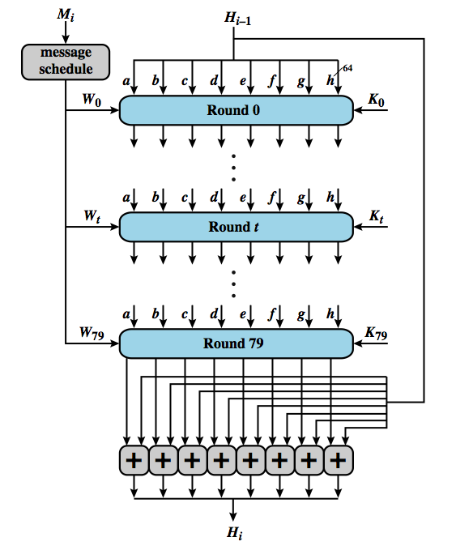
SHA-512 Round
Notes:
Each round takes as input the 512-bit buffer value abcdefgh, and updates the contents of the buffer. At input to the first round, the buffer has the value of the intermediate hash value, H_{i–1}. Each round t makes use of a 64-bit value W_{t}, derived from the current 1024-bit block being processed (M_{i}). Each round also makes use of an additive constant K_{t}, where 0 ≤ t ≤ 79 indicates one of the 80 rounds. These words represent the first sixty-four bits of the fractional parts of the cube roots of the first eighty prime numbers. The constants provide a “randomized” set of 64-bit patterns, which should eliminate any regularities in the input data. The operations performed during a round consist of circular shifts, and primitive Boolean functions based on AND, OR, NOT, and XOR.
The output of the eightieth round is added to the input to the first round (H_{i–1}) to produce H_{i}. The addition is done independently for each of the eight words in the buffer with each of the corresponding words in H_{i–1}, using addition modulo 2⁶⁴.

Slide 21
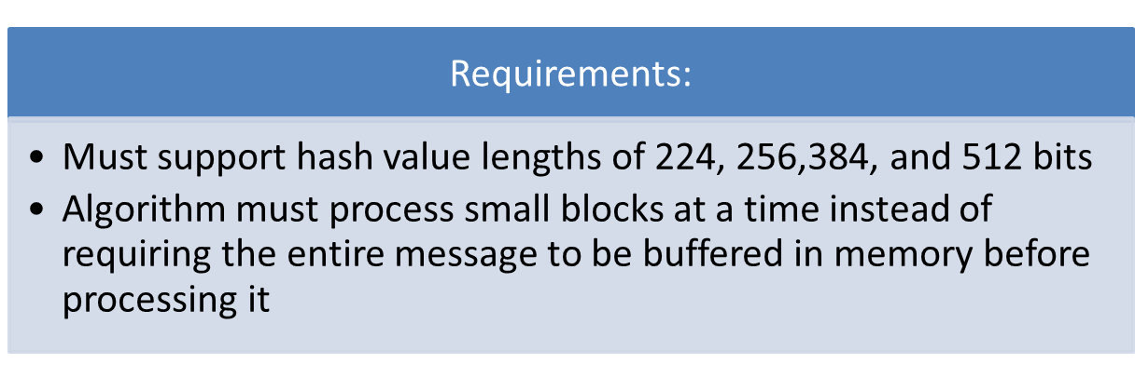
SHA-3
SHA-2 shares same structure and mathematical operations as its predecessors and causes concern
Due to time required to replace SHA-2 should it become vulnerable, NIST announced in 2007 a competition to produce SHA-3
Notes:
SHA-2, particularly the 512-bit version, would appear to provide unassailable
security. However, SHA-2 shares the same structure and mathematical operations
as its predecessors, and this is a cause for concern. Because it will take years to find
a suitable replacement for SHA-2, should it become vulnerable, NIST decided to
begin the process of developing a new hash standard.
Accordingly, NIST announced in 2007 a competition to produce the next
generation NIST hash function, to be called SHA-3. The basic requirements that
must be satisfied by any candidate for SHA-3 are the following.
1. It must be possible to replace SHA-2 with SHA-3 in any application by a simple
drop-in substitution. Therefore, SHA-3 must support hash value lengths of
224, 256, 384, and 512 bits.
2. SHA-3 must preserve the online nature of SHA-2. That is, the algorithm must
process comparatively small blocks (512 or 1024 bits) at a time instead of
requiring that the entire message be buffered in memory before processing it.

Slide 22
Other Secure Hash Functions
most based on iterated hash function design
  if compression function is collision resistant
  so is resultant iterated hash function
MD5 (RFC1321)
  was a widely used hash developed by Ron Rivest
  produces 128-bit hash, now too small
  also have cryptanalytic concerns
Whirlpool (NESSIE endorsed hash)
  developed by Vincent Rijmen & Paulo Barreto
  compression function is AES derived W block cipher
  produces 512-bit hash
Notes:
As was the case with symmetric block ciphers, most important modern hash functions follow a basic design structure shown in Figure 20.2, referred to as an iterated hash function and initially proposed by Merkle. The motivation for this iterative structure is that if the function for a single block, known as a compression function, is collision resistant, then so is the resultant iterated hash function. Therefore, the structure can be used to produce a secure hash function to operate on a message of any length. The problem of designing a secure hash function reduces to that of designing a collision-resistant compression function that operates on inputs of some fixed size. This has proved to be a fundamentally sound approach, and newer designs simply refine the structure and add to the hash code length.
The MD5 message-digest algorithm (RFC 1321) was developed by Ron Rivest. Until the last few years, when both brute-force and cryptanalytic concerns have arisen, MD5 was the most widely used secure hash algorithm. The algorithm takes as input a message of arbitrary length and produces as output a 128-bit message digest. The input is processed in 512-bit blocks, which is now thought too small for security.
Whirlpool was developed by Vincent Rijmen and Paulo Barreto. It is one of only two hash functions endorsed by NESSIE (New European Schemes for Signatures, Integrity, and Encryption). It is based on the use of a block cipher, specifically designed for this use, for the compression function. The block cipher W has a similar structure and uses the same elementary functions as AES, but with a 512-bit block and key size. The algorithm takes as input a message with a maximum length of less than 2²⁵⁶ bits and produces as output a 512-bit message digest. The input is processed in 512-bit blocks.

Slide 23
HMAC
interest a MAC using a cryptographic hash
  due to speed and code availability
must incorporate key into use of hash alg
HMAC (RFC2104) widely supported
  used in IPsec, TLS & SET
HMAC treats hash as “black box”
HMAC proven secure if embedded hash function has reasonable cryptographic strength
Notes:
In recent years, there has been increased interest in developing a MAC derived from a cryptographic hash code, such as SHA-1, since these are usually faster, and code is widely available. A hash function such as SHA-1 was not designed for use as a MAC and cannot be used directly for that purpose because it does not rely on a secret key. There have been a number of proposals for the incorporation of a secret key into an existing hash algorithm. The approach that has received the most support is HMAC.
HMAC has been issued as RFC 2104, has been chosen as the mandatory-to-implement MAC for IP Security, and is used in other Internet protocols, such as Transport Layer Security (TLS, soon to replace Secure Sockets Layer) and Secure Electronic Transaction (SET). HMAC treats the hash function as a "black box." This has two benefits. First, an existing implementation of a hash function can be used as a module in implementing HMAC. In this way, the bulk of the HMAC code is prepackaged and ready to use without modification. Second, if it is ever desired to replace a given hash function in an HMAC implementation, all that is required is to remove the existing hash function module and drop in the new module. This could be done if a faster hash function were desired. More important, if the security of the embedded hash function were compromised, the security of HMAC could be retained simply by replacing the embedded hash function with a more secure one. Also, HMAC can be proven secure provided that the embedded hash function has some reasonable cryptographic strengths.

Slide 24
HMAC Design Objectives
To use, without modifications, available hash functions
To allow for easy replaceability of the embedded hash function in case faster or more secure hash functions are found or required
To preserve the original performance of the hash function without incurring a significant degradation
To use and handle keys in a simple way
To have a well-understood cryptographic analysis of the strength of the authentication mechanism based on reasonable assumptions on the embedded hash function
Notes:
RFC 2104 lists the following design objectives for HMAC:
• To use, without modifications, available hash functions—in particular, hash
functions that perform well in software, and for which code is freely and
widely available
• To allow for easy replaceability of the embedded hash function in case faster
or more secure hash functions are found or required
• To preserve the original performance of the hash function without incurring a
significant degradation
• To use and handle keys in a simple way
• To have a well-understood cryptographic analysis of the strength of the
authentication mechanism based on reasonable assumptions on the embedded
hash function
The first two objectives are important to the acceptability of HMAC. HMAC
treats the hash function as a “black box.” This has two benefits. First, an existing
implementation of a hash function can be used as a module in implementing
HMAC. In this way, the bulk of the HMAC code is prepackaged and ready to use
without modification. Second, if it is ever desired to replace a given hash function
in an HMAC implementation, all that is required is to remove the existing hash
function module and drop in the new module. This could be done if a faster
hash function were desired. More important, if the security of the embedded hash
function were compromised, the security of HMAC could be retained simply by
replacing the embedded hash function with a more secure one.
The last design objective in the preceding list is, in fact, the main advantage
of HMAC over other proposed hash-based schemes. HMAC can be proven secure
provided that the embedded hash function has some reasonable cryptographic
strengths. We return to this point later in this section, but first we examine the
structure of HMAC.

Slide 25
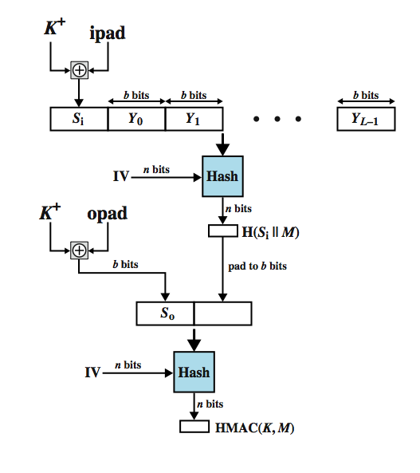
HMAC Structure
ipad = 36
opad = 5C
Notes:
Figure 20.4 illustrates the overall operation of HMAC, which implements:
HMAC(K,M) = Hash[(K+ XOR opad)||Hash[(K+ XOR ipad)||M)]
the elements of this are:
K+ is K padded with zeros on the left so that the result is b bits in length
ipad is a pad value of 36 hex repeated to fill block
opad is a pad value of 5C hex repeated to fill block
M is the message input to HMAC (including any padding)
In words:
1. Append zeros to the left end of K to create a b-bit string K⁺ (e.g., if K is of length 160 bits and b = 512, then K will be appended with 44 zero bytes 0x00).
2. XOR (bitwise exclusive-OR) K⁺ with ipad to produce the b-bit block S_{i}.
3. Append M to S_{i}.
4. Apply H to the stream generated in step 3.
5. XOR K⁺ with opad to produce the b-bit block S_{o}.
6. Append the hash result from step 4 to S_{o}.
7. Apply H to the stream generated in step 6 and output the result.
HMAC should execute in approximately the same time as the embedded hash function for long messages. HMAC adds three executions of the basic hash function (for S_{i}, S_{o}, and the block produced from the inner hash).

Slide 26
Security of HMAC
security based on underlying hash strength
either attacker computes output even with random secret IV
  brute force key O(2^{n}), or use birthday attack
or attacker finds collisions in hash function even when IV is random and secret
  ie. find M and M' such that H(M) = H(M')
  birthday attack O(2^{n/2})
Notes:
The security of any MAC function based on an embedded hash function depends on the cryptographic strength of the underlying hash function. The security of a MAC function is generally expressed in terms of the probability of successful forgery with a given amount of time spent by the forger and a given number of message-MAC pairs created with the same key. In essence, the probability of successful attack is either:
1. The attacker is able to compute an output of the compression function even with an IV that is random, secret, and unknown to the attacker. For this attack, the IV of the hash function is replaced by a secret, random value of n bits. An attack on this hash function requires either a brute-force attack on the key, which is a level of effort on the order of 2^{n}, or a birthday attack, which is a special case of the next attack; or
2. The attacker finds collisions in the hash function even when the IV is random and secret. Here the attacker is looking for two messages M and M' that produce the same hash: H(M) = H(M'). This is the birthday attack, and requires an effort of 2^{n/2} for a hash length of n. On this basis, the security of MD5 is called into question, because a level of effort of 2⁶⁴ looks feasible with today's technology. Does this mean that a 128-bit hash function such as MD5 is unsuitable for HMAC? The answer is no, because when attacking HMAC, the attacker cannot generate message/code pairs off line because the attacker does not know K. Therefore, the attacker must observe a sequence of messages generated by HMAC under the same key and perform the attack on these known messages. For a hash code length of 128 bits, this requires 2⁶⁴ observed blocks (2⁷² bits) generated using the same key. On a 1-Gbps link, one would need to observe a continuous stream of messages with no change in key for about 150,000 years in order to succeed. Thus, if speed is a concern, it is fully acceptable to use MD5 rather than SHA as the embedded hash function for HMAC.

Slide 27
RSA Public-Key Encryption
by Rivest, Shamir & Adleman in 1977
best known & widely used public-key alg
uses exponentiation of integers modulo a prime
encrypt: C = Me mod n
decrypt: M = C^{d} mod n = (Me) ^{d} mod n = M
both sender and receiver know values of n and e
only receiver knows value of d
public-key encryption algorithm with
  public key PU = {e, n} & private key PR = {d, n}.
Notes:
Perhaps the most widely used public-key algorithms are RSA and Diffie-Hellman. One of the first public-key schemes was developed in 1977 by Ron Rivest, Adi Shamir, and Len Adleman at MIT and first published in 1978. The RSA scheme has since that time reigned supreme as the most widely accepted and implemented approach to public-key encryption. RSA is a block cipher in which the plaintext and ciphertext are integers between 0 and n – 1 for some n. Encryption and decryption are of the following form, for some plaintext block M and ciphertext block C:
C = Me mod n
M = C^{d} mod n = (Me)^{d} mod n = M^{ed} mod n
Both sender and receiver must know the values of n and e, and only the receiver knows the value of d. This is a public-key encryption algorithm with a public key of PU = {e, n} and a private key of PR = {d, n}. See text for details of how these values are derived, and their requirements.

Slide 28
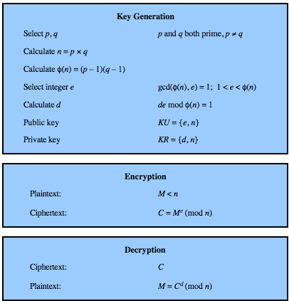
RSA Algorithm
Notes:
Figure 20.5 summarizes the RSA algorithm. Begin by selecting two prime numbers, p and q and calculating their product n, which is the modulus for encryption and decryption. Next, we need the quantity Then select an integer e that is relatively prime to φ(n) [i.e., the greatest common divisor of e and φ(n) is 1]. Finally, calculate d as the multiplicative inverse of e, modulo φ(n). It can be shown that d and e have the desired properties.
Suppose that user A has published its public key and that user B wishes to send the message M to A. Then B calculates C = Me (mod n) and transmits C. On receipt of this ciphertext, user A decrypts by calculating M = C^{d} (mod n).

Slide 29
Key Choice
Let p and q be two large prime numbers
Let N = pq
Choose e relatively prime to (p−1)(q−1)
  a prime number larger than p-1 and q-1
Find d such that ed mod (p−1)(q−1) = 1

Slide 30
RSA
Recall that e and N are public
If attacker can factor N, he can use e to easily find d
  since ed mod (p−1)(q−1) = 1
Factoring the modulus breaks RSA
It is not known whether factoring is the only way to break RSA

Slide 31
Does RSA Really Work?
Given c = Me mod N we must show
  M = c^{d} mod N = M^{ed} mod N
We’ll use Euler’s Theorem
  If x is relatively prime to N then x^{ϕ(N)} mod N =1
    ϕ(n): number of positive integers less than n that are relatively prime to n.
    If p is prime then, ϕ(p) = p-1

Slide 32
Does RSA Really Work?
Facts:
  ed mod (p − 1)(q − 1) = 1
  ed = k(p − 1)(q − 1) + 1 by definition of mod
  ϕ(N) = (p − 1)(q − 1)
  Then ed − 1 = k(p − 1)(q − 1) = kϕ(N)
M^{ed} = M^{(ed-1)+1} = M⋅M^{ed-1} = M⋅M^{kϕ(N)}
= M⋅(M^{ϕ(N)}) ^{k} mod N = M⋅1 ^{k} mod N
= M mod N

Slide 33
Example
Select primes p=11, q=3.
N = p* q = 11*3 = 33
Choose e = 3
check gcd(e, p-1) = gcd(3, 10) = 1
  i.e. 3 and 10 have no common factors except 1
check gcd(e, q-1) = gcd(3, 2) = 1
therefore gcd(e, (p-1)(q-1)) = gcd(3, 20) = 1

Slide 34
Example (cont.)
p-1 * q-1 = 10 * 2 = 20
Compute d such that
e * d mod (p-1)*(q-1) = 1
3 * d mod 20 = 1
d = 7
Public key = (N, e) = (33, 3)
Private key = (N, d) = (33, 7)

Slide 35
Example (cont.)
Now say we want to encrypt message m = 7
c = Me mod N = 7³ mod 33 = 343 mod 33 = 13
  Hence the ciphertext c = 13
To check decryption, we compute
M' = c^{d} mod N = 13⁷ mod 33 = 7

Slide 36
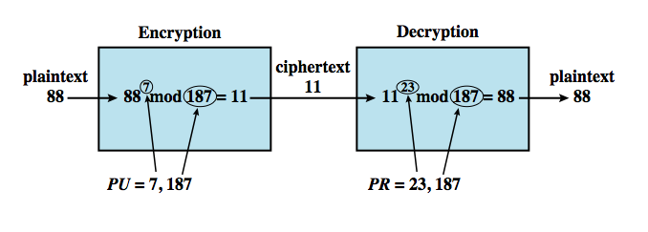
RSA Example
p = 17 and q = 11
choose e = 7
n = pq = 17 × 11 = 187
de mod 160 = 1
=> d = 23
φ(n) = (p – 1)(q – 1) = 16 × 10 = 160
Notes:
An example is shown in Figure 20.6. For this example, the keys were generated as:
1. Select two prime numbers, p = 17 and q = 11.
2. Calculate n = pq = 17 × 11 = 187.
3. Calculate φ(n) = (p – 1)(q – 1) = 16 × 10 = 160.
4. Select e s.t. e is relatively prime to φ(n) = 160 and less than φ(n); we choose e = 7.
5. Determine d such that de mod 160 = 1 and d < 160. The correct value is d = 23, because 23 × 7 = 161 = (1 × 160) + 1.
The resulting keys are public key PU = {7, 187} and private key PR = {23, 187}. The example shows the use of these keys for a plaintext input of M = 88.
For encryption, we need to calculate C = 88⁷ mod 187 = 11, which can be done efficiently by exploiting the properties of modular arithmetic, as shown in the text.
For decryption, we calculate M = 11²³ mod 187 = 88.

Slide 37
More Efficient RSA
Modular exponentiation example
  5²⁰ = 95367431640625 = 25 mod 35
A better way: repeated squaring
  Note that 20 = 2 ⋅ 10, 10 = 2 ⋅ 5, 5 = 2 ⋅ 2 + 1, 2 = 1⋅ 2
  5¹= 5 mod 35
  5²= (5¹) ² = 5² = 25 mod 35
  5⁵= (5²) ² ⋅ 5¹ = 25² ⋅ 5 = 3125 = 10 mod 35
  5¹⁰ = (5⁵) ² = 10² = 100 = 30 mod 35
  5²⁰ = (5¹⁰) ² = 30² = 900 = 25 mod 35
No huge numbers and it’s efficient!

Slide 38


Security of RSA
brute force
  trying all possible private keys
  use larger key, but then slower
mathematical attacks (factoring n)
  see improving algorithms (QS, GNFS, SNFS)
  currently 1024-2048-bit keys seem secure
timing attacks (on implementation)
  use - constant time, random delays, blinding
chosen ciphertext attacks (on RSA props)
Notes:
Four possible approaches to attacking the RSA algorithm are:
• Brute force: This involves trying all possible private keys. The defense against this is to use a large key space. However, because of the complex calculations used in both key generation and encryption/decryption, larger keys slow the speed of execution.
• Mathematical attacks: Most discussions of the cryptanalysis of RSA have focused on the task of factoring n into its two prime factors, since finding φ(n) given n is equivalent to factoring n. Until the mid-1990s, factoring attacks used the quadratic sieve. The recent attack on RSA-130 used the generalized number field sieve (GNFS), and was able to factor a larger number than RSA-129 at only 20% of the computing effort. We can expect further refinements in GNFS, and the use of an even better algorithm, such as the special number field sieve (SNFS). It is reasonable to expect a breakthrough that would enable a general factoring performance in about the same time as SNFS, or even better. Thus, we need to be careful in choosing a key size for RSA. For the near future, a key size in the range of 1024 to 2048 bits seems secure.
• Timing attacks: These depend on the running time of the decryption algorithm, and is analogous to a burglar guessing a safe combination by observing how long it takes to turn the dial from number to number. The attack exploits the common use of a modular exponentiation algorithm in RSA encryption and decryption, but the attack can be adapted to work with any implementation that does not run in fixed time. Although the timing attack is a serious threat, there are simple countermeasures that can be used such as constant time calcs, random delays or blinding computations.
• Chosen ciphertext attacks: This type of attack exploits properties of the RSA algorithm. A discussion of this attack is beyond the scope of this book.

Slide 39
RSA key-length strength
RSA has challenges for different key-lengths
  RSA-140
    Factored in 1 month using 200 machines in 1999
  RSA-155 (512-bit)
    Factored in 3.7 months using 300 machines in 1999
  RSA-160
    Factored in 20 days in 2003
  RSA-200
    Factored in 18 month in 2005
  RSA-210, RSA-220, RSA-232, … RSA-2048

Slide 40
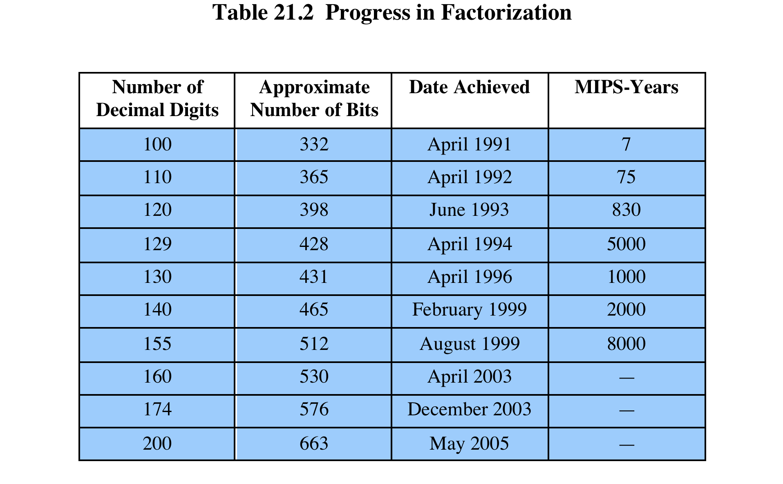
Notes:
For a large n with large prime factors, factoring is a hard problem, but not
as hard as it used to be. Just as it had done for DES, RSA Laboratories issued
challenges for the RSA cipher with key sizes of 100, 110, 120, and so on, digits. The
latest challenge to be met is the RSA-200 challenge with a key length of 200 decimal
digits, or about 663 bits. Table 21.2 shows the results to date. The level of effort is
measured in MIPS-years: a million-instructions-per-second processor running for
one year, which is about 3 * 10¹³ instructions executed (MIPS-year numbers not
available for last 3 entries).
A striking fact about Table 21.2 concerns the method used. Until the
mid-1990s, factoring attacks were made using an approach known as the quadratic
sieve. The attack on RSA-130 used a newer algorithm, the generalized number field
sieve (GNFS), and was able to factor a larger number than RSA-129 at only 20% of
the computing effort.
The threat to larger key sizes is twofold: the continuing increase in computing
power, and the continuing refinement of factoring algorithms. We have seen
that the move to a different algorithm resulted in a tremendous speedup. We can
expect further refinements in the GNFS, and the use of an even better algorithm is
also a possibility. In fact, a related algorithm, the special number field sieve (SNFS),
can factor numbers with a specialized form considerably faster than the generalized
number field sieve. It is reasonable to expect a breakthrough that would enable
a general factoring performance in about the same time as SNFS, or even better.
Thus, we need to be careful in choosing a key size for RSA. For the near future, a
key size in the range of 1024 to 2048 bits seems secure.
In addition to specifying the size of n , a number of other constraints have been
suggested by researchers. To avoid values of n that may be factored more easily, the
algorithm’s inventors suggest the following constraints on p and q :
1. p and q should differ in length by only a few digits. Thus, for a 1024-bit key
(309 decimal digits), both p and q should be on the order of magnitude of
10 ⁷⁵ to 10 ¹⁰⁰ .
2. Both (p - 1) and (q - 1) should contain a large prime factor.
3. gcd (p - 1, q - 1) should be small.
In addition, it has been demonstrated that if e < n and d < n^{1/4} , then d can be easily
determined [WIEN90].

Slide 41

Diffie-Hellman Key Exchange
first public-key type scheme proposed
by Diffie & Hellman in 1976 along with the exposition of public key concepts
  note: Williamson (UK CESG) secretly proposed the concept in 1970
practical method to exchange a secret key
used in a number of commercial products
Notes:
The idea of public key schemes, and the first practical scheme, which was for key distribution only, was published in 1977 by Diffie & Hellman. The concept had been previously described in a classified report in 1970 by Williamson (UK CESG) - and subsequently declassified in 1987. The purpose of the algorithm is to enable two users to exchange a secret key securely that can then be used for subsequent encryption of messages. The algorithm itself is limited to the exchange of the keys. The Diffie-Hellman algorithm depends for its effectiveness on the difficulty of computing discrete logarithms (see text for discussion).

Slide 42
Diffie-Hellman Key Exchange
public-key distribution scheme
  cannot be used to exchange an arbitrary message
  rather it can establish a common key
  known only to the two participants
based on exponentiation in a finite field
  modulo a prime or a polynomial
security relies on the difficulty of computing discrete logarithms
Notes:
The purpose of the algorithm is to enable two users to securely exchange a key that can then be used for subsequent encryption of messages. The algorithm itself is limited to the exchange of secret values, which depends on the value of the public/private keys of the participants. The Diffie-Hellman algorithm uses exponentiation in a finite (Galois) field (modulo a prime or a polynomial), and depends for its effectiveness on the difficulty of computing discrete logarithms.

Slide 43
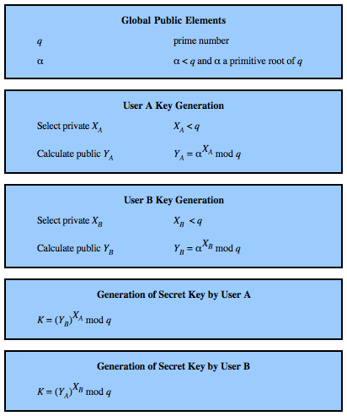
Diffie-Hellman Algorithm
Notes:
The Diffie-Hellman key exchange algortihm is summarized in Figure 20.7. For this scheme, there are two publicly known numbers: a prime number q and an integer α that is a primitive root of q. Suppose the users A and B wish to exchange a key. User A selects a random integer X_{A} < q and computes . Similarly, user B independently selects a random integer X_{B} < q and computes . Each side keeps the X value private and makes the Y value available publicly to the other side. Users A and B compute the key as shown. These two calculations produce identical results, as shown in the text. The result is that the two sides have exchanged a secret value.
Furthermore, because X_{A} and X_{B} are private, an adversary only has the following ingredients to work with: q, α, Y_{A}, and Y_{B}. Thus, the adversary is forced to take a discrete logarithm to determine the key. For example, to determine the private key of user B, an adversary must compute: X_{B} = dlog_{α,q}(Y_{B}). The adversary can then calculate the key K in the same manner as user B calculates it.
The security of the Diffie-Hellman key exchange lies in the fact that, while it is relatively easy to calculate exponentials modulo a prime, it is very difficult to calculate discrete logarithms. For large primes, the latter task is considered infeasible.

Slide 44
Diffie-Hellman Setup
all users agree on global parameters:
  large prime integer or polynomial p
  g = primitive root mod p
    for every integer a that has gcd(a, p) = 1, there is an integer k such that g^{k} ≡ a (mod p)
each user generates their key
  chooses a secret key (number): a < p
  compute their public key: A = gª mod p
Notes:
In the Diffie-Hellman key exchange algorithm, there are two publicly known numbers: a prime number p and an integer g that is a primitive root of p. The prime p and primitive root g can be common to all using some instance of the D-H scheme. Note that the primitive root g is a number whose powers successively generate all the elements mod p. Users Alice and Bob choose random secrets a's, and then "protect" them using exponentiation to create their public A's. For an attacker monitoring the exchange of the A's to recover either of the a's, they'd need to solve the discrete logarithm problem, which is hard.

Slide 45
Diffie-Hellman Key Exchange
shared session key for users is K_{AB}:
  K_{AB} = g^{ab} mod p
  = A^{b} mod p (which B can compute)
  = Bª mod p (which A can compute)
g can be small
  2 or 5 is common
a, b, p should be large
attacker needs a or b to obtain the session key
  must solve discrete log
Notes:
The actual key exchange for either party consists of raising the others "public key' to power of their private key. The resulting number (or as much of as is necessary) is used as the key for a block cipher or other private key scheme. For an attacker to obtain the same value they need at least one of the secret numbers, which means solving a discrete log, which is computationally infeasible given large enough numbers. Note that if Alice and Bob subsequently communicate, they will have the same key as before, unless they choose new public-keys.

Slide 46
Diffie-Hellman Example
users Alice & Bob who wish to swap keys
  agree on prime p=353 and g=3
select random secret keys:
  A chooses a=97, B chooses b=233
compute respective public keys:
  A=3⁹⁷ mod 353 = 40 (Alice)
  B=3²³³ mod 353 = 248 (Bob)
compute shared session key as:
  K_{AB} = Bª mod 353 = 248⁹⁷ = 160 (Alice)
  K_{AB} = A^{b} mod 353 = 40²³³ = 160 (Bob)
Notes:
Here is an example of Diffie-Hellman from the text.

Slide 47
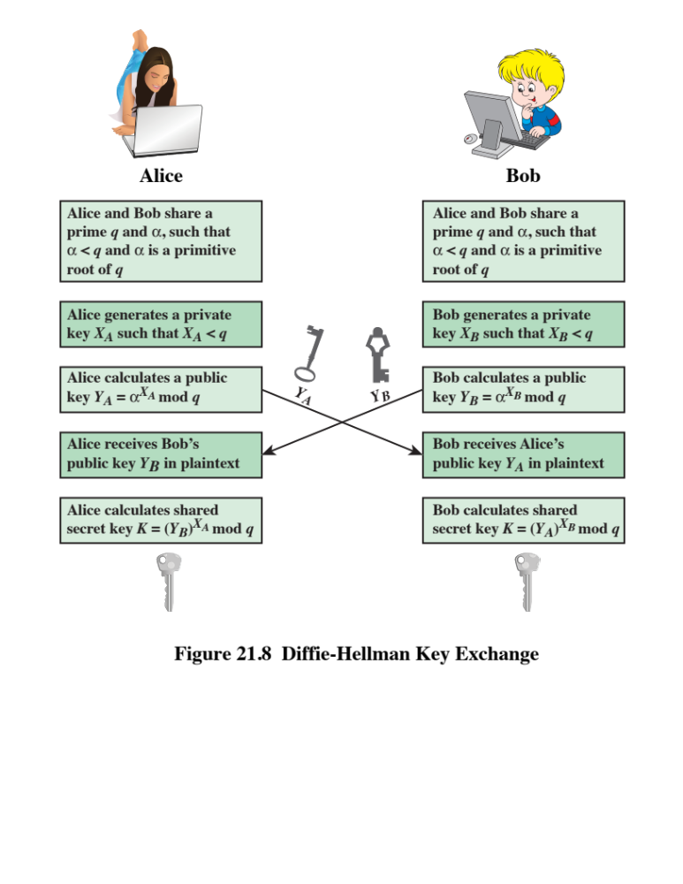
Notes:
Figure 21.8 shows a simple protocol that makes use of the Diffie-Hellman calculation. Suppose that user A wishes to set up a connection with user B and use a secret key to encrypt messages on that connection. User A can generate a one-time private key X_{A}, calculate Y_{A}, and send that to user B. User B responds by generating a private value X_{B}, calculating Y_{B}, and sending Y_{B} to user A. Both users can now calculate the key. The necessary public values q and α would need to be known ahead of time. Alternatively, user A could pick values for q and α and include those in the first message.
As an example of another use of the Diffie-Hellman algorithm, suppose that a group of users (e.g., all users on a LAN) each generate a long-lasting private value X_{A} and calculate a public value Y_{A}. These public values, together with global public values for q and α, are stored in some central directory. At any time, user B can access user A's public value, calculate a secret key, and use that to send an encrypted message to user A. If the central directory is trusted, then this form of communication provides both confidentiality and a degree of authentication. Because only A and B can determine the key, no other user can read the message (confidentiality). Recipient A knows that only user B could have created a message using this key (authentication). However, the technique does not protect against replay attacks.

Slide 48
Man-in-the-Middle Attack
attack is:
  Darth generates private keys X_{D1} & X_{D2}, and their public keys Y_{D1} & Y_{D2}
  Alice transmits Y_{A} to Bob
  Darth intercepts Y_{A} and transmits Y_{D1} to Bob. Darth also calculates K₂
  Bob receives Y_{D1} and calculates K₁
  Bob transmits X_{A} to Alice
  Darth intercepts X_{A} and transmits Y_{D2} to Alice. Darth calculates K₁
  Alice receives Y_{D2} and calculates K₂
all subsequent communications compromised
Notes:
The protocol depicted in Figure 20.8 is insecure against a man-in-the-middle attack. Suppose Alice and Bob wish to exchange keys, and Darth is attacks as follows:
1. Darth generates two private keys X_{D1} and X_{D2}, and public keys Y_{D1} & Y_{D2}.
2. Alice transmits Y_{A} to Bob.
3. Darth intercepts Y_{A} and transmits Y_{D1} to Bob. Darth also calculates K2
4. Bob receives Y_{D1} and calculates K1.
5. Bob transmits X_{A} to Alice.
6. Darth intercepts X_{A} and transmits Y_{D2} to Alice. Darth calculates .
7. Alice receives Y_{D2} and calculates .
At this point, Bob and Alice think that they share a secret key, but instead Bob and Darth share secret key K1 and Alice and Darth share secret key K2. All future communication between Bob and Alice is compromised in the following way:
1. Alice sends an encrypted message M: E(K2, M).
2. Darth intercepts the encrypted message and decrypts it, to recover M.
3. Darth sends Bob E(K1, M) or E(K1, M'), where M' is any message. In the first case, Darth simply wants to eavesdrop on the communication without altering it. In the second case, Darth wants to modify the message going to Bob.
The key exchange protocol is vulnerable to such an attack because it does not authenticate the participants. This vulnerability can be overcome with the use of digital signatures and public-key certificates

Slide 49
Key Exchange Protocols
users could create random Diffie-Hellman keys each time they communicate
users could create a known Diffie-Hellman key and publish in a directory, then consulted and used to securely communicate with them
both of these are vulnerable to a man-in-the-middle attack
  authentication of the keys is needed
Notes:
Detail a couple of possible Key Exchange Protocols based on Diffie-Hellman. Note that these are vulnerable to a meet-in-the-Middle Attack, and that authentication of the keys is needed.

Slide 50


Other Public-Key Algorithms
Digital Signature Standard (DSS)
  FIPS PUB 186 from 1991, revised 1993 & 96
  uses SHA-1 in a new digital signature alg
  cannot be used for encryption or key exchange
elliptic curve cryptography (ECC)
  equal security for smaller bit size than RSA
  seen in standards such as IEEE P1363
  still very new, but promising
  based on a mathematical construct known as the elliptic curve
Notes:
The National Institute of Standards and Technology (NIST) has published Federal Information Processing Standard FIPS PUB 186, known as the Digital Signature Standard (DSS). The DSS makes use of the SHA-1 and presents a new digital signature technique, the Digital Signature Algorithm (DSA). The DSS was originally proposed in 1991 and revised in 1993 in response to public feedback concerning the security of the scheme. There was a further minor revision in 1996. The DSS uses an algorithm that is designed to provide only the digital signature function. Unlike RSA, it cannot be used for encryption or key exchange.
The vast majority of the products and standards that use public-key cryptography for encryption and digital signatures use RSA. The bit length for secure RSA use has increased over recent years, and this has put a heavier processing load on applications using RSA. This burden has ramifications, especially for electronic commerce sites that conduct large numbers of secure transactions. Recently, a competing system has begun to challenge RSA: elliptic curve cryptography (ECC). Already, ECC is showing up in standardization efforts, including the IEEE P1363 Standard for Public-Key Cryptography. The principal attraction of ECC compared to RSA is that it appears to offer equal security for a far smaller bit size, thereby reducing processing overhead. On the other hand, although the theory of ECC has been around for some time, it is only recently that products have begun to appear and that there has been sustained cryptanalytic interest in probing for weaknesses. Thus, the confidence level in ECC is not yet as high as that in RSA. ECC is fundamentally more difficult to explain, and a full mathematical description is beyond the scope of this book. The technique is based on the use of a mathematical construct known as the elliptic curve.

Slide 51
Symmetric vs Asymmetric
 | Secret Key (Symmetric) | Public Key (Asymmetric)
Number of keys | 1 per pair | 2 per person
Protection of key | Must be kept secret | One key must be kept secret; the other can be freely exposed
Best uses | Cryptographic workhorse; secrecy and integrity of datasingle characters to blocks of data, messages, files | Key exchange, authentication
Key distribution | Must be out-of-band | Public key can be used to distribute other keys
Speed | Fast | Slow; typically, 1,000 times slower than secret key

Slide 52

Summary
Secure hash functions
  Simple hash functions
  The SHA secure hash function
  SHA-3
  Diffie-Hellman and other asymmetric algorithms
  Diffie-Helman key exchange
  Other public-key cryptography algorithms
  The RSA public-key encryption algorithm
  Description of the algorithm
  The security of RSA
HMAC
  HMAC design objectives
  HMAC algorithm
  Security of HMAC
Notes:
Chapter 21 summary.

