Slide 1

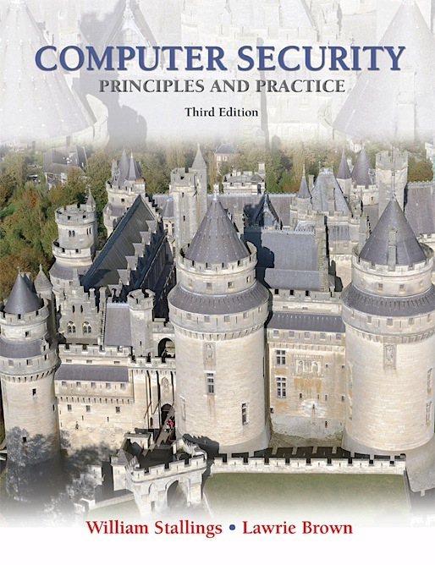
Lecture 3: Cryptographic Tools
modified from slides of Lawrie Brown
Notes:
This chapter provides an overview of computer security. We begin with a discussion of what we mean by computer security. In essence, computer security deals with computer-related assets that are subject to a variety of threats and for which various measures are taken to protect those assets. Accordingly, the next section of this chapter provides a brief overview of the categories of computer-related assets that users and system managers wish to preserve and protect, and a look at the various threats and attacks that can be made on those assets. Then, we survey the measures that can be taken to deal with such threats and attacks. This we do from three different viewpoints, in Sections 1.3 through 1.5 . We then look at some recent trends in computer security and lay out in general terms a computer security strategy.

Slide 2
Cryptographic Tools
Cryptographic algorithms
important element in security services
review various types of elements
symmetric encryption
public-key (asymmetric) encryption
digital signatures and key management
secure hash functions
Notes:
An important element in many computer security services and applications is the use of cryptographic algorithms. This chapter provides an overview of the various types of algorithms, together with a discussion of their applicability. For each type of algorithm, we introduce the most important standardized algorithms in common use. For the technical details of the algorithms themselves, see Part Four. We begin with symmetric encryption, which is used in the widest variety of contexts, primarily to provide confidentiality. Next, we examine secure hash functions and discuss their use in message authentication. The next section examines public-key encryption, also known as asymmetric encryption. We then discuss the two most important applications of public-key encryption, namely digital signatures and key management. In the case of digital signatures, asymmetric encryption and secure hash functions are combined to produce an extremely useful tool. Finally, in this chapter we provide an example of an application area for cryptographic algorithms by looking at the encryption of stored data.

Slide 3

Symmetric Encryption
universal technique for providing confidentiality
also referred to as single-key encryption
two requirements for secure use:
need a strong encryption algorithm
sender and receiver must have obtained copies of the secret key in a secure fashion
and must keep the key secure
Notes:
The universal technique for providing confidentiality for transmitted or stored data is symmetric encryption.
This section introduces the basic concept of symmetric encryption. This is followed by an overview of the two most important symmetric encryption algorithms: the Data Encryption Standard (DES) and the Advanced Encryption Standard (AES), which are block encryption algorithms. Finally, this section introduces the concept of symmetric stream encryption algorithms.
Symmetric encryption, also referred to as conventional encryption or single-key encryption, was the only type of encryption in use prior to the introduction of public-key
encryption in the late 1970s. Countless individuals and groups, from Julius Caesar to the German U-boat force to present-day diplomatic, military, and commercial users, have used symmetric encryption for secret communication. It remains the more widely used of the two types of encryption.
There are two requirements for secure use of symmetric encryption:
1. We need a strong encryption algorithm. At a minimum, we would like the algorithm to be such that an opponent who knows the algorithm and has
access to one or more ciphertexts would be unable to decipher the ciphertext or figure out the key. This requirement is usually stated in a stronger form:
The opponent should be unable to decrypt ciphertext or discover the key even if he or she is in possession of a number of ciphertexts together with the plaintext
that produced each ciphertext.
2. Sender and receiver must have obtained copies of the secret key in a secure fashion and must keep the key secure. If someone can discover the key and
knows the algorithm, all communication using this key is readable.

Slide 4
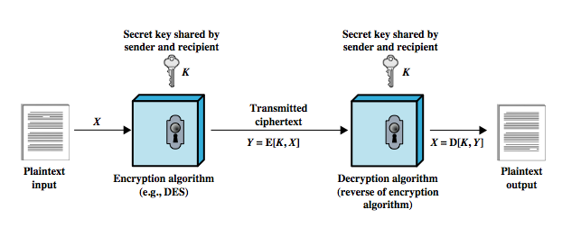
Symmetric Encryption
Notes:
A symmetric encryption scheme has five ingredients (Figure 2.1):
• Plaintext: This is the original message or data that is fed into the algorithm as input.
• Encryption algorithm: The encryption algorithm performs various substitutions and transformations on the plaintext.
• Secret key: The secret key is also input to the encryption algorithm. The exact substitutions and transformations performed by the algorithm depend on the key.
• Ciphertext: This is the scrambled message produced as output. It depends on the plaintext and the secret key. For a given message, two different keys will produce two different ciphertexts.
• Decryption algorithm: This is essentially the encryption algorithm run in reverse. It takes the ciphertext and the secret key and produces the originalplaintext.

Slide 5
Attacking Symmetric Encryption
Cryptanalytic Attacks
Brute-Force Attack
rely on:
nature of the algorithm
plus some knowledge of the general characteristics of the plaintext
even some sample plaintext-ciphertext pairs
exploits the characteristics of the algorithm to attempt to deduce a specific plaintext or the key being used
if successful all future and past messages encrypted with that key are compromised
try all possible keys on some ciphertext until an intelligible translation into plaintext is obtained
on average half of all possible keys must be tried to achieve success
Notes:
There are two general approaches to attacking a symmetric encryption scheme. The first attack is known as cryptanalysis.
Cryptanalytic attacks rely on the nature of the algorithm plus perhaps some knowledge of the general characteristics of the plaintext or even some sample plaintext-ciphertext pairs. This type of attack exploits the characteristics of the algorithm to attempt to deduce a specific plaintext or to deduce the key being used. If the attack succeeds in deducing the key, the effect is catastrophic: All future and past messages encrypted with that key are compromised.
The second method, known as the brute-force attack, is to try every possible key on a piece of ciphertext until an intelligible translation into plaintext is obtained. On average, half of all possible keys must be tried to achieve success.

Slide 6
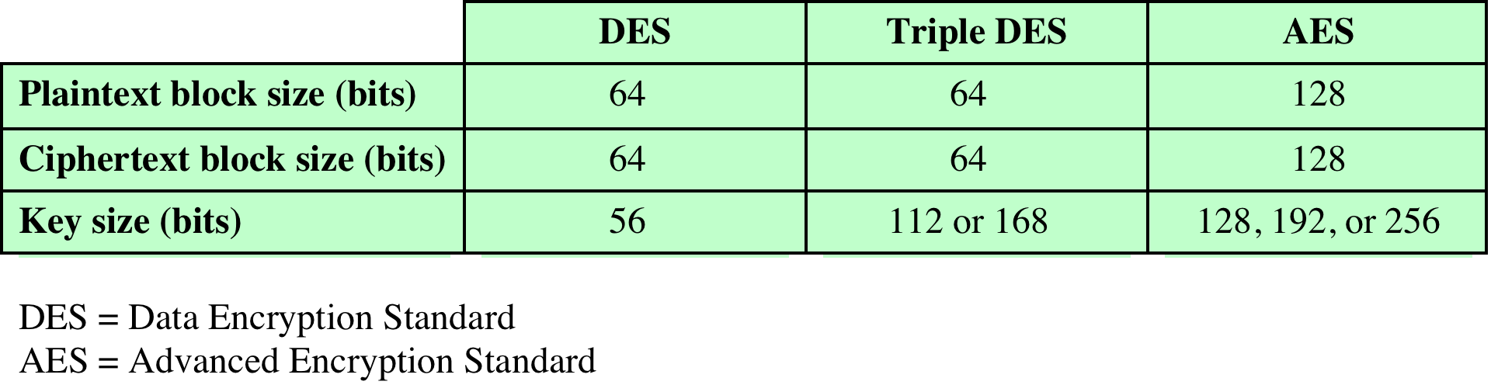
Symmetric Encryption Algorithms
Notes:
The most commonly used symmetric encryption algorithms are block ciphers. A block cipher processes the plaintext input in fixed-size blocks and produces a block of ciphertext of equal size for each plaintext block. The algorithm processes longer plaintext amounts as a series of fixed-size blocks. The most important symmetric algorithms, all of which are block ciphers, are the Data Encryption Standard (DES), triple DES, and the Advanced Encryption Standard (AES); see Table 2.2. This subsection provides an overview of these algorithms. Chapter 20 presents the technical details.

Slide 7
Data Encryption Standard (DES)
most widely used encryption scheme
referred to as the Data Encryption Algorithm
uses 64 bit plaintext block and 56 bit key to produce a 64 bit ciphertext block
strength concerns:
concerns about algorithm
DES is the most studied encryption algorithm in existence
use of 56-bit key
Electronic Frontier Foundation (EFF) announced in July 1998 that it had broken a DES encryption in < 3days
Notes:
The most widely used encryption scheme is based on the Data Encryption Standard (DES) adopted in 1977 by the National Bureau of Standards, now the National Institute of Standards and Technology (NIST), as Federal Information Processing Standard 46 (FIPS PUB 46).
The algorithm itself is referred to as the Data Encryption Algorithm (DEA). DES takes a plaintext block of 64 bits and a key of 56 bits, to produce a ciphertext block of 64 bits.
Concerns about the strength of DES fall into two categories: concerns about the algorithm itself and concerns about the use of a 56-bit key. The first concern refers to the possibility that cryptanalysis is possible by exploiting the characteristics of the DES algorithm. Over the years, there have been numerous attempts to find and exploit weaknesses in the algorithm, making DES the most-studied encryption algorithm in existence. Despite numerous approaches, no one has so far reported a fatal weakness in DES.
A more serious concern is key length. With a key length of 56 bits, there are 256 possible keys, which is approximately 7.2 1016 keys. Thus, on the face of it, a brute-force attack appears impractical. Assuming that, on average, half the key space has to be searched, a single machine performing one DES encryption per micro second would take more than a thousand years (see Table 2.1) to break the cipher.
However, the assumption of one encryption per microsecond is overly conservative. DES finally and definitively proved insecure in July 1998, when the Electronic Frontier Foundation (EFF) announced that it had broken a DES encryption using a special-purpose “DES cracker” machine that was built for less than $250,000. The attack took less than three days. The EFF has published a detailed description of the machine, enabling others to build their own cracker [EFF98]. And, of course, hardware prices will continue to drop as speeds increase, making DES virtually worthless.
It is important to note that there is more to a key-search attack than simply running through all possible keys. Unless known plaintext is provided, the analyst must be able to recognize plaintext as plaintext. If the message is just plain text in English, then the result pops out easily, although the task of recognizing English would have to be automated. If the text message has been compressed before encryption, then recognition is more difficult. And if the message is some more general type of data, such as a numerical file, and this has been compressed, the problem becomes even more difficult to automate. Thus, to supplement the brute-force approach, some degree of knowledge about the expected plaintext is needed, and some means of automatically distinguishing plaintext from garble is also needed. The EFF approach addresses this issue as well and introduces some automated techniques that would be effective in many contexts.
A final point: If the only form of attack that could be made on an encryption algorithm is brute force, then the way to counter such attacks is obvious: Use longer keys. To get some idea of the size of key required, let us use the EFF cracker as a basis for our estimates. The EFF cracker was a prototype and we can assume that with today’s technology, a faster machine is cost effective. If we assume that a cracker can perform 1 million decryptions per μs, which is the rate used in Table 2.1, then a DES code would take about 10 hours to crack. This is a speed-up of approximately a factor of 7 compared to the EFF result

Slide 8
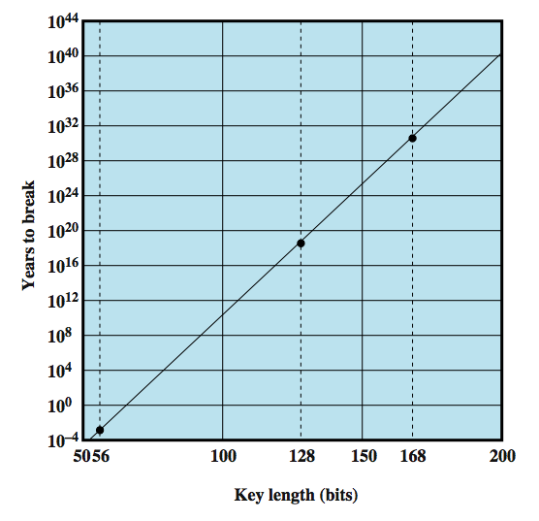
Time to Break a Code
assuming 10⁶ decryptions/µs
Notes:
Figure 2.2 shows how long it would take to crack a DES-style algorithm as a function of key size.2 For example, for a 128-bit key, which is common among contemporary algorithms, it would take over 1018 years to break the code using the EFF cracker. Even if we managed to speed up the cracker by a factor of 1 trillion (1012), it would still take over 1 million years to break the code. So a 128-bit key is guaranteed to result in an algorithm that is unbreakable by brute force.

Slide 9
Average Time Required for Exhaustive Key Search
Notes:
Table 2.2 shows how much time is required for
a brute-force attack for various key sizes. As can be seen, a single PC can break
DES in about a year; if multiple PCs work in parallel, the time is drastically shortened.
And today’s supercomputers should be able to find a key in about an hour.
Key sizes of 128 bits or greater are effectively unbreakable using simply a brute-force
approach. Even if we managed to speed up the attacking system by a factor
of 1 trillion (10¹² ), it would still take over 100,000 years to break a code using a
128-bit key.

Slide 10
Triple DES (3DES)
repeats basic DES algorithm three times using either two or three unique keys
attractions:
168-bit key length overcomes the vulnerability to brute-force attack of DES
underlying encryption algorithm is the same as in DES
drawbacks:
algorithm is sluggish in software
uses a 64-bit block size
Notes:
The life of DES was extended by the use of triple DES (3DES), which involves repeating the basic DES algorithm three times, using either two or three unique keys, for a key size of 112 or 168 bits. Triple DES (3DES) was first standardized for use in financial applications in ANSI standard X9.17 in 1985. 3DES was incorporated as part of the Data Encryption Standard in 1999, with the publication of FIPS PUB 46-3.
3DES has two attractions that assure its widespread use over the next few years. First, with its 168-bit key length, it overcomes the vulnerability to brute-force attack of DES. Second, the underlying encryption algorithm in 3DES is the same as in DES. This algorithm has been subjected to more scrutiny than any other encryption algorithm over a longer period of time, and no effective cryptanalytic attack based on the algorithm rather than brute force has been found. Accordingly, there is a high level of confidence that 3DES is very resistant to cryptanalysis. If security were the only consideration, then 3DES would be an appropriate choice for a standardized encryption algorithm for decades to come.
The principal drawback of 3DES is that the algorithm is relatively sluggish in software. The original DES was designed for mid-1970s hardware implementation and does not produce efficient software code. 3DES, which requires three times as many calculations as DES, is correspondingly slower. A secondary drawback is that both DES and 3DES use a 64-bit block size. For reasons of both efficiency and security,
a larger block size is desirable.

Slide 11
Advanced Encryption Standard (AES)
needed a replacement for 3DES
NIST called for proposals for a new AES in 1997
selected Rijndael in November 2001
3DES was not reasonable for long term use
should have a security strength equal to or better than 3DES
published as FIPS 197
significantly improved efficiency
symmetric block cipher
128 bit data and 128/192/256 bit keys
Notes:
Because of its drawbacks, 3DES is not a reasonable candidate for long-term use. As a replacement, NIST in 1997 issued a call for proposals for a new Advanced Encryption Standard (AES), which should have a security strength equal to or better than 3DES and significantly improved efficiency. In addition to these general requirements, NIST specified that AES must be a symmetric block cipher with a block length of 128 bits and support for key lengths of 128, 192, and 256 bits. Evaluation criteria included security, computational efficiency, memory requirements, hardware and software suitability, and flexibility.
In a first round of evaluation, 15 proposed algorithms were accepted. A second round narrowed the field to 5 algorithms. NIST completed its evaluation process and published a final standard (FIPS PUB 197) in November of 2001. NIST selected Rijndael as the proposed AES algorithm. AES is now widely available in commercial products. AES is described in detail in Chapter 20.

Slide 12

Practical Security Issues
typically data unit is larger than a single 64-bit or 128-bit block
electronic codebook (ECB) mode
the simplest approach to multiple-block encryption
each block is encrypted using the same key
exploit regularities in the plaintext
modes of operation
alternative techniques to increase the security for large sequences
overcomes the weaknesses of ECB
Notes:
Typically, symmetric encryption is applied to a unit of data larger than a single 64-bit or 128-bit block. E-mail messages, network packets, database records, and other plaintext sources must be broken up into a series of fixed-length block for encryption by a symmetric block cipher. The simplest approach to multiple-block encryption is known as electronic codebook (ECB) mode, in which plaintext is handled b bits at a time and each block of plaintext is encrypted using the same key. Typically b 64 or b 128
For lengthy messages, the ECB mode may not be secure. A cryptanalyst may be able to exploit regularities in the plaintext to ease the task of decryption. For example, if it is known that the message always starts out with certain predefined fields, then the cryptanalyst may have a number of known plaintext-ciphertext pairs to work with.
To increase the security of symmetric block encryption for large sequences of data, a number of alternative techniques have been developed, called modes of operation. These modes overcome the weaknesses of ECB; each mode has its own particular advantages. This topic is explored in Chapter 20.

Slide 13
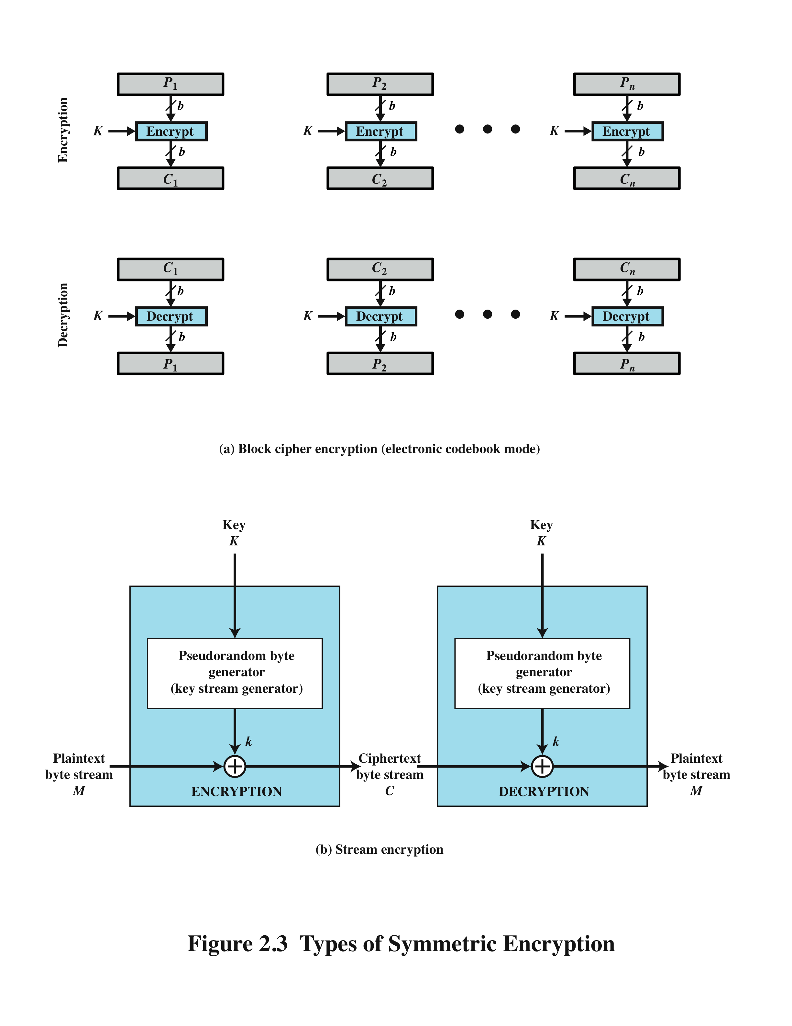
Block Cipher Encryption Stream Encryption
Notes:
Figure 2.3a shows the ECB mode. A plaintext of length nb is divided into n b-bit blocks (P1, P2,c,Pn). Each block is encrypted using the same algorithm and the same encryption key, to produce a sequence of n b-bit blocks of ciphertext (C1, C2,c,Cn).
Figure 2.3b is a representative diagram of stream cipher structure. In this structure a key is input to a pseudorandom bit generator that produces a stream of 8-bit numbers that are apparently random. A pseudorandom stream is one that is unpredictable without knowledge of the input key and which has an apparently random character (see Section 2.5). The output of the generator, called a keystream, is combined one byte at a time with the plaintext stream using the bitwise exclusive-OR (XOR) operation.

Slide 14
Block & Stream Ciphers
Block Cipher
processes the input one block of elements at a time
produces an output block for each input block
can reuse keys
more common
Stream Cipher
processes the input elements continuously
produces output one element at a time
primary advantage is that they are almost always faster and use far less code
encrypts plaintext one byte at a time
pseudorandom stream is one that is unpredictable without knowledge of the input key
Notes:
A block cipher processes the input one block of elements at a time, producing an output block for each input block. A stream cipher processes the input elements continuously, producing output one element at a time, as it goes along. Although block ciphers are far more common, there are certain applications in which a stream cipher is more appropriate. Examples are given subsequently in this book.
A typical stream cipher encrypts plaintext one byte at a time, although a stream cipher may be designed to operate on one bit at a time or on units larger than a byte at a time. Figure 2.3b is a representative diagram of stream cipher structure. In this structure a key is input to a pseudorandom bit generator that produces a stream of 8-bit numbers that are apparently random. A pseudorandom stream is one that is unpredictable without knowledge of the input key and which has an apparently random character (see Section 2.5). The output of the generator, called a keystream, is combined one byte at a time with the plaintext stream using the bitwise exclusive-OR (XOR) operation.
With a properly designed pseudorandom number generator, a stream cipher can be as secure as block cipher of comparable key length. The primary advantage of a stream cipher is that stream ciphers are almost always faster and use far less code than do block ciphers. The advantage of a block cipher is that you can reuse keys. For applications that require encryption/decryption of a stream of data, such as over a data communications channel or a browser/Web link, a stream cipher might be the better alternative. For applications that deal with blocks of data, such as file transfer, e-mail, and database, block ciphers may be more appropriate. However, either type of cipher can be used in virtually any application.

Slide 15
Message Authentication
protects against active attacks
verifies received message is authentic
contents have not been altered
from authentic source
timely and in correct sequence
can use conventional encryption
only sender & receiver share a key
Notes:
Encryption protects against passive attack (eavesdropping). A different requirement is to protect against active attack (falsification of data and transactions). Protection against such attacks is known as message or data authentication.
A message, file, document, or other collection of data is said to be authentic when it is genuine and came from its alleged source. Message or data authentication is a procedure that allows communicating parties to verify that received or stored messages are authentic. The two important aspects are to verify that the contents of the message have not been altered and that the source is authentic. We may also wish to verify a message’s timeliness (it has not been artificially delayed and replayed) and sequence relative to other messages flowing between two parties. All of these concerns come under the category of data integrity as described in Chapter 1.
It would seem possible to perform authentication simply by the use of symmetric encryption. If we assume that only the sender and receiver share a key (which is as it should be), then only the genuine sender would be able to encrypt a message successfully for the other participant, provided the receiver can recognize a valid message. Furthermore, if the message includes an error-detection code and a sequence number, the receiver is assured that no alterations have been made and that sequencing is proper. If the message also includes a timestamp, the receiver is assured that the message has not been delayed beyond that normally expected for network transit.
In fact, symmetric encryption alone is not a suitable tool for data authentication. To give one simple example, in the ECB mode of encryption, if an attacker reorders the blocks of ciphertext, then each block will still decrypt successfully. However, the reordering may alter the meaning of the overall data sequence. Although sequence numbers may be used at some level (e.g., each IP packet), it is typically not the case that a separate sequence number will be associated with each b-bit block of plaintext. Thus, block reordering is a threat.

Slide 16
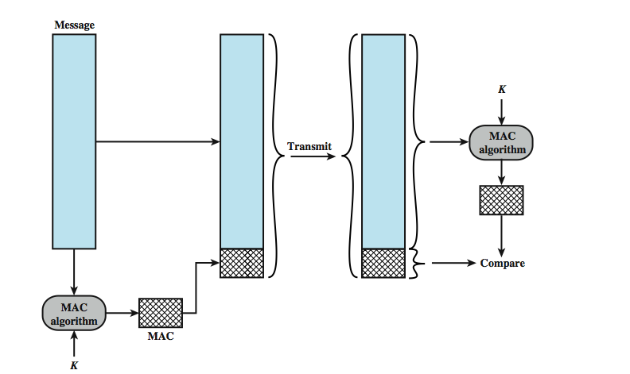
Message Authentication Codes
Notes:
One authentication technique involves the use of a secret key to generate a small block of data, known as a message authentication code, that is appended to the message. This technique assumes that two communicating parties, say A and B, share a common secret key KAB. When A has a message to send to B, it calculates the message authentication code as a complex function of the message and the key: MACM F(KAB, M).4 The message plus code are transmitted to the intended recipient. The recipient performs the same calculation on the received message, using the same secret key, to generate a new message authentication code. The received code is compared to the calculated code (Figure 2.4). If we assume that only the receiver and the sender know the identity of the secret key, and if the received code matches the calculated code, then
1. The receiver is assured that the message has not been altered. If an attacker alters the message but does not alter the code, then the receiver’s calculation of the code will differ from the received code. Because the attacker is assumed not to know the secret key, the attacker cannot alter the code to correspond to the alterations in the message.
2. The receiver is assured that the message is from the alleged sender. Because no one else knows the secret key, no one else could prepare a message with a proper code.
3. If the message includes a sequence number (such as is used with X.25, HDLC, and TCP), then the receiver can be assured of the proper sequence, because an attacker cannot successfully alter the sequence number.
A number of algorithms could be used to generate the code. The NIST specification, FIPS PUB 113, recommends the use of DES. DES is used to generate an encrypted version of the message, and the last number of bits of ciphertext are used as the code. A 16- or 32-bit code is typical.
The process just described is similar to encryption. One difference is that the authentication algorithm need not be reversible, as it must for decryption. It turns out that because of the mathematical properties of the authentication function, it is less vulnerable to being broken than encryption.

Slide 17
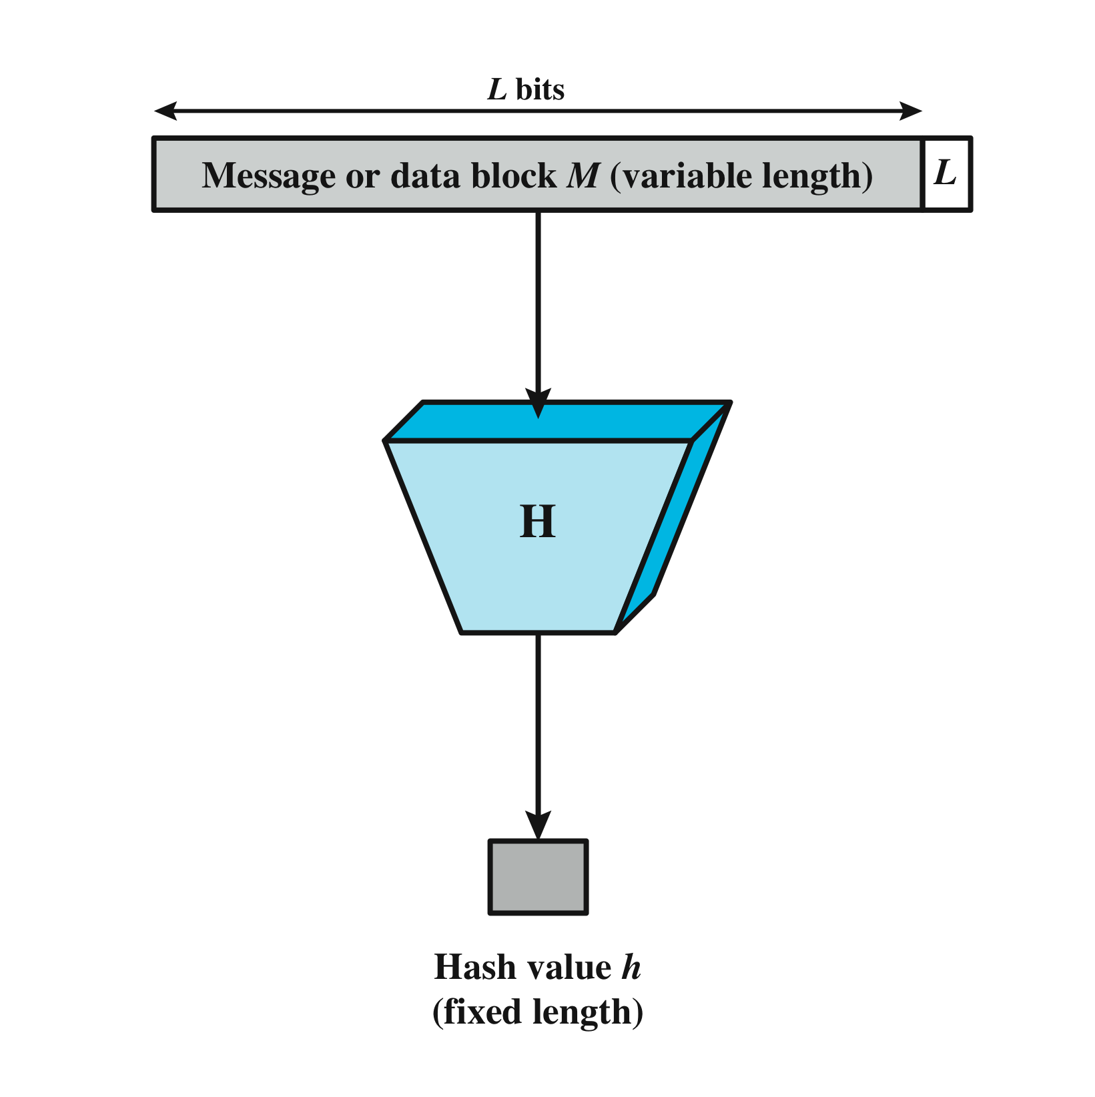
Secure Hash Functions
Notes:
An alternative to the message authentication code is the one-way hash function. As with the message authentication code, a hash function accepts a variable-size message M as input and produces a fixed-size message digest H(M) as output (Figure 2.5). Typically, the message is padded out to an integer multiple of some fixed length (e.g., 1024 bits) and the padding includes the value of the length of the original message in bits. The length field is a security measure to increase the difficulty for an attacker to produce an alternative message with the same hash value.

Slide 18
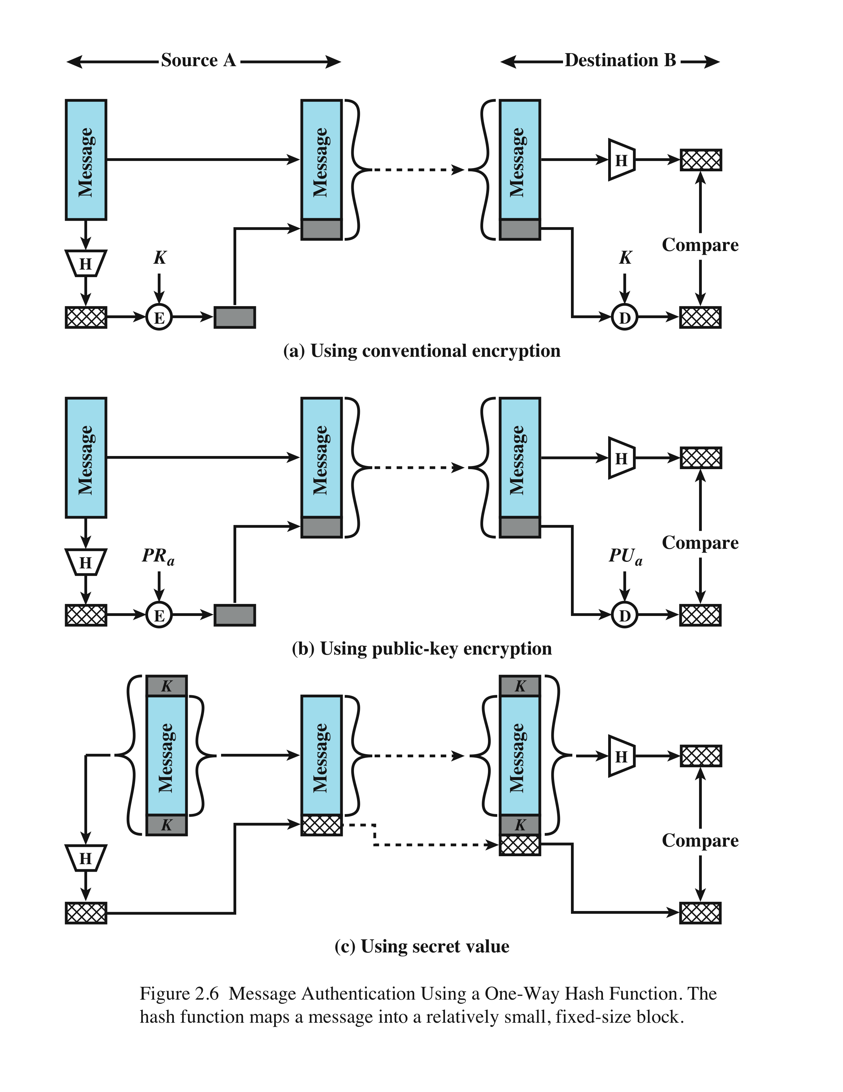
Message Authentication Using a One-Way Hash Function
Notes:
Unlike the MAC, a hash function does not also take a secret key as input. To authenticate a message, the message digest is sent with the message in such a way that the message digest is authentic. Figure 2.6 illustrates three ways in which the message can be authenticated using a hash code. The message digest can be encrypted using symmetric encryption (part a); if it is assumed that only the sender and receiver share the encryption key, then authenticity is assured. The message digest can also be encrypted using public-key encryption (part b); this is explained in Section 2.3. The public-key approach has two advantages: It provides a digital signature as well as message authentication; and it does not require the distribution of keys to communicating parties.
These two approaches have an advantage over approaches that encrypt the entire message in that less computation is required. But an even more common approach is the use of a technique that avoids encryption altogether. Several reasons for this interest are pointed out in [TSUD92]:
• Encryption software is quite slow. Even though the amount of data to be encrypted per message is small, there may be a steady stream of messages into and out of a system.
• Encryption hardware costs are non-negligible. Low-cost chip implementations of DES are available, but the cost adds up if all nodes in a network must have this capability.
• Encryption hardware is optimized toward large data sizes. For small blocks of data, a high proportion of the time is spent in initialization/invocation overhead.
• An encryption algorithm may be protected by a patent.
Figure 2.6c shows a technique that uses a hash function but no encryption for message authentication. This technique, known as a keyed hash MAC, assumes that two communicating parties, say A and B, share a common secret key K. This secret key is incorporated into the process of generating a hash code. In the approach illustrated in Figure 2.6c, when A has a message to send to B, it calculates the hash function over the concatenation of the secret key and the message: MDM = H(KMK).6 It then sends [ MMDM] to B. Because B possesses K, it can recompute H(K7M7K) and verify MDM. Because the secret key itself is not sent, it should not be possible for an attacker to modify an intercepted message. As long as the secret key remains secret, it should not be possible for an attacker to generate a false message.
Note that the secret key is used as both a prefix and a suffix to the message. If the secret key is used as either only a prefix or only a suffix, the scheme is less secure. This topic is discussed in Chapter 21. Chapter 21 also describes a scheme known as HMAC, which is somewhat more complex than the approach of Figure 2.6c and which has become the standard approach for a keyed hash MAC.

Slide 19
Hash Function Requirements
can be applied to a block of data of any size
produces a fixed-length output
H(x) is relatively easy to compute for any given x
one-way or pre-image resistant
infeasible to find x such that H(x) = h
second pre-image or weak collision resistant
infeasible to find y ≠ x such that H(y) = H(x)
collision resistant or strong collision resistance
infeasible to find any pair (x, y) such that H(x) = H(y)
Notes:
The purpose of a hash function is to produce a “fingerprint” of a file, message, or other block of data. To be useful for message authentication, a hash function H must have the following properties:
1. H can be applied to a block of data of any size.
2. H produces a fixed-length output.
3. H(x) is relatively easy to compute for any given x, making both hardware and software implementations practical.
4. For any given code h, it is computationally infeasible to find x such that H(x) h. A hash function with this property is referred to as one-way or preimage resistant.
5. For any given block x, it is computationally infeasible to find y x with H(y) H(x). A hash function with this property is referred to as second preimage resistant. This is sometimes referred to as weak collision resistant.
6. It is computationally infeasible to find any pair (x, y) such that H(x) H(y). A hash function with this property is referred to as collision resistant. This is sometimes referred to as strong collision resistant.
The first three properties are requirements for the practical application of a hash function to message authentication.
The fourth property is the one-way property: It is easy to generate a code given a message, but virtually impossible to generate a message given a code. This property is important if the authentication technique involves the use of a secret value (Figure 2.6c).
The secret value itself is not sent; however, if the hash function is not one way, an attacker can easily discover the secret value: If the attacker can observe or intercept a transmission, the attacker obtains the message M and the hash code MDM H(SAB || M). The attacker then inverts the hash function to obtain SAB || M H-1(MDM). Because the attacker now has both M and SAB || M, it is a trivial matter to recover SAB.
The fifth property guarantees that it is impossible to find an alternative message with the same hash value as a given message. This prevents forgery when an encrypted hash code is used (Figures 2.6a and b). If this property were not true, an attacker would be capable of the following sequence: First, observe or intercept a message plus its encrypted hash code; second, generate an unencrypted hash code from the message; third, generate an alternate message with the same hash code.
A hash function that satisfies the first five properties in the preceding list is referred to as a weak hash function. If the sixth property is also satisfied, then it is referred to as a strong hash function. A strong hash function protects against an attack in which one party generates a message for another party to sign. For example, suppose Bob gets to write an IOU message, send it to Alice, and she signs it. Bob finds two messages with the same hash, one of which requires Alice to pay a small amount and one that requires a large payment. Alice signs the first message and Bob is then able to claim that the second message is authentic.

Slide 20
Security of Hash Functions
approaches to attack a secure hash function
cryptanalysis
exploit logical weaknesses in the algorithm
brute-force attack
strength of hash function depends solely on the length of the hash code produced by the algorithm
additional secure hash function applications:
Passwords: hash of a password is stored by an operating system
intrusion detection: store H(F) for each file on a system and secure the hash values
Notes:
As with symmetric encryption, there are two approaches to attacking a secure hash function: cryptanalysis and brute-force attack.
As with symmetric encryption algorithms, cryptanalysis of a hash function involves exploiting logical weaknesses in the algorithm. The strength of a hash function against brute-force attacks depends solely on the length of the hash code produced by the algorithm.
For a hash code of length n, the level of effort required is proportional to the following:
Preimage resistant 2n
Second preimage resistant 2n
Collision resistant 2n/2
If collision resistance is required (and this is desirable for a general-purpose secure hash code), then the value 2n/2 determines the strength of the hash code against brute-force attacks. Van Oorschot and Wiener [VANO94] pre sented a design for a $10 million collision search machine for MD5, which has a 128-bit hash length, that could find a collision in 24 days. Thus a 128-bit code may be viewed as inadequate. The next step up, if a hash code is treated as a sequence of 32 bits, is a 160-bit hash length. With a hash length of 160 bits, the same search machine would require over four thousand years to find a collision. With today’s technology, the time would be much shorter, so that 160 bits now appears suspect.
In recent years, the most widely used hash function has been the Secure Hash Algorithm (SHA). SHA was developed by the National Institute of Standards and Technology (NIST) and published as a federal information processing standard (FIPS 180) in 1993. When weaknesses were discovered in SHA, a revised version was issued as FIPS 180-1 in 1995 and is generally referred to as SHA-1. SHA-1 produces a hash value of 160 bits. In 2002, NIST produced a revised version of the standard, FIPS 180–2, that defined three new versions of SHA, with hash value lengths of 256, 384, and 512 bits, known as SHA-256, SHA-384, and SHA-512. These new versions have the same underlying structure and use the same types of modular arithmetic and logical binary operations as SHA-1. In 2005, NIST announced the intention to phase out approval of SHA-1 and move to a reliance on the other SHA versions by 2010. As discussed in Chapter 21, researchers have demonstrated that SHA-1 is far weaker than its 160-bit hash length suggests, necessitating the move to the newer versions of SHA.
We have discussed the use of hash functions for message authentication and for the creation of digital signatures (the latter is discussed in more detail later in this chapter). Here are two other examples of secure hash function applications:
• Passwords: Chapter 3 explains a scheme in which a hash of a password is stored by an operating system rather than the password itself. Thus, the actual password is not retrievable by a hacker who gains access to the password file. In simple terms, when a user enters a password, the hash of that password is compared to the stored hash value for verification. This application requires preimage resistance and perhaps second preimage resistance.
• Intrusion detection: Store H(F) for each file on a system and secure the hash values (e.g., on a CD-R that is kept secure). One can later determine if a file has been modified by recomputing H(F). An intruder would need to change F without changing H(F). This application requires weak second preimage resistance

Slide 21
Public-Key Encryption Structure
publicly proposed by Diffie and Hellman in 1976
based on mathematical functions
asymmetric
uses two separate keys
public key and private key
public key is made public for others to use
some form of protocol is needed for distribution
Notes:
Public-key encryption, first publicly proposed by Diffie and Hellman in 1976
[DIFF76], is the first truly revolutionary advance in encryption in literally thousands
of years. Public-key algorithms are based on mathematical functions rather than on
simple operations on bit patterns, such as are used in symmetric encryption algorithms.
More important, public-key cryptography is asymmetric, involving the use
of two separate keys, in contrast to symmetric encryption, which uses only one key.
The use of two keys has profound consequences in the areas of confidentiality, key
distribution, and authentication.
Before proceeding, we should first mention several common misconceptions
concerning public-key encryption. One is that public-key encryption is more secure
from cryptanalysis than symmetric encryption. In fact, the security of any encryption
scheme depends on (1) the length of the key and (2) the computational work involved
in breaking a cipher. There is nothing in principle about either symmetric or public-key
encryption that makes one superior to another from the point of view of resisting cryptanalysis.
A second misconception is that public-key encryption is a general- purpose
technique that has made symmetric encryption obsolete. On the contrary, because of
the computational overhead of current public-key encryption schemes, there seems no
foreseeable likelihood that symmetric encryption will be abandoned. Finally, there is
a feeling that key distribution is trivial when using public-key encryption, compared to
the rather cumbersome handshaking involved with key distribution centers for symmetric
encryption. For public-key key distribution, some form of protocol is needed,
often involving a central agent, and the procedures involved are no simpler or any
more efficient than those required for symmetric encryption.
As the names suggest, the public key of the pair is made public for others to
use, while the private key is known only to its owner. A general-purpose public-key
cryptographic algorithm relies on one key for encryption and a different but related
key for decryption.
The essential steps are the following:
1. Each user generates a pair of keys to be used for the encryption and decryption
of messages.
2. Each user places one of the two keys in a public register or other accessible
file. This is the public key. The companion key is kept private. As Figure 2.7a
suggests, each user maintains a collection of public keys obtained from others.
3. If Bob wishes to send a private message to Alice, Bob encrypts the message
using Alice’s public key.
4. When Alice receives the message, she decrypts it using her private key. No
other recipient can decrypt the message because only Alice knows Alice’s private
key.
With this approach, all participants have access to public keys, and private keys
are generated locally by each participant and therefore need never be distributed.
As long as a user protects his or her private key, incoming communication is secure.
At any time, a user can change the private key and publish the companion public
key to replace the old public key.

Slide 22
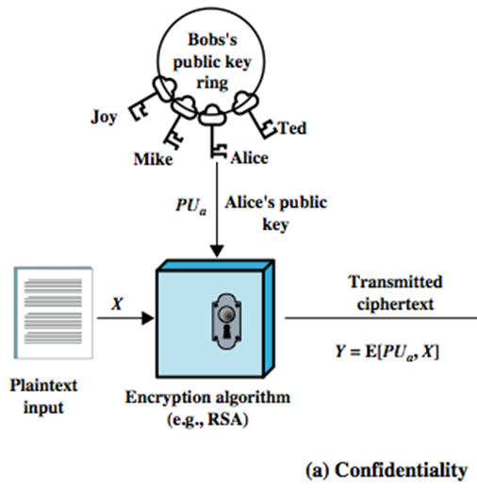
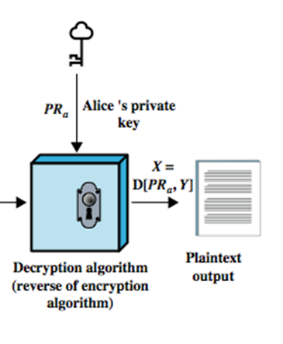
Public-Key Encryption
Confidentiality
Notes:
A public-key encryption scheme has six ingredients (Figure 2.7a):
• Plaintext: This is the readable message or data that is fed into the algorithm as
input.
• Encryption algorithm: The encryption algorithm performs various transformations
on the plaintext.
• Public and private key: This is a pair of keys that have been selected so that
if one is used for encryption, the other is used for decryption. The exact
transformations performed by the encryption algorithm depend on the public
or private key that is provided as input.
Ciphertext: This is the scrambled message produced as output. It depends on
the plaintext and the key. For a given message, two different keys will produce
two different ciphertexts.
• Decryption algorithm: This algorithm accepts the ciphertext and the matching
key and produces the original plaintext.
As the names suggest, the public key of the pair is made public for others to
use, while the private key is known only to its owner. A general-purpose public-key
cryptographic algorithm relies on one key for encryption and a different but related
key for decryption.
The essential steps are the following:
1. Each user generates a pair of keys to be used for the encryption and decryption
of messages.
2. Each user places one of the two keys in a public register or other accessible
file. This is the public key. The companion key is kept private. As Figure 2.7a
suggests, each user maintains a collection of public keys obtained from others.
3. If Bob wishes to send a private message to Alice, Bob encrypts the message
using Alice’s public key.
4. When Alice receives the message, she decrypts it using her private key. No
other recipient can decrypt the message because only Alice knows Alice’s private
key.
With this approach, all participants have access to public keys, and private keys
are generated locally by each participant and therefore need never be distributed.
As long as a user protects his or her private key, incoming communication is secure.
At any time, a user can change the private key and publish the companion public
key to replace the old public key.
Note that the scheme of Figure 2.7a is directed toward providing confidentiality:
Only the intended recipient should be able to decrypt the ciphertext because only
the intended recipient is in possession of the required private key. Whether in fact
confidentiality is provided depends on a number of factors, including the security of
the algorithm, whether the private key is kept secure, and the security of any protocol
of which the encryption function is a part.

Slide 23
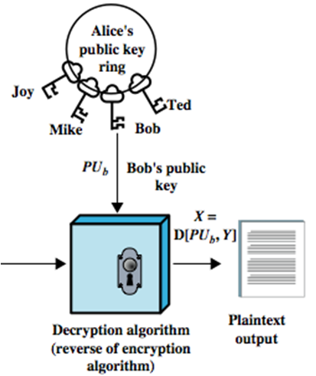
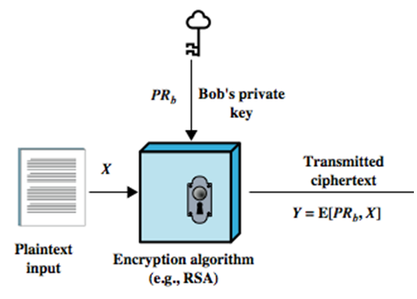
Private-Key Encryption
Authentication
Notes:
Figure 2.7b illustrates another mode of operation of public-key cryptography.
In this scheme, a user encrypts data using his or her own private key.
Anyone who knows the corresponding public key will then be able to decrypt the
message.
The scheme of Figure 2.7b is directed toward providing authentication
and/or data integrity. If a user is able to successfully recover the plaintext from
Bob’s ciphertext using Bob’s public key, this indicates that only Bob could have
encrypted the plaintext, thus providing authentication. Further, no one but
Bob would be able to modify the plaintext because only Bob could encrypt the
plaintext with Bob’s private key. Once again, the actual provision of authentication
or data integrity depends on a variety of factors. This issue is addressed
primarily in Chapter 21, but other references are made to it where appropriate in
this text.

Slide 24
Requirements for Public-Key Crypto.
computationally easy to create key pairs
useful if either key can be used for each role
computationally easy for sender knowing public key to encrypt messages
computationally infeasible for opponent to otherwise recover original message
computationally easy for receiver knowing private key to decrypt ciphertext
computationally infeasible for opponent to determine private key from public key
Notes:
The cryptosystem illustrated in Figure 2.7 depends on a cryptographic algorithm
based on two related keys. Diffie and Hellman postulated this system without demonstrating
that such algorithms exist. However, they did lay out the conditions that
such algorithms must fulfill [DIFF76]:
1. It is computationally easy for a party B to generate a pair (public key PUb,
private key PRb).
2. It is computationally easy for a sender A, knowing the public key and the
message to be encrypted, M, to generate the corresponding ciphertext:
C = E(PUb, M)
3. It is computationally easy for the receiver B to decrypt the resulting ciphertext
using the private key to recover the original message:
M = D(PRb,C) = D[PRb, E(PUb, M)]
4. It is computationally infeasible for an opponent, knowing the public key, PUb,
to determine the private key, PRb.
5. It is computationally infeasible for an opponent, knowing the public key, PUb,
and a ciphertext, C, to recover the original message, M.
We can add a sixth requirement that, although useful, is not necessary for all
public-key applications:
6. Either of the two related keys can be used for encryption, with the other used
for decryption.
M = D[PUb, E(PRb, M)] = D[PRb, E(PUb, M)]

Slide 25
Asymmetric Encryption Algorithms
RSA (Rivest, Shamir, Adleman)
developed in 1977
most adopted approach to public-key encryption
block cipher in which the plaintext and ciphertext are between 0 and n-1
Diffie-Hellman key exchange algorithm
enables two users to securely reach agreement about a shared secret
limited to the exchange of the keys
Digital Signature Standard (DSS)
provides only a digital signature function with SHA-1
cannot be used for encryption or key exchange
Elliptic curve cryptography (ECC)
security like RSA, but with much smaller keys
Notes:
RSA One of the first public-key schemes was developed in 1977 by Ron Rivest, Adi
Shamir, and Len Adleman at MIT and first published in 1978 [RIVE78]. The RSA
scheme has since reigned supreme as the most widely accepted and implemented
approach to public-key encryption. RSA is a block cipher in which the plaintext and
ciphertext are integers between 0 and n – 1 for some n.
In 1977, the three inventors of RSA dared Scientific American readers to decode
a cipher they printed in Martin Gardner’s “Mathematical Games” column. They
offered a $100 reward for the return of a plaintext sentence, an event they predicted
might not occur for some 40 quadrillion years. In April of 1994, a group working over
the Internet and using over 1600 computers claimed the prize after only eight months
of work [LEUT94]. This challenge used a public-key size (length of n) of 129 decimal
digits, or around 428 bits. This result does not invalidate the use of RSA; it simply
means that larger key sizes must be used. Cur rently, a 1024-bit key size (about 300
decimal digits) is considered strong enough for virtually all applications.
DIFFIE-HELLMAN KEY AGREEMENT The first published public-key algo rithm
appeared in the seminal paper by Diffie and Hellman that defined public-key
cryptography [DIFF76] and is generally referred to as Diffie-Hellman key exchange,
or key agreement. A number of commercial products employ this key exchange
technique.
The purpose of the algorithm is to enable two users to securely reach agreement
about a shared secret that can be used as a secret key for subsequent symmetric
encryption of messages. The algorithm itself is limited to the exchange of the keys.
DIGITAL SIGNATURE STANDARD The National Institute of Standards and Technology
(NIST) has published Federal Information Processing Standard FIPS PUB 186,
known as the Digital Signature Standard (DSS). The DSS makes use of SHA-1
and presents a new digital signature technique, the Digital Signature Algorithm
(DSA). The DSS was originally proposed in 1991 and revised in 1993 in response to
public feedback concerning the security of the scheme. There was a further minor
revision in 1996. The DSS uses an algorithm that is designed to provide only the digital
signature function. Unlike RSA, it cannot be used for encryption or key exchange.
ELLIPTIC CURVE CRYPTOGRAPHY The vast majority of the products and standards
that use public-key cryptography for encryption and digital signatures use RSA.
The bit length for secure RSA use has increased over recent years, and this has put
a heavier processing load on applications using RSA. This burden has ramifications,
especially for electronic commerce sites that conduct large numbers of secure
transactions. Recently, a competing system has begun to challenge RSA: elliptic
curve cryptography (ECC). Already, ECC is showing up in standardization efforts,
including the IEEE (Institute of Electrical and Electronics Engineers) P1363
Standard for Public-Key Cryptography.
The principal attraction of ECC compared to RSA is that it appears to offer
equal security for a far smaller bit size, thereby reducing processing overhead. On
the other hand, although the theory of ECC has been around for some time, it is
only recently that products have begun to appear and that there has been sustained
cryptanalytic interest in probing for weaknesses. Thus, the confidence level in ECC
is not yet as high as that in RSA.

Slide 26
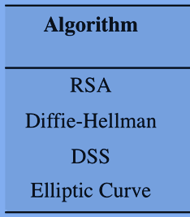

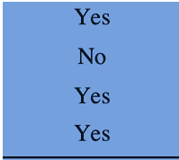
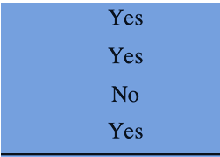
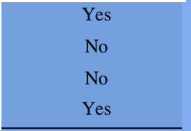
Applications for Public-Key Cryptosystems
Notes:
Table 2.3 indicates the applications supported by the algorithms
discussed in this section.

Slide 27
Digital Signatures
used for authenticating both source and data integrity
created by encrypting hash code with private key
does not provide confidentiality
even in the case of complete encryption
message is safe from alteration but not eavesdropping
Notes:
Public-key encryption can be used for authentication, as suggested by Figure 2.6b.
Suppose that Bob wants to send a message to Alice. Although it is not important that
the message be kept secret, he wants Alice to be certain that the message is indeed
from him. For this purpose, Bob uses a secure hash function, such as SHA-512, to
generate a hash value for the message and then encrypts the hash code with his private
key, creating a digital signature. Bob sends the message with the signature attached.
When Alice receives the message plus signature, she (1) calculates a hash value for
the message; (2) decrypts the signature using Bob’s public key; and (3) compares the
calculated hash value to the decrypted hash value. If the two hash values match, Alice
is assured that the message must have been signed by Bob. No one else has Bob’s
private key and therefore no one else could have created a ciphertext that could be
decrypted with Bob’s public key. In addition, it is impossible to alter the message
without access to Bob’s private key, so the message is authenticated both in terms of
source and in terms of data integrity.
It is important to emphasize that the digital signature does not provide confidentiality.
That is, the message being sent is safe from alteration but not safe from
eavesdropping. This is obvious in the case of a signature based on a portion of the
message, because the rest of the message is transmitted in the clear. Even in the
case of complete encryption, there is no protection of confidentiality because any
observer can decrypt the message by using the sender’s public key.

Slide 28
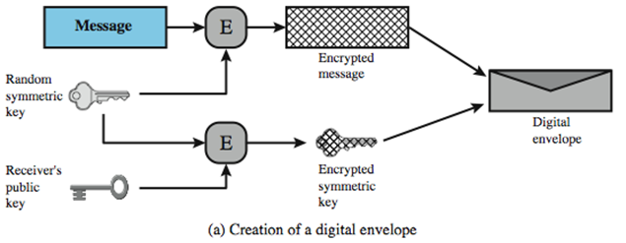
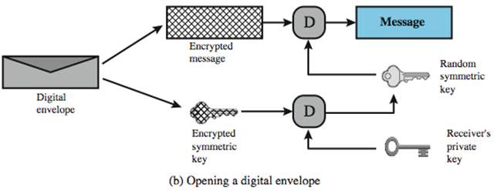
Digital Envelopes
protects a message without needing to first arrange for sender and receiver to have the same secret key
equates to the same thing as a sealed envelope containing an unsigned letter
Notes:
Another application in which public-key encryption is used to protect a symmetric
key is the digital envelope, which can be used to protect a message without needing
to first arrange for sender and receiver to have the same secret key. The technique
is referred to as a digital envelope, which is the equivalent of a sealed envelope
containing an unsigned letter. The general approach is shown in Figure 2.9. Suppose
Bob wishes to send a confidential message to Alice, but they do not share a symmetric
secret key. Bob does the following:
1. Prepare a message.
2. Generate a random symmetric key that will be used this one time only.
3. Encrypt that message using symmetric encryption the one-time key.
4. Encrypt the one-time key using public-key encryption with Alice’s public key.
5. Attach the encrypted one-time key to the encrypted message and send it to
Alice.
Only Alice is capable of decrypting the one-time key and therefore of recovering
the original message. If Bob obtained Alice’s public key by means of Alice’s
public-key certificate, then Bob is assured that it is a valid key.

Slide 29
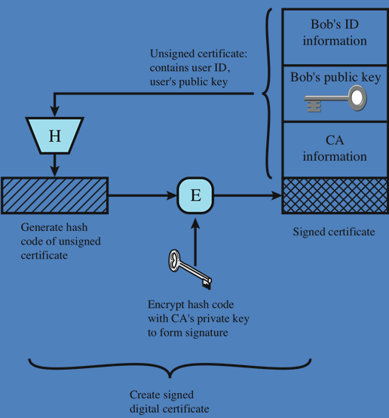
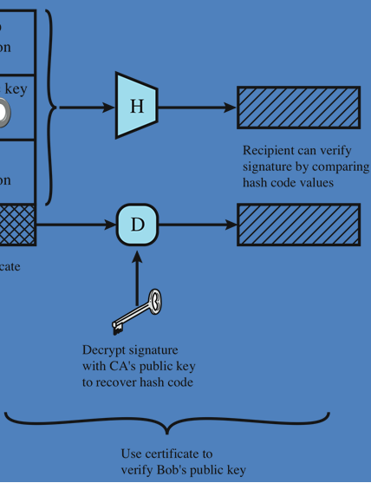
Public Key Certificates
Notes:
On the face of it, the point of public-key encryption is that the public key is public.
Thus, if there is some broadly accepted public-key algorithm, such as RSA, any
participant can send his or her public key to any other participant or broadcast the
key to the community at large. Although this approach is convenient, it has a major
weakness. Anyone can forge such a public announcement. That is, some user could
pretend to be Bob and send a public key to another participant or broadcast such a
public key. Until such time as Bob discovers the forgery and alerts other participants,
the forger is able to read all encrypted messages intended for A and can use the
forged keys for authentication.
The solution to this problem is the public-key certificate. In essence, a certificate
consists of a public key plus a user ID of the key owner, with the whole block
signed by a trusted third party. The certificate also includes some information about
the third party plus an indication of the period of validity of the certificate. Typically,
the third party is a certificate authority (CA) that is trusted by the user community,
such as a government agency or a financial institution. A user can present his
or her public key to the authority in a secure manner and obtain a signed certificate.
The user can then publish the certificate. Anyone needing this user’s public key
can obtain the certificate and verify that it is valid by means of the attached trusted
signature. Figure 2.8 illustrates the process.
One scheme has become universally accepted for formatting public-key
certificates: the X.509 standard. X.509 certificates are used in most network security
applications, including IP Security (IPsec), Transport Layer Security (TLS), Secure
Shell (SSH), and Secure/Multipurpose Internet Mail Extension (S/MIME). We
examine most of these applications in Part Five.

Slide 30
Random Numbers
Uses include generation of:
keys for public-key algorithms
stream key for symmetric stream cipher
symmetric key for use as a temporary session key or in creating a digital envelope
handshaking to prevent replay attacks
session key
Notes:
A number of network security algorithms based on cryptography make use of
random numbers. For example,
• Generation of keys for the RSA public-key encryption algorithm (described
in Chapter 21) and other public-key algorithms.
• Generation of a stream key for symmetric stream cipher.
• Generation of a symmetric key for use as a temporary session key or in creating
a digital envelope.
• In a number of key distribution scenarios, such as Kerberos (described in
Chapter 23), random numbers are used for handshaking to prevent replay
attacks.
• Session key generation, whether done by a key distribution center or by one of
the principals.
These applications give rise to two distinct and not necessarily compatible
requirements for a sequence of random numbers: randomness and unpredictability.

Slide 31
Random Number Requirements
Randomness
Unpredictability
criteria:
uniform distribution
frequency of occurrence of each of the numbers should be approximately the same
independence
no one value in the sequence can be inferred from the others
each number is statistically independent of other numbers in the sequence
opponent should not be able to predict future elements of the sequence on the basis of earlier elements
Notes:
Traditionally, the concern in the generation of a sequence of
allegedly random numbers has been that the sequence of numbers be random in
some well-defined statistical sense. The following two criteria are used to validate
that a sequence of numbers is random:
• Uniform distribution: The distribution of numbers in the sequence should be
uniform; that is, the frequency of occurrence of each of the numbers should be
approximately the same.
• Independence: No one value in the sequence can be inferred from the others.
Although there are well-defined tests for determining that a sequence of numbers
matches a particular distribution, such as the uniform distribution, there is no such
test to “prove” independence. Rather, a number of tests can be applied to demonstrate
if a sequence does not exhibit independence. The general strategy is to apply a number
of such tests until the confidence that independence exists is sufficiently strong.
In the context of our discussion, the use of a sequence of numbers that appear
statistically random often occurs in the design of algorithms related to cryptography.
For example, a fundamental requirement of the RSA public-key encryption scheme
is the ability to generate prime numbers. In general, it is
difficult to determine if a given large number N is prime. A brute-force approach
would be to divide N by every odd integer less than 1N. If N is on the order, say,
of 10150, a not uncommon occurrence in public-key cryptography, such a brute-force
approach is beyond the reach of human analysts and their computers. However, a
number of effective algorithms exist that test the primality of a number by using a
sequence of randomly chosen integers as input to relatively simple computations.
If the sequence is sufficiently long (but far, far less than 110150), the primality of
a number can be determined with near certainty. This type of approach, known
as randomization, crops up frequently in the design of algorithms. In essence, if a
problem is too hard or time-consuming to solve exactly, a simpler, shorter approach
based on randomization is used to provide an answer with any desired level of
confidence.
UNPREDICTABILITY
In applications such as reciprocal authentication and session key
generation, the requirement is not so much that the sequence of numbers be statistically
random but that the successive members of the sequence are unpredictable. With
“true” random sequences, each number is statistically independent of other numbers
in the sequence and therefore unpredictable. However, as is discussed shortly, true
random numbers are not always used; rather, sequences of numbers that appear to
be random are generated by some algorithm. In this latter case, care must be taken
that an opponent not be able to predict future elements of the sequence on the basis
of earlier elements.

Slide 32
Random versus Pseudorandom
cryptographic applications typically use algorithms for random number generation
algorithms are deterministic and therefore produce sequences of numbers that are not statistically random
pseudorandom numbers are:
sequences produced that satisfy statistical randomness tests
likely to be predictable
true random number generator (TRNG):
uses a nondeterministic source to produce randomness
most operate by measuring unpredictable natural processes
e.g. radiation, gas discharge, leaky capacitors
increasingly provided on modern processors
Notes:
Cryptographic applications typically make use of algorithmic techniques for random
number generation. These algorithms are deterministic and therefore produce
sequences of numbers that are not statistically random. However, if the algorithm is
good, the resulting sequences will pass many reasonable tests of randomness. Such
numbers are referred to as pseudorandom numbers.
You may be somewhat uneasy about the concept of using numbers generated
by a deterministic algorithm as if they were random numbers. Despite what might
be called philosophical objections to such a practice, it generally works. As one
expert on probability theory puts it [HAMM91],
For practical purposes we are forced to accept the awkward concept
of “relatively random” meaning that with regard to the proposed
use we can see no reason why they will not perform as if they were
random (as the theory usually requires). This is highly subjective
and is not very palatable to purists, but it is what statisticians regularly
appeal to when they take “a random sample”—they hope that
any results they use will have approximately the same properties as
a complete counting of the whole sample space that occurs in their
theory.
A true random number generator (TRNG) uses a nondeterministic source to
produce randomness. Most operate by measuring unpredictable natural processes,
such as pulse detectors of ionizing radiation events, gas discharge tubes, and leaky
capac itors. Intel has developed a commercially available chip that samples thermal
noise by amplifying the voltage measured across undriven resistors [JUN99].
A group at Bell Labs has developed a technique that uses the variations in the
response time of raw read requests for one disk sector of a hard disk [JAKO98].
LavaRnd is an open source project for creating truly random numbers using inexpensive
cameras, open source code, and inexpensive hardware. The system uses a
saturated charge- coupled device (CCD) in a light-tight can as a chaotic source to
produce the seed. Software processes the result into truly random numbers in a
variety of formats.

Slide 33
Application: Encryption of Stored Data
common to encrypt transmitted data
much less common for stored data
there is often little protection beyond domain authentication and operating system access controls
approaches to encrypt stored data:
data are archived for indefinite periods
use a commercially available encryption package
back-end appliance
library based tape encryption
background laptop/PC data encryption
even though erased, until disk sectors are reused data are recoverable
Notes:
One of the principal security requirements of a computer system is the protection
of stored data. Security mechanisms to provide such protection include access control,
intrusion detection, and intrusion prevention schemes, all of which are discussed
in this book. The book also describes a number of technical means by which
these various security mechanisms can be made vulnerable. But beyond technical
approaches, these approaches can become vulnerable because of human factors.
We list a few examples here, based on [ROTH05].
• In December of 2004, Bank of America employees backed up and sent to its
backup data center tapes containing the names, addresses, bank account numbers,
and Social Security numbers of 1.2 million government workers enrolled
in a charge-card account. None of the data were encrypted. The tapes never
arrived and indeed have never been found. Sadly, this method of backing up
and shipping data is all too common. As an another example, in April of 2005,
Ameritrade blamed its shipping vendor for losing a backup tape containing
unencrypted information on 200,000 clients.
• In April of 2005, San Jose Medical group announced that someone had physically
stolen one of its computers and potentially gained access to 185,000
unencrypted patient records.
• There have been countless examples of laptops lost at airports, stolen from a
parked car, or taken while the user is away from his or her desk. If the data on the
laptop’s hard drive are unencrypted, all of the data are available to the thief.
Although it is now routine for businesses to provide a variety of protections,
including encryption, for information that is transmitted across networks, via the
Internet, or via wireless devices, once data are stored locally (referred to as data at
rest), there is often little protection beyond domain authentication and operating
system access controls. Data at rest are often routinely backed up to secondary storage
such as CDROM or tape, archived for indefinite periods. Further, even when
data are erased from a hard disk, until the relevant disk sectors are reused, the data
are recoverable. Thus it becomes attractive, and indeed should be mandatory, to
encrypt data at rest and combine this with an effective encryption key management
scheme.
There are a variety of ways to provide encryption services. A simple approach
available for use on a laptop is to use a commercially available encryption package
such as Pretty Good Privacy (PGP). PGP enables a user to generate a key from a
password and then use that key to encrypt selected files on the hard disk. The PGP
package does not store the password. To recover a file, the user enters the password,
PGP generates the password, and PGP decrypts the file. So long as the user protects
his or her password and does not use an easily guessable password, the files are fully
protected while at rest. Some more recent approaches are listed in [COLL06]:
• Back-end appliance: This is a hardware device that sits between servers and
storage systems and encrypts all data going from the server to the storage system
and decrypts data going in the opposite direction. These devices encrypt
data at close to wire speed, with very little latency. In contrast, encryption
software on servers and storage systems slows backups. A system man ager
configures the appliance to accept requests from specified clients, for which
unencrypted data are supplied.
• Library-based tape encryption: This is provided by means of a co-processor board
embedded in the tape drive and tape library hardware. The co-processor encrypts
data using a nonreadable key configured into the board. The tapes can then be sent
off-site to a facility that has the same tape drive hardware. The key can be exported
via secure e-mail or a small flash drive that is transported securely. If the matching
tape drive hardware co-processor is not available at the other site, the target facility
can use the key in a software decryption package to recover the data.
• Background laptop and PC data encryption: A number of vendors offer software
products that provide encryption that is transparent to the application and
the user. Some products encrypt all or designated files and folders. Other products
create a virtual disk, which can be maintained locally on the user’s hard
drive or maintained on a network storage device, with all data on the virtual
disk encrypted. Various key management solutions are offered to restrict access
to the owner of the data.

Slide 34
Summary
symmetric encryption
conventional or single-key only type used prior to public-key
five parts: plaintext, encryption algorithm, secret key, ciphertext, and decryption algorithm
two attacks: cryptanalysis and brute force
most commonly used algorithms are block ciphers (DES, triple DES, AES)
public-key encryption
based on mathematical functions
asymmetric
six ingredients: plaintext, encryption algorithm, public and private key, ciphertext, and decryption algorithm
hash functions
message authentication creation of digital signatures
digital signatures
hash code is encrypted with private key
digital envelopes
protects a message without needing to first arrange for sender and receiver to have the same secret key
random numbers
requirements: randomness and unpredictability
validation: uniform distribution, independence
pseudorandom numbers
Notes:
Chapter 2 summary.

