Slide 1
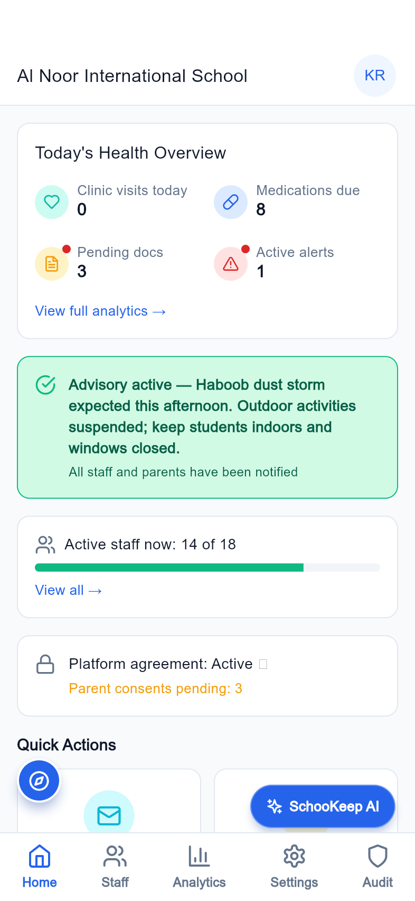
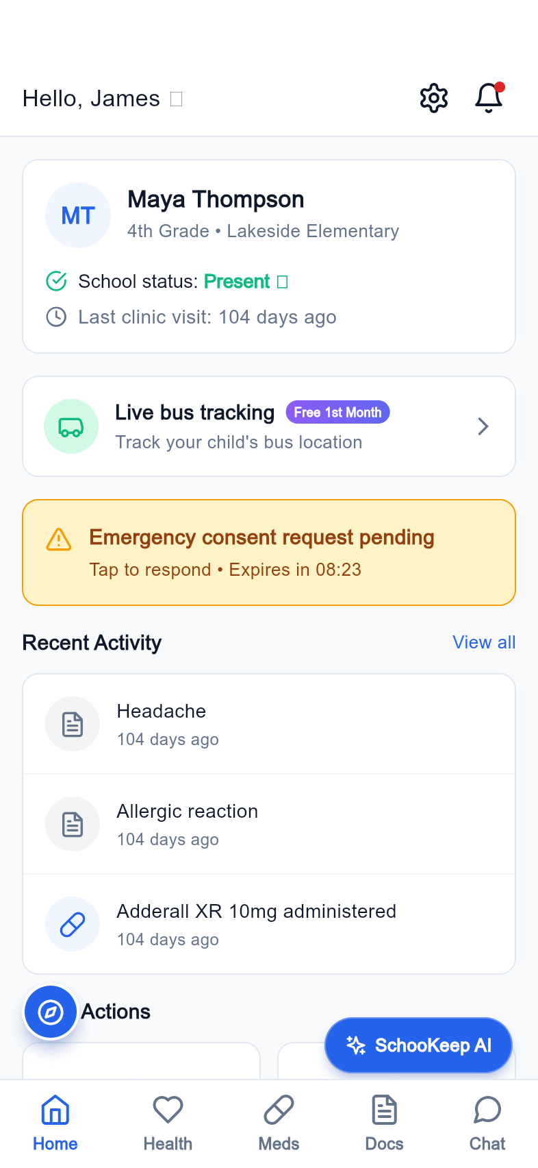
SCHOOL HEALTH, CONNECTED
SchooKeep
A shared operating layer for school health, family communication, and student safety.
Better handoffs.
Clearer accountability.
One school community.
Flutter product demonstration
Local demo data, captured from the running app
School leadership
Parent experience
SchooKeep | Product pitch | 05 October 2026
01

Slide 2
THE PROBLEM
Care breaks down between handoffs
The product addresses coordination gaps across the school day.
01
02
03
Fragmented context
Time-sensitive decisions
Limited visibility
Clinic notes, consent, medication status, and pickup instructions sit in different workflows.
A health event often requires the nurse, parent, teacher, and leadership to act on the same information.
Schools need a clear operational view and a traceable record of who acted and when.
SchooKeep | Product pitch | 05 October 2026
02

Slide 3
THE SOLUTION
A connected school health workspace
Role-specific mobile screens bring each team into the same operating model.
01
02
03
Coordinate care
Connect families
Close the loop
Clinic visits, dose workflows, physician review, and student health records.
Consent, documents, health history, medication reporting, and authorized pickups.
Leadership analytics, staff permissions, school advisories, and audit views.
SchooKeep | Product pitch | 05 October 2026
03

Slide 4
PRODUCT BREADTH
Built around the whole school
Eleven role experiences, with shared authentication and system states.
Principal
Vice principal
Nurse
Physician
Parent
Teacher
Counselor
Secretary
Cafeteria
Security
Bus driver
148 route screenshots included in the product library.
SchooKeep | Product pitch | 05 October 2026
04

Slide 5
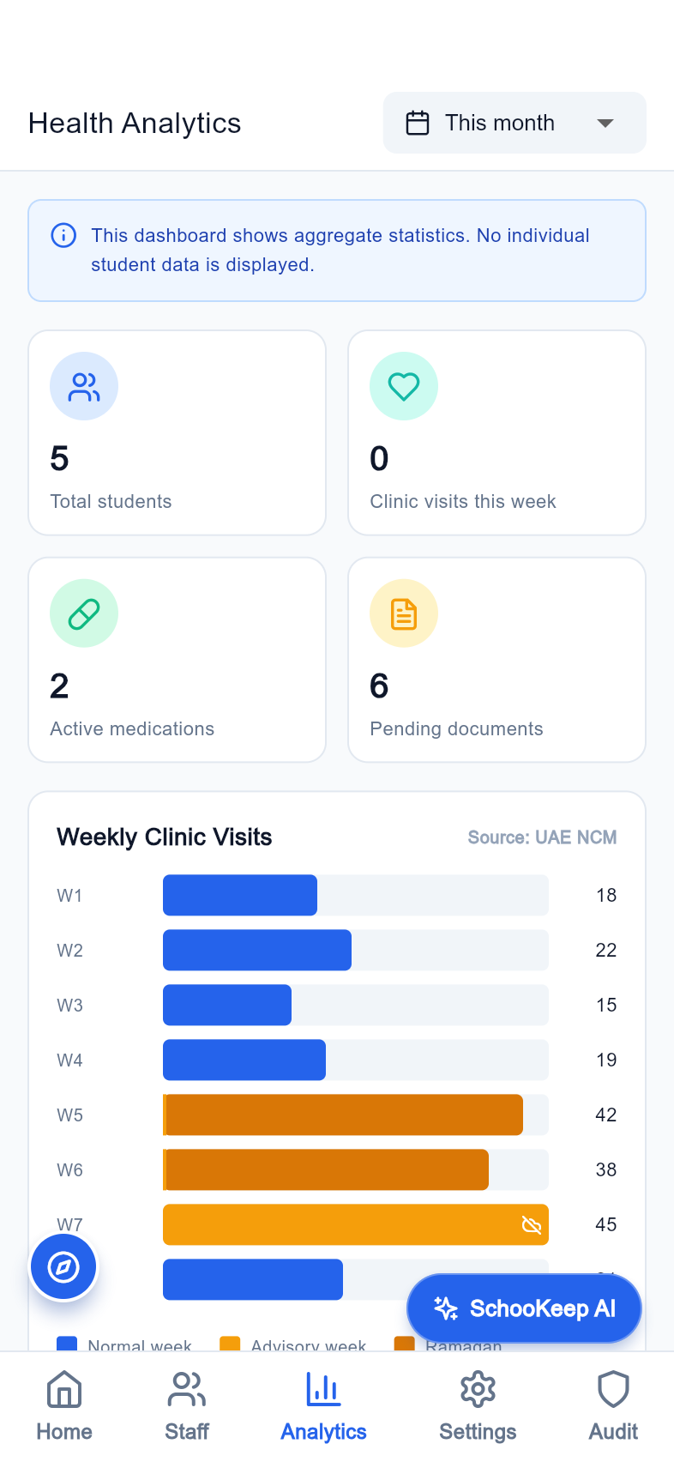
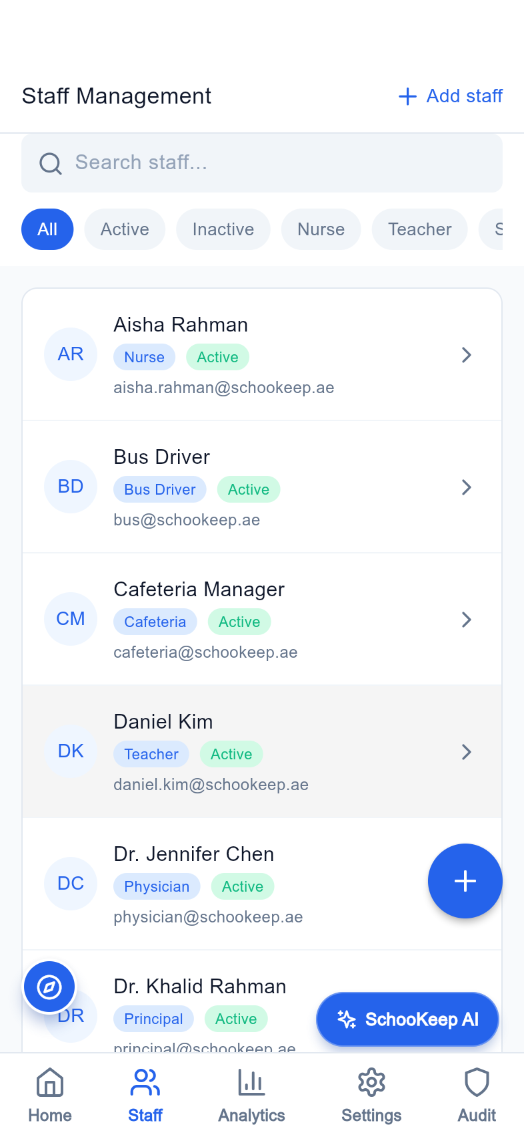
LEADERSHIP
See the school health picture
A daily overview brings care activity, documents, alerts, and staff visibility together.
An operational home
Bring today's priorities into one leadership screen.
Staff and access oversight
Manage the people who deliver each part of the service.
Analytics and reporting
Review trends and support school-level planning.
Daily overview
Health analytics
Staff management
SchooKeep | Product pitch | 05 October 2026
05
Notes:
Screens captured from the Flutter release build using a local seeded Laravel backend and supplied admin account. Demo data; no claim of production use. A daily overview brings care activity, documents, alerts, and staff visibility together.

Slide 6
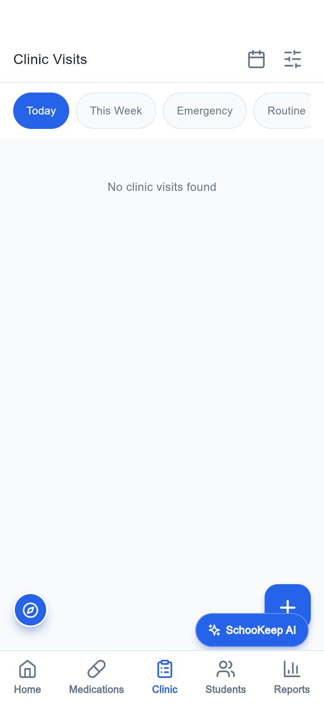
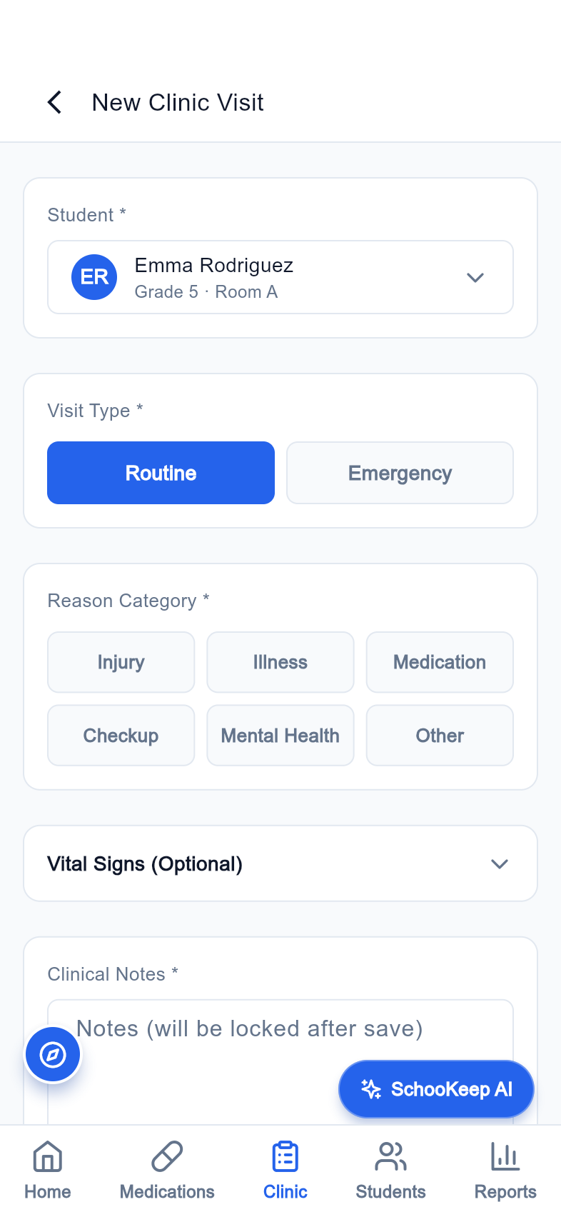
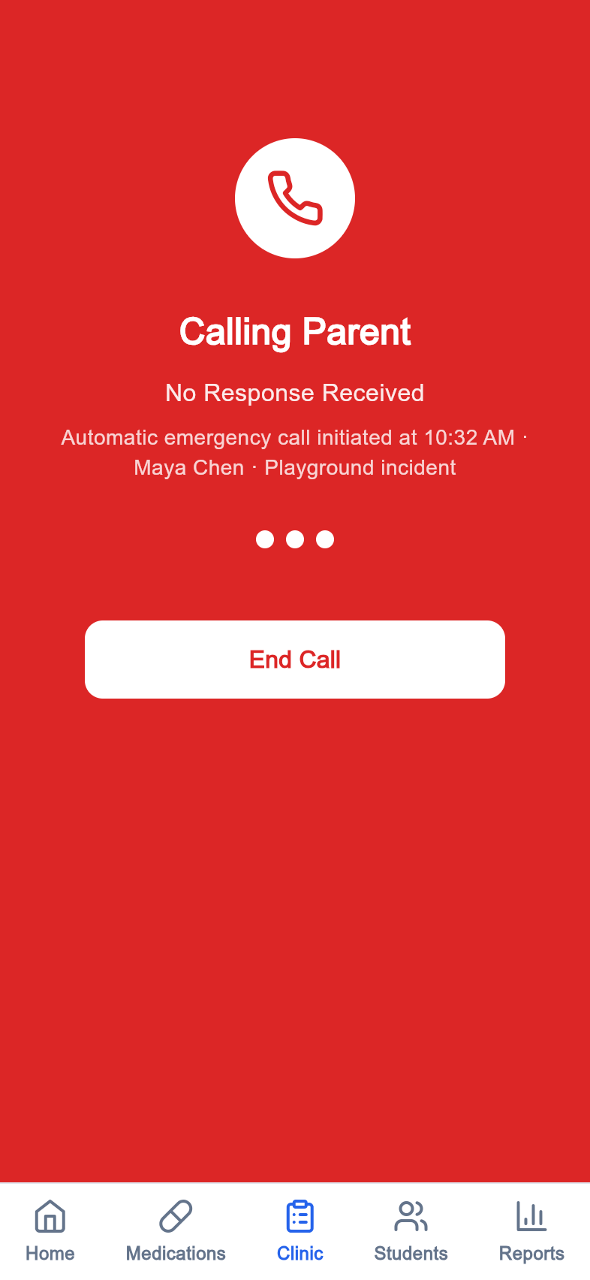
CLINICAL CARE
Give the nurse a focused workspace
Clinical operations span student lookup, visits, documentation, and emergency escalation.
Student health context
Access health information alongside the student record.
Visit documentation
Organize routine clinic activity and visit details.
Escalation paths
Make urgent next steps visible in the workflow.
Clinic visits
New visit
Emergency escalation
SchooKeep | Product pitch | 05 October 2026
06
Notes:
Screens captured from the Flutter release build using a local seeded Laravel backend and supplied admin account. Demo data; no claim of production use. Clinical operations span student lookup, visits, documentation, and emergency escalation.

Slide 7
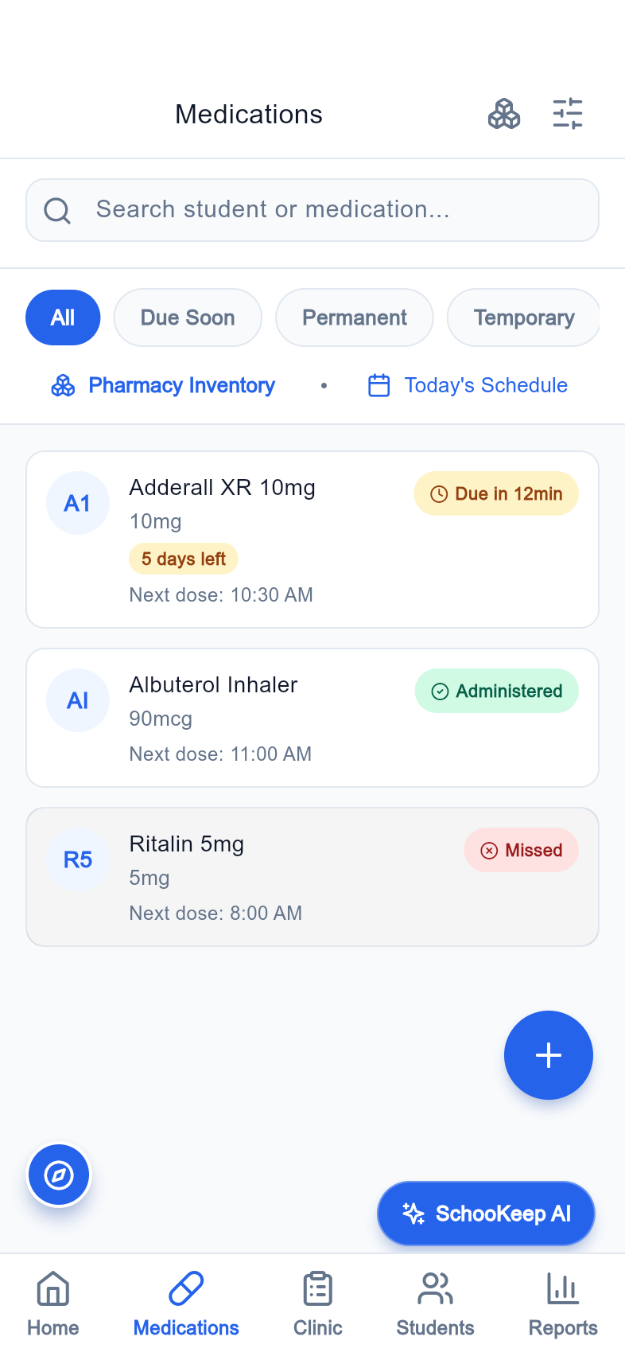
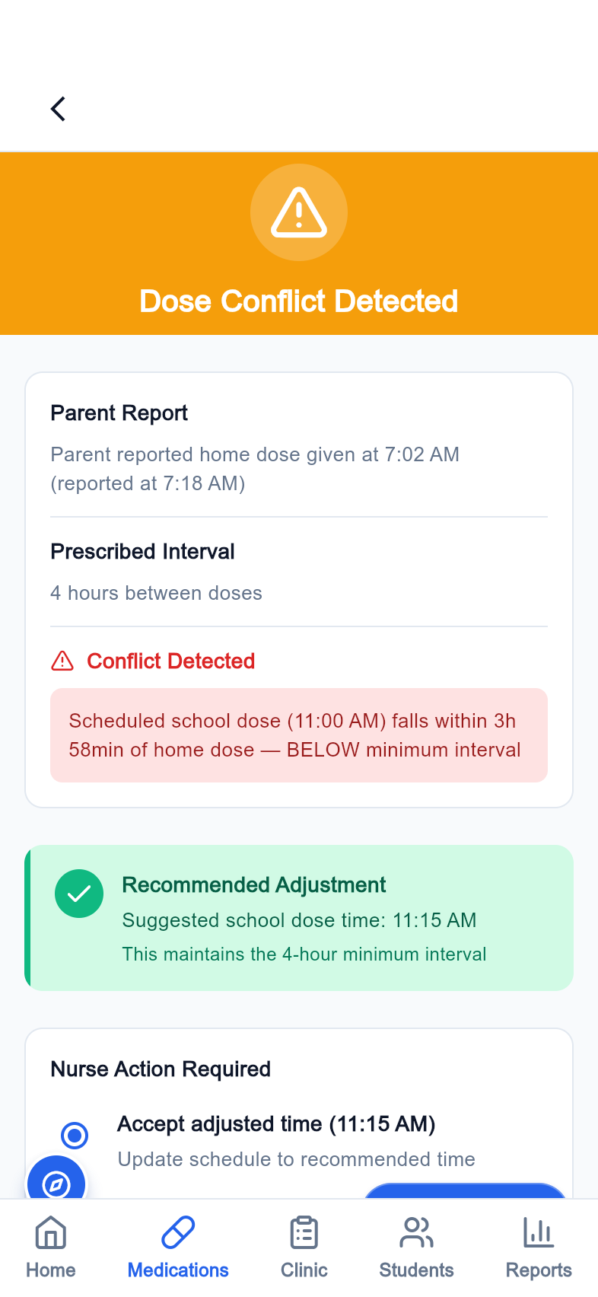
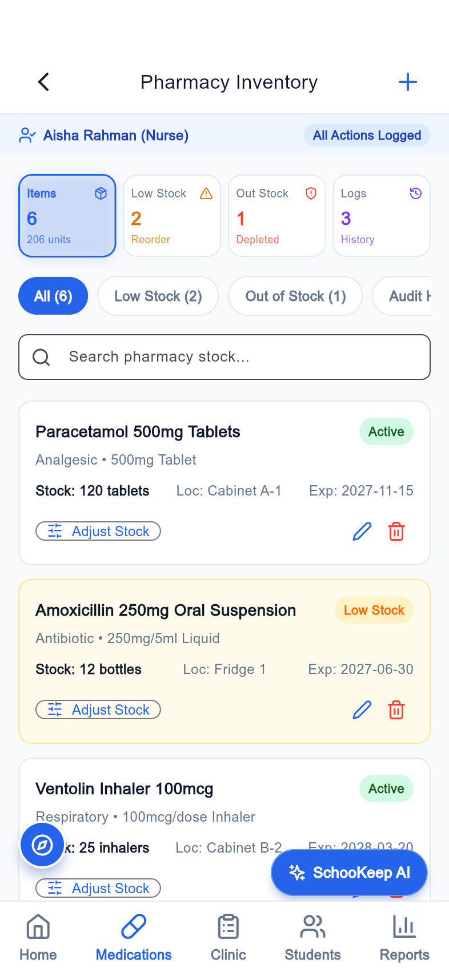
MEDICATION WORKFLOW
Make each dose a deliberate action
Daily doses, conflict states, and inventory are represented in the clinical experience.
Plan the day
Review medication work in a dedicated dose view.
Confirm and flag
Use confirmation and dose-conflict screens to structure the handoff.
Track supplies
Give medication stock its own operational view.
Medication list
Conflict alert
Pharmacy inventory
SchooKeep | Product pitch | 05 October 2026
07
Notes:
Screens captured from the Flutter release build using a local seeded Laravel backend and supplied admin account. Demo data; no claim of production use. Daily doses, conflict states, and inventory are represented in the clinical experience.

Slide 8
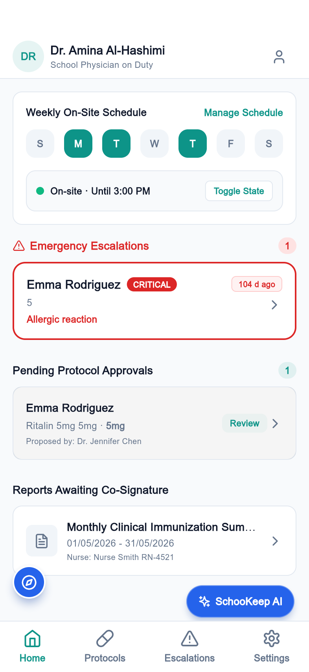
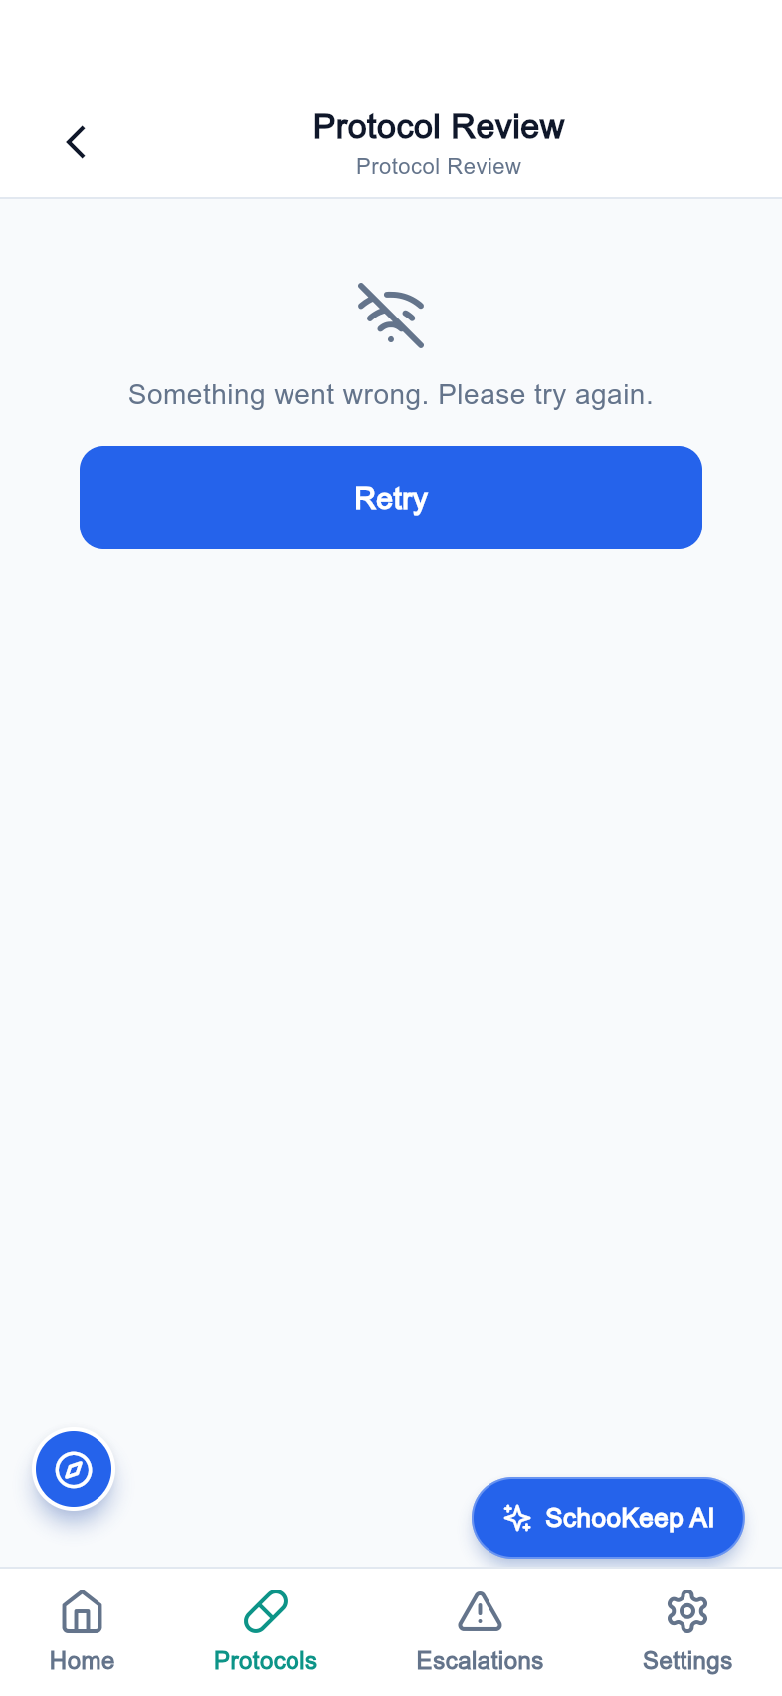
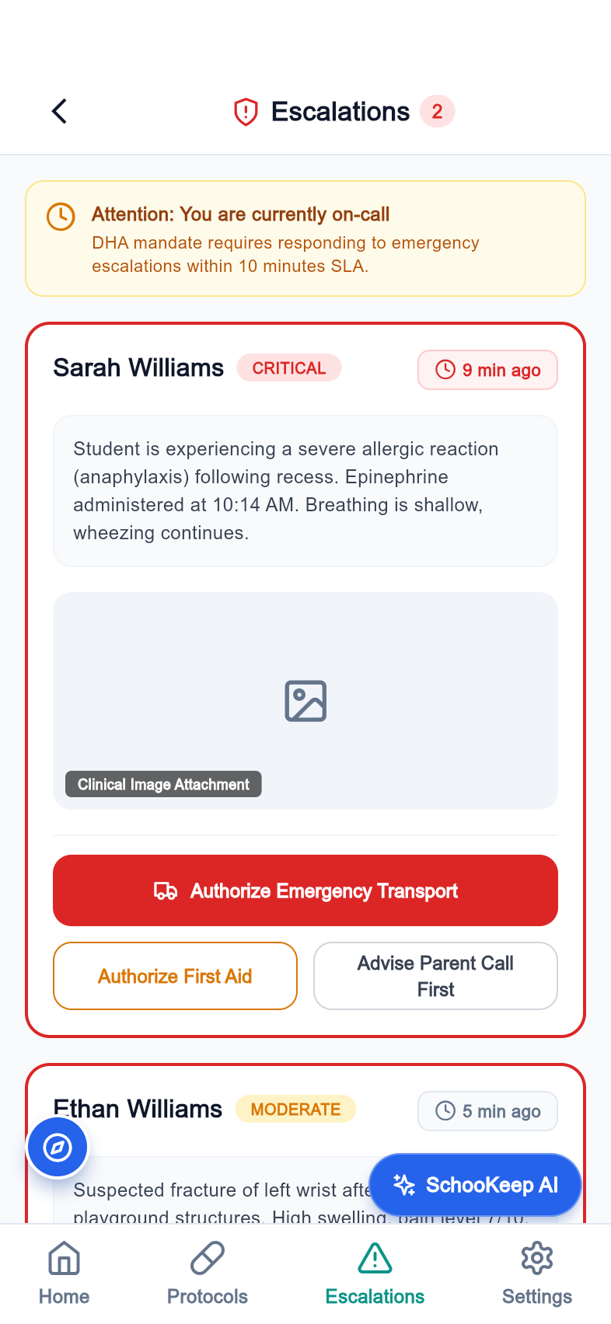
PHYSICIAN OVERSIGHT
Extend care beyond the clinic desk
A physician workspace supports protocol review, escalations, and scheduling.
Protocol review
Provide a dedicated review area for medication protocols.
Clinical escalation inbox
Surface cases that need additional clinical attention.
Availability planning
Represent physician schedules in the app.
Physician home
Protocol review
Escalation inbox
SchooKeep | Product pitch | 05 October 2026
08
Notes:
Screens captured from the Flutter release build using a local seeded Laravel backend and supplied admin account. Demo data; no claim of production use. A physician workspace supports protocol review, escalations, and scheduling.

Slide 9
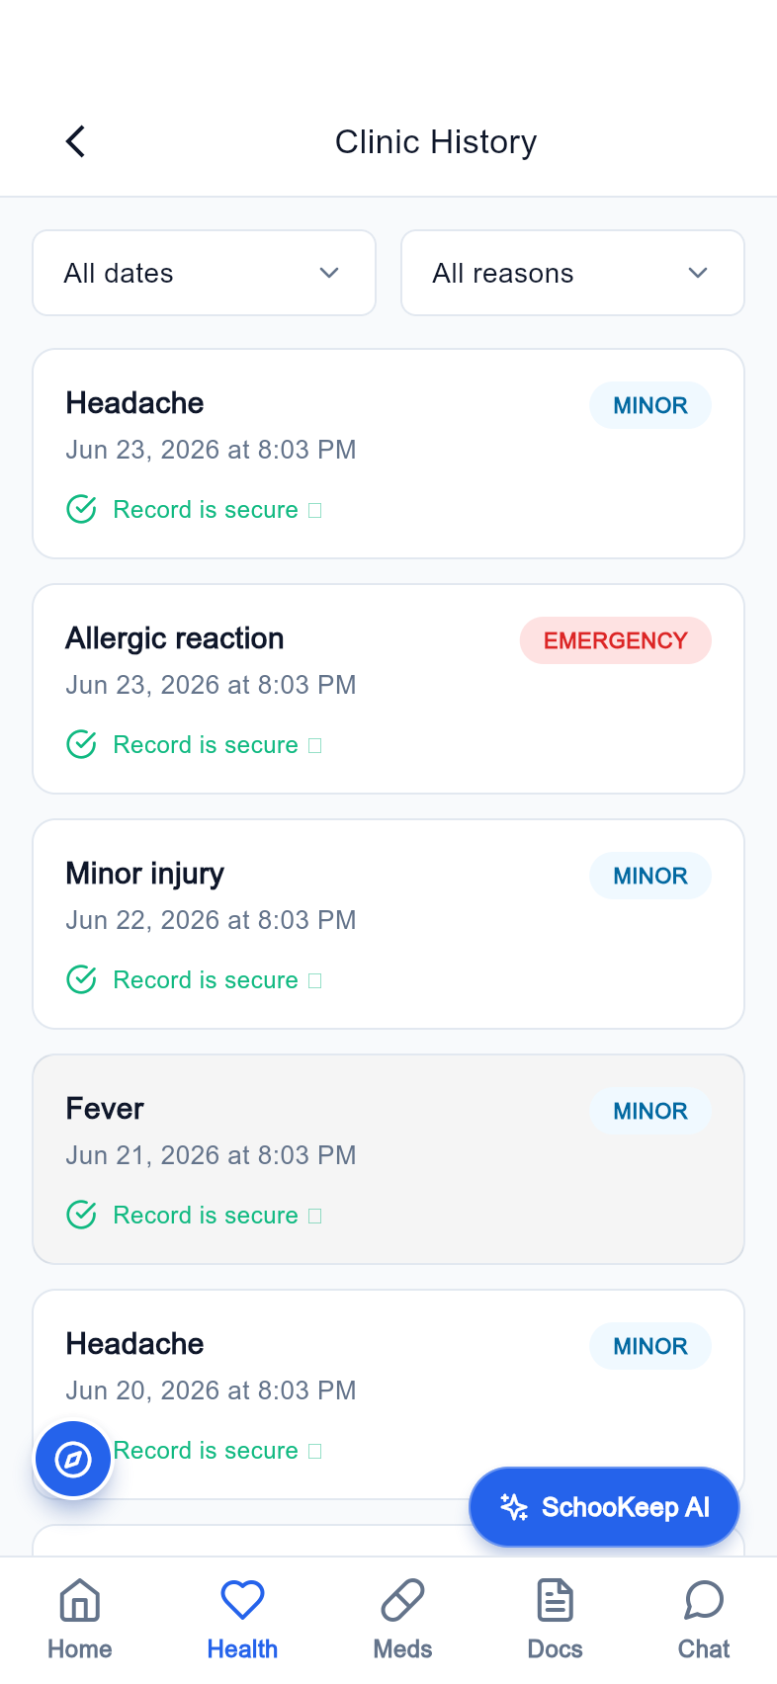
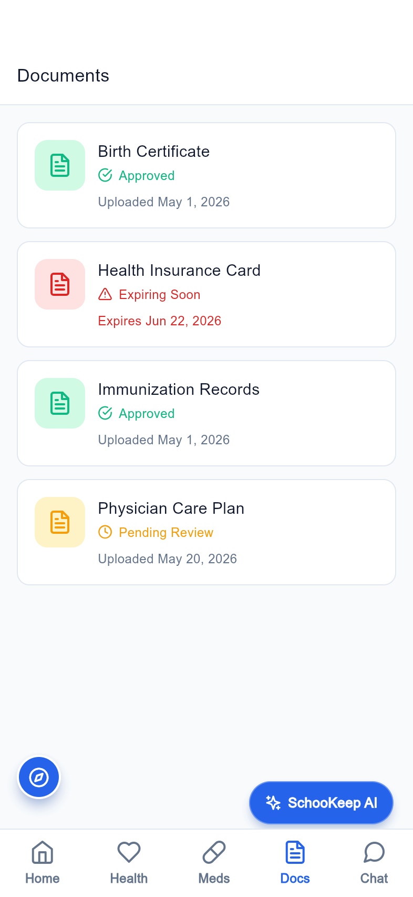
FAMILY EXPERIENCE
Keep parents part of the care loop
The parent app brings health, medication, and document workflows into a familiar mobile experience.
A family-facing home
Give guardians a clear starting point for the school day.
Health and medication history
Keep the child's care activity visible to the family.
Documents in one place
Provide an accessible path for school health paperwork.
Parent home
Health history
Documents
SchooKeep | Product pitch | 05 October 2026
09
Notes:
Screens captured from the Flutter release build using a local seeded Laravel backend and supplied admin account. Demo data; no claim of production use. The parent app brings health, medication, and document workflows into a familiar mobile experience.

Slide 10
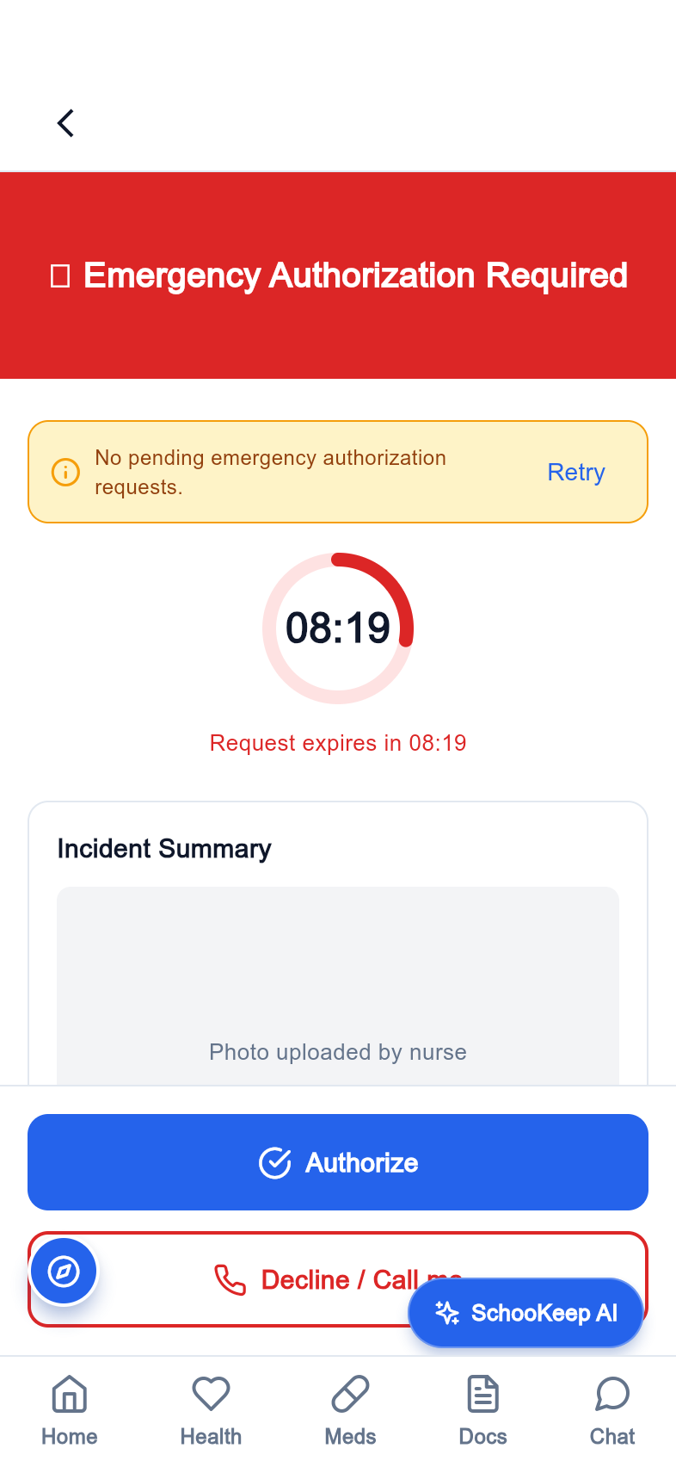
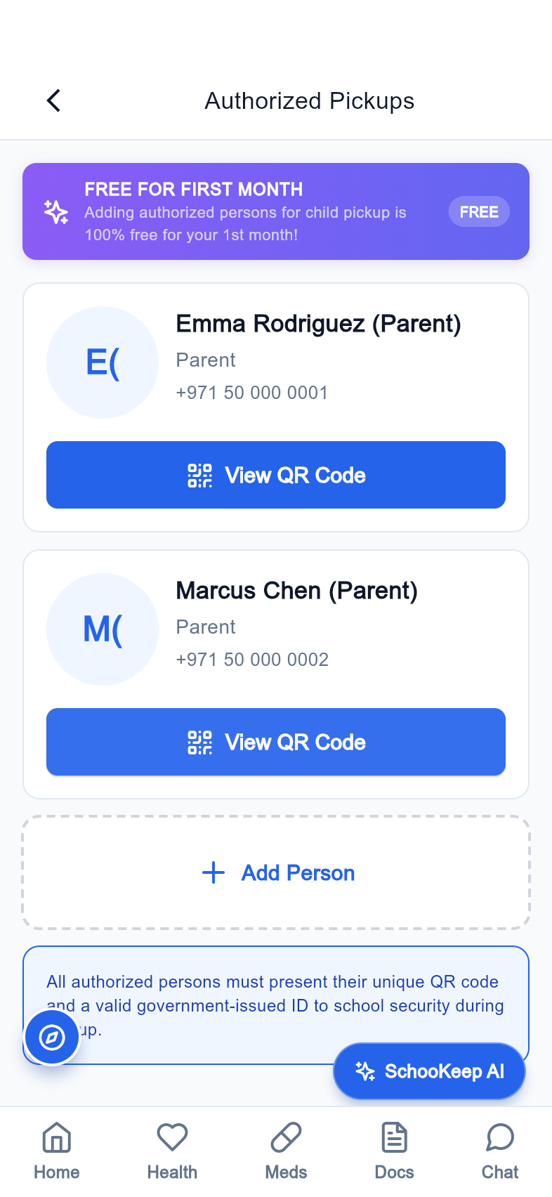
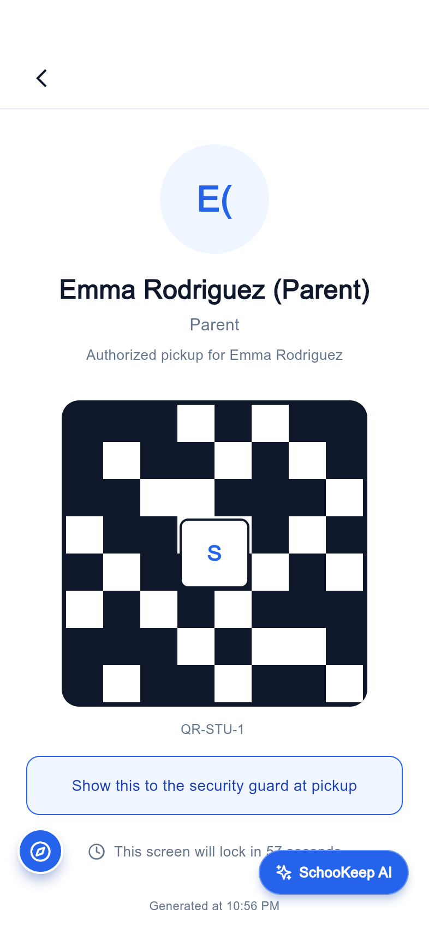
CONSENT AND HANDOFFS
Connect a request to a response
Consent and authorized pickup screens show the link between school operations and guardians.
Emergency response
Provide a dedicated parent consent screen.
Authorized persons
Organize the people approved for pickup.
QR presentation
Represent a scannable pickup identity in the family app.
Consent response
Authorized persons
Pickup QR code
SchooKeep | Product pitch | 05 October 2026
10
Notes:
Screens captured from the Flutter release build using a local seeded Laravel backend and supplied admin account. Demo data; no claim of production use. Consent and authorized pickup screens show the link between school operations and guardians.

Slide 11
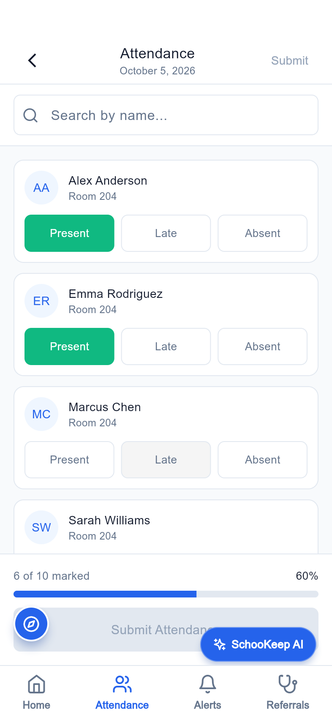
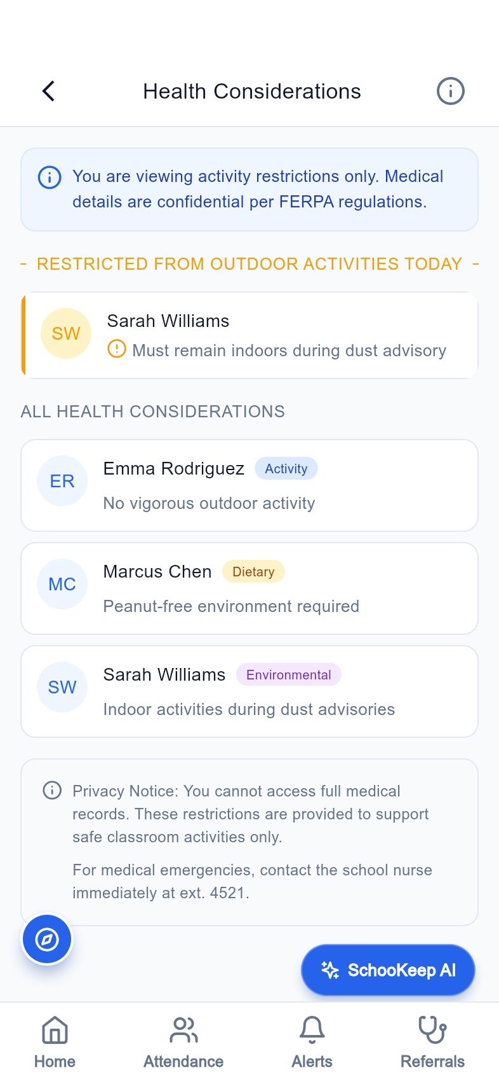
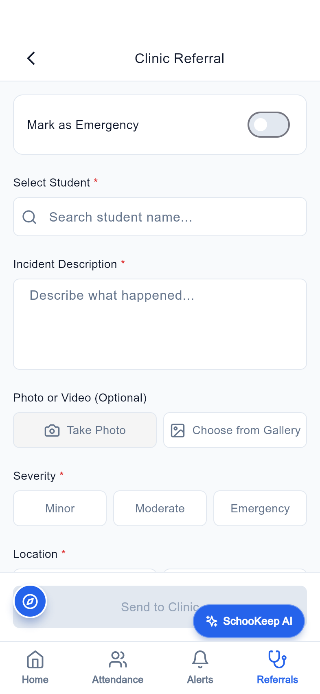
CLASSROOM AWARENESS
Bring health context into the school day
Teachers have focused views for attendance, health considerations, referrals, and exemptions.
Attendance context
A classroom view supports daily operational awareness.
Health considerations
Keep relevant student needs visible to the teacher.
Referral workflow
Offer a structured route into the school clinic.
Attendance
Health considerations
Clinic referral
SchooKeep | Product pitch | 05 October 2026
11
Notes:
Screens captured from the Flutter release build using a local seeded Laravel backend and supplied admin account. Demo data; no claim of production use. Teachers have focused views for attendance, health considerations, referrals, and exemptions.

Slide 12
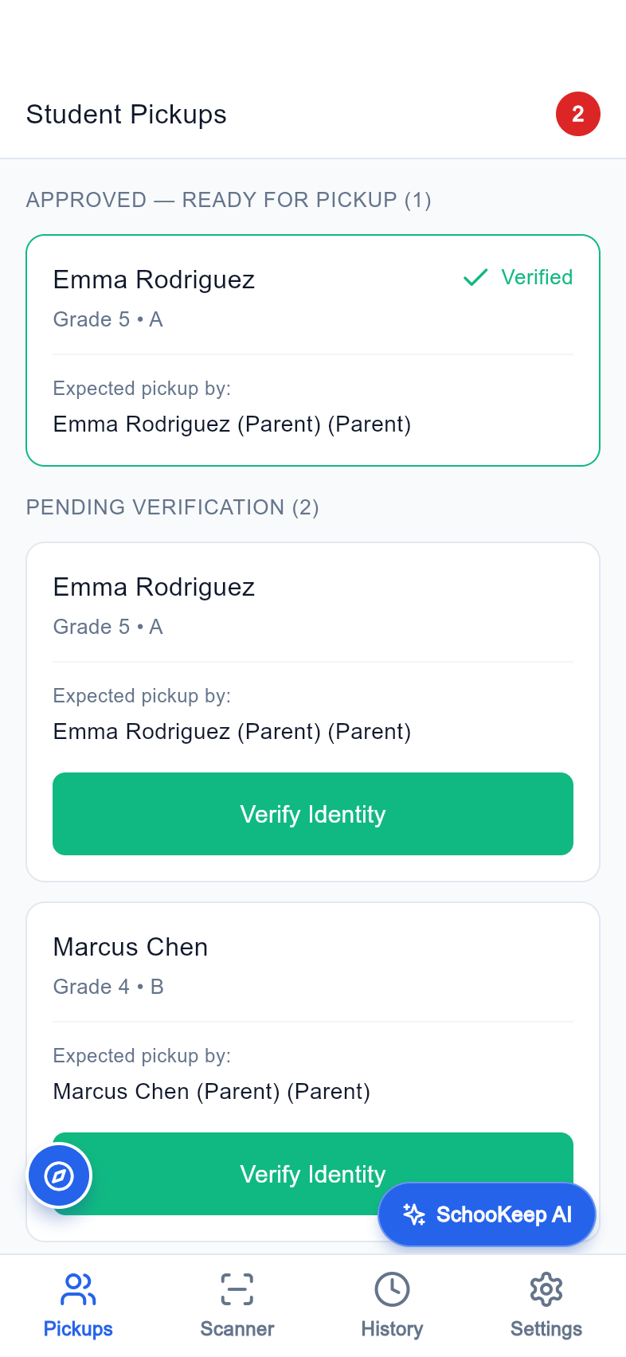
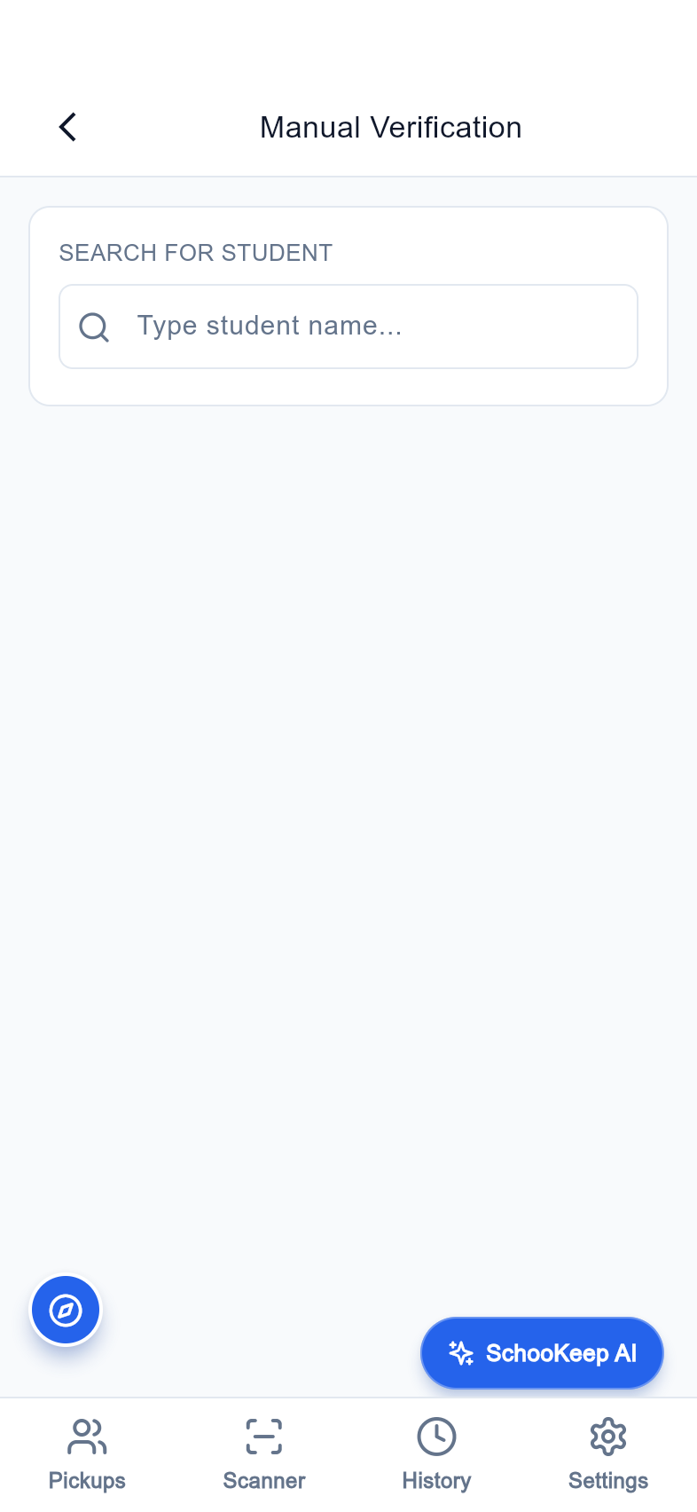
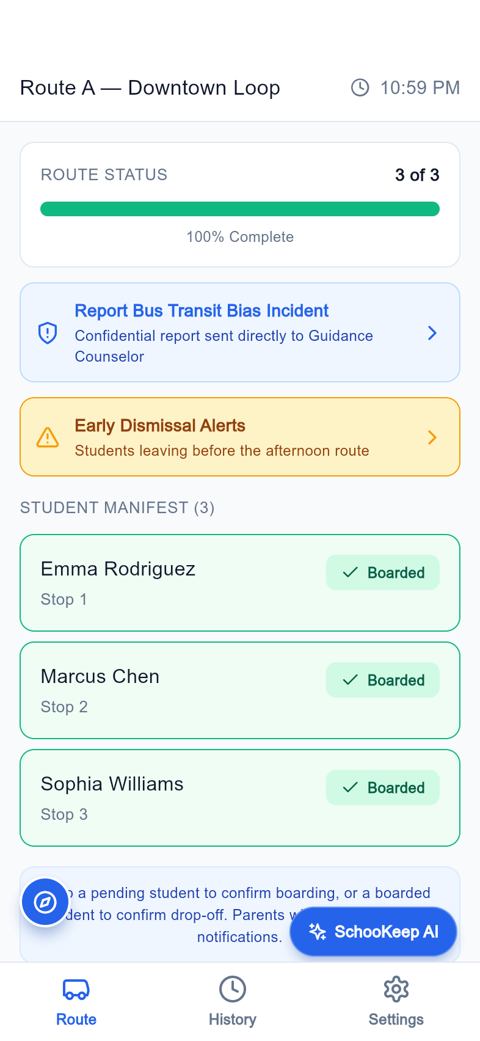
STUDENT SAFETY
Support arrival and departure handoffs
Security and transport have dedicated operational views.
Pickup verification
Queue and manual verification screens organize gate activity.
Transport operations
Route, boarding, and history workflows support the driver.
Shared responsibility
Connect the school, transport staff, and authorized guardians.
Pickup queue
Manual verification
Bus route
SchooKeep | Product pitch | 05 October 2026
12
Notes:
Screens captured from the Flutter release build using a local seeded Laravel backend and supplied admin account. Demo data; no claim of production use. Security and transport have dedicated operational views.

Slide 13
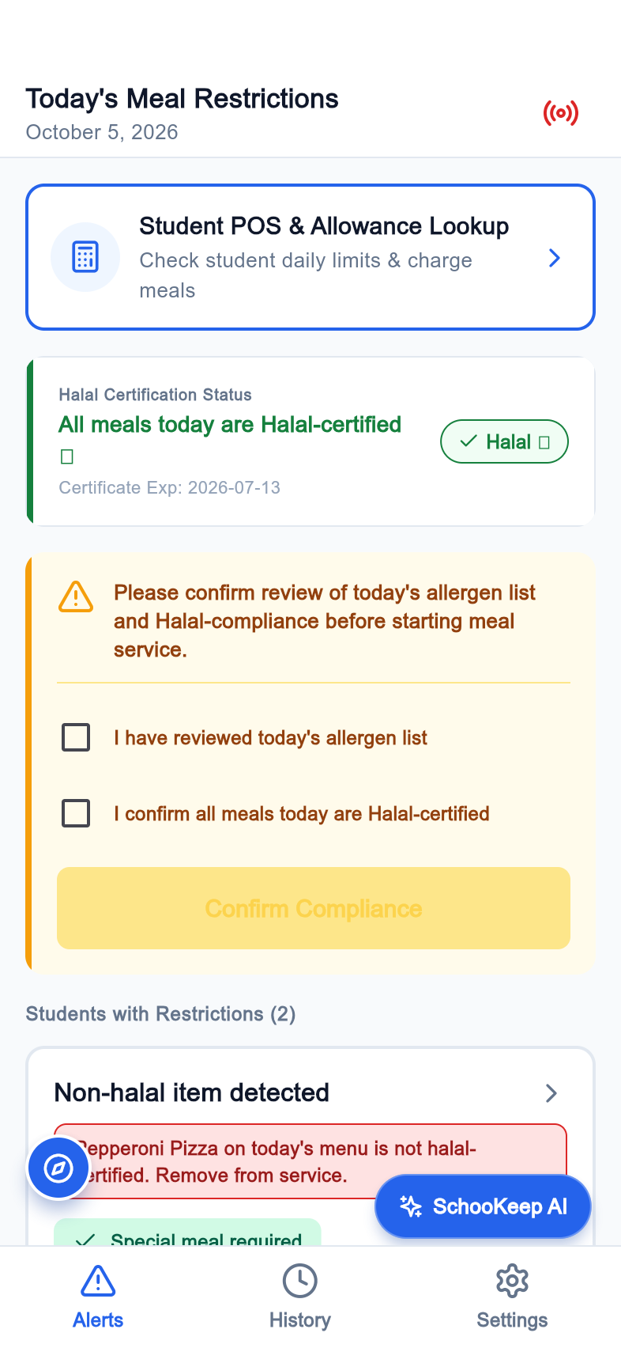
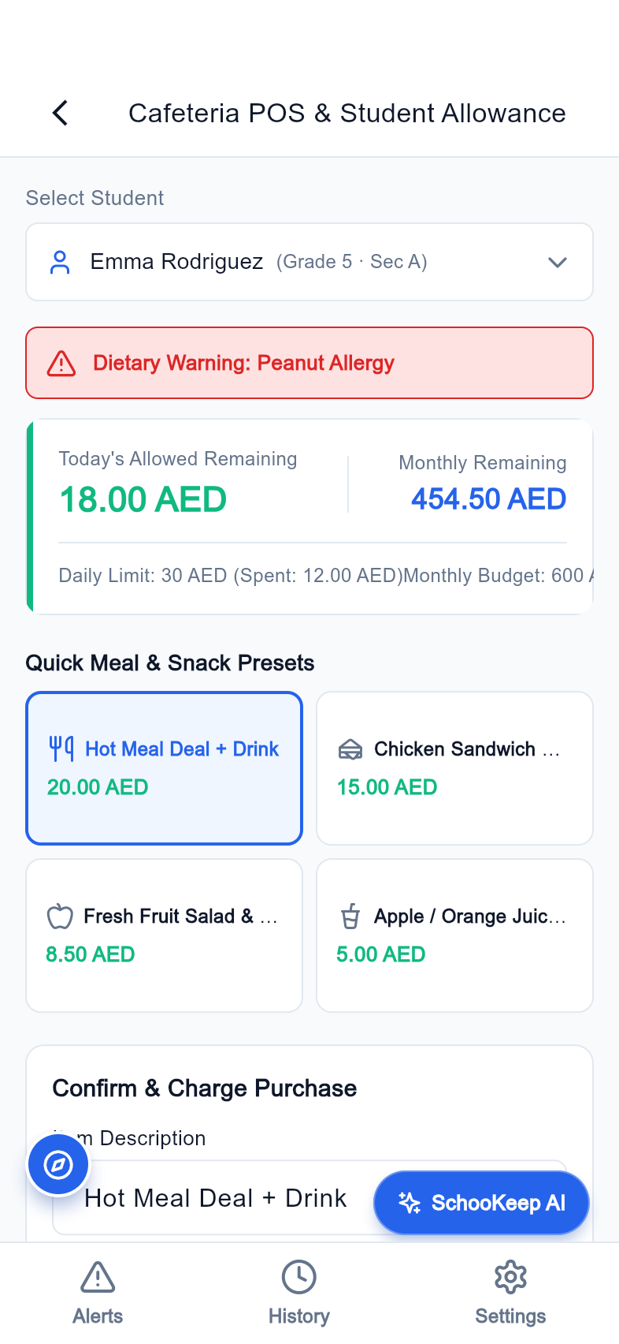
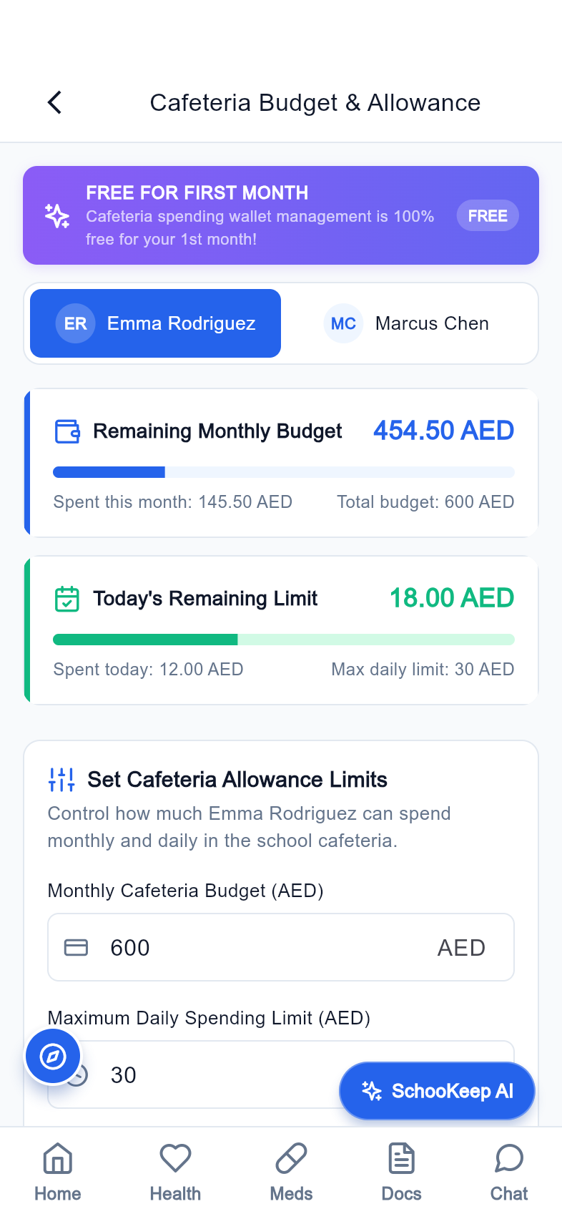
FOOD SAFETY
Make cafeteria decisions more informed
Allergen alerts and point-of-sale workflows extend the product beyond the clinic.
Allergen awareness
Provide the cafeteria with dedicated alert screens.
Daily operations
Bring point of sale into the staff experience.
Family budget visibility
Represent cafeteria budgets in the parent app.
Cafeteria alerts
Point of sale
Family budget
SchooKeep | Product pitch | 05 October 2026
13
Notes:
Screens captured from the Flutter release build using a local seeded Laravel backend and supplied admin account. Demo data; no claim of production use. Allergen alerts and point-of-sale workflows extend the product beyond the clinic.

Slide 14
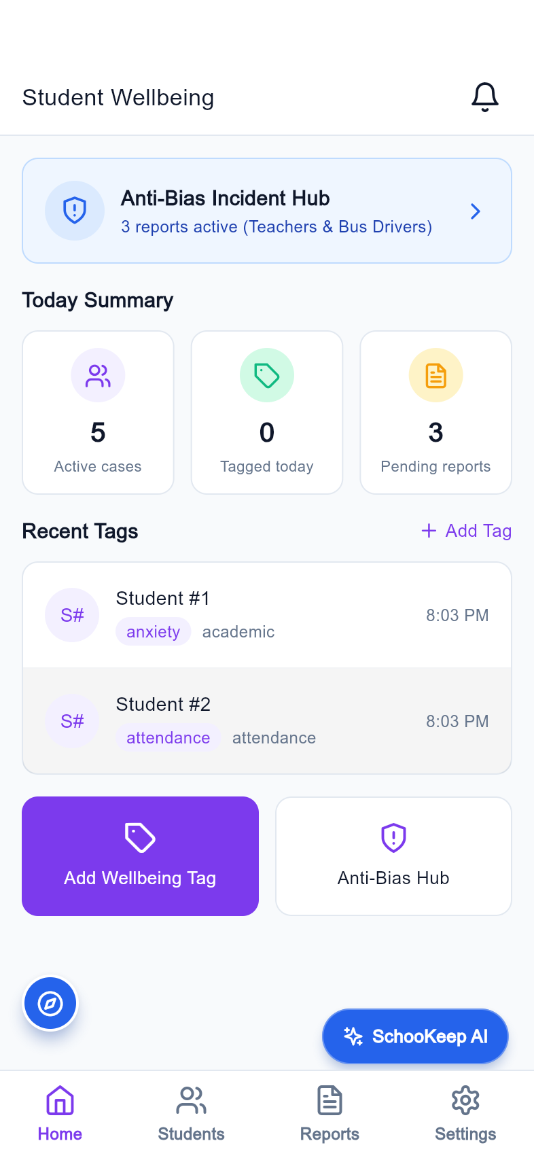
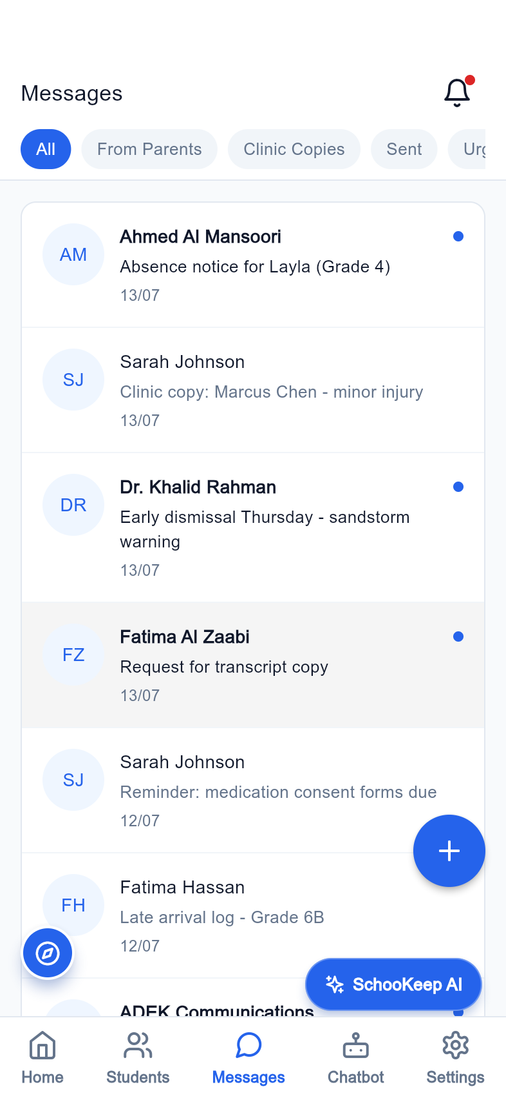
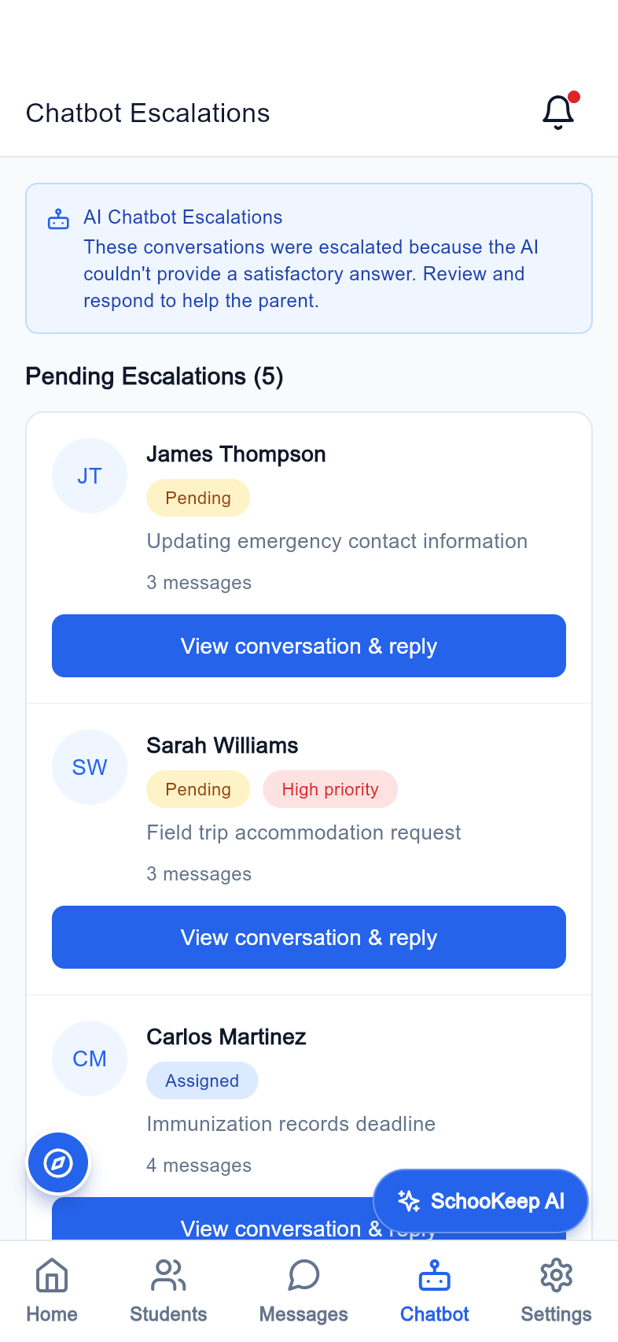
SCHOOL SUPPORT
Support the people behind each handoff
Counselor and secretary screens broaden the operational footprint.
Student support
Counselor records and report workflows represent ongoing care.
Office coordination
The secretary has student, messaging, and import views.
Triage and follow-up
Queue screens make outstanding work visible.
Counselor dashboard
Office messaging
Chatbot queue
SchooKeep | Product pitch | 05 October 2026
14
Notes:
Screens captured from the Flutter release build using a local seeded Laravel backend and supplied admin account. Demo data; no claim of production use. Counselor and secretary screens broaden the operational footprint.

Slide 15
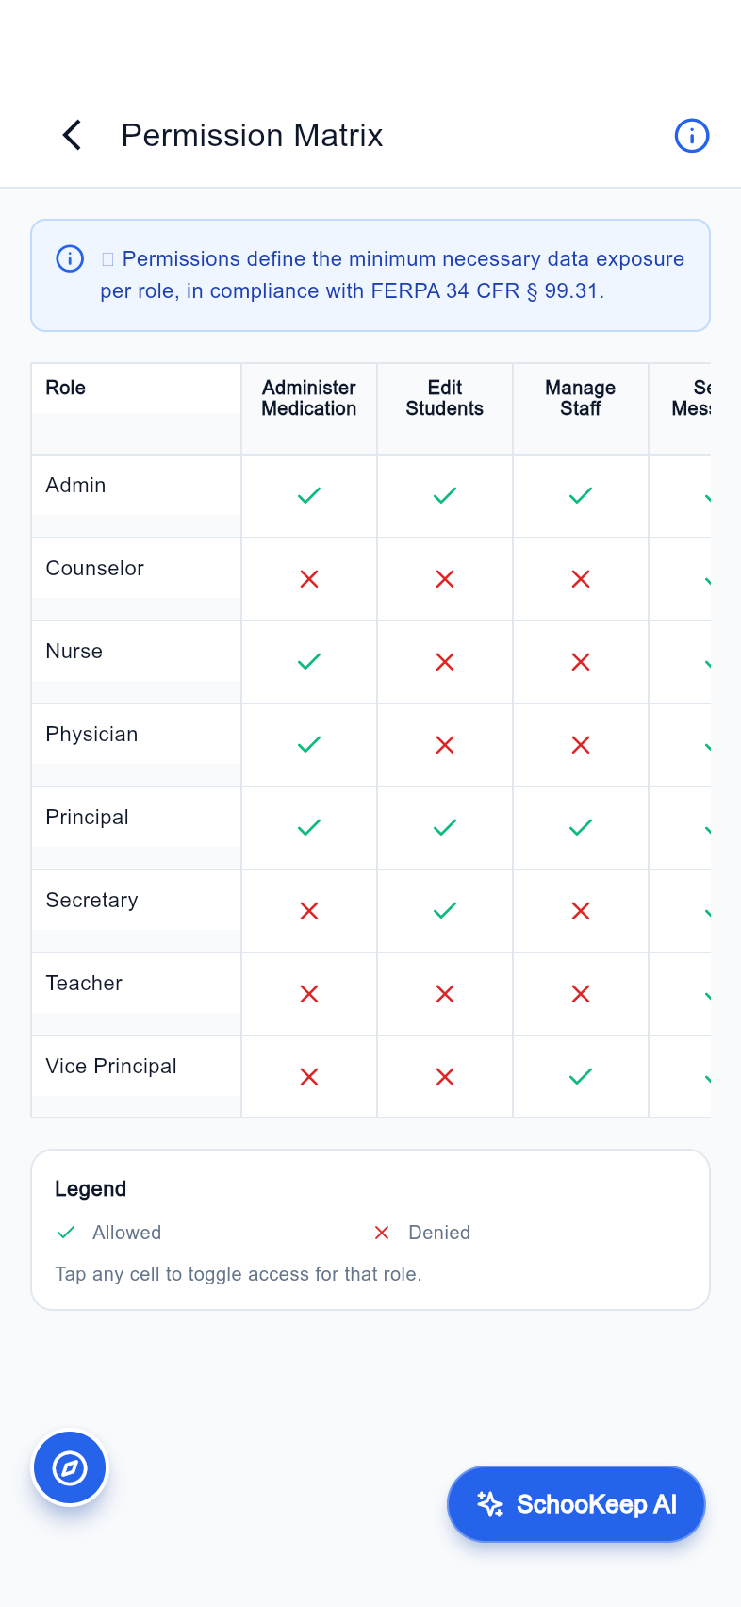
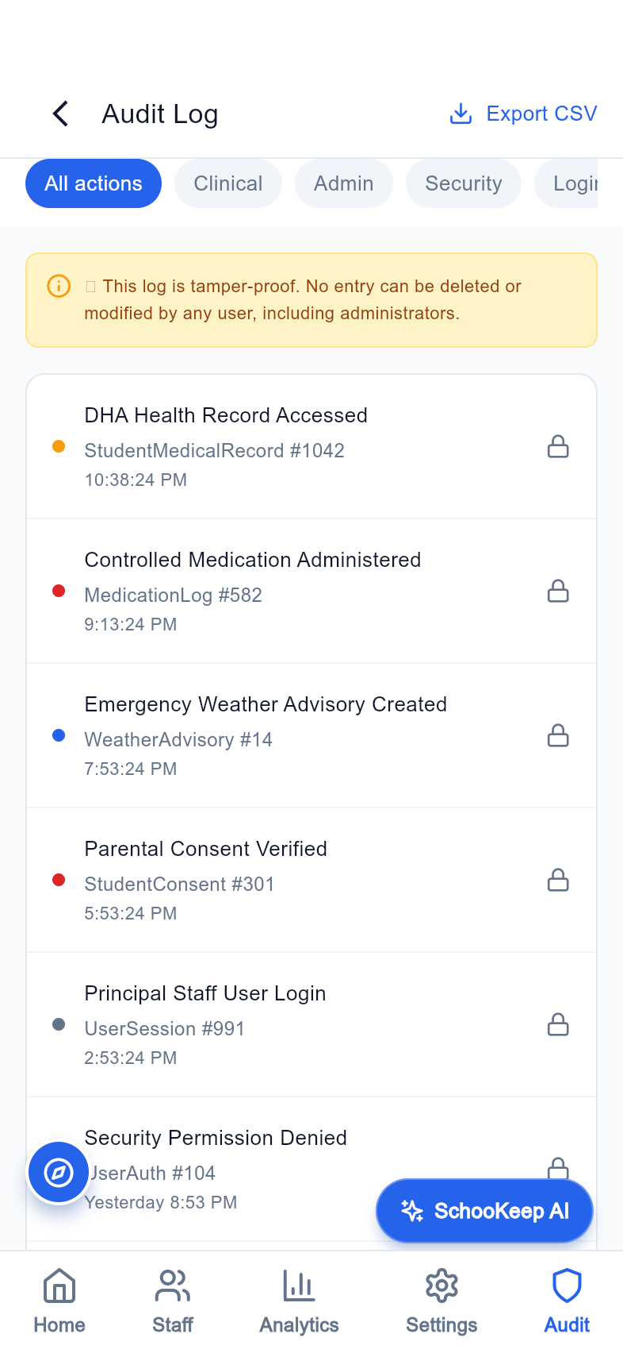
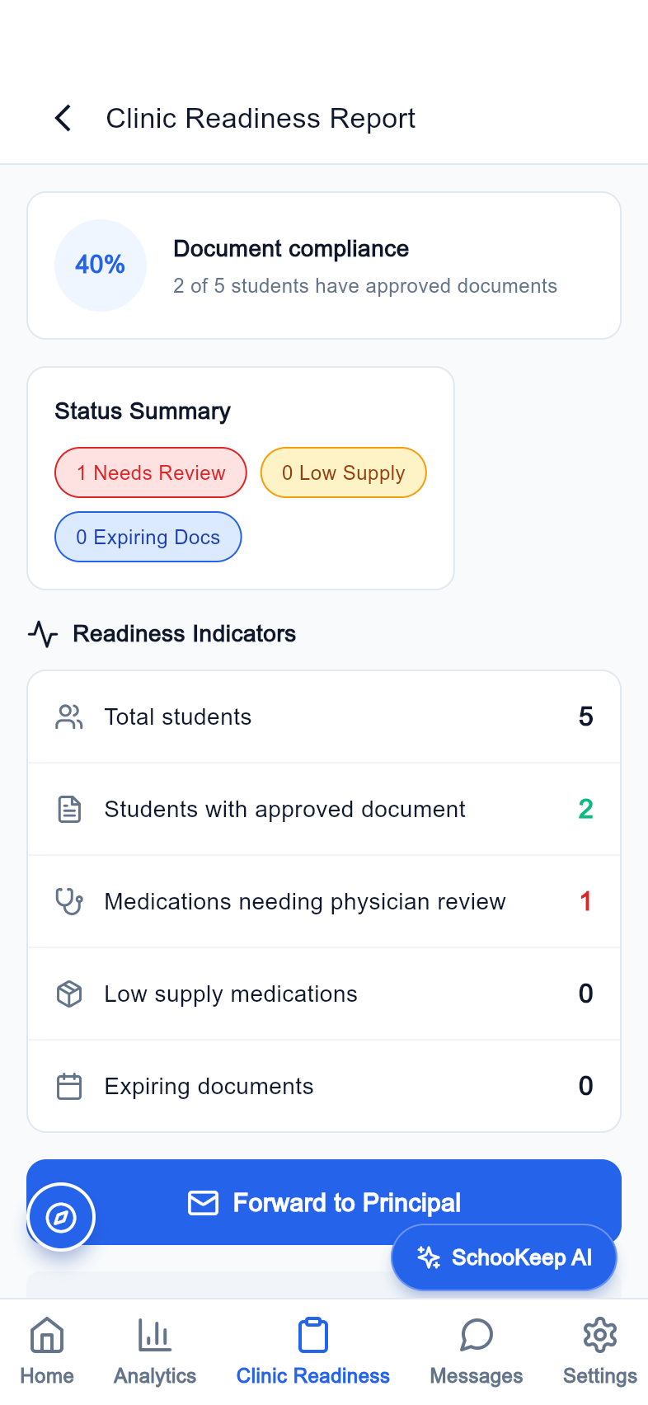
GOVERNANCE
Make access and readiness visible
Permission, audit, and readiness views support accountable school operations.
Role permissions
Show the access model in a dedicated matrix.
Audit visibility
Provide a view of recorded system activity.
Clinic readiness
Give school operations a readiness and equipment workflow.
Permissions
Audit log
Clinic readiness
SchooKeep | Product pitch | 05 October 2026
15
Notes:
Screens captured from the Flutter release build using a local seeded Laravel backend and supplied admin account. Demo data; no claim of production use. Permission, audit, and readiness views support accountable school operations.

Slide 16
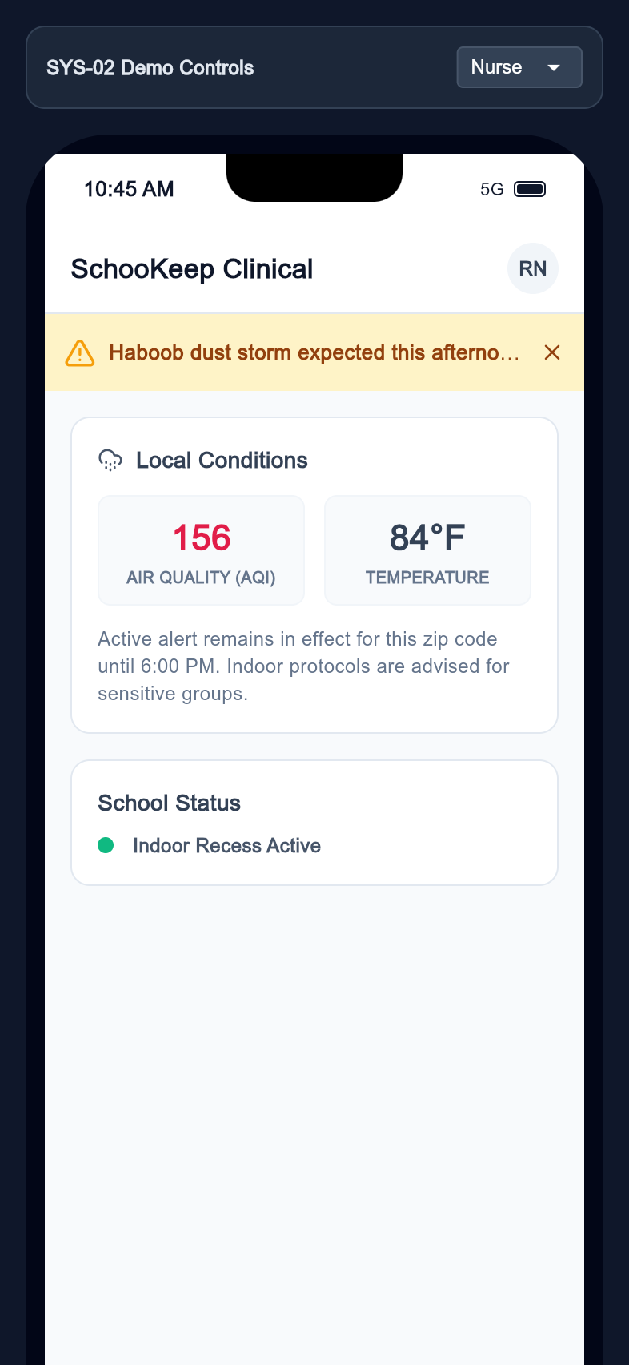
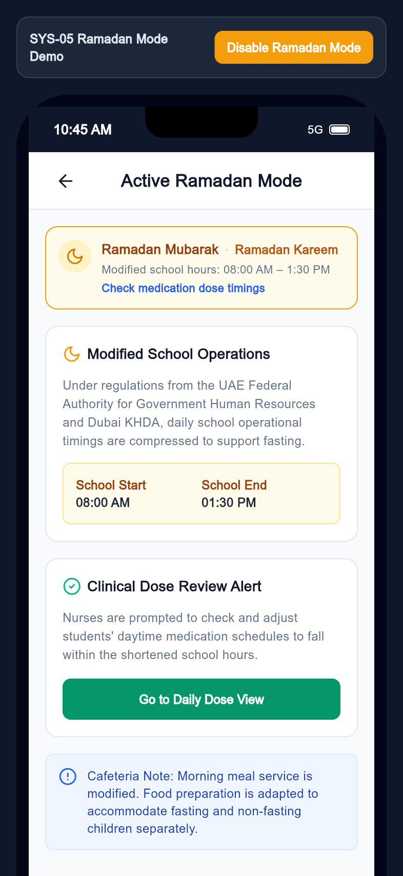
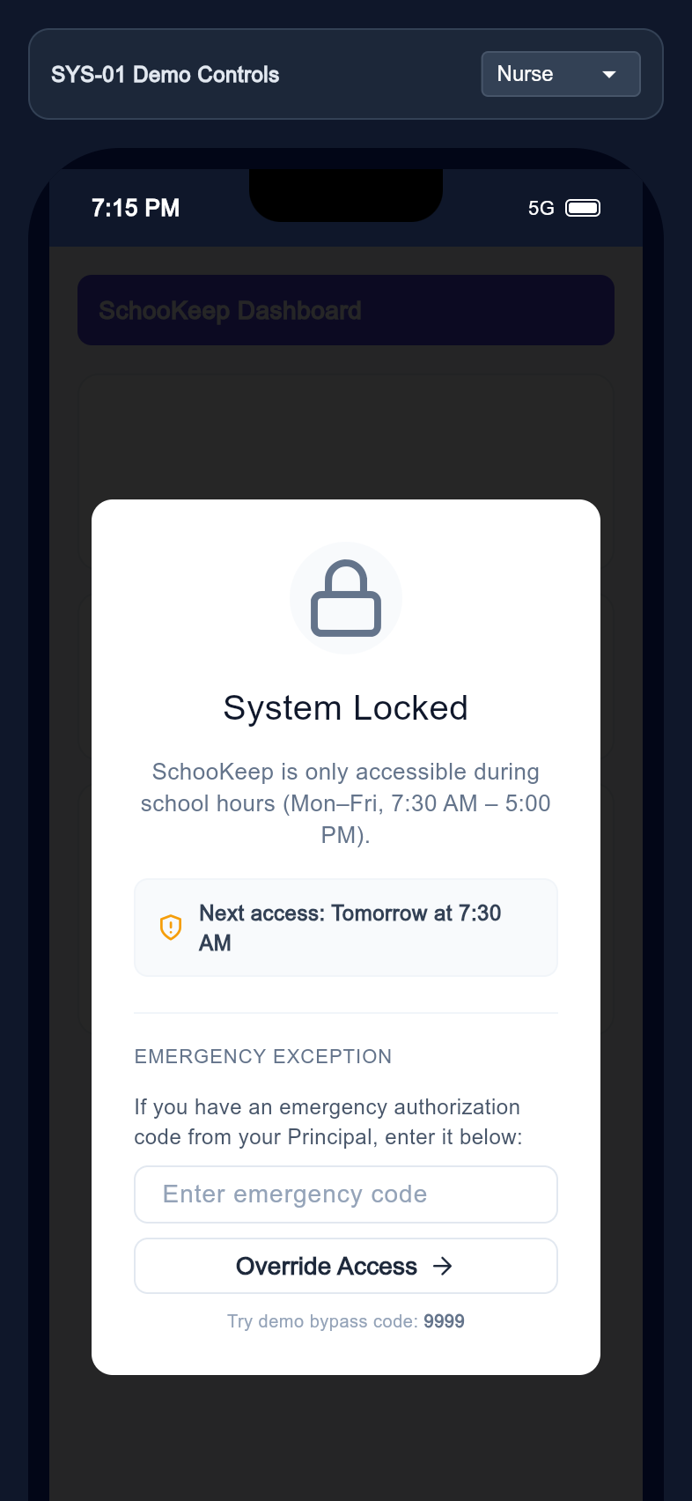
REGIONAL PRODUCT DESIGN
Designed for the school context
The app includes English/Arabic localization and contextual school system states.
Bilingual foundation
English and Arabic strings and right-to-left layouts are present in the codebase.
School-wide advisories
Weather advisory screens represent shared restrictions.
Contextual operating modes
Ramadan and after-hours states are part of the experience.
Weather advisory
Ramadan mode
After-hours state
SchooKeep | Product pitch | 05 October 2026
16
Notes:
Screens captured from the Flutter release build using a local seeded Laravel backend and supplied admin account. Demo data; no claim of production use. The app includes English/Arabic localization and contextual school system states.

Slide 17
COMMERCIAL HYPOTHESIS
Start with a school-level subscription
A proposed model for validation, rather than committed pricing.
01
02
03
School license
Implementation
Group expansion
An annual subscription priced by school size or student band. Validate willingness to pay in pilots.
Offer setup, training, and rollout support. Scope integration work separately.
Expand from one school to a school group after demonstrating adoption and operating value.
SchooKeep | Product pitch | 05 October 2026
17

Slide 18
PILOT PROPOSAL
Prove the workflow before scaling
An illustrative eight-week pilot with agreed measures and owners.
01
02
03
Weeks 1-2: Prepare
Weeks 3-6: Operate
Weeks 7-8: Evaluate
Map current workflows, confirm roles, review data handling, and establish a baseline.
Pilot clinic, consent, and parent communications with a defined cohort and support cadence.
Measure adoption, documentation completeness, consent response time, and handoff follow-through.
SchooKeep | Product pitch | 05 October 2026
18

Slide 19
THE NEXT STEP
Find the right pilot school
Validate the value with the people who will use the system every day.
Seeking a design partner
A school leadership team, nurse, and parent cohort willing to shape the rollout and define success.
Agree the pilot scope.
Name an operational owner.
Choose the measures that matter.
SchooKeep | Product pitch | 05 October 2026
19

Slide 20
EVIDENCE AND SCOPE
What this presentation demonstrates
Product screenshots are evidence of the current app experience, not commercial or clinical outcomes.
Capture method
Presentation boundaries
Flutter release web build; 393 x 852 mobile viewport; local seeded Laravel backend; supplied admin account. Original icon assets, with Arial fallback for network-loaded text fonts.
Demo data is shown. Some flows use sample IDs or static states. External maps and services were not verified. Production deployment, clinical outcomes, security certification, traction, pricing, and integrations are not claimed.
Included: route-indexed screenshot library, browser gallery, and editable PowerPoint deck.
SchooKeep | Product pitch | 05 October 2026
20

