Slide 1
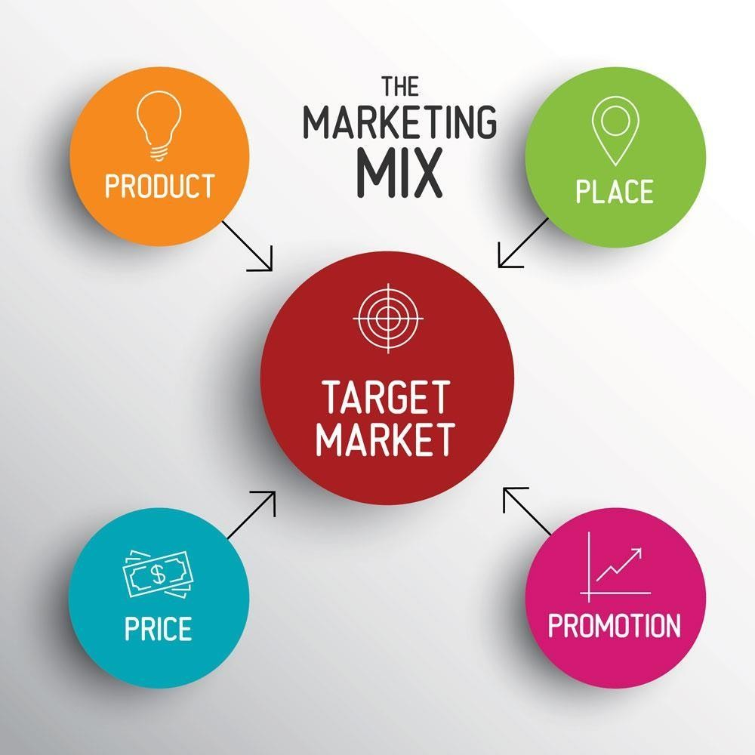
MARKETING MIX

Slide 2


Watch the video : https://www.youtube.com/watch?v=kx7iADO9kfA
The marketing Mix consists of the 4 Ps- Product, Price, Place, Promotion. Sometimes you can find a fifth one: Packaging.
Product : New product development, improve existing products, create a new product
Price: High, medium or low price
Place:
How does the company get the products to its customers (channels of distribution)? Where will it be sold? Stores, internet websites, mail order catalogues…
Promotion: Promotion includes advertising, promotion and public relations. It enhances product and brand awareness.
Packaging: what will make the product eye- catching and attractive?

Slide 3
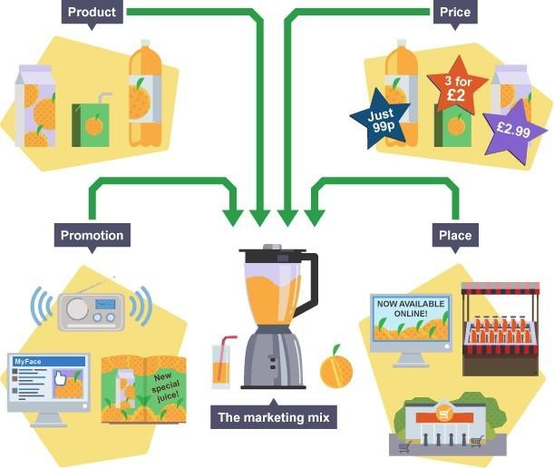
The marketing mix is the combination of product, price, place and promotion for any business venture.
No one element of the marketing mix is more important than another − each element ideally supports the others. Firms modify each element in the marketing mix to establish an overall brand image and unique selling point (USP) that makes their products stand out from the competition.

Slide 4
unique selling point
The unique thing about the product that makes ansumers Duy it. This can be Dranding, packaging or a feature of the product.

Slide 5
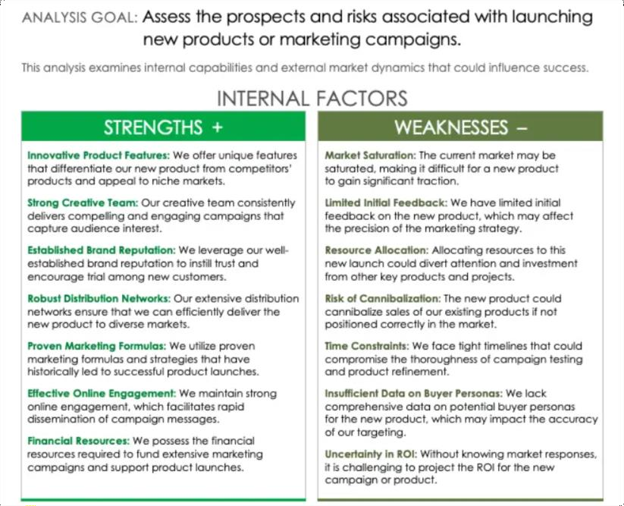
Two important tools exist to help companies to identify the marketing conditions that will be faced by newly marketed products
The SWOT analysis is a tool used to understand a company’s strengths, weaknesses, opportunities and threats on the market.

Slide 6



EXTERNAL FACTORS
Emerging Morkef Trends: be can capitalize on
Compstltls'• Counl••ocIfons: Compe ti ore may launch s•miIor proc/uc Is oc ogrpess‹ve compo‹grs in response. diluting our morket shore.
Economic Downltxns: Economic downturns could reduce consumer spending and adversely oftec t sales of thx• nc'w product.
Changing Consum•r Frelerenc •s Vol ia sniffs ‹n coruumer preferences cauio render th« proouc t c< campaign less appealing.
Supply Cfioln ¢Xscuptlons: Supply cr\oin i$$uer conta delay tha prcduc I launch or disrupt c ompoign cmd los.
keguJotoiy Chollanges: New procluc ts. especia8y in c ertoin industñer. face stringent reguiatory cnoyenges thot c ould delay or block market entrx.
N•gotl•e rvbllcity: And negative publicity relaieo fo t‘he product c ouIO harm the brond*s reputo t'oo arid affect tnc overall sec cess of fee launch.
feclinologTcol Failures: Depenc/enc e an new technologie s could pose risks if fhose tecUndo@es fail 'o perform as eye tel.
i7•chn•loOic •I In*•gro+lab: integrating line lotost technology into our product or campaign can offs a c Dmpetitive edge and ottrocI loch savvy cc•nsumers.
Flr+t-Mo•ei A d•ontoge: Lounc hing me rxoouct ecxly m the mcr1cet cycie could secure a first-r over advantage and orand loyalty.
Cross Setting Fc'tenhols: \^/e con exploit cross -seeing
'Q' uFñfia-s with existing produC Is to enhance customer value.
, Global Exponslon: This Lunch could serve as a stepping stone towards expanding our pre acne e in new inlernational mane ts.
' Svstoinob8fty £ocvs: ositioninq roe product with a focus on sustainability could attract envñonmentdiy conscious consumers.
i Porlner›hlp and Colloborotton: CaIloD‹xotivo partner\h‹ps can e*tend reach and add cf&diDiIity to the campaign or pro€luC t.

