Slide 1

Guideline for Power Grid Simulator
Han Zhou
Department of Electrical and Computer Engineering
University of California, Riverside, CA
Notes:
1
1
1

Slide 2
Introduction
Repository: EMspice_python/pg_sim/
10 source code & 1 makefile: element.cpp; element.h; mna.cpp; mna.h; parser.cpp; parser.h; function_ibm.cpp; function_ibm.h; em_cmd_ibm.cpp; parameter.h; Makefile
Functionality:
1. Netlist parser (Interconnect tree parser)
2. IR drop simulator (Nodal voltage solver)
3. EM filter (EM immortality identifier)

Slide 3
Interface
Input: IBM-format spice file (.sp) of a power grid
Source: dumped from Synopsys ICC; self-generated
Format reference: Power Grid Analysis Benchmarks
e.g., armcore.sp, newVdd_ibmpg2.spice
Output:
1. The EM condition of the power grid (on screen) , including:
total node and interconnect tree number,
EM voltage and saturation volume (if exists) of each tree,
failed tree number and its index.
2. Nodal voltage of each node (File: tree_node_voltage.txt)
3. Current density of each branch (File: tree_curden.txt)
4. Width of each branch (File: tree_width.txt)
5. …

Slide 4
Code details
em_cmd_ibm.cpp: Main function
element.cpp; element.h: Define classes needed
mna.cpp; mna.h: Solve MNA directly using CXSparse
parser.cpp; parser.h: Read circuit information from spice file
parameter.h; Define EM-related parameters
function_ibm.cpp; function_ibm.h:
Parse interconnect tree, store nodal voltage and perform EM analysis

Slide 5
Usage
Library dependency:
IT++: IT++ is a C++ library of mathematical, signal processing and communication classes and functions. (Version: itpp-4.3.1)
UMFPACK: multifrontal LU factorization.
CSparse and CXSparse: a concise sparse Cholesky factorization package.
Compile:
make
Executable file:
em_cmd

Slide 6
Usage
Run:
Use alone
rm tree_*; touch tree_ftid.txt; touch tree_width.txt
./em_cmd {filename}
Note: before running PGSim, clean up all the previous generated .txt files (rm tree_*) and create two new files (touch tree_ftid.txt; touch tree_width.txt)
Use with EMSpice
just copy em_cmd to the python_version directory, then run EM_spice.py

Slide 7
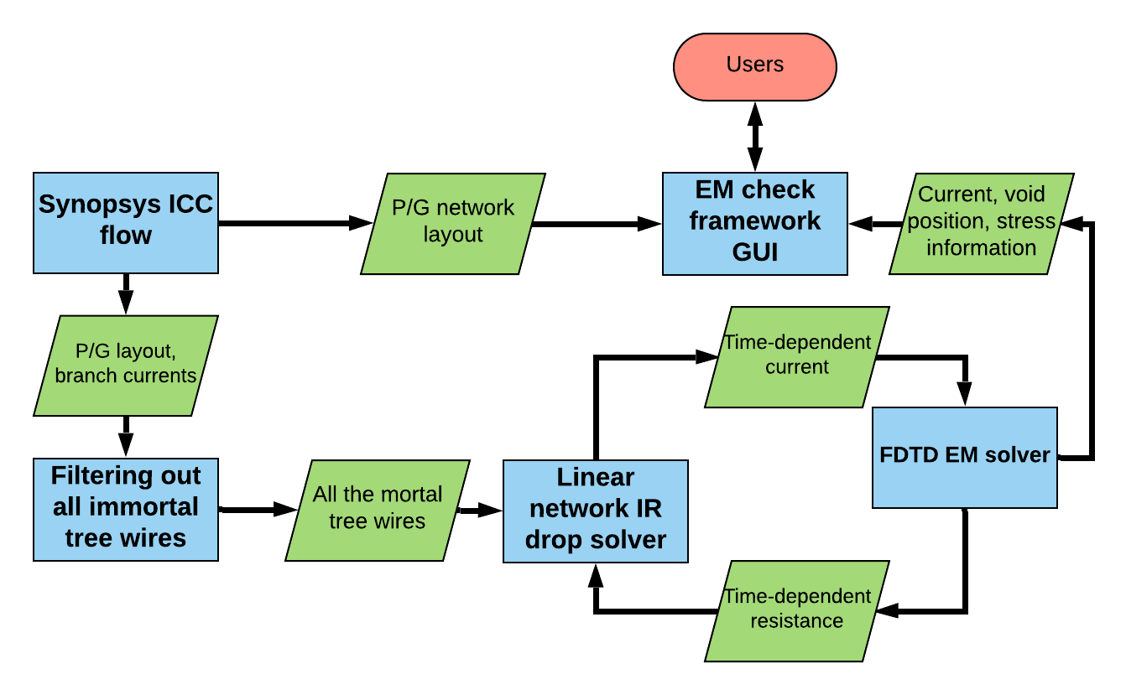
PGSim in EMSpice
Netlist parser
EM filter
IR drop simulator

