Slide 1
Understanding the NHL data
Notebook 01 — Business understanding & data understanding
Predicting final standings and in-season coach changes
Notes:
This deck walks through notebook 01: what problem we are solving, how we translated it into data mining goals, and what we learned from exploring the data.

Slide 2
The problem and who would use it
The day before an NHL season starts, predict:
(a) the final regular-season standings (b) which teams will change coach during the season
Team management
Set expectations, budgets and ticket prices; judge whether the coach is at risk.
Coaches & agents
Know which jobs may open up during the season.
Media, fans, betting
Season previews, odds, fantasy leagues.
No end user to interview — requirements come from the assignment and hockey knowledge.
Notes:
Task (c) has not been announced yet, so we focus on (a) and (b).

Slide 3
Requirements and domain rules
Standings use points: 2 per win, 1 per tie (until 2004), 1 per overtime loss (since 1999); shootouts replaced ties in 2005
Teams play in divisions and conferences; the top teams make the playoffs
League size and season length changed a lot: 1994 had 48 games, 2004 was cancelled, salary cap from 2005
Coaches are usually fired after bad results, but some leave for other reasons (health, resignation, interim)
Key constraint
Only information available the day before the season can be used: last season's results, roster history and the opening-day coach.
Notes:
We had no end user to interview, so requirements come from the assignment and hockey knowledge. These rules directly shape how we read the data later (ties, OTL, short seasons).

Slide 4
From business goals to data mining goals
Business goal | Data mining task | How we measure it
Predict final standings better than repeating last season's order | Regression: predict points per game, then sort teams | Spearman correlation, average rank error vs last season's order
Flag teams likely to change coach, better than guessing | Classification: more than one coach in the season (yes/no) | PR-AUC, precision, recall, F1 vs always "no" and vs the base rate
Our decisions: NHL only · 2009 is the test season · 2005–2008 are validation · "coach change" = more than one coach during the season
Notes:
Each business goal maps to one DM task with a measurable baseline. Decisions we made ourselves: NHL only, 2009 = test, 2005-2008 = validation, a coach change = more than one coach in a season.

Slide 5
What is in the files
22
1,459
43,848
0
CSV tables loaded
team-seasons in Teams (1909–2009)
player rows in Scoring
duplicate rows in any table
Five leagues in Teams, but only the NHL continues to 2009
Some tables cover short periods: shootouts 2005–09, Stanley Cup (*SC) 1912–25
Master and abbrev are not seasonal; the year in HOF is the induction year
Notes:
Overview table in the notebook gives size, year range, leagues, duplicates and missing % for each of the 22 tables.

Slide 6
Looking at real rows: traps in the data
Same name, different meaning
"G" means games in Teams but goals in Scoring; Coaches uses lowercase g, w, l, t.
Stints
Players, goalies and coaches can have several stints in one season (moved teams mid-season).
Post* columns
These are playoff stats — not usable for the regular season target.
Empty old seasons
Early seasons have many blank columns; 1909 has no special-teams stats at all.
Notes:
Looking at actual rows instead of trusting the diagram saved us from several mistakes.

Slide 7
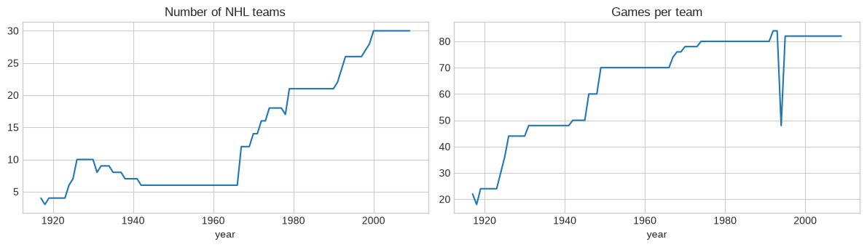
How the league changed
What we see
6 teams until 1966, then growth to 30 by 2000. Seasons grew from ~20 to 80–84 games. 2004 missing, 1994 only 48 games.
Decision
Compare teams using points per game, and use data from 1967 on (after the first expansion).
Notes:
Line plots of teams per season and games per team. This is why we use points per game and start in 1967.

Slide 8
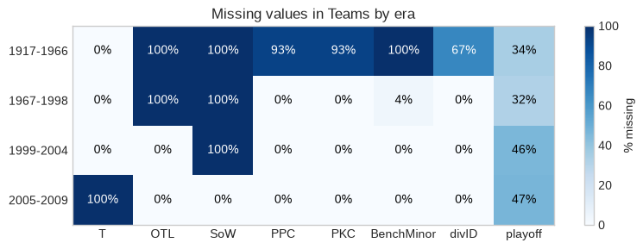
Missing values follow the rules of each era
Ties (T) end in 2005; OTL starts 1999; SoW starts 2005
Special teams (PPC, PKC) 93% missing before 1967, complete after
Blank "playoff" = missed the playoffs (16 of 30 teams qualify), not unknown
Conclusion: blanks are not random — we cannot just fill them with zeros.
Notes:
Heatmap of % missing per field per era. Checked by era rather than for the whole table, because stats did not exist in older seasons.

Slide 9
What does "rank" actually mean?
Team (2008) | Div | Stored rank | Pts | League rank
San Jose Sharks | PC | 1 | 117 | 1
Boston Bruins | NE | 1 | 116 | 2
Detroit Red Wings | CE | 1 | 112 | 3
Washington Capitals | SE | 1 | 108 | 4
New Jersey Devils | AT | 1 | 106 | 5
Chicago Blackhawks | CE | 2 | 104 | 6
Stored rank goes 1–5 inside each of the 6 divisions → it is a division rank
Five of the top six teams by points all have rank 1
We rank league-wide by points ourselves; 12 teams share a points total, so ties get the same rank
Notes:
We used 2008 for this check and avoided looking at 2009, the test season.

Slide 10
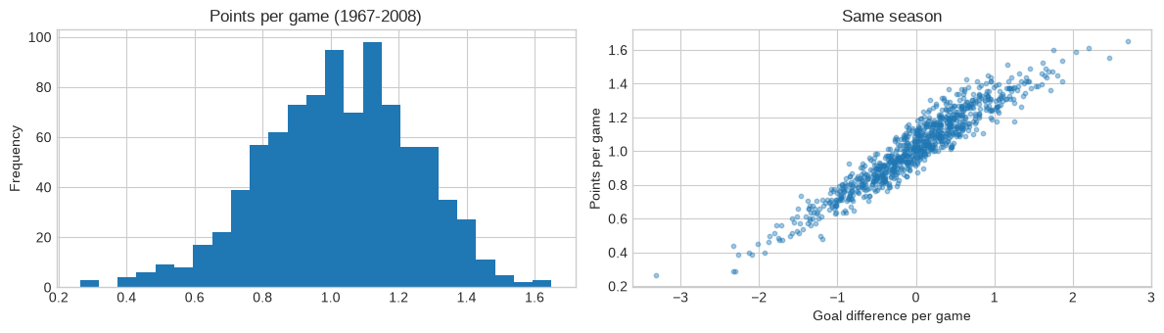
Team performance: points vs goal difference
r = 0.95
But…
This season's goal difference is unknown before the season. We can only use last season's — so the question is how much last season carries over.
goal difference vs points, same season
Notes:
Histogram of points per game and scatter of goal difference vs points per game, 1967-2008.

Slide 11
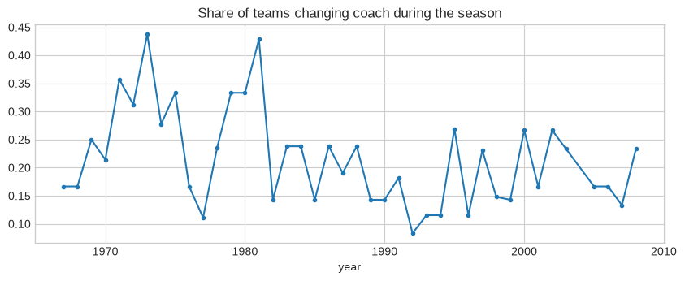
Coach changes are rare and noisy
21.0%
191 of 908 team-seasons (1967–2008) changed coach
79.0%
accuracy of always guessing "no" — but finds zero changes
Imbalanced target → we evaluate with precision, recall and PR-AUC, not accuracy. The yearly rate swings from ~8% to 44%.
Notes:
A change = a team with more than one coaching stint in a season. Detroit 1998 had two co-coaches in the same stint, which we do not count as a change.

Slide 12
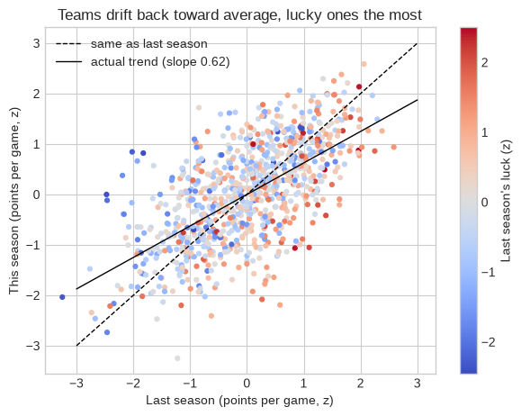
Teams regress to the mean
0.62
r = −0.27
slope: this season on last season
last season's luck vs change (p < 0.001)
Last season's luck | Avg change (SD)
Unluckiest 25% | +0.26
2nd | +0.12
3rd | −0.04
Luckiest 25% | −0.24
Lucky teams fall back → luck and goal stats should beat "same order as last year".
Notes:
Three variables in one plot: last season (x), this season (y) and last season luck (colour). Luck = actual points share minus Pythagorean expectation. Points standardized within each season so eras are comparable.

Slide 13
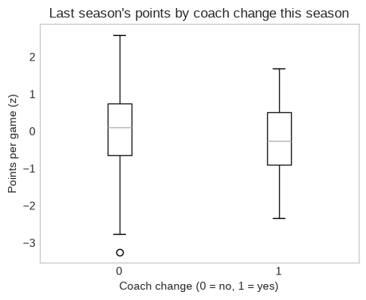
What comes before a coach change?
Last season | Change rate
Bottom third | 27.6%
Middle third | 19.5%
Top third | 16.4%
Points: median −0.26 (changed) vs 0.11 (kept), Mann-Whitney p = 0.0005
Chi-square = 11.7, p = 0.003
Luck: no difference (p = 0.62) → teams react to results, not to whether they were deserved
Big overlap in the boxplot → last season alone won't be enough
Notes:
Mann-Whitney because the distributions are not assumed normal; chi-square on change rate by last season standing.

Slide 14
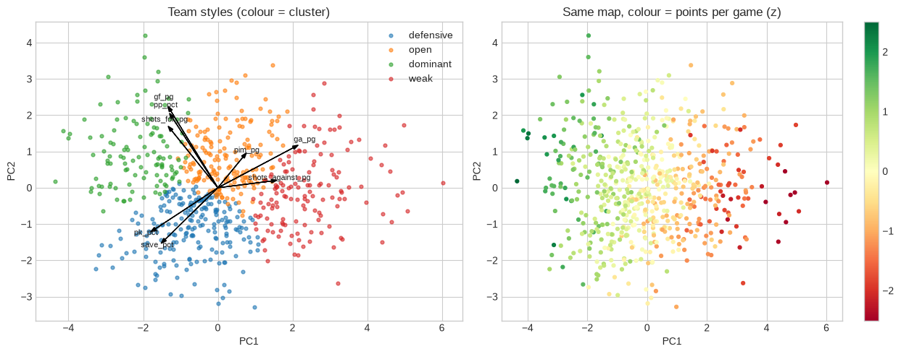
Team styles: PCA + k-means
PC1 (39%) = defence
goals/shots against, PK, save %
PC2 (20%) = offence
goals, shots, power play
Points follow PC1 → defence and goaltending separate teams most.
Cluster | Teams | Points (z) | Next-season change | Next-season coach change
Dominant | 112 | +1.15 | −0.24 | 14.2%
Defensive | 212 | +0.24 | −0.08 | 14.9%
Open | 173 | 0.00 | −0.12 | 21.4%
Weak | 142 | −1.27 | +0.56 | 23.9%
Notes:
8 stats per team-season (1983-2008), standardized within season. PCA for main directions, k-means for groups. Silhouette is low (0.22 best) so styles are a continuum; we keep 4 groups because they are easy to read.

Slide 15
Methods used and why
Method | Why we used it
Overview tables, missing % by era (heatmap) | Know coverage; show blanks are structural, not random
Line plots, histogram, scatter + correlation | League evolution; target distribution; link goals → points
Within-season z-scores, Pythagorean "luck" | Make eras comparable; separate deserved vs lucky results
Regression slope, Pearson, quartile table (3-D plot) | Measure regression to the mean and the role of luck
Mann-Whitney, chi-square, boxplot | Test what precedes coach changes without assuming normality
PCA + k-means + silhouette (biplot) | Find team styles and relate them to next-season outcomes
Notes:
Maps to the rubric: diversity and complexity of statistical methods and plots, each justified by a question.

Slide 16
Key takeaways
1
Regression to the mean
Lucky teams fall back most → luck and goal stats should beat last season's order.
2
Coach changes follow results
Bad points matter (p = 0.0005), luck does not (p = 0.62).
3
Defence separates teams
Weak and open teams change coach more often.
Notes:
Wrap up with the three findings that feed the models, then hand over to notebook 02.

