Slide 1


AN ALGORITHMIC APPROACH TO PREDICT HONDA’S STOCK MARKET TRENDS
Dr. Mahdi Aliyari-Shoorehdeli Amir Mohammad Saffar
FUNDAMENTAL OF INTELLIGENT SYSTEMS

Slide 2


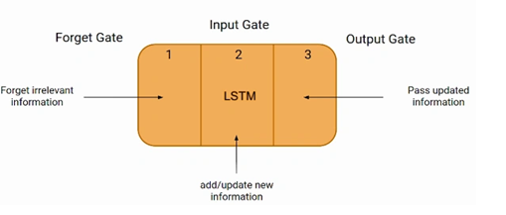
FUNDAMENTAL OF INTELLIGENT SYSTEMS
An Algorithmic Approach to Predict Honda’s Stock Market Trends
Stock price forecasting takes a major part in financial market analysis, providing investors and traders with information for making meaningful decisions. The project aims to develop a deep learning-based approach for Long Short-Term Memory (LSTM) stock price prediction
Introduction:
Method
Results
Future works
2 of 8

Slide 3
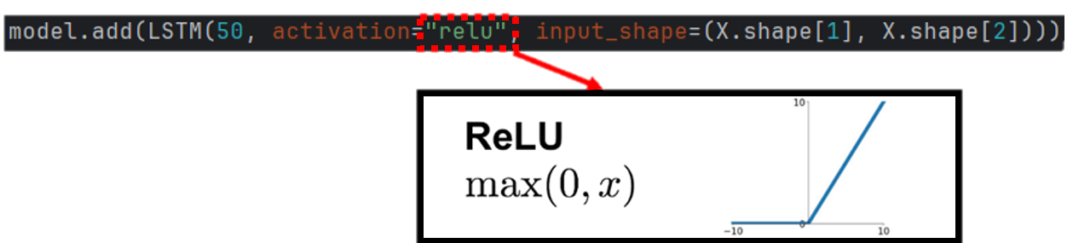
FUNDAMENTAL OF INTELLIGENT SYSTEMS
An Algorithmic Approach to Predict Honda’s Stock Market Trends
Loss Function: Mean Squared Error (MSE).
Optimizer: Adam optimizer for
adaptive learning rate adjustment.
Epochs: 20
Batch Size: 32
80% Training
10% Validation
10% Testing
The LSTM model is designed with:
LSTM Layer: 50 neurons with ReLU activation.
Dropout Layer: 20% dropout (preventing overfit).
Dense Output Layer: Single neuron for
predicting the next day's price.
Data collection
Method
Results
Future works
3 of 8

Slide 4
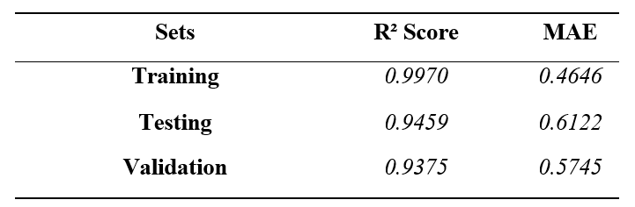
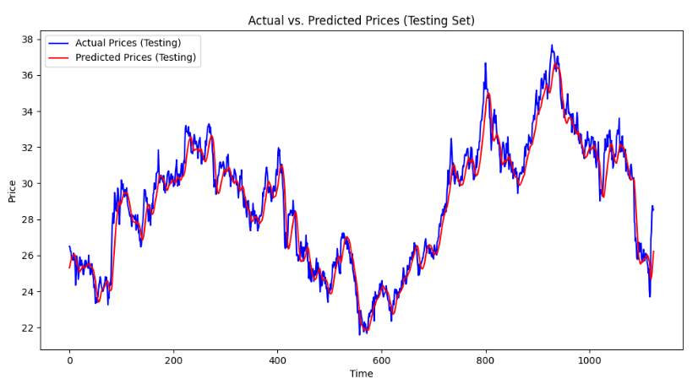
FUNDAMENTAL OF INTELLIGENT SYSTEMS
An Algorithmic Approach to Predict Honda’s Stock Market Trends
Data collection
Method
Results
Future works
4 of 8

Slide 5
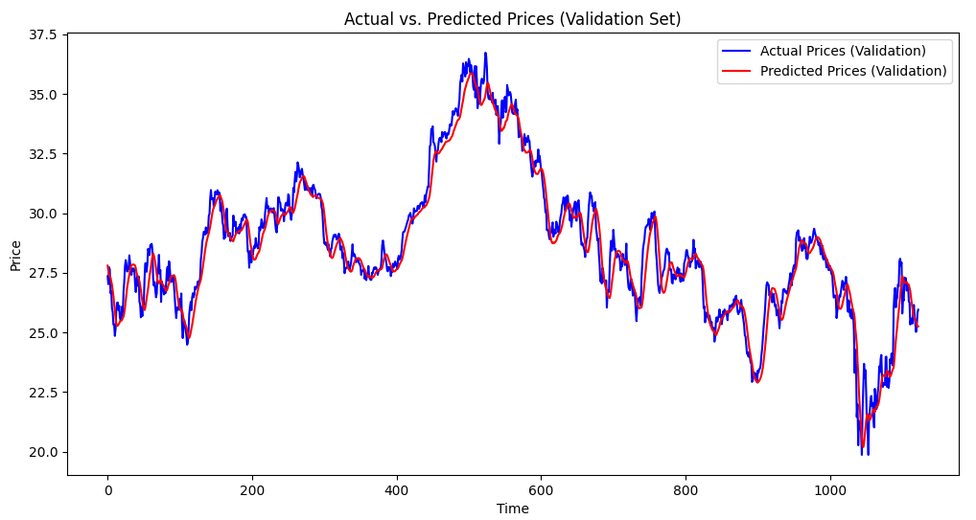
FUNDAMENTAL OF INTELLIGENT SYSTEMS
An Algorithmic Approach to Predict Honda’s Stock Market Trends
Data collection
Method
Results
Future works
5 of 8

Slide 6
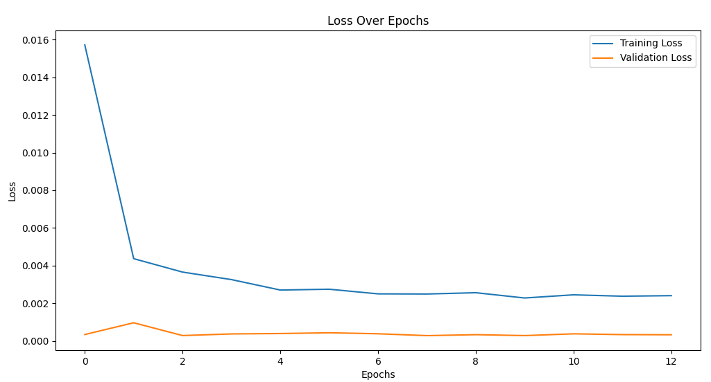
FUNDAMENTAL OF INTELLIGENT SYSTEMS
An Algorithmic Approach to Predict Honda’s Stock Market Trends
Data collection
Method
Results
Future works
6 of 10

Slide 7
FUNDAMENTAL OF INTELLIGENT SYSTEMS
An Algorithmic Approach to Predict Honda’s Stock Market Trends
Using Bidirectional LSTM: By processing data in both forward and backward directions, Bidirectional LSTMs could enhance feature learning and prediction accuracy. But also, the runtime is going to increase significantly.
Experimenting with Different Sequence Lengths: Testing shorter or longer input sequences (30 or 90 days) might improve predictions depending on the dataset characteristics.
Adding More Features: Incorporating additional features like Open Price, Moving Averages.
Data collection
Method
Results
Future works
7 of 10

Slide 8


29th International Computer Conference (csicc)
Motion-Based Human Spatial Problem-Solving Assessment Using Hand Movement Analysis
Thank you for your attention!
8 of 10

