Slide 1
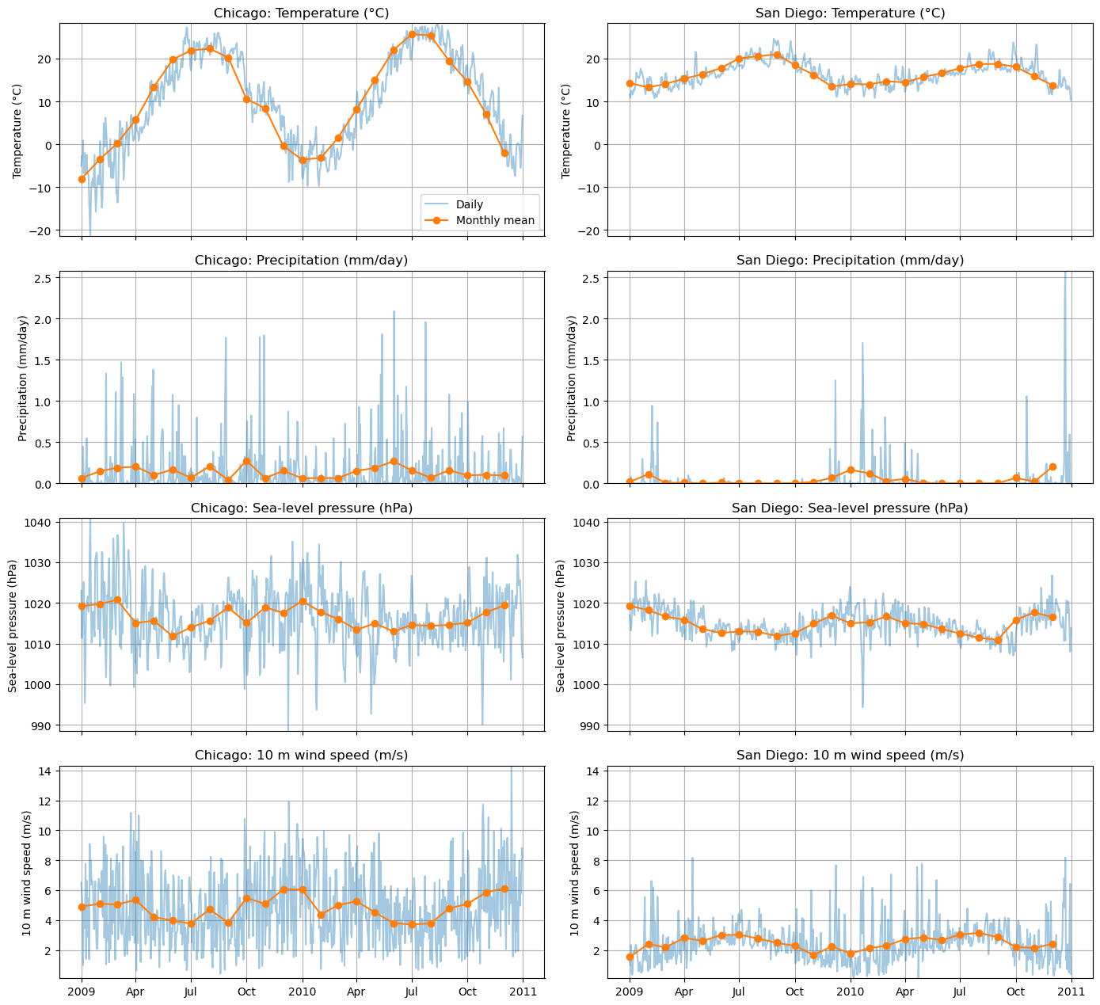
Chicago and San Diego weather patterns
How do the cities differ?
Which temperature models
work best for each city?
730 daily means across 2009–2010
Nearest ERA5 grid point to each city
Initial exploration included temperature,
precipitation, pressure and wind.
Daily rainfall totals need a unit check.
ERA5 course data, 2009–2010. Notebook Section 11, cell 59.
1
Notes:
I began by comparing Chicago and San Diego across temperature, precipitation, pressure, and wind. These plots use daily mean ERA5 data from 2009 and 2010 at the nearest grid point to each city. My initial goal was to identify clear differences before choosing a modeling question.
Planned narration: 20 seconds.
This slide belongs to the five-minute main presentation.
Source: ERA5 course data, 2009–2010. Notebook Section 11, cell 59.

Slide 2

Contrasting temperature patterns
Chicago temperature SD: 10.90 C
San Diego temperature SD: 2.77 C
The source graph’s “US average” is the rectangular study-region average.
Quoted maxima are daily means. The red line marks the study-region maximum date.
Notebook cell 60. Statistics describe daily mean temperatures in this two-year sample.
2
Notes:
Chicago showed much greater temperature variation: a standard deviation of about 10.9 degrees Celsius, compared with 2.8 in San Diego. The highest city daily means were about 28.3 degrees in Chicago and 24.6 in San Diego. These are maxima within this sample. That contrast led me to ask whether the same model settings would suit both cities.
Planned narration: 25 seconds.
This slide belongs to the five-minute main presentation.
Source: Notebook cell 60. Statistics describe daily mean temperatures in this two-year sample.

Slide 3

Exploring a precipitation event
Selected date
13 March 2010
The largest supplied
regional precipitation value
selected this day.
One event is descriptive.
It does not establish
weather causality.
Original precipitation scaling retained. Its interpretation as daily rainfall totals remains unvalidated.
Notebook cell 61. Region means use the rectangular study area, without a country mask.
3
Notes:
I also examined wind on March thirteenth, 2010, the day with the largest displayed regional precipitation value. This was exploratory. The regional average covers a rectangle rather than a United States land mask, and the precipitation scaling still needs validation as daily rainfall totals. This uncertainty limits rainfall conclusions, so I keep the final results focused on temperature.
Planned narration: 25 seconds.
This slide belongs to the five-minute main presentation.
Source: Notebook cell 61. Region means use the rectangular study area, without a country mask.

Slide 4

Next-day temperature forecasting
Current and recent weather predict tomorrow’s temperature
Chicago: both models near 1.46 C
San Diego: linear 0.63 C, NN 0.68 C
A chronological forecast task. Its errors answer a different question from the seasonal models.
Saved notebook cell 62 results. 542 training examples and 181 later test examples.
4
Notes:
My first prediction experiment used current and lagged weather information to predict tomorrow’s temperature. I trained on the earlier seventy-five percent of dates and tested on the final quarter. Chicago’s linear regression and neural network both had average errors of about 1.46 degrees. In San Diego, linear regression scored 0.63, compared with 0.68 for the network. Greater model complexity did not automatically improve this forecast.
Planned narration: 30 seconds.
This slide belongs to the five-minute main presentation.
Source: Saved notebook cell 62 results. 542 training examples and 181 later test examples.

Slide 5
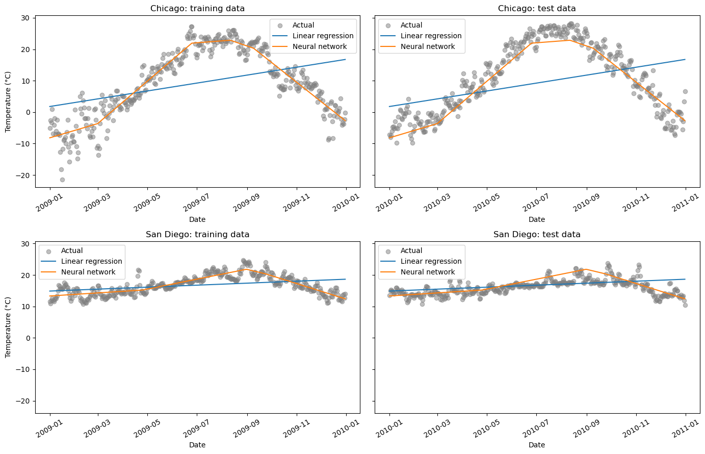
Learning the seasonal temperature pattern
Input: day of year
Target: that day’s temperature
2010 MAE
Straight line to 10-neuron NN
Chicago
8.91 to 2.92 C
San Diego
1.68 to 1.48 C
The calendar-only model learns seasonal shape. It does not use recent weather.
Saved notebook cell 64 results. Train on 2009, evaluate on 2010.
5
Notes:
I then changed the question: can a neural network learn the seasonal temperature pattern from day of year alone? I trained on 2009 and evaluated on 2010. Chicago’s average absolute error fell from 8.91 degrees for straight-line regression to 2.92 for the network. San Diego’s fell from 1.68 to 1.48. The network could represent the seasonal rise and fall that a straight line missed. This evaluates a different task from predicting tomorrow’s weather.
Planned narration: 35 seconds.
This slide belongs to the five-minute main presentation.
Source: Saved notebook cell 64 results. Train on 2009, evaluate on 2010.

Slide 6
Monthly validation and network size
Hold out the final seven days of each month in 2009
281 training days and 84 validation days
Chicago
10 neurons
2.498 C
San Diego
20 neurons
1.183 C
This split tests missing dates within 2009. It does not provide a direct comparison with the 2010 scores.
month_end_results/model_comparison.csv. Same dates, preprocessing and seed for every width.
6
Notes:
To choose network settings with coverage of every season, I held out the final seven days of each month in 2009. That gave 84 validation days and 281 training days. This asks how well the model fills gaps within one year, so its scores cannot be compared directly with the 2010 evaluation. I compared five, ten, and twenty neurons. Chicago’s lowest validation error was about 2.50 degrees with ten neurons. San Diego’s was about 1.18 with twenty. Better training fit did not consistently mean better validation predictions.
Planned narration: 40 seconds.
This slide belongs to the five-minute main presentation.
Source: month_end_results/model_comparison.csv. Same dates, preprocessing and seed for every width.

Slide 7
Tuning the L2 weight penalty
A stronger penalty
discourages large weights
Validation MAE
5.8% lower
Training error rises
slightly as validation
error falls
The original best overall MAEs remain unchanged. Four of six models retain the original penalty.
week6_regularization_results/comparison.csv. San Diego, 10 neurons, same monthly split and seed.
7
Notes:
Week Six suggested controlling overfitting with regularization. I varied the L2 penalty, which discourages large weights, while keeping network size fixed. The original models already used a weak penalty. For San Diego’s ten-neuron model, increasing alpha from 0.0001 to 0.001 reduced validation error from 1.28 to 1.21 degrees, about six percent. Training error rose slightly, from 1.15 to 1.19. This helped a smaller model, while the original overall MAE winners remained unchanged.
Planned narration: 35 seconds.
This slide belongs to the five-minute main presentation.
Source: week6_regularization_results/comparison.csv. San Diego, 10 neurons, same monthly split and seed.

Slide 8
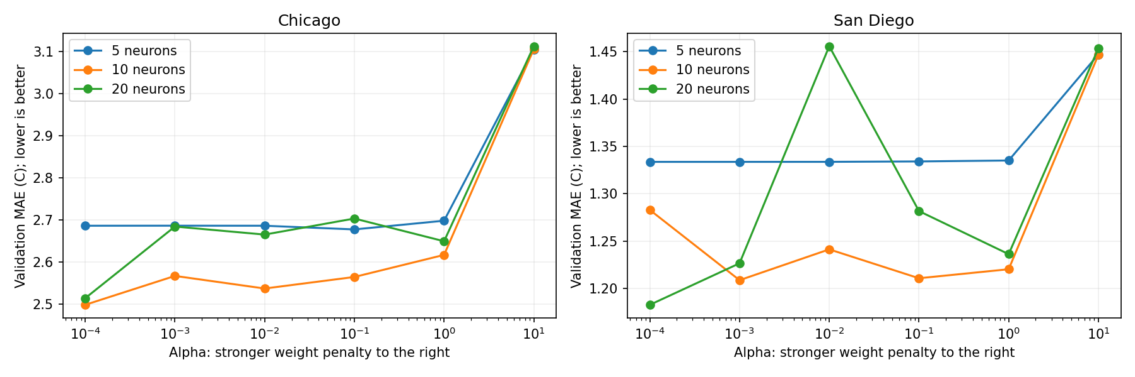
Penalty strength and sensitivity
Stronger penalties do not steadily improve validation MAE.
The San Diego spike shows sensitivity of the fitted solution. A single curve does not establish a universal ranking.
week6_regularization_results/alpha_validation_mae.png. One initialization per point.
8
Notes:
I scanned penalty strengths because more regularization is not always better. San Diego’s twenty-neuron model shows a spike in validation error at alpha 0.01, followed by lower errors. Changing the penalty can lead training to different fits, and initialization matters. This shows sensitivity to settings, rather than a rule that twenty neurons always performs poorly.
Planned narration: 25 seconds.
This slide belongs to the five-minute main presentation.
Source: week6_regularization_results/alpha_validation_mae.png. One initialization per point.

Slide 9
Testing an ensemble
Neither ensemble
improved the
best original MAE
Some weaker fits pull
the average away from
a good solution
The full curve and
member-spread plot
appear in the appendix
Member disagreement measures initialization sensitivity. It is not a calibrated forecast interval.
week6_ensemble_results/scores.csv. Five fixed seeds, 0 through 4, averaged in Celsius.
9
Notes:
I averaged five networks with different initial weights to test whether predictions became more reliable. The ensemble did not beat either city’s original winner. Some weaker fits pulled the mean away from better solutions. In the appendix plot, the shaded spread shows disagreement between fits. It is not a calibrated interval for future temperatures.
Planned narration: 25 seconds.
This slide belongs to the five-minute main presentation.
Source: week6_ensemble_results/scores.csv. Five fixed seeds, 0 through 4, averaged in Celsius.

Slide 10
What the analysis establishes
What the results support
What still needs testing
Chicago shows greater temperature
variation in this sample.
Model choices depend on the city
and the prediction question.
L2 helped one smaller network.
The best overall MAE did not improve.
One training year and one L2 seed
Validation both tunes and reports
Related temperatures on nearby days
Calendar input omits daily weather
Next: an untouched year, repeated initializations, and a sine/cosine seasonal baseline.
Synthesis of Section 11 and later validation experiments. Full original figures follow in the appendix.
10
Notes:
The comparison shows that model choices depend on the city and the prediction question. Our earlier forecast had only one chronological test split. The later monthly and L2 experiments used one training year, and validation both selected settings and measured their performance. Nearby days are related, and training includes later dates. Those results do not establish future forecasting improvement. With only calendar input and one seed for the L2 scan, I would next repeat initializations, evaluate untouched years, and compare a seasonal baseline using sine and cosine features.
Planned narration: 40 seconds.
This slide belongs to the five-minute main presentation.
Source: Synthesis of Section 11 and later validation experiments. Full original figures follow in the appendix.

Slide 11

Appendix 1: Chicago seasonal training/test fit
Alternative view of the same 2009 training and 2010 seasonal evaluation shown in slide 5.
Original notebook cell 63, output 0. Figure preserved in full.
11
Notes:
Alternative view of the same 2009 training and 2010 seasonal evaluation shown in slide 5.
Source: Original notebook cell 63, output 0. Figure preserved in full.

Slide 12

Appendix 2: San Diego seasonal training/test fit
Alternative view of the same 2009 training and 2010 seasonal evaluation shown in slide 5.
Original notebook cell 63, output 1. Figure preserved in full.
12
Notes:
Alternative view of the same 2009 training and 2010 seasonal evaluation shown in slide 5.
Source: Original notebook cell 63, output 1. Figure preserved in full.

Slide 13
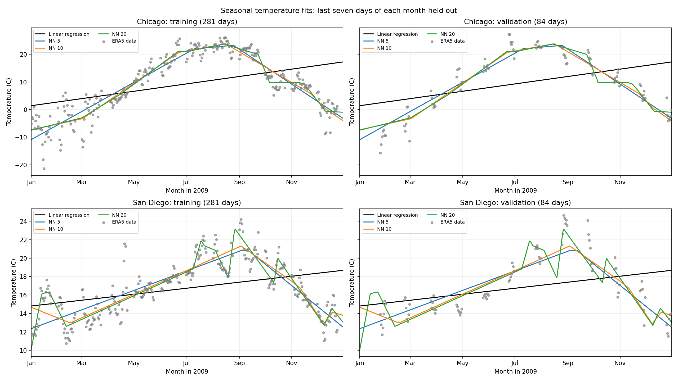
Appendix 3: Monthly seasonal fits
2009 monthly holdout. The fitted curves use 281 training days and score 84 withheld days.
month_end_results/seasonal_fits.png
13
Notes:
2009 monthly holdout. The fitted curves use 281 training days and score 84 withheld days.
Source: month_end_results/seasonal_fits.png

Slide 14
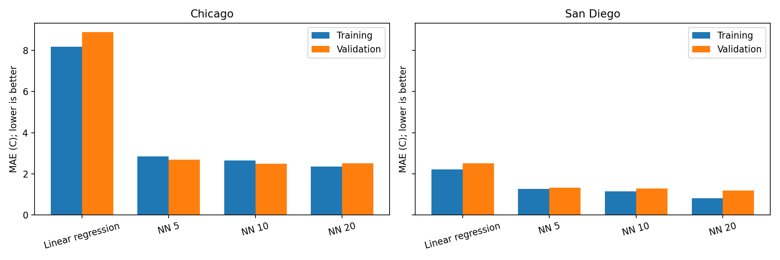
Appendix 4: Full monthly MAE comparison
Original monthly comparison, including the straight-line baseline. Calendar-only seasonal reconstruction.
month_end_results/training_validation_mae.png
14
Notes:
Original monthly comparison, including the straight-line baseline. Calendar-only seasonal reconstruction.
Source: month_end_results/training_validation_mae.png

Slide 15
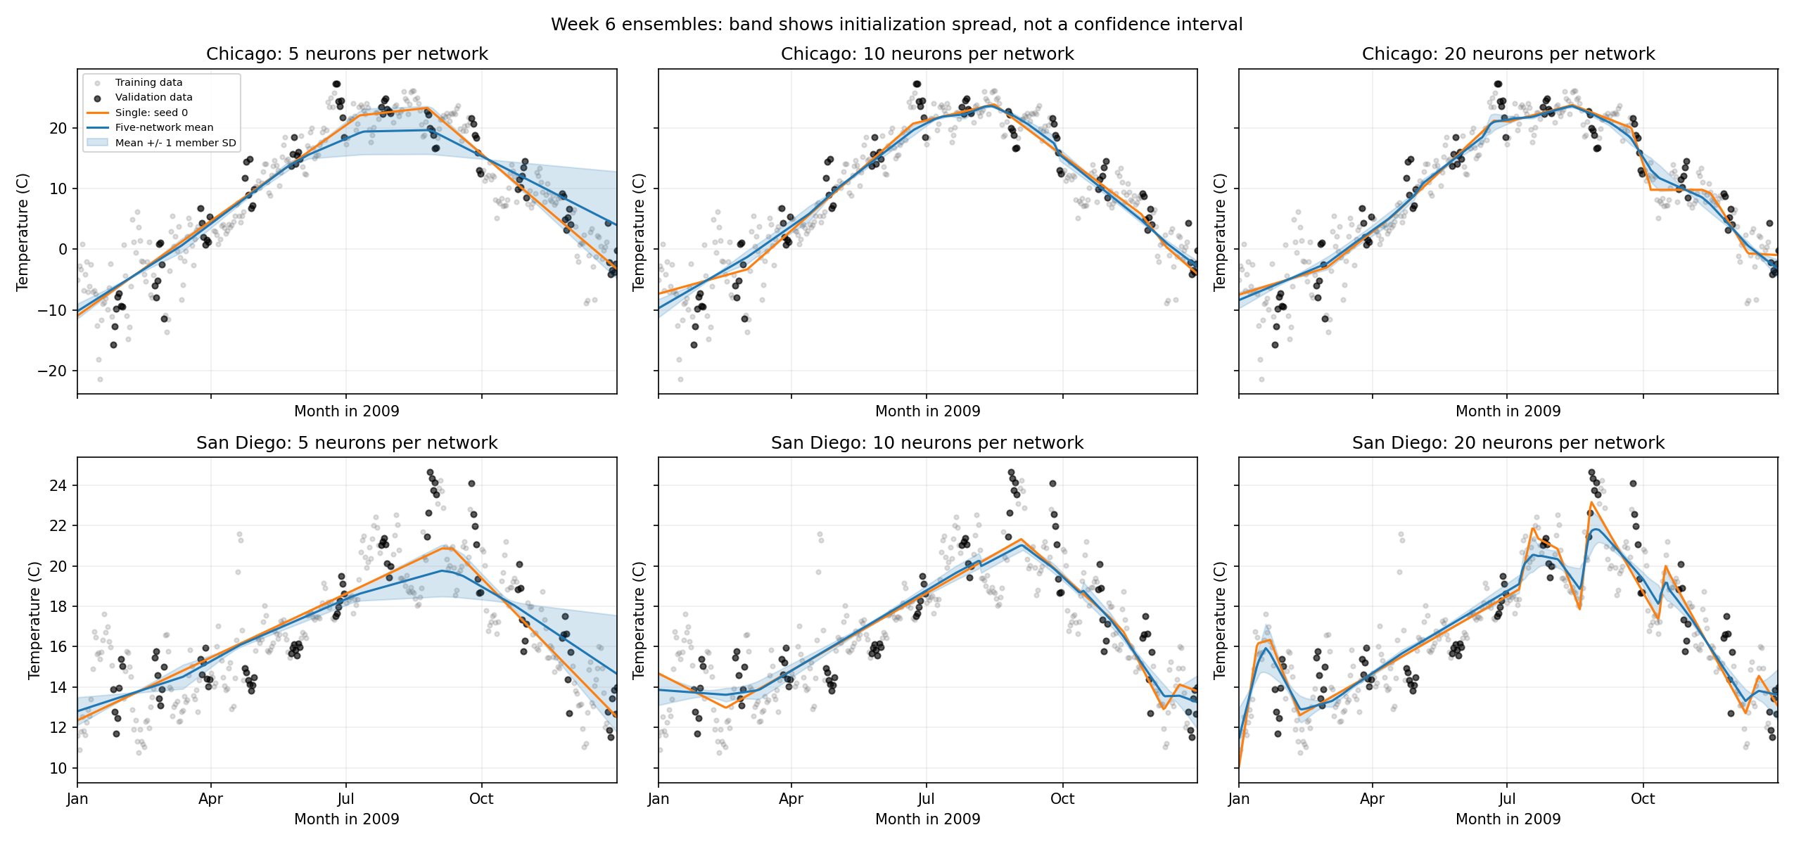
Appendix 5: Ensemble fits and member spread
The band shows mean plus or minus one member SD. It is not a calibrated forecast interval.
week6_ensemble_results/ensemble_comparison.png
15
Notes:
The band shows mean plus or minus one member SD. It is not a calibrated forecast interval.
Source: week6_ensemble_results/ensemble_comparison.png

Slide 16
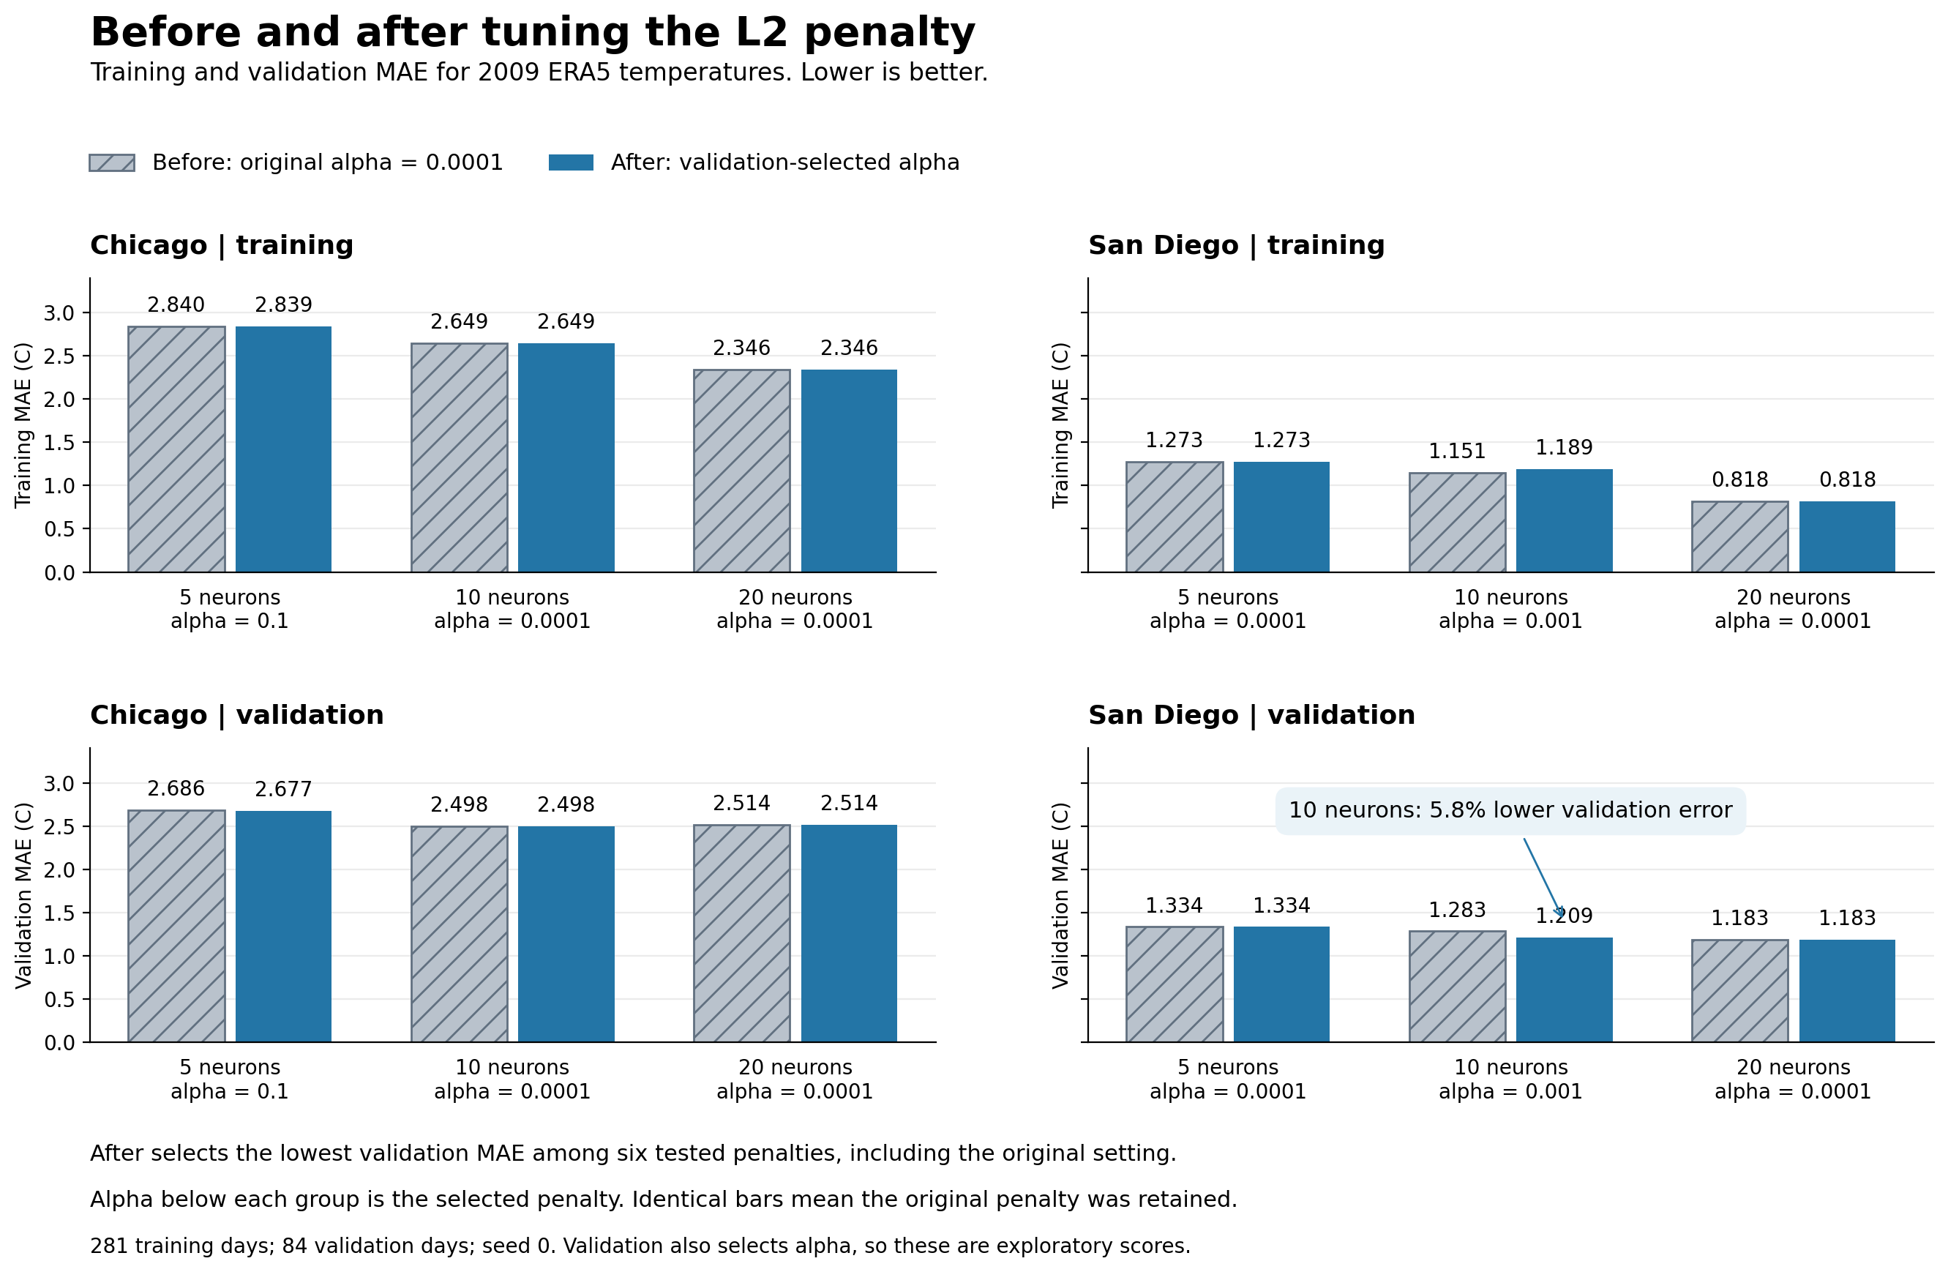
Appendix 6: Full L2 before-and-after comparison
Before already uses alpha 0.0001. Four selected settings retain that original penalty.
week6_regularization_results/before_after_l2.png
16
Notes:
Before already uses alpha 0.0001. Four selected settings retain that original penalty.
Source: week6_regularization_results/before_after_l2.png

Slide 17
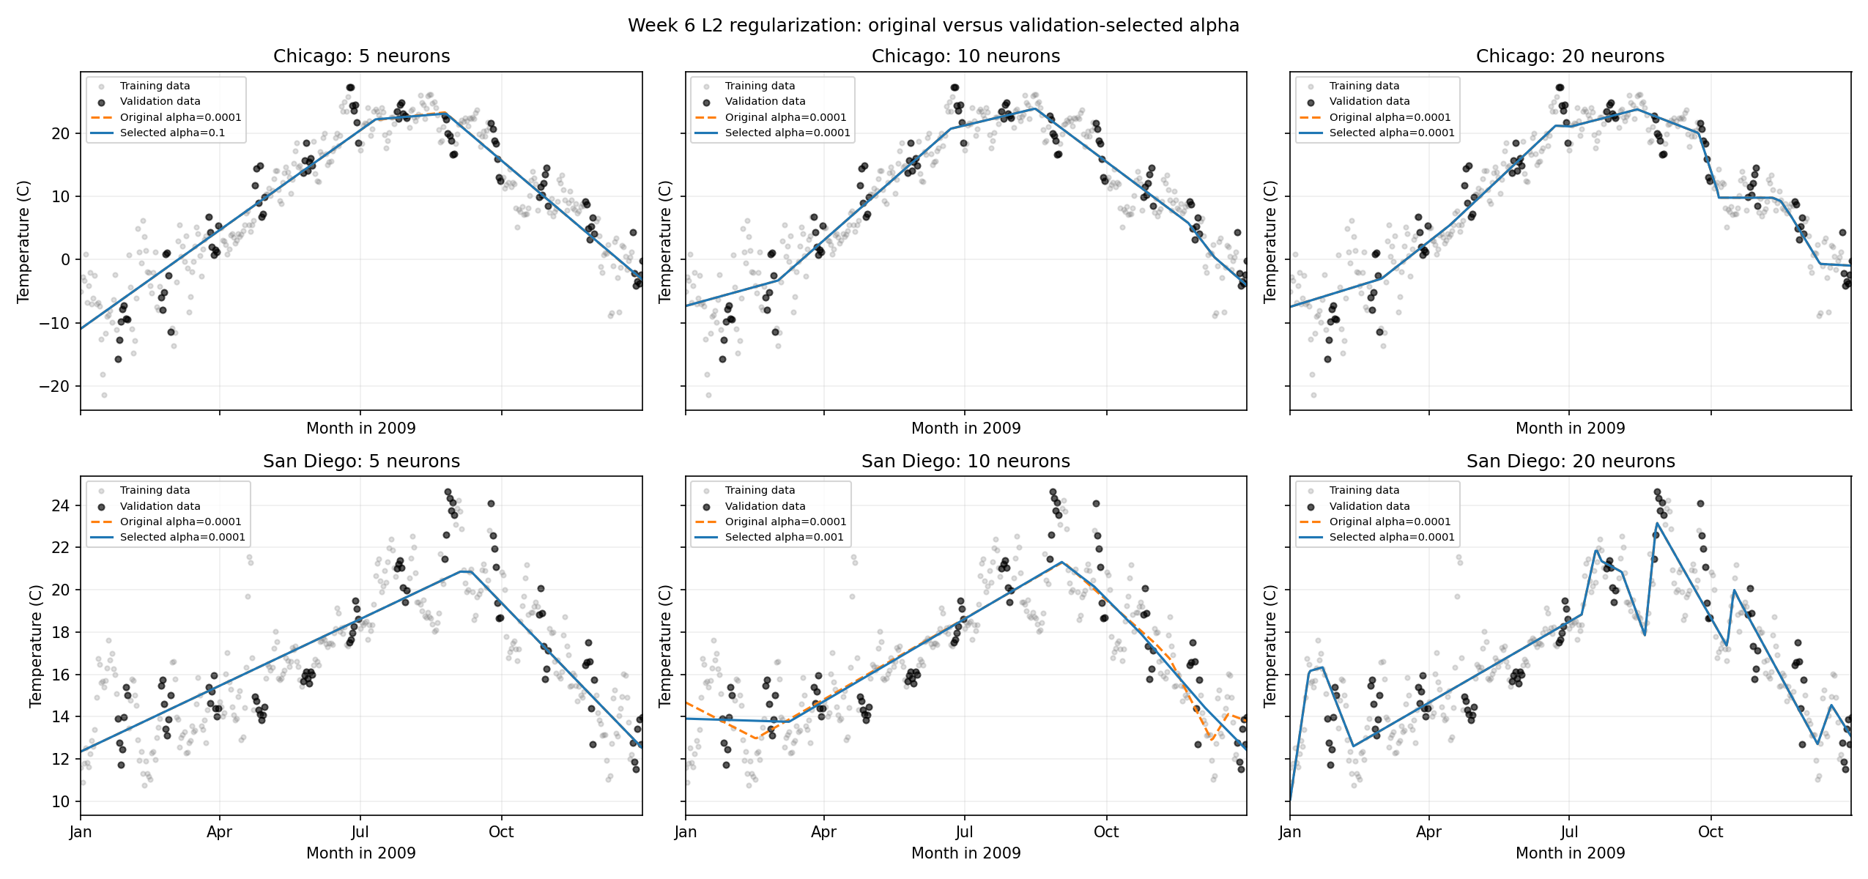
Appendix 7: Original and selected L2 fits
Each width compares the original penalty with a penalty selected using validation MAE.
week6_regularization_results/seasonal_comparison.png
17
Notes:
Each width compares the original penalty with a penalty selected using validation MAE.
Source: week6_regularization_results/seasonal_comparison.png

Slide 18
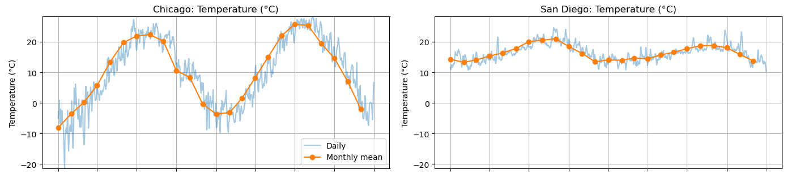
Appendix 8: Temperature comparison
Blue: daily values. Orange: monthly means. All series cover 2009–2010.
Enlarged complete variable row from the original Section 11 city comparison, 2009–2010.
Detail from notebook cell 59. Both city panels and their original axes are preserved.
18
Notes:
Blue: daily values. Orange: monthly means. All series cover 2009–2010.
Enlarged complete variable row from the original Section 11 city comparison, 2009–2010.
Source: Detail from notebook cell 59. Both city panels and their original axes are preserved.

Slide 19
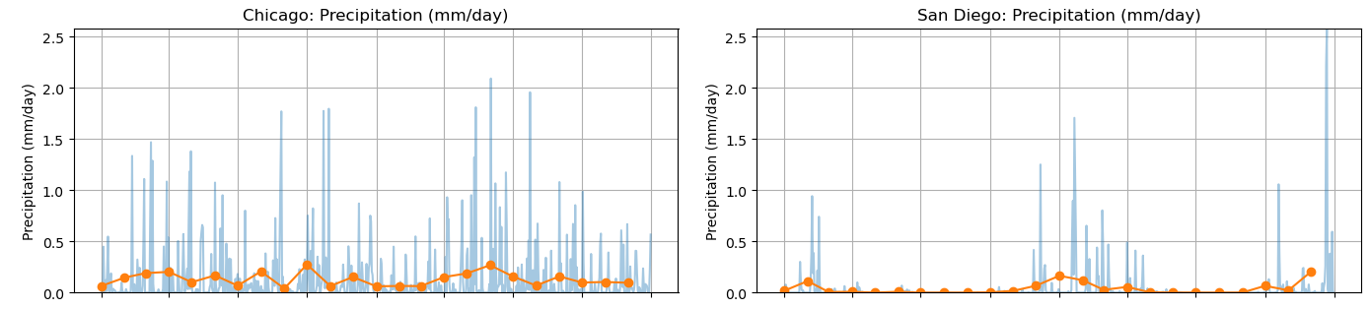
Appendix 9: Precipitation comparison
Blue: daily values. Orange: monthly means. All series cover 2009–2010.
Original precipitation scaling retained. Daily rainfall totals remain unvalidated.
Detail from notebook cell 59. Both city panels and their original axes are preserved.
19
Notes:
Blue: daily values. Orange: monthly means. All series cover 2009–2010.
Original precipitation scaling retained. Daily rainfall totals remain unvalidated.
Source: Detail from notebook cell 59. Both city panels and their original axes are preserved.

Slide 20
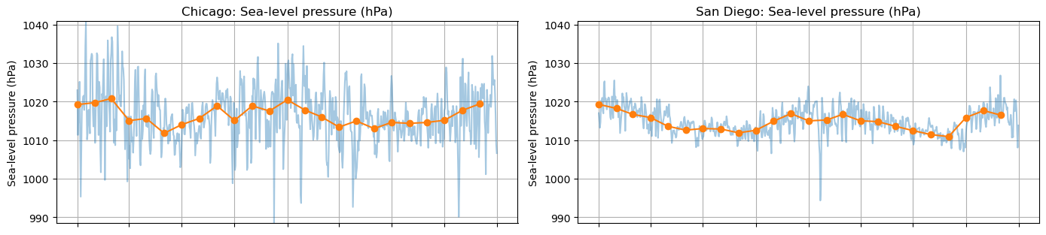
Appendix 10: Pressure comparison
Blue: daily values. Orange: monthly means. All series cover 2009–2010.
Enlarged complete variable row from the original Section 11 city comparison, 2009–2010.
Detail from notebook cell 59. Both city panels and their original axes are preserved.
20
Notes:
Blue: daily values. Orange: monthly means. All series cover 2009–2010.
Enlarged complete variable row from the original Section 11 city comparison, 2009–2010.
Source: Detail from notebook cell 59. Both city panels and their original axes are preserved.

Slide 21
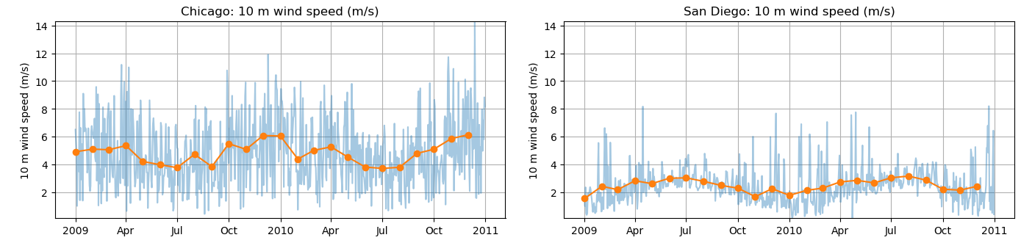
Appendix 11: Wind comparison
Blue: daily values. Orange: monthly means. All series cover 2009–2010.
Wind magnitude uses daily mean horizontal components, rather than mean hourly speed or gusts.
Detail from notebook cell 59. Both city panels and their original axes are preserved.
21
Notes:
Blue: daily values. Orange: monthly means. All series cover 2009–2010.
Wind magnitude uses daily mean horizontal components, rather than mean hourly speed or gusts.
Source: Detail from notebook cell 59. Both city panels and their original axes are preserved.

