Slide 1
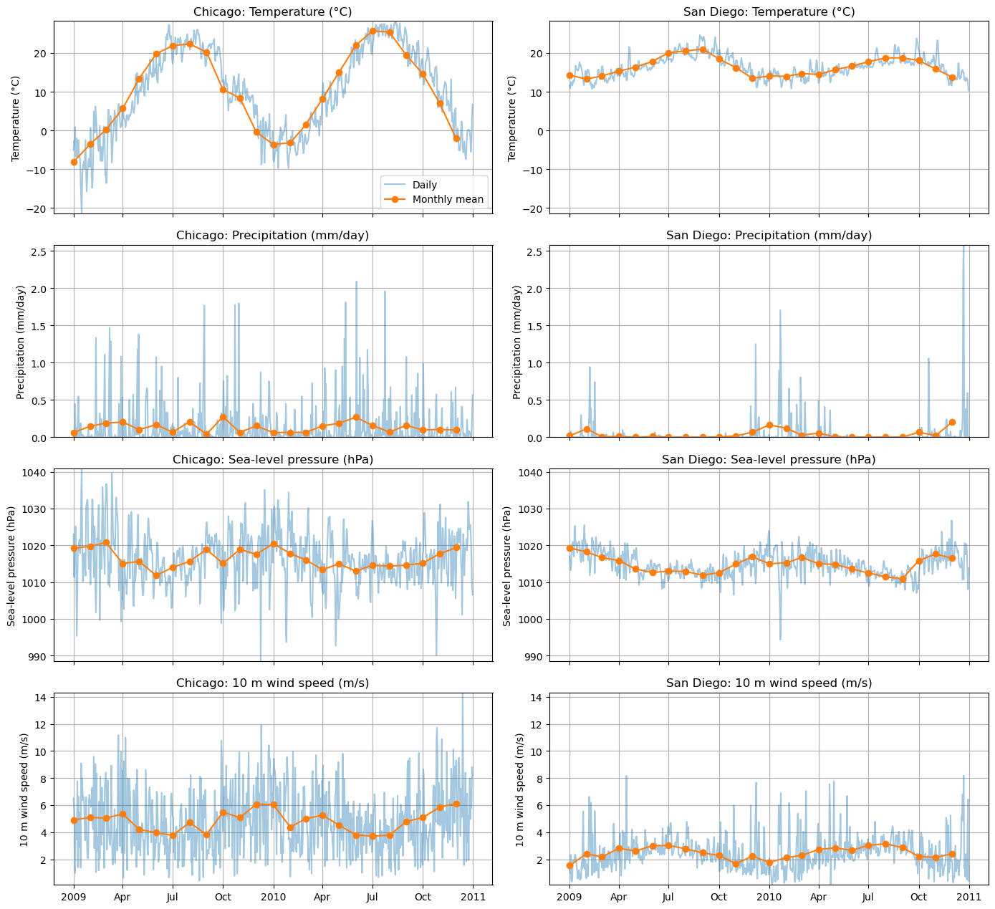
Chicago and San Diego weather comparison
Daily values and monthly means, 2009–2010. Precipitation totals remain unvalidated.
1
Notes:
I began by comparing Chicago and San Diego across temperature, precipitation, pressure, and wind. I used ERA5 daily means from 2009 and 2010 at the nearest grid points, exploring patterns before choosing a modeling question.
Source: presentation/assets/notebook_11_cell_059_output_00.png
Original notebook panel arrangement preserved.
Planned narration: 15 seconds.

Slide 2

Temperature patterns and sample maxima
Chicago varies more. “US average” refers to the rectangular study-region average.
2
Notes:
Chicago showed much greater temperature variation: a standard deviation of about 10.9 degrees Celsius, compared with 2.8 in San Diego. The highest city daily means were about 28.3 and 24.6 degrees. These are sample maxima, and two years do not establish a climate trend.
Source: presentation/assets/notebook_12_cell_060_output_01.png
Original notebook panel arrangement preserved.
Planned narration: 20 seconds.

Slide 3

Exploring a precipitation event
13 March 2010 has the largest supplied regional precipitation value. Daily rainfall totals need validation.
3
Notes:
I examined wind on the day with the largest displayed regional precipitation value. That average covers a rectangular study region. The precipitation scaling still needs validation as daily rainfall totals, which limits the rainfall conclusions.
Source: presentation/assets/notebook_13_cell_061_output_01.png
Original notebook panel arrangement preserved.
Planned narration: 15 seconds.

Slide 4

Predicting tomorrow’s temperature
Chronological 75/25 split. The neural network does not consistently beat linear regression.
4
Notes:
I first used current and lagged weather to predict tomorrow’s temperature, training on the earlier seventy-five percent of dates. Chicago’s linear and neural models both scored about 1.46 degrees. San Diego’s linear model scored 0.63, compared with 0.68 for the network. This used one chronological test split.
Source: presentation/assets/notebook_14_cell_062_output_00.png
Original notebook panel arrangement preserved.
Planned narration: 25 seconds.

Slide 5

Chicago seasonal prediction
Train on 2009, evaluate on 2010. Chicago MAE: straight line 8.91 C, neural network 2.92 C.
5
Notes:
I then asked whether day of year alone could capture the seasonal pattern. Training on 2009 and evaluating on 2010, Chicago’s error fell from 8.91 degrees with a straight line to 2.92 with the network.
Source: presentation/assets/notebook_15_cell_063_output_00.png
Original notebook panel arrangement preserved.
Planned narration: 15 seconds.

Slide 6

San Diego seasonal prediction
The same annual split. San Diego MAE: straight line 1.68 C, neural network 1.48 C.
6
Notes:
I repeated the seasonal experiment for San Diego. Error fell from 1.68 degrees with the straight line to 1.48 with the network. The improvement was smaller here.
Source: presentation/assets/notebook_16_cell_063_output_01.png
Original notebook panel arrangement preserved.
Planned narration: 15 seconds.

Slide 7
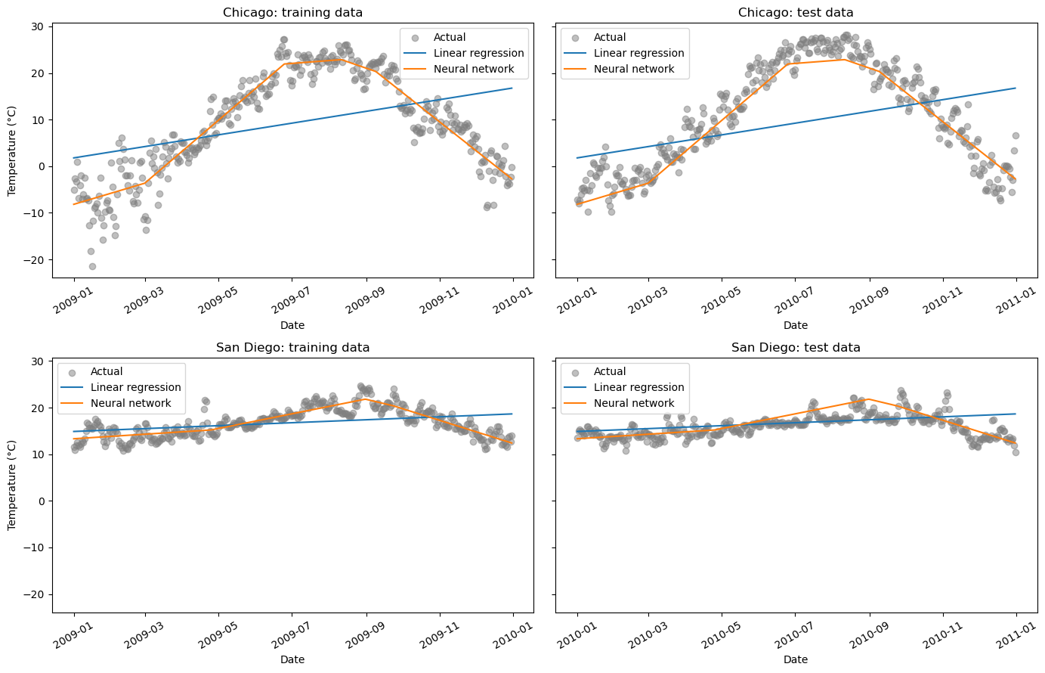
Seasonal prediction in both cities
The same experiment as the previous two slides, with both cities and both years shown together.
7
Notes:
This combined view shows the same seasonal experiment as the previous two slides. It makes the larger improvement in Chicago easier to compare.
Source: presentation/assets/notebook_17_cell_064_output_00.png
Original notebook panel arrangement preserved.
Planned narration: 10 seconds.

Slide 8
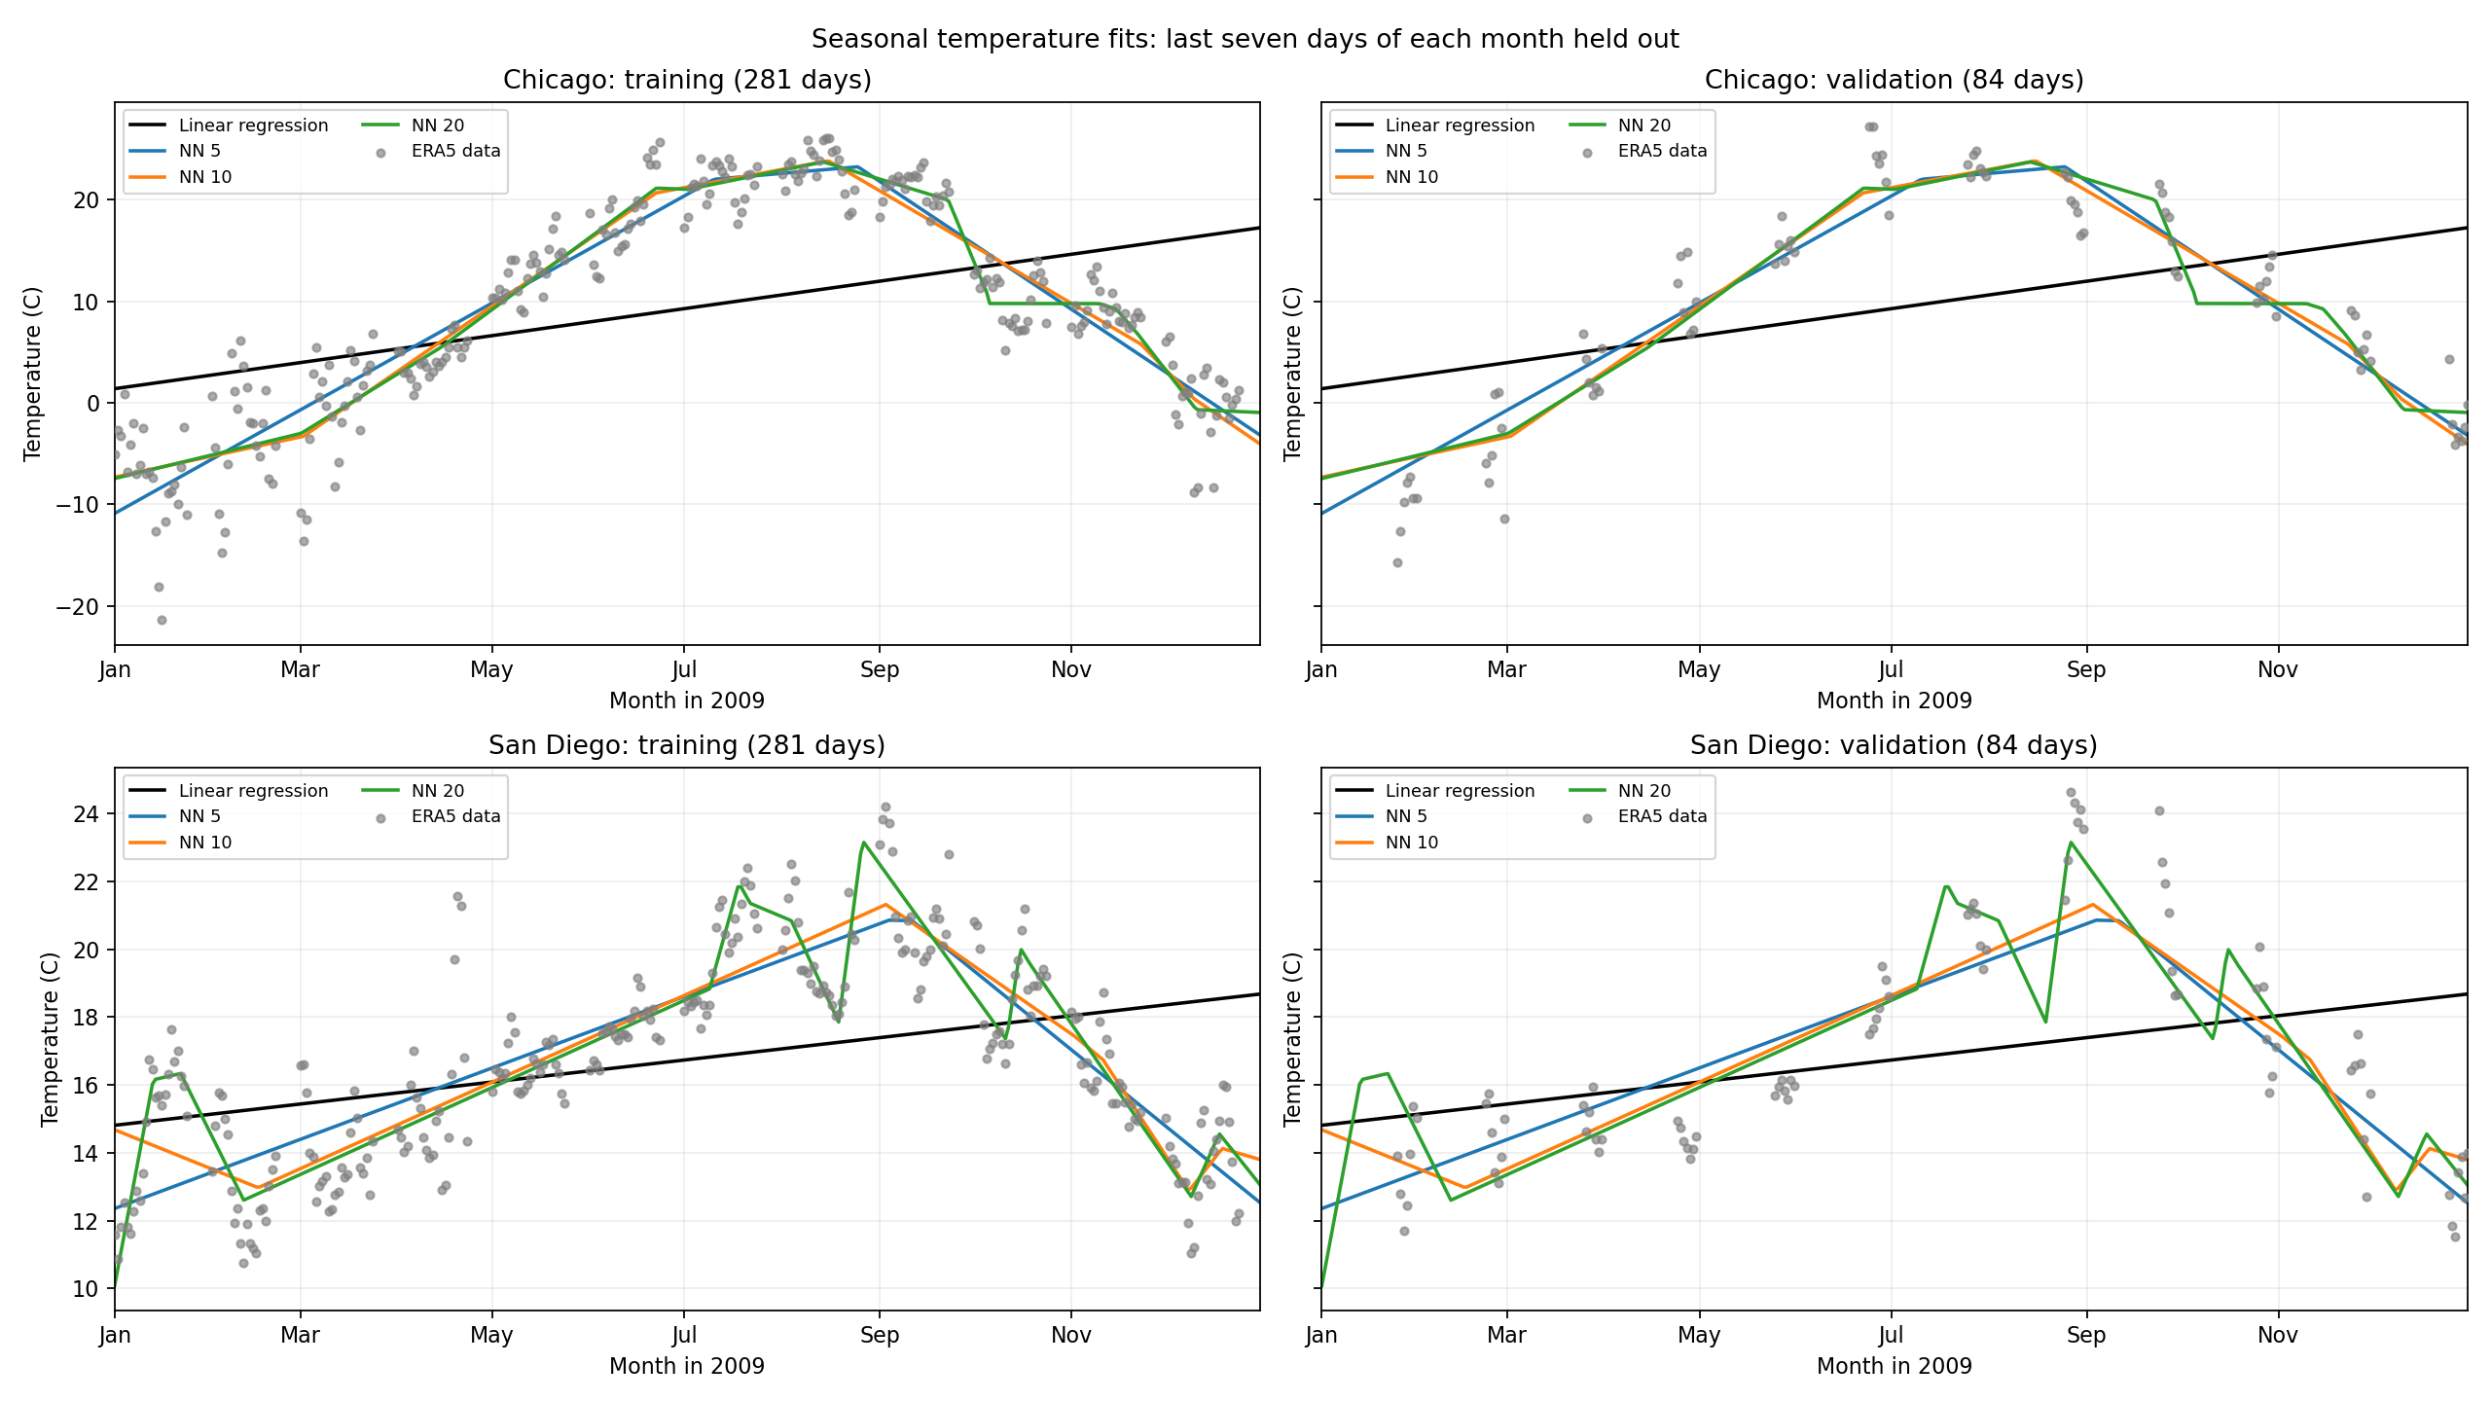
Monthly validation: 5, 10 and 20 neurons
2009: 281 training days and 84 validation days, holding out the final seven days of each month.
8
Notes:
To compare network settings across all seasons, I held out the final seven days of every month in 2009. That left 281 training days and 84 validation days. These curves compare five, ten, and twenty neurons on identical dates. This changes the evaluation question, so lower errors cannot be compared directly with the 2010 results.
Source: month_end_results/seasonal_fits.png
Original notebook panel arrangement preserved.
Planned narration: 25 seconds.

Slide 9
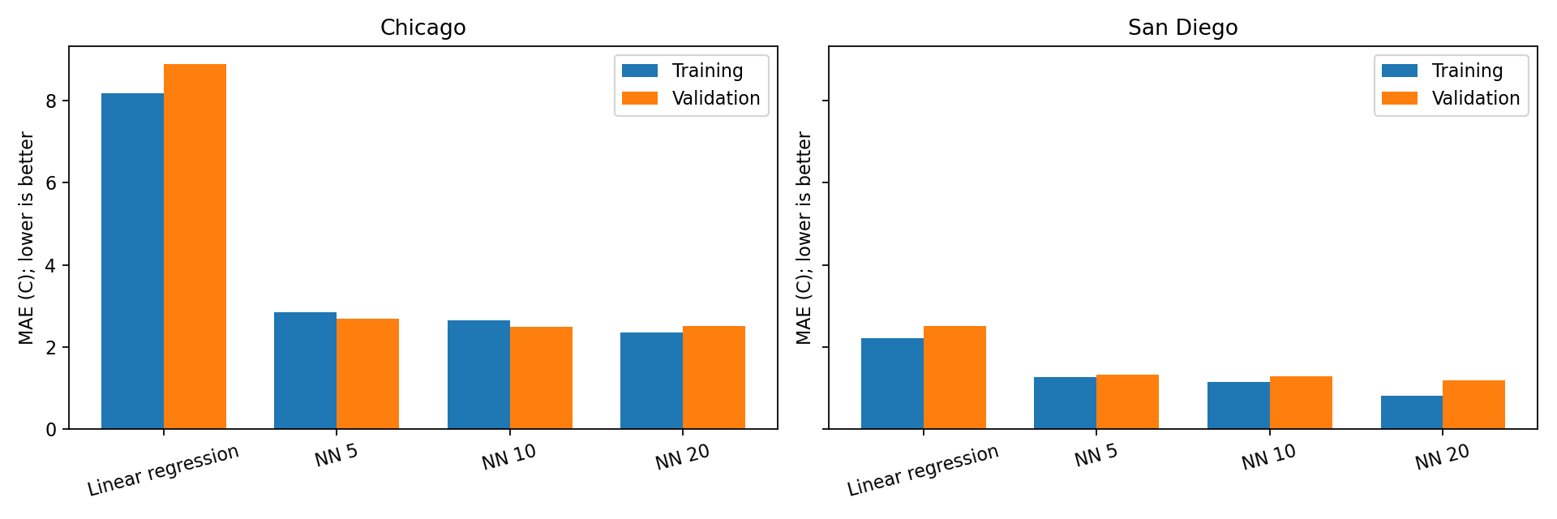
Training and validation errors
Validation MAE selects 10 neurons in Chicago (2.498 C) and 20 in San Diego (1.183 C).
9
Notes:
The bars compare training and validation error. More neurons improved training fit, but did not consistently improve validation. Chicago’s lowest validation error was about 2.50 degrees with ten neurons, almost tied with twenty. San Diego’s was about 1.18 with twenty. I chose settings using validation error.
Source: month_end_results/training_validation_mae.png
Original notebook panel arrangement preserved.
Planned narration: 20 seconds.

Slide 10
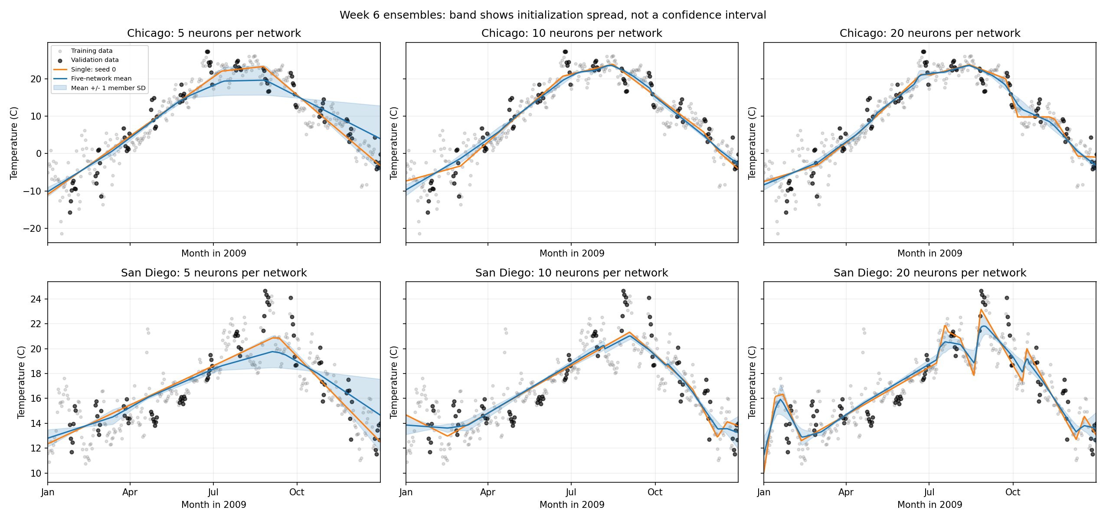
Comparing single networks and ensembles
Five seeds did not beat the original winners. The band shows member disagreement, not forecast confidence.
10
Notes:
I averaged five networks with different initial weights to test whether predictions became more reliable. The ensemble did not lower either city’s best single-model MAE. The shaded spread shows disagreement between fits, not calibrated weather uncertainty.
Source: week6_ensemble_results/ensemble_comparison.png
Original notebook panel arrangement preserved.
Planned narration: 15 seconds.

Slide 11
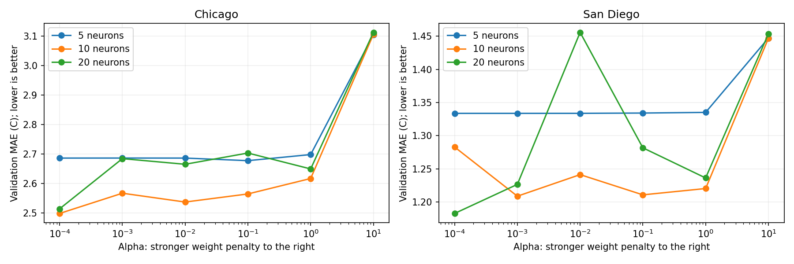
Effect of L2 penalty strength
Stronger penalties do not steadily lower validation error. The penalty scan uses one initialization.
11
Notes:
I also tested six L2 penalty strengths. Alpha penalizes large weights, but stronger penalties did not steadily lower validation error. San Diego’s twenty-neuron model spiked at one setting. Different penalties can lead training to different fits, and initialization can change the ranking.
Source: week6_regularization_results/alpha_validation_mae.png
Original notebook panel arrangement preserved.
Planned narration: 20 seconds.

Slide 12
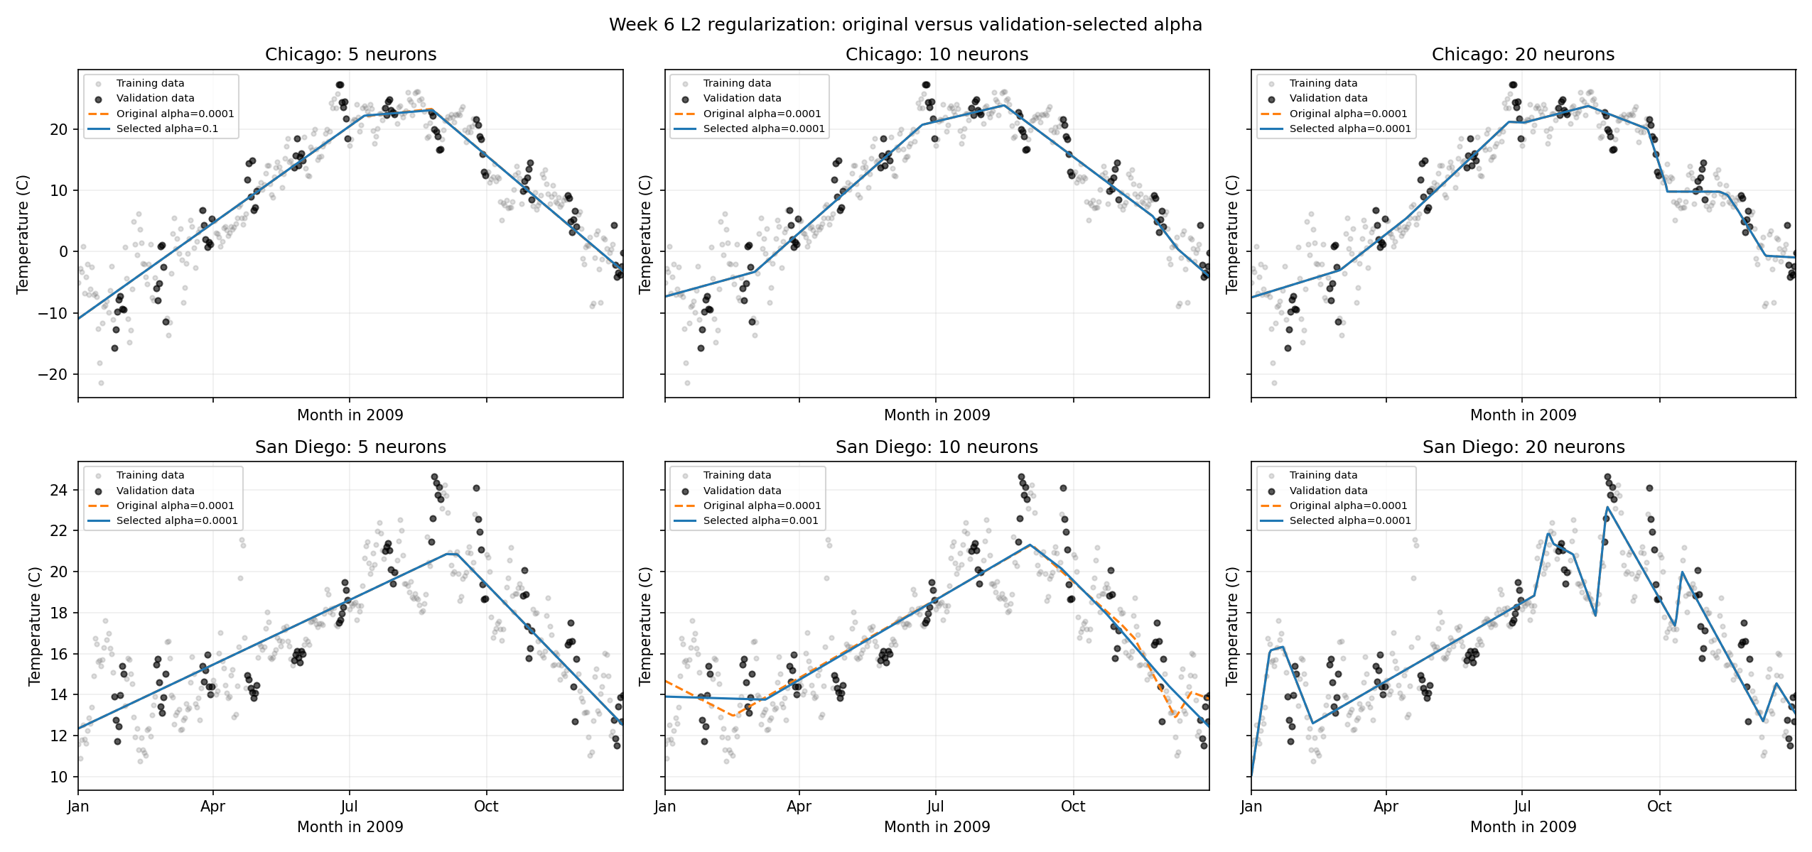
Seasonal fits before and after L2 tuning
Original alpha 0.0001 versus validation-selected alpha. Four models retain their original penalty.
12
Notes:
These panels compare original fits with their validation-selected penalties. The originals already used weak L2 regularization. Four models kept their original setting, so their curves overlap. Stronger penalties did not consistently improve every model.
Source: week6_regularization_results/seasonal_comparison.png
Original notebook panel arrangement preserved.
Planned narration: 15 seconds.

Slide 13
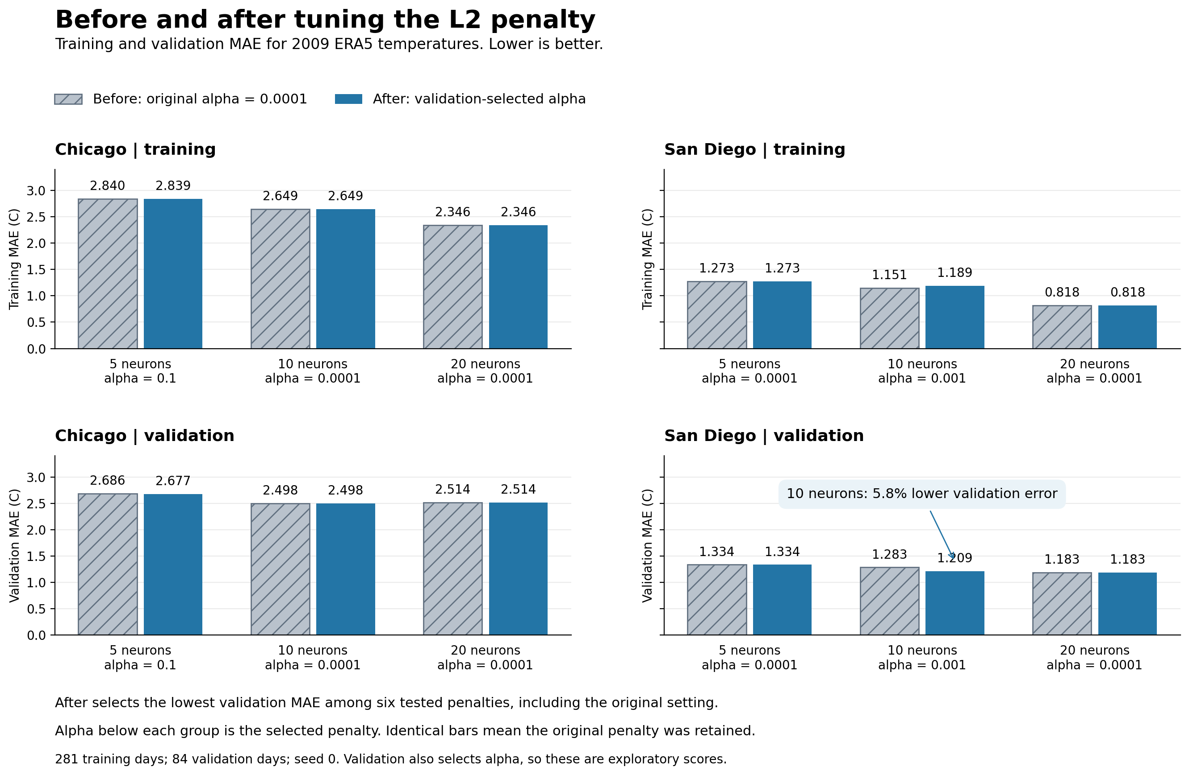
Before and after L2: error comparison
San Diego, 10 neurons: validation MAE improves 5.8%. Training error rises slightly. Overall winners stay unchanged.
13
Notes:
The clearest L2 change was San Diego’s ten-neuron network. Validation error fell from about 1.28 to 1.21 degrees, while training error rose slightly. A closer training fit was therefore unnecessary for better predictions on these held-out weeks.
Source: week6_regularization_results/before_after_l2.png
Original notebook panel arrangement preserved.
Planned narration: 20 seconds.

Slide 14
Conclusions: what we tested and learned
How do the cities differ, and which temperature models work best?
City patterns
Chicago varied more. Networks learned seasonal curves better than straight lines, but did not consistently improve tomorrow’s forecasts.
Network size
Monthly validation favored 10 neurons in Chicago and 20 in San Diego. More neurons did not consistently improve accuracy.
L2 and ensembles
L2 reduced San Diego’s 10-neuron validation error by 5.8%. The overall MAE winners stayed unchanged, and ensembles did not beat them.
Why: flexible curves capture seasonality. A small penalty can reduce overfitting, but added complexity offers no guaranteed gain.
14
Notes:
The results depend on the task and city. Chicago showed stronger seasonal variability. The neural network learned seasonal curvature better than a straight line, but did not consistently improve the next-day forecast. Monthly validation selected ten neurons for Chicago and twenty for San Diego. L2 reduced San Diego’s ten-neuron validation MAE by about 5.8 percent, but the lowest-MAE overall choices stayed unchanged. Ensembles also failed to beat the best single-model MAE.
Sources: notebook cells 59 and 62–64; month_end_results/model_comparison.csv; week6_ensemble_results/scores.csv; week6_regularization_results/comparison.csv.
Planned narration: 35 seconds.

Slide 15
Limitations and future exploration
Limitations
Future exploration
L2 tuning uses 2009 and one initialization.
Repeat multiple initializations and evaluate untouched years.
The same validation weeks select settings and report accuracy. Nearby days are related.
Keep a separate final test period. Use chronological evaluation for future forecasts.
Day of year misses daily weather. A straight line is a weak seasonal baseline.
Compare a sine/cosine seasonal baseline and add recent weather predictors.
Two years limit climate claims. Daily rainfall totals remain unvalidated.
Study longer records and verify precipitation units before rainfall conclusions.
15
Notes:
The monthly results reconstruct 2009 gaps. One training year and one L2 initialization limit robustness. Reusing validation for selection and reporting, alongside related neighboring days, requires a separate final test. I would repeat seeds, use untouched years, and evaluate forecasts chronologically. Calendar-only inputs and the weak straight-line baseline motivate sine and cosine features and richer weather predictors. Two years cannot establish climate trends, and rainfall totals need unit checks. Longer records would strengthen these conclusions.
Sources: notebook cells 59 and 62–64; month_end_results/model_comparison.csv; week6_ensemble_results/scores.csv; week6_regularization_results/comparison.csv.
Planned narration: 35 seconds.

