Slide 1
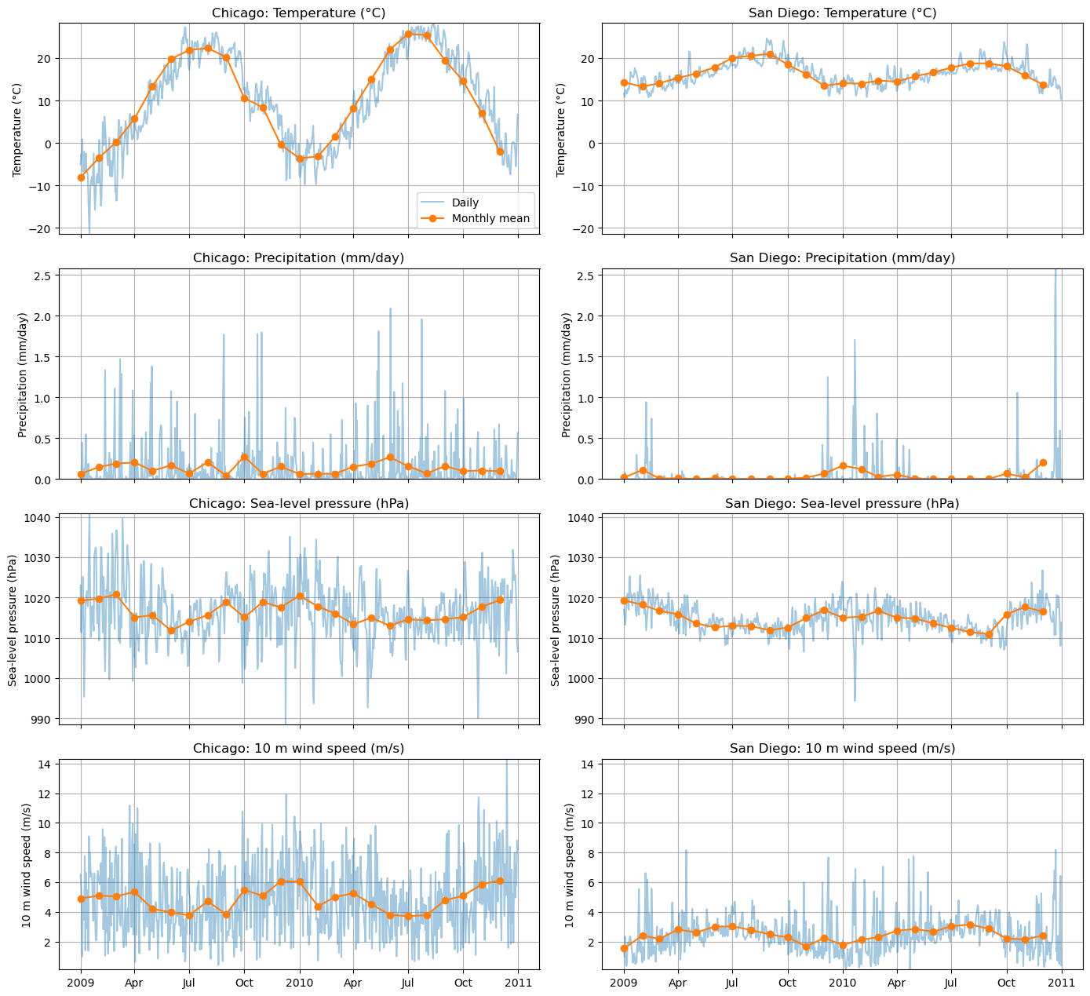
Chicago and San Diego weather comparison
Daily values and monthly means, 2009–2010. Precipitation totals remain unvalidated.
1
Notes:
I began by comparing Chicago and San Diego across temperature, precipitation, pressure, and wind. These graphs cover daily mean ERA5 data from 2009 and 2010 at the nearest grid point to each city. I explored their patterns before choosing a modeling question.
Source: presentation/assets/notebook_11_cell_059_output_00.png
Original notebook panel arrangement preserved.
Planned narration: 20 seconds.

Slide 2

Temperature patterns and sample maxima
Chicago varies more. “US average” refers to the rectangular study-region average.
2
Notes:
Chicago showed greater temperature variation: a standard deviation of about 10.9 degrees Celsius, compared with 2.8 in San Diego. The highest city daily means were about 28.3 degrees in Chicago and 24.6 in San Diego. These are sample maxima. Two years of data do not establish a long-term climate trend.
Source: presentation/assets/notebook_12_cell_060_output_01.png
Original notebook panel arrangement preserved.
Planned narration: 25 seconds.

Slide 3

Exploring a precipitation event
13 March 2010 has the largest supplied regional precipitation value. Daily rainfall totals need validation.
3
Notes:
I also examined wind on the day with the largest displayed regional precipitation value. The average covers a rectangular study region, and the precipitation scaling needs validation as daily rainfall totals. This uncertainty limits rainfall conclusions, so I keep the final results focused on temperature.
Source: presentation/assets/notebook_13_cell_061_output_01.png
Original notebook panel arrangement preserved.
Planned narration: 20 seconds.

Slide 4

Predicting tomorrow’s temperature
Chronological 75/25 split. The neural network does not consistently beat linear regression.
4
Notes:
I used current and lagged weather information to predict tomorrow’s temperature. I trained on the earlier seventy-five percent of dates and tested on the final quarter. Chicago’s linear regression and neural network both had average errors of about 1.46 degrees. San Diego’s linear model scored 0.63, compared with 0.68 for the network. Complexity did not automatically improve this forecast, which used one chronological test split.
Source: presentation/assets/notebook_14_cell_062_output_00.png
Original notebook panel arrangement preserved.
Planned narration: 30 seconds.

Slide 5

Chicago seasonal prediction
Train on 2009, evaluate on 2010. Chicago MAE: straight line 8.91 C, neural network 2.92 C.
5
Notes:
I then asked whether day of year alone could capture the seasonal pattern. In Chicago, I trained on 2009 and evaluated on 2010. The neural network represented the seasonal rise and fall better than a straight line, reducing average absolute error from 8.91 to 2.92 degrees.
Source: presentation/assets/notebook_15_cell_063_output_00.png
Original notebook panel arrangement preserved.
Planned narration: 20 seconds.

Slide 6

San Diego seasonal prediction
The same annual split. San Diego MAE: straight line 1.68 C, neural network 1.48 C.
6
Notes:
I repeated the same seasonal experiment for San Diego. Error fell from 1.68 degrees with straight-line regression to 1.48 with the network. Its advantage was smaller here, showing why both cities needed evaluation.
Source: presentation/assets/notebook_16_cell_063_output_01.png
Original notebook panel arrangement preserved.
Planned narration: 15 seconds.

Slide 7
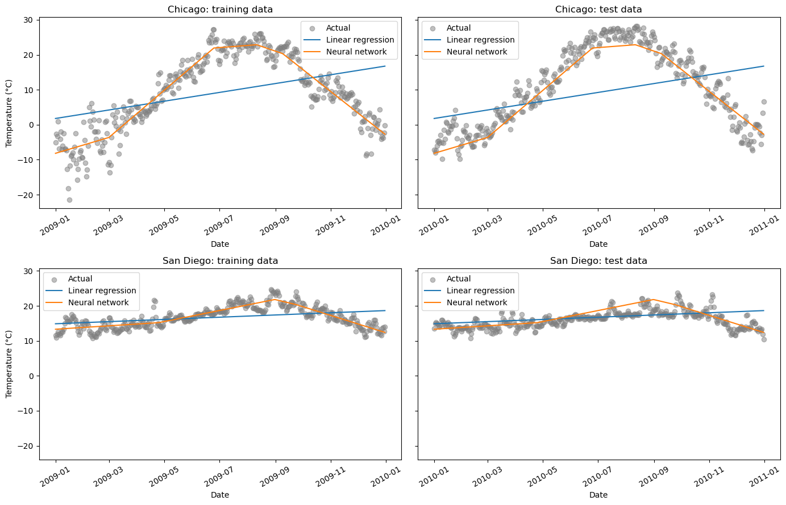
Seasonal prediction in both cities
The same experiment as the previous two slides, with both cities and both years shown together.
7
Notes:
This combined view brings the previous two city comparisons together. It shows the same experiment, rather than an additional independent test. The network improves both cities’ seasonal predictions, with a much larger gain in Chicago.
Source: presentation/assets/notebook_17_cell_064_output_00.png
Original notebook panel arrangement preserved.
Planned narration: 15 seconds.

Slide 8
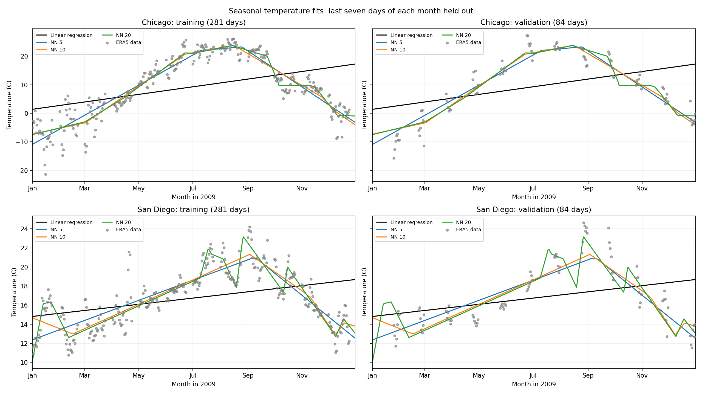
Monthly validation: 5, 10 and 20 neurons
2009: 281 training days and 84 validation days, holding out the final seven days of each month.
8
Notes:
To choose network settings across all seasons, I held out the final seven days of each month in 2009. That gave 84 validation days and 281 training days. The curves compare five, ten, and twenty neurons on identical dates. This asks how well models fill gaps within one year. Training includes later and neighboring days, so these scores cannot be compared directly with the earlier 2010 evaluation.
Source: month_end_results/seasonal_fits.png
Original notebook panel arrangement preserved.
Planned narration: 30 seconds.

Slide 9
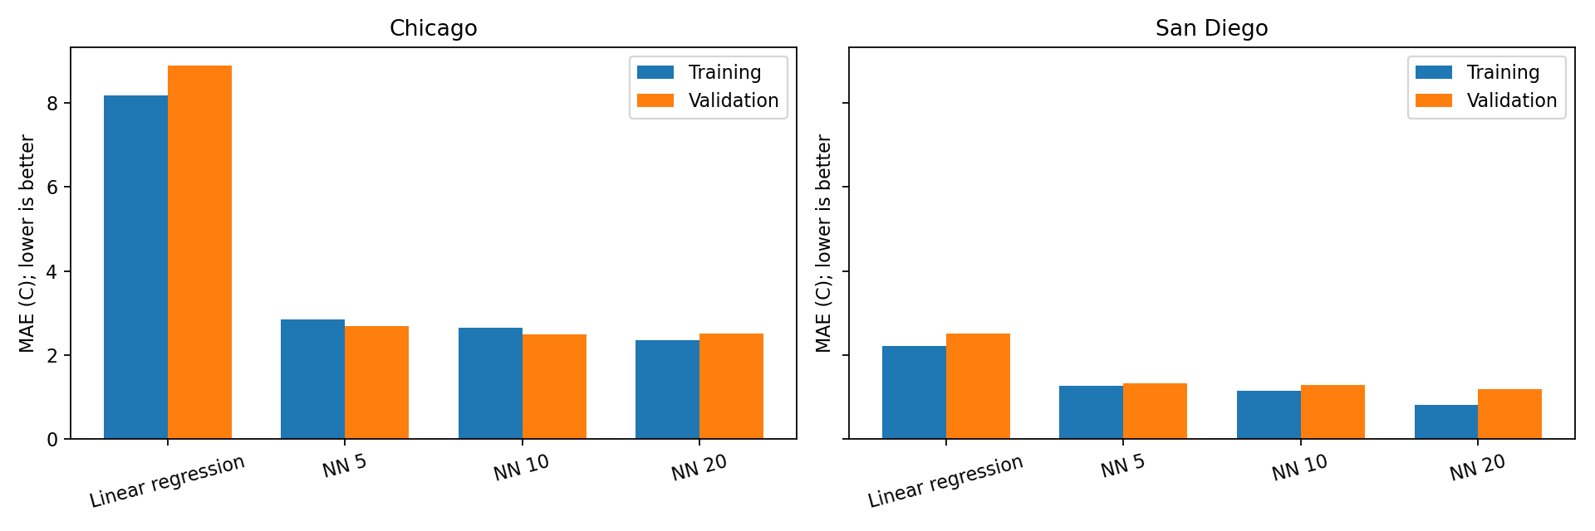
Training and validation errors
Validation MAE selects 10 neurons in Chicago (2.498 C) and 20 in San Diego (1.183 C).
9
Notes:
The bars make the training and validation tradeoff clearer. More neurons improved training fit, but did not consistently improve validation predictions. Chicago’s lowest validation error was about 2.50 degrees with ten neurons, although twenty was nearly tied. San Diego’s was about 1.18 with twenty. I selected using validation error. These results describe one initialization and do not establish a universally best network size.
Source: month_end_results/training_validation_mae.png
Original notebook panel arrangement preserved.
Planned narration: 30 seconds.

Slide 10
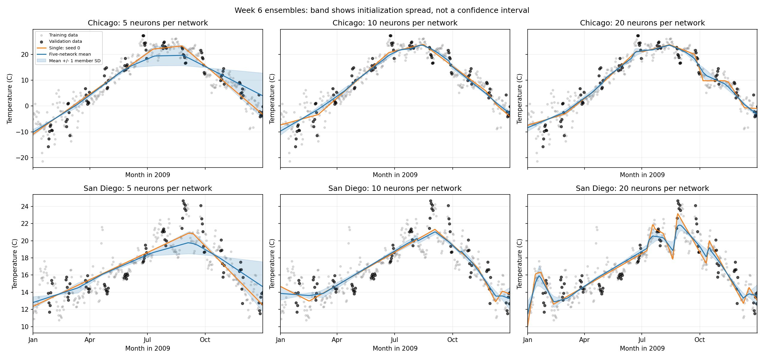
Comparing single networks and ensembles
Five seeds did not beat the original winners. The band shows member disagreement, not forecast confidence.
10
Notes:
I averaged five networks with different initial weights to test whether predictions became more reliable. The ensemble did not beat either city’s original winner. Some weaker fits pulled the mean away from better solutions. The shaded band shows initialization disagreement, not a calibrated interval for future temperatures.
Source: week6_ensemble_results/ensemble_comparison.png
Original notebook panel arrangement preserved.
Planned narration: 20 seconds.

Slide 11
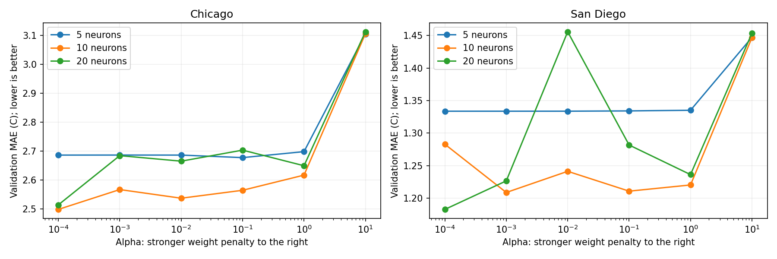
Effect of L2 penalty strength
Stronger penalties do not steadily lower validation error. The penalty scan uses one initialization.
11
Notes:
Week Six suggested regularization. Alpha controls the L2 penalty on large weights. I compared six penalty strengths at each network size. Validation error did not decrease steadily. San Diego’s twenty-neuron model spiked at alpha 0.01. Different penalties can lead training to different fits, so one spike does not show that twenty neurons always performs poorly.
Source: week6_regularization_results/alpha_validation_mae.png
Original notebook panel arrangement preserved.
Planned narration: 25 seconds.

Slide 12
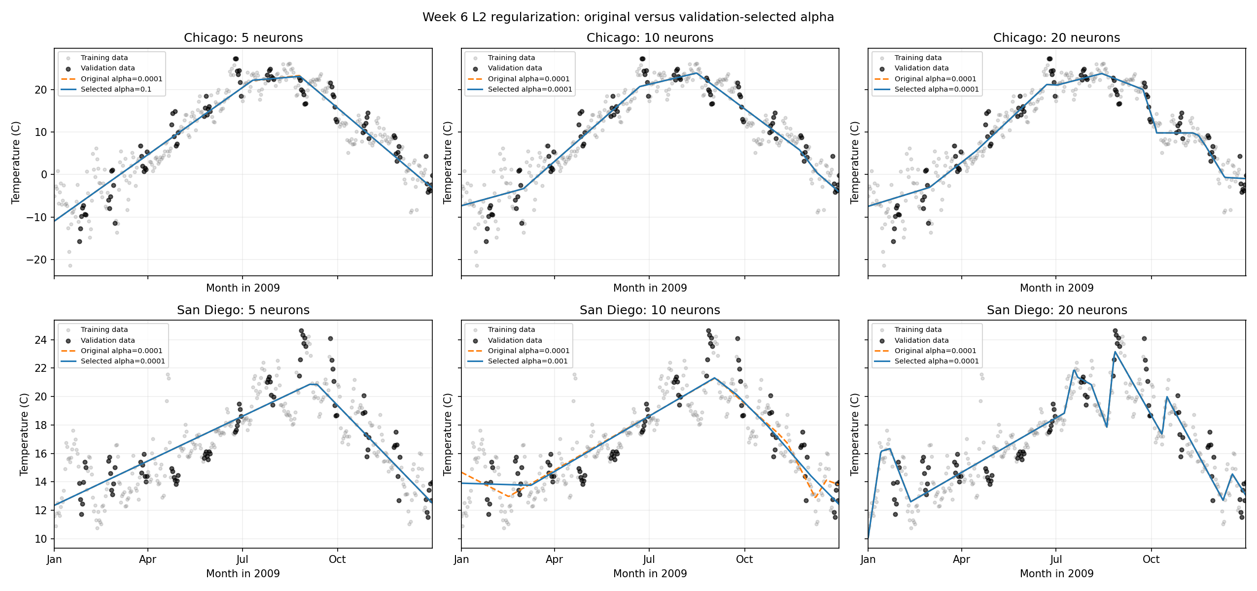
Seasonal fits before and after L2 tuning
Original alpha 0.0001 versus validation-selected alpha. Four models retain their original penalty.
12
Notes:
These panels compare each original fit with its validation-selected penalty. The original models already used weak L2 regularization. Four of the six models kept that original setting, so their curves overlap. Stronger regularization did not consistently improve every model.
Source: week6_regularization_results/seasonal_comparison.png
Original notebook panel arrangement preserved.
Planned narration: 20 seconds.

Slide 13
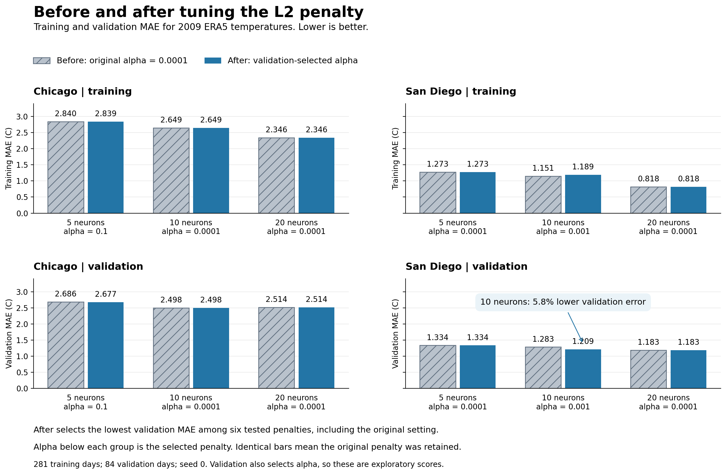
Before and after L2: error comparison
San Diego, 10 neurons: validation MAE improves 5.8%. Training error rises slightly. Overall winners stay unchanged.
13
Notes:
The clearest change was San Diego’s ten-neuron model: validation error fell from 1.28 to 1.21 degrees, about six percent, while training error rose slightly. The original overall MAE winners stayed unchanged. These later experiments use one training year, calendar input, and validation data to both choose and score settings. They do not establish improved future forecasting. I would next repeat initializations and evaluate untouched years.
Source: week6_regularization_results/before_after_l2.png
Original notebook panel arrangement preserved.
Planned narration: 30 seconds.

