Slide 1
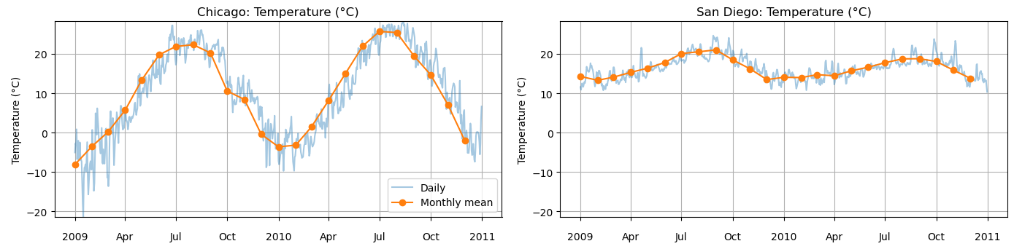
Chicago and San Diego weather patterns
ERA5 daily means, 2009–2010. Nearest grid point to each city.
Which patterns differ, and which temperature models work best?
The initial comparison also covered precipitation, pressure and wind.
Blue shows daily values. Orange shows monthly means across 2009–2010.
ERA5 course data, 2009–2010. Notebook Section 11, cell 59.
1
Notes:
I began by comparing Chicago and San Diego across temperature, precipitation, pressure, and wind. These plots use daily mean ERA5 data from 2009 and 2010 at the nearest grid point to each city. My initial goal was to identify clear differences before choosing a modeling question.
Planned narration: 20 seconds.
This slide belongs to the five-minute main presentation.
Source: ERA5 course data, 2009–2010. Notebook Section 11, cell 59.

Slide 2

Contrasting temperature patterns
Chicago temperature SD: 10.90 C
San Diego temperature SD: 2.77 C
The source graph’s “US average” is the rectangular study-region average.
Quoted maxima are daily means. The red line marks the study-region maximum date.
Notebook cell 60. Statistics describe daily mean temperatures in this two-year sample.
2
Notes:
Chicago showed much greater temperature variation: a standard deviation of about 10.9 degrees Celsius, compared with 2.8 in San Diego. The highest city daily means were about 28.3 degrees in Chicago and 24.6 in San Diego. These are maxima within this sample. That contrast led me to ask whether the same model settings would suit both cities.
Planned narration: 25 seconds.
This slide belongs to the five-minute main presentation.
Source: Notebook cell 60. Statistics describe daily mean temperatures in this two-year sample.

Slide 3

Exploring a precipitation event
Selected date
13 March 2010
The highest regional
precipitation value
selected this day.
One event is descriptive.
It does not establish
weather causality.
Original precipitation scaling retained. Its interpretation as daily rainfall totals remains unvalidated.
Notebook cell 61. Region means use the rectangular study area, without a country mask.
3
Notes:
I also examined wind on March thirteenth, 2010, the day with the largest displayed regional precipitation value. This was exploratory. The regional average covers a rectangle rather than a United States land mask, and the precipitation scaling still needs validation as daily rainfall totals. This uncertainty limits rainfall conclusions, so I keep the final results focused on temperature.
Planned narration: 25 seconds.
This slide belongs to the five-minute main presentation.
Source: Notebook cell 61. Region means use the rectangular study area, without a country mask.

Slide 4

Next-day temperature forecasting
Current and recent weather predict tomorrow’s temperature
Chicago: both models near 1.46 C
San Diego: linear 0.63 C, NN 0.68 C
A chronological forecast task. Its errors answer a different question from the seasonal models.
Saved notebook cell 62 results. 542 training examples and 181 later test examples.
4
Notes:
My first prediction experiment used current and lagged weather information to predict tomorrow’s temperature. I trained on the earlier seventy-five percent of dates and tested on the final quarter. Chicago’s linear regression and neural network both had average errors of about 1.46 degrees. In San Diego, linear regression scored 0.63, compared with 0.68 for the network. Greater model complexity did not automatically improve this forecast.
Planned narration: 30 seconds.
This slide belongs to the five-minute main presentation.
Source: Saved notebook cell 62 results. 542 training examples and 181 later test examples.

Slide 5

Learning the seasonal temperature pattern
Day of year predicts same-day temperature. Train on 2009, evaluate on 2010.
Chicago MAE: 8.91 to 2.92 C
San Diego MAE: 1.68 to 1.48 C
Both compare straight-line regression with a 10-neuron network using calendar input only.
Notebook cells 63–64. Chicago view shown. The San Diego view follows in the appendix.
5
Notes:
I then changed the question: can a neural network learn the seasonal temperature pattern from day of year alone? I trained on 2009 and evaluated on 2010. Chicago’s average absolute error fell from 8.91 degrees for straight-line regression to 2.92 for the network. San Diego’s fell from 1.68 to 1.48. The network could represent the seasonal rise and fall that a straight line missed. This evaluates a different task from predicting tomorrow’s weather.
Planned narration: 35 seconds.
This slide belongs to the five-minute main presentation.
Source: Notebook cells 63–64. Chicago view shown. The San Diego view follows in the appendix.

Slide 6
Monthly validation and network size
Hold out the final seven days of each month in 2009
281 training days and 84 validation days
Chicago
10 neurons
2.498 C
San Diego
20 neurons
1.183 C
This split tests missing dates within 2009. It does not provide a direct comparison with the 2010 scores.
month_end_results/model_comparison.csv. Same dates, preprocessing and seed for every width.
6
Notes:
To choose network settings with coverage of every season, I held out the final seven days of each month in 2009. That gave 84 validation days and 281 training days. This asks how well the model fills gaps within one year, so its scores cannot be compared directly with the 2010 evaluation. I compared five, ten, and twenty neurons. Chicago’s lowest validation error was about 2.50 degrees with ten neurons. San Diego’s was about 1.18 with twenty. Better training fit did not consistently mean better validation predictions.
Planned narration: 40 seconds.
This slide belongs to the five-minute main presentation.
Source: month_end_results/model_comparison.csv. Same dates, preprocessing and seed for every width.

Slide 7
Tuning the L2 weight penalty
A stronger penalty
discourages large weights
Validation MAE
5.8% lower
Training error rises
slightly as validation
error falls
The original best overall MAEs remain unchanged. Four of six models retain the original penalty.
week6_regularization_results/comparison.csv. San Diego, 10 neurons, same monthly split and seed.
7
Notes:
Week Six suggested controlling overfitting with regularization. I varied the L2 penalty, which discourages large weights, while keeping network size fixed. The original models already used a weak penalty. For San Diego’s ten-neuron model, increasing alpha from 0.0001 to 0.001 reduced validation error from 1.28 to 1.21 degrees, about six percent. Training error rose slightly, from 1.15 to 1.19. This helped a smaller model, while the original overall MAE winners remained unchanged.
Planned narration: 35 seconds.
This slide belongs to the five-minute main presentation.
Source: week6_regularization_results/comparison.csv. San Diego, 10 neurons, same monthly split and seed.

Slide 8
Penalty strength and sensitivity
Stronger penalties do not steadily improve validation MAE.
Each step multiplies alpha by 10. One initialization per point limits the ranking.
week6_regularization_results/all_scores.csv. Original values with larger editable labels.
8
Notes:
I scanned penalty strengths because more regularization is not always better. San Diego’s twenty-neuron model shows a spike in validation error at alpha 0.01, followed by lower errors. Changing the penalty can lead training to different fits, and initialization matters. This shows sensitivity to settings, rather than a rule that twenty neurons always performs poorly.
Planned narration: 25 seconds.
This slide belongs to the five-minute main presentation.
Source: week6_regularization_results/all_scores.csv. Original values with larger editable labels.

Slide 9
Testing an ensemble
Neither ensemble
improved the
best original MAE
Some weaker fits pull
the average away from
a good solution
The full curve and
member-spread plot
appear in the appendix
Member disagreement measures initialization sensitivity. It is not a calibrated forecast interval.
week6_ensemble_results/scores.csv. Five fixed seeds, 0 through 4, averaged in Celsius.
9
Notes:
I averaged five networks with different initial weights to test whether predictions became more reliable. The ensemble did not beat either city’s original winner. Some weaker fits pulled the mean away from better solutions. In the appendix plots, the light blue boundaries show disagreement between fits. They are not calibrated intervals for future temperatures.
Planned narration: 25 seconds.
This slide belongs to the five-minute main presentation.
Source: week6_ensemble_results/scores.csv. Five fixed seeds, 0 through 4, averaged in Celsius.

Slide 10
What the analysis establishes
What the results support
What still needs testing
Chicago shows greater temperature
variation in this sample.
Model choices depend on the city
and the prediction question.
L2 helped one smaller network.
The best overall MAE did not improve.
One training year and one L2 seed
Validation both tunes and reports
Related temperatures on nearby days
Calendar input omits daily weather
Next: an untouched year, repeated initializations, and a sine/cosine seasonal baseline.
Synthesis of Section 11 and later validation experiments. Full original figures follow in the appendix.
10
Notes:
The comparison shows that model choices depend on the city and the prediction question. Our earlier forecast had only one chronological test split. The later monthly and L2 experiments used one training year, and validation both selected settings and measured their performance. Nearby days are related, and training includes later dates. Those results do not establish future forecasting improvement. With only calendar input and one seed for the L2 scan, I would next repeat initializations, evaluate untouched years, and compare a seasonal baseline using sine and cosine features.
Planned narration: 40 seconds.
This slide belongs to the five-minute main presentation.
Source: Synthesis of Section 11 and later validation experiments. Full original figures follow in the appendix.

Slide 11

Appendix 1: San Diego seasonal model
2009 training and 2010 evaluation. This is the San Diego view of the same experiment shown in slide 5.
presentation/assets/notebook_16_cell_063_output_01.png
11
Notes:
2009 training and 2010 evaluation. This is the San Diego view of the same experiment shown in slide 5.
Source: presentation/assets/notebook_16_cell_063_output_01.png

Slide 12
Appendix 2: Chicago training fits
Training observations appear as dots. Every curve is fitted to the same training dates.
All dates are in 2009. The horizontal axis now shows the model’s numerical input, day of year.
month_end_results/predictions.csv. Original monthly-fit values with complete standalone axes.
12
Notes:
Day of year predicts daily mean temperature. Fitted curves use 281 training days; each month supplies seven held-out validation dates.
Source: month_end_results/predictions.csv. Original monthly-fit values with complete standalone axes.

Slide 13
Appendix 3: Chicago validation fits
Validation observations appear as dots. Every curve is fitted to the same training dates.
All dates are in 2009. The horizontal axis now shows the model’s numerical input, day of year.
month_end_results/predictions.csv. Original monthly-fit values with complete standalone axes.
13
Notes:
Day of year predicts daily mean temperature. Fitted curves use 281 training days; each month supplies seven held-out validation dates.
Source: month_end_results/predictions.csv. Original monthly-fit values with complete standalone axes.

Slide 14
Appendix 4: San Diego training fits
Training observations appear as dots. Every curve is fitted to the same training dates.
All dates are in 2009. The horizontal axis now shows the model’s numerical input, day of year.
month_end_results/predictions.csv. Original monthly-fit values with complete standalone axes.
14
Notes:
Day of year predicts daily mean temperature. Fitted curves use 281 training days; each month supplies seven held-out validation dates.
Source: month_end_results/predictions.csv. Original monthly-fit values with complete standalone axes.

Slide 15
Appendix 5: San Diego validation fits
Validation observations appear as dots. Every curve is fitted to the same training dates.
All dates are in 2009. The horizontal axis now shows the model’s numerical input, day of year.
month_end_results/predictions.csv. Original monthly-fit values with complete standalone axes.
15
Notes:
Day of year predicts daily mean temperature. Fitted curves use 281 training days; each month supplies seven held-out validation dates.
Source: month_end_results/predictions.csv. Original monthly-fit values with complete standalone axes.

Slide 16
Appendix 6: Chicago full MAE comparison
The same monthly 2009 split applies to every model. Lower MAE is better.
The straight-line baseline has no explicit seasonal sine or cosine features.
month_end_results/model_comparison.csv
16
Notes:
The original comparison includes the straight-line baseline and all three neural-network widths.
Source: month_end_results/model_comparison.csv

Slide 17
Appendix 7: San Diego full MAE comparison
The same monthly 2009 split applies to every model. Lower MAE is better.
The straight-line baseline has no explicit seasonal sine or cosine features.
month_end_results/model_comparison.csv
17
Notes:
The original comparison includes the straight-line baseline and all three neural-network widths.
Source: month_end_results/model_comparison.csv

Slide 18
Appendix 8: Chicago, 5 neurons, ensemble
Light blue bounds equal the ensemble mean plus or minus one member standard deviation.
They measure disagreement between initializations and are not calibrated forecast intervals.
week6_ensemble_results/predictions.csv
18
Notes:
The original mean-plus/minus-member-SD band is shown as upper and lower boundary curves. All numerical predictions and spreads are unchanged.
Source: week6_ensemble_results/predictions.csv

Slide 19
Appendix 9: Chicago, 10 neurons, ensemble
Light blue bounds equal the ensemble mean plus or minus one member standard deviation.
They measure disagreement between initializations and are not calibrated forecast intervals.
week6_ensemble_results/predictions.csv
19
Notes:
The original mean-plus/minus-member-SD band is shown as upper and lower boundary curves. All numerical predictions and spreads are unchanged.
Source: week6_ensemble_results/predictions.csv

Slide 20
Appendix 10: Chicago, 20 neurons, ensemble
Light blue bounds equal the ensemble mean plus or minus one member standard deviation.
They measure disagreement between initializations and are not calibrated forecast intervals.
week6_ensemble_results/predictions.csv
20
Notes:
The original mean-plus/minus-member-SD band is shown as upper and lower boundary curves. All numerical predictions and spreads are unchanged.
Source: week6_ensemble_results/predictions.csv

Slide 21
Appendix 11: San Diego, 5 neurons, ensemble
Light blue bounds equal the ensemble mean plus or minus one member standard deviation.
They measure disagreement between initializations and are not calibrated forecast intervals.
week6_ensemble_results/predictions.csv
21
Notes:
The original mean-plus/minus-member-SD band is shown as upper and lower boundary curves. All numerical predictions and spreads are unchanged.
Source: week6_ensemble_results/predictions.csv

Slide 22
Appendix 12: San Diego, 10 neurons, ensemble
Light blue bounds equal the ensemble mean plus or minus one member standard deviation.
They measure disagreement between initializations and are not calibrated forecast intervals.
week6_ensemble_results/predictions.csv
22
Notes:
The original mean-plus/minus-member-SD band is shown as upper and lower boundary curves. All numerical predictions and spreads are unchanged.
Source: week6_ensemble_results/predictions.csv

Slide 23
Appendix 13: San Diego, 20 neurons, ensemble
Light blue bounds equal the ensemble mean plus or minus one member standard deviation.
They measure disagreement between initializations and are not calibrated forecast intervals.
week6_ensemble_results/predictions.csv
23
Notes:
The original mean-plus/minus-member-SD band is shown as upper and lower boundary curves. All numerical predictions and spreads are unchanged.
Source: week6_ensemble_results/predictions.csv

Slide 24
Appendix 14: Chicago training, L2
Selected alpha for 5, 10 and 20 neurons: 0.1, 0.0001, 0.0001.
Identical pairs retain the original penalty. The validation data also choose the penalty.
week6_regularization_results/comparison.csv
24
Notes:
Before already uses alpha 0.0001. After selects the lowest validation MAE at each width, including the original setting.
Source: week6_regularization_results/comparison.csv

Slide 25
Appendix 15: Chicago validation, L2
Selected alpha for 5, 10 and 20 neurons: 0.1, 0.0001, 0.0001.
Identical pairs retain the original penalty. The validation data also choose the penalty.
week6_regularization_results/comparison.csv
25
Notes:
Before already uses alpha 0.0001. After selects the lowest validation MAE at each width, including the original setting.
Source: week6_regularization_results/comparison.csv

Slide 26
Appendix 16: San Diego training, L2
Selected alpha for 5, 10 and 20 neurons: 0.0001, 0.001, 0.0001.
Identical pairs retain the original penalty. The validation data also choose the penalty.
week6_regularization_results/comparison.csv
26
Notes:
Before already uses alpha 0.0001. After selects the lowest validation MAE at each width, including the original setting.
Source: week6_regularization_results/comparison.csv

Slide 27
Appendix 17: San Diego validation, L2
Selected alpha for 5, 10 and 20 neurons: 0.0001, 0.001, 0.0001.
Identical pairs retain the original penalty. The validation data also choose the penalty.
week6_regularization_results/comparison.csv
27
Notes:
Before already uses alpha 0.0001. After selects the lowest validation MAE at each width, including the original setting.
Source: week6_regularization_results/comparison.csv

Slide 28
Appendix 18: Chicago, 5 neurons, L2 fits
Alpha 0.1: fits look similar. Validation MAE improves by only 0.009 C.
All fits use 281 training days and 84 month-end validation days in 2009.
week6_regularization_results/predictions.csv
28
Notes:
Original versus validation-selected penalty. Points show exactly the same observations as in the original figure.
Source: week6_regularization_results/predictions.csv

Slide 29
Appendix 19: Chicago, 10 neurons, L2 fits
Original alpha 0.0001 retained. The fitted curves are identical.
All fits use 281 training days and 84 month-end validation days in 2009.
week6_regularization_results/predictions.csv
29
Notes:
Original versus validation-selected penalty. Points show exactly the same observations as in the original figure.
Source: week6_regularization_results/predictions.csv

Slide 30
Appendix 20: Chicago, 20 neurons, L2 fits
Original alpha 0.0001 retained. The fitted curves are identical.
All fits use 281 training days and 84 month-end validation days in 2009.
week6_regularization_results/predictions.csv
30
Notes:
Original versus validation-selected penalty. Points show exactly the same observations as in the original figure.
Source: week6_regularization_results/predictions.csv

Slide 31
Appendix 21: San Diego, 5 neurons, L2 fits
Original alpha 0.0001 retained. The fitted curves are identical.
All fits use 281 training days and 84 month-end validation days in 2009.
week6_regularization_results/predictions.csv
31
Notes:
Original versus validation-selected penalty. Points show exactly the same observations as in the original figure.
Source: week6_regularization_results/predictions.csv

Slide 32
Appendix 22: San Diego, 10 neurons, L2 fits
Alpha 0.001: validation MAE improves from 1.283 to 1.209 C.
All fits use 281 training days and 84 month-end validation days in 2009.
week6_regularization_results/predictions.csv
32
Notes:
Original versus validation-selected penalty. Points show exactly the same observations as in the original figure.
Source: week6_regularization_results/predictions.csv

Slide 33
Appendix 23: San Diego, 20 neurons, L2 fits
Original alpha 0.0001 retained. The fitted curves are identical.
All fits use 281 training days and 84 month-end validation days in 2009.
week6_regularization_results/predictions.csv
33
Notes:
Original versus validation-selected penalty. Points show exactly the same observations as in the original figure.
Source: week6_regularization_results/predictions.csv

Slide 34
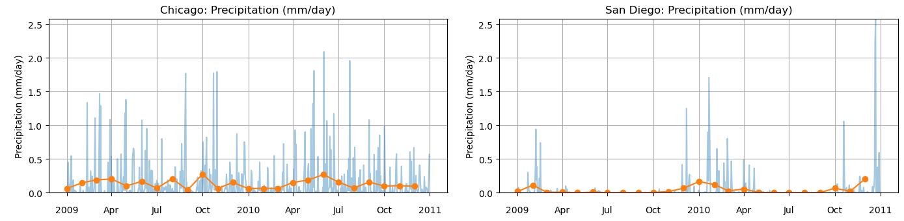
Appendix 24: Precipitation comparison
Blue: daily values. Orange: monthly means. Both cities cover 2009–2010.
The original precipitation scaling remains unvalidated as daily rainfall totals.
presentation/assets/comparison_detail_precipitation_labeled.png
34
Notes:
Blue: daily values. Orange: monthly means. Both cities cover 2009–2010.
The original precipitation scaling remains unvalidated as daily rainfall totals.
Source: presentation/assets/comparison_detail_precipitation_labeled.png

Slide 35
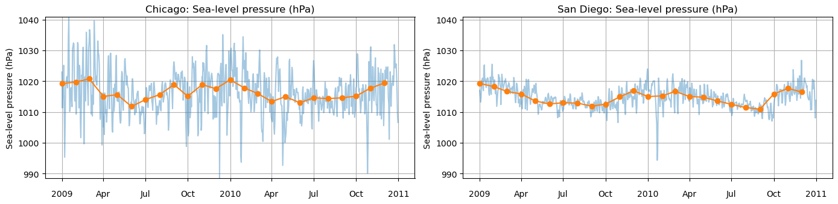
Appendix 25: Pressure comparison
Blue: daily values. Orange: monthly means. Both cities cover 2009–2010.
The original pressure values are shown in hectopascals.
presentation/assets/comparison_detail_pressure_labeled.png
35
Notes:
Blue: daily values. Orange: monthly means. Both cities cover 2009–2010.
The original pressure values are shown in hectopascals.
Source: presentation/assets/comparison_detail_pressure_labeled.png

Slide 36
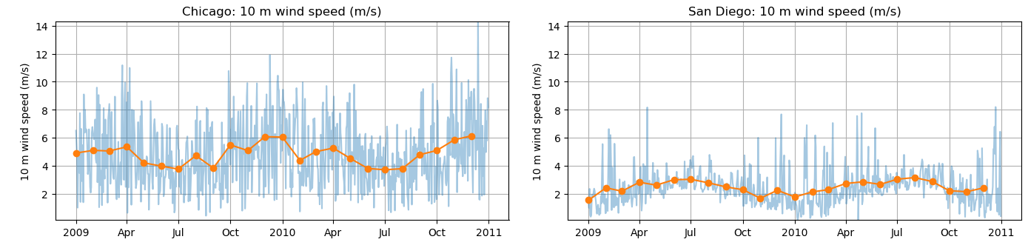
Appendix 26: Wind comparison
Blue: daily values. Orange: monthly means. Both cities cover 2009–2010.
Wind magnitude uses daily mean components, rather than mean hourly speed or gusts.
presentation/assets/comparison_detail_wind.png
36
Notes:
Blue: daily values. Orange: monthly means. Both cities cover 2009–2010.
Wind magnitude uses daily mean components, rather than mean hourly speed or gusts.
Source: presentation/assets/comparison_detail_wind.png

