Slide 1
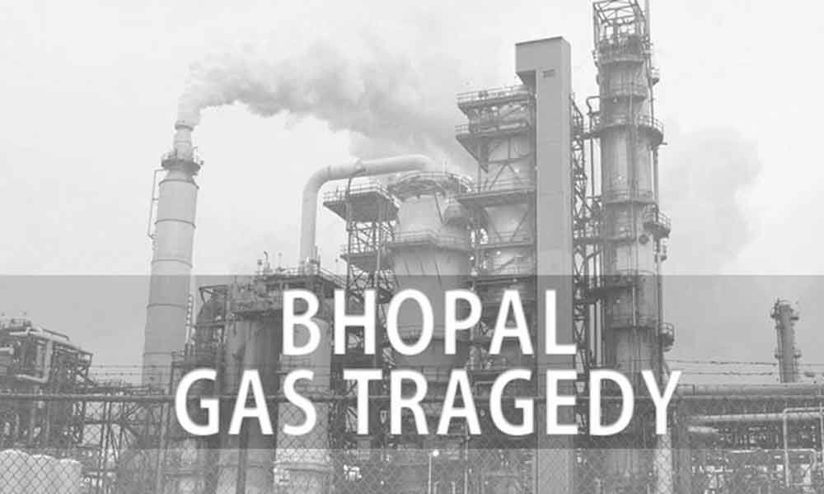

Slide 2
Outlines:
Brief overview
The accident
The legacy
Compensation and legal aspects
The impact
The reaction
Conclusion

Slide 3

Brief Overview:
On December 3, 1984, a catastrophic gas leak occurred at the Union Carbide pesticide plant in Bhopal, India, resulting in thousands of deaths and long-lasting health effects for the local population.

Slide 4
The Incident:
Details of the incident: A storage tank containing 40 tons of methyl isocyanate (MIC) gas leaked, releasing toxic gas into the surrounding area.
Consequences: Over 5,000 people died within the first three days, and over 500,000 were exposed to the gas. Many of these people suffered from severe respiratory problems, blindness, and neurological damage.

Slide 5
The legacy:
Ongoing struggles: Many of the victims of the Bhopal gas tragedy continue to struggle with the health effects and financial consequences of the disaster.
Remembrance: The Bhopal gas tragedy is remembered as a tragic reminder of the dangers of irresponsible corporate practices and the importance of prioritizing safety and responsibility.

Slide 6
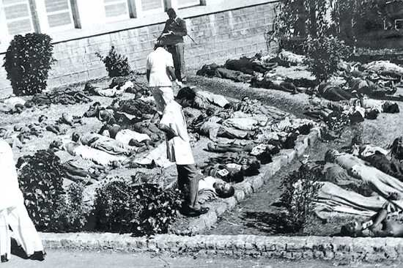
Compensation and legal aspects
Compensation of $470 million ($500 per dead).
Twenty years of passiveness.
Case was reviewed and put up in American Court.
DOW Refused Union Carbide’s Liabilities in Bhopal, India.

Slide 7
The Impact:
Human toll: The Bhopal gas tragedy had a devastating impact on the lives of the local population, and many people continue to suffer from the health effects of the gas leak to this day.
Environmental impact: The disaster also had a significant environmental impact, contaminating the soil and water in the area.

Slide 8
The Reaction:
Global response: The Bhopal gas tragedy shocked the world and led to widespread outrage and calls for accountability.
Changes in regulations: The disaster also led to significant changes in regulations and emergency response planning in the chemical industry, focusing on preventing similar disasters.

Slide 9
Conclusion:
The Bhopal gas tragedy is a disaster that shocked the world and had far-reaching consequences for the local population and the entire world. It is a tragedy that should never be forgotten and serves as a reminder of the importance of safety measures and corporate responsibility.

