Slide 1
SOLUTION ENGINEERING / DEVOPS TAKE-HOME
ConvoScore
Turning raw support conversations into a scored, reviewable, on-call-ready pipeline.
Amir Weiser · Architecture, ingestion, scoring, deployment, and operations
Notes:
One line: this is a small service that scores support conversations with an LLM and makes the results reviewable and observable - built to show how I'd design, deploy, and operate a real system, not just make a demo run once.

Slide 2
OVERVIEW
What ConvoScore does, and why it's shaped this way
What it does
Why this architecture
▸ Ingests support conversations two ways — an API call, or a file dropped into storage
▸ Scores each one with an LLM — sentiment, a 0–1 risk score, a short rationale
▸ Stores results durably and makes them reviewable by a person — no separate frontend
▸ Decouples ingestion from scoring — a slow or failed OpenAI call never blocks the caller
▸ One shared pipeline behind both entry points — one code path to trust and test
▸ Designed around two honest constraints — SQS is at-least-once, and an LLM call can't be made atomic with a DB commit
ConvoScore · Overview
02 / 10
Notes:
This slide exists so the reviewer sees I read the brief as a set of constraints, not just a feature list. Additional scope notes if asked: kept deliberately right-sized — no CI, no service mesh, no ORM, no new database. The two constraints on the right (SQS at-least-once, LLM-call/DB-commit non-atomicity) shape almost every design choice in the rest of the deck.

Slide 3
ARCHITECTURE
One pipeline, two doors in
pending row (sync write)
API
POST /conversations
S3 event
poll
store result
S3
incoming/{id}.json
SQS
processing queue
Worker
PostgreSQL
Direct upload
(no API call)
score
after 3 attempts
SQS DLQ
OpenAI
Review UI
pipeline flow
pending-row write (sync)
exhausted after retries
▸ The API never calls OpenAI — it writes a pending row to Postgres, puts the object in S3, and returns 202
▸ A direct upload skips the API entirely — the same S3 → SQS → worker path picks it up
▸ One validation contract, one scoring path, one place the DLQ can be reached from
ConvoScore · Architecture
03 / 10
Notes:
The point of this diagram is 'one pipeline, two doors in.' Whether a conversation arrives via the API or lands in S3 directly, it converges on the exact same S3 -> SQS -> worker code path - there's no special-casing based on how it arrived. The amber line is the one part that's NOT on that shared path: the API writes the 'pending' row straight to Postgres, synchronously, before it ever touches S3, so the id exists immediately and the caller gets a stable status URL right away.

Slide 4
INGESTION
How conversations get in: two paths, one pipeline
Path 1 — API
Path 2 — Direct S3 upload
1
POST /conversations with the conversation text
1
A file lands in S3 under incoming/ — no API call at all
2
Validated once; a “pending” row is written to Postgres immediately
2
An S3 event notification delivers straight to SQS
3
Conversation is written to S3; API returns 202 without waiting for scoring
3
The worker creates the row itself, keyed by the S3 object key
Both converge on the same S3 → SQS → worker pipeline — one validation contract, one scoring code path
ConvoScore · Ingestion paths
04 / 10
Notes:
API path detail: the request body is validated through the same Pydantic model the worker also uses (rejects missing/empty/whitespace-only/non-string/over-20,000 character text). If the S3 write's outcome is genuinely unknown (e.g. a timeout), the row stays visible and pending rather than being silently deleted - deleting on an ambiguous failure could erase a conversation S3 actually accepted.
Direct-upload detail: source_key (the S3 key) is the idempotency anchor, since a direct upload never gets an id from the API. A UNIQUE constraint on source_key means the same key uploaded twice finds the existing row instead of duplicating it.

Slide 5
SCORING
How scoring is triggered — and what happens when it fails
retry (visibility timeout)
poll
commit result
SQS
processing queue
Worker
PostgreSQL
score
after 3 attempts
SQS DLQ
OpenAI
▸ The worker polls SQS continuously — a message stays invisible while it's being worked, and reappears automatically if not finished in time
▸ A transient failure is retried automatically; after 3 attempts SQS moves the message to the DLQ on its own
▸ Duplicate deliveries and out-of-order retries are both handled — the same object never scores into two rows, and a stale attempt can't overwrite a newer result
ConvoScore · Scoring trigger
05 / 10
Notes:
Trigger is SQS visibility, full stop - the worker is a simple poll loop, nothing depends on the API being up. Idempotency: source_key is UNIQUE. Claim fencing (the load-bearing safety net): every claim gets a fresh processing_token, so a superseded/slower attempt is rejected at the database level rather than silently overwriting a newer, correct result - without it, 'whoever writes last wins' could clobber a good row with a stale one. Honest remaining gap: a crash between 'OpenAI answered' and 'the guarded commit landed' can still cause one extra paid OpenAI call - SQS is at-least-once and an LLM call can't be made atomic with a DB commit.

Slide 6
SCORING SAFELY
OpenAI: structured output, bounded retries, isolated secret
▸ The model returns a validated structured result — sentiment, a 0–1 risk score, a one-sentence rationale — not text parsed out of free-form output
▸ Requests are bounded by a timeout and a small number of automatic retries, so one slow or failing call can't stall the worker indefinitely
▸ A refusal is treated as a scoring failure like any other, and its explanation text is never stored or logged — it can echo back part of the flagged input
▸ The OpenAI API key is only ever injected into the worker — the API service never receives it, because the API never calls OpenAI
ConvoScore · OpenAI integration
06 / 10
Notes:
Every result also captures model name, prompt version, input/output token counts, and an estimated cost in USD from a hardcoded per-model price table (an estimate, not a billing feed). Retries use one mechanism (tenacity with exponential backoff) - the SDK's own built-in retries are explicitly disabled so there's exactly one retry policy to reason about, not two stacked on each other. The API-can't-leak-the-key point is a fact about the deployment, not just a policy: the key is never injected into that pod's environment at all.

Slide 7
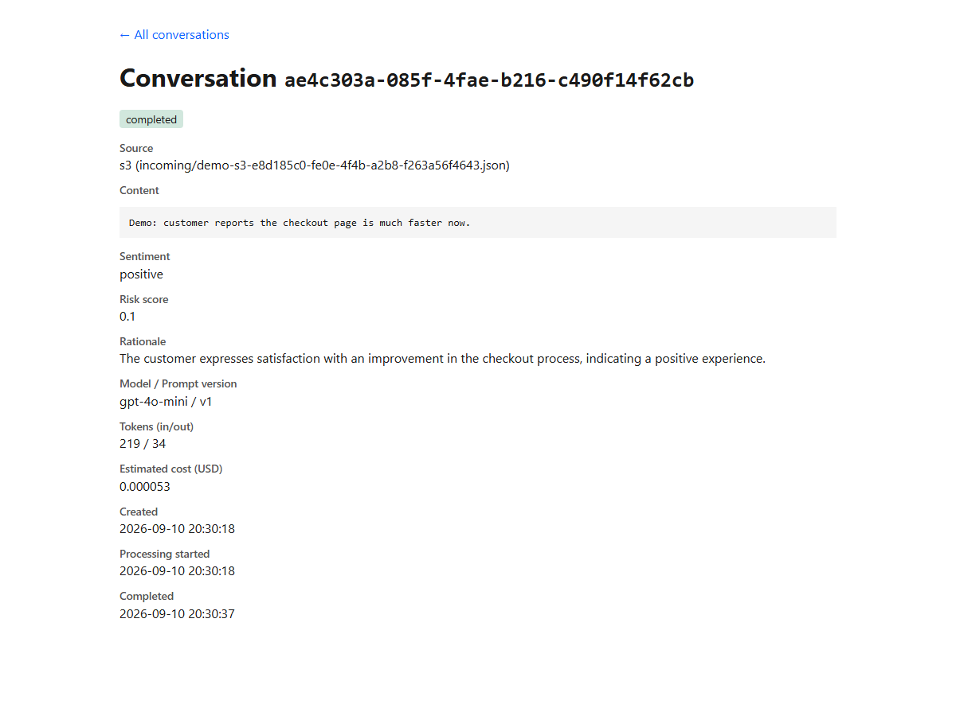
STORAGE & REVIEW
PostgreSQL durability, and a human in the loop
▸ One table, one clear state machine — pending → processing → completed, or failed
▸ Postgres runs as a StatefulSet with a PersistentVolumeClaim — restart the pods and the data, including timestamps, survives unchanged
▸ Review is two server-rendered pages — a list and a detail view — no separate frontend to build or ship
ConvoScore · Storage and review
07 / 10
Notes:
The screenshot is a real conversation from the deployed system, not a mock. Durability is demonstrated, not just claimed: the restart demo captures a completed row's full result before deleting the API, worker, and Postgres pods, then proves the row is byte-for-byte identical afterward, including completed_at - a re-scored duplicate would also say 'completed' but with a different timestamp, so that field is the real proof, not just the status.

Slide 8
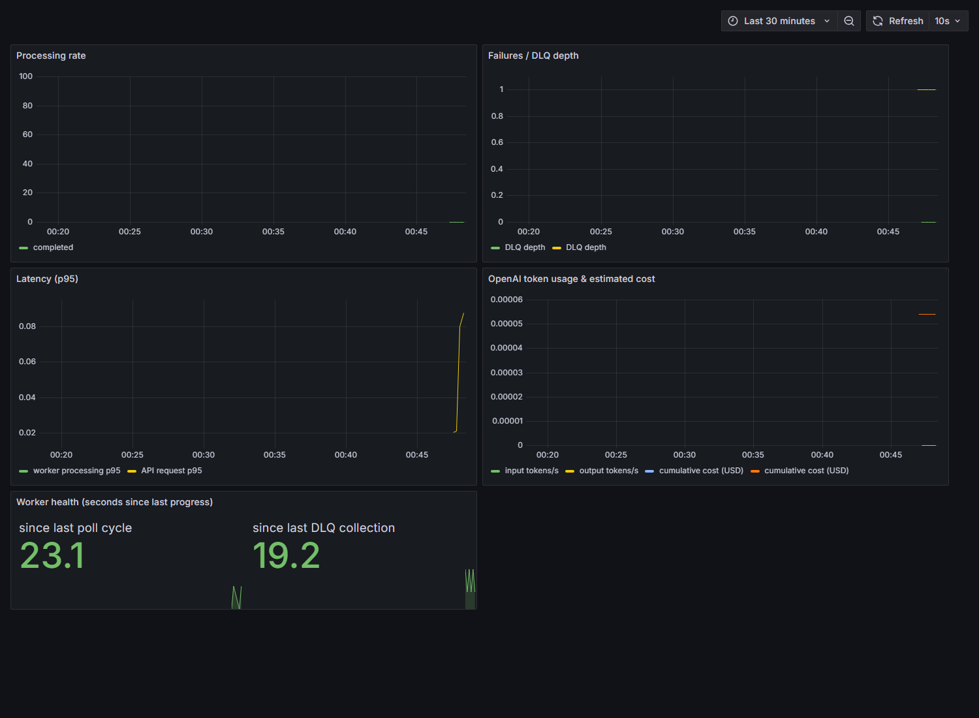
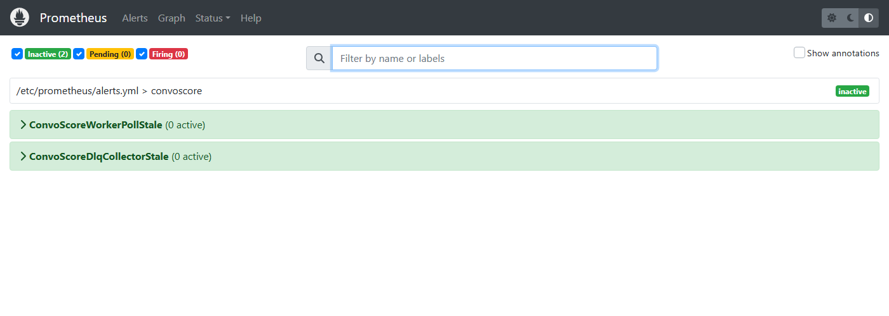
OBSERVABILITY
Logs, metrics, a dashboard — and a failure induced on purpose
▸ Structured JSON logs and Prometheus metrics cover latency, processing outcomes, DLQ depth, and OpenAI tokens/cost
▸ A deterministic trigger fails one conversation on purpose — it retries 3 times and lands in the DLQ, while a healthy conversation submitted alongside it completes normally the whole time
▸ The dashboard and alerts show it live — DLQ depth rises during the failure, and the alert clears once the message is drained
ConvoScore · Observability
08 / 10
Notes:
On-call would watch: DLQ depth rising, two 'last progress' staleness gauges on the worker loop and DLQ collector (a bare TCP liveness check only proves the process is alive, not that it's doing anything - these catch a wedged loop that liveness alone would miss), the API's 5xx rate, and the cost counter's rate of change as a runaway-spend signal. Both screenshots are from the live deployed system. Worth mentioning if asked: found and fixed a real bug preparing these - the health gauges are defined in a module shared by both API and worker processes, so without a job-label filter the API's own always-zero copy made both alerts fire permanently. Exactly the kind of false positive that trains on-call to ignore alerts.

Slide 9
INFRASTRUCTURE
Terraform, one image, Helm, and secrets kept out of the chart
▸ Terraform provisions the S3 bucket, the processing queue, its DLQ, and the event notification wiring them together
▸ One Docker image, two runtime commands — the API and worker run the same image; Helm just overrides the container command
▸ Deployed via Helm: non-root, read-only filesystem, health probes tuned to real startup behavior
▸ Secrets are created out-of-band and referenced by name — never templated into the chart or committed to Git; IAM policies follow least privilege per component
ConvoScore · Infrastructure
09 / 10
Notes:
Docker: multi-stage build - a builder stage installs dependencies into a venv, the runtime stage copies only that venv plus app/, no git metadata/tests/Terraform state. Deploy safety: deploy.sh tags images with the current git SHA and refuses to build at all if any tracked source/Docker/Helm/Terraform file has uncommitted changes, so one tag can never silently point at two different images. Least privilege specifics: the API can only PutObject under incoming/*; the worker can GetObject there and Receive/Delete/GetAttributes only on the processing queue plus GetUrl/GetAttributes on the DLQ - never a wildcard resource. Honest caveat: LocalStack Community doesn't enforce IAM at the API-call level, so these policies show the intended real-AWS shape, not a currently-enforced restriction.

Slide 10
HONEST TRADEOFFS
What this skips, and what changes in production
Tradeoffs & exclusions
What changes in production
▸ No exactly-once claim anywhere — SQS is at-least-once by design
▸ A crash between an OpenAI response and the DB commit can still cause one extra paid call — bounded and rare, not eliminated
▸ LocalStack doesn't enforce the IAM policies Terraform defines — they show the intended shape for real AWS
▸ Scoped down on purpose — no CI, no service mesh, no ORM, no new database
▸ RDS for PostgreSQL and managed SQS/S3, instead of a self-hosted Postgres pod and LocalStack
▸ Workload identity (e.g. IRSA) and an external secret manager, instead of static credentials and manual Kubernetes Secrets
▸ High availability, autoscaling on queue depth, persistent metrics storage, real alert routing
▸ Narrowing — not fully closing — the OpenAI-response-to-commit duplicate window, e.g. with an idempotency key on the LLM call
ConvoScore · Tradeoffs and roadmap
10 / 10
Notes:
This slide is deliberately unflattering on the left and forward-looking on the right. Every item on the left is something I found or decided, not something a reviewer would have to find themselves. On the right: frame it as 'what I'd do next with more time and a real budget,' not 'what's missing from this submission' - the take-home was deliberately scoped smaller than this list on purpose. Note the duplicate-call window is narrowed by an idempotency key, not solved outright - a transactional outbox pattern doesn't apply here since the non-atomic boundary is an external OpenAI call, not two local writes. Other production gaps worth naming if asked: Prometheus/Grafana storage is emptyDir today (no history across restarts), Grafana uses anonymous viewer access, and cost figures are estimates from a hardcoded pricing table - all explicit, documented tradeoffs for a local take-home, not oversights.

