Slide 1
STOCK
PREDICTION
An introduction to using data to make money!

Slide 2
AGENDA
Install Python 3.5
Install PyCharm
Install Libraries
Set Up PyCharm
Code!

Slide 3

INSTALLING PYTHON 3.5
https://www.python.org/downloads/release/python-354/
Find appropriate installation file for your computer
Linux users can find installation instructions online

Slide 4

INSTALLING PYCHARM
https://www.jetbrains.com/pycharm/
Make sure you download the correct version for your computer!
.exe for Windows
.dmg for Mac
.tar.gz for Linux
Create account with your student email to get Professional for free

Slide 5
INSTALLING LIBRARIES
Open your Terminal/Command Prompt
Enter these commands one by one
$ pip3 install numpy
$ pip3 install scipy
$ pip3 install tensorflow
$ pip3 install keras
$ pip3 install requests
If that doesn’t work…
$ sudo pip3 install numpy
$ sudo pip3 install scipy
$ sudo pip3 install tensorflow
$ sudo pip3 install keras
$ sudo pip3 install requests

Slide 6
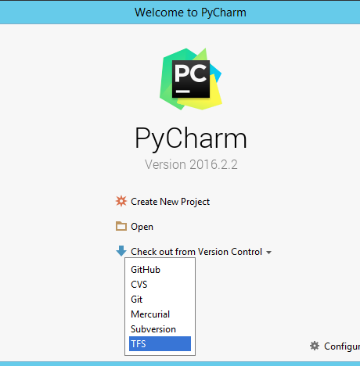
SET UP PYCHARM
Open PyCharm
Create New Project
Location: Any directory, name our project “StockPredict”
Interpreter: Locate and select Python 3.5
Hit Create button

Slide 7
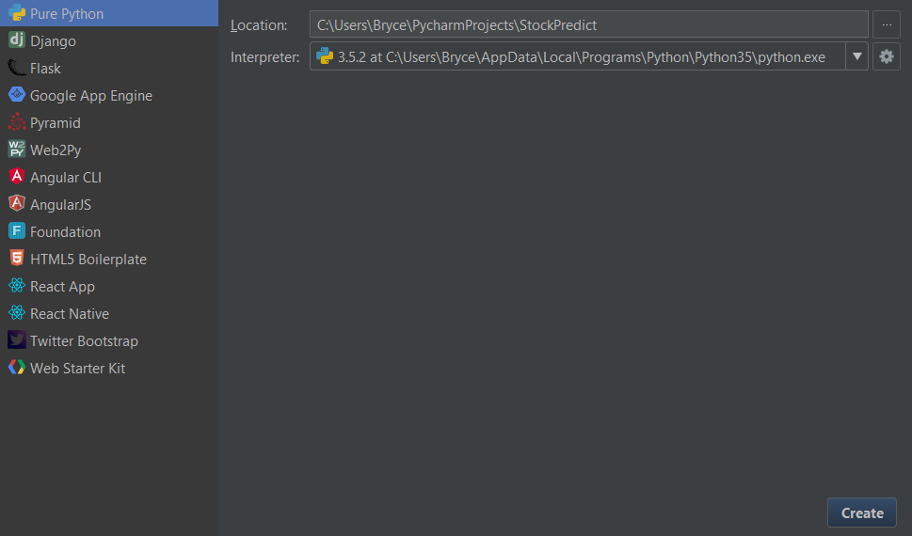

Slide 8
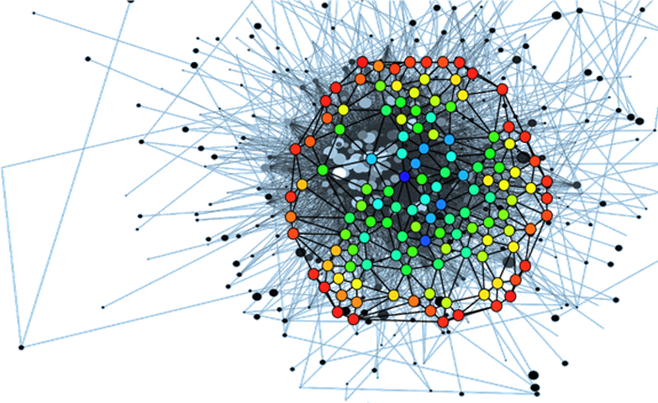
INTRO TO MACHINE LEARNING
Data guided
Trained on inputs and outputs
Predicts outputs given inputs
More data = more precise
Garbage in = Garbage out

Slide 9
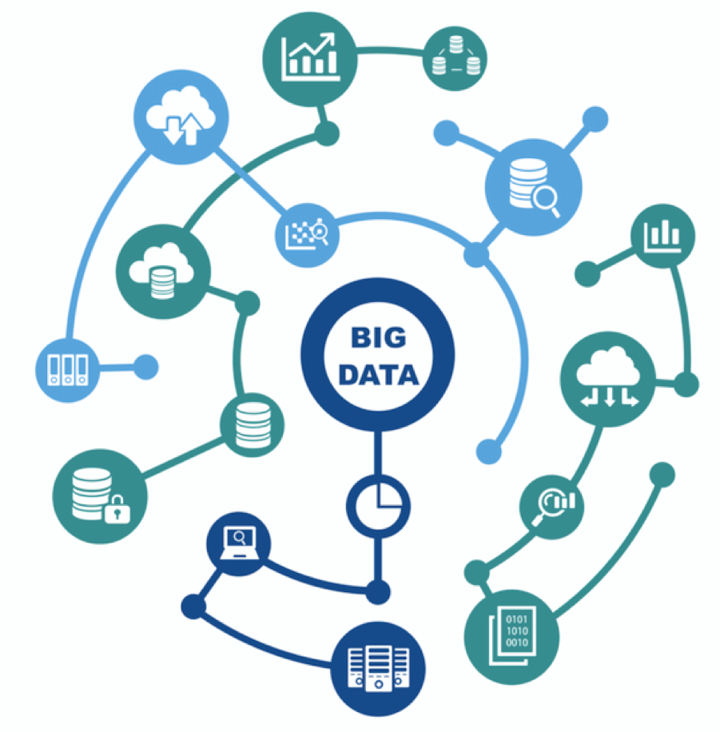
DATA CLEANSING
Good data is…
Is very big
Well-balanced between classifications
Has no corrupt records
Is separable

Slide 10
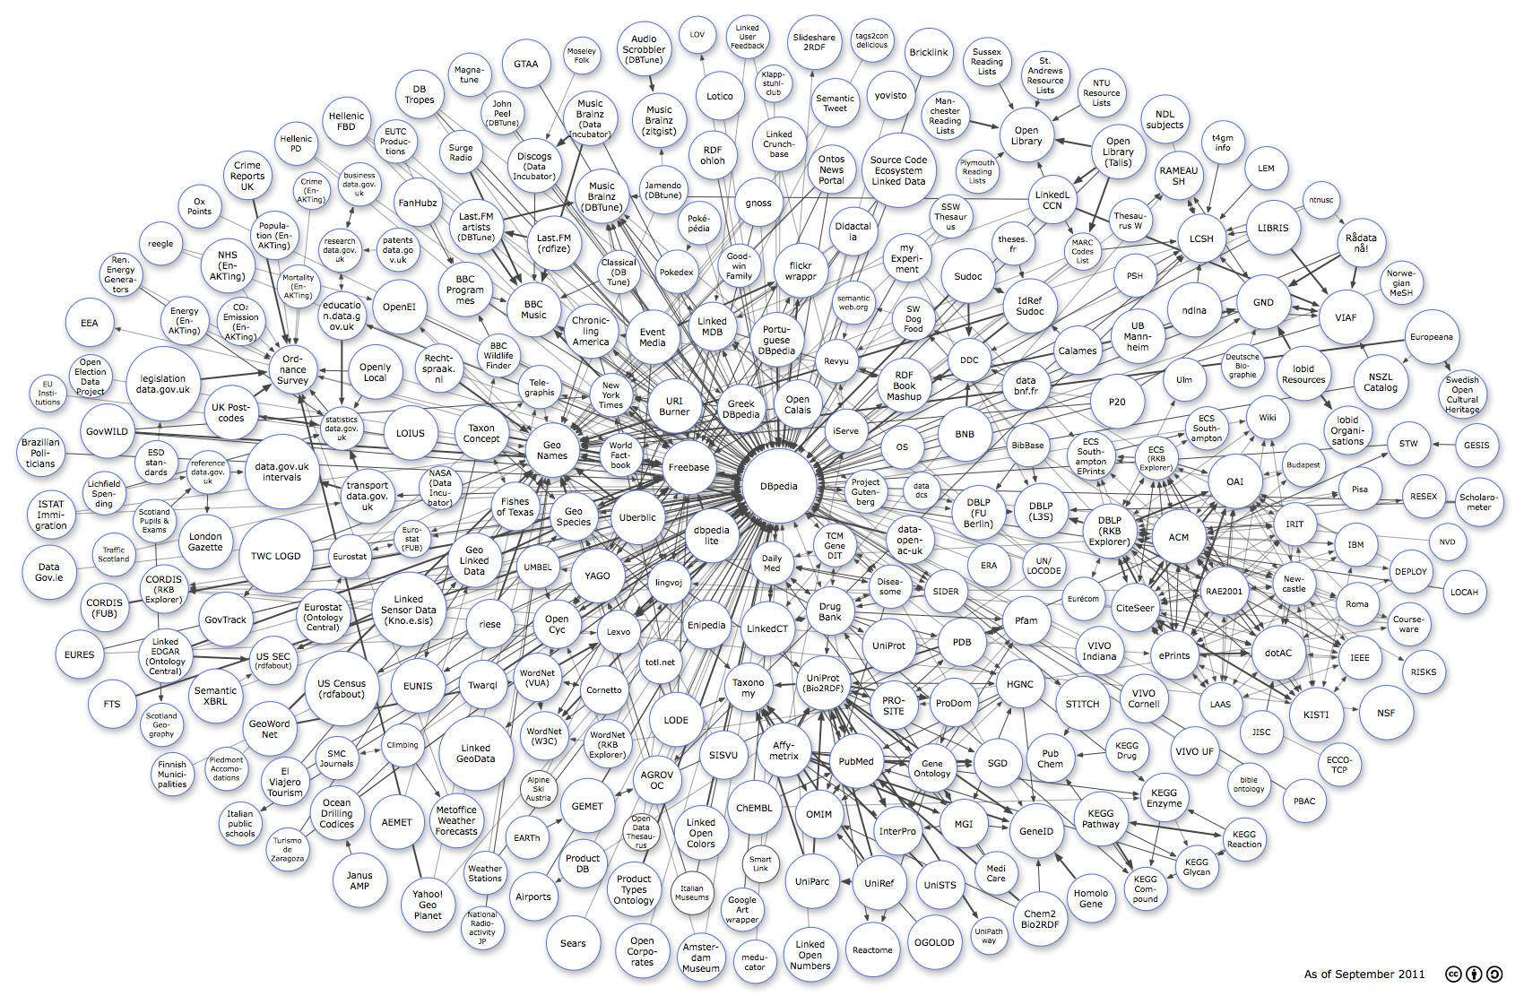
INPUTS
Inputs are called features
More features can increase or decrease accuracy
Large inputs should be normalized

Slide 11
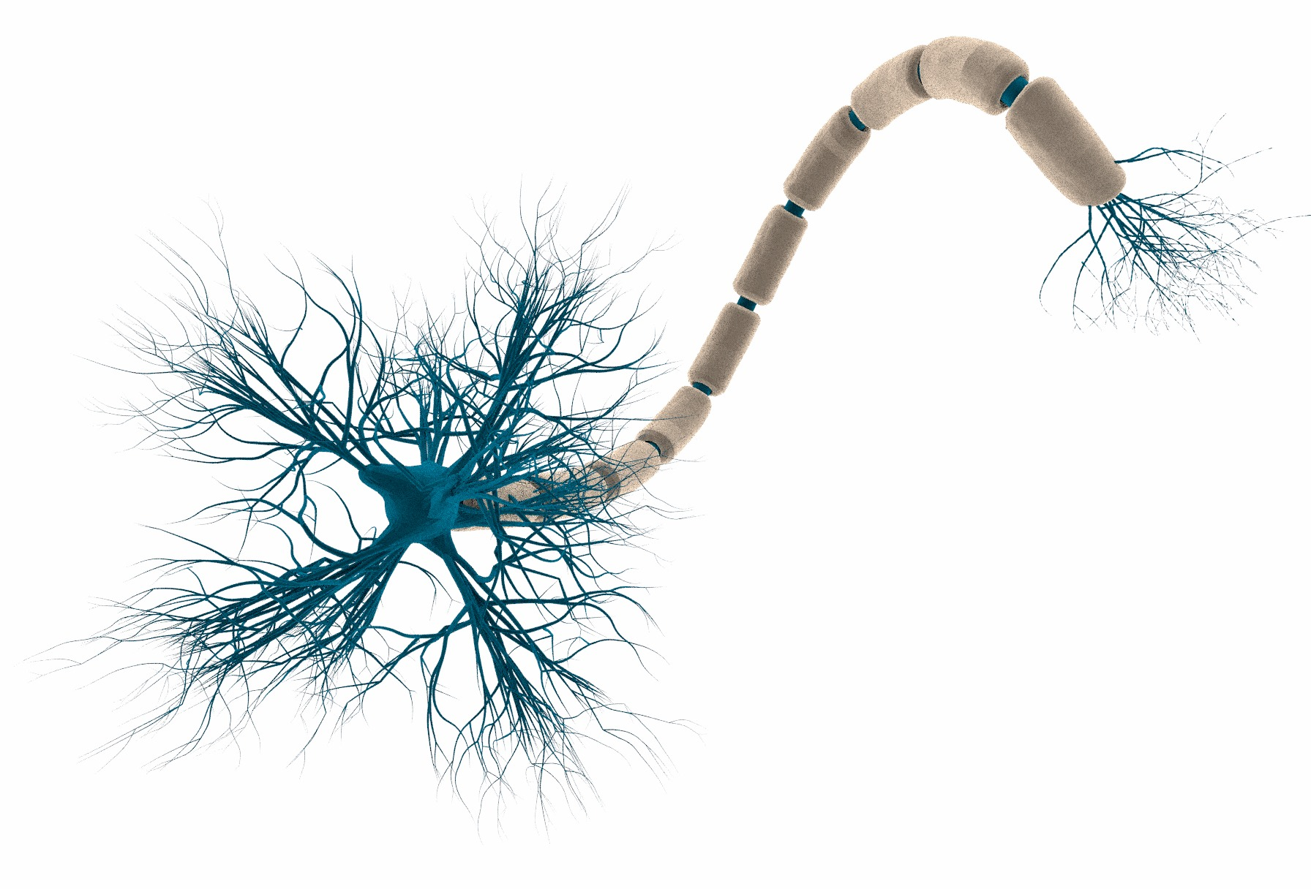
NEURAL NETWORK
Layers of hidden units
Inputs from previous layers multiplied by a “weight”, summed with a “bias”, then “activated” by a function
Weights and biases adjusted automatically throughout training
Works similarly to a brain

Slide 12
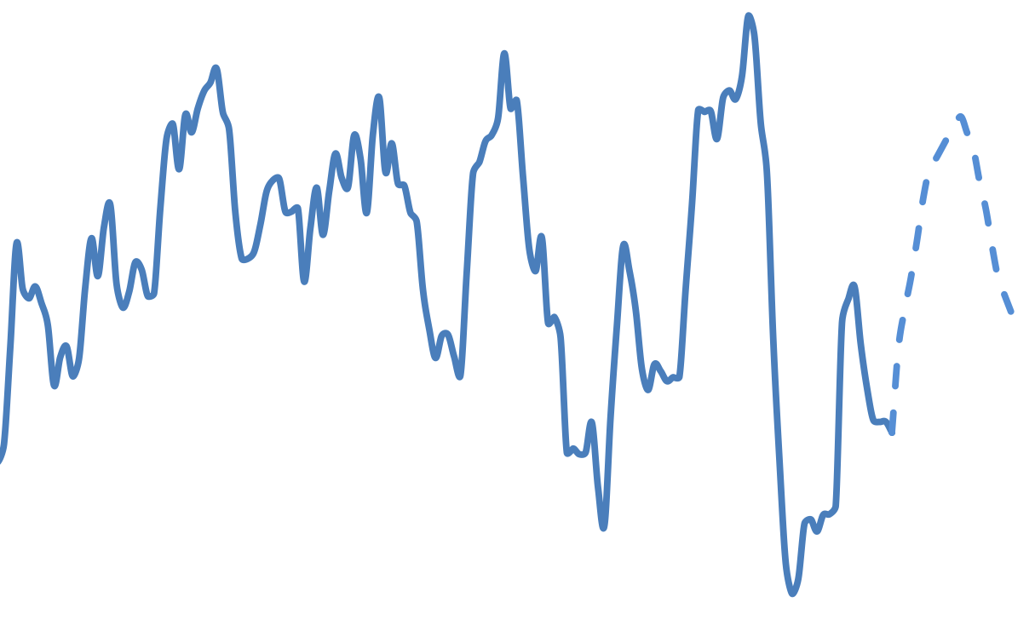
OUTPUTS
For classification, as many units as possible classes
For stock prediction, a single unit

Slide 13
TIME TO CODE

Slide 14
REFLECTIONS
Not enough data
Unsophisticated features
High loss
Inaccurate long term predictions
Neglected to use Recurrent Neural Network (RNN)
Didn’t consider outside variables
Very little training

