Slide 1


Jordan university of science and technology
Computer Science Department , CS498
Marwan Shalakhti
Amir Zureikat
Alaa Amjad

Slide 2
The title of our project will about
Titanic: Machine Learning from Disaster

Slide 3
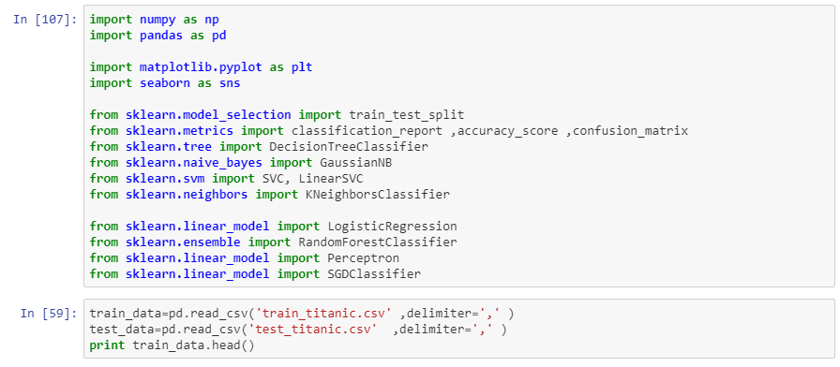
Reading the data :

Slide 4
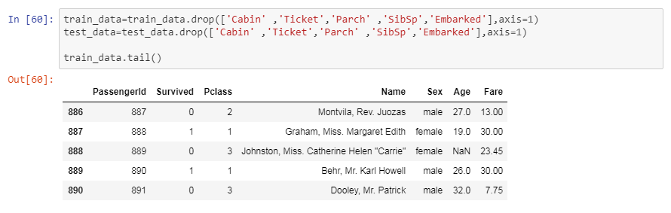
cleaning the data :

Slide 5
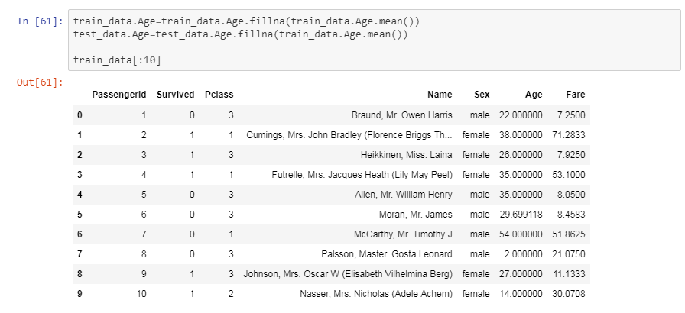
cleaning the data :

Slide 6
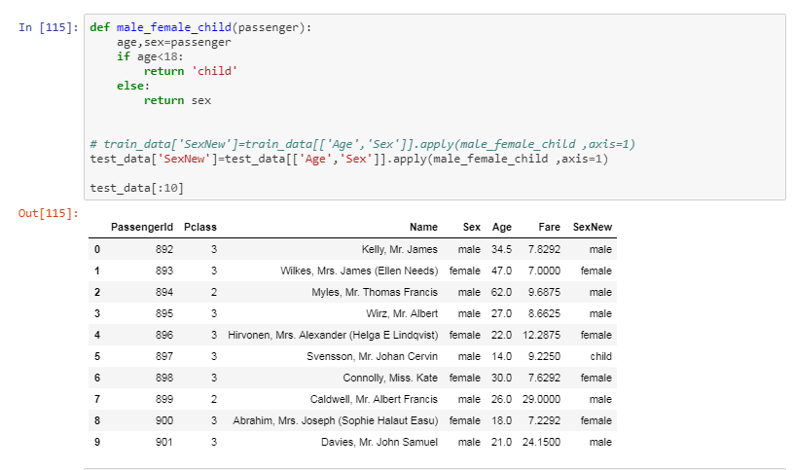
Visualizing the data

Slide 7
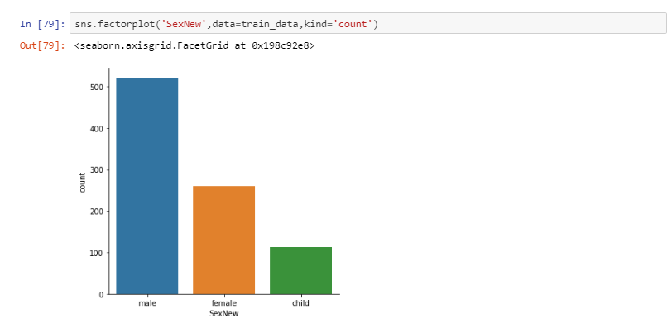
Visualizing the data

Slide 8
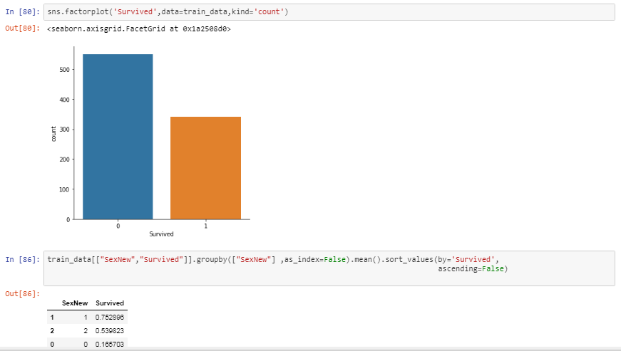
Visualizing the data

Slide 9
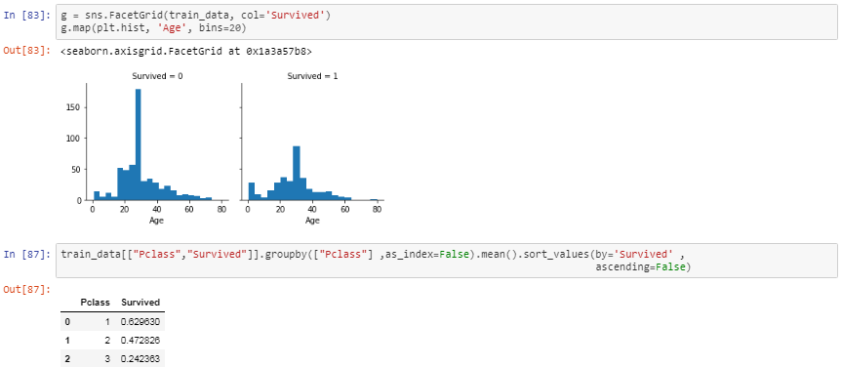
Visualizing the data

Slide 10
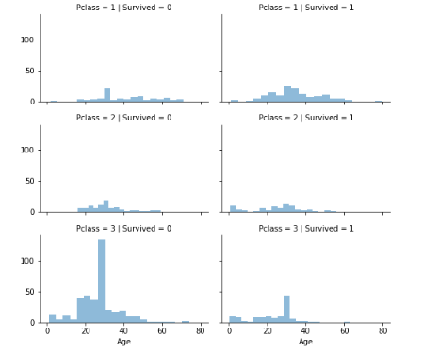
Visualizing the data

Slide 11
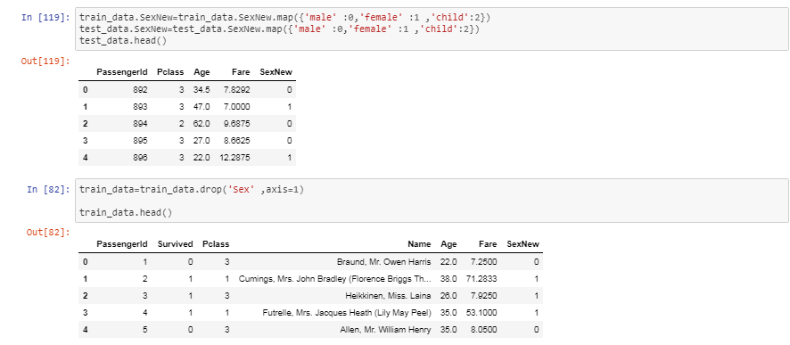

Slide 12
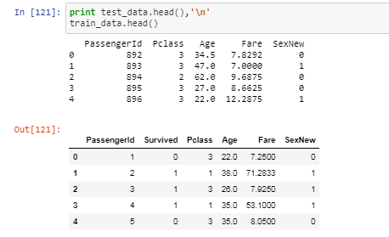

Slide 13
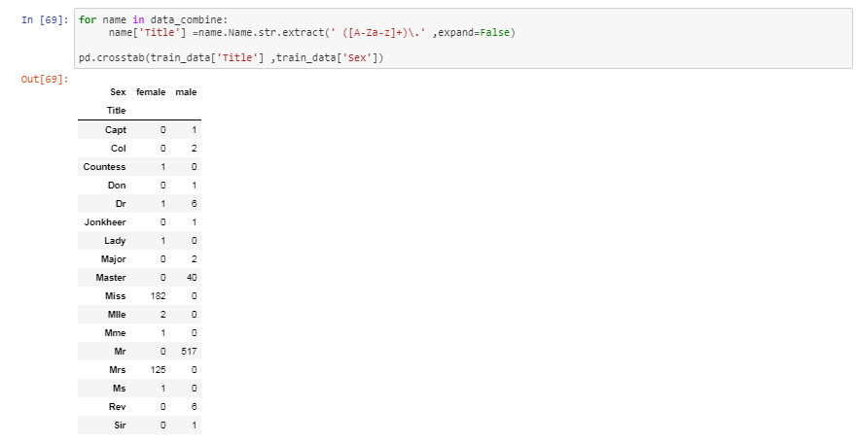

Slide 14
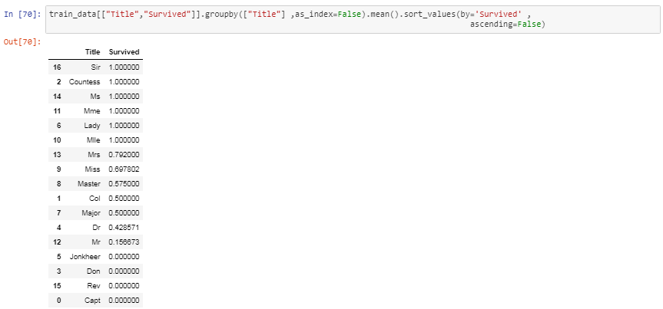

Slide 15
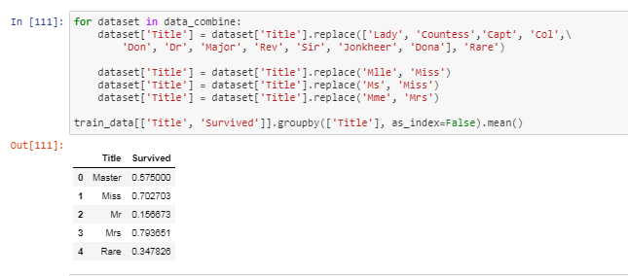

Slide 16
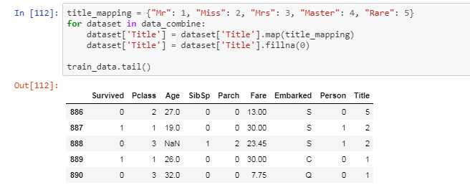

Slide 17
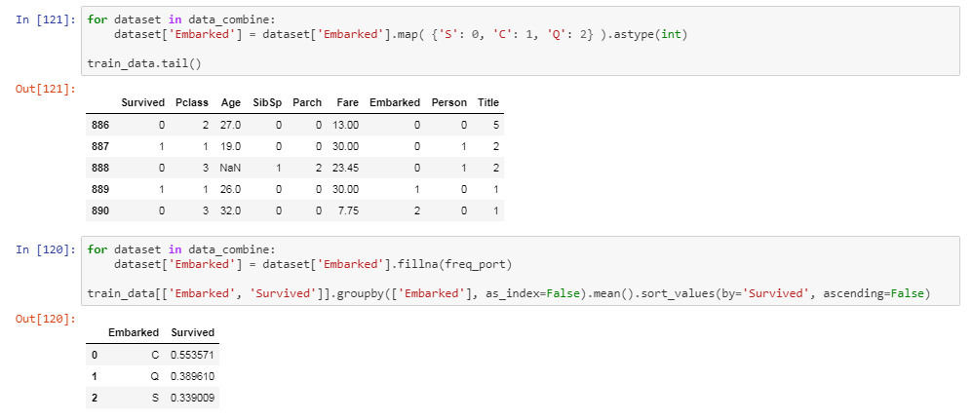

Slide 18
the models I have use it
score | model
98.2 | Random Forest
97.98 | Decision Tree
91.81 | Support Vector Machines
84.74 | KNN
80.58 | Logistic Regression
77.78 | Naive Bayes

