Slide 1

Intro to Web App Development CS 4640 Programming Languages for Web Applications

Slide 2
Web and Internet
Web
HTML, CSS, Browser
Specifies the shared communication protocols → over network: DNS, FTP, HTTP, POP, SSH, Telnet, …
Provides host-to-host communication services: TCP, …
Transports packets from host across network boundaries: IP, ICMP, …
Operates on the link that a host is physically connected to: MAC (Ethernet, DSL, …)
Internet
Application layer
Transport layer
Internet layer
Link layer
Computer network
A set of standards or infrastructures for distributing information to the world

Slide 3
Hypertext and the WWW
1945: Vannevar Bush proposes hypertext
1965: Ted Nelson coins the term “Hypertext” – beyond the linear constraints of text
1969: ARPANET comes online
1980: Tim Berners-Lee writes ENQUIRE, a notebook program allowing links to be made between nodes with titles
1989: Tim Berners-Lee’s Information Management proposal became WWW
1990: HTML defined
1992: CERN (Switzerland) releases WWW
1993: First browser: NCSA Mosaic
1994: First widely used commercial browser: Netscape
1997: More than 31,000,000 pages
2000: More than 100,000,000 hosts, more back-end programming than front-end hypertext
2004: 3,307,998,701 pages (Google)
May-2019: More than 1,943,000,000 websites (www.internetlivestats.com),
and large number of web app failures

Slide 4
Aspects to Consider
Software engineering aspect
How can we design for change and reuse?
Many developers may involve
What happens when a new develop joins the team?
How can a developer successfully maintain / change / refactor the code without understanding the whole system?
Usability aspect
How can we design web apps that are usable for their intended purpose?
A web app may serve millions of users with different needs
What happens when a new user interacts with the app?
How can we make a web app less frustrating to use?

Slide 5

URI: Uniform Resource Identifier
URI: <scheme>://<domain><path>?<query>
http://www.ce.iug.edu/~up3f/ce5640/syllabus.html
Use HTTP scheme
(Other popular schemes:
ftp, mailto, file)
Connect to ce.iug.edu
May be host name or an IP address
Optional port number (e.g., :8080 for port 8080)
e.g., http://localhost:8080/myproject/register.php
Request resource
Stored in up3f/ce5640 folder
(More information:
https://en.wikipedia.org/wiki/Uniform_Resource_Identifier)

Slide 6
URI, URL, and URN
URI: Uniform Resource Identifier
Specify resource either by location or by name, or both
URL: Uniform Resource Locator
Specify resource by location
URN: Uniform Resource Name
Specify resource by name
URI
URL
URN
http://www.domain.com:1234/path/to/resource?p1=v1&p2&v2
protocol
domain
(or host)
port
resource path
query

Slide 7
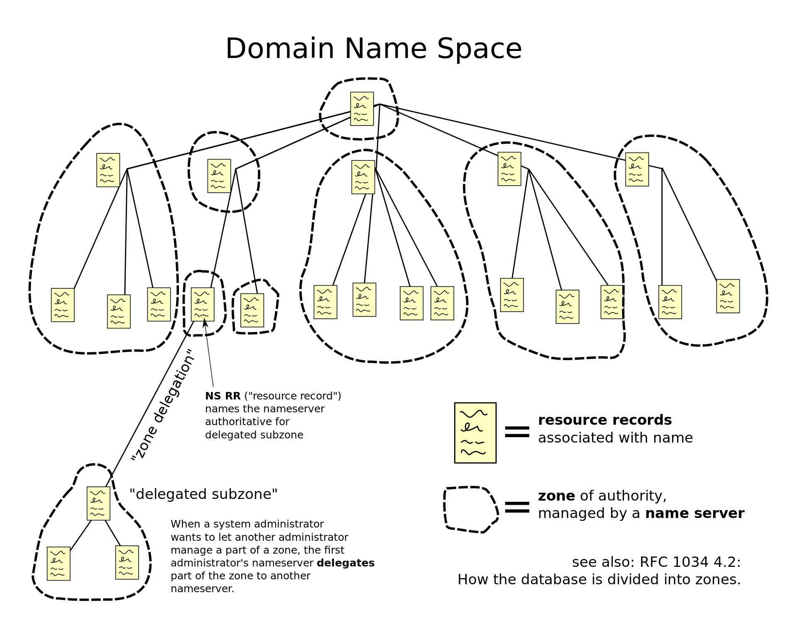
DNS: Domain Name System
Mapping from names to IP addresses
Hierarchical Domain Name System for class Internet, organized into zones, each served by a name server
[ref: https://en.wikipedia.org/wiki/Domain_Name_System]

Slide 8

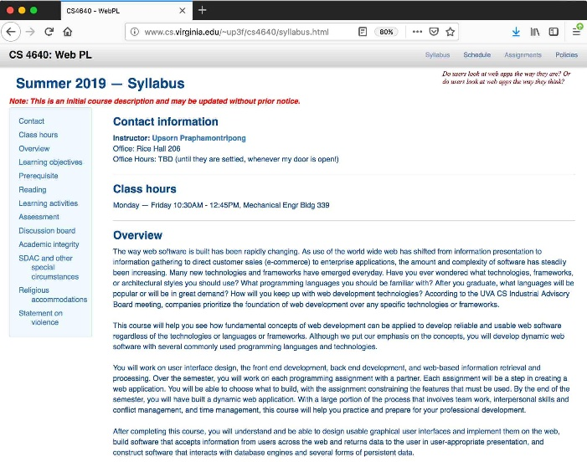


HTTP: HyperText Transfer Protocol
GET request
Other popular types:
POST, PUT, DELETE, HEAD
Resource
Protocol and
versions
http://www.ce.iug.edu/~up3f/ce5640/syllabus.htm
HTTP Request
GET /~up3f/ce5640/syllabus.html HTTP/1.1
Host: ce.iugaza.edu
Accept: text/html
...
Request line
Request header
Blank line then
request message body
OK response
HTML returned content
Response status codes:
1xx Informational
2xx Success
3xx Redirection
4xx Client error
5xx Server error
Common MIME types:
application/json
application/pdf
image/png
HTTP Response
HTTP/1.1 200 OK
Content-Type: text/html; charset=UTF-8
...
<html>
<head><title>ce 5640</title></head>
<body>...
Response line
Response header
Blank line then
response message body
Web server
HTML
document

Slide 9
Properties of HTTP
Request-response
Interactions always initiated by client request to server
Server responds with results
Stateless
Each request-response cycle independent from other
Any state information (login credentials, shopping carts, exam scores, ...) needs to be maintained somehow

Slide 10
Client-side vs. Server-side
http://www.ce.iug.edu/~up3f/ce5640/syllabus.htm
HTTP Request
GET /~up3f/ce5640/syllabus.html HTTP/1.1
Host: ce.iugaza.edu
Accept: text/html
...
HTTP Response
HTTP/1.1 200 OK
Content-Type: text/html; charset=UTF-8
...
<html>
<head><title>Ce 5640</title></head>
<body>...
Web server

Slide 11
General Web Terminology
Web page: Data that fits in one browser screen
Static: HTML exists as a file on a computer
Dynamic: Created as needed
Web site: A collection of connected web pages
Web application: A program that is deployed on the web
User interface (UI) is in HTML
User interacts through HTTP’s request / response cycle

Slide 12
Static Web Pages
URL corresponds to directory location on server
Server responds to HTTP request by returning requested files or documents
Advantages
Simple
Disadvantages
No interactivity

Slide 13
Dynamic Web Pages
Server responds to HTTP request by running a program that processes the request and produces the response
Different content is displayed each time the web page is viewed
Two types of dynamic web page
Client-side scripting
Server-side scripting

Slide 14
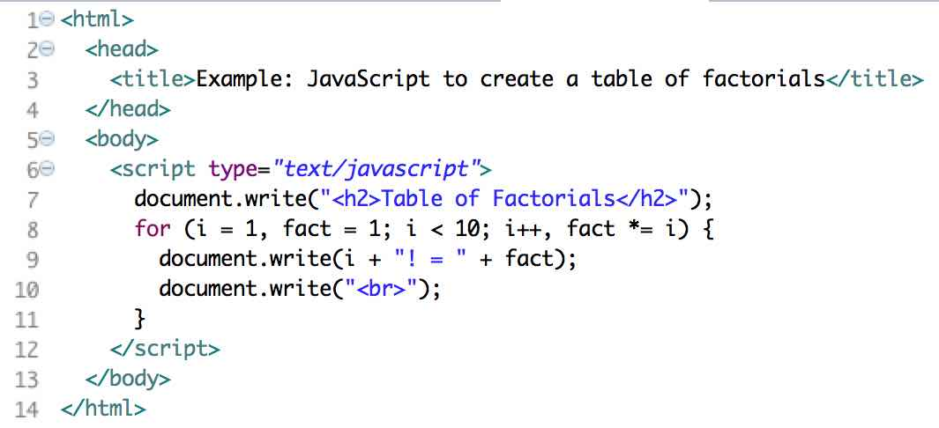
Client-Side Scripting
Generate HTML on the client through scripts
Example:
JavaScript
Advantages
Interactivity, input validation, customization, improving usability
Disadvantages
Browser compatibility

Slide 15
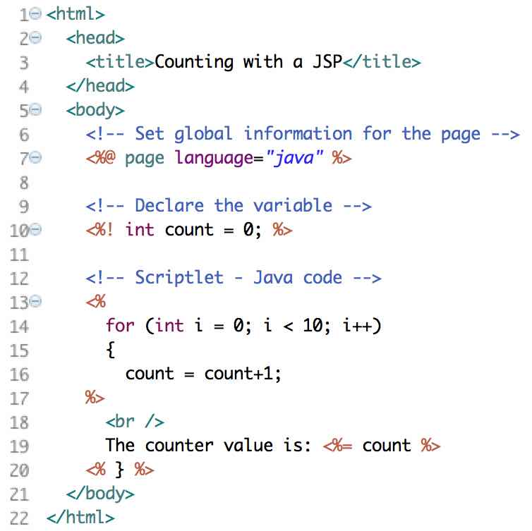
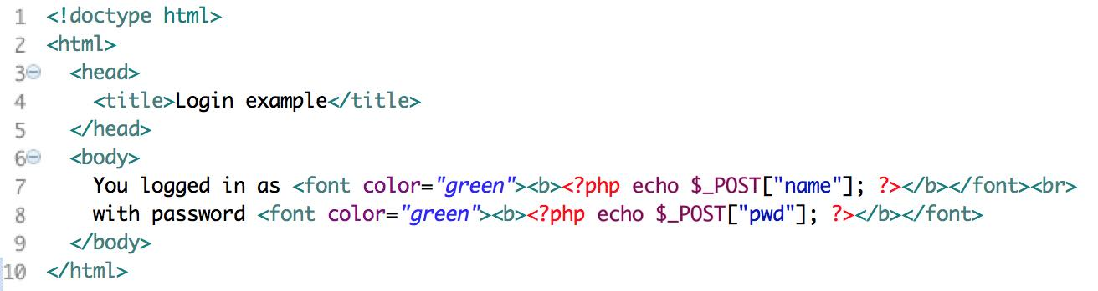
Server-Side Scripting
Generate HTML on the server through scripts
Early approaches emphasized embedding server code inside HTML pages
Examples: PHP, JSP
JSP
PHP

Slide 16
The Web Today
Increasingly reliance
Modern web applications are
Distributed (world-wide)
Heterogeneous (hardware and software)
Highly user interactive
Built on new technology
Evolve from one architecture style to another, combine multiple styles
Newer architectural styles are not always better – more complex and may be overkill for simple sites
The software is
Very loosely coupled
Written in multiple languages
Often generated dynamically

Slide 17
Important Quality Attributes
Reliability
Usability
Security
Customers have little “site loyalty” and will switch quickly, thus time to market is much less important than in other application areas.
(but still important!)
Availability
Scalability
Maintainability
Performance & Time to market
…

Slide 18
Summary
Web sites and web apps are now too complicated for individuals to manage
They need to be engineered by teams of people with diverse talents:
Programming skills
Graphics design
Usability
Information layout and engineering
Data communications
Database
We need web site engineering

