Slide 1
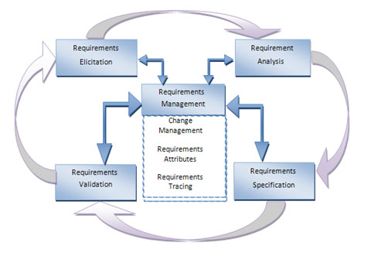

Slide 2
Requirements Analysis

Slide 3
Requirements Analysis and Definition
Requirements Analysis and Definition is the second stage in the systems engineering and software development process
This stage breaks down functional and non-functional requirements to a basic design view to provide a clear system development process framework. A thorough requirement analysis process involves various entities, including business, stakeholders and technology requirements.

Slide 4
Functional Requirements
Describe the processing (i.e.,functions to be supported) by the new system.
Describe the inputs into the system.
Describe the outputs of the system.
Finally, they describe the data that must be managed by the system
Non-Functional Requirements
Describe how well the system supports the functional requirements (hence the name non-functional, or quality requirements)
This description may include:
Performance criteria
Reliability requirements
Security considerations
Usability requirements

Slide 5
Software engineering task bridging the gap between system requirements engineering and software design.
Provides software designer with a model of:
system information
function
behavior
System
Engineering
Software
Requirements
Analysis
Software
Design

Slide 6
Analysis Objectives
Identify customer’s needs.
Evaluate system for feasibility.
Economic feasibility
cost/benefit analysis
Technical feasibility
hardware/software/people, etc.
Legal feasibility
Alternatives
there is always more than one way to do it
Perform economic and technical analysis.
Allocate functions to system elements.
Establish schedule and constraints.
Create system definitions.

