Slide 1
Egypt Train
Railway Reservation System

Slide 2
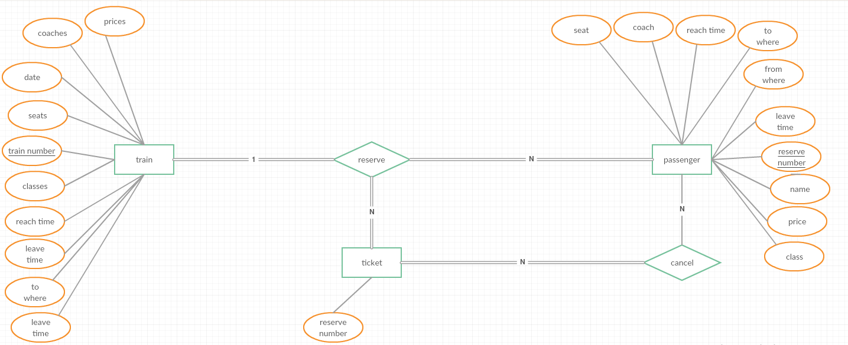
The ERD of railway reservation System

Slide 3
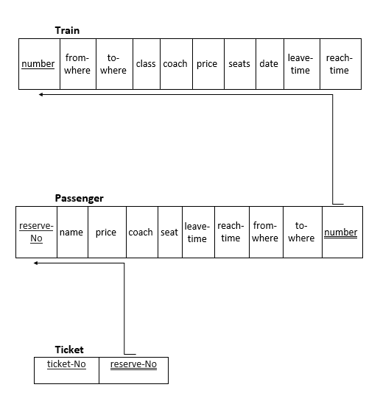
The Mapping of ERD Railway Reservation System

Slide 4
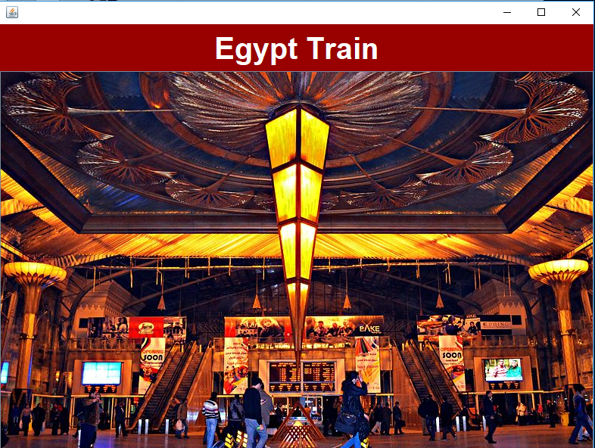
The Home Page
Where we can:
Go to search frame by clicking on the photo.

Slide 5
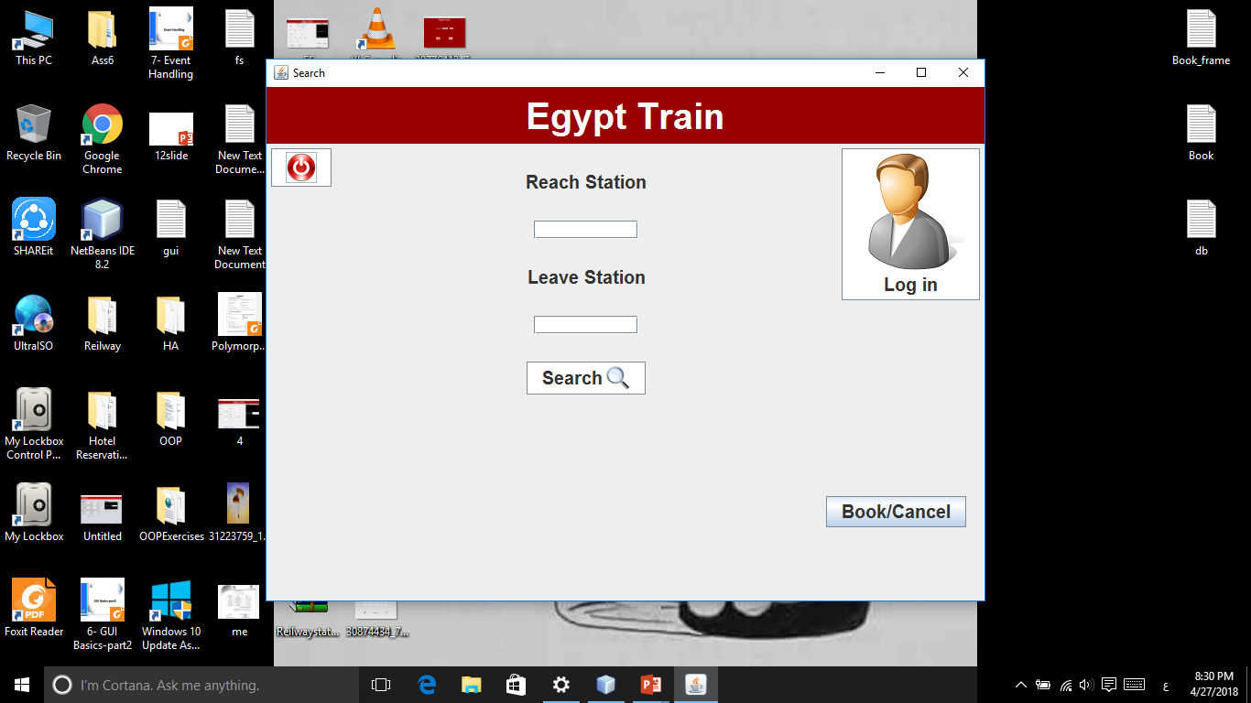
Here we can:
Enter reach and leave stations then go to result search frame.
Go to password frame.
Go to book/cancel frame.
Exit from the system.

Slide 6
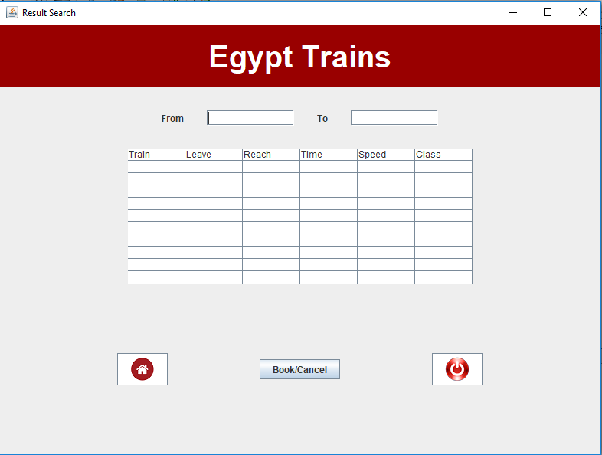
Here we can:
Know the data of available trains for reach and leave stations we entered before.
Go to book/cancel frame.
Go to search frame.
Exit from the system.

Slide 7
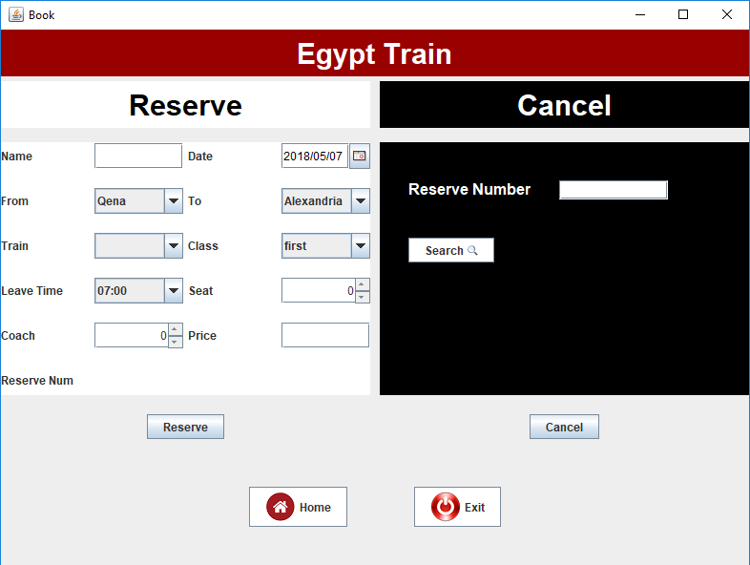
Here we can:
Reserve a ticket in a train .
Canceling a reservation.
Search for data of a reservation.
Go to search frame.
Exit from the system.

Slide 8
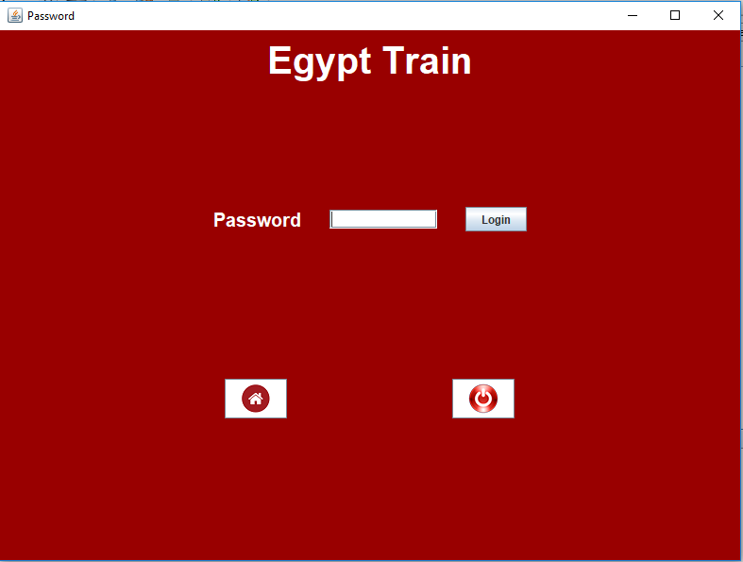
Here:
We should enter the password to go to train data and passenger reservation frames.
We can go to search frame.
We can exit from the system.

Slide 9
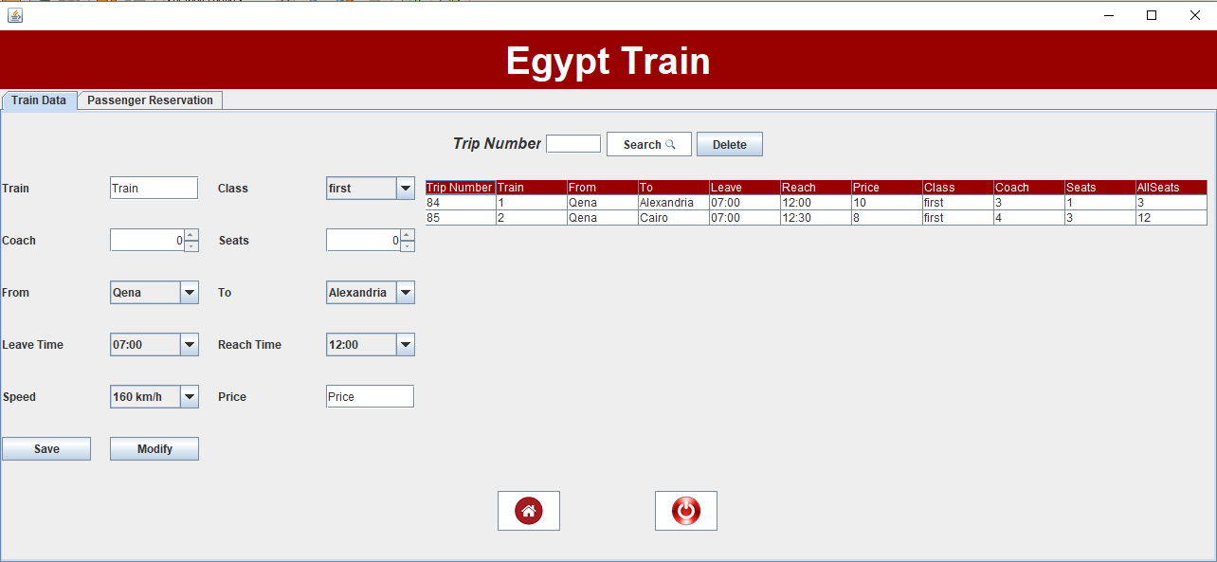
Here we can:
Search for a train data.
Enter a train data and save it.
Modify a train data.
Delete a train data.
Go to search frame.
Exit from the system.

Slide 10
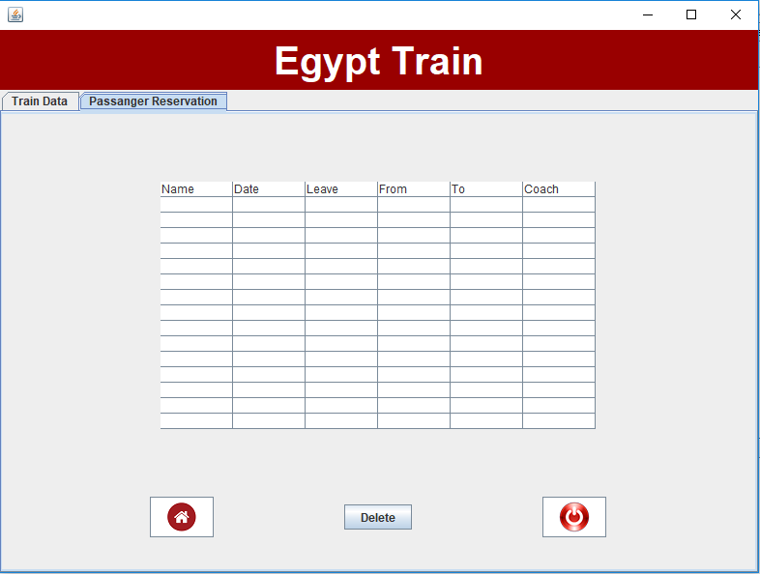
Here we can:
Know the data of passengers reservations.
Delete a data of a passenger reservation .
Go to search frame.
Exit from the system.

Slide 11
Thank you

