Slide 1


Slide 2
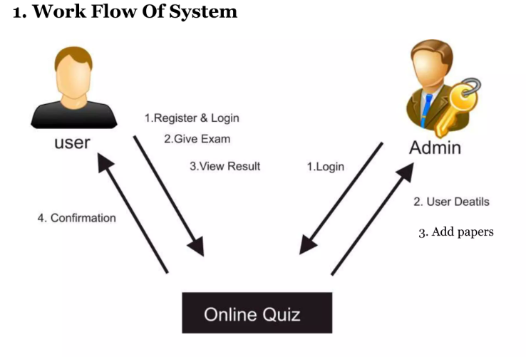
System (Database) Overview
The Online Quiz and Challenge System is a database-driven platform for learning and testing programming skills. It stores information about programming languages, problems, challenges, users, quizzes, and more. Users can be administrators with special rights or regular users who take quizzes and challenges. The system keeps track of user scores, submissions, and progress. Administrators create content, while users engage by choosing languages, taking Quiz, and submitting answers. The system encourages learning and friendly competition while managing data efficiently.

Slide 3
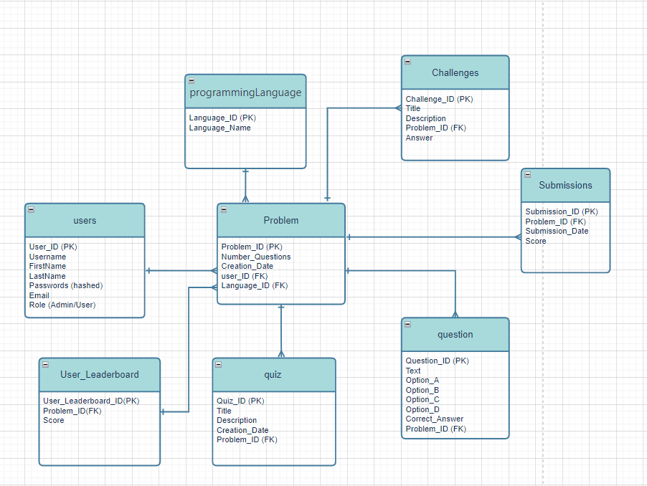
Entity-Relationship diagram

Slide 4
Table: programmingLanguage
Table: Problem
Column Name | Data Type | Constraints
Language_ID | INT | Primary Key, NOT NULL
Language_Name | VARCHAR(255)
Column Name | Data Type | Constraints
Problem_ID | INT | Primary Key, NOT NULL
Number_Questions | INT
Creation_Date | DATE
user_ID | INT | Foreign Key (users), NOT NULL
Language_ID | INT | Foreign Key (ProgrammingLanguage) Language_ID >0

Slide 5
Table: Challenges
Table: users
Column Name | Data Type | Constraints
Challenge_ID | INT | Primary Key, NOT NULL
Title | VARCHAR(255)
Description | TEXT
Problem_ID | INT | Foreign Key (Problem)
Answer | TEXT
Column Name | Data Type | Constraints
User_ID | INT | Primary Key, NOT NULL
Username | VARCHAR(255) | NOT NULL, UNIQUE
FirstName | VARCHAR(50) | NOT NULL
LastName | VARCHAR(50) | NOT NULL
Passwords | VARCHAR(50) | NOT NULL
Email | VARCHAR(255) | UNIQUE
Role | VARCHAR(50) | CHECK (Role IN ('Admin', 'User')), NOT NULL

Slide 6
Table: User_Leaderboard
Table: quiz
Column Name | Data Type | Constraints
User_Leaderboard_ID | INT | Primary Key, NOT NULL
Problem_ID | INT | Foreign Key (Problem)
Score | INT | Check score >=0
Column Name | Data Type | Constraints
Quiz_ID | INT | Primary Key, NOT NULL
Title | VARCHAR(255) | NOT NULL
Description | TEXT
Creation_Date | DATE
Problem_ID | INT | Foreign Key (Problem)

Slide 7
Table: question
Table: Submissions
Column Name | Data Type | Constraints
Question_ID | INT | Primary Key, NOT NULL
Text | TEXT | Foreign Key (Problem)
Option_A | VARCHAR(255)
Option_B | VARCHAR(255)
Option_C | VARCHAR(255)
Option_D | VARCHAR(255)
Correct_Answer
Problem_ID |  | Foreign Key (Problem)
Column Name | Data Type | Constraints
Quiz_ID | INT | Primary Key, NOT NULL
Title | VARCHAR(255) | NOT NULL, UNIQUE
Description | TEXT
Creation_Date | DATE
Problem_ID | INT | Foreign Key (Problem)

Slide 8
